Slide 1
Quantum properties of supersymmetric gauge theories
Speaker: Alessandro Banaudi
Tutor: Alberto Santambrogio
Co-tutor: Andrea Mauri

Slide 2
What is a supersymmetric gauge theory?
Gauge Theory
Supersymmetry
+
Quantum field theory which describes elementary particles and their fundamental interactions.
The fields considered are invariant under gauge transformations.
A space-time symmetry that relates two classes of elementary particles: bosons (integer-valued spin) and fermions (half-integer-valued spin).
PARTICLES | SUPERPARTICLES
BOSONS | FERMIONS
FERMIONS | BOSONS
Examples: QED, QCD, ...

Slide 3
Why are these theories interesting?
Physics beyond Standard Model.
Cancellations between bosonic and fermionic divergences.
Large amount of symmetries.
Some subsectors are exactly solvable (integrable).
A possible springboard to quantum gravity through AdS/CFT correspondence.

Slide 4
The central role of N = 4 SYM
N = 4 SYM is the pioneer of the supersymmetric gauge theories.
It is a maximally supersymmetric gauge theory.
It is a quantum conformal field theory.
It is integrable in some limits.
Its strong coupling regime corresponds to the supergravity limit of the string theory in a AdS background.

Slide 5
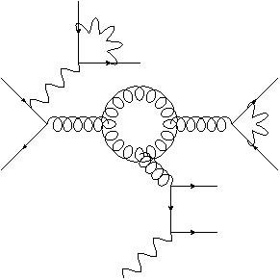
N = 4 SYM is the starting point.
We are mainly interested in 2 different theories:
N = 2 SCQCD (4 dimensions);
ABJM theory (3 dimensions).
N = 2
SCQCD
N = 4 SYM
QCD
AdS/CFT
ABJM theory
Gravity
AdS/CFT

Slide 6
The research project
N = 2 SCQCD
Computation of scattering amplitudes.
Properties of amplitudes and symmetries.
Relations amplitudes/Wilson loops.
ABJM
Computation of scattering amplitudes.
Computation of the dilatation operator.
Integrability.

Slide 7
In the computation of scattering amplitudes, we use the formalism of Feynman (super)diagrams.
We read from the action the Feynman rules for propagators and vertices of the theory;
We build all the possible diagrams (until the perturbative order considered) for the considered process;
We compute one by one the diagrams.

Slide 8
Main goals
In N = 2 SCQCD, we will compare some properties of scattering amplitudes with the corresponding ones in N = 4 SYM and in QCD.
In ABJM, we will compute the dilatation operator at 6 loops in order to test a recent proposal based on integrability.

Slide 9
Thank you for your attention

