Slide 1
Nanometer-scale morphology
and surface charge density
influence on protein adsorption
Francesca Borghi
Supervisor: Alessandro Podestà
PhD in Physics, Astrophysics and Applied Physics 16/10/2012

Slide 2
BIOCOMPATIBILITY
The ability of a material to perform with an appropriate host
response in a specific application *
INTRODUCTION
Cell Adhesion
and Morphology
STATE OF ART
Proliferation
SO WHAT?
…about my project
Differentiation
Surface topography
flat surface
rough surface
Surface wettability
WHAT I HAVE DONE
WHAT I’M GOING TO DO!
30 μm
30 μm
Hydrophobic surface**
Hydrophilic surface
Rigidity and deformability
of the cell adhesion substrate
CONCLUSIONS
Surface chemical composition
* David F. Williams, “Williams Dictionary of Biomaterials”, Liverpool University Press, 1, (1999)
**Lucie Bacakova , Elena Filova , Martin Parizek , Tomas Ruml , Vaclav Svorcik, Modulation of cell adhesion, proli feration and differentiation on materials designed for body implants, Biotechnology Advances 29 (2011) 739–767

Slide 3
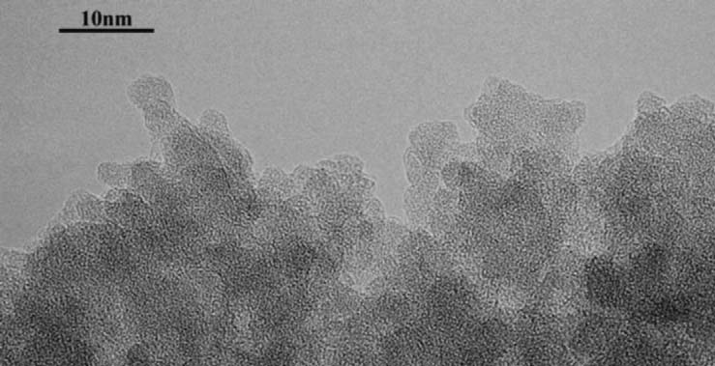
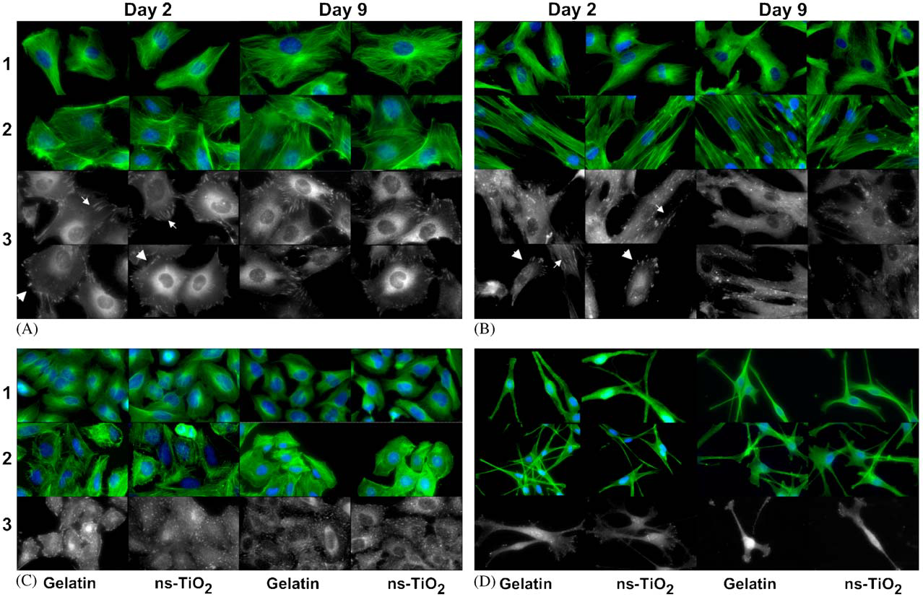
Ns-TiO2 THIN FILM BIOCOMPATIBILITY
INTRODUCTION
STATE OF ART
Ns-TiO2
100 nm
SO WHAT?
…about my project
TEM IMAGE *
AFM IMAGES *
WHY?
WHAT I HAVE DONE
WHAT I’M GOING TO DO!
CONCLUSIONS
* Roberta Carbone et all , Biocompatibility of cluster-assembled nanostructured TiO2 with primary and cancer cells, Biomaterials 27 (2006) 3221–3229

Slide 4
Ns-TiO2 THIN FILM BIOCOMPATIBILITY
INTRODUCTION
STATE OF ART
SO WHAT?
…about my project
EFFECTS OF SURFACE PROPERTIES ON PROTEIN ADSORPTION
One by one !
Quantitative characterization
WHAT I HAVE DONE
Morphology
INCREASED ADSORPTION
PROTEIN NUCLEATION
WHAT I’M GOING TO DO!
100 nm
CONCLUSIONS

Slide 5
Ns-TiO2 THIN FILM BIOCOMPATIBILITY
INTRODUCTION
STATE OF ART
SO WHAT?
…about my project
EFFECTS OF SURFACE PROPERTIES ON PROTEIN ADSORPTION
One by one !
Quantitative characterization
WHAT I HAVE DONE
Wettability
morphology
PROTEIN DENSITY
CONFORMATIONAL STATE
WHAT I’M GOING TO DO!
Surface
hydrophilicity
wettability
CONCLUSIONS

Slide 6
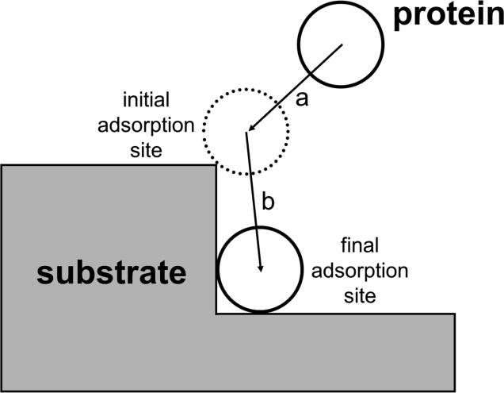
Ns-TiO2 THIN FILM BIOCOMPATIBILITY
INTRODUCTION
STATE OF ART
SO WHAT?
…about my project
EFFECTS OF SURFACE PROPERTIES ON PROTEIN ADSORPTION
One by one !
Quantitative characterization
WHAT I HAVE DONE
Electrostatic interactions?
Protein surface charge distribution
WHAT I’M GOING TO DO!
Surface charge density
CONCLUSIONS

Slide 7
Ns-TiO2 THIN FILM BIOCOMPATIBILITY
INTRODUCTION
STATE OF ART
SO WHAT?
…about my project
EFFECTS OF SURFACE PROPERTIES ON PROTEIN ADSORPTION
One by one !
Quantitative characterization
WHAT I HAVE DONE
ABOUT MY PROJECT
Characterization of ns-TiO2 surface charge density
and IsoElectric Point(IEP)
Correlation between morphology
and charge density
Protein adsorption depending on all these chemico-physical surface properties
WHAT I’M GOING TO DO!
CONCLUSIONS

Slide 8
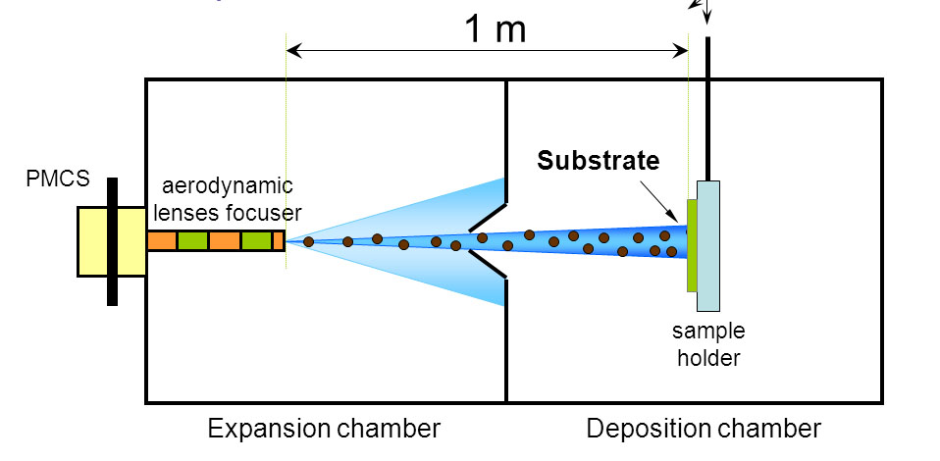
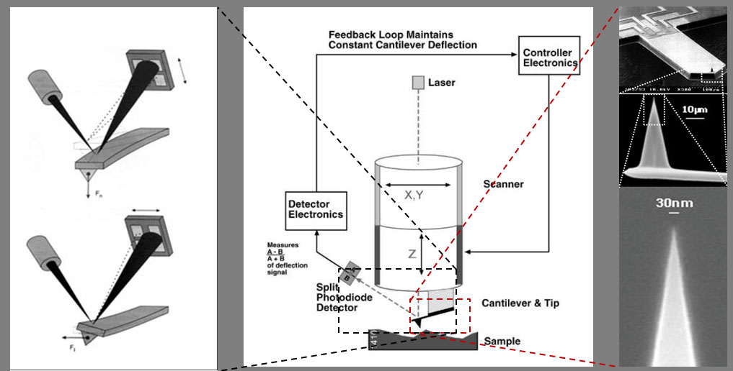
FILM PRODUCTION
PROCESS (PMCS)
MORPHOLOGICAL
CHARACTERIZATION (AFM)
INTRODUCTION
STATE OF ART
SO WHAT?
…about my project
WHAT I HAVE DONE
AFM ns-TiO2 TOPOGRAPHIC IMAGE and 3D MAP
WHAT I’M GOING TO DO!
CONCLUSIONS
500 nm

Slide 9
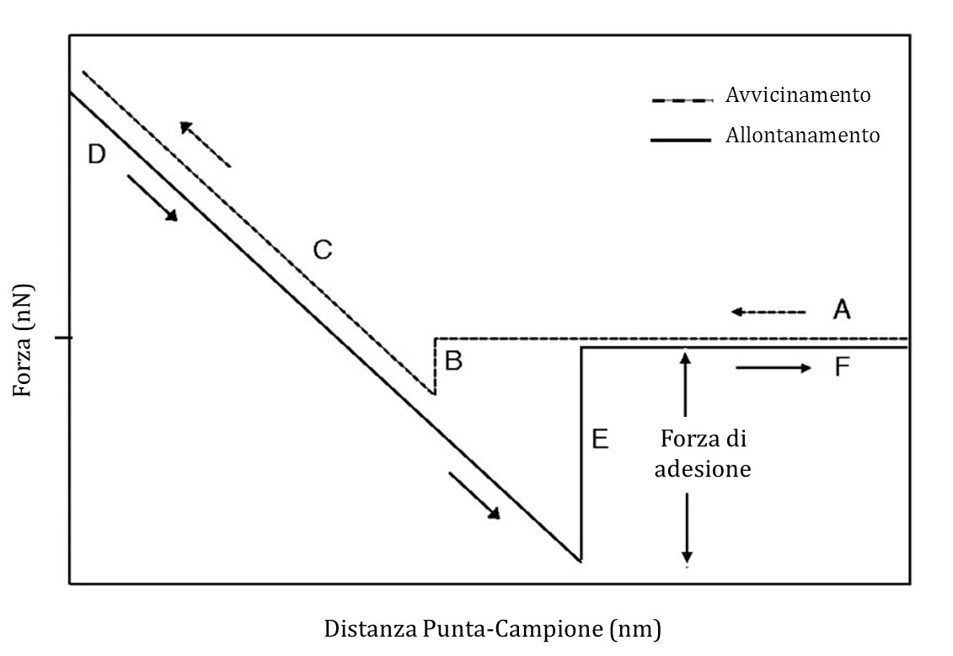
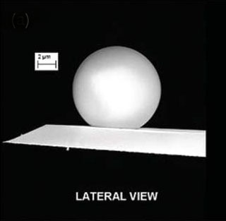
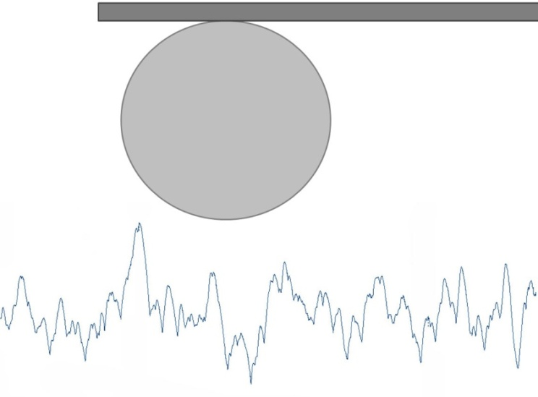
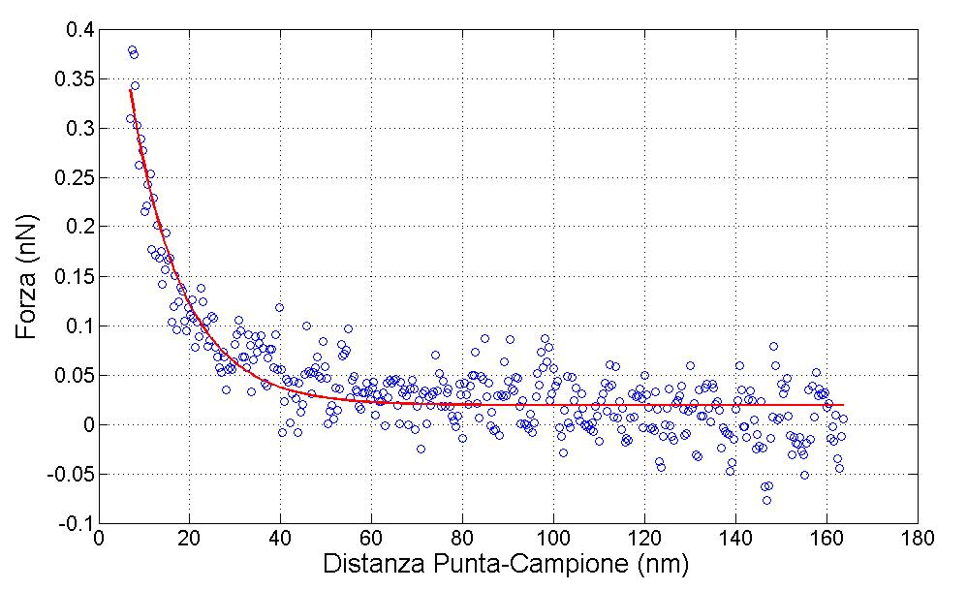
SURFACE CHARGE DENSITY CHARACTERIZATION BY AFM
INTRODUCTION
STATE OF ART
SO WHAT?
…about my project
WHAT I HAVE DONE
${\text{F}}_{el}$ ≈ $\frac{4πR{\text{λ}}_{D}}{εε_{0}}σ_{S}σ_{T}$ $e^{− \frac{D}{{\text{λ}}_{D}}}$
WHAT I’M GOING TO DO!
CONCLUSIONS
DLVO THEORY
(R, D >> λD ) ; λD= 0.3/$√\text{[}\text{NaCl}\text{]}$
Flat surface interacting with a spherical object

Slide 10
RESULTS
DEBYE LENGTH
pH~5.4 and [NaCl]=1 mM
CHARGE DENSITY
INTRODUCTION
STATE OF ART
SO WHAT?
…about my project
WHAT I HAVE DONE
FORCE CURVES
ISOELECTRIC POINT
WHAT I’M GOING TO DO!
CONCLUSIONS

Slide 11
RESULTS
INTRODUCTION
NO DIFFERENT PHASE OR CRYSTAL ORIENTATION
NO SPECIFIC ADSORPTION OF NaCl
COSTANT DENSITY OF DEFECTS, COORDINATION NUMBER, VALENCE…
STATE OF ART
MORPHOLOGY!
SO WHAT?
…about my project
WHAT I HAVE DONE
WHAT I’M GOING TO DO!
$$γ={\left(\frac{λ_{D}}{ξ}\right)}^{2}$$
$$γ={\left(\frac{λ_{D}}{ξ}\right)}^{2}\frac{1+{\left(2R_{q}/ξ\right)}^{2}}{{2\left(2R_{q}/ξ\right)}^{2}}$$
ϑ≤45°
ϑ >45°
CONCLUSIONS
CORRELATION BETWEEN MORPHOLOGY AND IEP
DOUBLE LAYER INTERACTION
BETWEEN SPHERE AND A ROUGH SURFACE

Slide 12
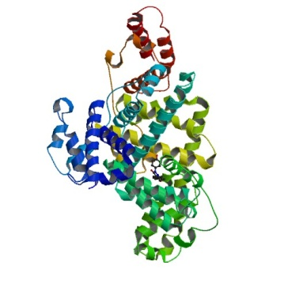
PRELIMINARY STUDY ON PROTEIN ADSORPTION
10 nm
INTRODUCTION
PROTEIN
STATE OF ART
Bovine Serum Albumin (BSA)
SO WHAT?
…about my project
METHODS
Protein Surface Interaction Microarray (PSIM)*
CONFOCAL MICROSPOPY
WHAT I HAVE DONE
BUFFER SOLUTION
Different pH and Ionic Strength (not only in physiological condition)
NO BSA PRECIPITATION IN ACIDIC SOLUTION
WHAT I’M GOING TO DO!
MODEL for the QUANTIFICATION of the adsorbed proteins
CONCLUSIONS
LANGMUIR ISOTHERM
* Pasquale Emanuele Scopelliti et all, The Effect of Surface Nanometre-Scale Morphology on Protein Adsorption, PLoS ONE 2010, 5

Slide 13
FUTURE OUTLOOK
INTRODUCTION
Systematic investigation of PROTEIN ADSORPTION processes
depending on SURFACE ROUGHNESS, WETTABILITY
and CHARGE DENSITY
(BSA, Fibronectin, Vitronectin)
STATE OF ART
SO WHAT?
…about my project
WHAT I HAVE DONE
WHAT I’M GOING TO DO!
Other NANOSTRUCTURED BIOCOMPATIBLE MATERIALS (ns-ZrOx)
CONCLUSIONS
The development of a PLATFORM of FUNCTIONALIZED and PATTERNED surfaces for the comprehension and the control of
protein-protein and protein-surface interactions

Slide 14
CONCLUSIONS
INTRODUCTION
Experimental data about the effects of surface nanoscale morphology on the properties of electric double layers
Correlation between morphological and other chemico-physical properties of nanostructured TiO2 surfaces,
with predominat role of the surface morphology
Possibility to study protein adsorption in different buffer conditions (ionic strenght and pH) in order to improve the knowledge about the dynamic of protein adsorption
STATE OF ART
SO WHAT?
…about my project
WHAT I HAVE DONE
WHAT I’M GOING TO DO!
F. Borghi, V. Vyas, A. Podestà, P. Milani The influence of surface roughness on DLVO interaction between a colloidal probe and cluster-assembled nanostructured titania thin films PloS ONE (submitted)
Ajay Singh, M. Ferri, M. Tamplenizza, F. Borghi et all Bottom-up engineering of the surface roughness of nanostructured cubic Zirconia to control cell adhesion Nanotechnology (in printing)
CONCLUSIONS
Thank you for your attention!

Slide 15
