Slide 1
γ spectroscopy of neutron-rich ^{95,96}Rb nuclei by the incomplete fusion reaction of ⁹⁴Kr on ⁷Li
Simone Bottoni
University of Milan
Mini Workshop 1°- year PhD students – October, 15 2012

Slide 2
Outline
Outline
Introduction
Why neutron-rich nuclei?
Why radioactive beams?
Why incomplete fusion reactions?
The experiment ⁹⁴Kr + ⁷Li @ ISOLDE – CERN (8th Nov. – 12th Nov. 2012)
Motivation
Nuclear structure studies
Nuclear reaction studies
The experimental setup
Conclusions
Simone Bottoni - University of Milan

Slide 3
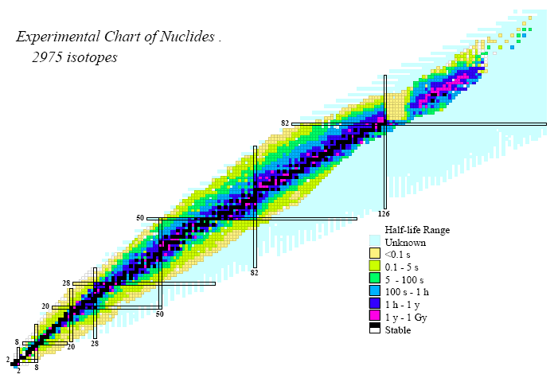
Introduction – Why neutron-rich nuclei?
Chart of Nuclides
Proton drip line S_{p}= 0
Nuclear properties well known
nearby the valley of stability
Neutron drip line S_{p}= 0
r - process
Nuclear properties far from stability
Proton number
^{95,96}Rb
Masses and radii
e.m. moments
Level scheme
Spectroscopic factor
Shape transitions
Shape coexistence
Collective excitations
Pairing interaction
Pigmy resonance
Neutron skin
N-N interaction
…….
Neutron number
Few experimental data available!
Simone Bottoni - University of Milan

Slide 4
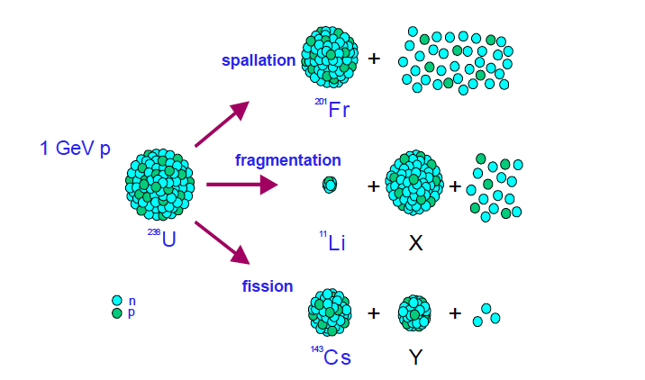
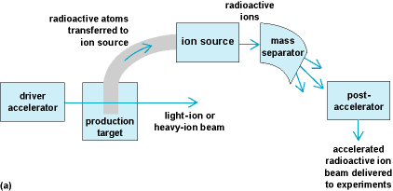
Introduction – Why radioactive beams?
Radioactive beams
IN FLIGHT:
Primary heavy ion beam (hundreds MeV/A)
Thin target
τ < 1 μs
No post acceleration
High intensity beam
ISOL:
Primary protons beam ( 1-1.5 GeV)
Thick target
τ > 100 ms
Post acceleration
High purity beam
Accelerated unstable nuclei
Advantages:
Discovery and study of new radioactive isotopes
Production of very neutron-rich nuclei
Limitations:
Intensity ( ≈ 10⁵ pps)
ISOL - Isotope Separation On Line
ISOLDE – CERN – ⁹⁴Kr - τ = 306 ms - E = 270 MeV - I = 2•10⁵ pps
Simone Bottoni - University of Milan

Slide 5
Introduction – Why incomplete fusion reactions?
Fusion evaporation reactions
Direct reactions
Complete fusion of projectile and target
Rapid neutrons evaporation
High energy and angular momentum transferred ✓
Quick decay toward the valley of stability ✗
Interaction mostly on the surface
Little energy or few particles transferred
Moderately neutron rich-nuclei ✓
Low energy and angular momentum excited states ✗
Break-up reactions
Elastic break-up
Weakly bound nuclei
High positive Q-Value
Medium -high excited states
Medium-high angular momentum transferred
Moderately neutron-rich nuclei
Supposed to be widely used in future with
a new generation of radioactive beams
⁷Li (⁹⁴Kr,αxn)
Incomplete fusion
Complete fusion
and cluster evaporation
Simone Bottoni - University of Milan

Slide 6
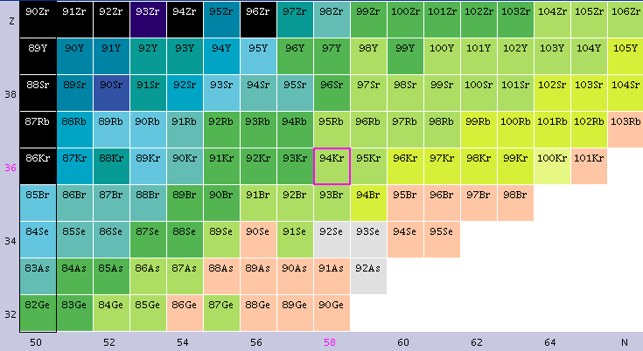
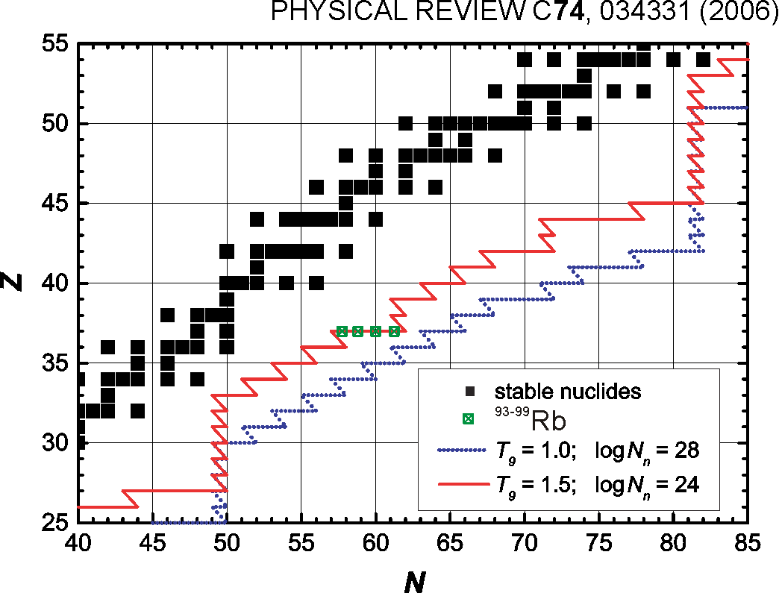
The experiment – Motivation
⁷Li (⁹⁴Kr,αxn) → ^{95,96}Rb at ≈ 3 MeV/A
Technique
Break-up of ⁷Li
Transfer of ³H in ⁹⁴Kr → ⁹⁷Rb
Evaporation of 1-2 neutrons
Detection of α particles in coincidence
with the γ decay
Motivation
Nuclear Structure:
γ spectroscopy of Rb isotopes at moderate high spin and excitation energy
Shape transitions and shell structure in the mass region A ≈ 100
β decay half-life and neutron emission probabilities different in spherical and deformed nuclei
Nuclear reaction:
Study of reaction mechanisms and dynamics for incomplete fusion reactions in inverse kinematics
⁹³⁻⁹⁹Rb
r-process
Simone Bottoni - University of Milan

Slide 7
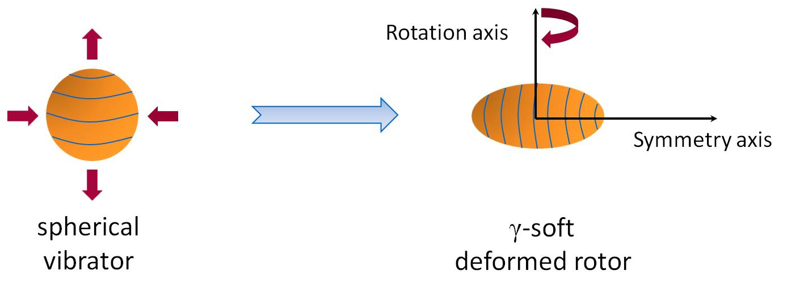
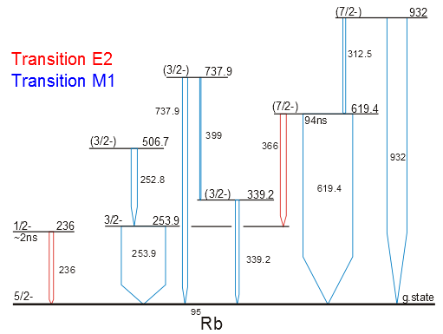
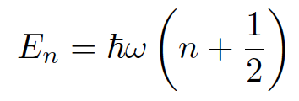
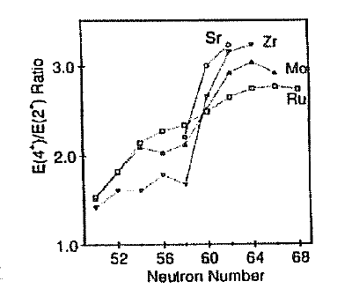
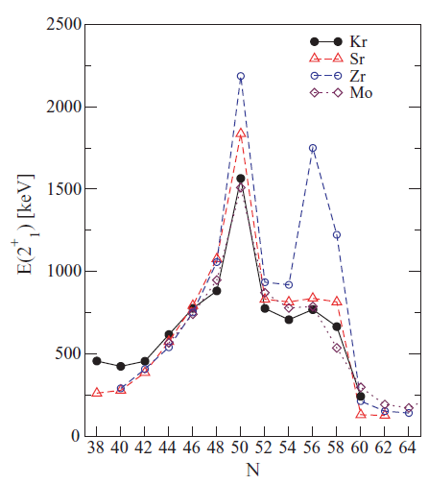
The experiment – Nuclear structure studies
Gamma spectroscopy
Shape transition
Coulomb Excitation at ISOLDE - G. Georgiev et al. - to be published
Limited Yrast spectroscopy
⁷Li (⁹⁴Kr,αxn) :
Intermediate Energy (up to 14.5 MeV)
Intermediate Spin (up to 15 )
J.L.Durell Proc.Int.Conf. On Spectroscopy
of Heavy Nuclei, 1990
N. Marginean et al., PRC80(2009), 021301
Shell structure
N-N interaction
Isomerism
Particle – Vibration coupling
Simone Bottoni - University of Milan

Slide 8
The experiment – Nuclear reaction studies
Theoretical predictions
Courtesy: Prof. K. Rusek
C .C calculations for α, t, ⁶Li and ⁷Li
C .C calculations for α particle emission
Advantages of inverse kinematics:
Very forward scattering angles
γ Doppler correction reduced
⁷Li (⁹⁴Kr,αxn):
S_{α} = 2.5 MeV
Q = +9.7 MeV
σ ≈ 35-70 mb
Other relevant reaction channels:
⁷Li elastic scattering
⁷Li break-up
⁷Li (⁹⁴Kr,⁹⁵Kr)⁶Li
⁷Li (⁹⁴Kr,txn) → Sr isotopes
Fusion-evaporation → Y isotopes
High selectivity on the ⁷Li (⁹⁴Kr,αxnγ ) reaction channel!
Simone Bottoni - University of Milan

Slide 9
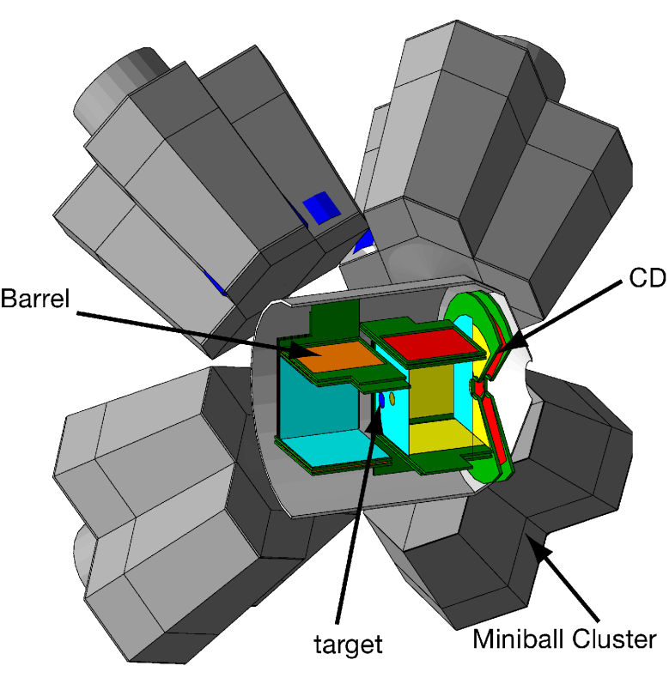
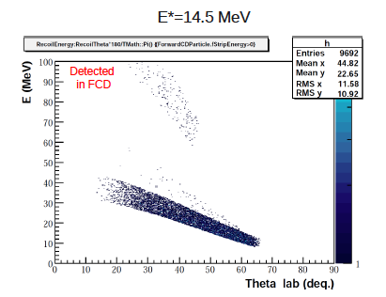
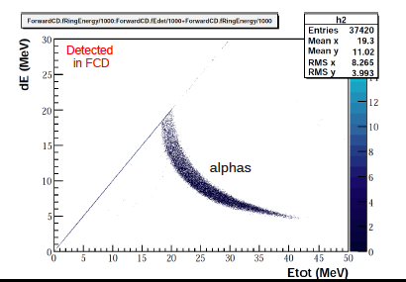
The experiment – Experimental setup
Experimental setup
MINIBALL
8 triple clusters of HpGe
6 segments for each cluster
Efficiency ≈ 7 %
Energy resolution ≈ 0.5 % at 1.3 MeV
HpGe array for γ spectroscopy (MINIBALL)
Si detector for particle identification (T-REX)
Particle – γ coincidence measurements
T-REX
Beam
Courtesy: F. Flavigny
Si detectors in barrel configuration
2 forward and backward CD
8 barrels (4 in the current configuration)
E – ΔE telescopes
Angular coverage for the current
configuration 24° < ϑ < 65°
Simone Bottoni - University of Milan

Slide 10
Conclusions
Conclusions
Importance of neutron-rich nuclei
Importance of radioactive beams
Study of the reaction ⁷Li (⁹⁴Kr,αxn) at 3 MeV/A
ISOLDE facility and particle – γ measurement
Shape transition and nuclear structure in Rb isotopes
Incomplete fusion reactions in inverse kinematics
Important test for future experiments with incomplete fusion reactions and a new
generation of heavier radioactive beams (Sn, Hg) at new facilities of higher energy
and intensity (HIE-ISOLDE, SPIRAL2, SPES etc. )
Simone Bottoni - University of Milan

Slide 11
Thank you for your attention
Simone Bottoni - University of Milan

