Slide 1


Sub-ppm ammonia detection in urban environments with carbon nanotubes gas sensors: possible strategies to enhance the sensitivity.
UNIVERSITY OF MILAN – CATHOLIC UNIVERSITY OF BRESCIA
Rigoni Federica
1° year Phd student
federicarigoni@gmail.com

Slide 2
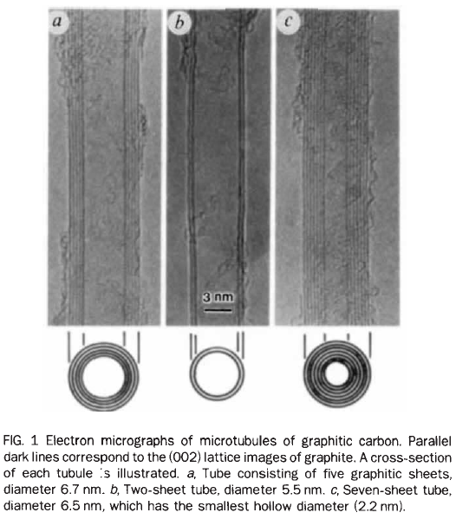
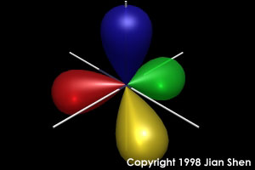
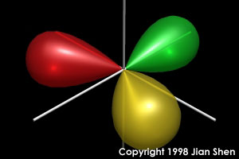
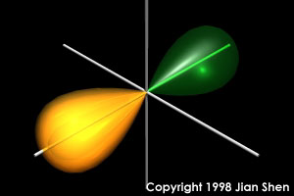
Carbon nanotubes
Several allotropic form of carbon, depending on its hybridization (diamond, graphite, graphene, fullerene, carbon nanotube …)
Many scientific papers start citing
“Carbon nanotubes, discovered by
Iijima in 1991 …”
Iijima produced a new allotropic form
of carbon (that he called microtubules
of graphitic carbon), using an arc-discharge
evaporation method similar to that
used for fullerene (C₆₀) synthesis.
Tetrahedral (3D)
Trigonal (2D)
Linear (1D)
sp³
sp²
sp
d = 3 nm
S. Iijima, Nature 354 (1991) 56

Slide 3
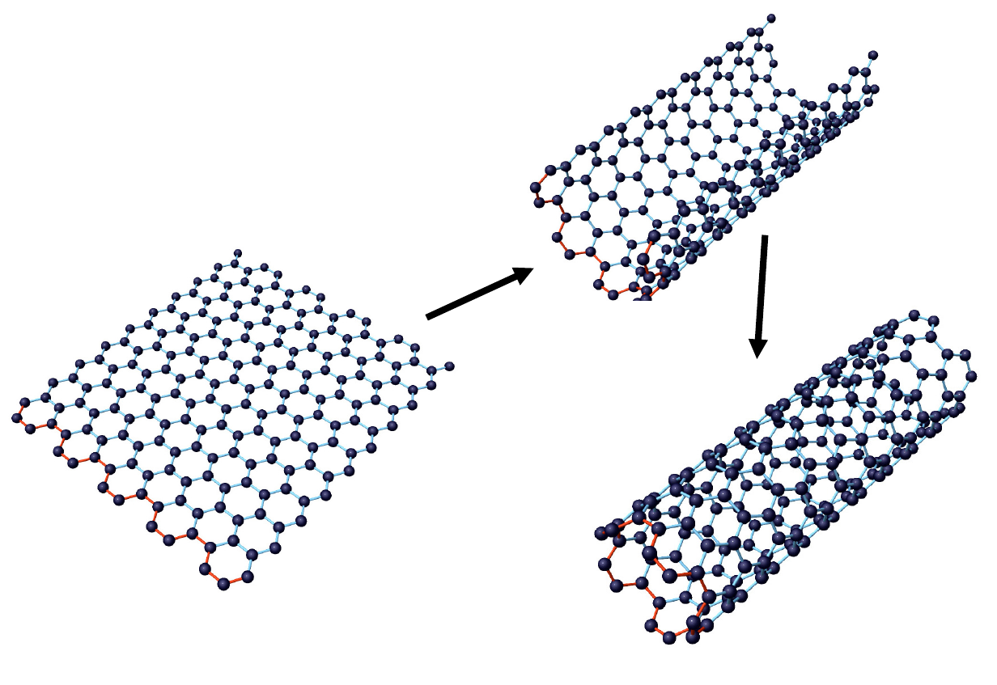
What are carbon nanotubes?
Roll-up
GRAPHENE SHEET
C hybridization sp²
CARBON NANOTUBE

Slide 4
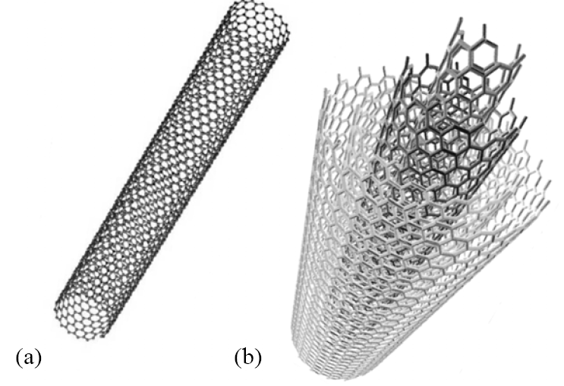
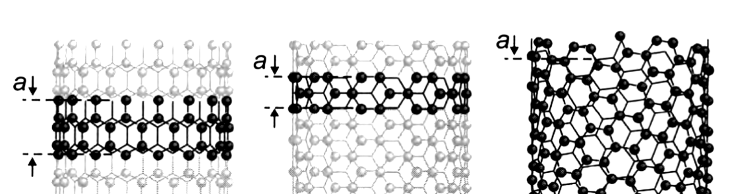
Single-wall carbon nanotube SWNT diameter 1-3 nm
Multi-wall carbon nanotube MWNT diameter up to 100 nm
diameter ≈ nm
length ≈ µm
1D crystal
Chiral indexes (n,m)
(17,0)
zig-zag
(10,10)
armchair
(12,8)
chiral
Different chiralities: different characteristics
If n-m = multiple of 3
metallic tube
otherwise
semiconductive tube

Slide 5
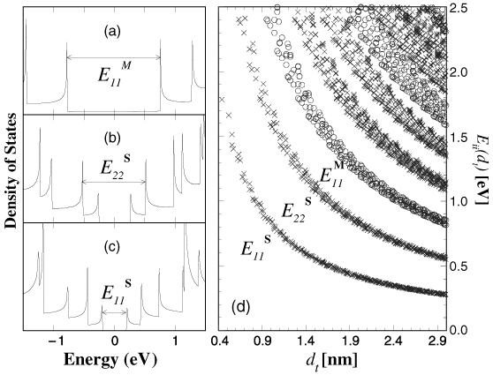
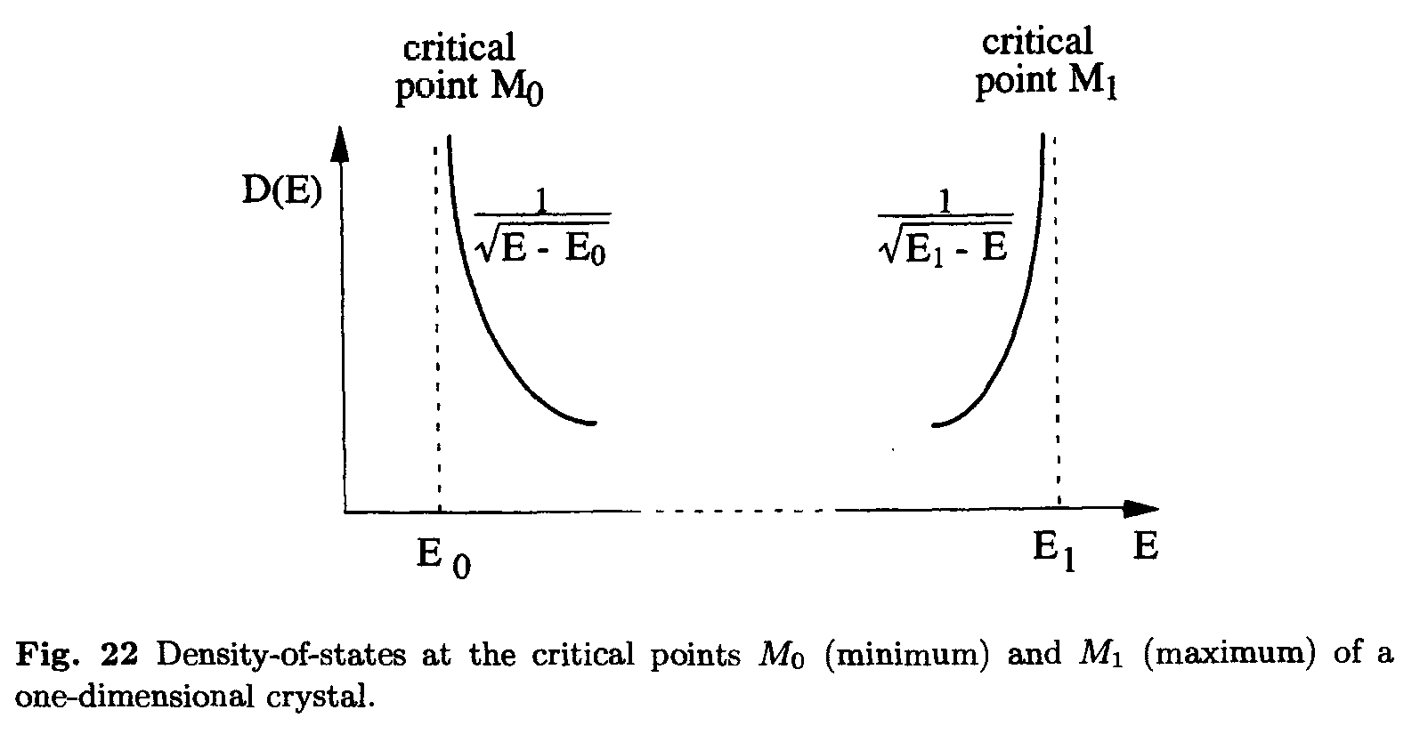
Electronic properties of SWNT
Single wall carbon nanotube has diameter ≈ nm and length ≈ µm,
We can consider it as a one-dimensional crystal.
Van Hove singularities
KATAURA PLOT
Density Of States in a 1D crystal
The KATAURA PLOT relates the energy of the band gaps in a carbon nanotube and its diameter (in the first-order tight binding approximation).
Kataura et al.Synthetic Metals 103 (1999) 2555

Slide 6
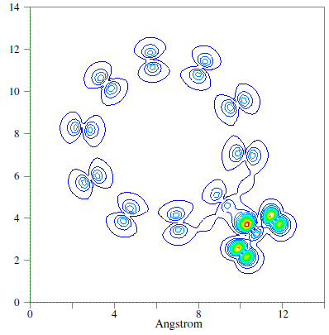
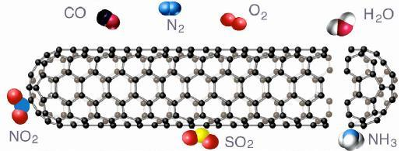
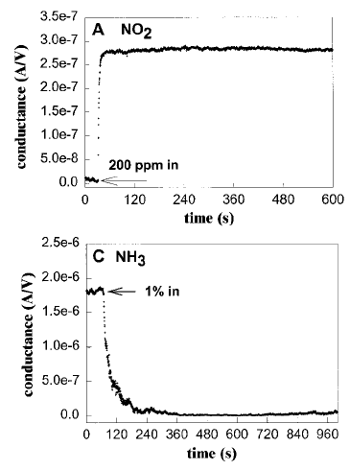
Carbon nanotubes as gas sensors
CNTs are appealing systems for extremely sensitive gas sensors for at least two reasons:
their one-dimensional nature makes them very sensitive to tiny external perturbations
huge surface-to-volume ratio
NO₂: OXIDIZING MOLECULE
BASIC IDEA:
The interaction resulting in a charge transfer between the gas molecule and the carbon nanotube causes a variation in the electrical conductance (or resistance) of the tube, detectable with an electronic system.
NH₃: REDUCING MOLECULE
Kong et al. Science, 287 (2000) 622

Slide 7
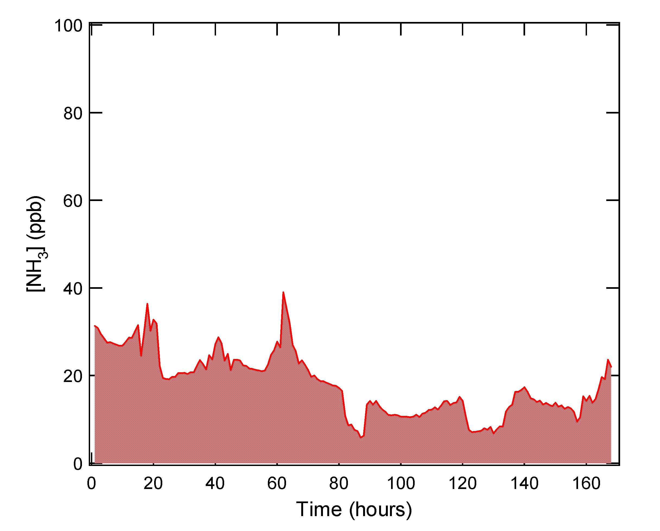
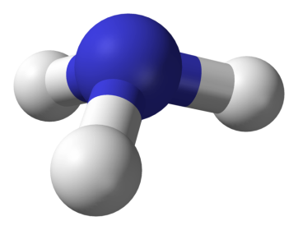
Why monitoring ammonia gas?
Hazardous substances, explosive, …
ppm (parts per million)
Environmental monitoring
ppb (parts per billion)
NH₃
In urban environment:
less than 50 ppb
NH₃ is one of the main precursors of secondary fine particulate (PM10, PM2.5)
Our goal: to enhance the sensitivity of carbon nanotubes based gas sensors in order to detect sub-ppm concentrations of NH₃.
Ammonia concentrations over one week
in Milan (data source: ARPA Lombardia)

Slide 8
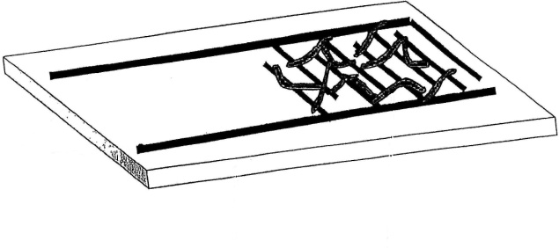
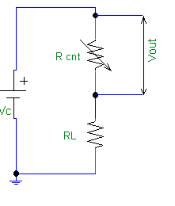



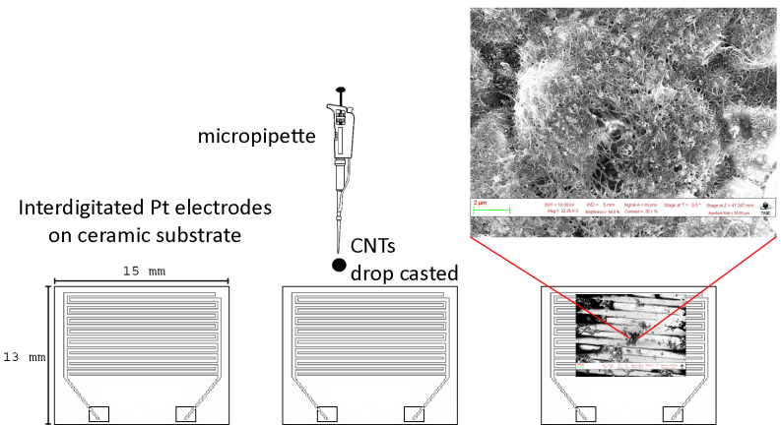
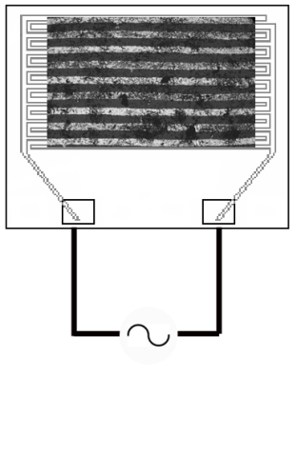
Chemiresistor gas sensor
SWNT dispersed in a solution of water, NaOH, Sodium Lauryl Sulfate
Interdigitated Pt electrodes
Electrical circuit
SWNT bridges between electrodes
Alumina (ceramic)substrate
Methods of preparation
Drop-casting
method
Dielectrophoresis
method
1 μl
1 μl
Alternate Current applied during the deposition
(V = 5 V ; f = 1 MHz)

Slide 9
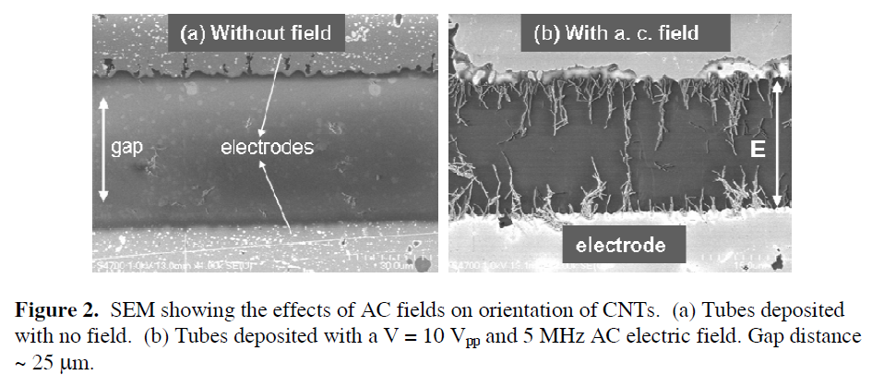
Strategies to enhance the sensitivity of a SWNT based chemiresistor
Sonication of the sample (in ultrasound bath) to reduce the film thickness
thinner the film on the substrate, better is the charge transfer from the gas molecule to the electrical contacts.
Dielectrophoresis method to align the SWNT
a method to better distribute the SWNT on the substrate is to apply an alternate current between the electrodes, during the deposition. In this way SWNTs tends to be aligned
Functionalization
Other architectures
(e.g. chem-FET)
Moscatello et al. MRS, 1057 (2008)

Slide 10
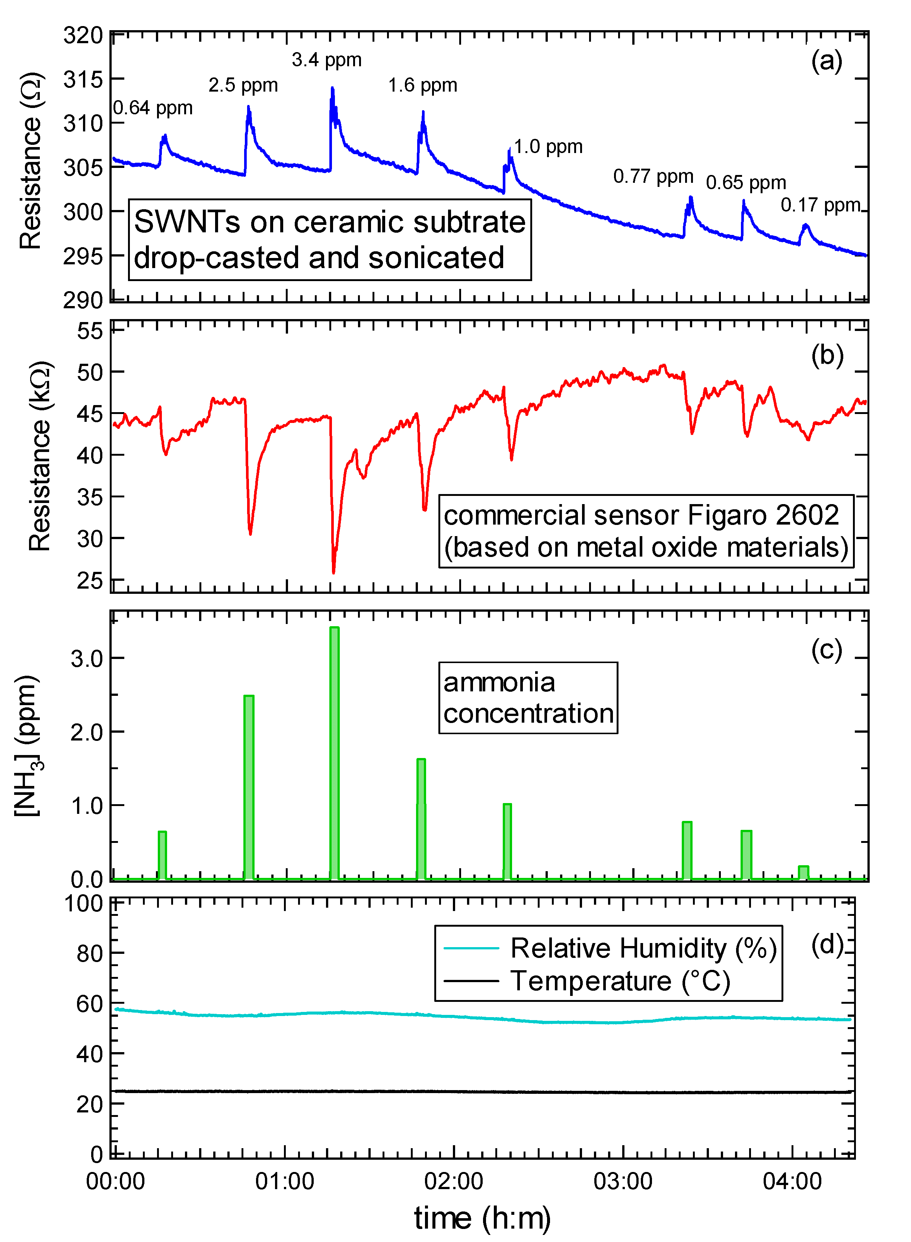
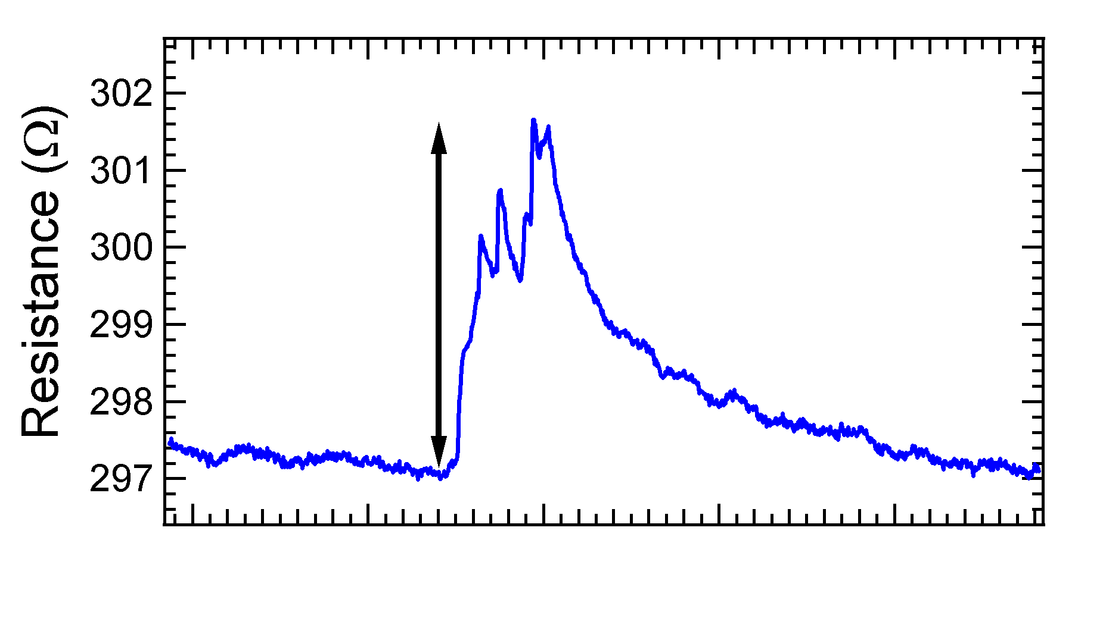
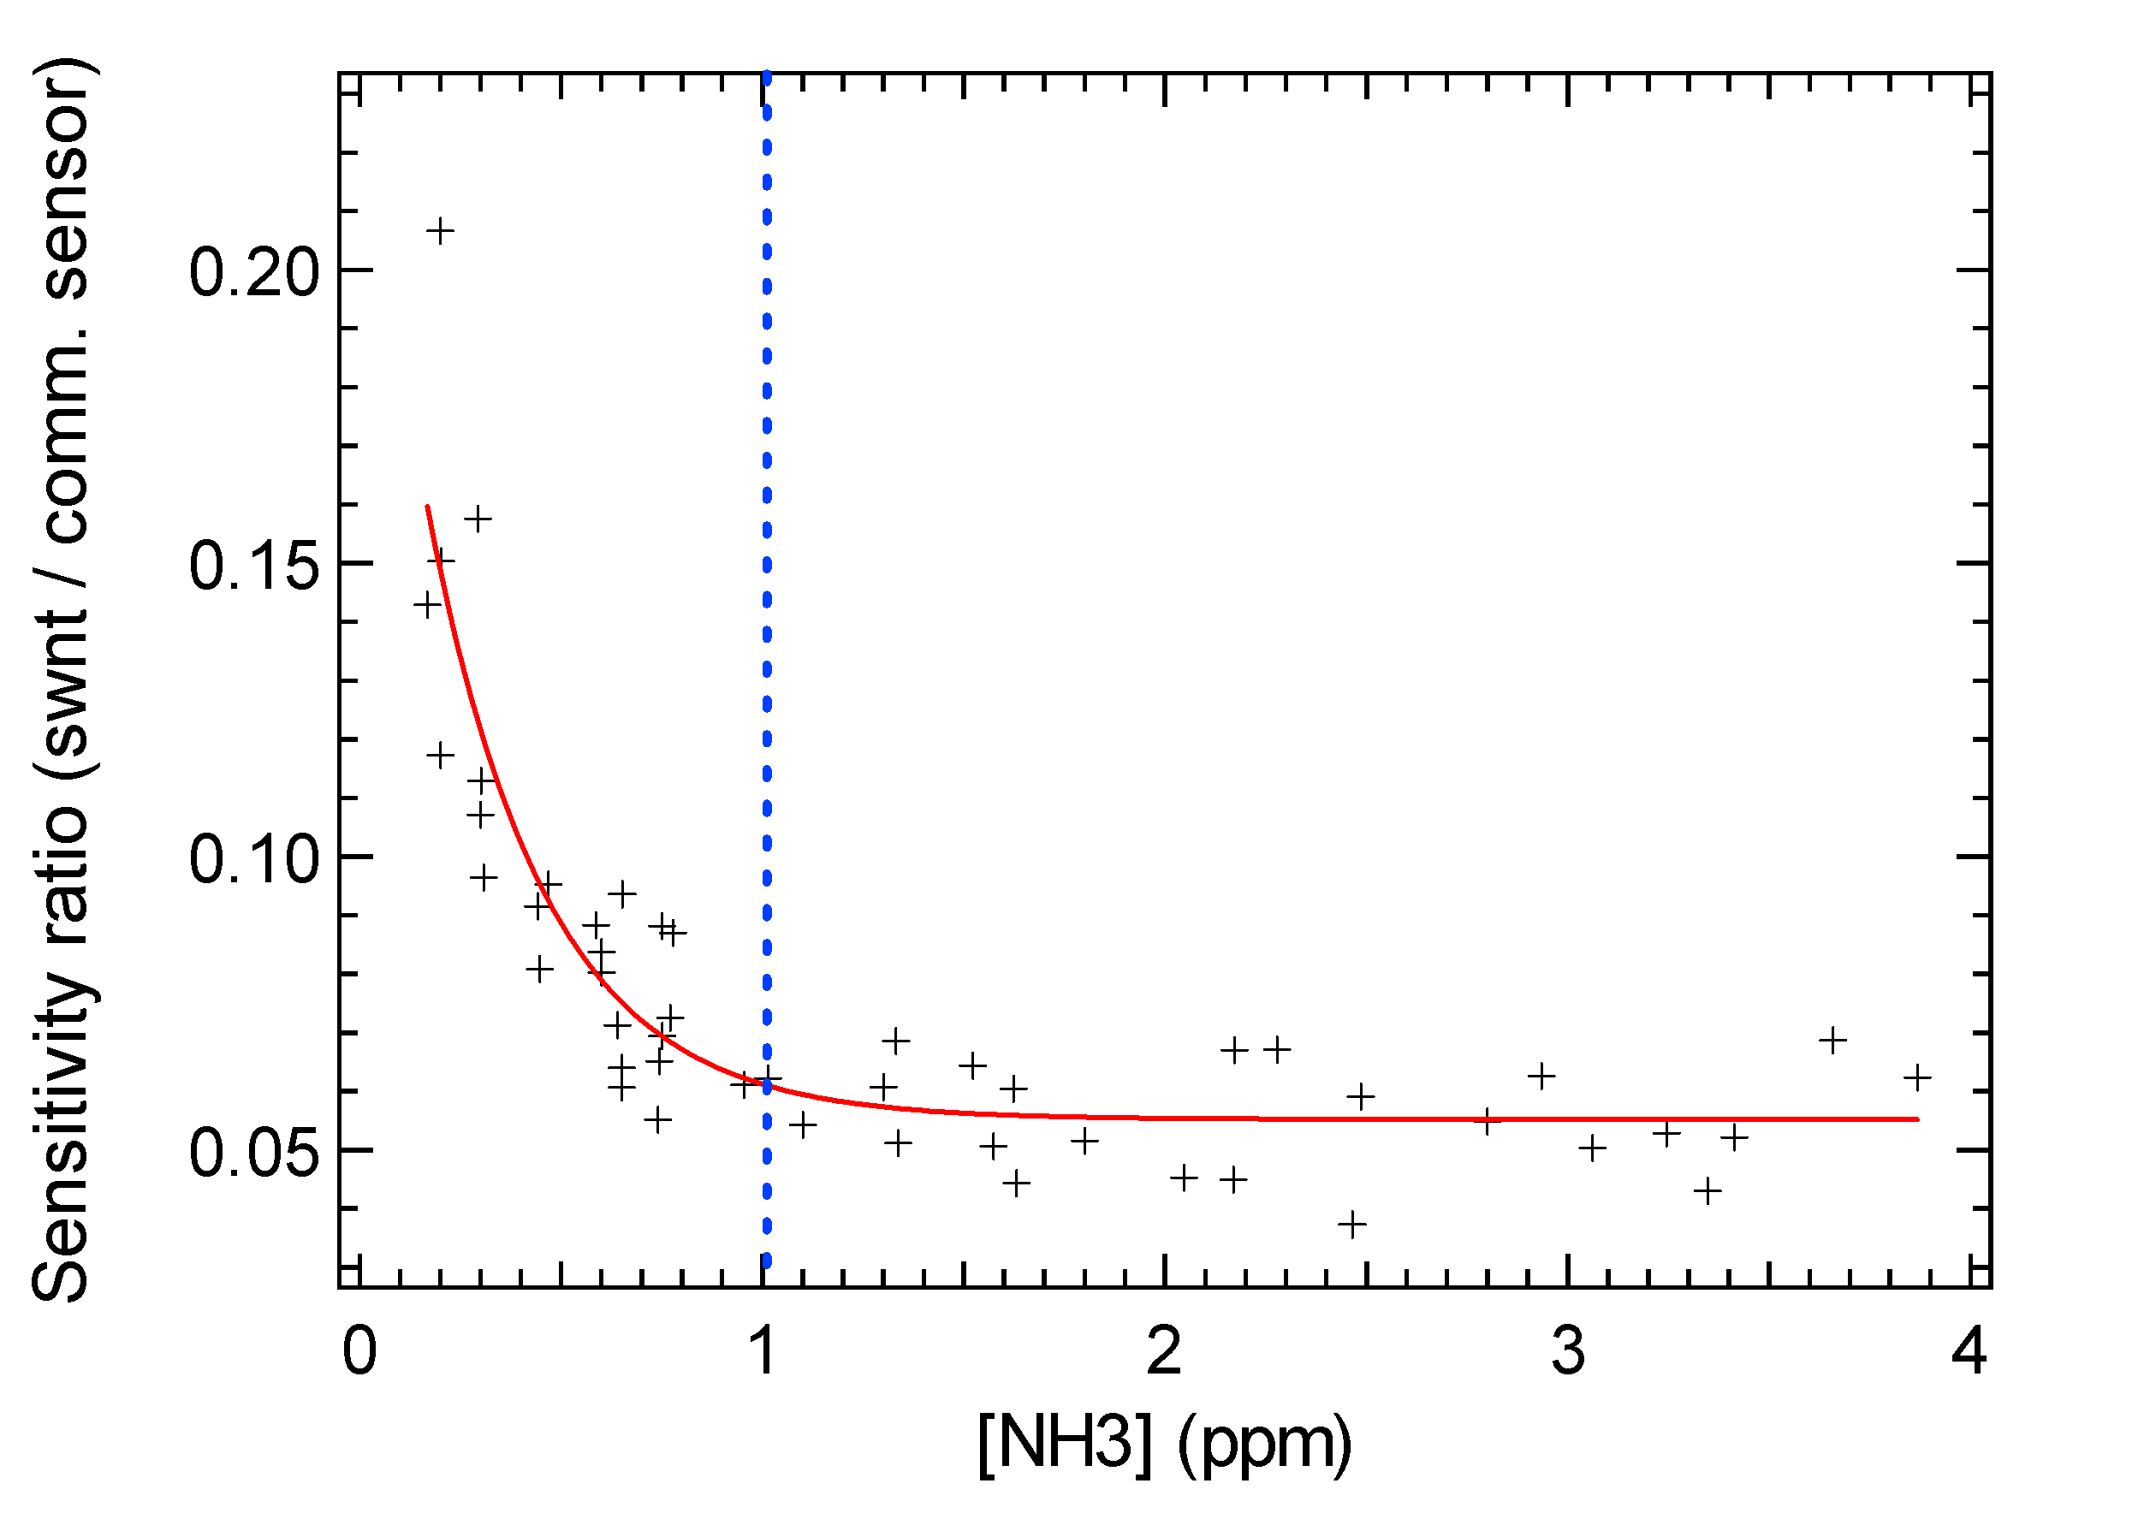
Response: variation of the resistance
SENSITIVITY:
sub-
ppm

Slide 11
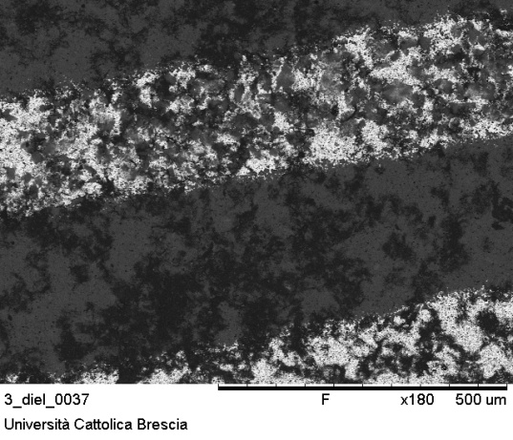
Dielectrophoresis method to align the CNT
1 μl
Drop-casting method
1 μl
Dielectrophoresis method
SEM
images

Slide 12
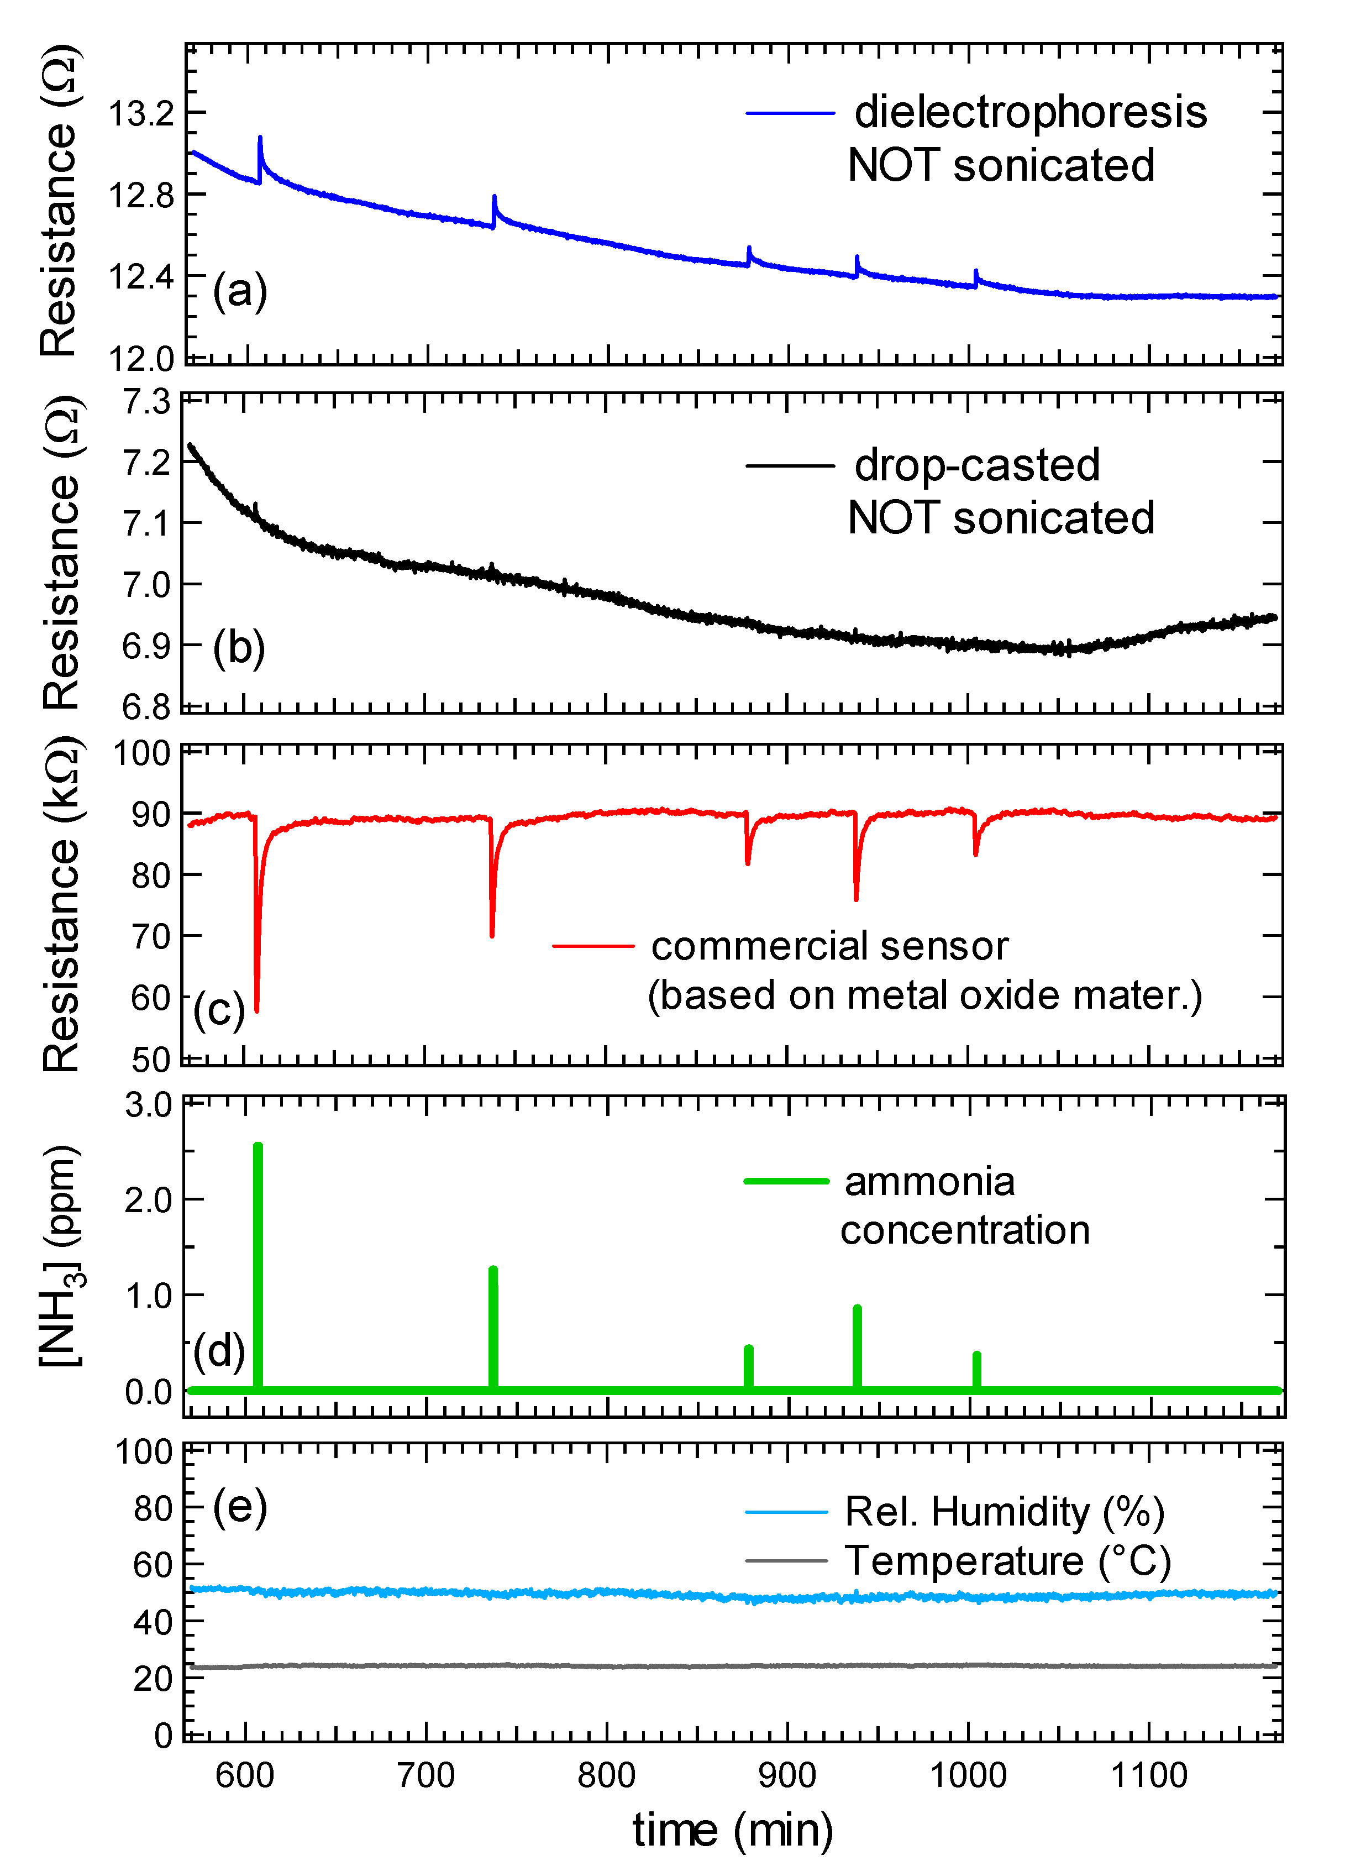
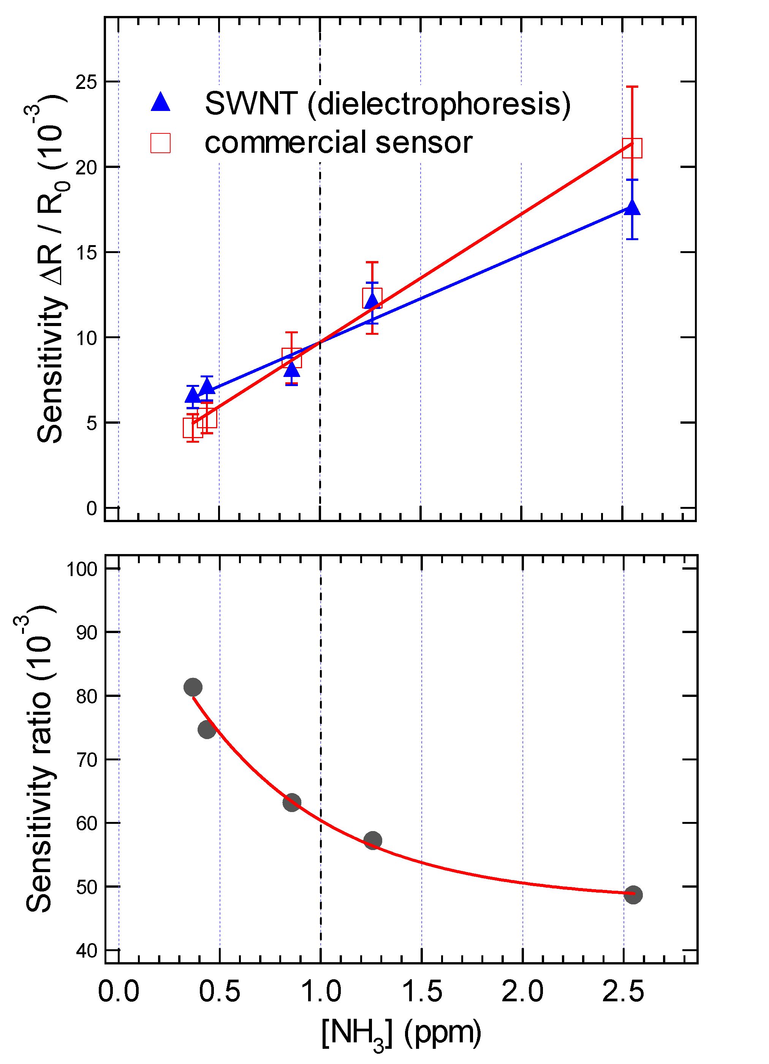
(a) ,(b) SWNT on ceramic ID substrate

Slide 13
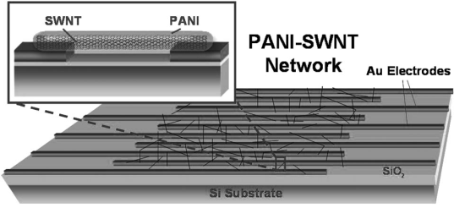
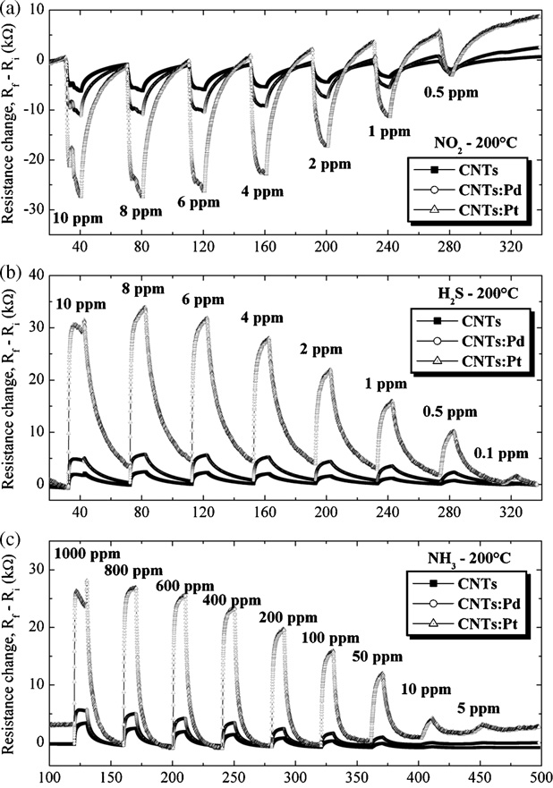
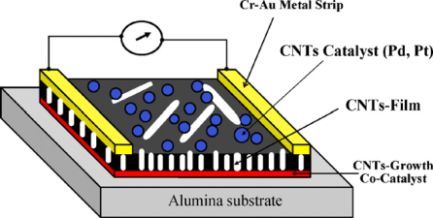
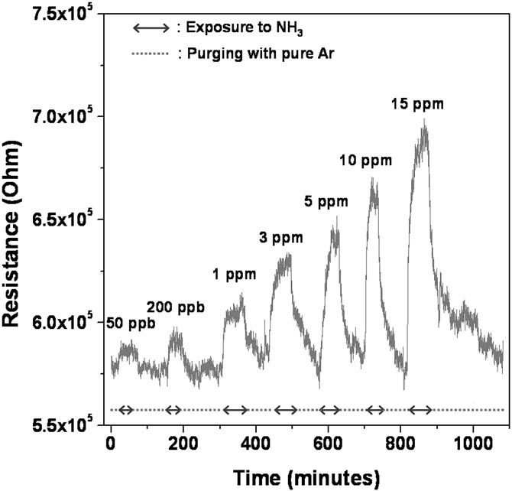
In literature…
There are many works on carbon nanotubes as ammonia gas sensors, but very few of them report the detection of concentrations below the ppm level.
Functionalization with Polyaniline
(PANI, a conductive polymer)
Functionalization with metal nanoparticles
High temperature
Penza et al. Sens. And Act. B, 135(2008) 289
Zhang et al. Electroanalysis, 18 (2006) 1153

Slide 14
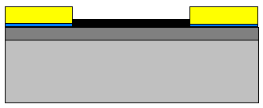
Future steps
Functionalization
Different device concepts, e.g. chemical Field Effect Transistor (chem-FET)
CNTs
Drain
Source
S
D
SiO2
GATE: p-doped Si
The gate allows to change the voltage (gate voltage V_{g}).

Slide 15
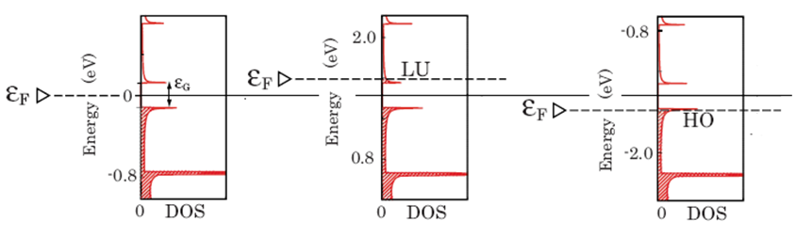
Chemical Field Effect Transistor (FET)
V_{gate} = 0
V_{gate} > 0
more electrons
V_{gate} < 0
more holes
K. Uchida et al., Phys. Rev. B 79, 85402 (2009)

Slide 16
Thanks for the attention!
QUESTIONS?

Slide 17
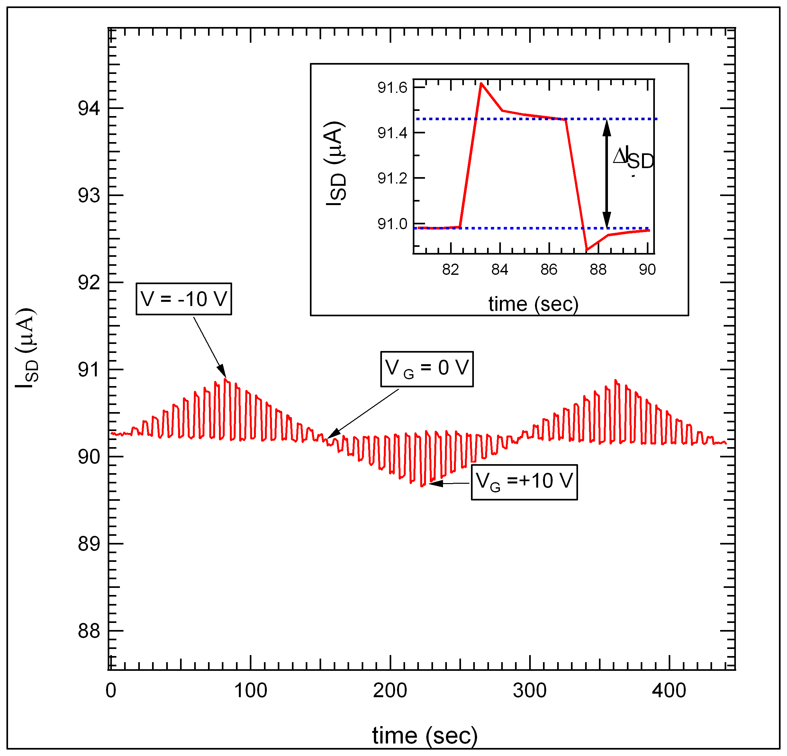
Chemical Field Effect Transistor (FET)

Slide 18
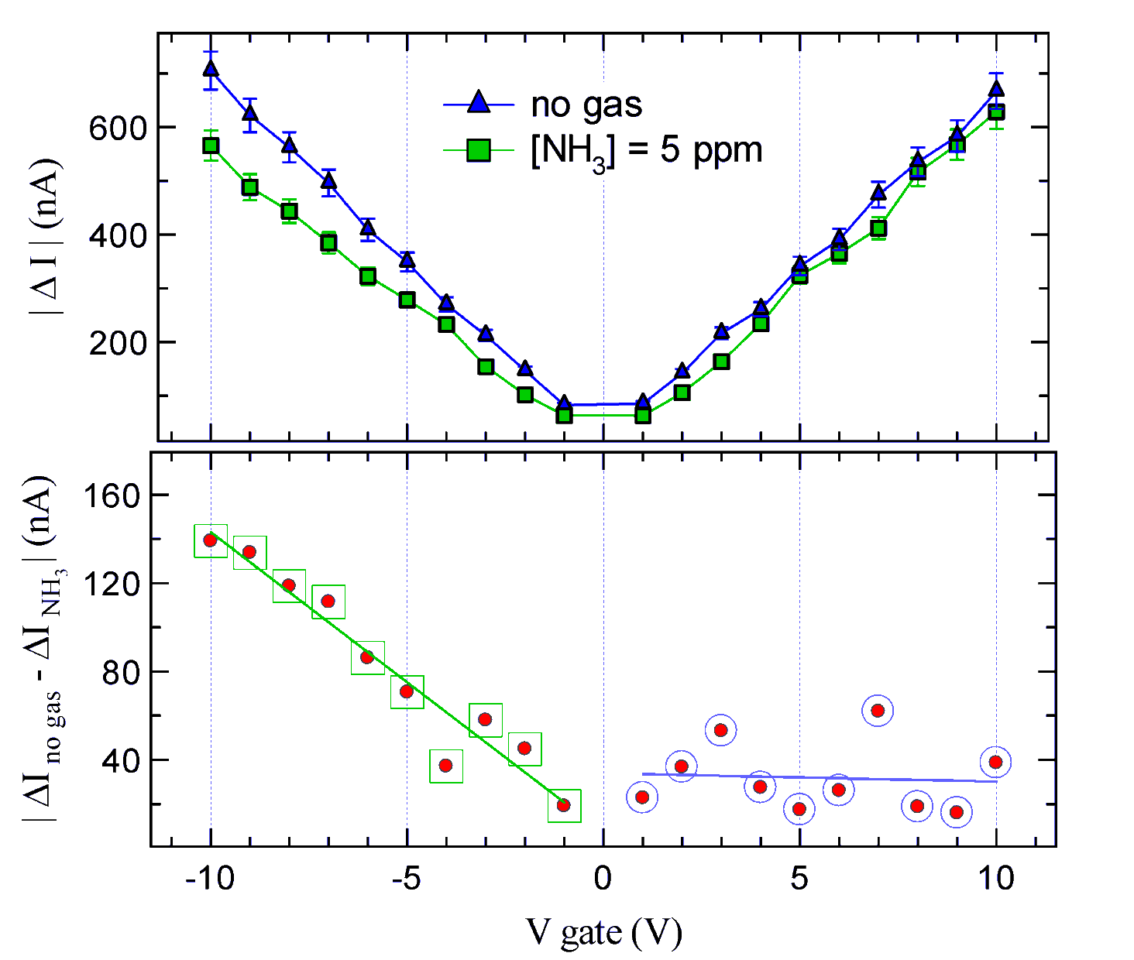
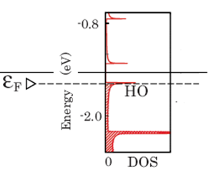
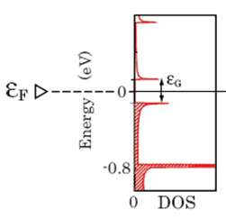
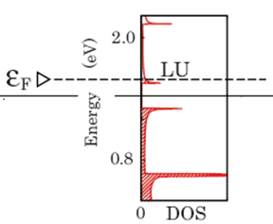
Chemical Field Effect Transistor (FET)
SWNTs
S
D
GATE: p-doped Si
V_{gate} < 0
V_{gate} = 0
V_{gate} > 0

Slide 19
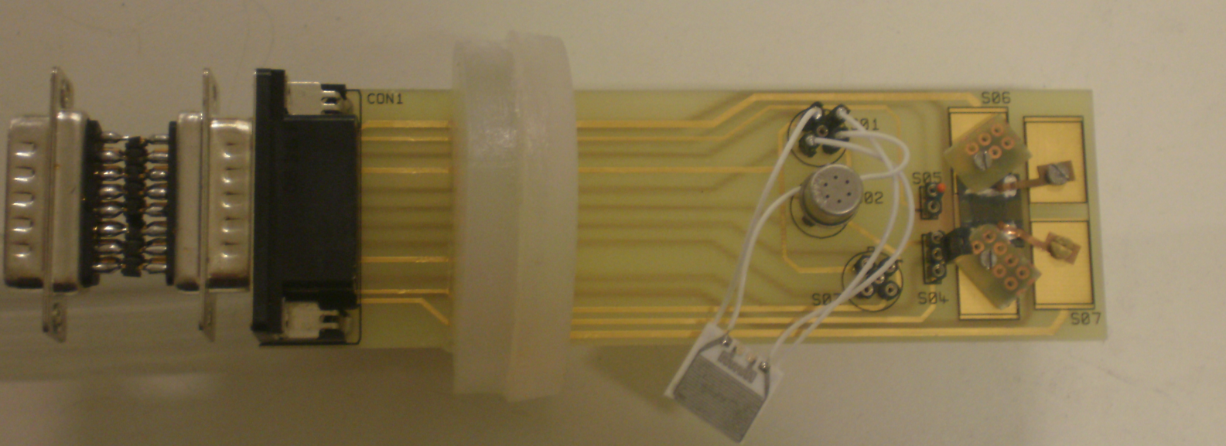
Experimental set-up
Commercial sensor
Based on metal oxides
Temperature sensor
Chem FET
Chemiresistor:
SWNT on interdigitated electrodes
Humidity sensor

Slide 20
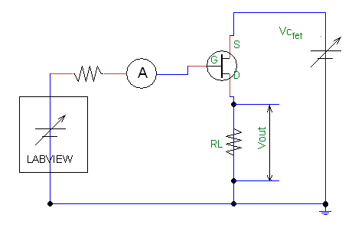


Electrical circuit
Chemiresistor
Chem-FET

Slide 21
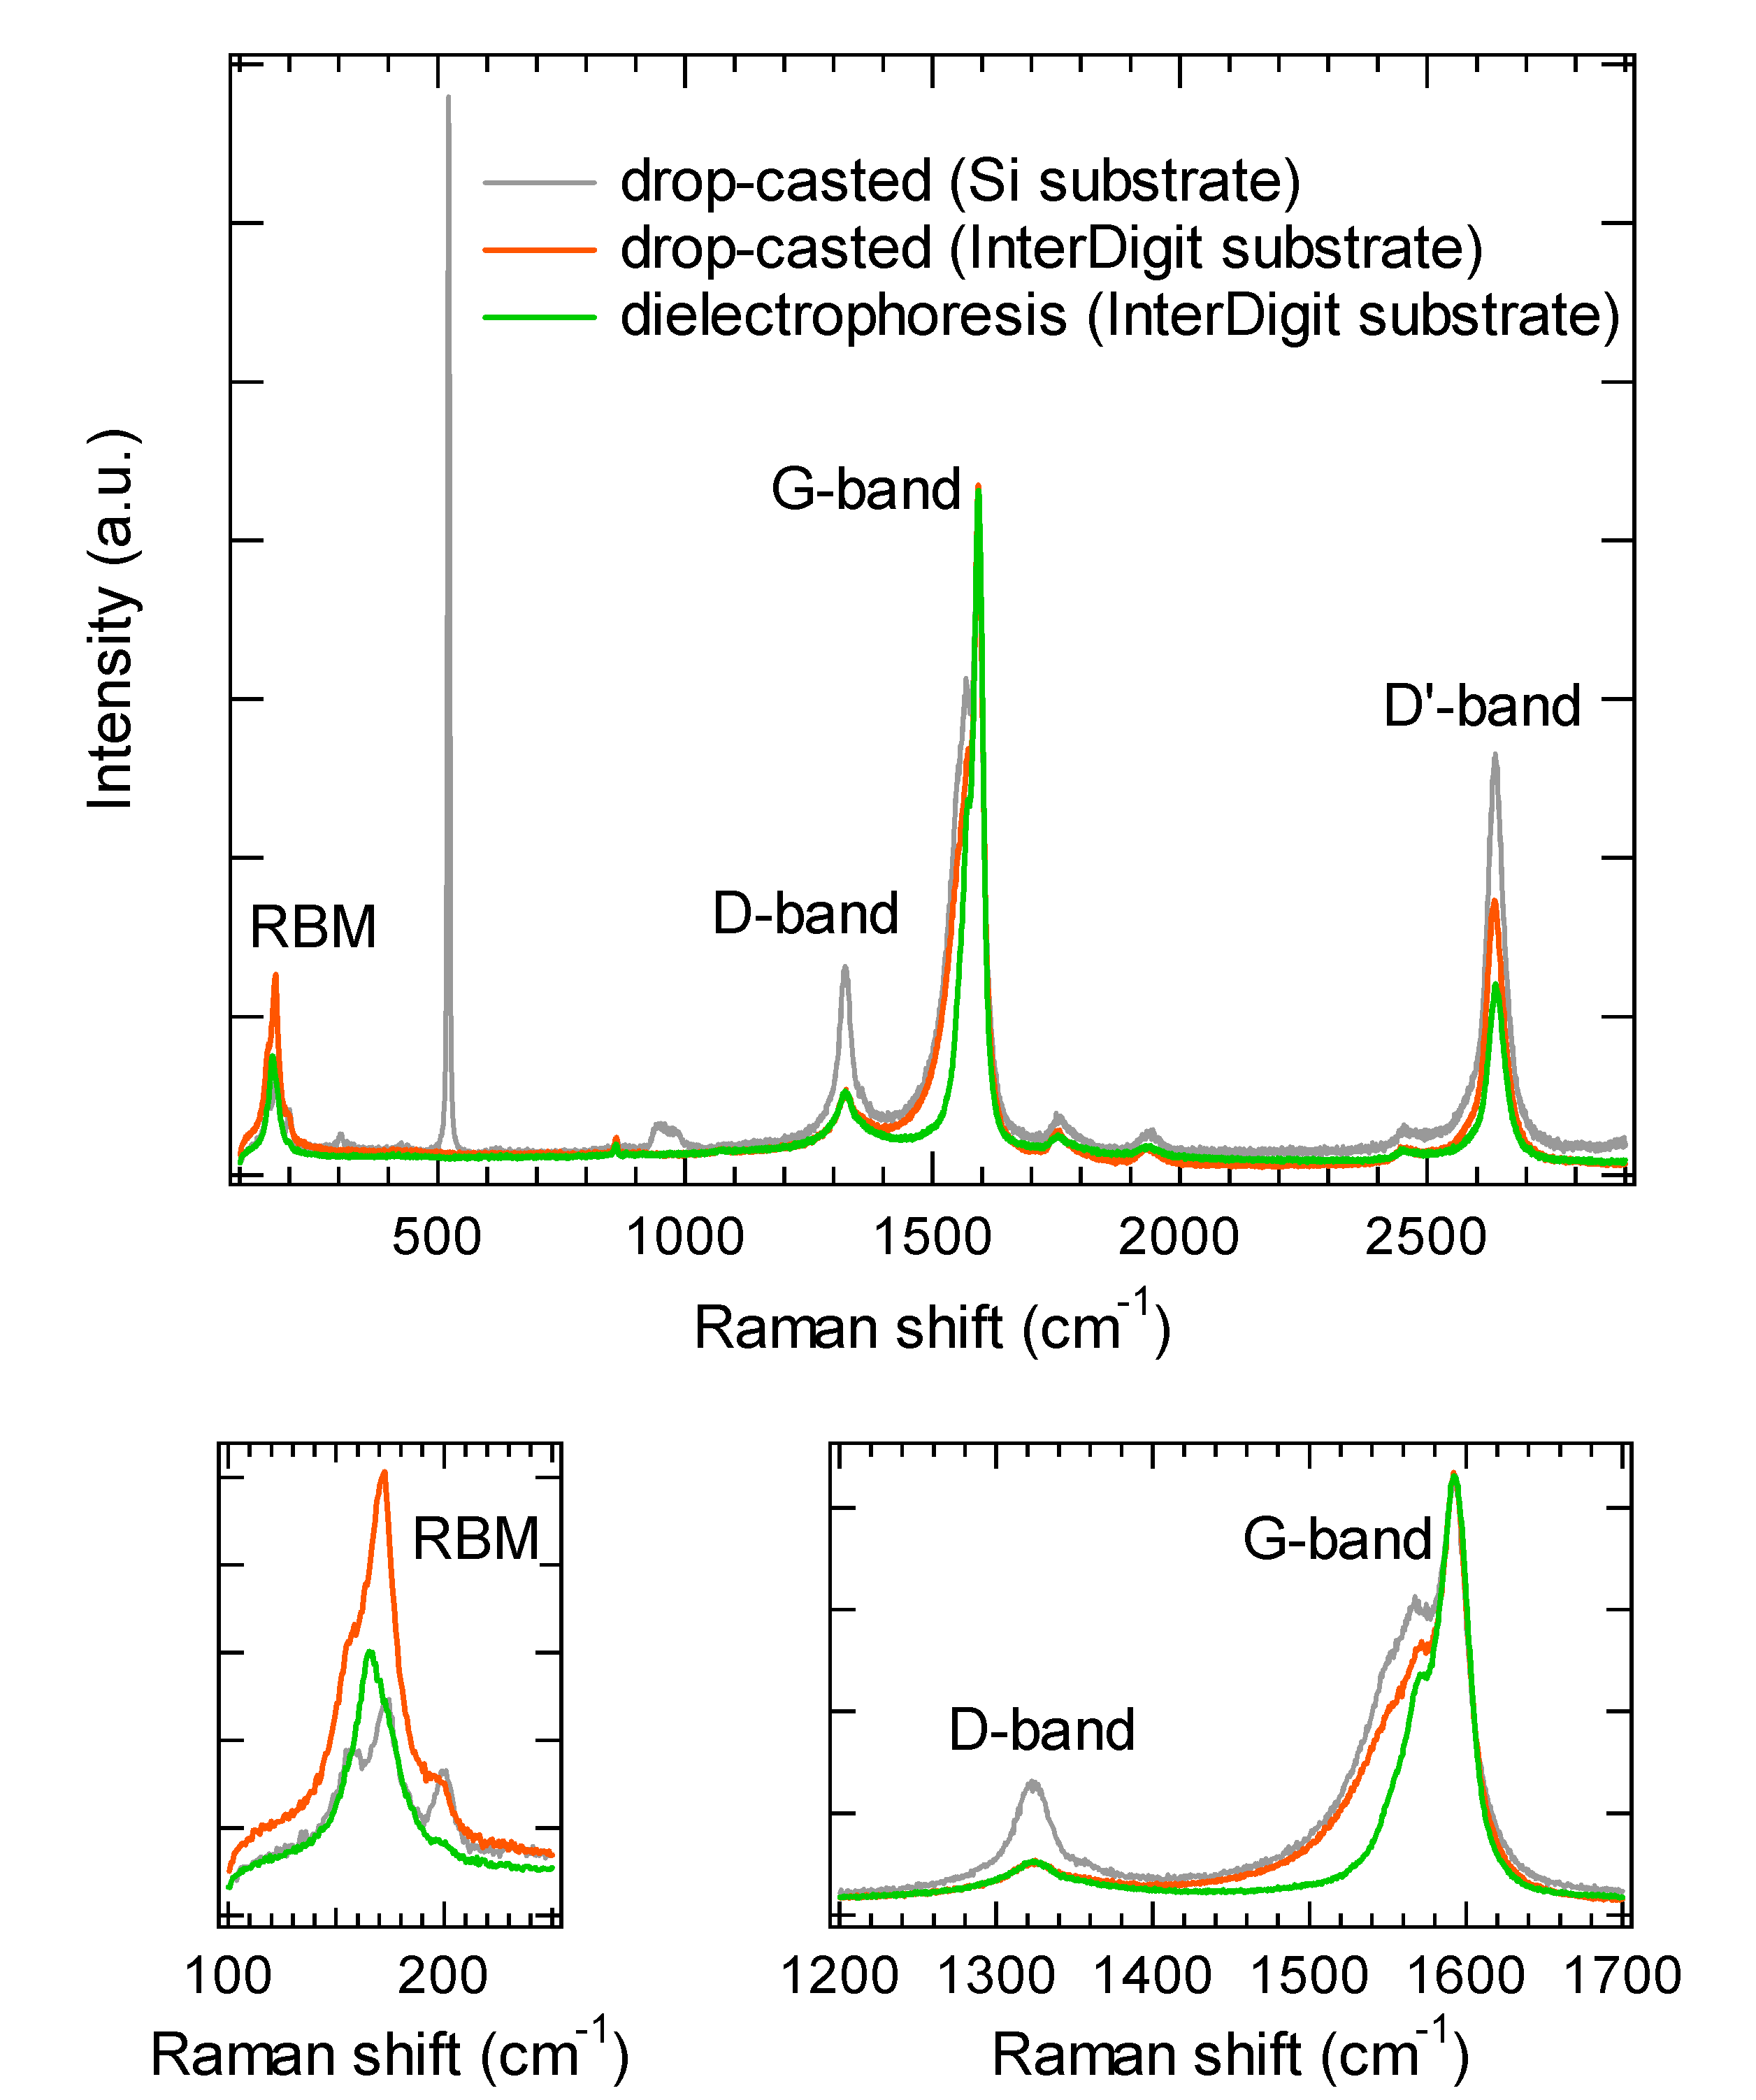
Raman

Slide 22
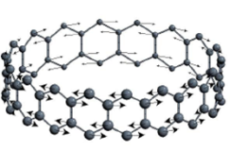
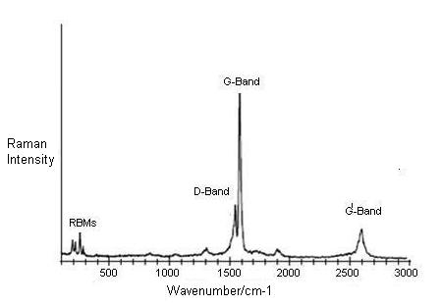
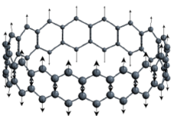
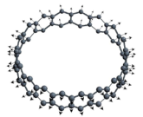
Raman spectrum of SWNT
Raman spectrum gives us many information about the vibrational modes of carbon nanotubes.
Principal peaks:
RBM: Radial Breathing Mode
(150 - 350 cm¯¹)
D-band: Disorder induced band
(1350 cm¯¹)
G-band: tangential (derived from the graphite like in-plane) mode
(1560 – 1600 cm¯¹)
G’-band: overtone of D-band
G-band
Intensity
RBM
D-band
G’-band
Raman shift (cm¯¹)
R. Graupner J. Raman Spectrosc. 38, 673 (2007)

Slide 23
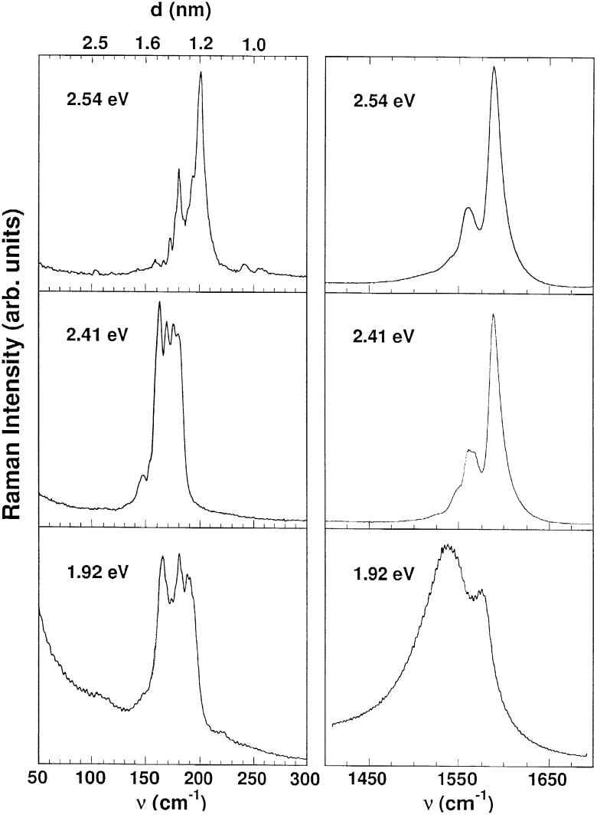
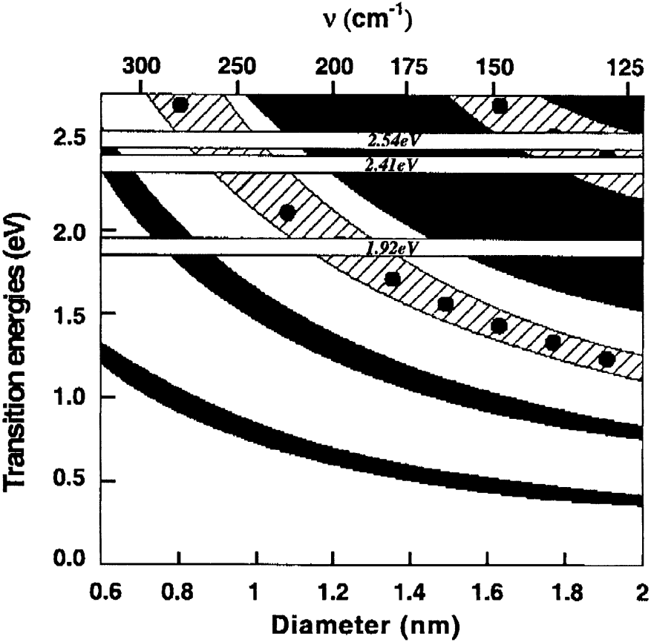
Metallic vs Semiconductive SWNTs
Raman spectra of SWNTs in bundles using different excitation energy (2.54, 2.41 and 1.92 eV).
The metallic or semiconducting character of the tubes is definitely confirmed by the line-shape of the TM (G-band).
Lorentian profile
RBM
G-band
semicond.
Lorentian profile
semicond.
S
M
Breit-Wigner-Fano
profile
S
S
metallic
L. Alvarez et al. Chem. Phys. Lett. 316, 186 (2000)

