Slide 1
Physics Colloquia – PhD School Università degli Studi di Milano
Exotic Nuclei
Piet Van Duppen
Instituut voor Kern- en Stralingsfysica
University of Leuven (KU Leuven), Belgium
What are exotic nuclei and why do we study their properties?
  key questions in nuclear-structure research/nuclear astrophysics
  the atom, its nucleus and the fundamental interactions
How to produce exotic nuclei?
  present the ISOLDE facility at CERN (Switzerland)
How are they studied?
  atomic spectroscopy (laser resonance ionization)
  exotic decay mode (β-delayed fission)
  Coulomb excitation using a post-accelerated radioactive ion beam
Conclusion and Future outlook

Slide 2

Key Questions: Nuclear Structure and Nuclear Astrophysics
How are complex nuclei built from their basic constituents?
  strong interaction in nuclear medium
• How to explain collective properties from individual nucleon behavior?
  collective versus individual
• How do regular and simple patterns emerge in the structure of complex nuclei?
  symmetries
• How and where are the elements made?
  stellar nucleosynthesis
→ Exotic Nuclei
→ Radioactive Ion Beams
www.nupecc.org

Slide 3
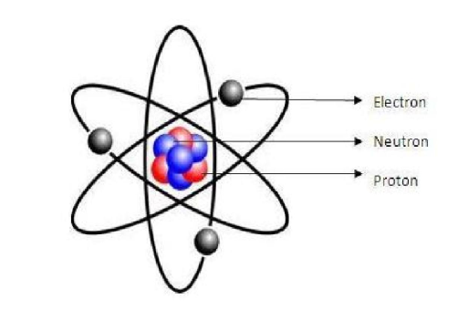
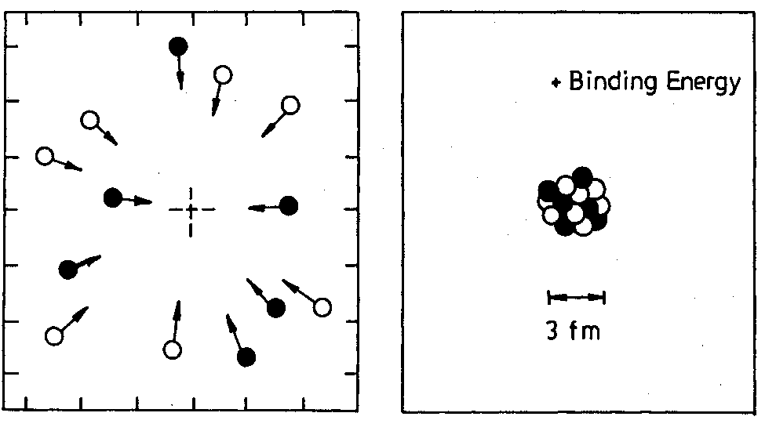
The atom: building blocks, interactions and energy (I)
Atom:
electron
m(ν) = 0.939565 GeV/c²
m(π) = 0.938783 GeV/c²
neutron
E = mc²
protron
Fundamental interactions:
Interaction | Strength | Reach
Strong | 1 | ∼10⁻¹⁴ m
Weak | 10⁻⁴ | ∼10⁻¹⁵ m
Electromagnetic | 1/137 | ∞
Gravitational | ∼10⁻³⁸ | ∞
Energy:
+ binding energy
26*m(π) + 30*m(ν) = 52.595 GeV/c²
m(⁵⁶Fe) = 52.103 GeV/c²
∼1% of total energy
proton neutron

Slide 4
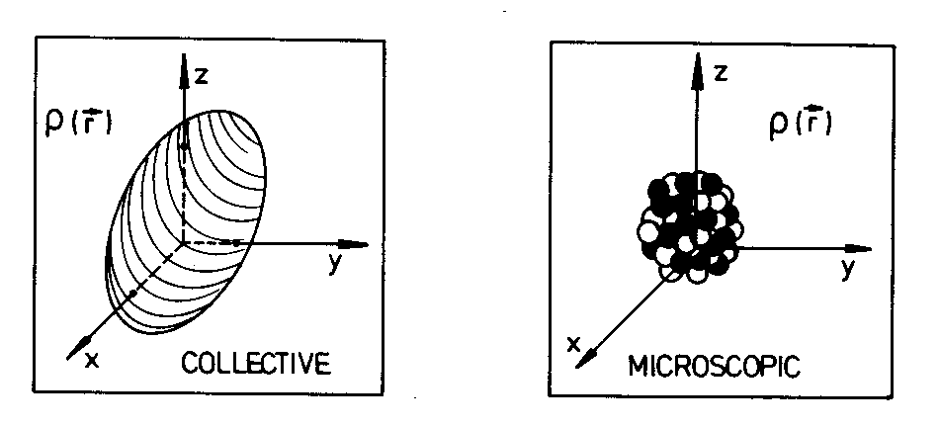
The atom: building blocks, interactions and energy (Ii)
Energy:
Atomic Nucleus is a many-body strongly interacting open quantum system
Single-particle and collective degrees of freedom
ground and excited states of ⁵⁶Fe (Z=26, N=30)
(keV)
2⁺
2657
4⁺
2085
2⁺
847
1 MeV
0⁺
0
E=52.1 GeV
⁵⁶Fe
1 GeV
excited states
E=mc²=0
nucleon
∼1 GeV

Slide 5
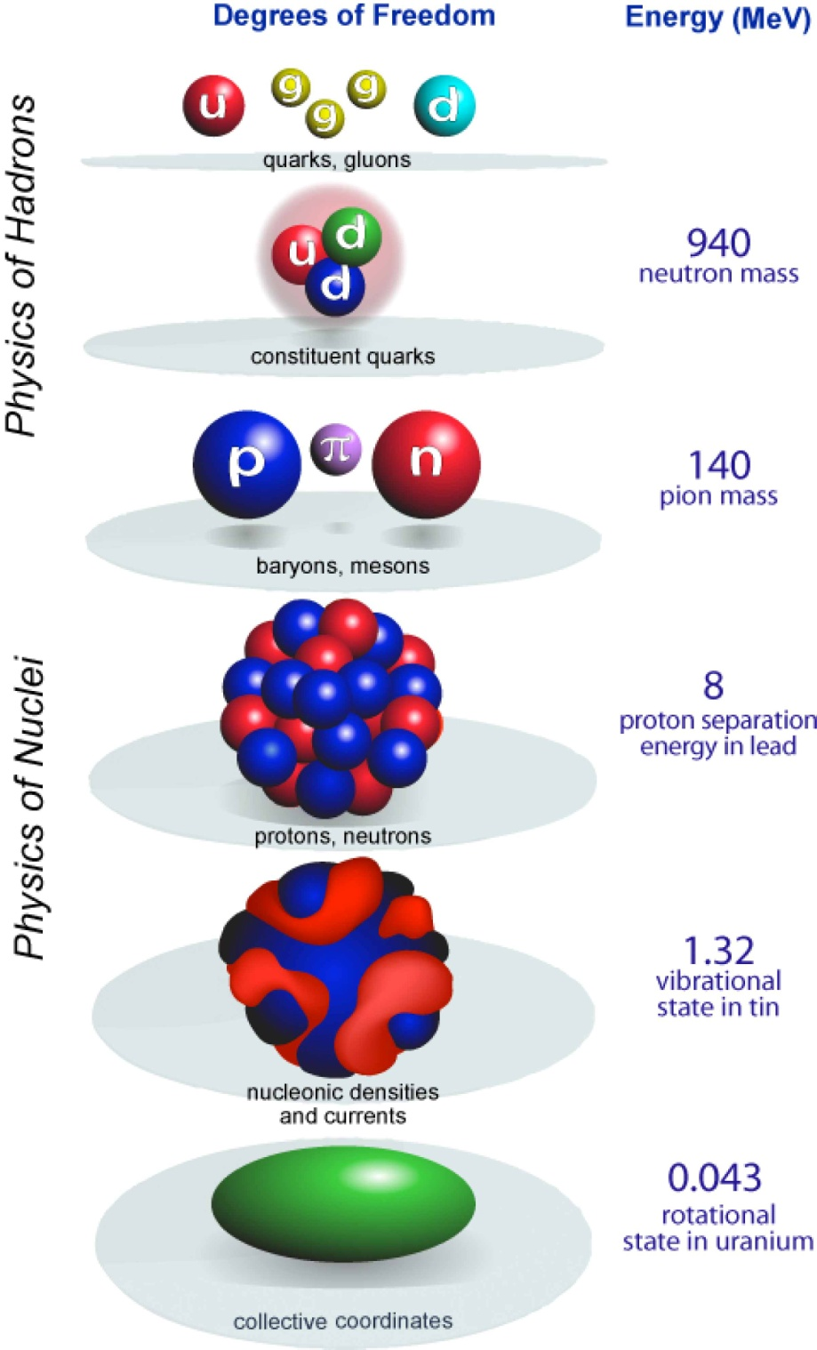
Sub-Atomic Physics: degrees of freedom - energy
Nuclear Structure
Courtesy: W. Nazarewicz

Slide 6
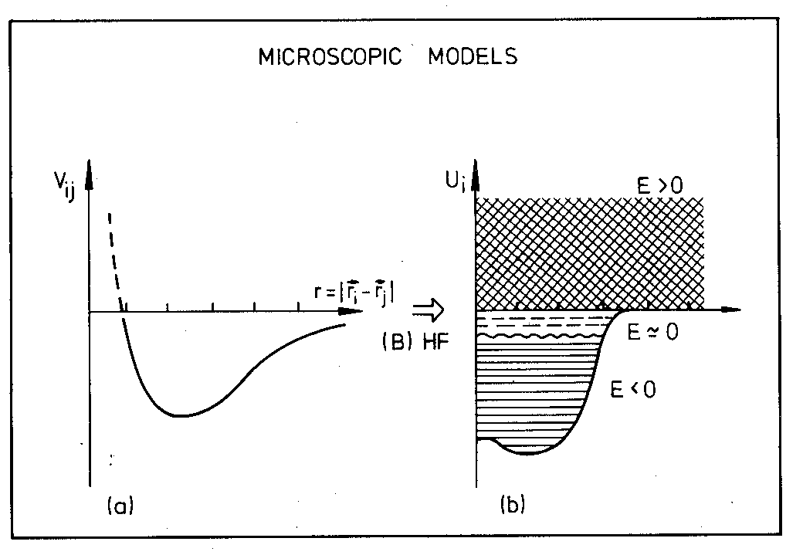
The Nuclear Many-Body Problem
Challenges:
strong interaction
number of nucleons
1
2
fm
10 fm
Fermi energy
Courtesy:
K. Heyde

Slide 7
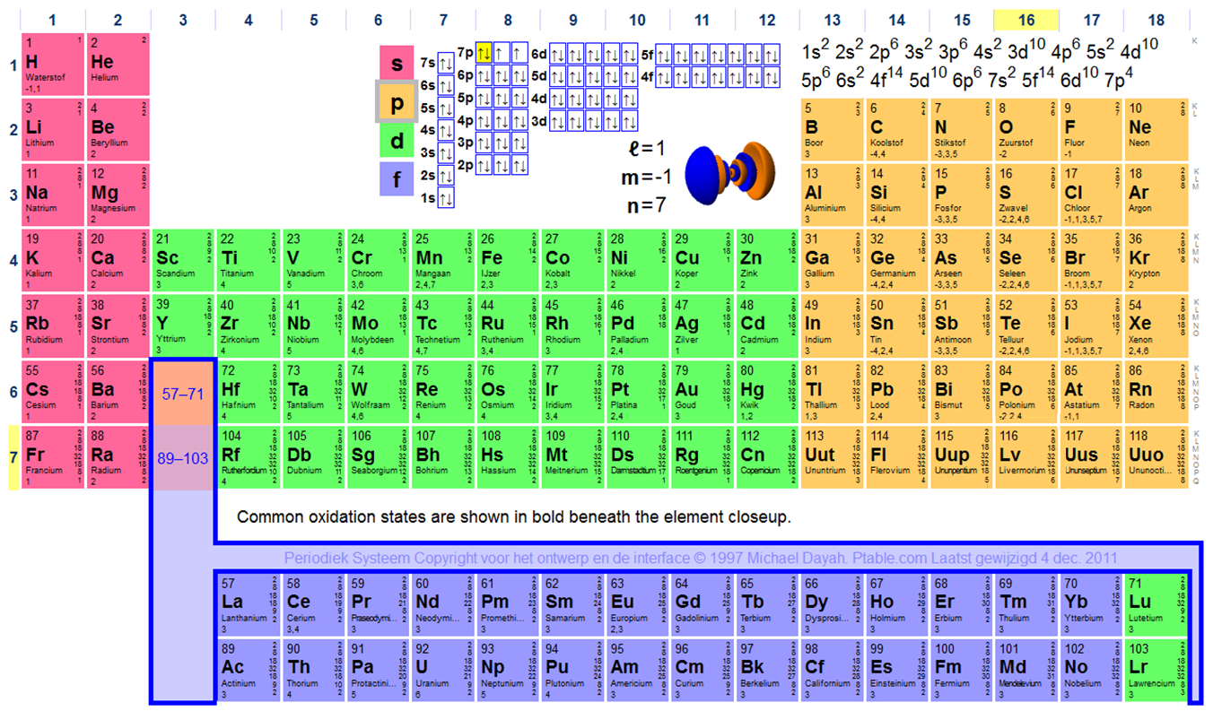
Mendelejev’s Table: the Chemical Elements
Noble gases (helium, neon, argon, ...): “magic” number of electrons
2
Energy
10
18
ionization
potential
36
54
0
86
electron
₁₁₄Fl: Flerovium
₁₁₆Lv: Livermorium
wikipedia

Slide 8
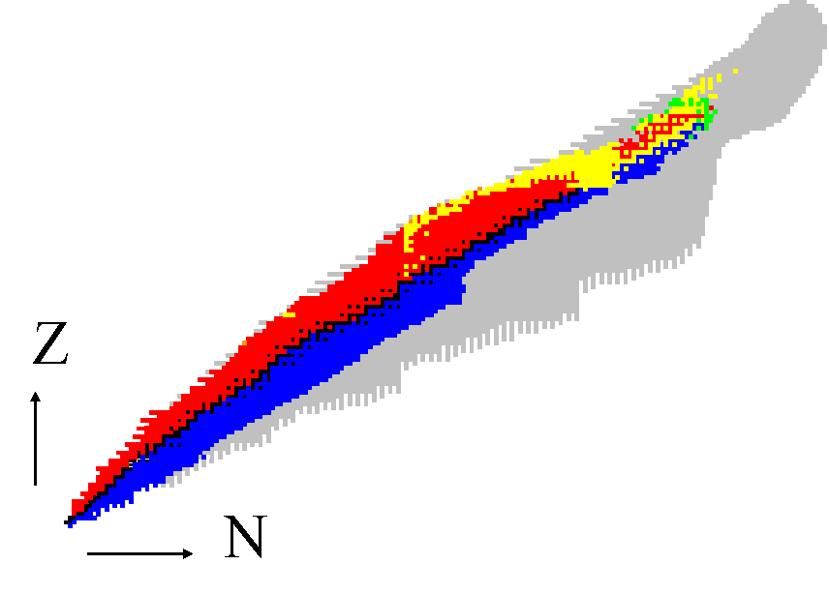
The Nuclear Chart: Radioactive Decay Modes
Spontaneous fission
α decay:
proton-rich nuclei
82
β⁺ decay:
π
ν
stable nuclei
neutron-rich nuclei
π
ν
β⁻ decay:
π
ν

Slide 9
The Nuclear Chart
Exotic Nuclei: unusual proton-to-neutron ratio
Magic Numbers
Examples: around the Z=82 (lead) isotopes
Doubly magic nuclei
82
proton drip line
²⁰⁸Pb (Z=82, N=132)
unknown territory
50
40
126
¹³²Sn (Z=50, N=82)
28
neutron drip line
20
82
50
20
28

Slide 10
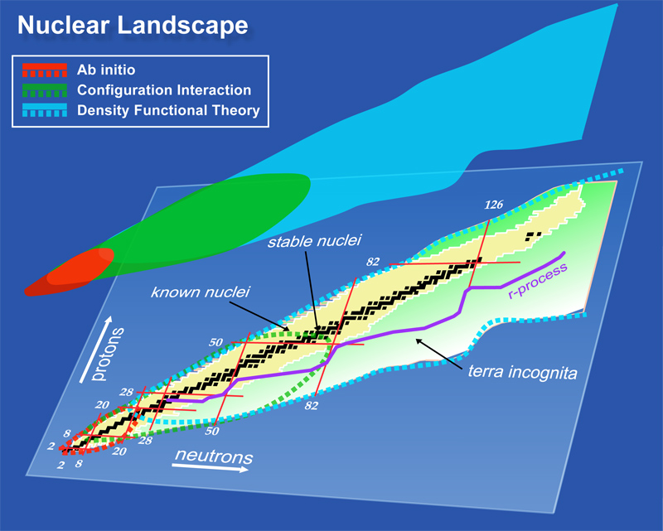
Nuclear Theory – Nuclear Models
Courtesy: W. Nazarewicz

Slide 11
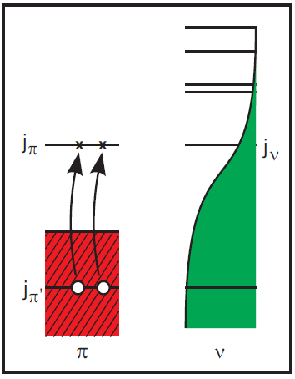
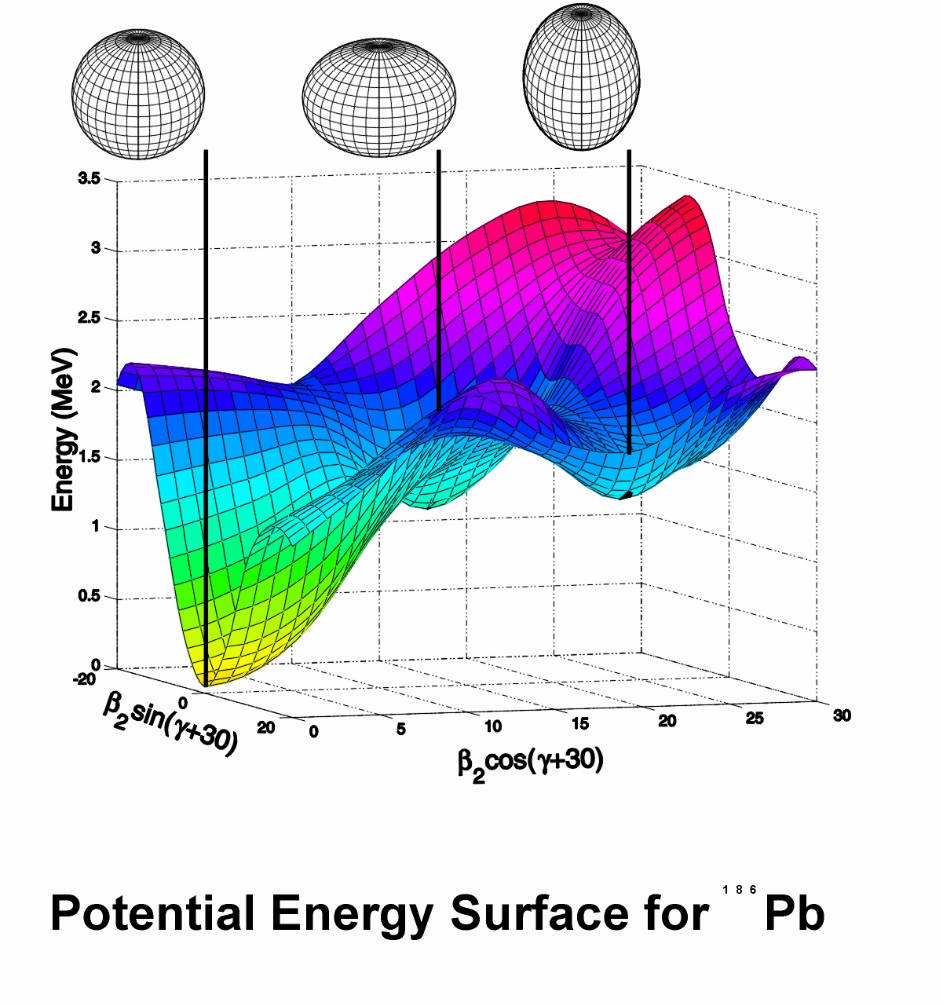
The Z=82 Shell Closure: Shape Coexistence
Spherical shell-model approach
Mean-field approach
Z=82
¹⁸⁶Pb
A. Andreyev et al., Nature 405 (2000) 430

Slide 12
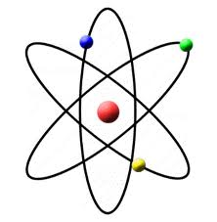
The Experimental Probes
Fusion evaporation, Fragmentation, Fission, Deep inelastic scattering
Energy
Inelastic and elastic scattering
Knock-out
T_{1/2}
I^{π}
^{A}Y
Gamma spectroscopy
Few-nucleon transfer
Radioactive decay
^{A-1}X (d,p)
Coulomb excitation
Laser spectroscopy
Mass spectroscopy
^{A}X

Slide 13
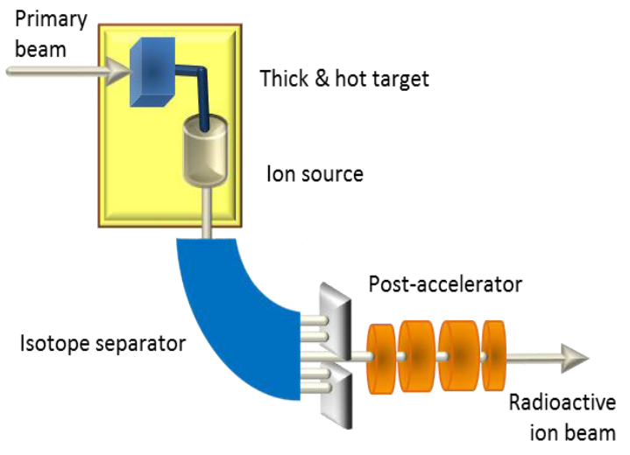
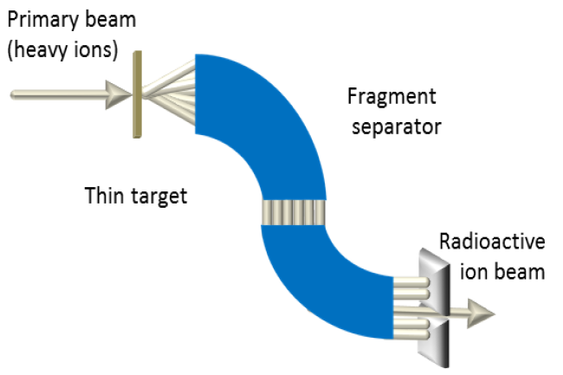
Beams of Exotic Nuclei
Radioactive Ion Beams are produced using two complementary ways
  Isotope Separator On Line method (ISOL)
  In-Flight method
The different steps are:
  Production of the exotic nuclei: nuclear reaction
  Purification/separation: ionization, electromagnetic fields
  Post-acceleration (for the ISOL method)
ISOL
In-Flight
courtesy: ISOL@MYRRHA

Slide 14

Production of Exotic Nuclei at ISOLDE-CERN
Primary nuclear reaction:
1.4 GeV proton on ²³⁸U
126
²³⁸U
spallation
82
50
50
fission
28
28
20
fragmentation

Slide 15
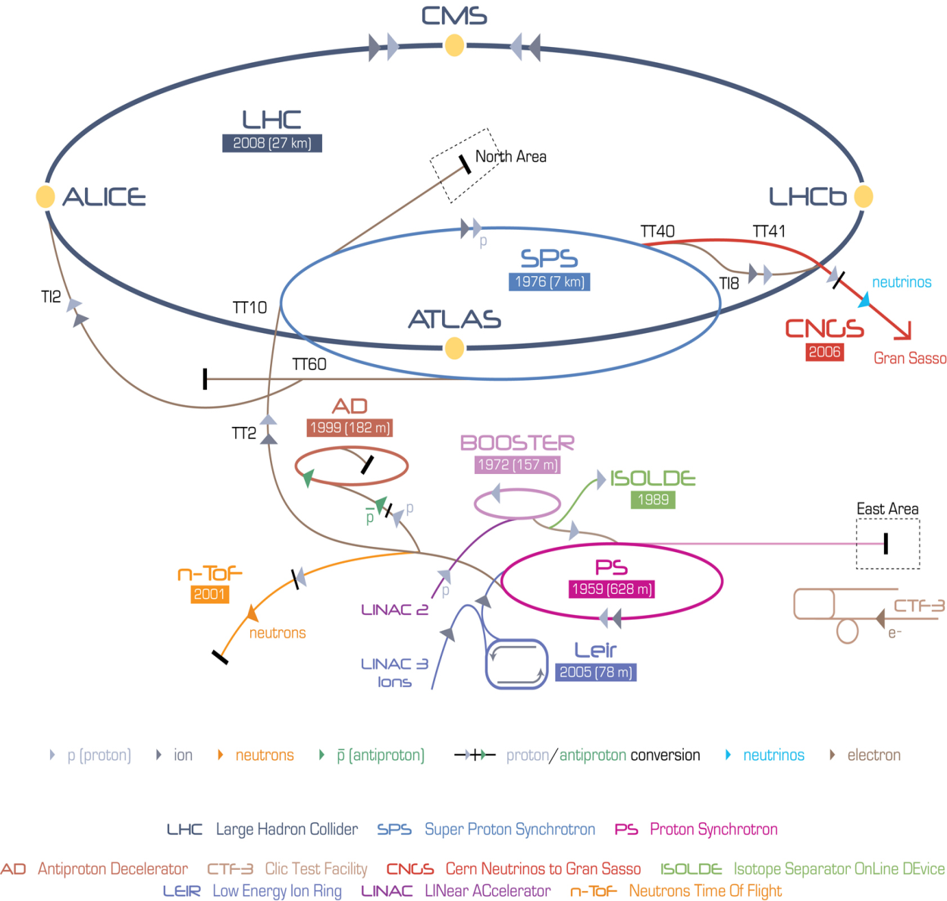
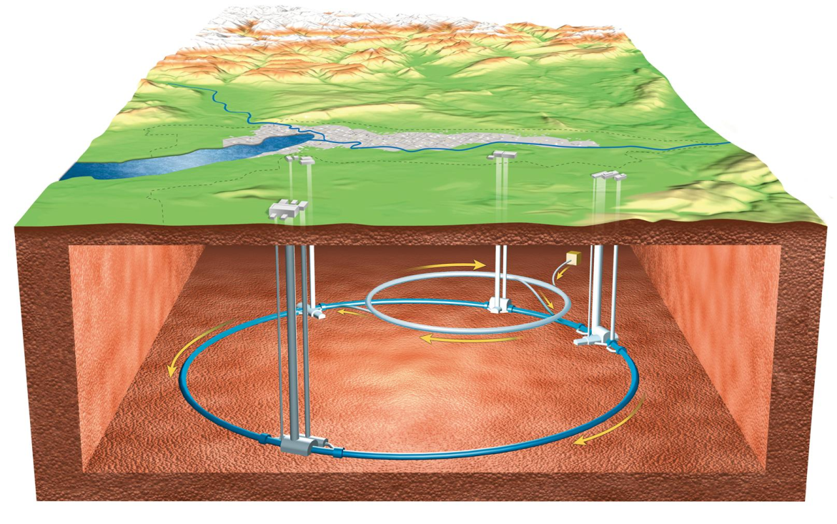
ISOLDE at CERN

Slide 16
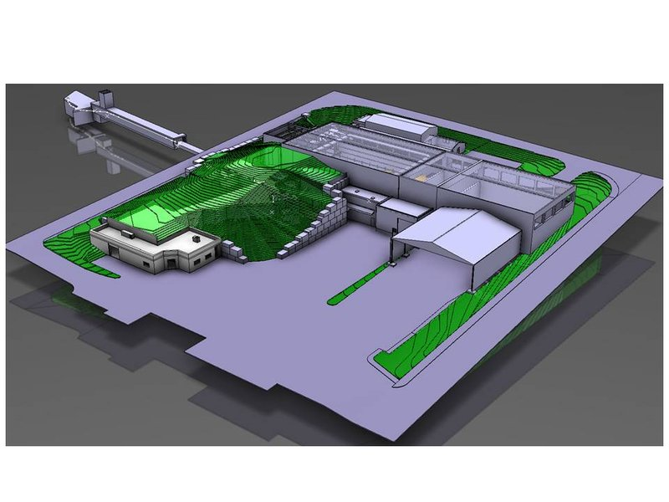
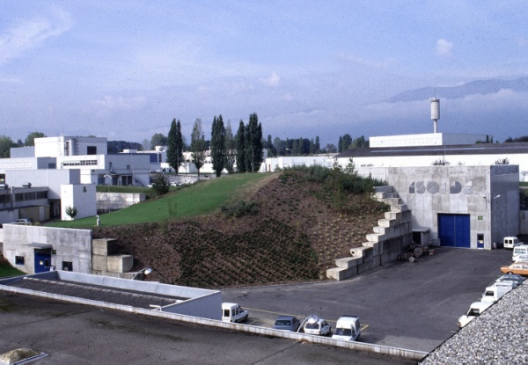
ISOLDE at CERN
Intensity (μA) | Energy (GeV)
2 | 1.4

Slide 17
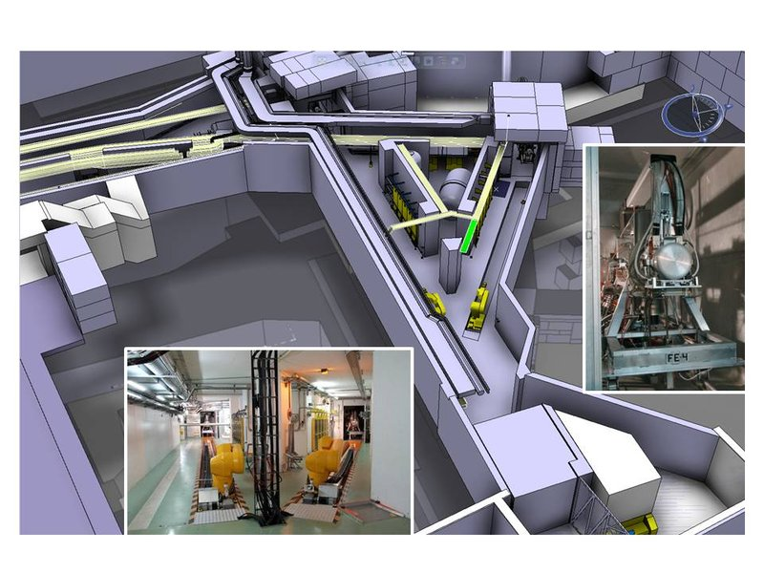
ISOLDE at CERN
Two target stations

Slide 18
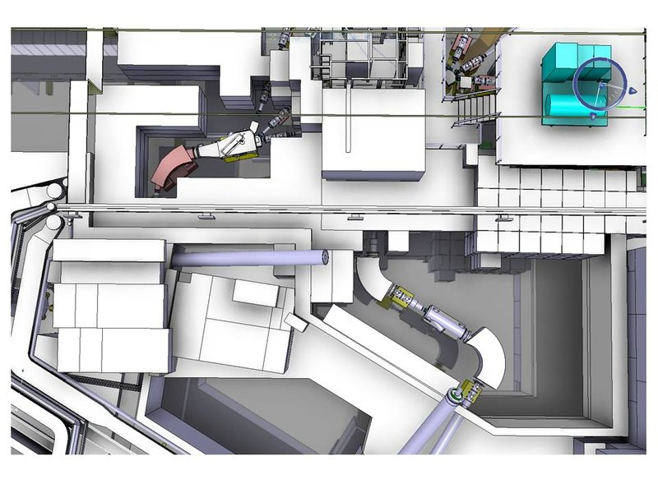
ISOLDE at CERN
GPS and HRS Separator

Slide 19
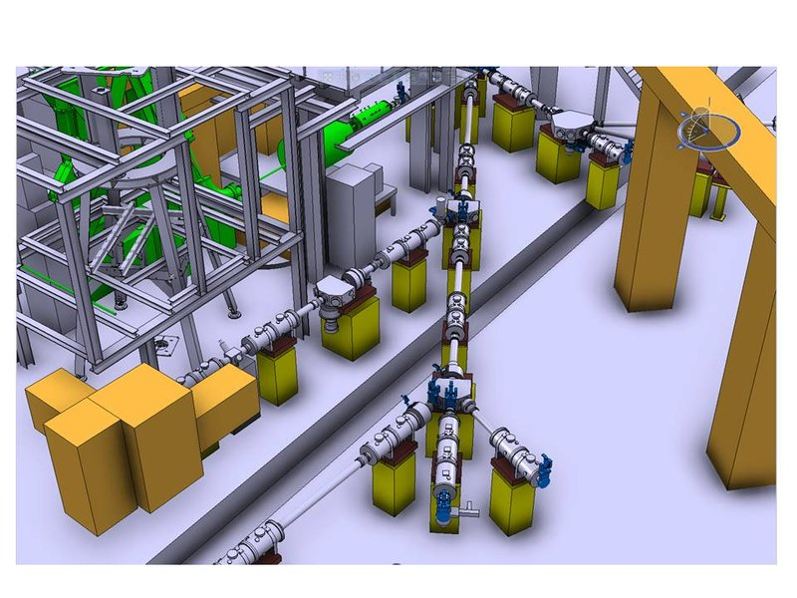
ISOLDE at CERN
Experimental hall: beam delivery at 60 keV

Slide 20
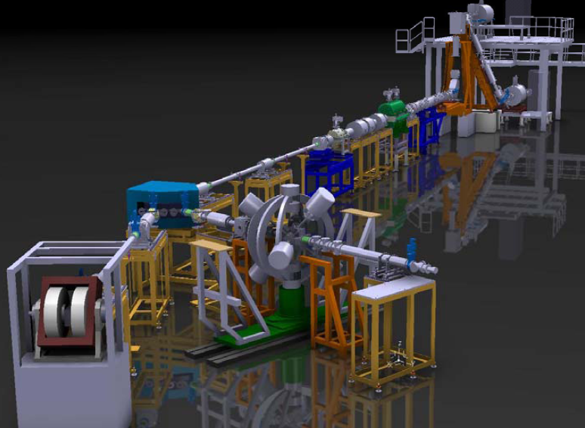
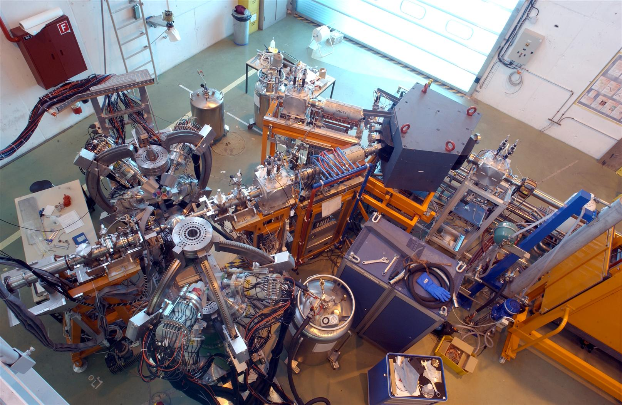
REX-ISOLDE: post accelerator
Acceleration of all 60 keV ISOLDE beams
Beam energy: 3 MeV/u (e.g. ¹⁸⁴Hg: 552 MeV)
Miniball experiment

Slide 21
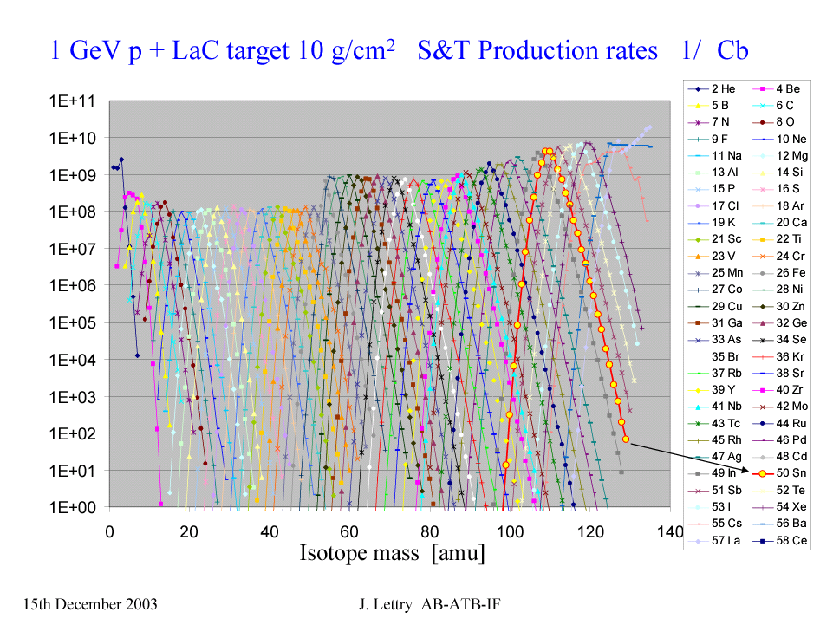
Production of Exotic Nuclei
1 GeV proton beam on a lanthanum (La) target
10⁶
Production rate (a.u.)
¹³²Sn
Mass separation
Element selective ion source
Note the radioactive inventory
Z=50
Sn
Mass separation
J. Lettry, V. Fedoseev (CERN)

Slide 22
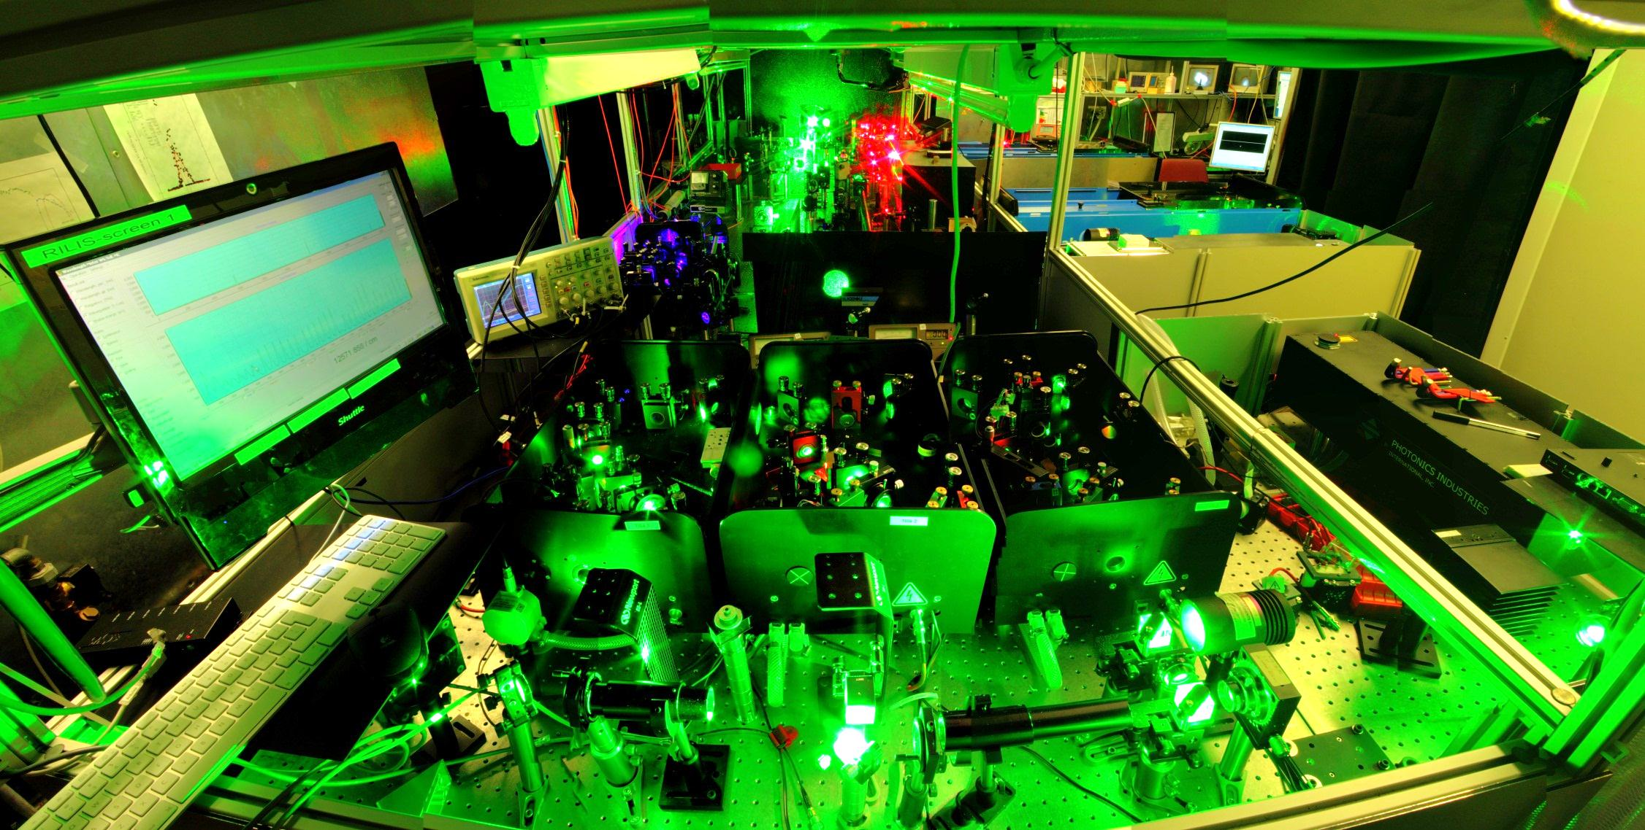
Laser Resonance Ionization

Slide 23
Laser resonance ionization and atomic spectroscopy
Element selective:
Isotope shift:
  nuclear-charge distribution
Hyperfine structure:
  magnetic moment, electric quadrupole moment
  spin of the nucleus
A⁺ + e⁻
Autoionizing State
Continuum
Collisions
First Ionization Limit
5-10 eV
λ₂
Rydberg
States
λ₁
A
Ground State

Slide 24
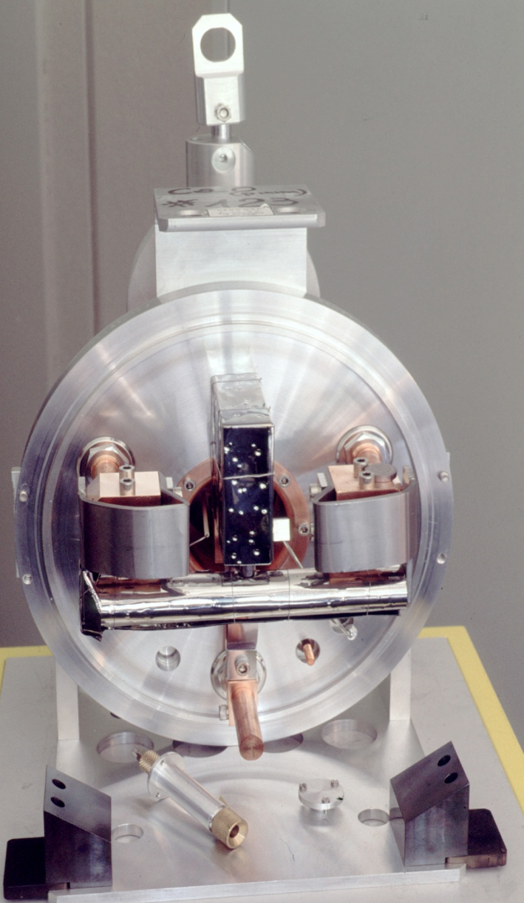
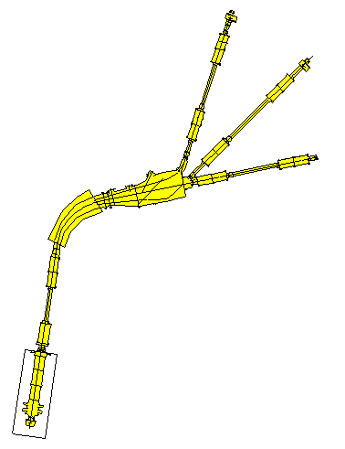
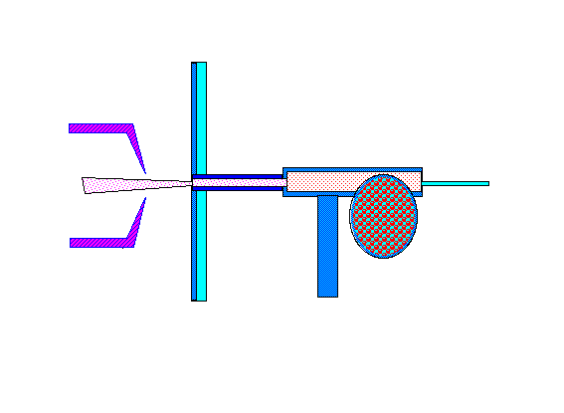
In-source laser spectroscopy: sensitivity
1500
¹⁸⁵Pb
I=13/2
si
α
I=3/2
mylar tape
1000
γ
ge
α counts
500
0
GPS
17642,8
17643,0
17643,2
17643,4
17643,6
extraction
electrode
60 kV
RILIS
wave number [cm⁻¹]
IP = 7.42 eV
continuum
laser
beam
+
+
ionizer
λ₃ = 511 nm & 578 nm
6p8p (1/2, 3/2)₂
target
DC
λ₂ = 600.186 nm
F’=I+J’=I+1
Proton
beam
6p7s (1/2, 1/2)₁
proton beam
1 - 1.4 GeV
λ₁ = 283.305 nm
target container
6p² (1/2, 1/2)₀
Pb
F=I+J=I
target
UC_{x}, g/cm²
V.N. Fedoseyev et al., Hyp.Int.127, 409 (2000)

Slide 25
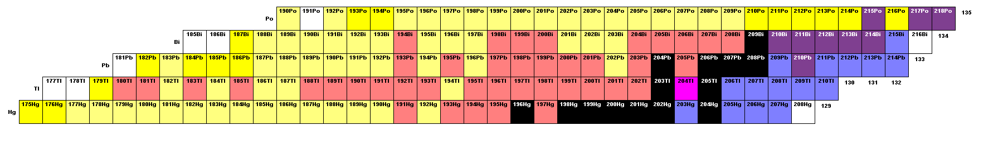
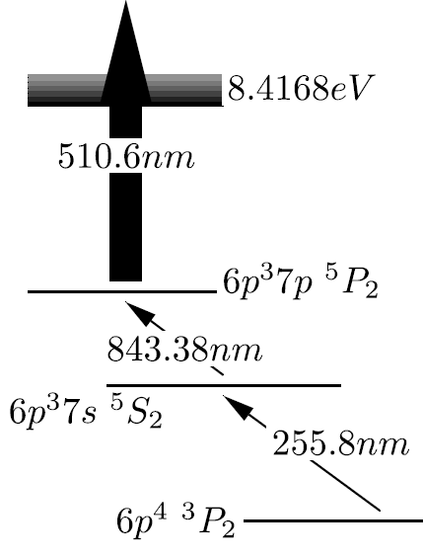
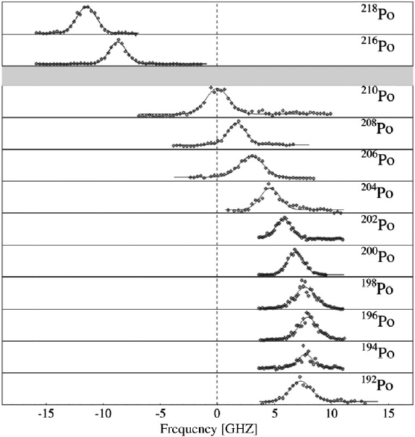
In-source laser spectroscopy: Pb (Z=82) and Po (Z=84)
N = 104
¹⁹²Po (33 ms)
N = 126
¹⁸²Pb (T_{1/2} = 55 ms)
Z = 82
188Po
189Po
191Po
²¹⁸Po
In-source laser spectroscopy: A=218 to 192
T_{1/2} = 3 yr to 33 ms
Intensity form 0.3 ion/s to over 10⁷ ion/s
Effect of 10⁻⁴
¹⁹²Po
Th. Cocolios et al., PRL106 (2011) 052503

Slide 26
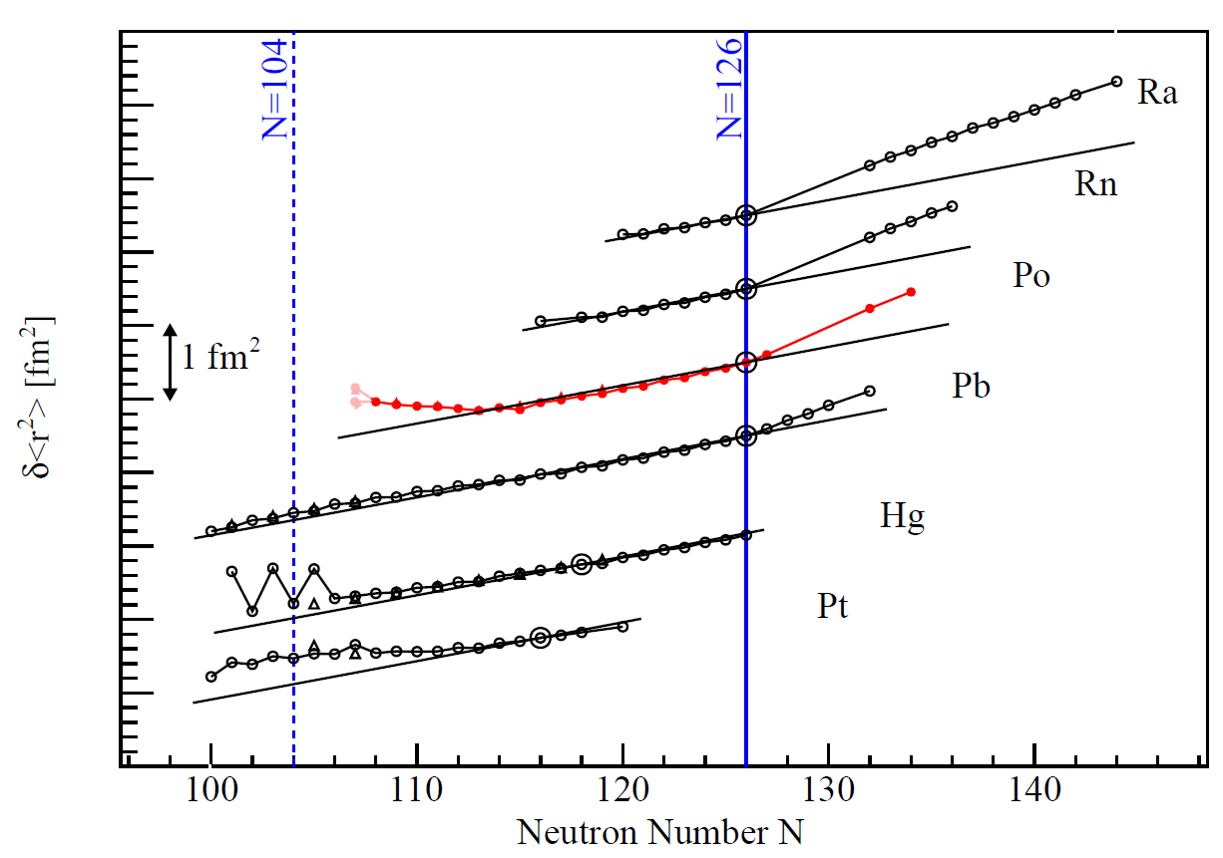
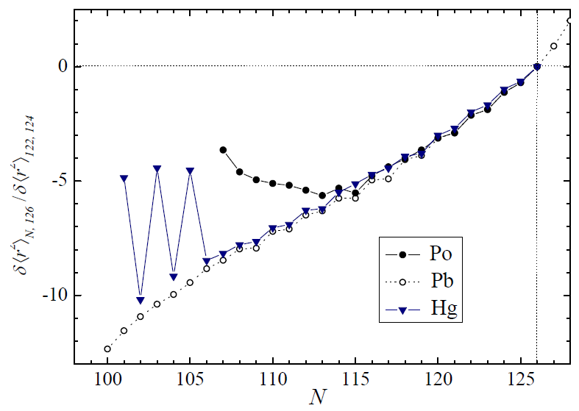
In-source laser spectroscopy: charge radii
spherical liquid drop
(Z=84)
(Z=82)
(Z=80)
T.E. Cocolios et al., PRL 106 (2011) 052503
M. Seliverstof et al., EPJ A41(2009) 315
H. De Witte et al., PRL 98 (2007) 112502

Slide 27
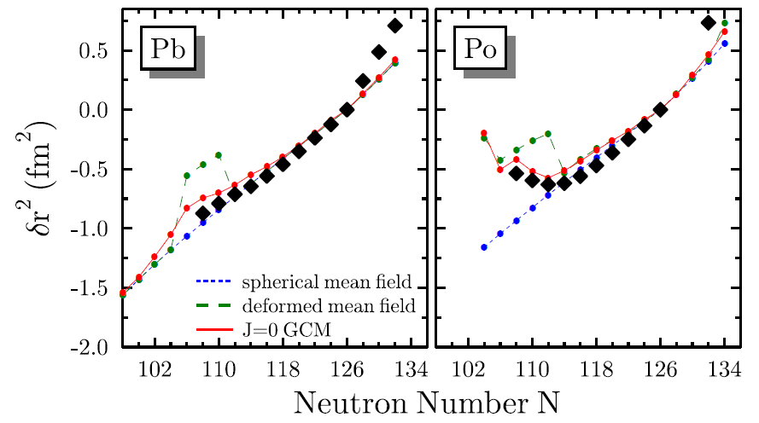
Comparison with beyond-mean field theory
M. Bender et al., PRC78 (2008) 054312
Th. Cocolios et al., PRL106 (2011) 052503
H. De Witte et al., PRL98 (2007) 112502

Slide 28
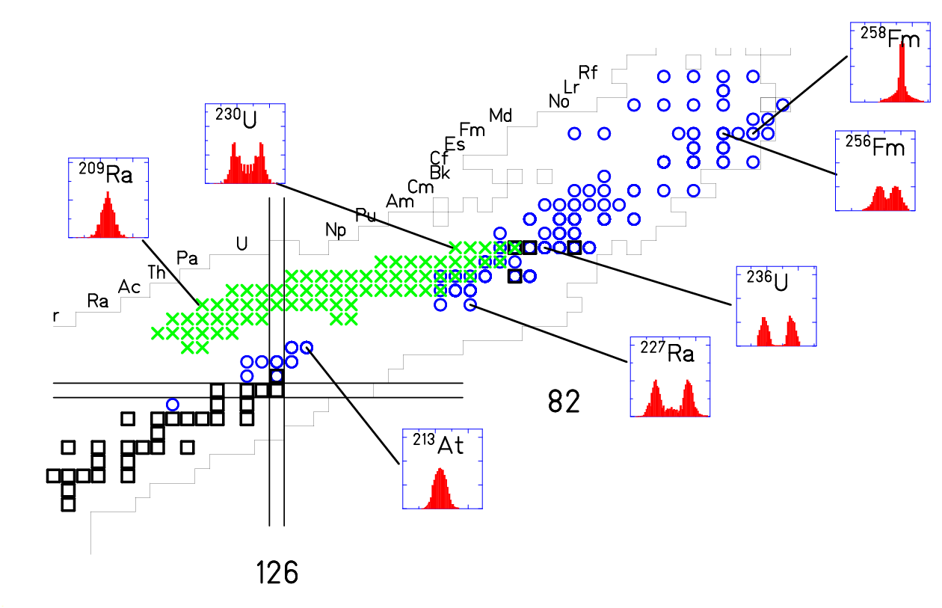

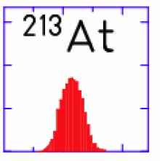
Fission studies: from asymmetry to symmetry
Heavy Actinides, N/Z~1.56: predominantly asymmetric;
influence of ¹³²Sn (Z=50, N=82)
Lightest Hg isotopes with
N/Z~1.25: asymmetric/symmetric?
²⁰²Rn
Z=82
Z=82
Z=82
Z=82
?
¹⁸⁷Ir
¹⁹⁶Au
- particle induced
x - e.m. –induced E*~11 MeV

Slide 29
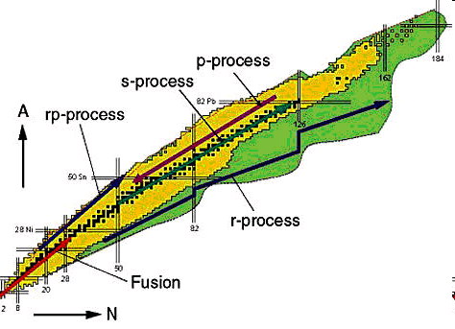
Fission and the r-process nucleosynthesis
Z
β−delayed fission
n-induced fission
spontaneous fission
r-process
r-process to the region with A>250
r-process
Fission
Fission A→A/2 ~125

Slide 30
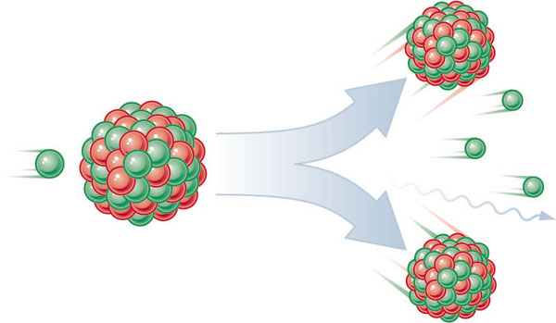
β-delayed fission of ¹⁸⁰Tl: an exotic decay process
¹⁸⁰Tl
Two-step process
10 cases know (region around uranium)
Rare process: probability 10⁻⁴ to 10⁻⁶
β⁺/EC
Q_{EC}
γ
β⁺/EC DF
γ
B_{f}
γ
¹⁸⁰Hg
deformation
¹⁸⁰Tl: T_{1/2} = 1.1 s, 150 atoms/second, β-delayed fission probability is 10⁻⁶
¹⁸⁰Hg (Z=80, N=100): expected to split into two ⁹⁰Zr(Z=40, N=50):
  → symmetric mass split

Slide 31
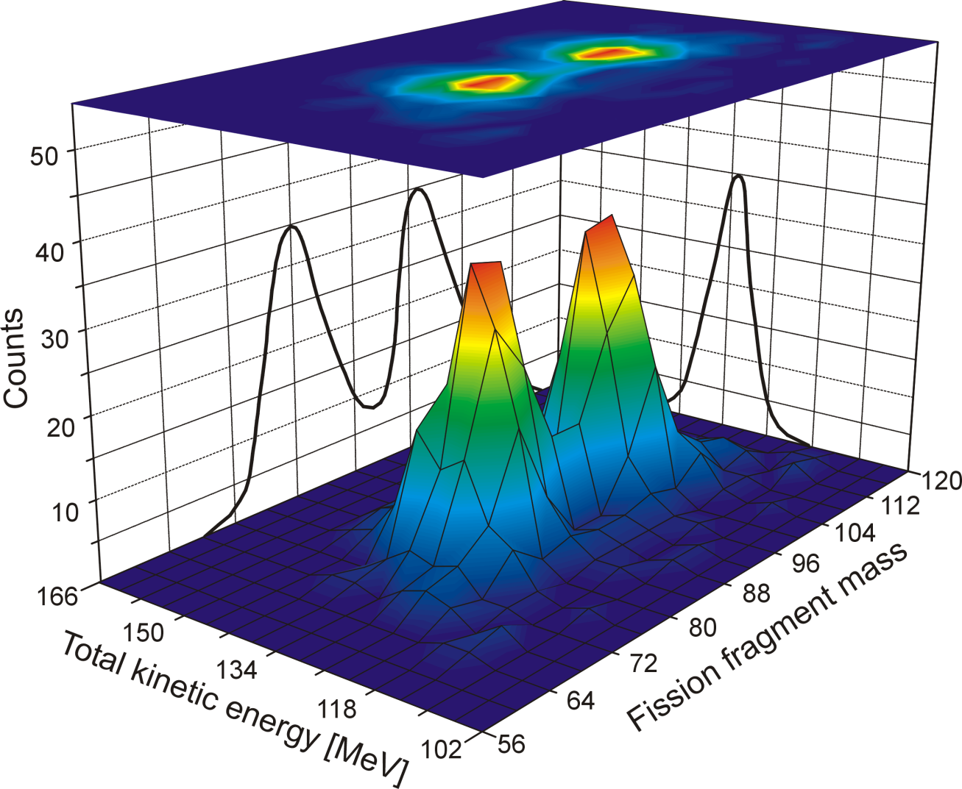
β-delayed fission of ¹⁸⁰Tl: the mass distribution
¹⁸⁰Hg fission asymmetrically centered around ¹⁰⁰Ru and ⁸⁰Kr
A. Andreyev et al., PRL 105 (2010) 252502

Slide 32
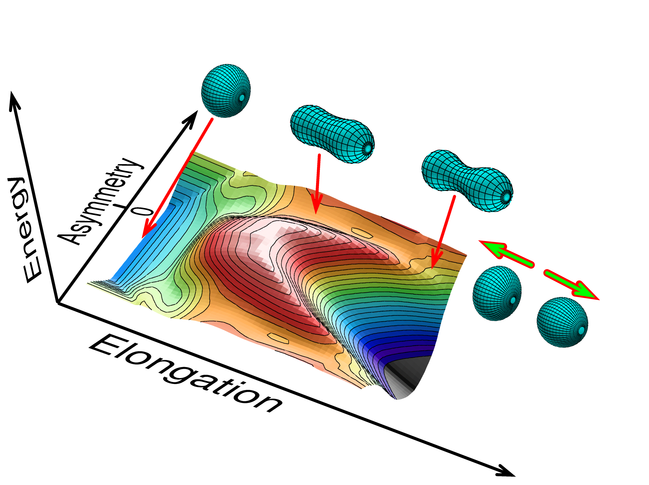
Potential Energy Surface of ¹⁸⁰Hg
Calculations according to 5 dimensional fission model by P. Moller et al.
⁸⁰Kr
¹⁰⁰Ru
⁹⁰Zr+⁹⁰Zr

Slide 33
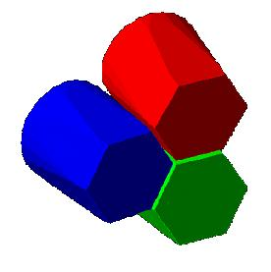
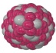
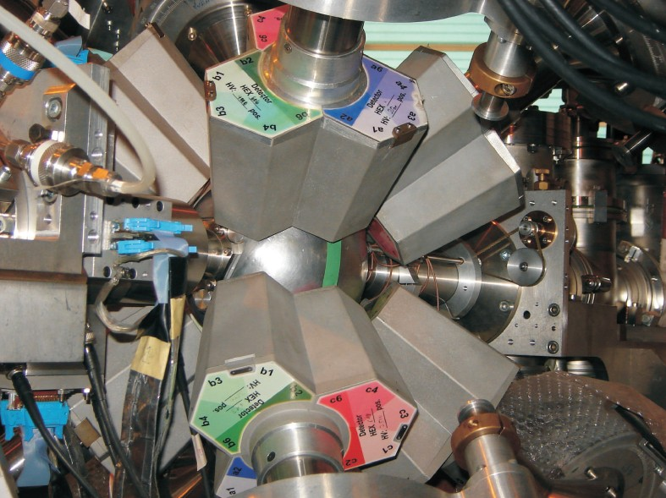
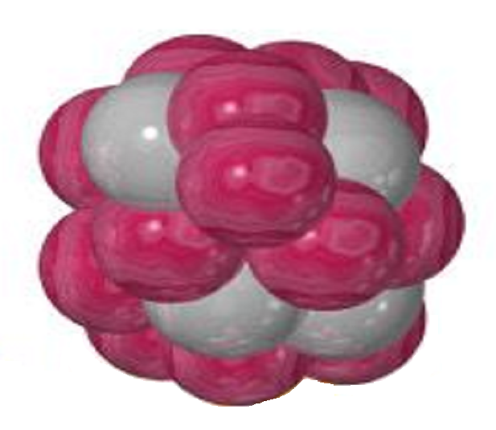
Coulomb excitation at REX-ISOLDE
Miniball Ge detector
E_{P}
¹⁸²Hg
2.85 MeV/u
10⁴ atoms/s
θ_{P}
target ¹¹²Cd
2 mg/cm²
Double sided silicon strip detector
E_{T}

Slide 34
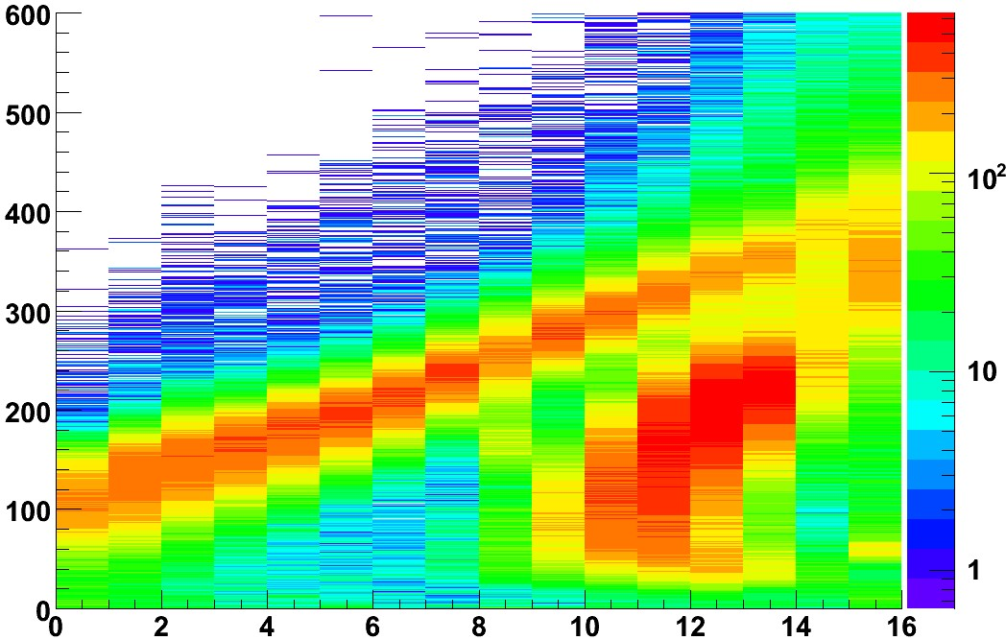
Analysis–Two particle events
Particle-particle-gamma events
→separate projectile and target
Energy (MeV)
target (e.g. ¹⁰⁴Pd)
Counts /MeV/strip
projectile (e.g. ¹⁸⁴Hg )
Strip Number

Slide 35
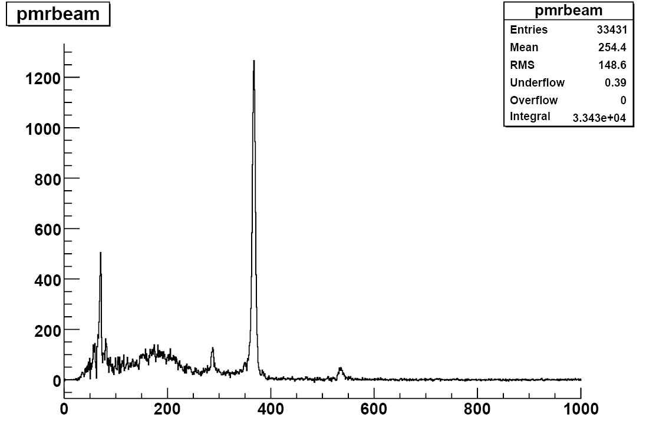
Coulomb excitation of ¹⁸⁴Hg on ¹²⁰Sn
1089
4⁺
653
4⁺
de-excitation
534
2⁺
367
2⁺
375
0⁺
0
0⁺
Coulomb
excitation
¹⁸⁴Hg
Counts
Hg X-rays
Extract energies, transition probabilities (B(E2) values), electrical moments
Energy (keV)

Slide 36
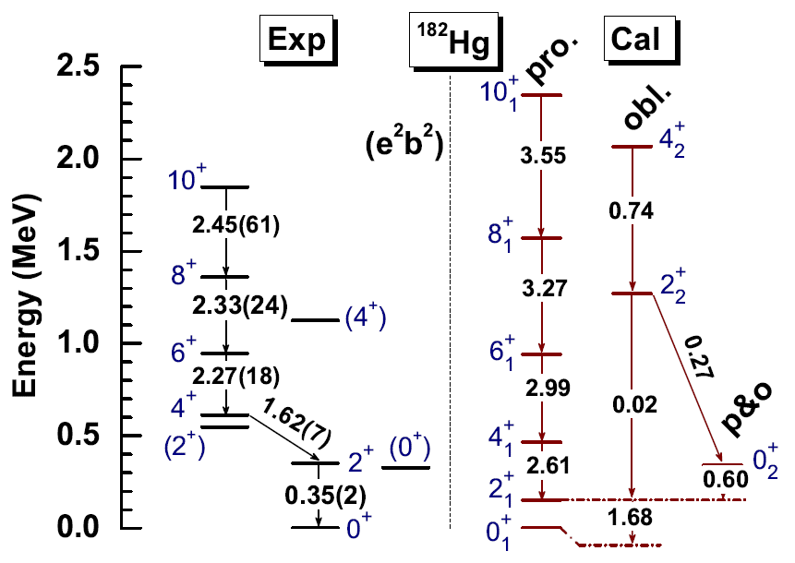
Comparison with theory
preliminary
1.36
1.53
1.91
0.09
0.33
a number of discrepancies: energies, transition rates

Slide 37
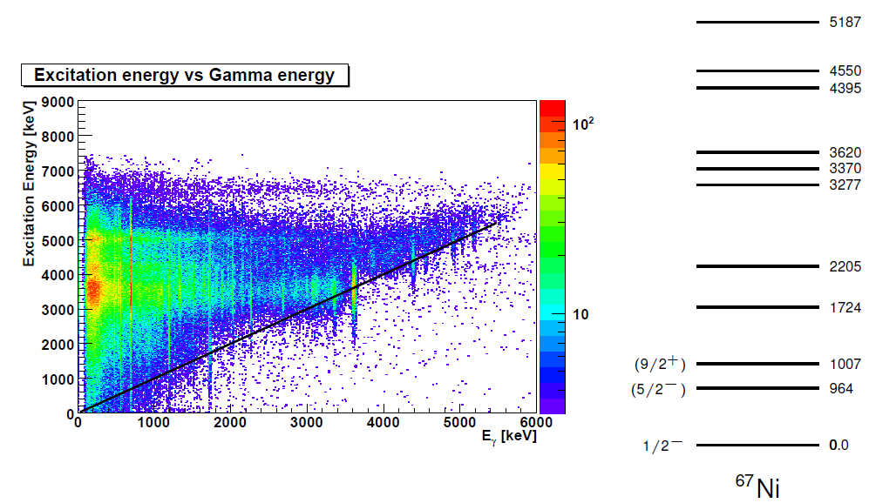
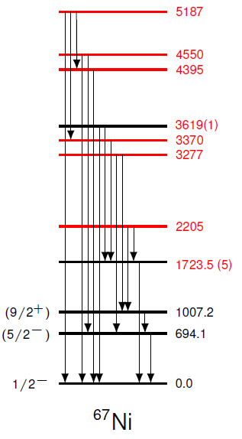
Conclusion
The study of exotic nuclei with their unusual proton-to-neutron ratio is essential to solve the nuclear many-body problem (examples were focused on the lead region).
The combination of different experimental probes/techniques were/are essential for the production and study of new, pure and more intense radioactive ion beams.
Post-acceleration allows reaction studies with exotic nuclei (nuclear structure, reaction dynamics and stellar nucleosynthesis)
⁶⁶Ni(d,p)⁶⁷Ni (with 10⁶ atoms/s)

Slide 38



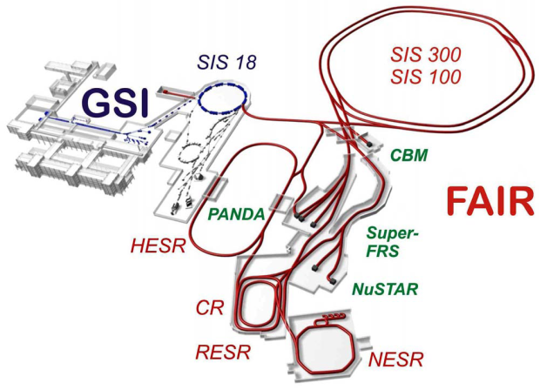



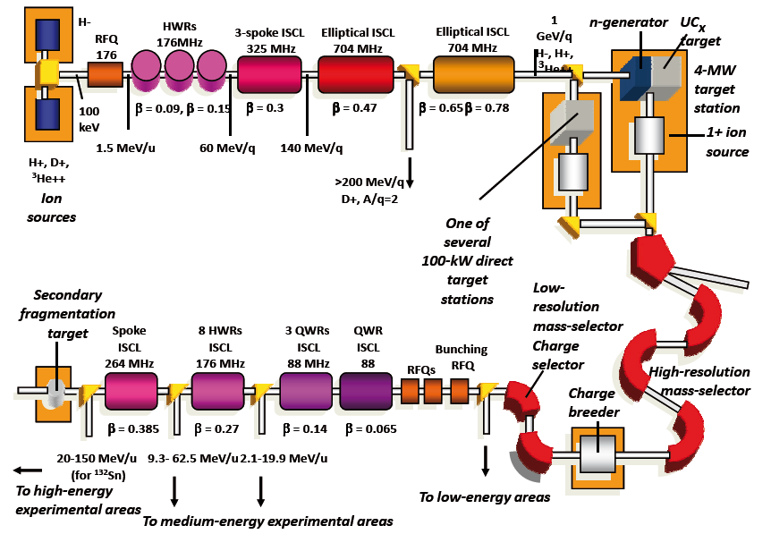



Outlook – Future Exploration of the Nuclear Chart
To answer fundamental questions in nuclear physics, nuclear astrophysics and atomic physics (e.g. atomic properties of the heaviest elements)
Applications (e.g. radioisotopes, trace analysis, ...)

Slide 39











Nucleus Physics – “The Core of the Matter, the Fuel of the Stars”
Cosmology
Particle physics
(high-energy physics)
Astrophysics
10²² cm Galaxies
0=>10²⁸ cm Big Bang
10¹⁸ cm Supernova
Quarks, leptons <10⁻¹⁹ cm
Hadrons <10⁻¹³ cm
Energy
10¹¹ cm The sun
Nuclei <10⁻¹² cm
Nuclear physics
10⁶ cm AMS in the climate
10² cm Diagnostics & therapy
Trapped atoms 10⁻⁸ cm
NMR of proteins 10⁻⁶ cm
10⁻³ cm Labeled cells
Climate
Atomic physics
v
Medicine
Solid-state physics, biology, …

