Slide 1

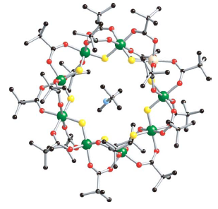
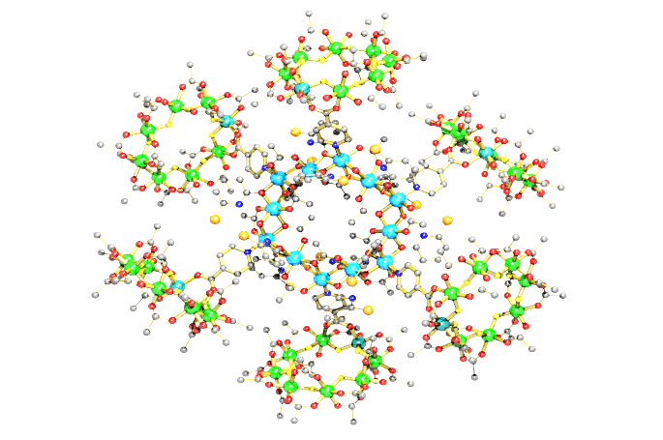

Scuola Di dottorato in fisica, astrofisica e fisica applicate
UNIVERSITÀ DEGLI STUDI DI MILANO
Magnetic Properties and spin dynamics in Antiferromagnetic Molecular RingS by ¹H NMR
Fatemeh Adelnia
Universita’ degli studi di Milano
Experiments performed at :
UNIVERSITA’ DEGLI STUDI DI PAVIA
Notes:
Good afternoon , ladies and gentleman , my name is fa ad ! Today I am here to introduce our experimental results of spin dynamic and magnet properties probing on AF Molecular rings as a subgroup of MNMS By H NmR which is investigating in our collaboration between universities of Milan and Pavia

Slide 2

Presentation outline
Molecular nanomagnets as milestones for the study of low-dimensional
magnetism: fundamental physics and applications
Wide-band solid-state NMR at a glance
Molecular spin dynamics vs temperature
Low temperature quantum level crossing

Slide 3
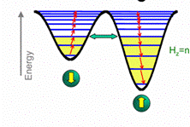

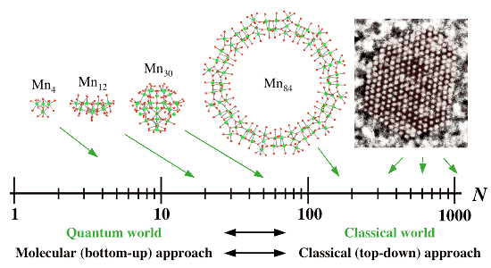
Molecular Nano Magnets (MNMs)
Promising candidates to study fundamental phenomena in physics
Quantum tunnelling of magnetization
Quantum information processing
Finite size effects in spin “chains”
Notes:
As you can see Molecular nano magnets are intermediate between quantum and classical world as a practical zero dimensional magnet ,so this field of material has attracted a lot of attention , in fact they have existed this possibility to investigate fundamental phenomena in physics such as quantum tunnelling , quantum information prossecing, finite size effects in Heisenberg spin chains. As you know These phenomena are interesting to expound the transition from classic to quantum behaviour. In addition , MNMs are promising candidates for applications in magnetic storage, magnetoelectronics and quantum computing.
(last decade Molecular NanoMagnets (MNMs) have attracted the attention of many scientific communities in the chemistry and physics worlds. Due to their fascinating spin dynamics properties, MNMs are known as an excellent platform to investigate magnetic and quantum phenomena such as zero-dimensional-magnetism, finite-size effects in Heisenberg spin chains, tunnelling of the magnetization and so on. In addition, MNMs are promising candidates for applications in magnetic storage, magnetoelectronics and quantum computing. )
http://www.unizar.es/magmanet/magmanet-eu/index.php?/short_history_of_molecular_magnetism.html

Slide 4
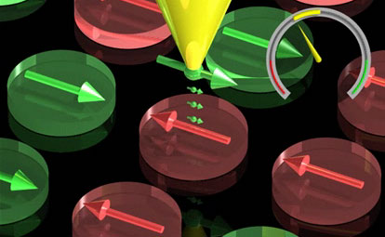
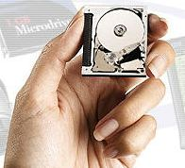
Molecular Nano Magnets Applications
Possible applications of MNMs :
High density magnetic memory
Magneto- optical recording
Quantum computing
Spintronics
Magnetic sensors…
Notes:
http://www.nanoscience.de/nanojoom/index.php/en/news/82-news-12.html

Slide 5
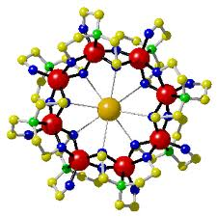
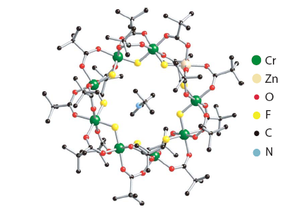
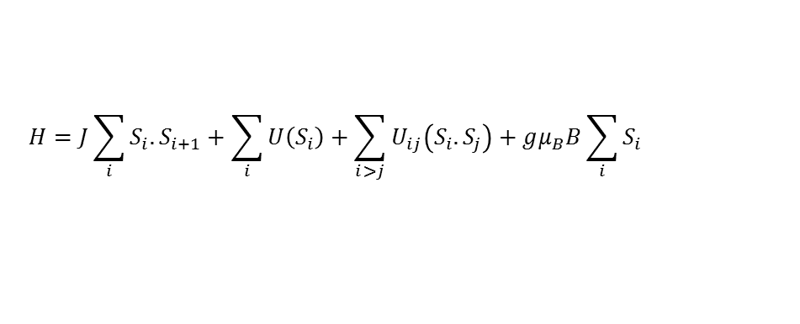
Antiferromagnetic (AFM) rings
Why Antiferromagnetic (AFM) rings?
As all molecular clusters, studying bulk means
studying single molecule as J_{inter-mol} << J_{intra-mol}
Put just the equation.
“B” is at subscript
As all molecular clusters, finite number of ions :
accurate spin Hamiltonian and exact
calculation of energy levels and eigenfunctions
$$H=J\sum_{i}{S_{i}.S_{i+1}+\sum_{i}{U\left(S_{i}\right)+\sum_{i>j}{U_{ij}\left(S_{i}.S_{j}\right)+gμ_{B}B\sum_{i}{S_{i}}}}}$$
Highly symmetric geometry
Ideal physical framework for low dimensional magnetism ( 0-D and/or 1-D)
Notes:
The antiferromagnetic AF ring systems, which are the target of our collaboration and also the object of this presentation, are a particularly interesting subgroup of molecular nanomagnets. These molecules can be prepared with a variable even or odd number of magnetic ions arranged in the form of coplanar “highsymmetry” rings of metal ions connected by oxo or hydroxo bridges.Other interesting point about this structures; One of the magnetic sites can be substituted for a different magnetic or non-magnetic ion to modify the level structure and the total spin of the molecule.
The individual molecules are shielded from each other by a shell of bulky ligands so that the magnetic interactions between neighboring molecules are very small and the observed magnetic properties of bulk samples are very nearly intramolecular in origin.
Since the intramolecular exchange couplings are way stronger than intermolecular interaction we are able to perform a measurement on the crystal bulk and the response would be that of the single molecule but magnified by the number of rings in the crystal.

Slide 6
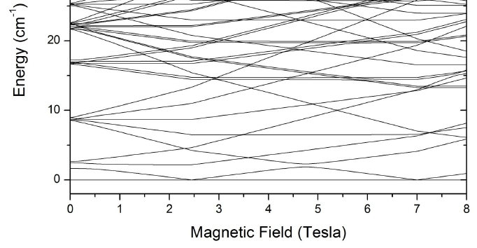
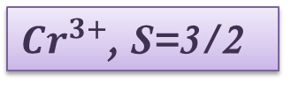
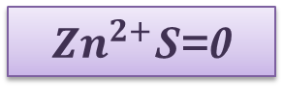
Antiferromagnetic open rings: the Cr8Zn case
${Zn}^{2+}$S=0
Finite size system Reduced number of spins
Discrete energy levels structure
Quantum phenomena
${Cr}^{3+}$, S=3/2
Spin topology of a Quasi-Zero-Dimensional magnetic system......
“Open” molecular ring : peculiar spin dynamics
Interesting quantum behaviors due to “real” or anti- level crossing
Notes:
Between this family Our collaboration is intrested about antiferromagnetic open ring such as Cr8zn and cr8Cd !!!
Cr₈Zn is an antiferromagnetic molecular ring composed by eight Cr³⁺, s=3/2, ions and one Zn²⁺ diamagnetic ion (i.e. Cr₈Zn can be considered as an open ring), with nearest-neighbour exchange constant J~17K, and a S_{T}=0 ground state. The distinctive spin dynamics expected from an open ring with an even number of magnetic ions and the possibility of inducing a ground state crossing among S_{T}=0 and S_{T}=1 by applying a
field of few Tesla, induced us to perform a ¹H NMR investigation.
In order to investigate the fundamental magnetic properties and the spin dynamics of these structures, is suggested different techniques , the main techniqe that can be utilized is nuclear magnetic Resonance , to continue I wish to explain why NMR?
In the big family of AFM molecular rings we have focused on AFM open rings
1)Special expected spin dynamic behavior and2) studyind of real and anti crossing level in cr8zn we decided to study cr8zn

Slide 7
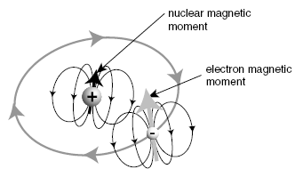
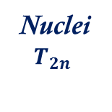
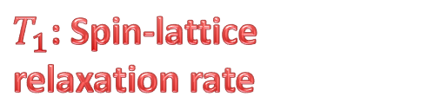
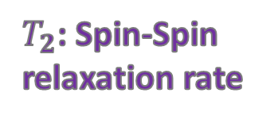

Nuclear Magnetic Resonance (NMR) as a local probe
By NMR
we are measuring the response of nuclei but, through it, we are studying the physical properties of the whole system (electrons, nuclei & phonons)
$T_{1}$: Spin-lattice relaxation rate
How is it possible ?
T_{1n}
Nuclei
$$T_{2n}$$
T_{1n}
Nuclei are a local probe
But
in interaction with the whole system
$T_{2}$: Spin-Spin relaxation rate
electron
$$T_{2e}$$
phonon
NMR
absorption spectra
T_{1e}

Slide 8
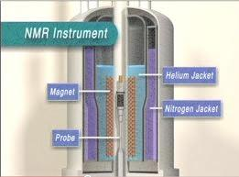
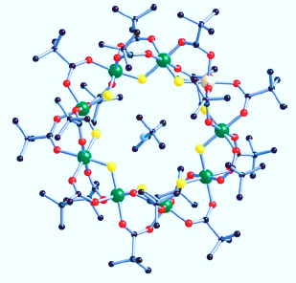
Nuclear Magnetic Resonance (NMR) : different local probes
Advanced tools for molecular spin dynamics investigation
¹H NMR
¹⁹F NMR
⁵³Cr NMR
⁵³Cr NMR
¹H NMR
Abundance proton (High sensitivity )
¹⁹F NMR
Study of NMR relaxation rates
and spectra
Notes:
As you know there are two intrinsic contributions for magnetic properties in all matterial , 1) nuclear spin 2) electron spin
In addition the magnetic properties of MNMs in ordinery temperature (let say above 1 k) come from electron spins but why NMR,
This is the most fascinating point about this techniqe , in fact in this method , by using nuclear resonance we will abserve electronic phenomenaan !!!
((Nuclear magnetic resonance NMR has been proved to be an efficient local probe of both static and dynamic properties of magnetic molecules9 and used in combination with thermodynamic magnetization measurements can give a good characterization of the magnetic properties and the spin dynamics in the AF rings.))
Please consider an AF Ring such as this shape, you can see differnt kind of nuclear in side of the weel which they can be considered as an observable quantity , so we can use of different resonance ferequency regarding to different nuclear to irradiate nuclear spins
According to this object , to study spin dynamic have been introduce H NMR , Fl NMR , Cr NMR in the case of this sample
(In order to study AFM wheels with nmr we were faced with two obvious choices. On one side there is chromium nmr, which can sense the locla magnetic moment via a direct hyperfine interaction, however signal is difficult to find because of low sensitivity and high local fields. Despite these issues, we had our share of success on Cr7Cd and Cr7Ni in the past.
The other choice is fluorine nmr. This probe can sense the transferred hyperfine interaction with neighboring moments, but the strenght of this interaction is low. Overall the fluorine NMR spectra are more structured than chromium NMR spectra and analysis is more challinging but the NMR signal is also higher, as a compensation. So we decided to try Fluorine.)

Slide 9

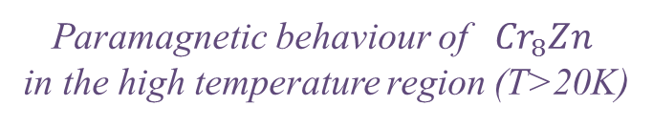



Spin dynamics vs temperature : ${}_{}^{1}{H }$NMR spectra
From ¹H NMR spectrum it is possible to extract the
Full Width at Half Maximum – FWHM, given by :
$$FWHM∝\sqrt{{<{∆θ}^{2}>}_{d}^{}+<{∆θ}^{2}>_{m}}$$
$${Cr}_{8}$$
$${Cr}_{8}Zn$$
Paramagnetic behaviour of ${Cr}_{8}Zn$
in the high temperature region (T>20K)
The temperature and magnetic field dependence of ¹H FWHM is similar to other antiferromagnetic molecular rings, but …….
Notes:
First of all proton NMR spectra, The proton NMR linewidth full width at half maximum FWHM or for all the rings is shown in Figure as a function of temperature at three values of the external magnetic field.
The temperature and magnetic field dependence of the line width in the case of Cr8Zn as you can see are similar to other kind of AF rings such as Cr8
In fact the shape and width of the proton NMR spectrum is determined by two main interactions: 1) the nuclear-nuclear dipolar
interaction and 2) the hyperfine interaction of the proton with the neighboring magnetic ions. The first interaction generates a temperature- and field-independent broadening
which depends on the hydrogen distribution in the molecule and is thus the same in all molecular magnets independently of their magnetic properties.
But about the hyperfine interaction !!!!
The hyperfine field resulting from the interaction of protons with local magnetic moments of Cr3+ may contain contributions from both the classical dipolar interaction and from a direct contact term due to the hybridization of proton s-wave function with the d-wave function of magnetic ions.
In order to more investigation of FWHM, I introduce the usual simple Gaussian approximation for the NMR line shape, which is proportional to the square root of the Second moment, the first part is due to nuclear nuclear interaction and the second part is due to nearby electronic moment

Slide 10
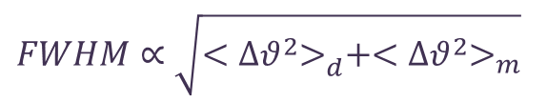
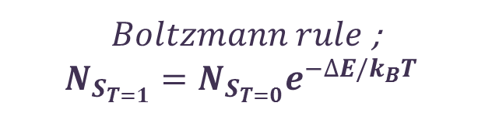
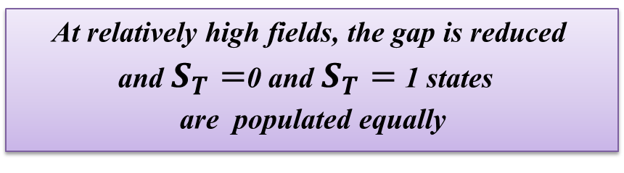

Spin dynamics vs temperature: ${}_{}^{1}{H }$NMR spectra
Dramatic Increase!!!
At relatively high fields, the gap is reduced
and $S_{T}=$0 and $S_{T}=$1 states
are populated equally
… the gap….
$Boltzmann rule$;
$$N_{S_{T=1}}=N_{S_{T=0}}e^{−∆E/k_{B}T}$$
$$H_{local}=H_{0}+H^{effect}$$
First excited state
S_{T}=1, M_{s}=+1
For T<20K, condensation in the G.S.
$$FWHM∝\sqrt{{<{∆θ}^{2}>}_{d}^{}+<{∆θ}^{2}>_{m}}$$
Notes:
First of all proton NMR spectra, The proton NMR linewidth full width at half maximum FWHM or for all the rings is shown in Figure as a function of temperature at three values of the external magnetic field.
The temperature and magnetic field dependence of the line width in the case of Cr8Zn as you can see are similar to other kind of AF rings such as Cr8
In fact the shape and width of the proton NMR spectrum is determined by two main interactions: 1) the nuclear-nuclear dipolar
interaction and 2) the hyperfine interaction of the proton with the neighboring magnetic ions. The first interaction generates a temperature- and field-independent broadening
which depends on the hydrogen distribution in the molecule and is thus the same in all molecular magnets independently of their magnetic properties.
But about the hyperfine interaction !!!!
The hyperfine field resulting from the interaction of protons with local magnetic moments of Cr3+ may contain contributions from both the classical dipolar interaction and from a direct contact term due to the hybridization of proton s-wave function with the d-wave function of magnetic ions.
In order to more investigation of FWHM, I introduce the usual simple Gaussian approximation for the NMR line shape, which is proportional to the square root of the Second moment, the first part is due to nuclear nuclear interaction and the second part is due to nearby electronic moment

Slide 11
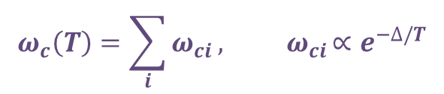

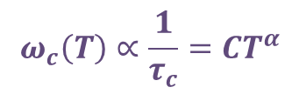


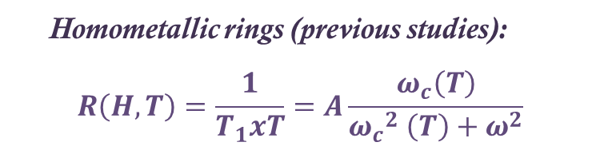
Spin dynamics vs temperature:
Spin-lattice Relaxation Rate (1/T₁)
${Cr}_{8}$ , ${Fe}_{6}$ , ${Fe}_{10}$ …
$${Cr}_{8}Zn$$
Homometallic rings (previous studies):
$$R\left(H,T\right)=\frac{1}{T_{1}xT}=A\frac{ω_{c}\left(T\right)}{{ω_{c}}_{}^{2} \left(T\right)+ω_{}^{2}}$$
Two alternatives;
Current case (heterometallic Cr8Zn):
$R\left(H,T\right)=\frac{1}{T_{1}xT}$
$$\frac{1}{T_{1}}=A′\frac{ω_{c}\left(T\right)}{{ω_{c}}_{}^{2} \left(T\right)+ω_{}^{2}}$$
$$ω_{c}\left(T\right)∝\frac{1}{τ_{c}}=CT^{α}$$
$$ω_{c}\left(T\right)=\sum_{i}{ω_{ci}}{, ω}_{ci}∝e^{−∆/T}$$
Theoretical calculation in progress…
Notes:
As you can see The temperature dependence of the spin lattice relaxation rate is shown in this Figure for different values of the external magnetic field. The main feature is
the presence of a field-dependent peak at low temperature. This peak is typical behavior of all molecular magnetic homometallic and heterometallic rings and clusters. A quantitative theoretical explanation of the peak was given before in terms of the magnetization relaxation due to spin-phonon interactions. It has provided an explanation for the origin of the universal behavior when the magnetization fluctuation is slowing down which is responsible for the observed peak. Wc is an important parameter which is called correlation frequency and it is proportional to correlation time, please take in to account wc is strictly related to oscillation frequency of electron spins!!
Wc is a mathematical equation but it seems to come from a physical phenomena regarding to electron spin- phonon interaction

Slide 12
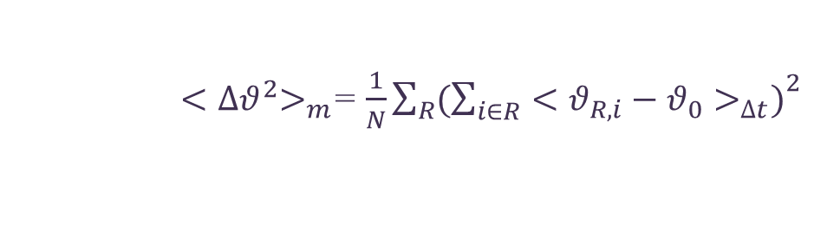

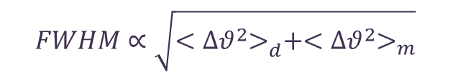
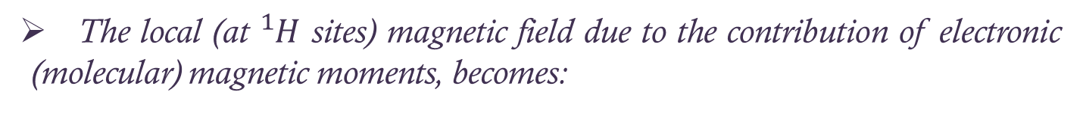
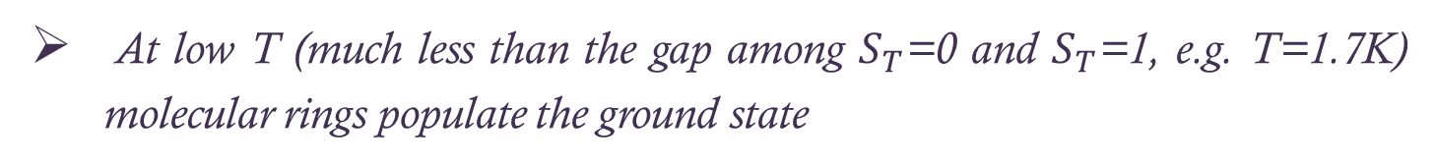

Low temperature quantum level crossing:
${}_{}^{1}{H }$NMR spectra
At low T (much less than the gap among $S_{T}$=0 and $S_{T}$=1, e.g. T=1.7K) molecular rings populate the ground state
Put e.g. instead of i.e.
  The local (at ${}_{}^{1}H$ sites) magnetic field due to the contribution of electronic (molecular) magnetic moments, becomes:
…. field, due to the contribution of
electronic (molecular) magnetic moments, becomes:
$$H_{local}=H_{0}+H^{effect}$$
$$FWHM∝\sqrt{{<{∆θ}^{2}>}_{d}^{}+<{∆θ}^{2}>_{m}}$$
approx. ∝ M
${<∆θ}^{2}>_{m}$= $\frac{1}{N}\sum_{R}{{(\sum_{i∈R}{{<θ_{R,i}−θ_{0}>}_{∆t})}}^{2}}$
$$=\frac{γ^{2}}{N}\sum_{R}{[\sum_{i∈R}{\sum_{j∈R}{\frac{A(θ_{i,j})}{r_{i,j}^{}3}}}}<m_{z,j}>_{∆t}]^{2}$$
Notes:
In order to analysis data by fitting of this equation; magnetic susceptibility measurement, have been performed with a superconducting quantum interference device SQUID magnetometer on Cr8Zn at two different external magnetic fields H=0.5 and 1.5T, applied perpendicular to the molecular c axis.
The mathematical results emphasize on a paramagnetic behavior for Cr8Zn molecular nanaomagnet in high temperature region (more than 40k) , which is correspond to other AF rings such as Cr8 . It seems in low temperature due to spin freezing, system fluctuation will decrease so they have more tendency to stay in ground state so the system behave such as quasi paramagnet not a perfect paramagnet
A’z as a dipolar coupling constant averaged over all protons and all orientations is ????????????????????
you can see a linear relation,in high temperature rigen pridected by this equation which obvioused in other case of moulecular nano magnet

Slide 13

Low temperature quantum level crossing:
${}_{}^{1}{H }$NMR spectra
After first GS level crossing
NMR spectral broadening due to the increase of the electronic magnetization value
non-magnetic
Ground State S_{T} = 0
After second GS level crossing
magnetic
Ground State S_{T} = 1
M(H) curve at T=2K
magnetic
Ground State S_{T} = 2
Calculated energy levels in
external magnetic field

Slide 14

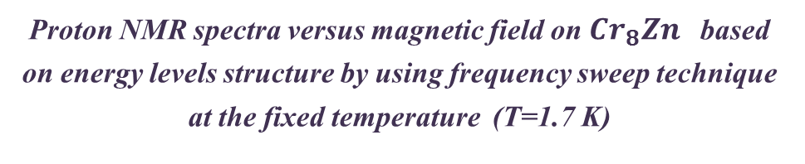




Low temperature quantum level crossing:
${}_{}^{1}{H }$NMR spectra
Proton NMR spectra versus magnetic field on ${Cr}_{8}Zn$based on energy levels structure by using frequency sweep technique at the fixed temperature (T=1.7 K)
NMR spectra broadening by
passing of crossing level
$${ω−ω}_{0} (MHz)$$
¹H NMR spectra before the first level crossing
($S_{T}=0↔$ Non-magnetized system)
Wrong x-axis label
Use ¹H instead of poroton
Put 3° circle correctly
$${ω−ω}_{0} (MHz)$$
¹H NMR spectra after the first level crossing
($S_{T}=0→S_{T}=1)$
( Non-magnetized »»» Magnetized system)
Calculated energy levels in
an external magnetic field
$${ω−ω}_{0} (MHz)$$
¹H NMR spectra after the second level crossing
(S_{T} = 1 → S_{T} = 2)

Slide 15
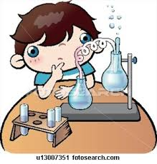
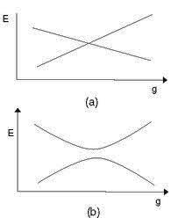
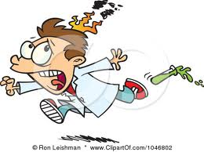
Low temperature quantum level crossing
Future investigation:
spin-lattice relaxation rate study of spin dynamics
(also level crossing problem details and mix of eigenfunctions)
Anti level crossing; Mixed functions
Real level crossing; Unmixed functions
Notes:
http://sachdev.physics.harvard.edu/qptweb/chap1.html

Slide 16

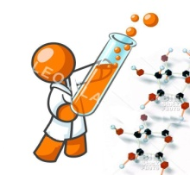
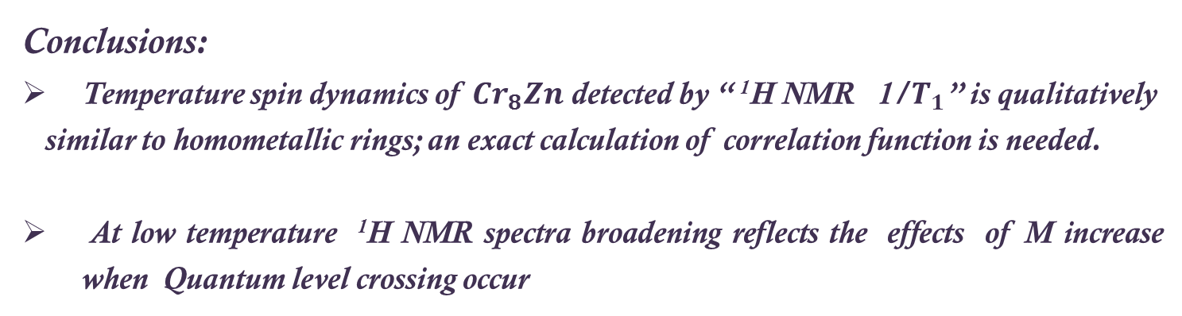
Conclusions and future study
Conclusions:
Temperature spin dynamics of ${Cr}_{8}Zn$ detected by “ ¹H NMR 1/$T_{1}$” is qualitatively
similar to homometallic rings; an exact calculation of correlation function is needed.
At low temperature ¹H NMR spectra broadening reflects the effects of M increase when Quantum level crossing occur
Put “:” among NMR and 1/T1. “1” is at subscript
… effects of M increase when quantum level crossings occur
Future issues :
Theoretical investigation of spin dynamics vs temperature
Quantum effects due to “Real ”/ Anti level crossing studied by means of
low-T ¹H NMR spin-lattice relaxation rate

Slide 17

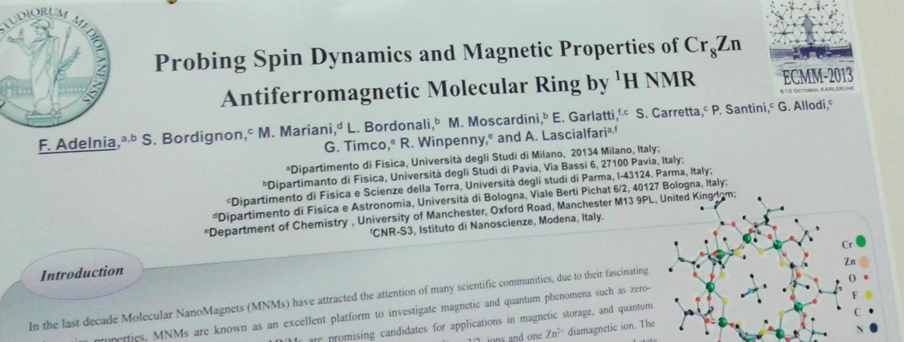
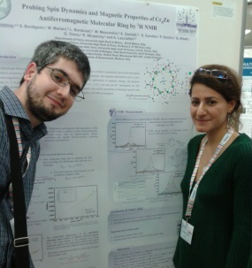
Scuola Di dottorato in fisica, astrofisica e fisica applicate
UNIVERSITÀ
DEGLI STUDI DI MILANO
Thank you
Special thanks ò
Pr. Lascialfari
January 15th 2013
Italy

Slide 18
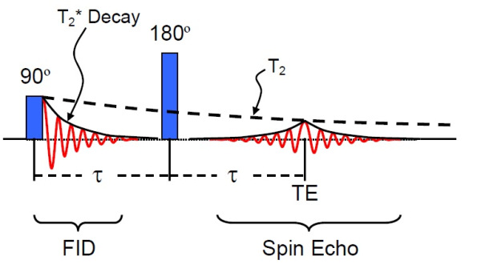
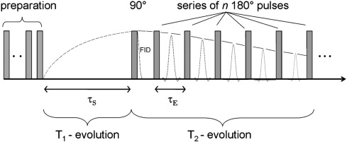
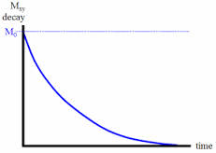
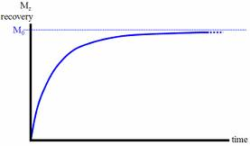


NMR sequences
Spin-echo pulse sequences
$T_{2} sequence$:
$T_{1} sequence$:
This slide can also be cut
You can put at the end as an example slide
T₂ relaxation curve
T₁ relaxation curve
NMR spectrum
Notes:
Proton NMR measurements including nuclear-spin-lattice relaxation time T1 and spin-spin relaxation time T2 were performed with π/ 2-π radio frequency rf pulses in the temperature range 4.2<T <300 K in different external magnetic field . Fourier transform FT of half of the echo spin signal yields the NMR spectrum in the case where the whole line could be irradiated with one rf pulse.

