Slide 1
Università degli Studi di Milano
Physics, Astrophysics and Applied Physics Ph.D. School
SPUTTER-ION PUMPS: STATE OF THE ART AND DEVELOPMENT OF NEW SOLUTIONS FOR THE EMPLOYMENT IN COMBINATION WITH NON-EVAPORABLE GETTERS
Tommaso Porcelli
Supervisor: Prof. Carlo Pagani (Università degli Studi di Milano/INFN-LASA)
Co-supervisors: Dr. Paolo Michelato (INFN-LASA)
Dr. Fabrizio Siviero (SAES Getters S.p.A.)
1st year-students Mini-workshop 2013 – 15th October 2013

Slide 2
Outline
Brief introduction to vacuum science and technology.
Pumping systems for UHV: non-evaporable getters (NEG) and sputter-ion pumps (SIP).
The idea of NEG + SIP coupling.
Experimental investigation of SIP pumping properties.
Conclusions.

Slide 3
What is vacuum?
Vacuum literally denotes the absence of matter. In practice, it refers to systems were pressure is lower than the atmospheric pressure.
Mean free path:
$$\overline{l}=\frac{\overline{c}}{z}=\frac{1}{\sqrt{2}n_{D}σ}$$
Low vacuum | ~10³ – 1 mbar
Medium vacuum | 1 – 10⁻³ mbar
High vacuum | 10⁻³ – 10⁻⁸ mbar
Ultra-high vacuum (UHV) | 10⁻⁸ – 10⁻¹² mbar
Extreme high vacuum (XHV) | <10⁻¹² mbar
$z$: collisions per unit time
$\overline{c}$: mean particle velocity
$n_{D}$: particle number density
$σ$: collision cross-section
Knudsen number:
$$Kn=\frac{\overline{l}}{d}$$
at P=10⁻⁹ mbar (air), $\overline{l}={10}^{5} m$
UHV: $\overline{l}≫d$ → molecular flow regime
$d$: characteristic length

Slide 4
Gas sources in UHV systems
It is impossible to create a perfect vacuum:
leaks,
permeation,
process gas,
internal outgassing and desorption.
Outgassing depends on:
time
materials and treatments → all-metal components for UHV applications
temperature
Desorption frequency:
$$ν=ν_{0}∙e^{−E/{kT}}$$
BAKE-OUT of the vacuum system is necessary.

Slide 5
Pumping systems for UHV
Different types of vacuum pumps are available, depending on the gas load to be handled and on the base pressure to be achieved:
gas-displacement vacuum pumps;
gas-binding vacuum pumps.
For UHV applications:
gas binding via condensation of molecules at a suitable temperature (cryopumps);
gas binding by an active substrate.
Non-evaporable getters
&
sputter-ion pumps

Slide 6
Non-evaporable getters (NEG)
Getter: solid material able to form stable bonds with chemically-active gas molecules on its surface by chemisorption.
NEG: the active surface is obtained by thermal diffusion of the surface oxide layer into the bulk of the material itself.
Typical NEG alloy elements:
Ti, Zr, Hf, V, Nb, Ta
Very good pumping performances for H₂, CO, CO₂, N₂, H₂O and O₂.
No pumping speed for hydrocarbons (CH₄,…) and noble gases (He, Ne, Ar, Kr, Xe, Rn).
No electric power needed (except for NEG activation).

Slide 7
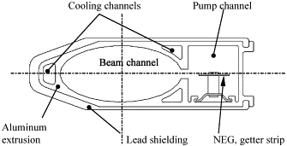
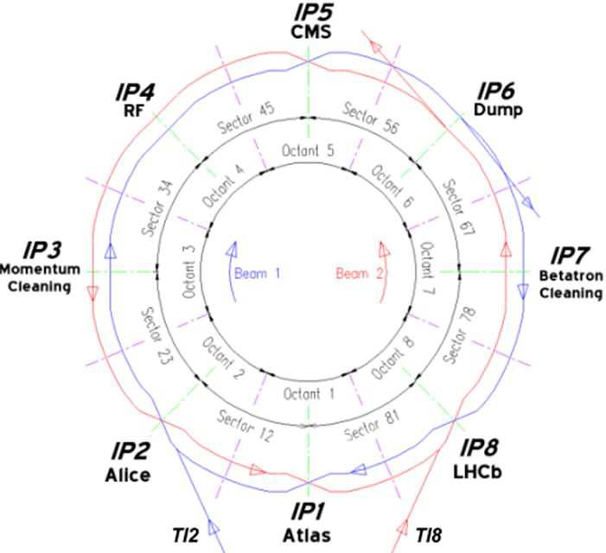
Use of NEG in particle accelerators
1980s:
First extensive use of NEG in an accelerator:
23 km of the Large Electron-Positron Collider (LEP) at CERN pumped by 30 mm wide and 100 µm thick NEG strips (SAES St101 Zr-Al alloy) [1].
Today:
About 6 km of the Large Hadron Collider (LHC) consist of UHV NEG-coated vacuum chambers at room temperature (TiZrV alloy), the so-called Long Straight Sections (LSS).
[1] C. Benvenuti, “Non-evaporable getters: from pumping strips to thin film coatings”.

Slide 8
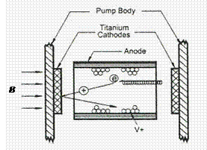
Sputter-ion pumps (SIP)
Well-exploited technology for the attainment and maintenance of UHV and XHV conditions.
Penning cell made of:
cylindrical anodes (stainless steel);
two parallel cathode plates (Ti, Ta).
Application of:
electric field → emission of electrons from the cathode;
external magnetic field along the anode axis → long helicoidal trajectories of electrons.
Formation and acceleration (~keV) toward the cathodes of gas ions through collisions with electrons.
Ions cause sputtering of cathode material:
→ active Ti layer on the inner surfaces of the SIP.

Slide 9
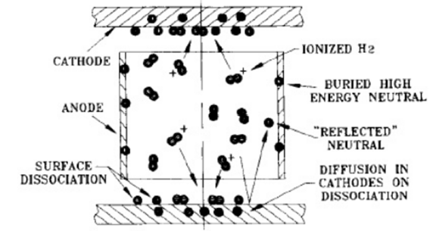
Pumping mechanisms of SIPs
Reactive gases:
chemical adsorption on the Ti film.
Noble gases:
burying of ions into the cathodes;
implantation of high-energy neutrals into the anodes and the inner surfaces of the pump [2].
Hydrocarbons:
cracking during ionization.
Standard-diode SIP: two Ti cathodes.
Noble-diode SIP: one Ti and one Ta cathode.
Triode SIP: grid.
Tantalum enhances the pumping of high-energy neutrals, thus improving the overall pumping efficiency for noble gases.
[2] I. Brodie et al., Phys. Rev. Lett. 21(17), 1224 (1968).

Slide 10
Limitations of NEG and SIP devices
SIP:
large dimensions and weight are required to ensure high pumping speed;
strong dependence on pumping history;
instability phenomena for noble gases;
regurgitation of previously-sorbed gases.
NEG:
no pumping for noble gases;
negligible pumping for hydrocarbons [3].
Investigations have been made in the past on the possibility to exploit a combination of these two technologies [4,5].
[3] P. Chiggiato, P. Costa Pinto, Thin Solids Films 515, 382-388 (2006).
[4] C. Benvenuti et al., Vacuum 44(5-7), 507-509 (1993).
[5] C.D. Park et al., J. Vac. Sci. Technol. A 29(1), 011012 (2011).

Slide 11
SIP + NEG coupling
SIP + NEG coupling:
getter cartridge;
small SIP, focused on the pumping of noble gases and hydrocarbons.
Main benefits:
much smaller occupied volume and weight;
gas released by SIP is intercepted by NEG → synergetic mechanism;
small SIP → lower outgassing and less intense magnetic field.

Slide 12
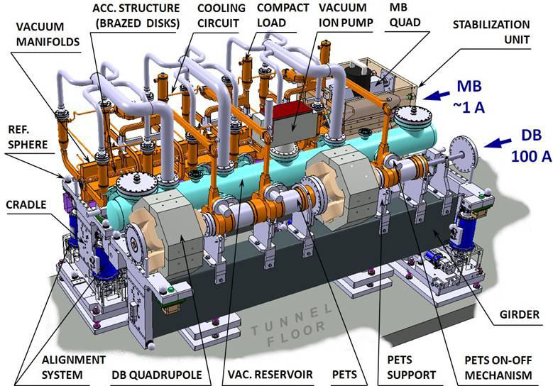
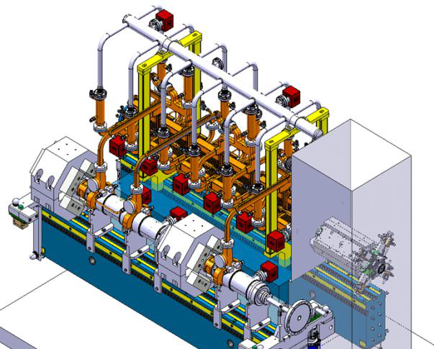
NEG + SIP: possible applications
Development of more compact and performing pumping systems for new accelerators:
simpler design;
less electric power needed;
less severe space constraints.
Proposed CLIC vacuum system layouts

Slide 13
Aims of this work
In-depth study of the critical aspects (pumping of hydrocarbons and noble gases, instability, outgassing,…) of SIPs.
Development of optimized and innovative SIP solutions focused on the employment with NEG.

Slide 14
Planned experimental approach
Sorption tests at low pressures (10⁻⁸ – 10⁻⁶ Torr) for different gases (H₂, He, CH₄, Ne, N₂, CO, O₂, Ar, CO₂, Kr, Xe) and different pumps.
Dependence of pumping speed on functioning parameters (applied voltage, applied magnetic field,…).
Residual gas and outgassing analyses as a function of the previous SIP pumping history (→ purging treatments).
Computer simulations of pressure profiles and residual pressure in vacuum systems, either through the Monte-Carlo (MOLFLOW+ [6]) or the Angular Coefficients method.
Optical emission spectroscopy analyses of the SIP discharge plasmas for different gases at low pressures (→ cracking of CH₄).
Possible experimentation of innovative technical solutions, based on the results of the above-mentioned analyses.
[6] R. Kersevan et al., J. Vac. Sci. Technol. A 27(4), 1017 (2009).

Slide 15
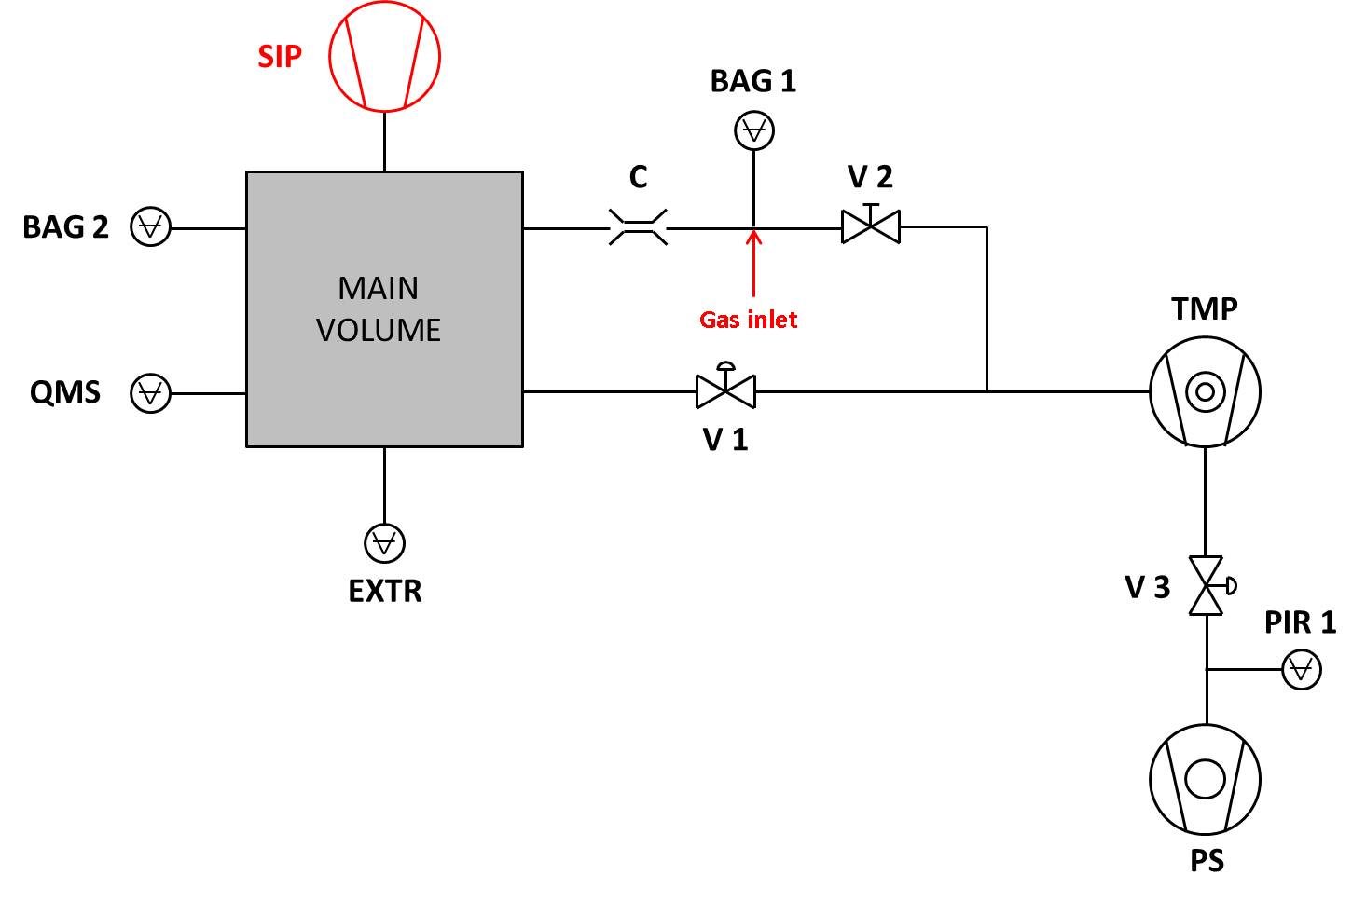
Sorption tests: experimental setup
Main volume: cylindrical stainless steel vessel, V=26.6 l;
two hot-cathode Bayard-Alpert gauges (BAG, 10⁻² – 10⁻¹⁰ Torr);
one extractor gauge (EXTR, 10⁻⁴ – 10⁻¹² Torr);
one quadrupole mass spectrometer (QMS) for partial pressure measurements;
one primary scroll pump (PS) connected in series to a turbomolecular pump (TMP), with a nominal pumping speed of 260 l/s for N₂.

Slide 16
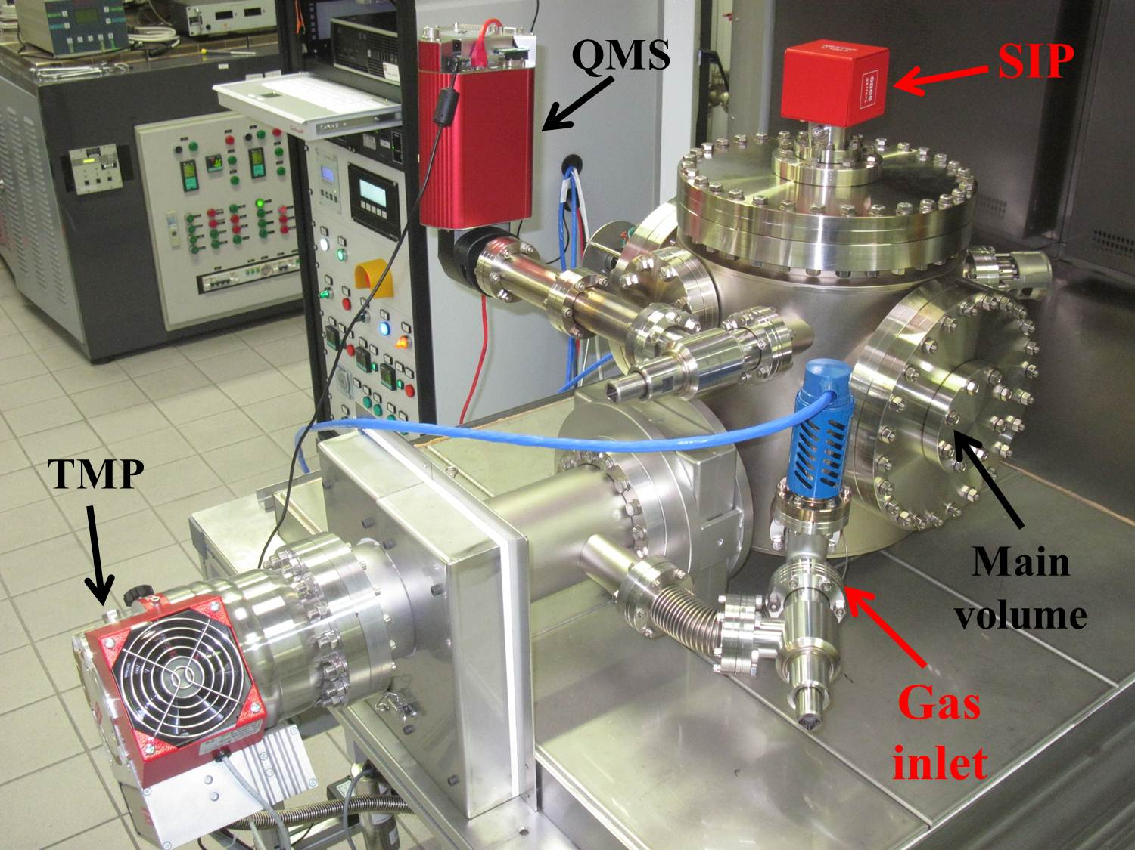
Sorption tests: experimental setup
The adopted procedure is the same used for determining the sorption capacity of non-evaporable getters in the molecular flow region.
Tests are performed keeping pressure in the main volume (P_{BAG 2}) constant, by regulating the opening of the leakage valve at the gas inlet.
Pumping speed S [l/s]:
$$S=C∙\frac{P_{BAG 1}−P_{BAG 2}}{P_{BAG 2}}$$
Quantity of sorbed gas Q [Torr·l]:
$$Q=\int{\left(P_{BAG 1}−P_{BAG 2}\right)dt}$$

Slide 17
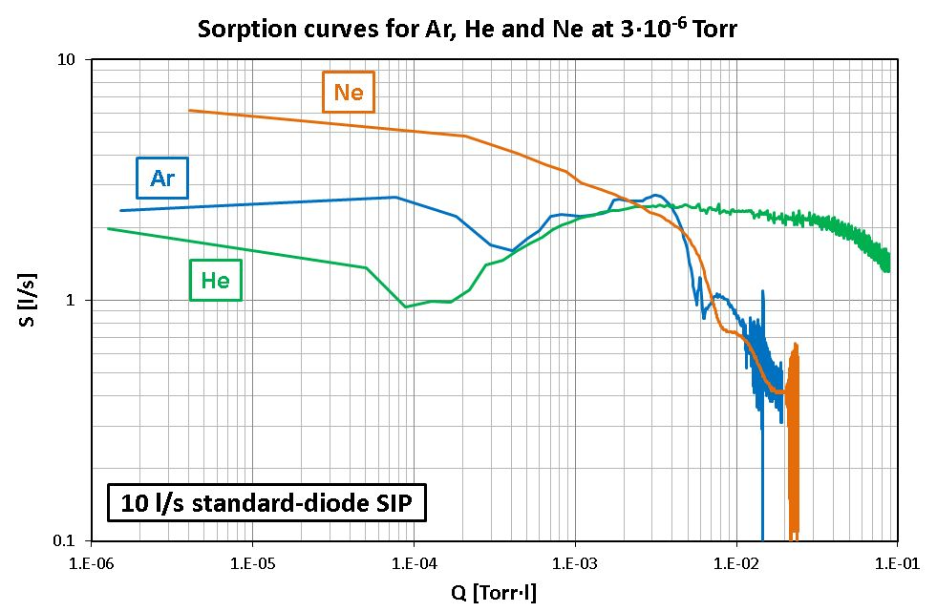
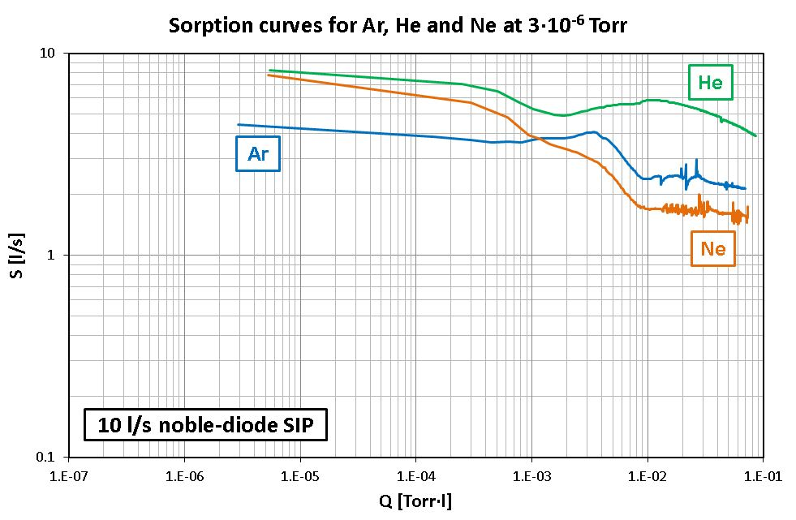
Sorption tests: standard vs. noble diode
Noble-diode SIP has higher performances for noble gases.
The outbreak and the extent of instability strongly depend on the gas, i.e. on its atomic mass number.

Slide 18
Conclusions
The possibility to have compact, light and, at the same time, efficient vacuum systems is nowadays vital for several scientific applications (particle accelerators, portable vacuum devices, analytical instruments,…).
NEG and SIP are well-known technologies but researchers have never specifically focused on their coupling and on the resulting mutual synergies.
The study of the critical aspects ( e.g. outgassing, instability) related to SIP functioning can throw light on the physical phenomena underlying their outbreak.

Slide 19
Thank you for your attention

