Slide 1


Quantitative elemental analysis of coal using LIBS and development of a prototype for power plant applications
Redoglio Daniele Andrea
Supervisors: Dott. M. A. C. Potenza
Dott. U. Perini
15/10/2013
First-year students’ workshop – Physics PhD School

Slide 2


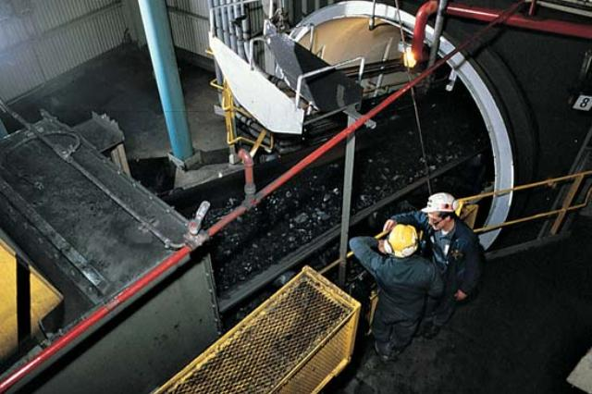

Coal characterization

Slide 3
Standard techniques
Termogravimetric
Chemical
XRF
Gamma
Neutron

Slide 4
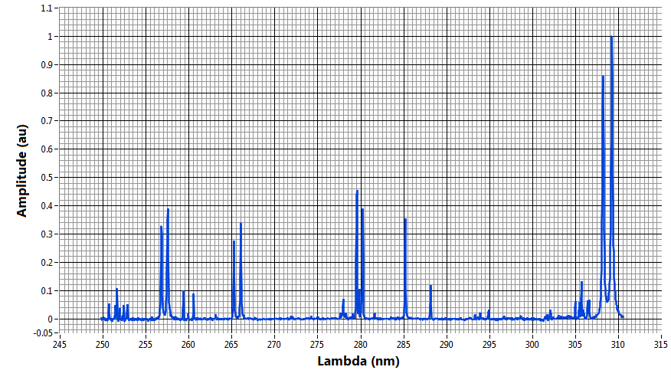
Laser Induced Breakdown Spectroscopy
Laser
sample
optics
spectrometer
optical fiber
PC

Slide 5
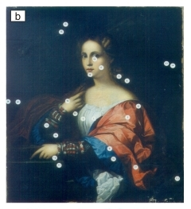

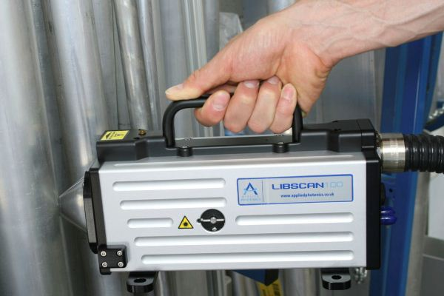
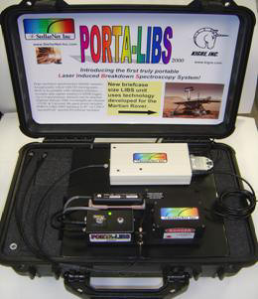
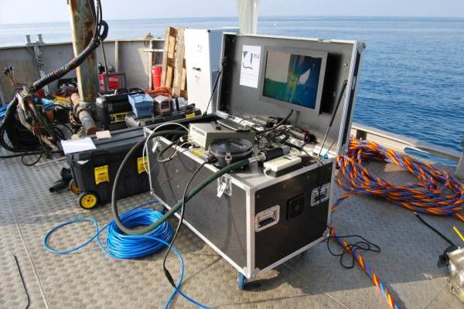
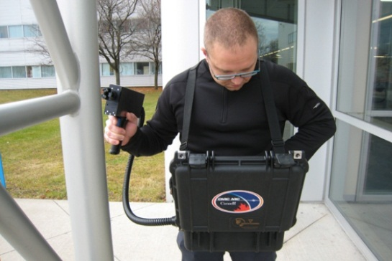
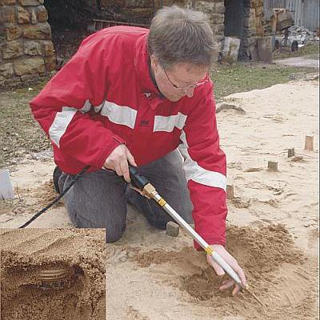
LIBS advantages

Slide 6
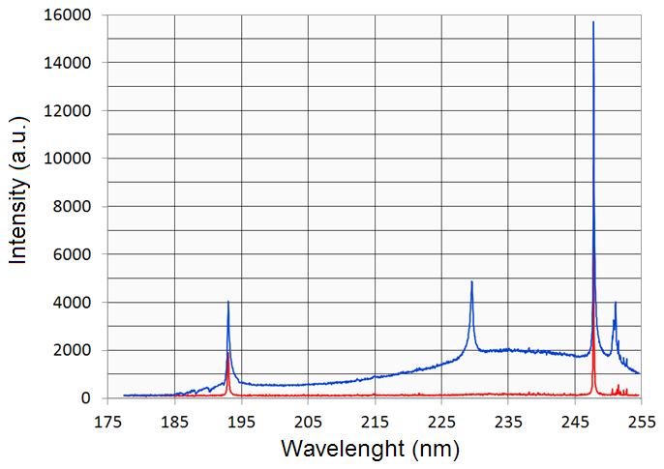
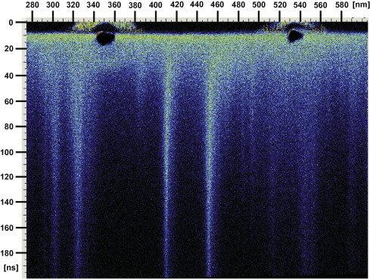
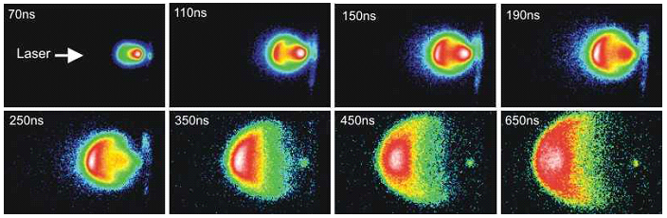
Plasma and signal evolution

Slide 7
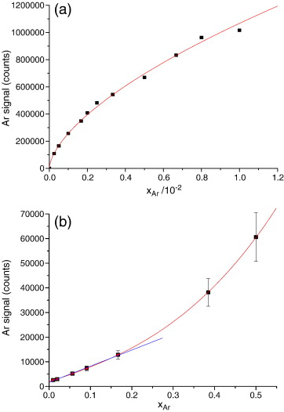
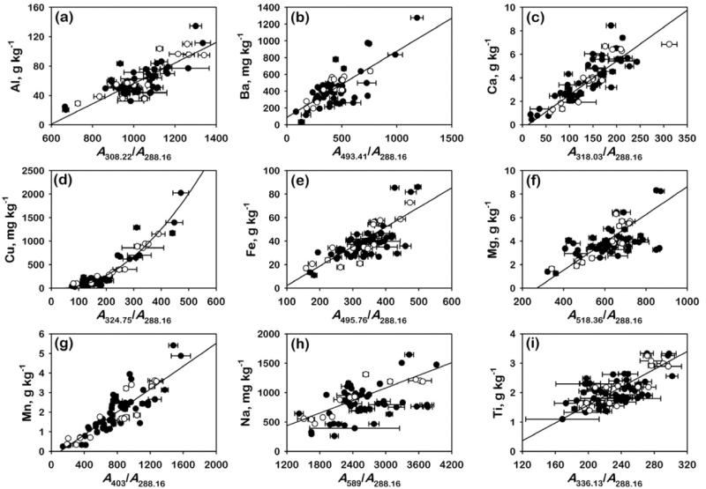
Spectral analysis

Slide 8
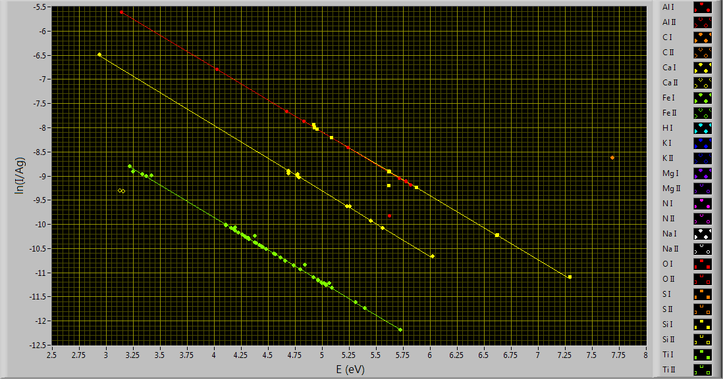
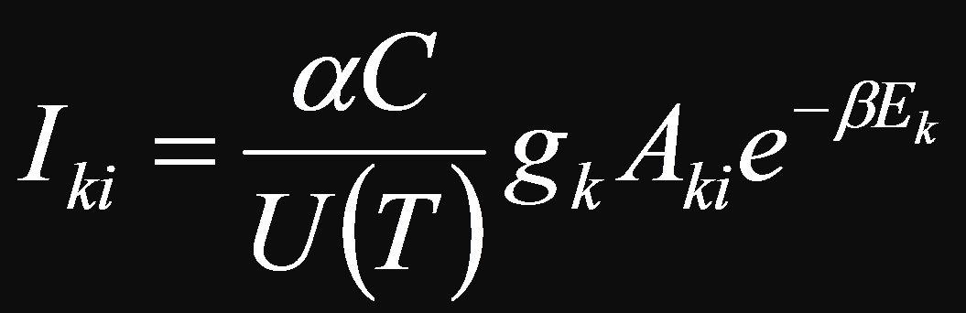
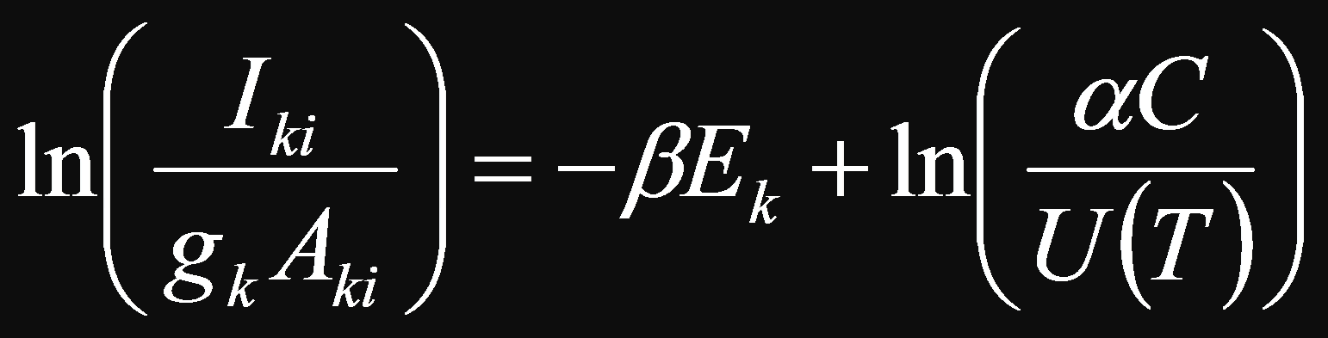
Calibration Free

Slide 9
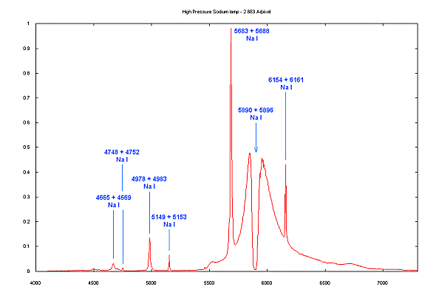
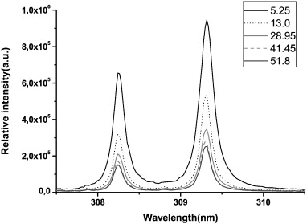
Self absorption

Slide 10
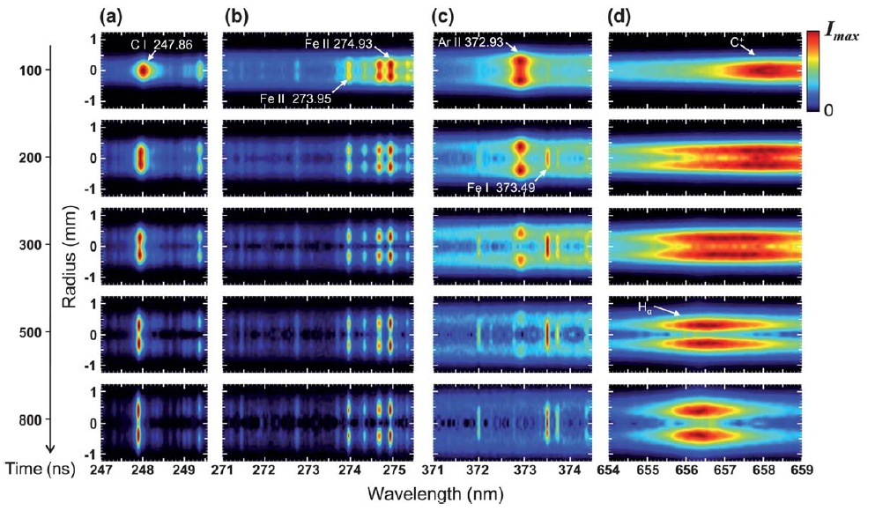
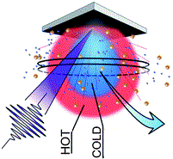
Plasma nonuniformity
Mercadier et al., JAAS, 2013, 28, 1446

Slide 11
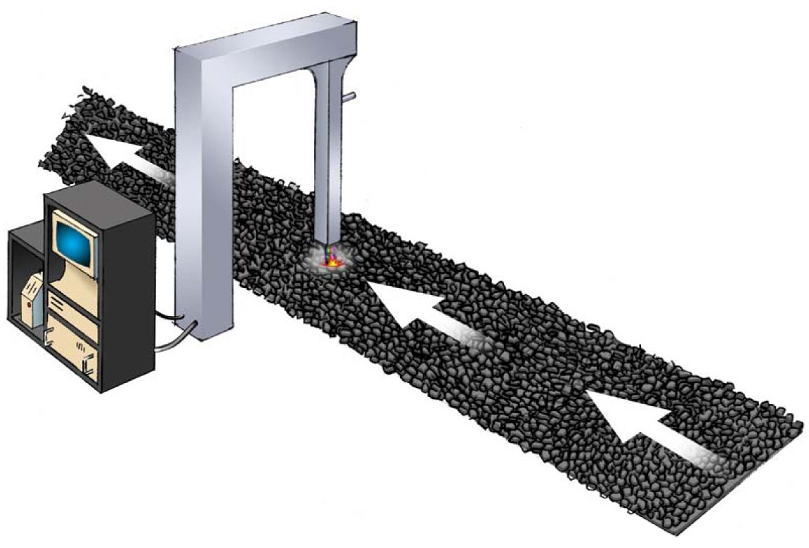
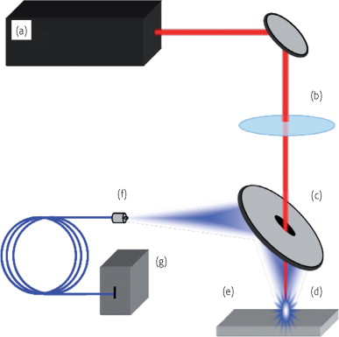
Online prototype

Slide 12
Conclusion
A new algorithm
Account for nonuniformity
Avoid calibration
A functioning prototype
Without focusing
Working in harsh conditions

Slide 13
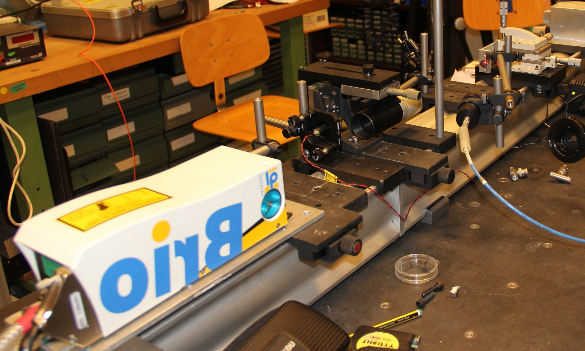
Laser Induced Breakdown Spectroscopy

