Slide 1

Study of spin dynamics in ferrite-based MNPs
Dott. Martina Basini
Supervised by: Alessandro Lascialfari

Slide 2
OUTLINE
Introduction to nanomagnetism
SUPERPARAMAGNETIC nanoparticles (MNPs):
  Biomedical appications
  MNPs as theranostic agents
MY RESEARCH :
  Samples
  Magnetic measurement
  NMR Profiles
  Results
CONCLUSIONS and PERSPECTIVES

Slide 3
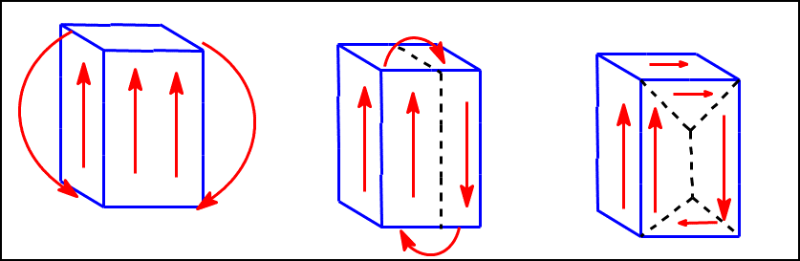
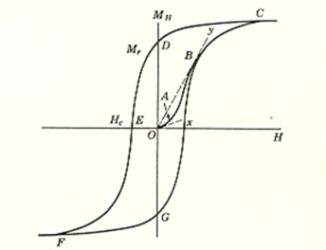
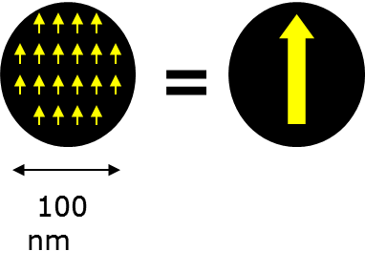
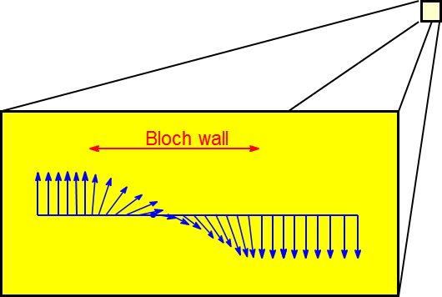
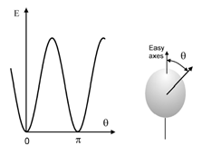
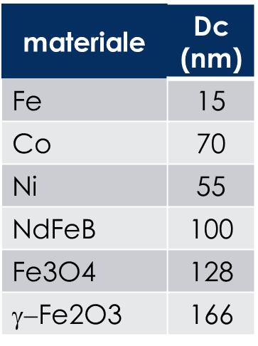
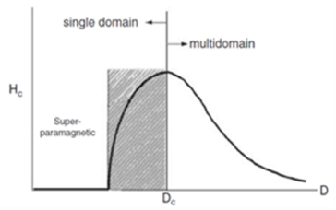
INTRODUCTION TO NANOMAGNETISM
Ferromagnetism
d < D_{c}
Superparamagnetism
All the spin move coherently
B = 0
Spins filipping in Nèel time
τ_{Ν} = τ₀(E) exp [ΔE_{a}/K_{b} (T-T₀)]
ΔE_{a} = Barrier
SOME CRITICAL DIAMETER:
COMPETITION between ANISOTROPY and THERMAL ENERGY

Slide 4
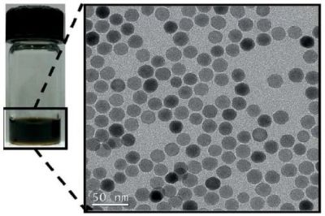
SUPERPARAMAGNETIC NANOPARTICLES
HOW ARE MNPs MADE?
POSSIBILITY OF FUNCTIONALIZATION
  MAGNETIC CORE:
MAGHEMITE (γ-Fe2O3) /
MAGNETITE (Fe3O4)
HYDROPHOBIC COATING:
OLEIC ACID
SOLVENT
HEXANE / ACQUEUS MEDIA

Slide 5




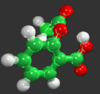
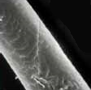



SUPERPARAMAGNETIC NANOPARTICLES
WHY ARE THEY APPEALING FOR BIOMEDICAL APPLICATIONS?
nanoparticles
CAN BE BIOCOMPATIBLE
POSSIBLE FUNCTIONALISATION
pollen
Human hair
Gene (width)
Bacteria
0.1 nm
1 nm
10 nm
100 nm
1 m
10 m
100 m
Aspirin molecule
Proteins
Cells
Virus
MAGNETIC TRANSPORT
DIMENSION
DNA

Slide 6
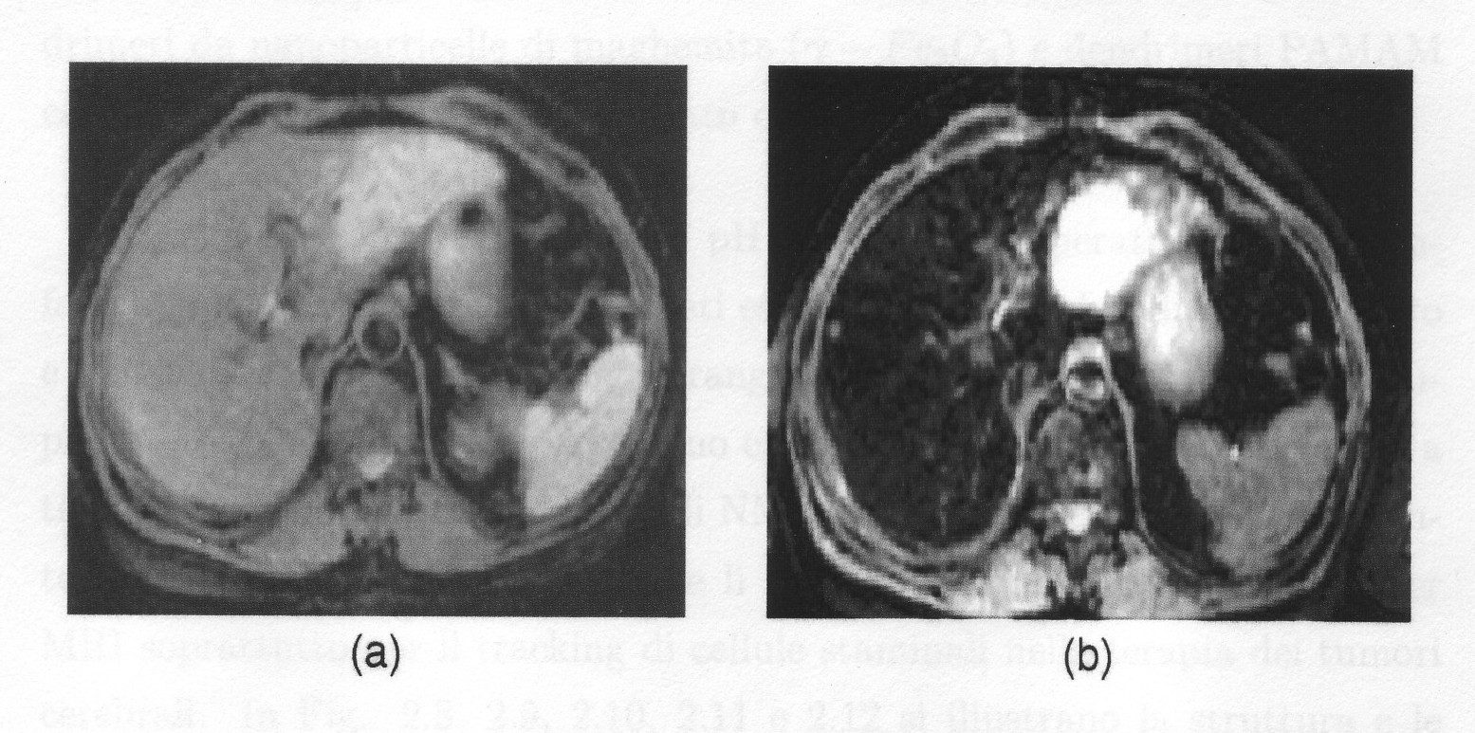
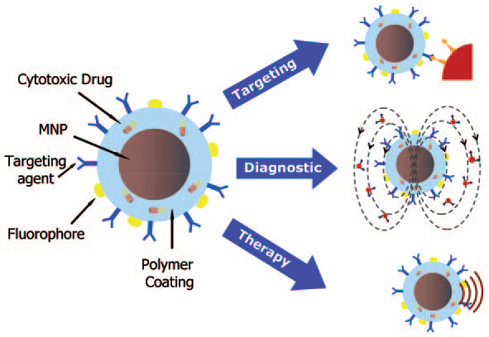
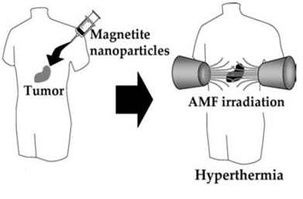
SUPERPARAMAGNETIC NANOPARTICLES
THE IDEAL TASK: A single theranostic nano-object !!
TARGETING:
DRUGS, ANTIBODY
Without CA
With CA
THERANOSTIC AGENTS:
DIAGNOSTIC:
CONTRAST AGENT (CA)
FOR MRI
THERAPY:
MAGNETIC
FLUIDHYPERTEMIA
DEPEND ON TRANSVERSE RELAXIVITY (PHYSICAL PROPERTY)

Slide 7
THE ROLE OF PHYSICIST
INVESTIGATION OF FUNDAMENTAL magnetic properties and relaxation rates’ mechanisms
CORRELATION
WITH APPLICATIVE properties
NMR
RELAXATION
DISPERSION CURVES
MAGNETIC MEASUREMENTS

Slide 8
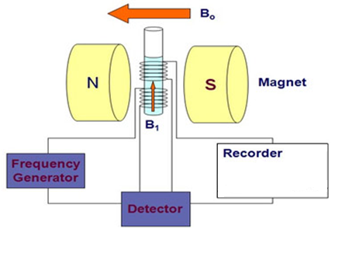
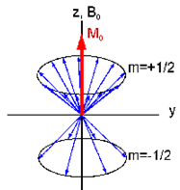
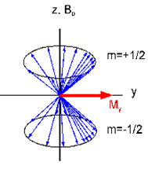
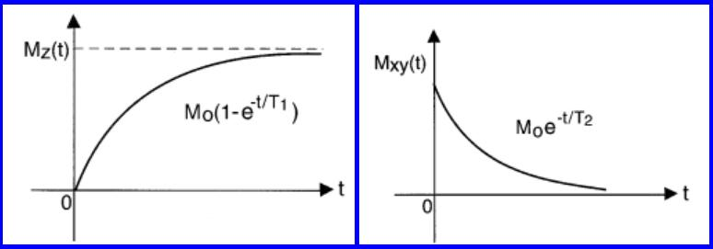
Few words on NMR TECHNIQUE
NMR
RELAXATION
Probe: ¹H (high natural abundance)
Measure: relaxation time of ¹H
T_{1n}
NUCLEI
(T_{2n})
ELECTRONS
(T_{2e})
1/T_{1n} ∼AχTJ_{e}(ω_{N})
1/T_{2n} ∼ J_{e}(0)
ALONE THEY WOULD RELAX IN YEARS
Interacting with MNP’s THEY RELAX IN t < s
T_{1n}
T_{1e}
PHONONS
Electronic
spectral density
J_{e}(ω) = FT [G(r , t)]
LOCAL HYPERFINE INTERACTION
BETWEEN NUCLEI AND ELECTRON
NOW (M_{z} = 0):
Start recording relaxation to equilibrium
B₁
90° PULSE
¹H relaxation:
LOCAL PROBE through the
EYES of HF INTERACTION!!

Slide 9

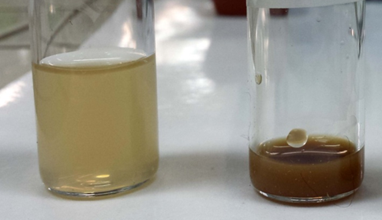
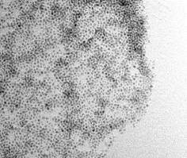
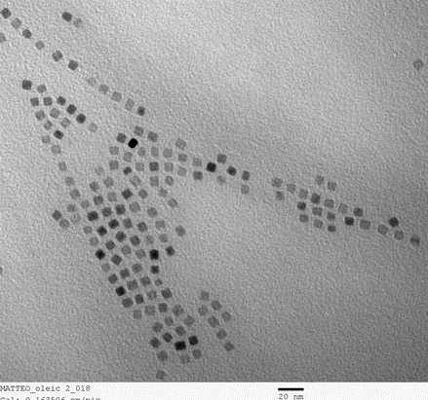
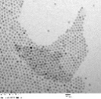
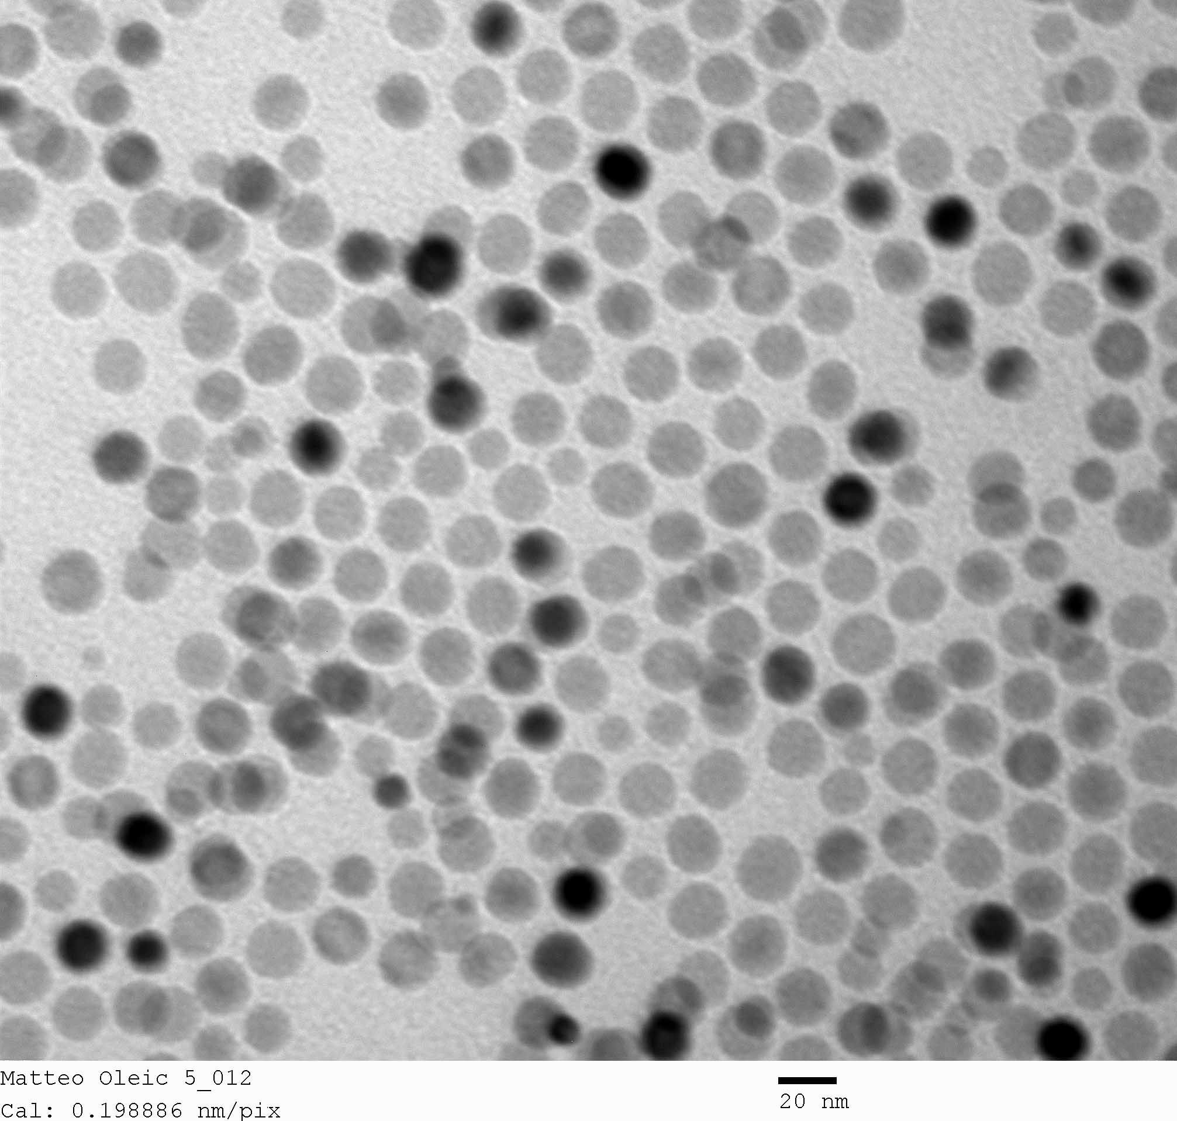
MY STUDY: SAMPLES
GOALS:
APPLICATIVE: IDENTIFY NEW possible MRI Contrast Agents
FUNDAMENTAL: Study of SPIN DYNAMICS
Solvent: HEXAN
TEM
A
d_{core} = 4 nm
σ = 0.15
Solvent:
ACQUEOUS MEDIA
B
L = 8.5 nm
C_acq
C
d_{core} = 8.5 nm
σ = 0.07
D_acq
D
d_{core} = 20 nm
σ = 0.09
The nanostructures we have studied contains surfactant-capped magnetite (Fe₃O₄) inorganic core with different controlled size ranging from 3.5 to 17.5 nm . The as-syntesized nanostructures are passivated by hydrophobic surfactants (oleic acid) and fully dispersed both in hexane and in acqueous media by means of microemulsions.

Slide 10
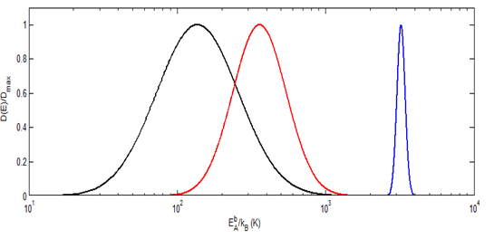
MY STUDY:
AC and DC Magnetic measurement
HYSTERESIS
Spins are bloked (H = 0 ; M ≠ 0)
BLOCKING-SPIN TEMPERATURE
B ≠ 0
ΔE_{a}
M
DC
T < T_{B}
B = 0
T_{B}
τ₀
T₀
10 ⁻¹⁰ - 10⁻¹² s
Max RESPONSE at
T_{MAX} ∼ T_{B}
such that
ωτ ∼ 1
AC
MEASURE THE INTERACTIONS
τ = τ₀(E) exp [ΔE_{a}/K_{B} (T-T₀)]
Energy Barrer distribution

Slide 11
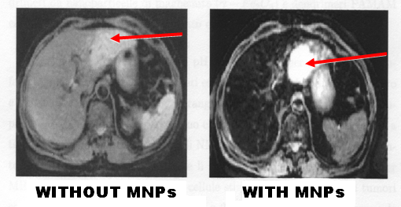
MY STUDY: NMR relaxation curves
Magnetic Resonant Imaging
MRI signal is:
s(t) = N(¹H) e^{-TE/T2} (1-e^{-TR/T1})
¹H relaxation times
(T₁ and T₂) depend on the capability to
EXCHANGE ENERGY
with the sorrounding:
!! LOCAL PROBE !!
MNPs shorten the relaxation time T₂ of ¹H of healty cells:
CONTRAST AGENTS
Key parameter for MNPs CA efficiency :
r₂ ~ 1 / T₂

Slide 12

MY STUDY: NMR Results
SIZE
SOLVENT
SHAPE
Acqueus media
INCREASE CA EFFICIENCY
4 nm promising as negative CA!!
SPHERICAL SHAPE

Slide 13
EXISTING MODELS….
FIT LINES
...Work for r1…
...Don’t Work for r2..

Slide 14
CONCLUSIONS and PERSPECTIVES
SPHERICAL shape is better
d ~ 20 nm displays the BEST EFFICIENCY:
r₂ = 50 s⁻¹mM⁻¹
d ~ 4 nm has r₂ = 27 s⁻¹mM⁻¹, VERY HIGH with respect to the SMALL SIZE…
WE NEED A THEORY FOR BOTH r₁ and r₂ !!!
…further work is required

