Slide 1
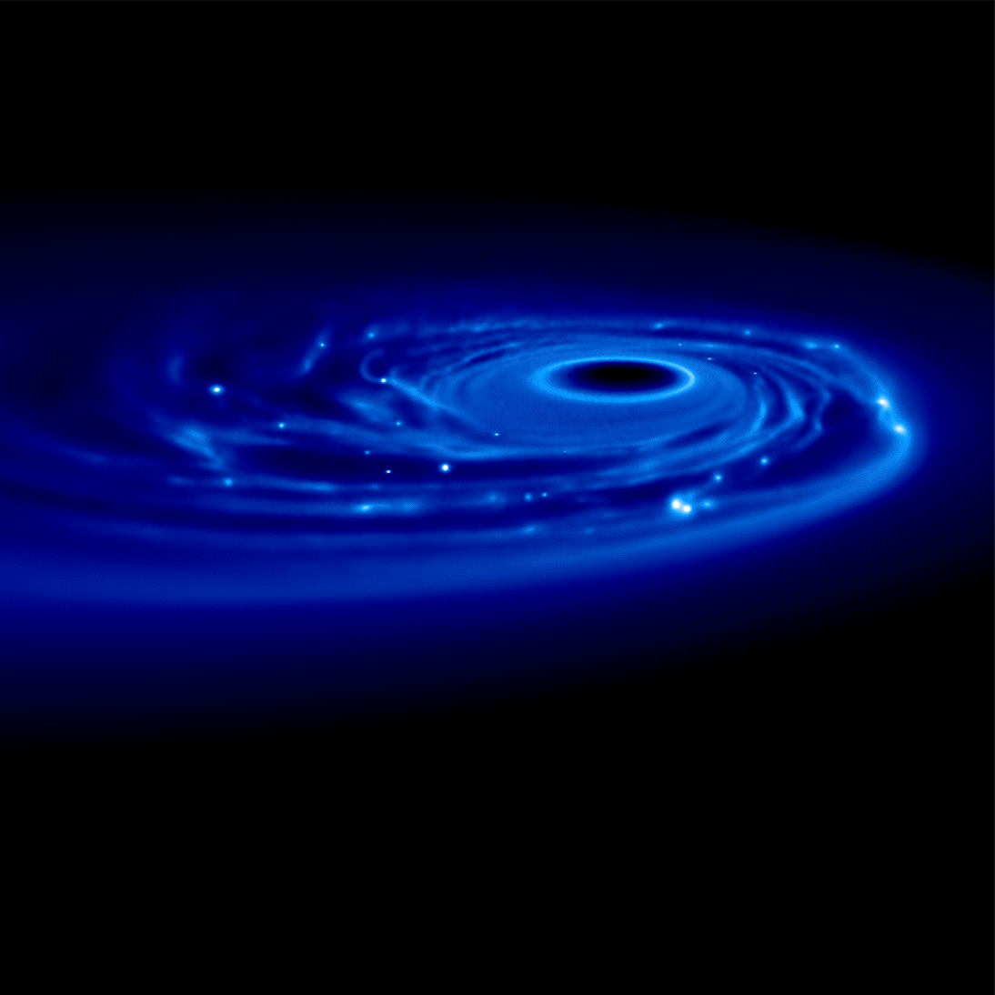
THE ROLE OF GRAVITATIONAL INSTABILITY IN THE DYNAMICS OF DUST GRAINS IN PROTOSTELLA DISCS
Giovanni Dipierro
Università degli Studi di Milano
Supervisor: Prof. Giuseppe Lodato
Collaborators: Paola Pinilla (Leiden), Leonardo Testi (ESO)

Slide 4
Core accretion model

Slide 5
Core accretion model
Critical step:
Dust growth to planetesimal: μm km
Notes:
Collisions and skicking

Slide 6
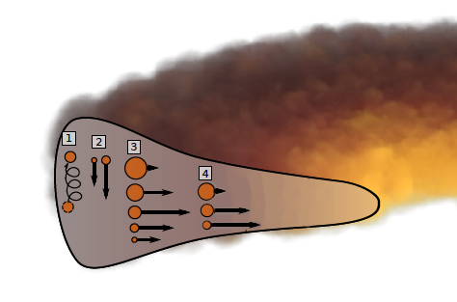
Dust dynamics and the growth barriers
Dust transport processes:
Turbolent mixing
Vertical settling
Radial drift
Gas drag
Dust-gas aerodynamical coupling:
V_{r, g}< 0
Adapted from Testi et al. 2014
Notes:
The simple concept of drag force leads to important implications, the first of which, radial drift , was realized
by Whipple (1972), Adachi et al. (1976), and by Weidenschilling (1977): an orbiting parcel of gas is in a force balance
between gravitational, centrifugal, and pressure forces. The pressure gradient is generally pointing outward because
densities and temperatures are higher in the inner disk. This additional pressure support results is a slightly sub-
Keplerian orbital velocity for the gas. In contrast, a freely orbiting dust particle feels only centrifugal forces and gravity,
and should therefore be in a Keplerian orbit. This slight velocity difference between gas and a free floating dust particle
thus causes an efficient deceleration of the dust particle, once embedded in the gaseous disk. Consequently,
the particle looses angular momentum and spirals towards 3 smaller radii. This inward drift velocity is only a small fraction
of the total orbital velocity (a few per mille), but, for St 1 particles, it still leads to an inward drift speed of the
order of 50 m s􀀀1 . It also means that particles of different sizes acquire very different radial velocities and also that
at any given radius, dust of the right size may be quickly moving towards the central star.

Slide 7
Brauer et al. 2008
Meter-sized barrier: on timescales as short as 100 yrs, a one-meter-sized object at 1 au moves towards the star. If τ_{drift} < τ_{growth} growth barrier
Meter-sized barrier in inner disc Millimeter-sized barrier in outer disc

Slide 8
Fragmentation barrier
While low velocity collision lead to particle growth, high-velocity inpact lead to destruction condition for fragmentation:
where the fragmentation velocity depends on material properties (Wada et al. 2009)
Sources of relative particle velocities:
Brownian motion
Radial drift velocities
Azimuthal relative velocities
Turbolent motion
Differential settling
Maximum value of grain size in the Epstein regime (Omel & Cuzzi 2007, Brauer et al. 2008):

Slide 9
Millimeter observation of protostellar discs
dust in the outer disc regions appears to have grown to sizes of at least ~ mm
dust needs to be retained in the disk for a relatively long time

Slide 10
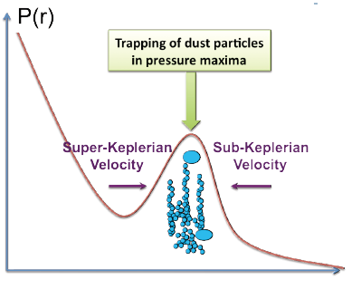
Possible solution to the radial drift and fragmentation barrier
Birstiel et al. 2010, Pinilla et al. 2012
Notes:
The grey area illustrate the range of predictions for global dust evolution models
without radial drift (Birnstiel et al. , 2010b), the two arrows illustrate the evolutionary trajectories in the first few million
years as predicted by the global models including the effect of radial drift (solid line) and including pressure traps in the
gas distribution to slow the rate of drift (better agreement)

Slide 11
Possible solution to the radial drift and fragmentation barrier
Birstiel et al. 2010, Pinilla et al. 2012
Notes:
The grey area illustrate the range of predictions for global dust evolution models
without radial drift (Birnstiel et al. , 2010b), the two arrows illustrate the evolutionary trajectories in the first few million
years as predicted by the global models including the effect of radial drift (solid line) and including pressure traps in the
gas distribution to slow the rate of drift

Slide 12
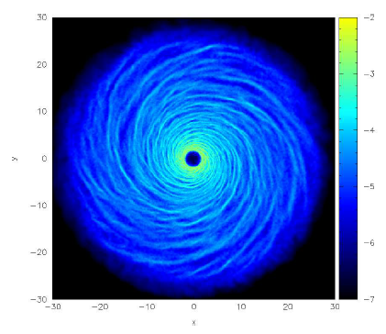
Particle trapping induced by gravitational instability
GI’s influence the disc dynamics through the propagation of density waves: formation of a prominent spiral structure

Slide 13
Spiral arms are overdensity and overpressure regions:
Enhanced density favours and speed up collisional growth
Velocity dispersion strongly reduced as the particle get “trapped”
Solid component may become gravitationally unstable and form bound object (Rice et al. 2004, 2006)

Slide 15
Thanks!

