Slide 1
End Year Seminar
Surface and interface physics of novel oxide heterostructures
Alessio Giampietri
XXIX Cycle
UNIVERSITÀ DEGLI STUDI DI MILANO
UNIVERSITÀ CATTOLICA
Del Sacro Cuore

Slide 2
Introduction
PRINCIPAL OBJECTIVES OF THIS WORK
● Setup and calibration of a RF magnetron sputtering deposition system for a set of different targets (LaAlO₃, LaCrO₃, Al₂O₃ and BiFeO₃).
● Determination of the optimal growth parameters (substrate temperature, pressure, sputtering power) for each target material.
● Complete characterization of the thin films using different experimental techniques.
● Detailed analysis of the properties of the thickness-dependent interfaces of thin films grown with different substrate temperatures, both through conventional XPS and synchrotron-based radiation.

Slide 3
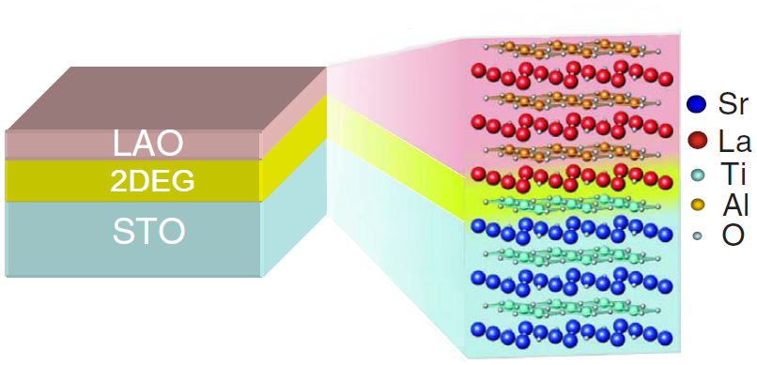
LaAlO₃/SrTiO₃
Both the LaAlO₃ (LAO) and the SrTiO₃ (STO) are wide gap insulators (5,6 eV and 3,2 eV respectively), but the LaAlO₃/SrTiO₃ heterostructure can be conductive, due to the formation of a 2DEG at the interface.
Requirements for the conductivity
● LAO film: Width over the critical thickness of 3 u.c.
● STO substrate: TiO₂ termination
Hypotheses for the conductivity
The origin of the interface conductivity and the 2DEG is still debated, but there are three more important hypotheses:
Electronic Reconstruction
Intermixing Phenomena
Oxygen Vacancies

Slide 4
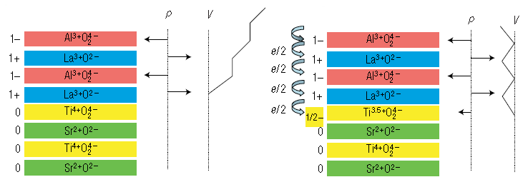
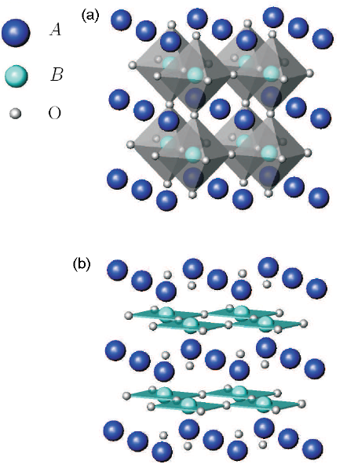
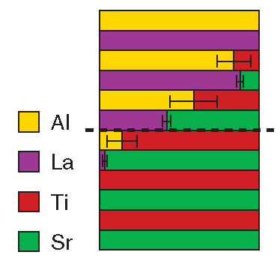
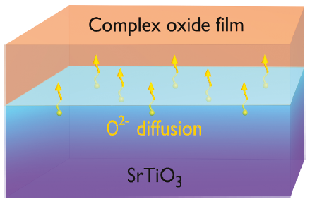
Polar catastrophe model
Electronic Reconstruction
The polar catastrophe can be avoided with an ½ e⁻ transfer from the surface to the interface.
Oxygen vacancies and intermixing
The polar catastrophe can also be avoided by compensation mechanisms (through Oxygen vacancies or intermixing).

Slide 5
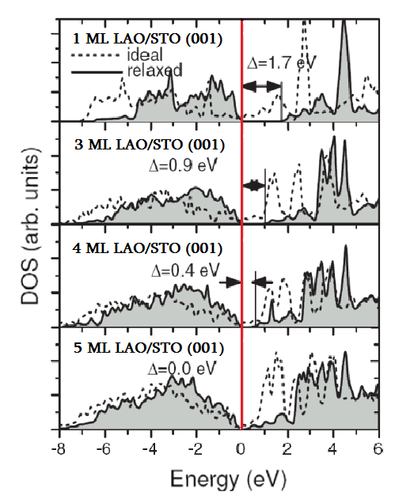
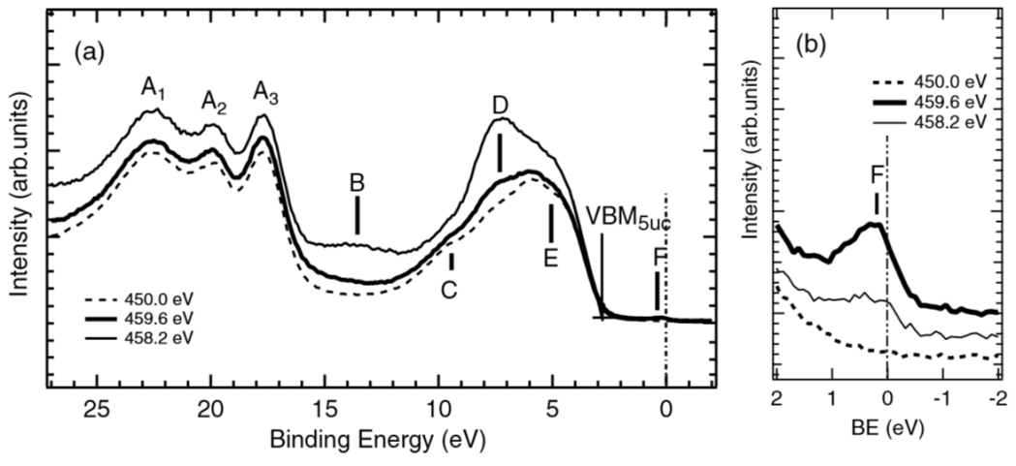
Spectroscopic evidence of the conductivity
EXPERIMENTAL DATA
The states near to the Fermi-edge (b) can be imaged experimentally in the resonant photoemission spectra of a 5ML LAO-STO heterostrucure.
● Dashed line: Off-resonance
● Thin line: Ti⁴⁺ resonance
● Thick line: Ti³⁺ resonance
Pentcheva et al., PRL 102 (2009)
Adapted from: Drera et al., PRB 90 (2014)
SIMULATIONS
In the density of states (DFT study) for 1–5 ML LAO on STO there is a band gap, but its size decreases with each added LAO layer.
Notes:
Experimental data: the intensities have been normalized to the maxima of the peaks measured at hν = 459.6 eV.

Slide 6
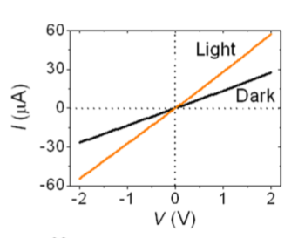
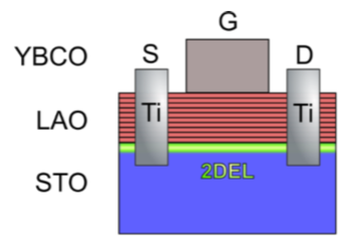
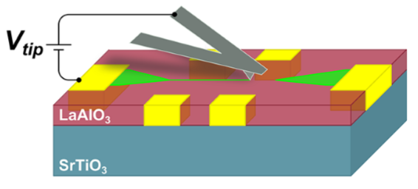
LaAlO₃/SrTiO₃ – Applications and devices
● Photovoltaic devices: The photovoltaic effect in the LaAlO₃/SrTiO₃ system is given by the residual polar field.
● Field Effect Transistor: The LaAlO₃/SrTiO₃ field effect transistor shows both a current and voltage gain (example: G≈40 if I_{GS}=5µA and V_{DS}=450mV).
● Nanowires: With the c-AFM lithography it’s possible to write nanowires on the LaAlO₃/SrTiO₃ surface. These structures display a 2D Hall mobility similar to the n-type Silicon nanowires.
Rectifying Diode: This system shows a conduction band profile and an I-V characteristic similar to the metal- semiconductor Schottky junctions.
Photodetector: The measured signal displays an high gain for the sensor dimensions, probably due to in-gap states due to the formation of Oxygen vacancies.
Liang et al., Scientific
Reports 3 (2013)
Förg et al., APL 100 (2012)
Irvin et al., Nano
Letters 13 (2013)

Slide 7
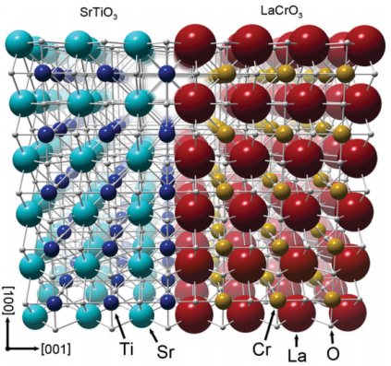
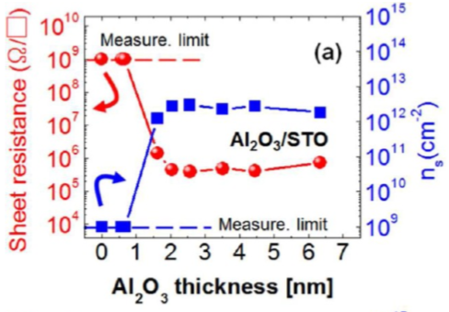
Other materials: LaCrO₃ and Al₂O₃
The existence of an insulator to metal transition in the LaAlO₃/SrTiO₃ heterostructure with a variation of the film thickness increased the studies on similar systems.
LaCrO₃/SrTiO₃:
The interface obtained with the substitution of Al with Cr was found to be insulating even with different film thickness, so the presence of La in the heterostructure is probably not important.
Al₂O₃/SrTiO₃:
The interface between Al₂O₃ and SrTiO₃ displays an insulator to metal transition with the variation of the film thickness. This suggests the possibility that the key element in the film is Al.
Colby et al., Physical Review B 88 (2013)
Lee et al., Nano Letters 12 (2012)

Slide 8
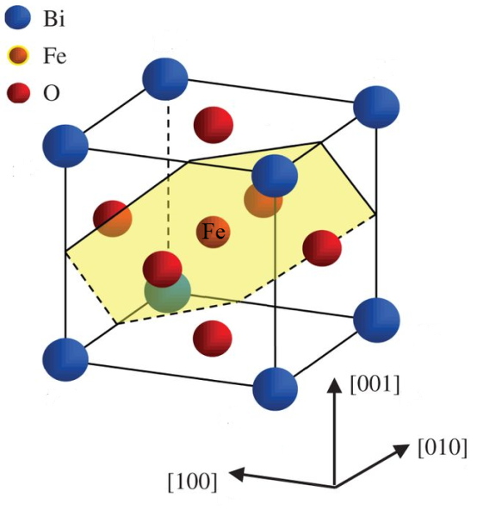
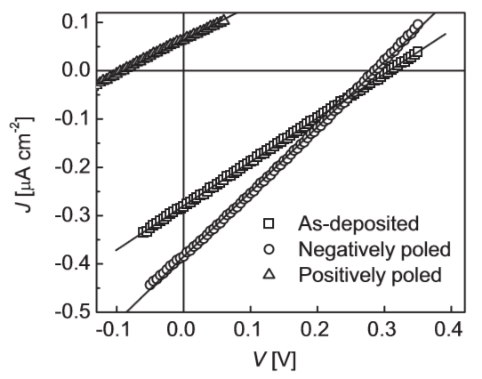
BiFeO₃/SrTiO₃
BiFeO₃ is the only single-phase multiferroic (both ferroelectric , antiferromagnetic and ferroelastic) material at room temperature.
Ferroelectric Curie temperature: T_{C} = 1103 K
Neel temperature: T_{N} = 643 K
BiFeO₃ (BFO) has got a pseudo-cubic unit-cell parameter (a ≈ 3.96 Å) of a rhombohedrally distorted perovskite structure (space group: R3c) .
Other interesting properties:
$●$ Remnant polarization as large as 90μC/cm².
$●$ Appreciable photoconductivity.
$●$ Low temperature of crystallization.
Ji et al., Adv. Mater. 22 (2010)
Notes:
Recently, a giant polarization has been demonstrated with properly tailored BFO ﬁlms, which can be an order of magnitude higher than those of their bulk ceramic and single crystal counterparts. (J. Wang et al., Science 299, 17192003)

Slide 9
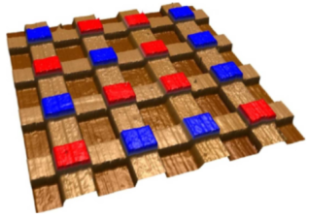
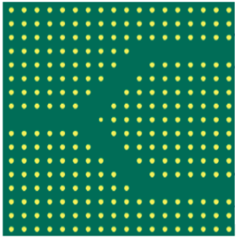
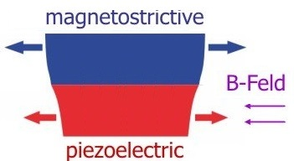
BiFeO₃ – Applications and devices
• High-density data storage (ferroelectric random access memory, FeRAMs): A ferroelectric layer evaporated onto a semiconducting wafer is subdivided into storage cells which can then be addressed by a single transistor.
• Nonlinear optical devices: Photonic crystals need an artificially engineered two-dimensional structuring of periodically poled crystals, which enables the optical power splitting.
• Magneto-electric sensors : The magnetoelectric (ME) sensors can detect alternate electromagnetic ﬁeld and constant magnetic ﬁeld through the coupling between a magnetostrictive and a piezoelectric layer.
Guo et al., Nat.
Comm. 4 (2013)
Ghaffari et al. , J Applied Sci. 8 (2008)
• Other applications: sensors (measurement of force, torque, acceleration, pressure, strain), actuators (positioning, inkjet printers and piezoelectric motors).
Notes:
In ME sensors a layer of magnetostrictive material is mechanically coupled to a piezoelectric material. An applied magnetic field H changes the lenght of a magnetostrictive material, thus causing mechanical stress and electrical polarization P in the piezoelectric layer, which can be measured as an electrical voltage V proportional to the magnetic field.
The devices have a very diverse range of applications, including medical technology such as mag-netoencephalography, magnetocardiography or measuring body processes magnetic ﬁelds, military technology in locating objects such as submarines, sunken ships. They also have applications in heart beat monitors, weapon systems positioning, weather prediction, steel pylons, archaeology, hazards warning systems, plate tectonics and radio wave propagation and planetary exploration.

Slide 10
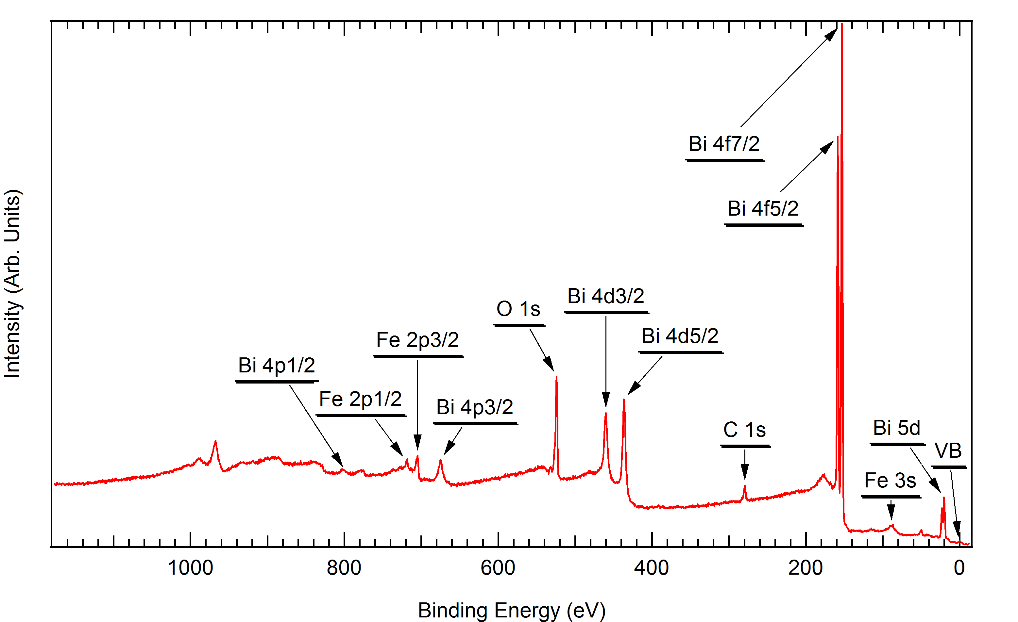
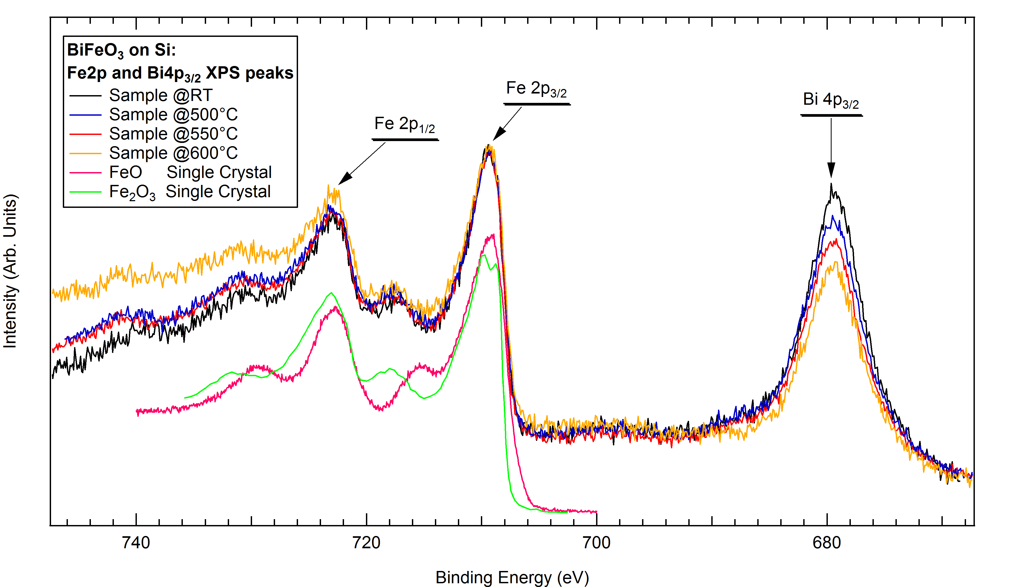
Effects of growth temperature on the morphology and physical properties
1) XPS ANALYSIS
From the X-ray Photoemission Spectroscopy analysis is possible to obtain information about the physical and chemical properties of the surface of the samples.
The analysis of the Fe 2p and Bi 4p_{3/2} peaks revealed that the samples are not stoichiometric.
Sample T vs. Peaks | Sample @RT | Sample @500°C | Sample @550°C | Sample @600°C
Fe 2p | 48,25% | 45,60% | 49,66% | 54,83%
Bi 4p_{3/2} | 51,75% | 54,40% | 50,34% | 45,17%

Slide 11
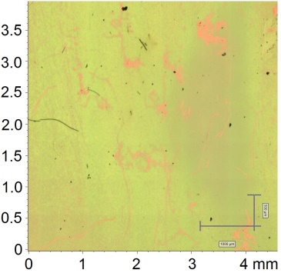
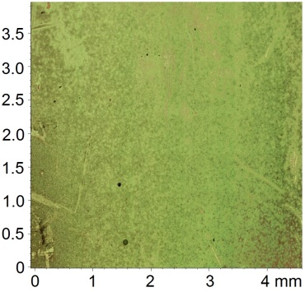
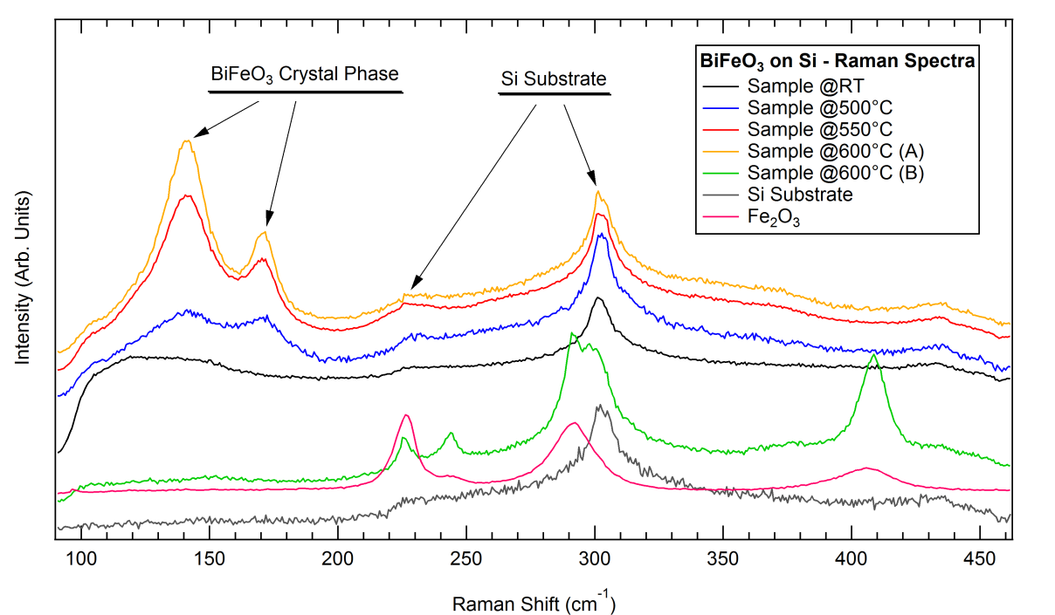
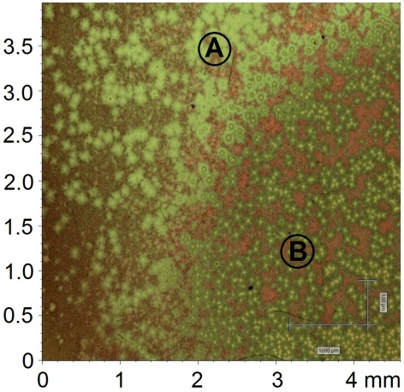
2) μ-RAMAN ANALYSIS
The features related to the BiFeO₃ perovskite phase are more visible when the thin films are grown at more than ≈500°C.
From the optical images in true colors we can see that the sample grown at 600°C is highly inhomogeneous.
Sample @500°C
Sample @550°C
Sample @600°C

Slide 12
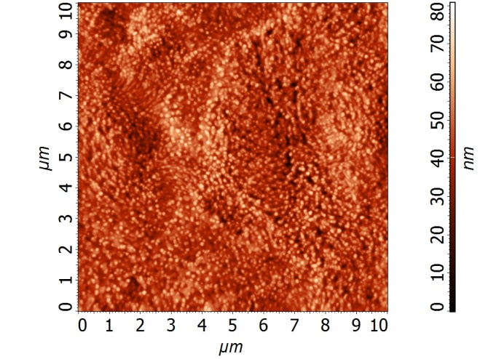
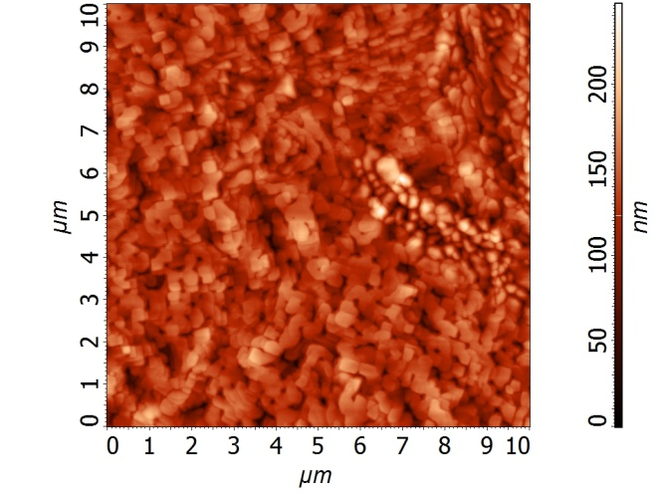
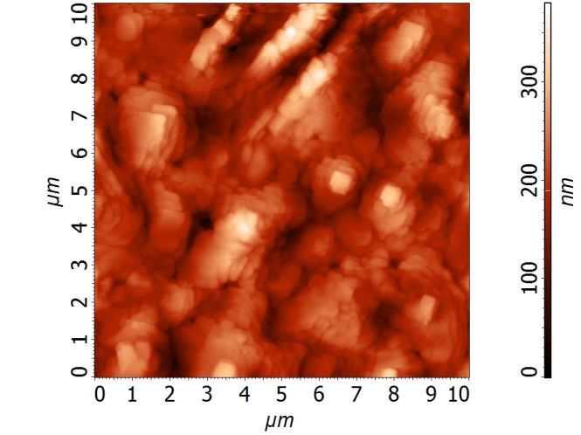
3) AFM ANALYSIS
With AFM is possible to analyze the morphology of the sample’s surface.
BiFeO₃//Si @500°C
Substrate Temperature | 500°C | 550°C | 600°C
Average Roughness | 8,59nm | 39,81nm | 54,54nm
Crystal Lateral Size | ≈ 0,1 μm | ≈ 0,3 μm | ≈ 0,5 μm
BiFeO₃//Si @600°C
BiFeO₃//Si @550°C

Slide 13
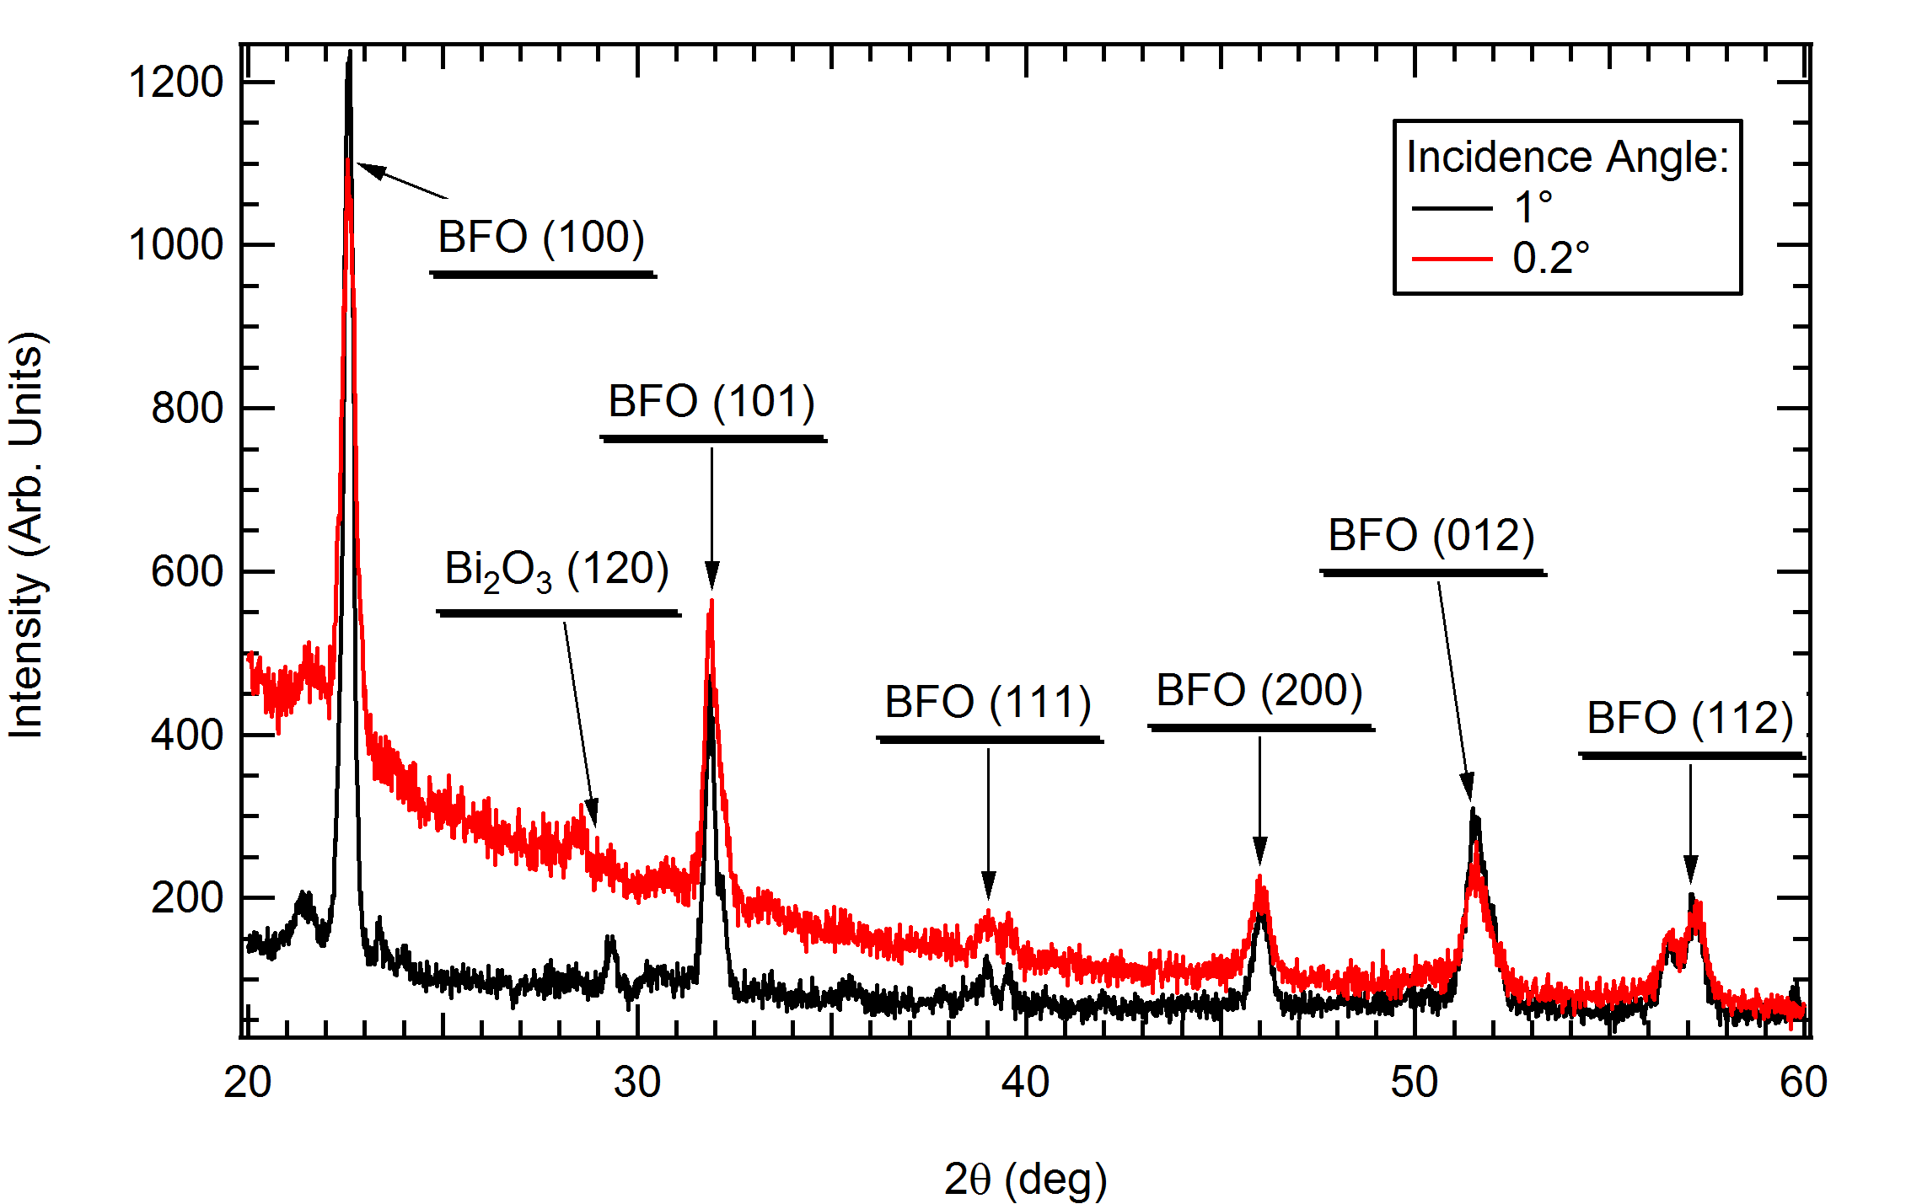
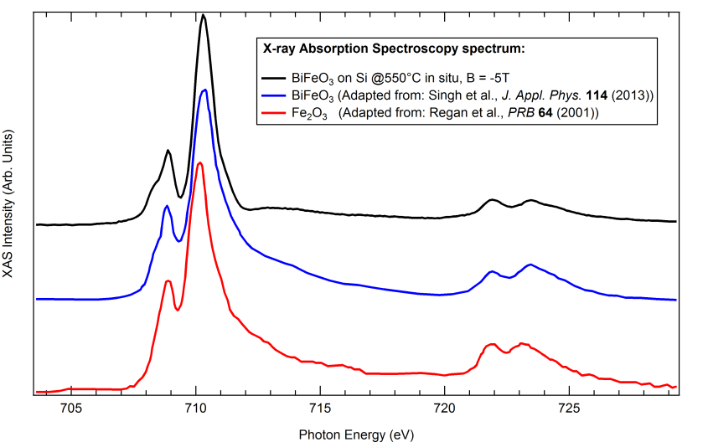
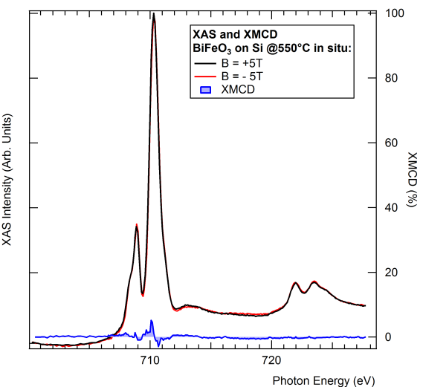
4) XRD ANALYSIS
From the XRD data we can see that there are mainly peaks related to the BiFeO₃ perovskite phase, and one peak related to the Bi₂O₃ residual impurity phase.
5) XAS AND XMCD ANALYSIS
The XAS spectrum displays a small feature at hν=708.19 eV (black arrow) which can be only found in epitaxial BiFeO₃ spectra.
The XMCD measured at ±5T shows a nearly absent signal, thus suggesting that the system is really antiferromagnetic.

Slide 14
Conclusions and perspectives
The calibration of a RF magnetron sputtering deposition system was done for the BiFeO₃ material, which was grown with different temperatures.
The BiFeO₃//Si systems were characterized with a multi-technique approach, and the optimal growth temperature for the films was close to 550°C. In this conditions a smooth, polycrystalline thin film is obtained, which displays a strong antiferromagnetic behavior.
A preliminary analysis on the BiFeO₃//SrTiO₃ was also done (not shown here), but this work requires further analysis of BiFeO₃ films grown on substrates with the correct TiO₂ termination.
The next step will be the deposition and the analysis of LaAlO₃, LaCrO₃ and Al₂O₃ films. The final step will be the analysis of the interface properties of this heterostructures, both through standard and synchrotron-based radiation.

Slide 15
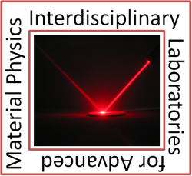
Thanks for the attention!
SUPERVISOR: XAS AND XMCD ^{[3]}:
Luigi Sangaletti^{[1]} Federica Bondino
Alessandro Lascialfari ^{[2]} Elena Magnano
RESEARCH GROUP ^{[1]}: Silvia Nappini
Giovanni Drera XRD DATA ^{[4]}:
Gabriele Salvinelli Ivano Alessandri
Federica Rigoni AFM SUPPORT ^{[1]}:
Chiara Pintossi Emanuele Cavaliere
[1] I-LAMP and Dipartimento di Matematica e Fisica, Università Cattolica, Via dei Musei 41, 25121 Brescia, Italy
[2] Dipartimento di Fisica, Università degli Studi di Milano, Via Celoria 16, 20133 Milano, Italy
[3] CNR-IOM, Laboratorio TASC, Strada Statale 14, Km. 163,5, 34149 Basovizza (Trieste), Italy
[4] INSTM and Chemistry for Technologies Laboratory, University of Brescia, Via Branze 38, 25123 Brescia, Italy

