Slide 1
Università degli Studi di Milano
STUDY OF CORRELATIONS
AND NON-MARKOVIANITY
IN DEPHASING OPEN QUANTUM SYSTEMS
Giacomo GUARNIERI
Supervisor: Bassano VACCHINI
Co-Supervisor: Matteo PARIS
PhD school of Physics, XXIX Cicle
Notes:
Good morning everybody, I'm Giacomo Guarnieri and in this brief talk I would like to introduce You to my recent research, which have concerned the 'Study of non-Markovianity and Correlations in Pure Dephasing Open Quantum Systems'. First thing to do then is to spend few words to generally define what those key words mean.

Slide 2
CONTENTS
Open Quantum Systems Theory
Quantum non-Markovianity
Two-time correlation functions and
Quantum Regression Theorem
A case of study:
The Pure Dephasing Spin-Boson System
Notes:
Let's start from Open Quantum Systems: what are they and why it is important to characterize and understand them.

Slide 3
CONTENTS
Open Quantum Systems Theory
Quantum non-Markovianity
Two-time correlation functions and
Quantum Regression Theorem
A case of study:
The Pure Dephasing Spin-Boson System
Notes:
Basically, a quantum system is called open whenever it is not seen as isolated from the rest of the Universe but instead it is considered in interaction with its surroundings. So this automatically answers at the question 'Why is this research field so important?' Well, because this situation is ubiquitous in reality: we always have to deal with a system that is not perfectly isolated and therefore the interaction with the environment determines changes in the system that have to be taken into account.

Slide 4
Open Quantum Systems Theory
System
$$ρ_{S}$$
HT = HS

Slide 5
Open Quantum Systems Theory
Environment
$$ρ_{E}$$
System
$$ρ_{S}$$
HT = HS + HE

Slide 6
Open Quantum Systems Theory
Environment
$$ρ_{E}$$
System
Interaction
Interaction
$$ρ_{S}$$
HT = HS + HE + HI
U(t,0)= exp [i HT t]
Notes:
The interaction between them is written in this last term of the Hamiltonian. The composite system is closed and so, at this level, we recover the usual formulation of quantum mechanics where the time evolution is determined by a unitary operator. However, it might be the case either that the treatise of the total system is too complex or that we are in any case interested in the reduced system only.

Slide 7
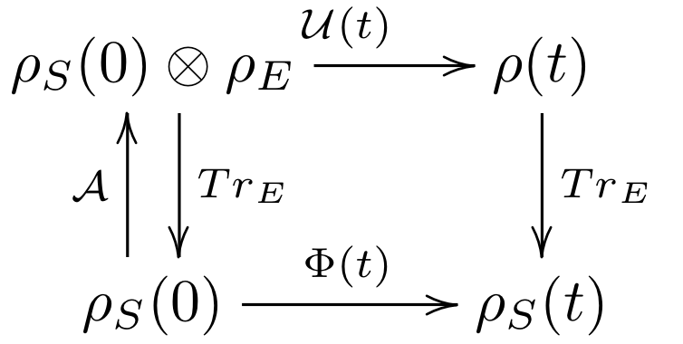
Open Quantum Systems Theory
$$Λ\left(t\right)$$
PROPERTIES OF
$$Λ\left(t\right)$$
COMPLETE POSITIVITY (CP)
TRACE PRESERVING (T)
Notes:
The mathematical formalization that traduces this operation to 'focus on the reduced system only' is the partial trace over the environment which allows to lower at the level of the reduced dynamics and which is nothing but an average over the environmental degrees of freedom.
If we start from a total product state (meaning that at the initial time no correlations exist between system ad environment) we can described the reduced dynamics and in its entirety by means of an appropriate linear map, called Quantum Dynamical Map, which incorporates the effects of the environment and, in order to represent a physically implementable operation has to be completely positive and trace preserving.

Slide 8
CONTENTS
Open Quantum Systems Theory
Quantum non-Markovianity
Two-time correlation functions and
Quantum Regression Theorem
A case of study:
The Pure Dephasing Spin-Boson System
Notes:
There exist two big categories of processes described by quantum dynamical maps: the ones called Markovian and the ones called non-Markovian. Let's see what we mean by Quantum non-Markovianity.
Despite in the world of classical stochastic processes, where Markovianity is a well-defined notion, in the Quantum realm this notion is more delicate and subtle.
We speak of Markovianity or non-Markovianity in quantum systems in relation to the presence or absence of memory effects in the dynamics: naively speaking, a dynamics is non-Markovian when the state of the system at a time t depends on its history.

Slide 9
Quantum non-Markovianity
The trace distance measures the distinguishability between states
$$D\left(ρ_{S}^{1}\left(t\right),ρ_{S}^{2}\left(t\right)\right)$$
Physical interpretation: evolution of information flow between S and E
D(t;ρ^{1,2})
Environment
System 1
System 2
Time (arbitrary units)
Notes:
Several definitions, which look at different properties of the dynamical map, of non-Markovianity have been given in recent years, one of the most significant is the one given by Breuer and others in a PRL of 2009.
The idea behind it is this: when you put a system in interaction with an environment, this interaction introduces noise which induces decoherence on the system.
Therefore, if we put two distinguishable systems in interaction with the same environment, where the distinguishability is measured by means of an appropriate distance on the Hilbert space called Trace Distance and denoted with D, then, during their evolution…

Slide 10
Quantum non-Markovianity
The trace distance measures the distinguishability between states
$$D\left(ρ_{S}^{1}\left(t\right),ρ_{S}^{2}\left(t\right)\right)$$
Physical interpretation: evolution of information flow between S and E
Environment
D(t;ρ^{1,2})
System 1
System 2
Time (arbitrary units)
Notes:
…they become less and less distinguishable to each other due to the noise and decoherence.
This lowered capability of distinguish between them can therefore be interpreted as a flux of information from the system to the environment.

Slide 11
Quantum non-Markovianity
The trace distance measures the distinguishability between states
$$D\left(ρ_{S}^{1}\left(t\right),ρ_{S}^{2}\left(t\right)\right)$$
Physical interpretation: evolution of information flow between S and E
Environment
D(t;ρ^{1,2})
System 1
System 2
Time (arbitrary units)
Notes:
Viceversa, if during the process a temporary increase in this change of distinguishability occurs, then this would indicate a backflow of information back from the environment to the system, aka a memory effect.

Slide 12
Quantum non-Markovianity
Backflow of information
Memory effects
non-Markovian dynamics
$$N\left(Λ\right)=max\int{\frac{d}{dt}D\left(ρ_{S}^{1}\left(t\right),ρ_{S}^{2}\left(t\right)\right)}dt$$
$$ρ^{1,2}$$
$$Ω$$
H.P. Breuer, E. M. Laine, J. Piilo, PRL 103, 210401 (2009)
B. H. Liu et al. , Nat. Phys. 7, 931 (2011)
Notes:
Following this line of reasoning Breuer and collaborators proposed to estimate the degree of non-Markovianity of a Quantum Dynamical Map by looking at the temporal region capital omega where the regrowth of the distinguishability occurs, namely when the derivative of the trace distance becomes positive, then summing up all these contributions and finally maximizing over all the possible choices of couples of initial states.
A remarkable feature that characterizes this particular measure of non-Markovianity among the others is that it can be experimentally measured, as was shown in this Nature paper.

Slide 13
CONTENTS
Open Quantum Systems Theory
Quantum non-Markovianity
Two-time correlation functions and
Quantum Regression Theorem
A case of study:
The Pure Dephasing Spin-Boson System
Notes:
Ok, now, one thing in particular is of utmost interest in quantum open systems: the correlations which onset between system and environment.

Slide 14
Two-time correlation functions and Quantum Regression Theorem
Mean Values :
$$〈A\left(t\right)〉={Tr}_{SE}\left[U\left(t,0\right)AU^{†}\left(t,0\right)ρ_{SE}\right]$$
Two-time CF:
$$〈A\left(t1\right)B\left(t2\right)〉={Tr}_{SE}\left[U^{†}\left(t1,0\right) A U\left(t1,0\right) U^{†}\left(t2,0\right) B U\left(t2,0\right) ρ_{SE}\right]$$
Notes:
In order to have fully statistically describe a composite system, it is therefore not sufficient to look at single-time expectation values, which are the mean values of operators and take this form here, but are also encoded in multi-time correlation functions. The first step in this direction is to consider the two-time correlation functions, which have this form (SHOW FORMULA).

Slide 15
Two-time correlation functions and Quantum Regression Theorem
Mean Values :
$$〈A\left(t\right)〉={Tr}_{SE}\left[U\left(t,0\right)AU^{†}\left(t,0\right)ρ_{SE}\right]$$
$$=TrS\left[A ρ_{S}(t)\right]$$
with
$ρ_{S}(t)$ = $TrE\left[U\left(t,0\right) ρ_{SE}\left(0\right)U^{†}(t,0)\right]$ = $Λ\left(t\right)$ $ρ_{S}\left(0\right)$
‘EASY’ !
Two-time CF:
$$〈A\left(t1\right)B\left(t2\right)〉={Tr}_{SE}\left[U^{†}\left(t1,0\right) A U\left(t1,0\right) U^{†}\left(t2,0\right) B U\left(t2,0\right) ρ_{SE}\right]$$
$$=TrS\left[A X_{S}(t1,t2)\right]$$
with
$X_{S}(t1,t2)=TrE\left[U\left(t1,t2\right) Bρ_{SE}\left(t1\right)U^{†}(t1,t2)\right]$ ≠ $Λ\left(t1,t2\right){ B ρ}_{S}\left(t1\right)$
VERY DIFFICULT!
Notes:
In general two-time correlation functions are extremely complicated quantities to access, especially when the dynamics which describes the process is non-Markovian.
This is due to the fact that, in contrast with mean values, which can be accessed only by means of the dynamical map at the level of the reduced dynamics, the two-time correlation functions generally cannot.

Slide 16
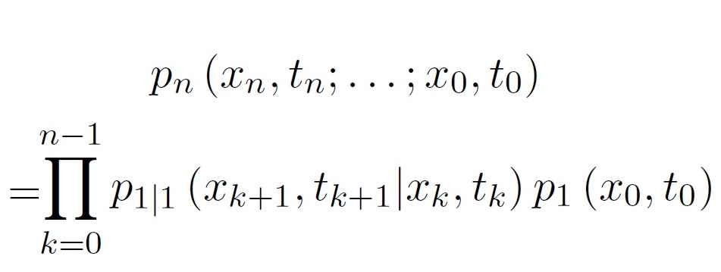
Two-time correlation functions and Quantum Regression Theorem
Classical World
of Stochastic Processes
?
Quantum World
Quantum non-Markovian
dynamics
Markovian process iff
&
$$〈A\left(t\right)〉$$
Mean Values :
relation
between
$$〈A\left(t1\right)B\left(t2\right)〉$$
Two-time CF:
Notes:
Therefore, motivated by what happens in the classical settings, where the Markovian property related joint probability distribution of different orders this way allowing to construct multi-time from single-time probability distributions, we wondered whether a connection and which connection exists in the Quantum realm between the occurrence of memory effects and, for example, relations which binds single-time expectation values and two-time correlation functions.

Slide 17
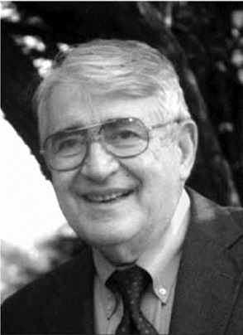
Two-time correlation functions and Quantum Regression Theorem
Mean Values :
$$〈A\left(t\right)〉={Tr}_{SE}\left[U\left(t,0\right)AU^{†}\left(t,0\right)ρ_{SE}\right]$$
Quantum Regression Theorem!
Two-time CF:
$$〈A\left(t1\right)B\left(t2\right)〉={Tr}_{SE}\left[U^{†}\left(t1,0\right) A U\left(t1,0\right) U^{†}\left(t2,0\right) B U\left(t2,0\right) ρ_{SE}\right]$$
M. Lax, Phys. Rev 172, 350 (1968)
Notes:
The most famous and employed relation which binds mean values and two-time correlation functions is the so-called Quantum Regression Theorem, introduced by Melvin Lax back in the Sixties.

Slide 18
Two-time correlation functions and Quantum Regression Theorem
$${\left\{A_{i}\left(t\right)\right\}}_{i=1,…,N^{2}},Tr\left[A_{i}^{†}A_{j}\right]=δ_{i,j}$$
Basis for the space of operators
$$\frac{d}{dt}〈A_{i}\left(t\right)〉=\sum_{j}{G_{ij}}〈A_{j}\left(t\right)〉$$
Closed and linear system
of evolution equations
for mean values
$$\frac{d}{dτ}〈A_{i}\left(t1\right)A_{k}(t2〉=\sum_{j}{G_{ij}}〈A_{j}\left(t1\right)A_{k}\left(t2\right)〉$$
Notes:
It essentially states that when the equation of motion for mean values of a set of operators which forms an orthonormal basis in the operator space are closed and linear, it can be proven that the differential equations for the two-time correlation functions share the same structure and therefore the latter can be inferred by the knowledge of the former.

Slide 19
Two-time correlation functions and Quantum Regression Theorem
$${\left\{A_{i}\left(t\right)\right\}}_{i=1,…,N^{2}},Tr\left[A_{i}^{†}A_{j}\right]=δ_{i,j}$$
Basis for the space of operators
$$\frac{d}{dt}〈A_{i}\left(t\right)〉=\sum_{j}{G_{ij}}〈A_{j}\left(t\right)〉$$
Closed and linear system
of evolution equations
for mean values
$$\frac{d}{dτ}〈A_{i}\left(t1\right)A_{k}(t2〉=\sum_{j}{G_{ij}}〈A_{j}\left(t1\right)A_{k}\left(t2\right)〉$$
Main assumption for the validity of QRT:
$$ρ_{SE}\left(t\right)=ρ_{S}\left(t\right)⊗ρ_{E}\left(0\right)$$
In most physical situation this assumption is never strictly satisfied!!
Search for regions of parameters where
$$ρ_{SE}\left(t\right)≈ρ_{S}\left(t\right)⊗ρ_{E}\left(0\right)$$
Notes:
The point is that the assumptions for the QRT to hold, the main of which being that the total state at every time is given by a product state of the system and of a fixed environment, are almost never strictly satisfied in physical systems.
Therefore in all these physical situations we have to search for dynamical regions of the parameters where the violations to the QRT can be considered small or negligible.

Slide 20
Question to answer
?
Quantum non-Markovianity
Quantum Regression Theorem
Notes:
Since Lax paper, the QRT could have been applied with satisfactory results only in particular subclasses of Quantum Markovian Processes, called Quantum Dynamical Semigroups which have very special properties. However no systematic study that relates non-Markovianity with the possibly approximate validity of this procedure has been done before.

Slide 21
CONTENTS
Open Quantum Systems Theory
Quantum non-Markovianity
Two-time correlation functions and
Quantum Regression Theorem
A case of study:
The Pure Dephasing Spin-Boson System
Notes:
My PhD research up to now has been devoted to this, namely to search for a relationship between the Quantum Regression Theorem and the non-Markovianity, for a typology of quantum dynamical processes known as pure-dephasing.

Slide 22
Pure Dephasing Spin-Boson System
Two-level system coupled to an infinite number of bosonic modes
The populations of the system are constants of motion!
$$ρ_{00},ρ_{11}$$
G.G. , A. Smirne, B. Vacchini , PRA 90, 022110 (2014)
Notes:
The physical situation we dealt with in our work, which has recently been published in the PRA, consists of a two-level system
(which can represents a two-level atom, a quantum dot, a spin, or even the two polarization degrees of freedom of a photon etc)
which is coupled to a bosonic bath
(that is a bath of an infinite number of harmonic oscillators or a radiation modes, as in a black body)
through an interaction Hamiltonian which commutes with its free part, this circumstance meaning that population of the system are not touched by the evolution.
Despite its apparent simplicity, which allows for analytic form for the total evolution operator, this model, called Pure Dephasing Spin-Boson, represents the building block of quantum computers and finds applications also in the general theory of measurement.

Slide 23
Pure Dephasing Spin-Boson System
The action of the total evolution operator can be explicitly evaluated
$$\left(j=0,1\right)$$
and therefore the reduced system state has the analytic form
where
is the DECOHERENCE FUNCTION.
Notes:
I said that this model allows for an analytic form of the total evolution operator, which takes the form of a displacement operator, a well-known operator in several fields such as Quantum Optics.
The system density matrix is then found to be of this form, where populations are constants and where the coherences (POINT TO THE OFF-DIAGONAL ELEMENTS WITH THE LASER) are suppressed by the so-called decoherence function.

Slide 24
Pure dephasing spin-boson model
If we assume...
Thermal Bath
Spectral Density
Ohmicity
Coupling strength
Cutoff frequency
the decoherence function, in the limit β → +∞, becomes
G.G. , A. Smirne, B. Vacchini , PRA 90, 022110 (2014)
Notes:
If we assume to deal with a thermal bath , coupled to the system through a spectral density of this form, which depends on the coupling constant lambda, on a parameter s called Ohmicity which governs the power-law of the low-frequency region, and a cut-off frequency, we can find analytic expressions for every quantity involved.
In particular I've displayed here the expression for the decoherence function because of its constitutive central role in every result, which takes this compact expression in the limit of zero temperature.

Slide 25
Pure dephasing spin-boson model
Non-Markovianity condition for the pure dephasing spin-boson
$∃ scrit$ = 2 such that
for $s<scrit$
the dynamics
is Markovian
for $s>scrit$
the dynamics
Is
non-Markovian
Indipendently of λ !!
Notes:
The condition of non-Markovianity then traduces into a condition on the parameter s: for values minor than a critical value, which for zero temperature is equal to 2, the dynamics is Markovian, otherwise is non-Markovian, indipendently on the coupling strength between S and E.

Slide 26
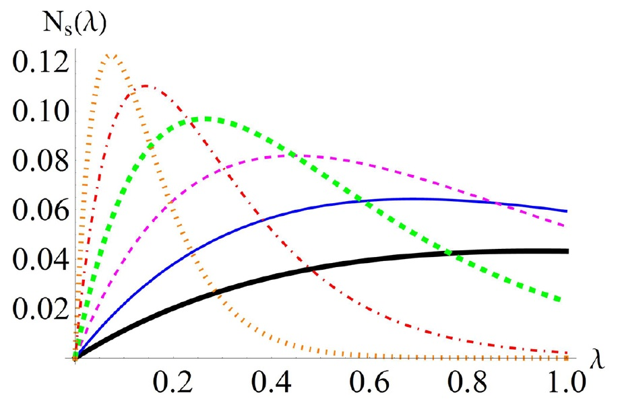
Pure dephasing spin-boson model
Non-Markovianity condition for the pure dephasing spin-boson
$∃ scrit$ = 2 such that
Increasing s!
for $s<scrit$
the dynamics
is Markovian
for $s>scrit$
the dynamics
Is
non-Markovian
Indipendently of λ !!
The degree of non-Markovianity though
depends on λ
Notes:
Of course, what depends also on lambda is "how much non-Markovian” is the dynamics, and you can see the Breuer measure of non-Markovianity plotted against lambda for increasing values of s.

Slide 27
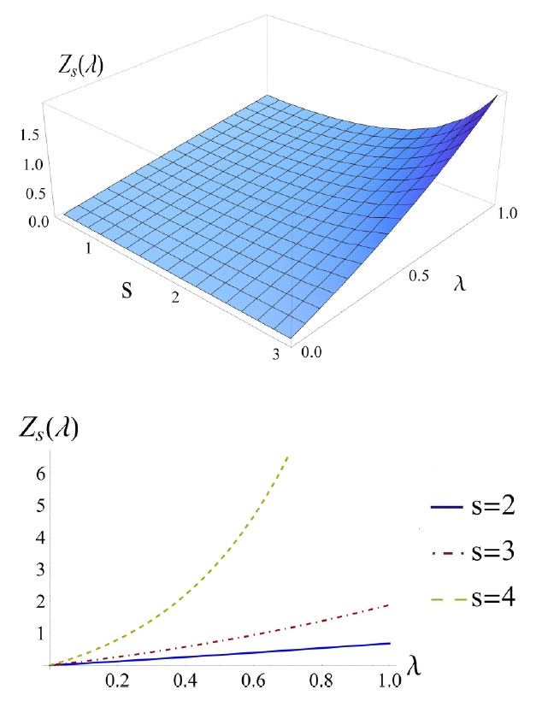
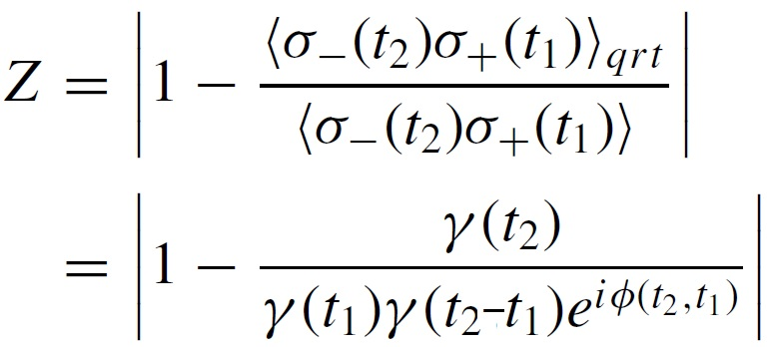
Pure dephasing spin-boson model
Two-time Correlation Functions
&
Quantum Regression Theorem
$$ρ_{SE}\left(t\right)≠ρ_{S}\left(t\right)⊗ρ_{E}\left(0\right)$$
To estimate the violations to the QRT by computing the
RELATIVE ERROR
S=1.5
Notes:
For what concerns instead the QRT, we found that the assumption for the QRT to hold is never satisfied and therefore we estimated the violations by computing the relative error between the two-time correlation functions with and without the quantum regression theorem. Here you can see how this relative error depends on the parameters of the spectral density.

Slide 28
Pure dephasing spin-boson model
Two-time Correlation Functions
&
Quantum Regression Theorem
$$ρ_{SE}\left(t\right)≠ρ_{S}\left(t\right)⊗ρ_{E}\left(0\right)$$
To estimate the violations to the QRT by computing the
RELATIVE ERROR
S=1.5
< s_{crit}!
Notes:
From the section of the 3D plot it becomes more clear that, even for Markovian regimes, the violations to the quantum regression theorem are not negligible (and not even small!).

Slide 29
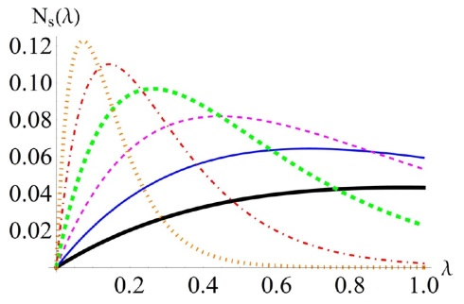
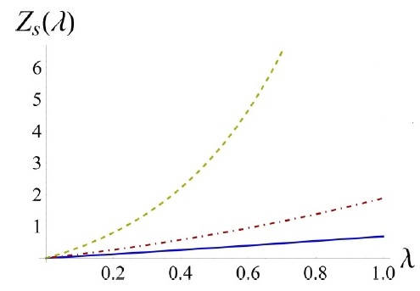
Pure dephasing spin-boson model
CONCLUSIONS
Quantum non-Markovianity
Quantum Regression Theorem
≠
Related to the
EFFECTS OF CORRELATIONS
between S and E at the level of the reduced dynamics
Related to the
ACTUAL CORRELATIONS
between S and E at the level of the overall dynamics
G.G. , A. Smirne, B. Vacchini , PRA 90, 022110 (2014)
Notes:
To conclude, we have then found, apart from a shared common qualitative behaviour on the parameters, there are differences between Quantum Regression Theorem and non-Markovianity, as been explicitly pinpointed by regions of parameters where the dynamics was Markovian (according to every definition existent of Quantum non-Markovianity and not only to the one I exposed here) but violations to the Quantum Regression Theorem were strong, and therefore the two-time correlation functions could not be constructed from mean values using this procedure without committing a consistent relative error.
The physical interpretation behind this difference relies in the role of the partial trace over the environment: while two-time correlation functions express a property of the composite system and then tell information on the correlations between S and E, the non-Markovianity property is related to the effects that such correlations have on the reduced dynamics. We can therefore read the results by saying that the correlations which onset during the evolution between S and E, while being strong, 'may not be felt' at the level of the reduced dynamics, because they are washed-out by the average over the environment.

Slide 30
THANK YOU

