Slide 1
Metabolic radiotherapy
Study and optimization of the production of relevant radionuclides
Simone Manenti
R10548-R17
Thuesday, November 18, 2014

Slide 2
Physics, Astrophysics and Applied Physics PhD school
Applied Physics
Physics for Biomedicine

Slide 3
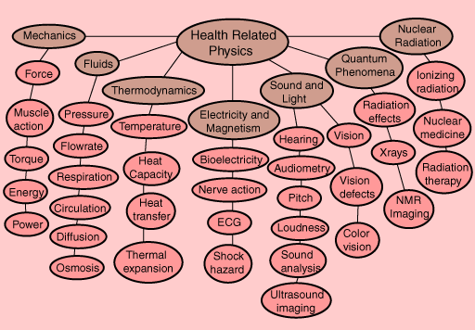
Image from http://hyperphysics.phy-astr.gsu.edu/

Slide 4
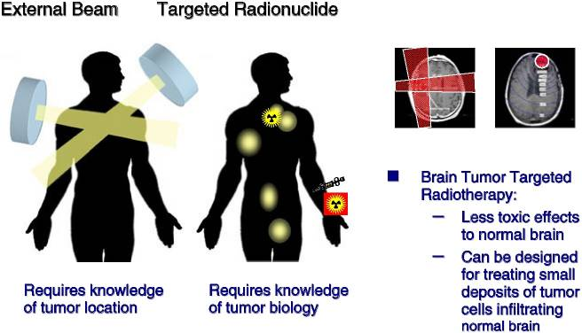
Available from: http://www.ncbi.nlm.nih.gov/books/NBK11464/

Slide 5
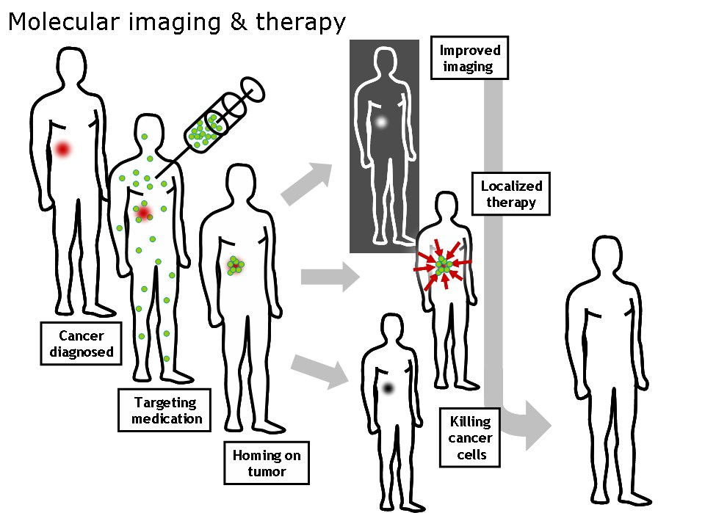
Theranostics:
therapy and diagnostics
Image from: “The Opensource Handbook of Nanoscience and Nanotechnology”

Slide 6
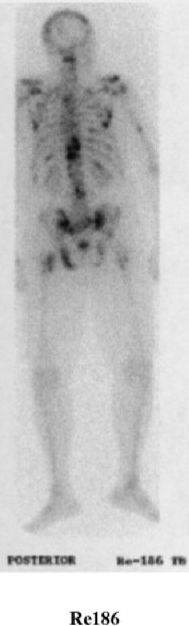
Characteristics of eligible radionuclides
half life: few hours (~6) to days (~10)
a suitable linear energy transfer (LET) value and range in the tissue
a γ-emission that lays in an energy region suitable for the imaging
high specific radioactivity (A_{s})
Radiochim. Acta, 70-71, Pages 249–272
“specific activity” is defined as the amount of radioactivity of the radionuclide of interest per unit mass of all the isotopes of the radionuclide itself

Slide 7
N.C.A.
Labelled
compound

Slide 8
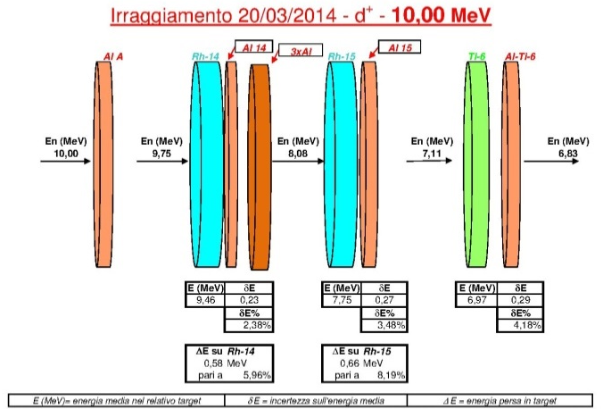
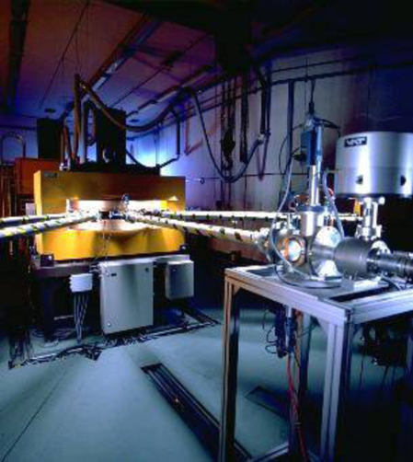
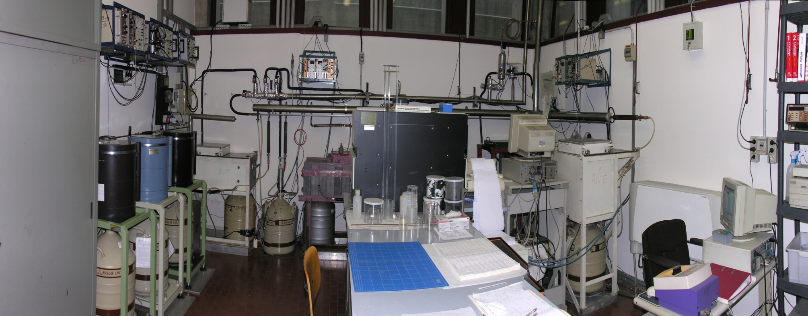
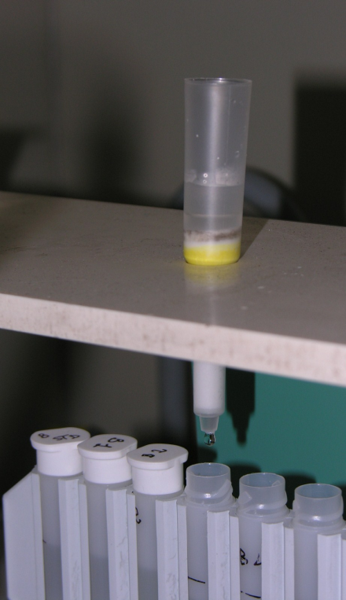
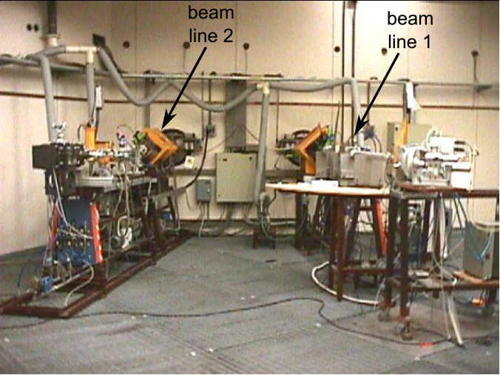
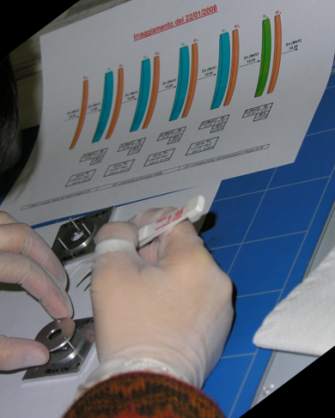
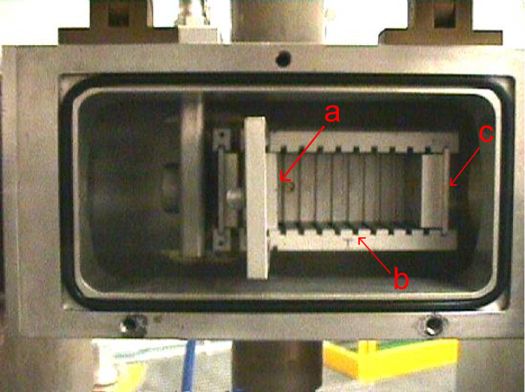
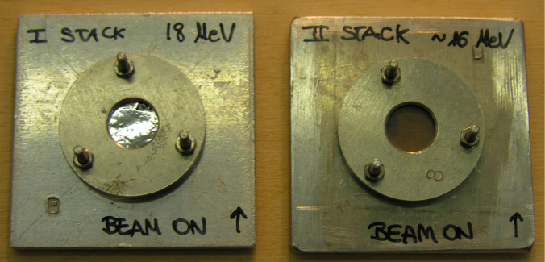
Experimental procedure

Slide 9
Positron, X-ray and Auger electron emitter: ⁸⁹Zr
⁸⁹Y(d,2n)⁸⁹Zr ⁸⁹Y(p,n)⁸⁹Zr
t_{1/2}= 78.4 h
electron capture=76.6%
β⁺=22.3% E_{max}(β+)=897 keV E_{ave.}(β+)=396.9 keV
E_{γ}=908.97 keV I_{γ}=100%
X-ray and Auger electron emitter: ¹⁰³Pd
¹⁰³Pd(d,2n)¹⁰³Pd
t_{1/2}=16.991 d
electron capture=100%
E_{γ}=357.45 keV I_{γ}=0.0221%
Notes:
Zr-89
Zirconium-89 is an attractive metallo-radionuclide for use in immuno-PET due to favorable decay characteristics.
Pd-103
The radionuclide ¹⁰³Pd has gained great significance in recent years
Prostate cancer is a common malignancy in men in the Western world. In recent years, improvement in biochemical diagnostic methods and the availability of a wide range of treatment options have increased the number of patients surviving free of disease.

Slide 12

Thank you for your attention
Grazie per l’attenzione

