Slide 1


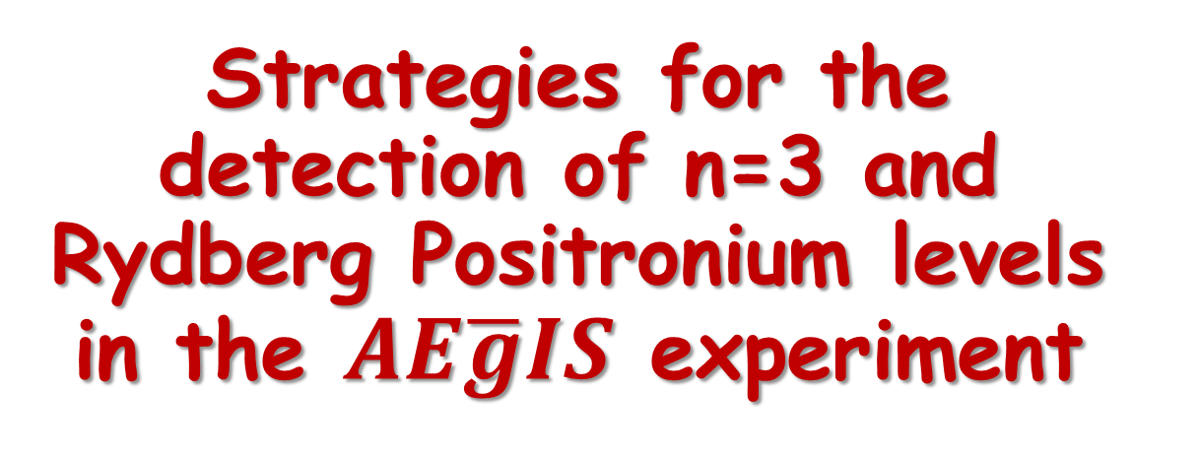
Strategies for the detection of n=3 and Rydberg Positronium levels in the $AE\overline{g}IS$ experiment
AEGIS
AEGIS
Zeudi Mazzotta
Supervisor: Fabrizio Castelli
Notes:
1. Goodmorning to all of you! I'm glad to be here, today, to talk to you about my Phd current and future work, expecially as a member of the AEgIS experiment.

Slide 2
OUTLINE
The AEgIS experiment
The role of the Positronium in the AEgIS experiment
Positronium Laser excitation and its detection
Notes:
2. I will start this adventure with a little journey inside the AEgIS experiment, then I will give you more details about the Positronium atom and its role inside the experiment. At that point we will be ready to talk about my studies on Ps laser excitation and its detection.

Slide 3
The physics behind the AEgIS experiment
Notes:
3. So...Let me just remind you

Slide 4
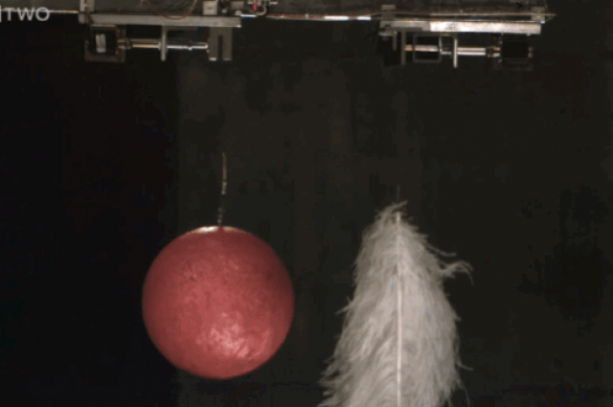
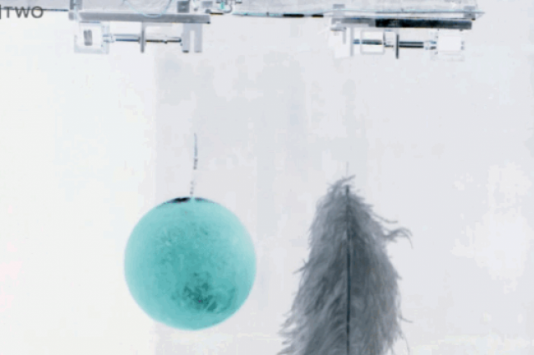
The weak equivalence principle (WEP)
All matter bodies at the same spacetime point in a given matter gravitational field will undergo the same acceleration
All antimatter bodies at the same spacetime point in a given antimatter gravitational field will undergo the same acceleration
Notes:
4. what the weak equivalence principle says: all MATTER bodies at the same spacetime point in a given MATTER gravitational field will undergo the same acceleration. CPT theorem states that we should have the same behaviour for ANTIMATTER bodies moving inside an ANTIMATTER gravitational field...

Slide 5
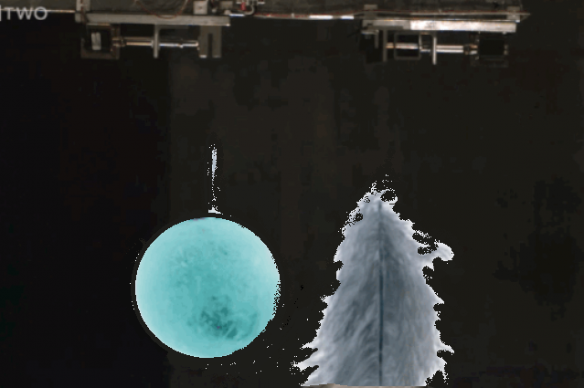
The weak equivalence principle (WEP)
All matter bodies at the same spacetime point in a given matter gravitational field will undergo the same acceleration
Will all antimatter bodies at the same spacetime point in a given matter gravitational field undergo the same acceleration?
All antimatter bodies at the same spacetime point in a given antimatter gravitational field will undergo the same acceleration
Notes:
5. But, what does it happen if we have ANTIMATTER in a given MATTER gravitational field?

Slide 6
The AEgIS experiment
Notes:
6. Giving an answer to this question is the main goal of the AEgIS experiment!

Slide 7






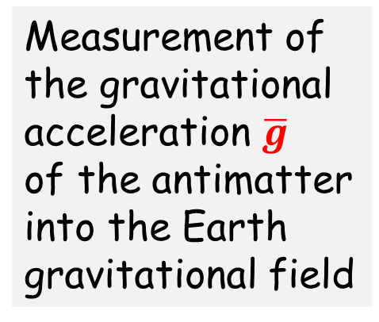
The main goal of AEgIS
Neutral antimatter:
Antihydrogen
$e^{+}$
$$p^{−}$$
Measurement of the gravitational acceleration $\overline{g}$
of the antimatter into the Earth gravitational field
$$\overline{H}$$
?
$$\overline{g}$$
Notes:
7. AEgIS performs a measurement of the gravitational acceleration of the antimatter into the Earth gravitational field. In particular, to avoid the presence of other forces, it studies the free fall of neutral matter by producing Antihydrogen atoms. But... how Antihydrogen can be made?

Slide 8
Antihydrogen production
Charge exchange with Positronium
AEgIS strategy
PROMISING TECHNIQUE
Control of the antihydrogen quantum state
Cold antihydrogen atoms (v_{antihydrogen} ~ v_{antiproton})
Advantages in the cross section (see later)
Usual strategy:
ATRAP,APLHA and ASACUSA experiments
The second seems to be the dominant process (highly exicited antihydrogen)
Antihydrogen atoms warmer than trapped antiprotons
(Hbar production when v_{antiproton} ~ v_{positron})
Low cross section
Antiprotons and positrons Recombinations
and
Notes:
8. We produce Antihydrogen via the Charge exchange reaction between antiprotons and Positronium atoms. In this way we can control the Hbar quantum state and obtain cold Hbar atoms; but the main advantage is the large cross section of this reaction. In fact, if we give a look to the usual way to produce Hbar atoms, that is to make antiprotons an positrons recombine together, we see that we cannot obtain too much cold Hbar atoms and the cross section is really low with respect to the first strategy. Positronium is for us a fundamental mean to produce Antihydrogen, so let's see what it is!

Slide 9
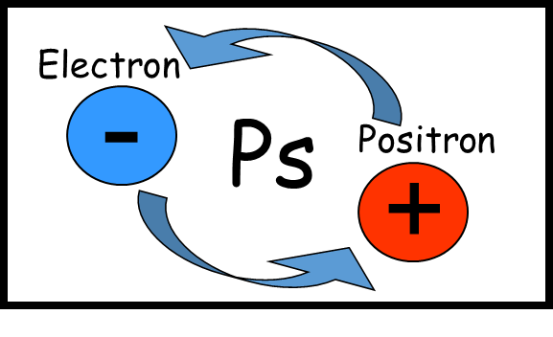
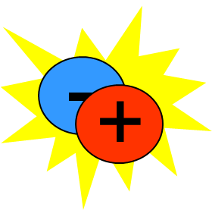
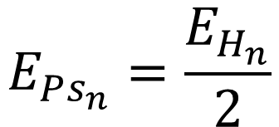
The Positronium atom
Ps n-level energy:
$$E_{Ps_{n}}=\frac{E_{H_{n}}}{2}$$
γ
para-Ps
Singlet state
Mean life 0,125ns
2γ annihilation
γ
orto-Ps
Triplet state
Mean life 142ns
3γ annihilation
γ
γ
γ
γ Energies = 511keV
γ Energies < 511keV
Notes:
9. It is a bound state of a positron and an electron. We have two different Ps states: the singlet one, called para-Ps and the triplet one called orto-Ps. The para-Ps has a really short mean life and when it dies annihilates into two gamma rays; the orto-Ps has a longer mean life and annihilates into three gamma rays.

Slide 10
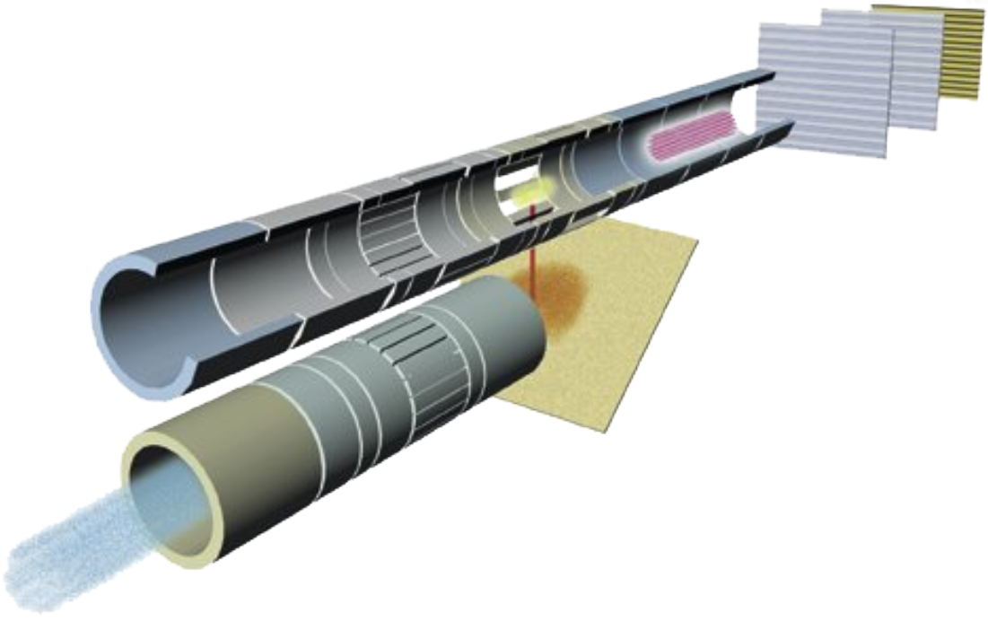
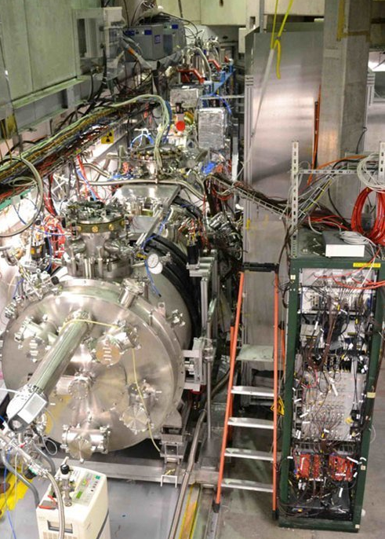
AEgIS in short
Antiprotons from CERN AD
(Antiproton Decelerator)
e+
p⁻
p⁻
e+ beam
Notes:
10. So, what do we do in AEgIS? The trip starts from two parallel lines. Along this line we manage positrons for the Positronium creation, along the other one we manage Antiprotons coming from the CERN Antiproton Decelerator.

Slide 11
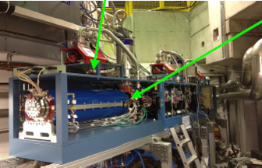
AEgIS in short
antiprotons cooling (~1K) and trapping
e+ accumulator
p⁻
e+
e+ pulse dumping and acceleration
5 Tesla magnet
Notes:
11. Here we have a positrons accumulator, whose task is to dump and accelerate them. Here we are in a 5 Tesla magnet where we trap and cool antiprotons.

Slide 12
AEgIS in short
Trapped&cooled antiprotons
1 Tesla magnet
e+ pulse implantation and Positronium formation
Notes:
12. The next step is the two line moving into a 1Tesla magnet, where cold antiprotons are stored and, off axis, positrons arrive onto a target to produce Positronium (later we will see how!).

Slide 13
AEgIS in short
Ps and p- overlap region:
Charge exchange reaction takes place!
1 Tesla magnet
Notes:
13. The Positronium cloud grows up until we have the overlapping with the antiprotons cloud. Here we have the Antihydrogen formation!

Slide 14


AEgIS in short
Antihydrogen accelerated beam
$$\overline{H}$$
1 Tesla magnet
$$\overline{H}$$
Notes:
14. Then Antihydrogen atoms are guided from an electric field gradient toward a Moirè deflectometer.

Slide 15



AEgIS in short
$$\overline{g}$$
$$\overline{H}$$
$\overline{g}=\frac{2∆x}{t^{2}}$
$$\overline{g}$$
$$\overline{H}$$
Moirè deflectometer
Notes:
15. in which we measure their vertical deflection, due to a gravitational acceleration, and the time of flight. In this way we can obtain gbar.

Slide 16
The role of the Positronium in the AEgIS experiment
Notes:
16. So, let's see more in detail the role of the Positronium. First of all we must understand how we produce it!

Slide 17

The Positronium creation
Positronium is created in the material bulk
A bunched positron beam is sent toward a porous «target» able to convert positrons into Positronium.
Silica or aerogel target
Positron pulse
Pores diameter
~10nm
A fraction of the Ps exiting the target is thermalized into the target pores
Positronium cloud
Notes:
17. We send a bunched positron beam toward a porous silica or aerogel target. In this way some positrons capture an electron from the material and generate Positronium, that exits the target through the pores and, bouncing on their walls, cools itself. As a result, we have outside the target a Ps cloud with a thermalized percentage.

Slide 18
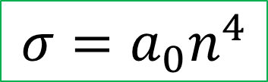

The role of the Positronium in the AEgIS experiment
$e^{+} e^{−}$distance
Ps is needed to create Antihydrogen in the
Charge exchange reaction
Ps area
The cross section of this reaction increases with the Ps principal quantum number:
Required Ps excitation to Rydberg levels (n=15…24) !!!
$$σ=a_{0}n^{4}$$
Notes:
18. The Ps atom plays a fundamental role in the AEgIS experiment, because, as we have already seen, it creates Antihydrogen with antiprotons, and it is the responsible of the large cross section of the reaction. In fact the cross section depends on the fourth power of the Ps principal quantum number. For this reason we can drastically increase it by exciting the atom to Rydberg levels!

Slide 19
Positronium laser excitation and its detection
Notes:
19. We reach this result via a laser excitation in the following way:

Slide 20
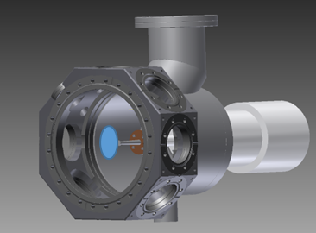
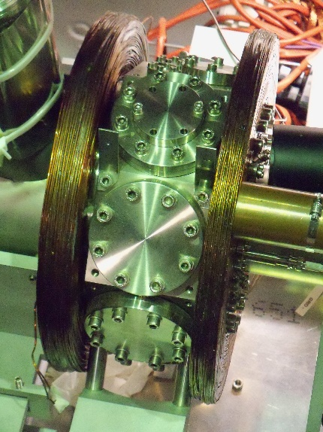
AEgIS Ps Rydberg laser excitation strategy
Continuum
We have to test if the laser excitation works!
0,75eV
~1670nm
High n
n=3
Use of an external test chamber, called BREADBOX
6,05eV
205nm
n=1
Notes:
20. We send simultaneaously two laser pulses: an UV laser pulse to excite it toward the third level and an IR laser pulse to excite it to Rydberg levels. This is a strategy that maximizes the excitation efficiency. As we must test if the laser works, we use an external dedicated chamber called Breadbox. Keep in mind these two coils around it!!!

Slide 21
n=3 excitation detection strategies
Changes in the γ-rays time distribution
Detection of 1312nm photons (spontaneously emitted in the n=3->n=2 de-excitation branch)
Ps laser ionization and charges collection
Notes:
21. First, we must detect the n=3 laser excitation. A first method, already used in other experiments, to do that, is to detect changes in the emitted gamma rays time distribution. A second method is to detect the radiation emitted from the n=3 to n=2 transition. A third method is to induce a laser ionization on the third level Ps population and to collect the created charges.

Slide 22
1.Detecting Ps n=3 laser excitation
By measuring changes in the γ-rays time distribution
Notes:
22. I will briefly describe my work on these three methods. I start with the first one!

Slide 23

1. Detection of Ps annihilations into gamma rays time distribution
para-Ps
orto-Ps
Singlet-triplet mixing due to the presence of a weak magnetic field (~200G) that mixes levels with the same m
n=3
$$\vec{B}$$
UV laser
Spontaneous emission: about 10ns
n=1
Singlet
Observation of enhanced 2γ rays annihilation rate at the time of laser on
Triplet
142ns
to decay into 3γ-rays
Only 0.124ns
to decay into 2γ-rays
γ
γ
Notes:
23. Why should we have changes in the gamma rays time distributions? This happens only if we have a weak magnetic field inside the chamber, that we can generate with the two coils around it! In fact, only orto-Ps is able to exit the target. When we excite it, the magnetic field brings some n=3 orto-Ps atom into the n=3 para-Ps state and, after the spontaneous emission towards to the ground state, we have a percentage of para-Ps that annihilates into two gamma rays quite immediately unlike the orto-Ps! For this reason we should have an annihilation peak at the time of the laser on!

Slide 24
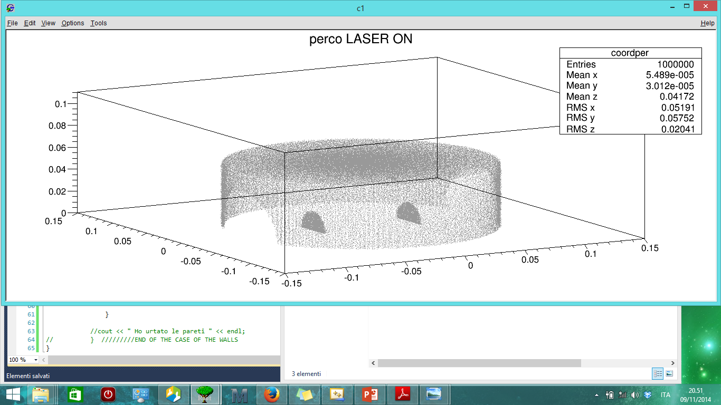
My Montecarlo simulation
c++ & ROOT
First simulation on Ps formation, excitation and TOF detection
3D Histogram:
BreadBox walls picture in the simulation
Target
Detectors
Notes:
24. I made the first Montecarlo simulation ever on the whole process. I'd like to show to you, for example, the Histogram I created that represents the bread box internal walls. Here we have the target and here the detectors. My program generates Ps and, after both excitation and magnetic quenching processes,

Slide 25
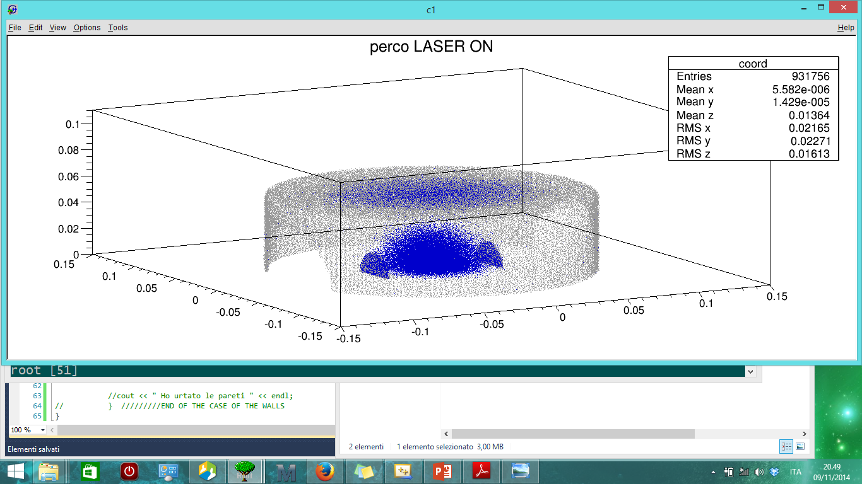
My Montecarlo simulation c++ & ROOT
First simulation on Ps formation, excitation and TOF detection
In each annihilation point we have γ-rays generation!
3D Histogram:
Ps annihilation points
Notes:
25. it graphs all the Ps annihilation points. From each point it induce a gamma rays emission and here you can see the intersections between gamma rays and the detectors.

Slide 26

My Montecarlo simulation c++ & ROOT
First simulation on Ps formation, excitation and TOF detection
In each annihilation point we have γ-rays generation!
3D Histogram:
γ-rays intersections with the detectors
Notes:
26.

Slide 27
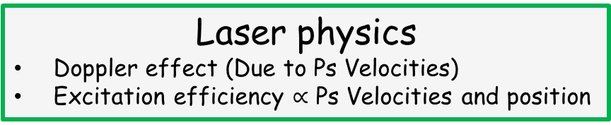
My Montecarlo simulation c++ & ROOT
First simulation on Ps formation, excitation and TOF detection
Elements taken into account
Chamber geometry
Laser physics
Doppler effect (Due to Ps Velocities)
Excitation efficiency $∝$ Ps Velocities and position
Positronium physics
Mean lives
Maxwell-Boltzmann velocities distributions
Decaying times
Annihilation behaviours
Gamma-rays energies generation
Detectors physics
Efficiency
Time resolution
Energy resolution
Notes:
27. In my simulation i toke into account several elements...the geometry of the chamber, Ps physics, laser physics and detectors physics. The more updated time distribution that the simulation gave to me is this one:

Slide 28
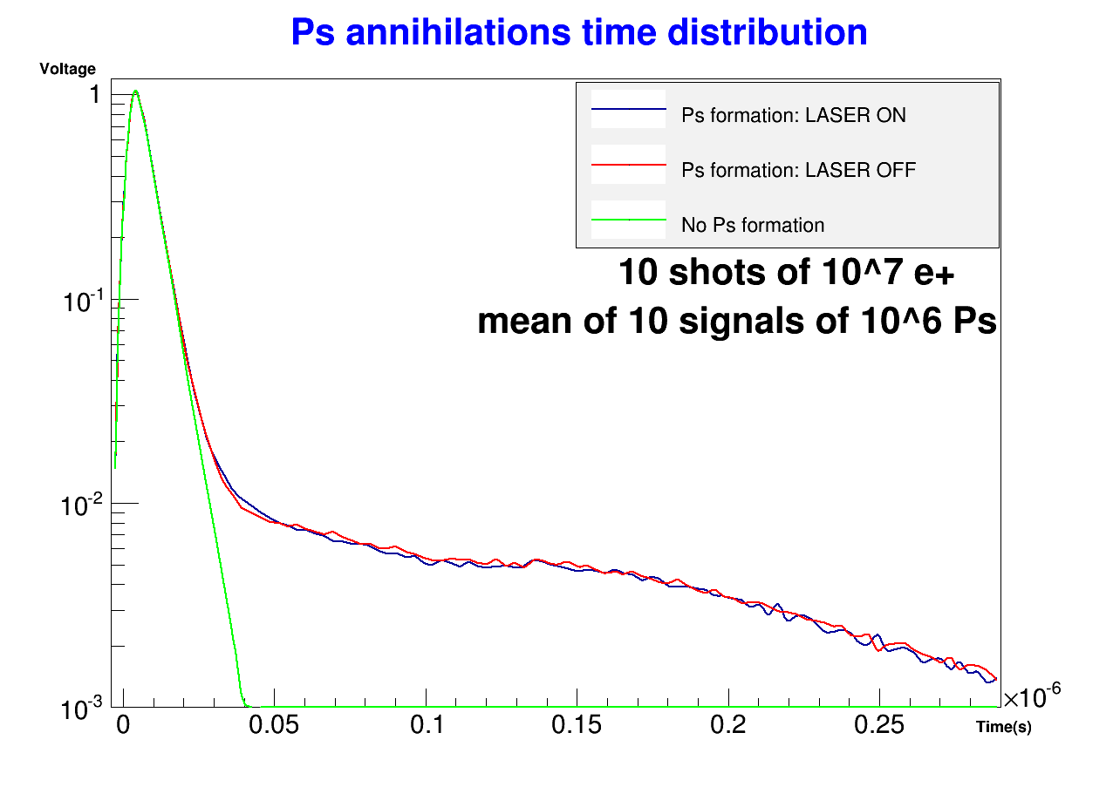

1. Detection of Ps annihilations into gamma rays time
Mean of 10 signals of ${10}^{6}$ Ps atoms
Notes:
28. The blue line represents the "laser on" situation, the red one "the laser off" situation and the green one is obtained when there is no Ps formation.

Slide 29
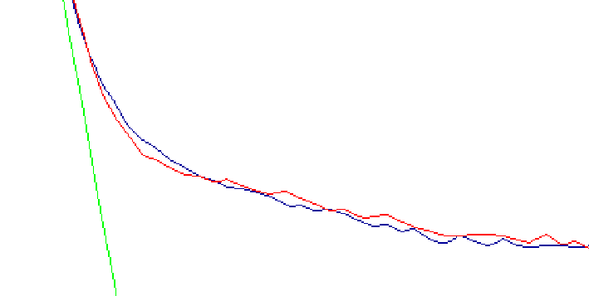

1. Detection of Ps annihilations into gamma rays time
Mean of 10 signals of ${10}^{6}$ Ps atoms
Increase of the «fast decaying» population and relative decrease of the «slower» counterpart
Notes:
29. What we expect to see is an increase of the fast decaying population and a relative decrease of the slower counterpart. As you can see, the signal is not so clear, therefore we need some improvements to be sure that a signal will be visible on our scopes! This reason forced us to look for other solutions!

Slide 30
2.Detecting Ps n = 3 laser excitation
By measuring the 3->2 spontaneous emission radiation
Notes:
30. For exemple the second strategy.

Slide 31
2. Detection of 1312nm photons
Excitation
De-excitation
n=3
1312nm
radiation
15%
n=2
85%
6,05eV
205nm
The goal of this strategy is to detect the radiation emitted from this transition
n=1
Notes:
31. When the Ps decays from the third level, it can do this either directly toward the ground state or towards the second level. The aim of this strategy is to detect the near infrared radiation emitted from this transition.

Slide 32
2. Detection of 1312nm photons
We chose to use an
InGaAs Avalanche Photodiode Detector (APD)
in a Geiger configuration for single photon detection.
IMAGING LENS
Imaging
Excited
Ps cloud
Transport
+
Focusing
Multimode fiber core
InGaAs
detector
1312nm radiation
Notes:
32. We planned to do this by collecting this radiation and sending onto an Ingaas Detector in geiger configuration.

Slide 33
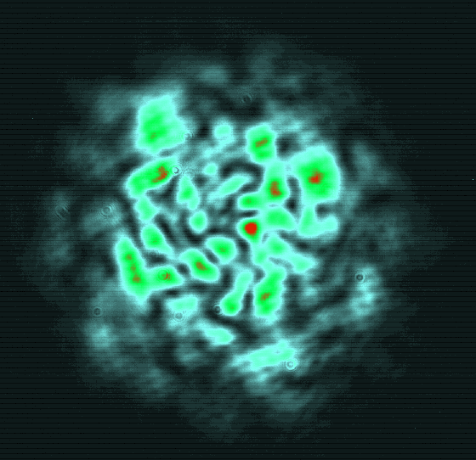
2. Detection of 1312nm photons
I estimated that, in order to have 1 count out of 10 e+ shots, we should deliver into the detector more than the 0,024% of the emitted radiation
Main challenge
MULTIMODE BEAM focusing onto the 25μm DIAMETER InGaAs active surface:
Theoretical and experimental studies!
(The active surface is so much little to reduce the dark counts rate)
Example of multimode beam
w=4mm
Notes:
33. I estimated that, to have 1 count out of 10 positrons shots, we should deliver into the detector more than the 0.024 percent of the emitted radiation. But there is a main challenge:
We have a multimode beam at the fiber exit, so it's really difficult to focus it onto our 25micron diameter active surface. This is a new problem, not so much studied in the literature, therefore we had to perform some theoretical and experimental studies, in the Milano laboratory, to understand how much we can focus our beam once we have chosen our fiber.

Slide 34
2. Detection of 1312nm photons
We have been able to plan an optical setup that, for every shot, gives us a
11% probability signal count
0,75% probability dark count
IMPORTANT
Work in progress:
Several improvement can be done!!!
Notes:
34. Finally we have been able to plan an optical setup that, with the laser on and for every positrons shot, provides us a 11 percent probability to have a signal count and a 0.75percent to have a dark count.
We are still working on it and a lot of improvements can be done yet!

Slide 35
3.Detecting Ps n = 3 laser excitation
By detecting the Ps laser ionization
Notes:
35. Now we have the last strategy, the newest one, that is just a proposal.

Slide 36

3.Ps ionization
BREADBOX SETUP
x-axis
xy-plane
electrode
secondary electrons emission at the time of e+ arriving on the target
10V/cm electric field
e+
e+
E
Laser UV
Porous target
Ionizing laser
n=3 excitation detection
e-
y-axis
electrode
i
Channel Plate and/or channeltron
5ns
29ns
t
Notes:
36. The idea is to send a ionization laser simultaneously with the exciting one, that ionizes only the excited atoms. In this way we can collect the charges and have a current signal. Let's see how it works. In the breadbox we must insert two electrodes, generating a uniform electric field in order to collect charges, and a channel plate or a channeltron to generate the current signal. When we send positrons towards the target, we have a background signal due to secondary electrons emission from the material. After, Ps is created and when we send the exciting and the ionizing laser, the charges created from the ionization move, electrons are collected giving another current peak.

Slide 37
3.Ps laser ionization
By sending a 1064nm laser pulse simultaneous to the exciting one (205nm) we can ionize a fraction of the n=3 excited Ps
Populations
Populations
E₁₀₆₄=10 mJ
n=1
n=1
n=3
Ionized Ps
n=3
n=2
n=2
Without 1064nm pulse
Time(ns)
With 1064 pulse
Time(ns)
Notes:
37. We simulated that, with a 10microJoule laser pulse, the n=3 population decreases faster than without it, because the 20percent of the atoms are ionized!

Slide 38
3.Ps ionization
BREADBOX SETUP
x-axis
xy-plane
electrode
secondary electrons emission at the time of e+ arriving on the target
10V/cm electric field
e+
e+
E
Laser UV
Porous target
Ionizing laser
n=3 excitation detection
e-
y-axis
electrode
Laser IR: Rydberg excitation
i
Channel Plate and/or channeltron
With a resonant IR: Rydberg excitation detection
5ns
29ns
t
Notes:
38. Moreover, this strategy can also be used to detect the Rydberg excitation!!! In fact, if we send the Rydberg excitation laser pulse with the other two pulses, the current peak generated from the ionization will be LOWER because we will have less n=3 atoms that can be ionized.

Slide 39
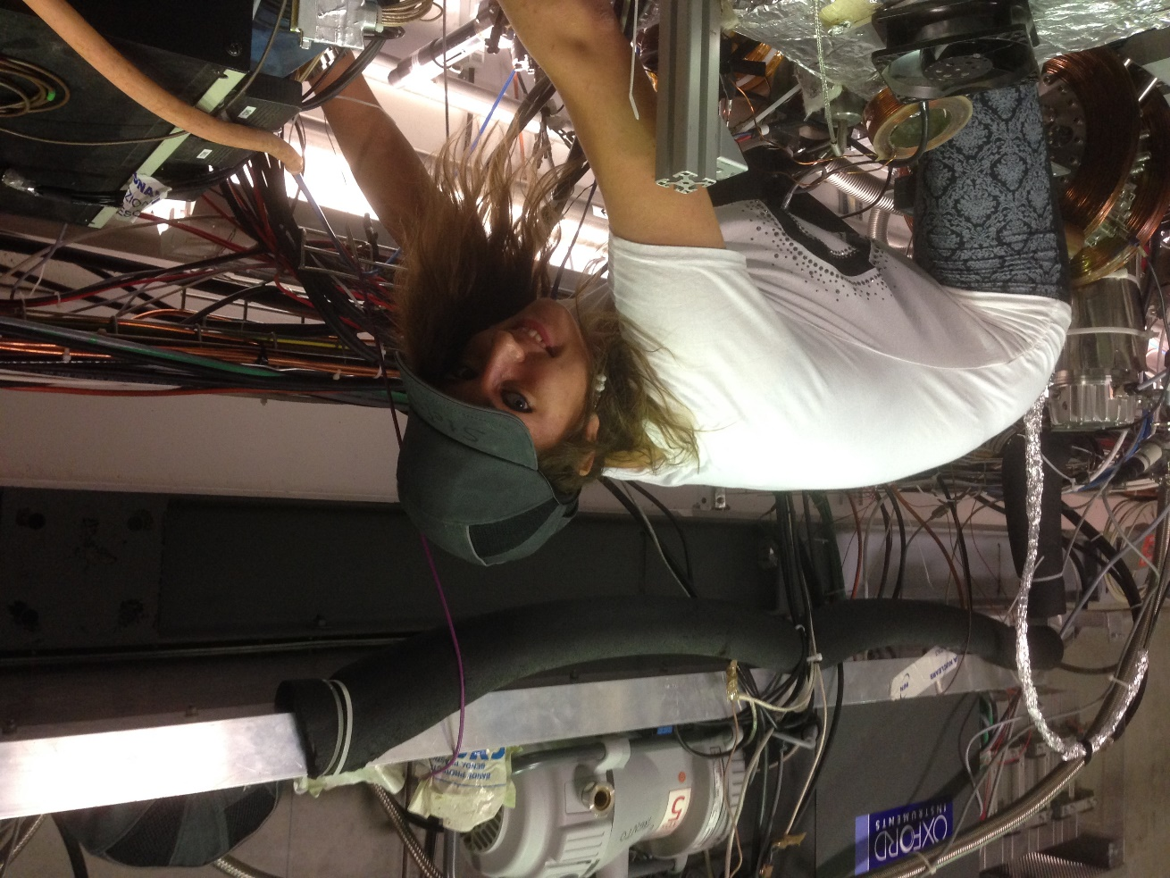
The work goes on!
Improve my simulation with more and more physics.
Simulate the laser ionization.
Study more in depth the detection of the laser Ps excitation and find the best way to perform it.
Carry on my work at CERN, in Geneva, where AEgIS apparatus and BreadBox are placed.
Notes:
39. I will continue all this works! By improving my simulation and taking advantage of it to simulate the laser ionization strategy. In this way I can study deeply the three methods to understand which one is the best one and start to perform it!
Meanwhile, I will carry on my work at CERN!!!!!!! where the experimental apparatus is placed!

Slide 40
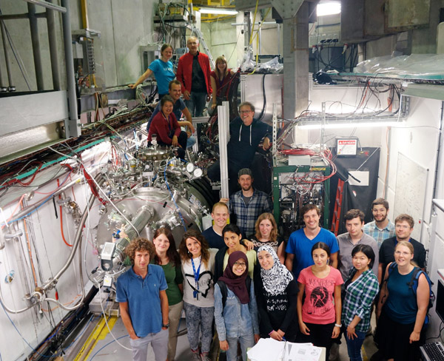

Thank you for your attention
Some of my AEgIS adventure mates inside the AEgIS experimental zone
Notes:
40. Thank you very much!

Slide 41
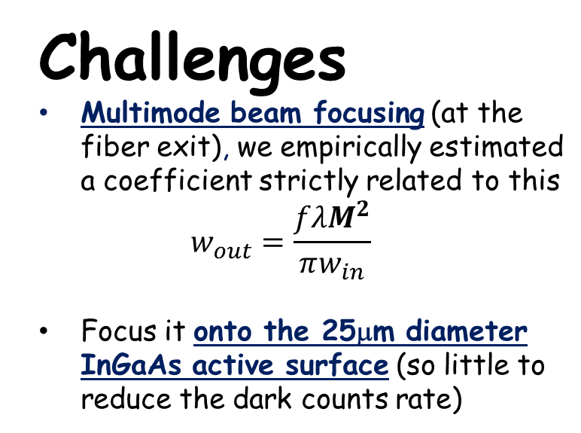
2. Detection of 1312nm photons
I estimated that, in order to have 1 count out of 10 e+ shots, we should deliver into the detector more than the 0,024% of the emitted radiation
Challenges
Multimode beam focusing (at the fiber exit), we empirically estimated a coefficient strictly related to this
$w_{out}=\frac{fλM^{2}}{πw_{in}}$
Focus it onto the 25μm diameter InGaAs active surface (so little to reduce the dark counts rate)
Example of multimode beam
w=4mm

Slide 42
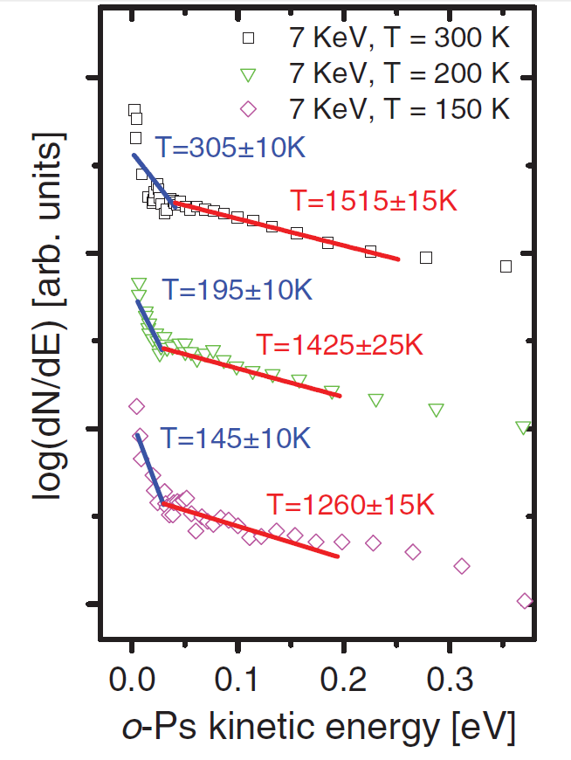
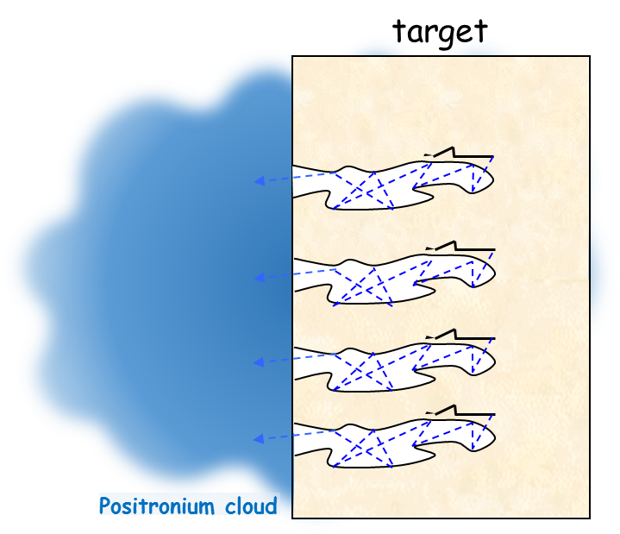
The Positronium termalization
PRL 104, 243401 (2010), Sebastiano Mariazzi, Paolo Bettotti, and Roberto S. Brusa, “Positronium Cooling and Emission in Vacuum from Nanochannels at Cryogenic Temperature”
A fraction of the Ps exiting the target is thermalized into the target pores

