Slide 1
NANOMECHANICAL AND TOPOGRAPHICAL IMAGING OF LIVING CELLS AND TISSUES
FOR THE INVESTIGATION
OF CELLULAR INTERACTIONS
Luca Puricelli
Molecular Beam and Nanocrystalline Materials Laboratory (LGM)
Dipartimento di Fisica & Centro Interdisciplinare Materiali e Interfacce Nanostrutturati (CIMaINa)
Università degli Studi di Milano
Physics, Astrophysics and Applied Physics PhD School
18/11/2014

Slide 2
FUNDAMENTAL CONCEPTS
The Atomic Force Microscope (AFM)
Working principles
Nanostructured surfaces:
- Which are their main
features and purposes?
Cellular mechanics:
- How does a cell react
to its environment?
Induced cellular differentiation

Slide 3
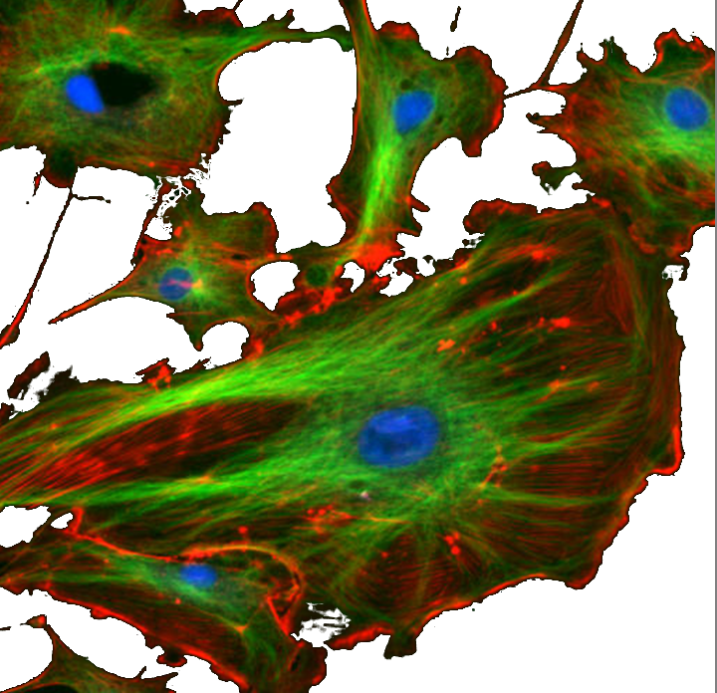
CELLULAR MECHANICS
Why measuring cells’ mechanical properties ?
CYTOSKELETON
*
Structural role: scaffolding
Biological primary functions
Adhesion
Proliferation
Intra-cellular transport
Differentiation
Signals transduction
Fluorescence microscopy image : endothelial cells
MECHANICAL PHENOTYPE
CELL’ S VITAL PARAMETERS
* E. L. Elson. Ann. Rev. Biophys. Chem (1988)

Slide 4
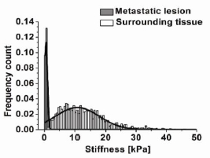
CELLULAR MECHANICS
Cellular (or tissues) elasticity correlated to :
Patho-physiological state
(even without clear morphological changes)*
Environment physico-chemical variations **
* M. Plodinec . Nature Nanotech. (2012)
** G. Lamour. Biomat. (2010)

Slide 5
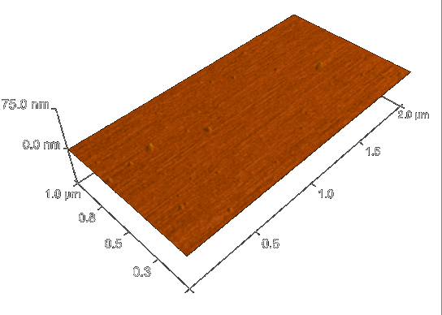
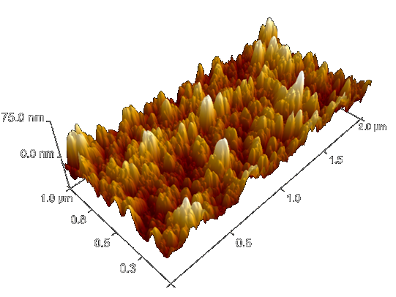
NANOSTRUCTURED SURFACES
Flat
VS
Nanostructured
Different physical properties for the same material:
RMS roughness
electric charge density
Surface Free Energy, etc..
May an engineered nanostructured surface influence a cell’s fate?

Slide 6
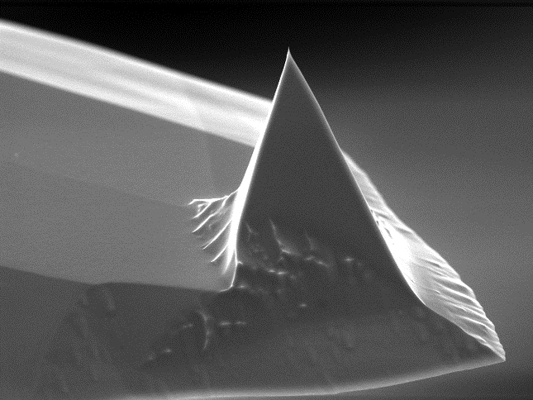
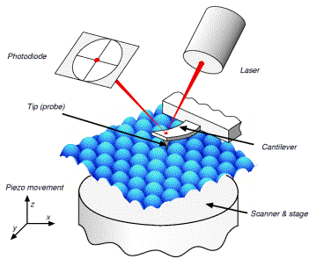
THE ATOMIC FORCE MICROSCOPE (AFM)
R ≈ 2-3 nm
h ≈ 10 um

Slide 7
AFM & CELLS
Height
nm
Topographic maps
Young Modulus
Mechanical tests:
(Force measurements)
AFM : COMBINED TOPOGRAPHIC/MECHANICAL IMAGING

Slide 8
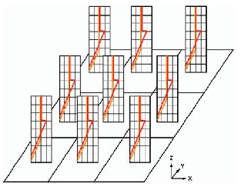
AFM & CELLS : FORCE VOLUME
Sample deformation
Force [nN]
Tip-sample distance [nm]
Force Volume :
- 100x100 μm²
64 x 64 force curves
ELASTICITY MAP
TOPOGRAPHY MAP

Slide 9
AFM & CELLS : EXPERIMENTAL PROTOCOL DEVELOPMENT
WHICH IS THE BEST PROBE?
R ≈ 2-3 nm
2R ≈
10 um
VS
70 um

Slide 10
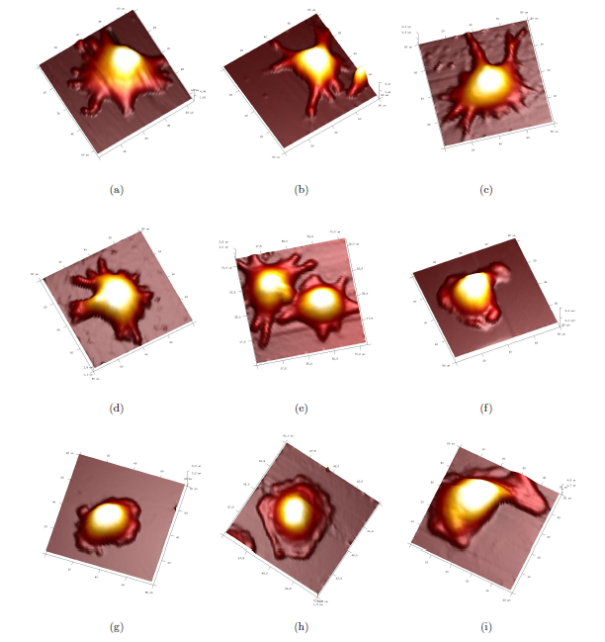
AFM & CELLS : EXPERIMENTAL PROTOCOL DEVELOPMENT
L. Puricelli et al.
“Nanomechanical and topographical imaging of living cells by Atomic Force Microscopy with colloidal probes"
Review of Scientific Instruments
Submitted on 16/09/14
Under revision
3d topo images

Slide 11
AFM & CELLS : PROTOCOL TEST
EFFECT OF CYTOCHALASIN-D ON CELLULAR ELASTICITY
Cytochalasin -D : micotoxin which disrupts actin filaments network
cytoskeleton weakening, Young modulus decreases
Height
Young Modulus
before
nm
after

Slide 12
AFM & CELLS : PROTOCOL TEST
EFFECT OF CYTOCHALASIN-D ON CELLULAR ELASTICITY
L. Puricelli et al.
“Nanomechanical and topographical imaging of living cells by Atomic Force Microscopy with colloidal probes"
Review of Scientific Instruments
Submitted on 16/09/14
Under revision
before
<E> = 235 ± 93 Pa
after
<E> = 142 ± 42 Pa

Slide 13
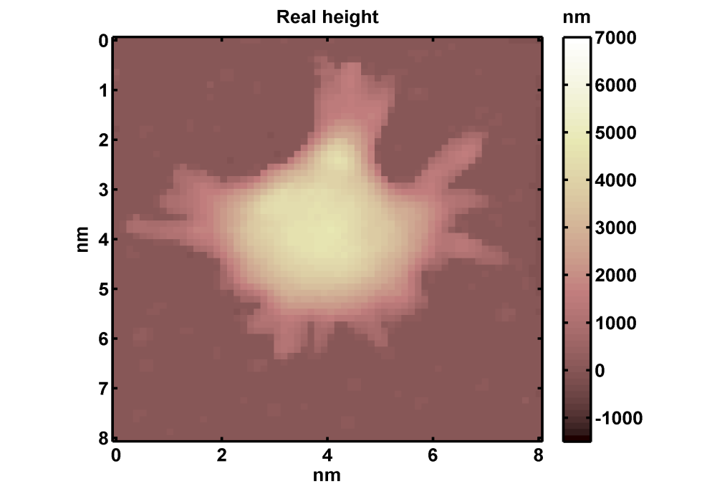
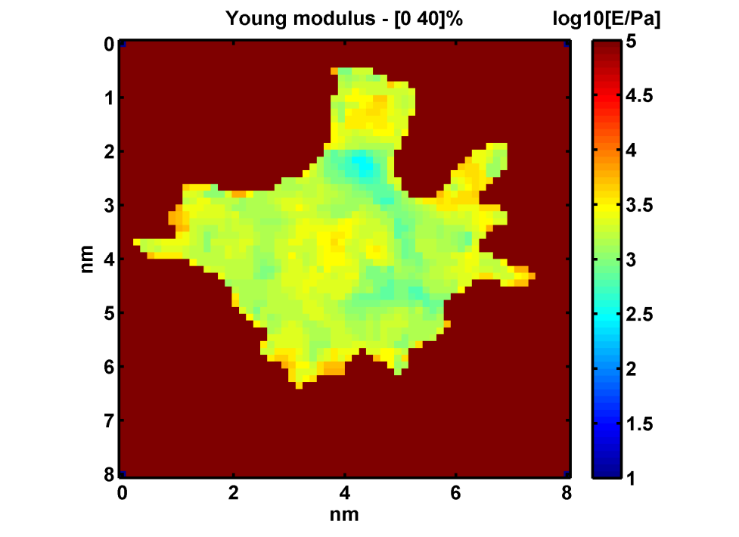
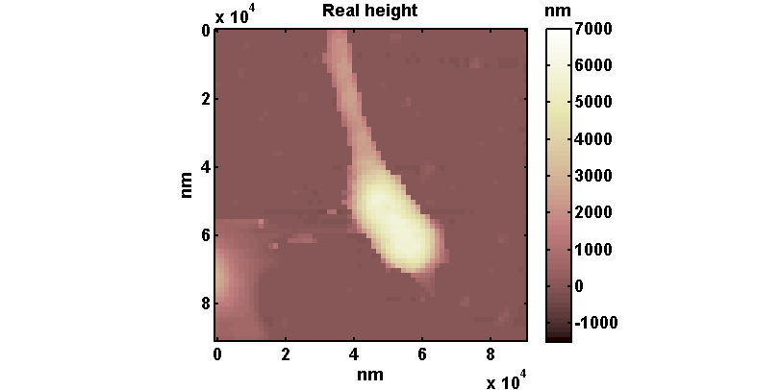
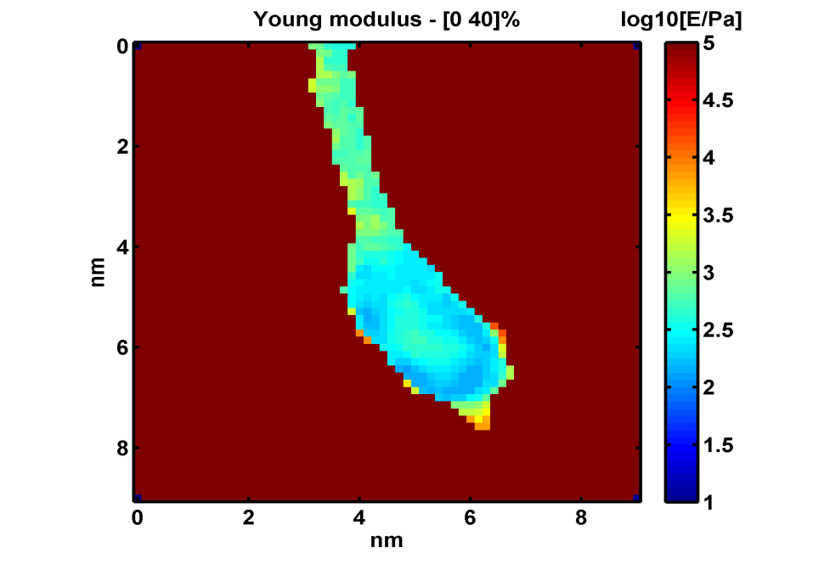
AFM & CELLS : PROTOCOL APPLICATION
CELLULAR DIFFERENTIATION INDUCED BY NANOSTRUCTURED SURFACES
X 10⁴
Height
X 10⁴
Young Modulus
24 hr
Flat Zirconia
X 10⁴
24hr
24 hr
Nanostructured zirconia
(15nm RMS roughness)
500 nm
X 10⁴
X 10⁴

Slide 14
AFM & CELLS : PROTOCOL APPLICATION
CELLULAR DIFFERENTIATION INDUCED BY NANOSTRUCTURED SURFACES
Nerve Growth Factor (NGF) VS Nanostructured Zirconia
Young modulus – cell body
Young modulus – neurites
Flat Zirconia +NGF
Flat Zirconia +NGF
nanostructured
zirconia (15nm rms)
nanostructured
zirconia (15nm rms)
C. Schulte, L. Puricelli et al.
“Nanoscale information of nanorough zirconia surface
favours neuronal differentiation by orchestrating
complex mechanotransductive events “
Under submission on “Journal of Cell Biology “
The Young modulus of PC12 cells body is reduced on the nanostructured zirconia
500 nm

Slide 15
CONCLUSIONS AND FUTURE PERSPECTIVES
Development and optimization of a common and robust methodology (covering all the steps of the experimental activity) for the AFM-based combined topographic/mechanical imaging of cells and tissues
Effective exploitation of AFM potentials in the biomedical field
Engineered nanostructured surfaces as cell culture plates for the study of the differentiation process
Applications of AFM in the fields of pre-diagnosis of cancer diseases, drugs testing, or regenerative medicine.

Slide 16
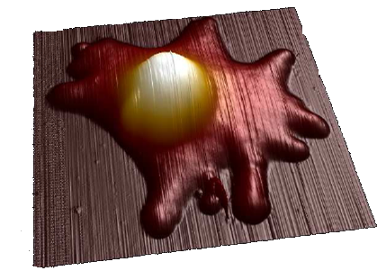
THANK YOU FOR YOUR ATTENTION!

Slide 17
AFM & CELLS : EXPERIMENTAL PROTOCOL DEVELOPMENT
FINITE THICKNESS EFFECT CORRECTION
Cell from HEK-293 line (human embryonic kidney)
 | Not-corrected | Corrected
Cell-body | 2.85 | 2.58
Lamellipodia | 3.56 | 2.82

Slide 18
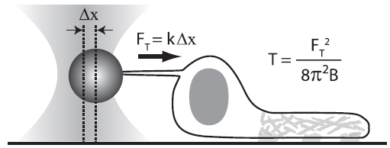
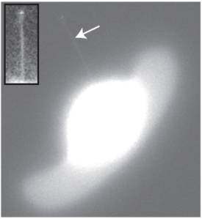
AFM & CELLS
Measuring cells’ nanomechanics - Why Atomic Force Microscopy ?
Standard tools in biology :
Compression between glass plates *
Micropipettes aspiration *
Tethers pulling with functionalized
microspheres or optical tweezers **
* A. Diz-Munoz et al. Trends in Cell Biology 23 (2013)
Low spatial resolution
Membrane surface tension: which linkage to membrane-cytoskeleton mechanical properties ?
** A. D. Lieber et al. Current Biology 23 (2013)
Need of direct cytoskeleton elasticity measurements, provided with high spatial resolution and in one-to-one correspondence with topographic map

Slide 19
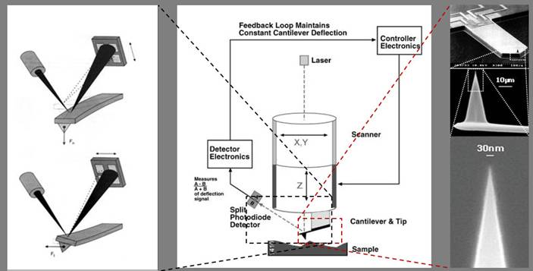
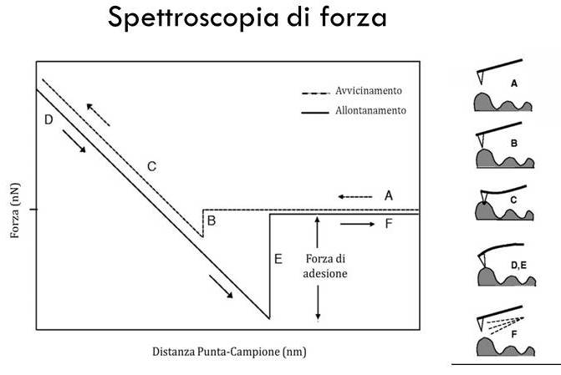
AFM & CELLS
Force spectroscopy
Approaching
Retracting
Force [nN]
Adhesion
Tip-sample distance [nm]

Slide 20
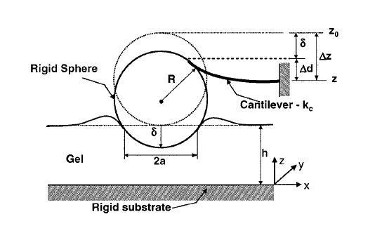
OPEN PROBLEMS: 1) CONTACT MECHANICS MODEL (HERTZ)
δ = sample indentation
δ₀ = contact point
F_{l} = applied force
R = microsphere radius
σ = F/A (stress)
ε = strain (relative deformation)
Poisson coefficient = 0.5
Young modulus: intrinsic parameter! (not dependent on sample dimensions or shape)
MAIN LIMITS:
Homogeneous and isotropic sample
Semi-infinite sample (negligible substrate
effect)
Purely elastic response
E ≈ constant (and scalar)
F_{A}(δ) ≈ F_{R}(δ)
δ , a << R
δ , a << h

Slide 21
OPEN PROBLEMS: 3) FINITE THICKNESS EFFECT CORRECTION
δ << h
Dimitriadis correction (spherical probes)
δ
h
Hertz
Opportunity to obtain mechanical properties from the whole cell surface :
Cytoplasmic protrusions (filopodia, lamellipodia), potentially rich in informations
On literature, data limited to the higher regions (nucleus) ≈ 10 % total surface area
Linearizable :
Opportunity to work in parallel on the whole force curves set (matrix linear regression)
Direct inspection of eventually different elastic regions (different slopes)
*[Dimitriadis et al. Biophys. J. 82:2798-2810 2002]

Slide 22
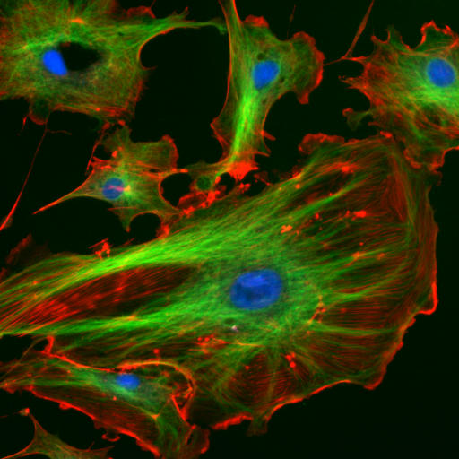
OPEN PROBLEMS: 4) MULTIPLE ELASTIC RANGES
INDENTATION RANGE SELECTION FOR YOUNG MODULUS FITTING
Complex problem:
Semi-automatic method: indentation percentages research
Hypothesis : local height is proportional to cytoskeletal components amount
thickness of cytoskeletal components
absolute indentation width of the different ranges
Strong hypothesis, need of manual check on a statistically significant force curves sample (≈ 50 -100)

Slide 23
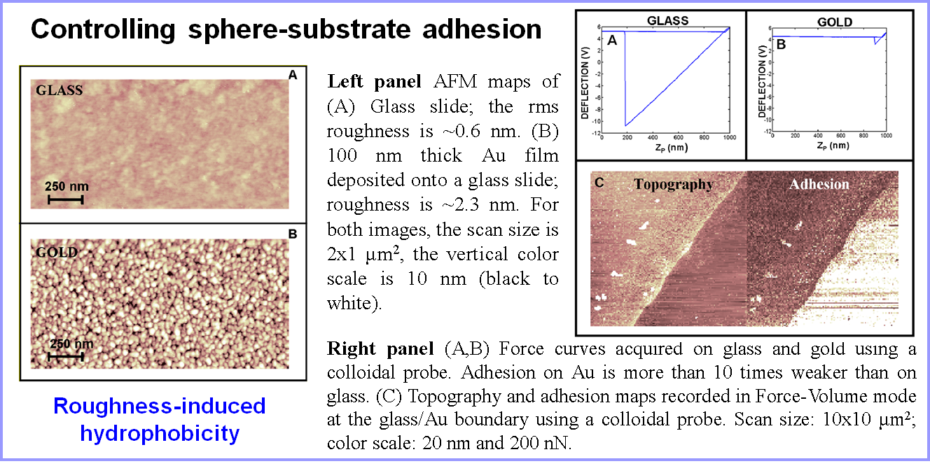
COMBINED TOPOGRAPHIC/MECHANICAL IMAGING PROTOCOL
Strong adhesion
Weak adhesion
M. Indrieri et al., Rev. Sci. Instrum. 82 (2011)

Slide 24
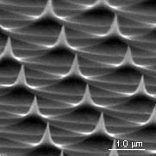
COMBINED TOPOGRAPHIC/MECHANICAL IMAGING PROTOCOL
COLLOIDAL SPHERICAL PROBES CHARACTERIZATION *
Reverse imaging
Radius fitting by means of spherical cap equations
Each spherical cap is independent: robust statistic
characterization
Appropriate filters to discarde images given by
damaged spikes
error ≤ 1%
* M. Indrieri et al., Rev. Sci. Instrum. 82 (2011)

Slide 25
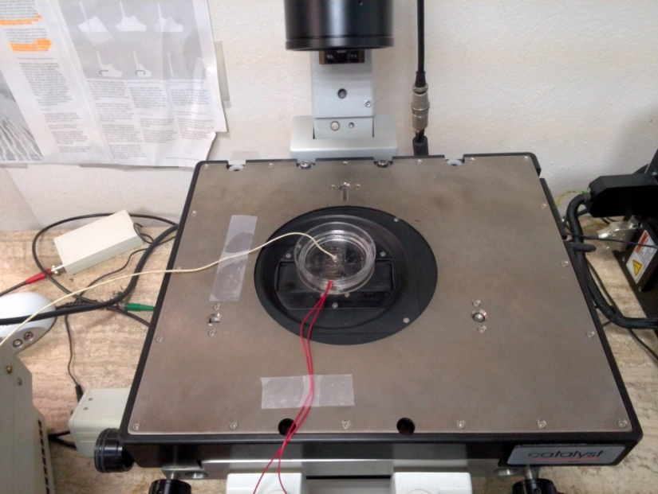
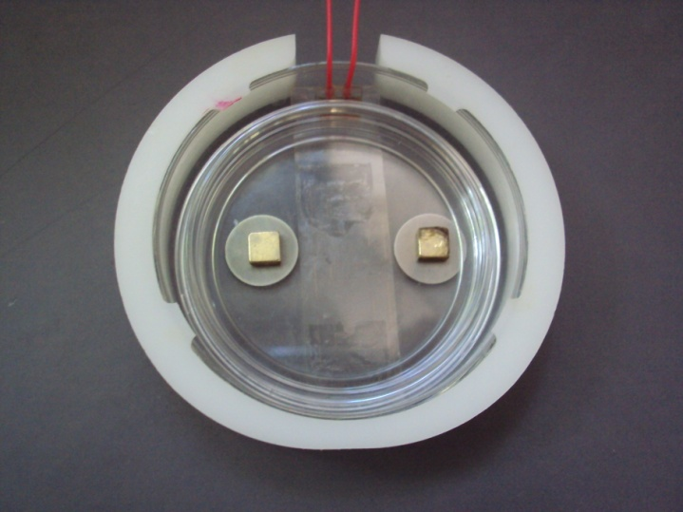
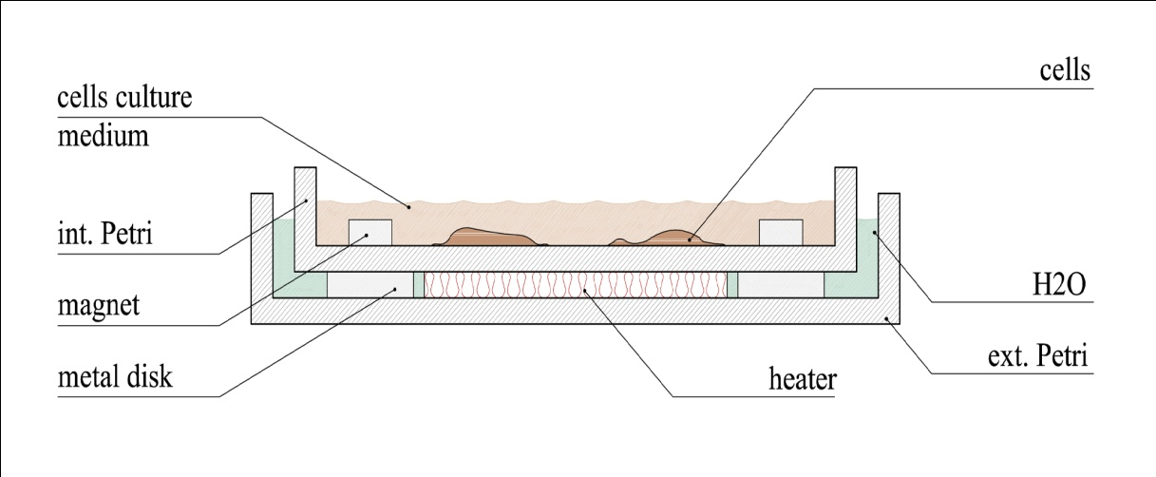
COMBINED TOPOGRAPHIC/MECHANICAL IMAGING PROTOCOL
3) TRANSFERRING IN A SUITABLE AFM THERMALIZED CELL (37°C)
FEATURES
Temperature control (36 ± 1 °C)
Transparent heater (good optical visibility)
Calibration curve : T = f (ΔV)
Plastic cap with an hole for AFM-head
(limiting culture medium vaporization)
t_{max} ≈ 5 h

Slide 26
COMBINED TOPOGRAPHIC/MECHANICAL IMAGING PROTOCOL
5a) Contact point determination
Algorithm for:
Force curve cut (noisy non-contact region plus a small region
near the contact point) and linearization
Fit on a suitable percentage of the cut-free indentation
region
Estimated error: dδ₀ = ± 10 nm
Fast algorithm : about 1-2 mins for the whole force curves set

Slide 27
COMBINED TOPOGRAPHIC/MECHANICAL IMAGING PROTOCOL
5b) Real topography map build-up
Cell from MDA-MB-231 line (human breast cancer)
def.
+

Slide 28
COMBINED TOPOGRAPHIC/MECHANICAL IMAGING PROTOCOL
5d) Young modulus total error estimate
Two main contributions:
Intrinsic variability of the bio-system (cell-by-cell differences)
Errors due to the measurement process on the single cell (experimental parameters uncertainties propagation and intrinsic variability of the single cell)
E₁
E₂
E₃
E_{N}

