Slide 1
Quantum to Classical Transition in Noisy Classical Environment
Jacopo TraPani

Slide 2
Markovian Environment
Non-Markovian Environment
I feel changed…
Who am I?
Preparation of Quantum state
Non Markovian Environment
Markovian Environment
The state changes but its quantum features
are not definitely destroyed by decoherence
System loses its quantum features because of decoherence

Slide 3
Gaussian noise stochastic model: Why?
Not feasible full quantum description
Classical stochastic fields give solution equivalent to the full quantum description in many situations
We have direct access on the correlations of the environment

Slide 4
Gaussian noise: classical stochastic field (CSF) model
Interaction Hamiltonian
Gaussian Noise

Slide 5
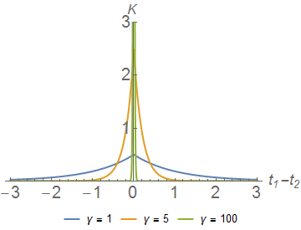
Stochastic Field
Ornstein-Uhlenbeck Kernel:
$\frac{1}{γ}$ is the correlation time of the environment

Slide 6
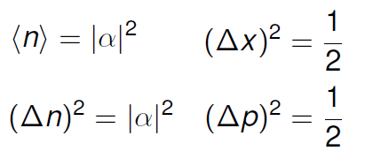
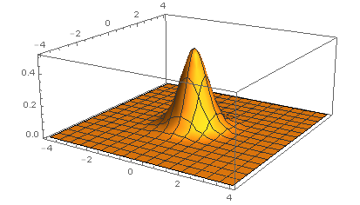
Quantum to Classical Transition
Coherent state |α > properties:
Glauber Sudarshan P-distribution:
Thermal state P(α):

Slide 7
Nonclassical Depth criterion
Quantum state
Classical state
The transition happens when P(α) turns positive!!
NCD criterion: we have to find the time tQ such that the P-distribution turns positive

Slide 8
The P-distribution is the Fourier transform
of the characteristic function of the state
Characteristic function evolution
genarates a positive P-distribution
It’s a property of the initial state!

Slide 9
Nonclassical Depth criterion
The result found is independent on the initial state!
State with same η have same decoherence time
The result found is a property of the channel!

Slide 10
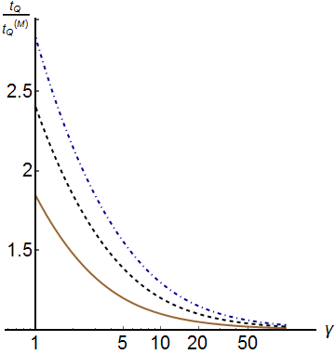
NCD: Resonant Interaction
Correlations
Persistence of nonclassicality
when
Markovian Regime!

Slide 11
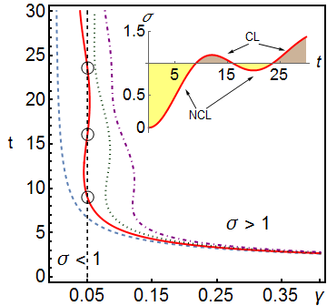
NCD: Off-Resonance Interaction
Detuning
Revivals of nonclassicality!!

Slide 12
Results
1. CSF is a good model for non Markovian and Markovian interaction
2. Same decoherence time for different states with same amount of nonclassicality
3. Larger environment correlations means lorger decoherence time
4. Detuning implies revivals of nonclassicality

