Slide 1
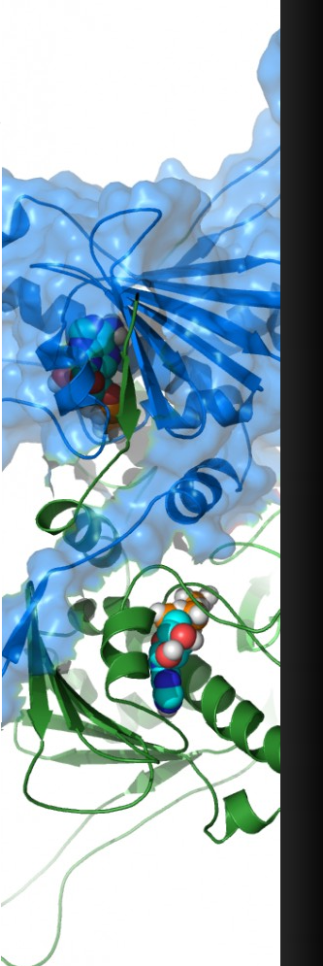
Path-Independent free energy evaluation of amino acid mutation
Riccardo Capelli
Dipartimento di Fisica, Università degli Studi di Milano

Slide 2
Proteins

Slide 3
Proteins
A protein is a polymer formed by
a sequence of amino acids (typically 10 ÷ 10³)

Slide 4
Proteins
A protein is a polymer formed by
a sequence of amino acids (typically 10 ÷ 10³)
Every amino acid is formed by 10 ÷ 20 atoms.
We have a complex system with
10² ÷ 10⁵ degrees of freedom

Slide 5
Proteins
A protein is a polymer formed by
a sequence of amino acids (typically 10 ÷ 10³)
Every amino acid is formed by 10 ÷ 20 atoms.
We have a complex system with
10² ÷ 10⁵ degrees of freedom
GB1 hairpin

Slide 6
Proteins
Streicher and Makhatadze, Biochem. 2007

Slide 7
Proteins

Slide 8
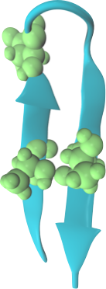
Free Energy
If we introduce a mutation in our
sequence the free energy profile changes
ΔGwt
ΔGmut

Slide 9
Free Energy
ΔGwt
ΔGmut
Useful for drug design
and protein engineering

Slide 10
Molecular dynamics simulations

Slide 11
Molecular dynamics simulations
GB1 hairpin has a characteristic folding/unfolding time of the order of 10 μs
A typical MD simulation for this system with
explicit water has a speed of 100 ns/day.
To see the overcome of the free energy barrier
(if we are lucky) we have to simulate the system for
at least 3 months.
Plain MD is not a viable way to compute ΔΔG values
because it is an equilibrium property of the system
that needs many folding/unfolding events.

Slide 12
Confinement Method

Slide 13
Confinement Method
ΔG=?
Ovchinnikov et al., J. Phys. Chem. B 2013

Slide 14
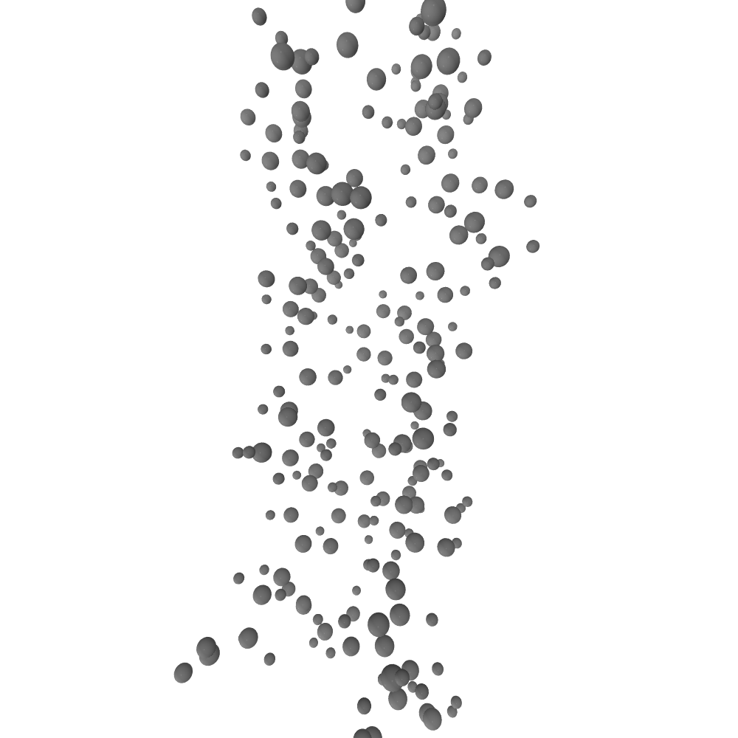
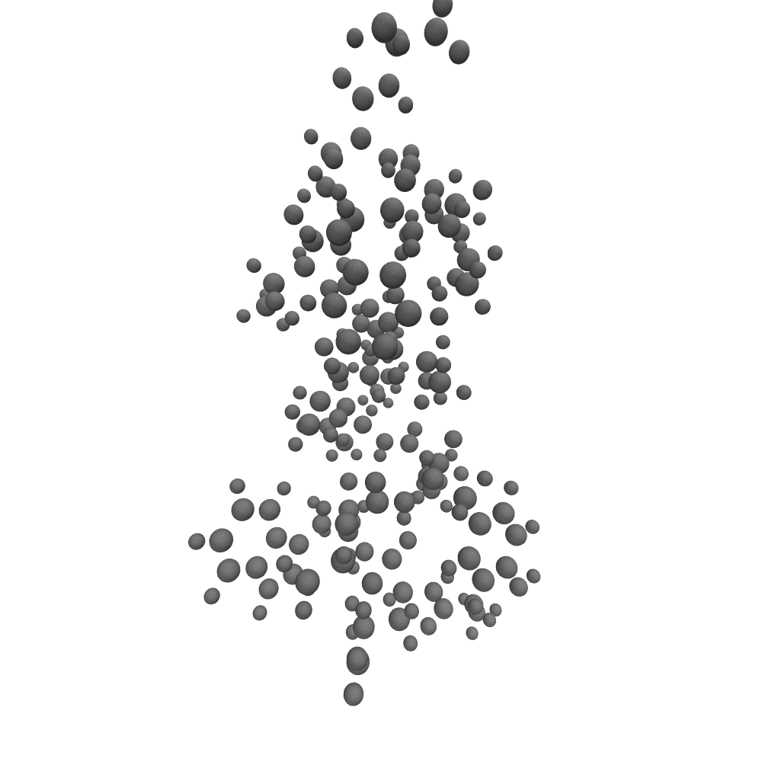
Confinement Method
Thermodynamic integration
ΔG=?
Ovchinnikov et al., J. Phys. Chem. B 2013

Slide 15
Confinement Method
Analytic free energy difference
ΔG=?
Ovchinnikov et al., J. Phys. Chem. B 2013

Slide 16
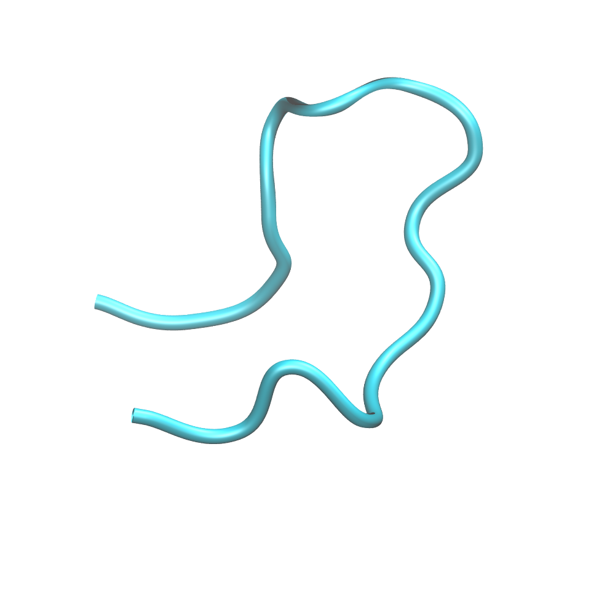
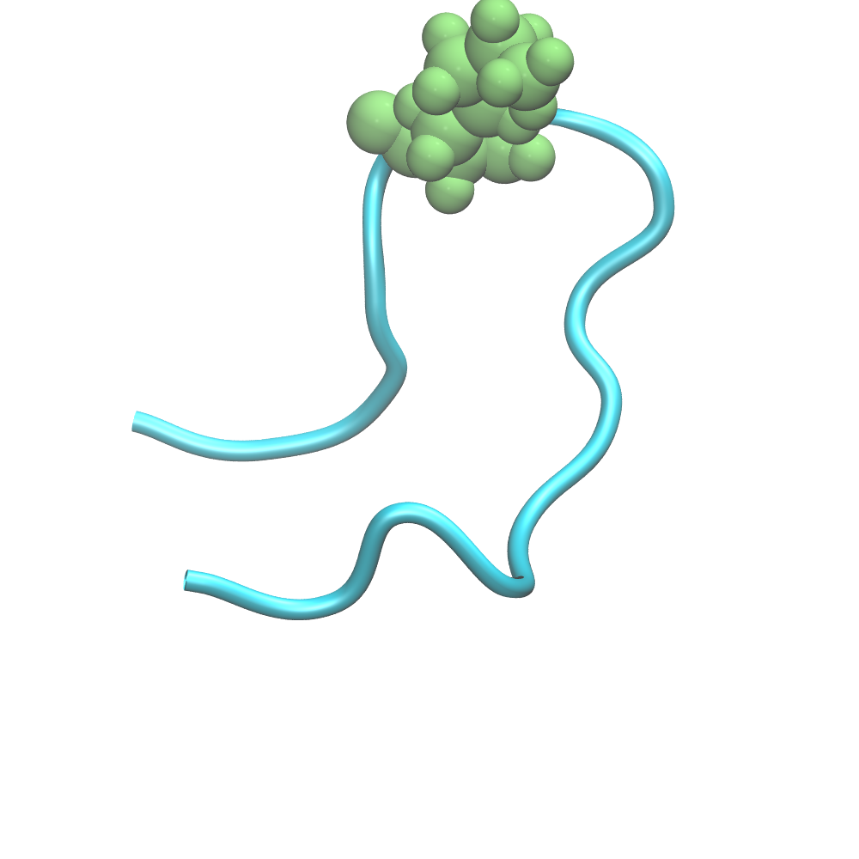
Single point mutant ΔΔG

Slide 17
Single point mutant ΔΔG

Slide 18
Native State
Analytic free energy difference

Slide 19
Single point mutant ΔΔG

Slide 20
Denatured State
Denatured state do not have a unique stable conformation
We can consider the denatured state as a random coil completely surrounded by the solvent
The only difference between mutant and wildtype in this approximation is due to the mutated site and its neighbors
(Seeliger and de Groot, Biophys. J. 2010)

Slide 21
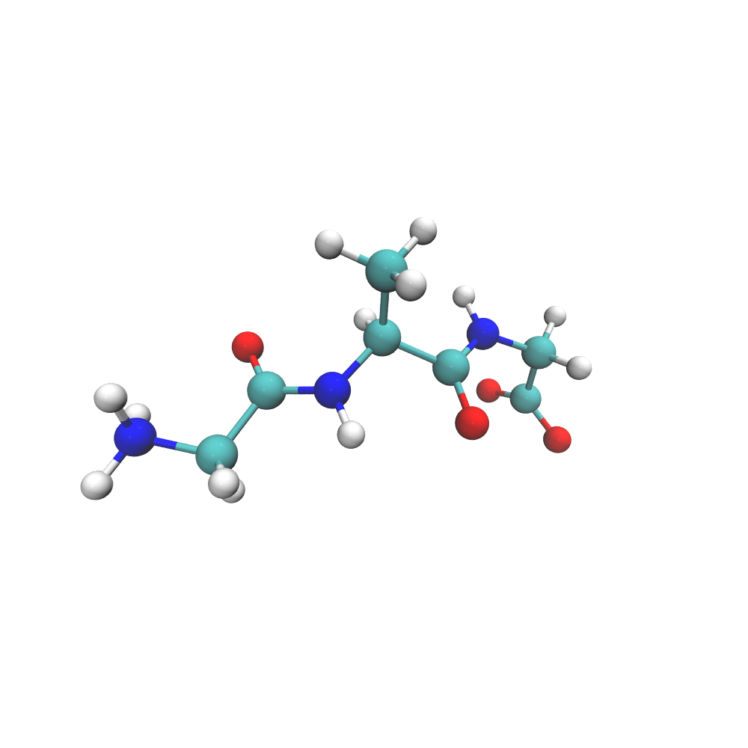
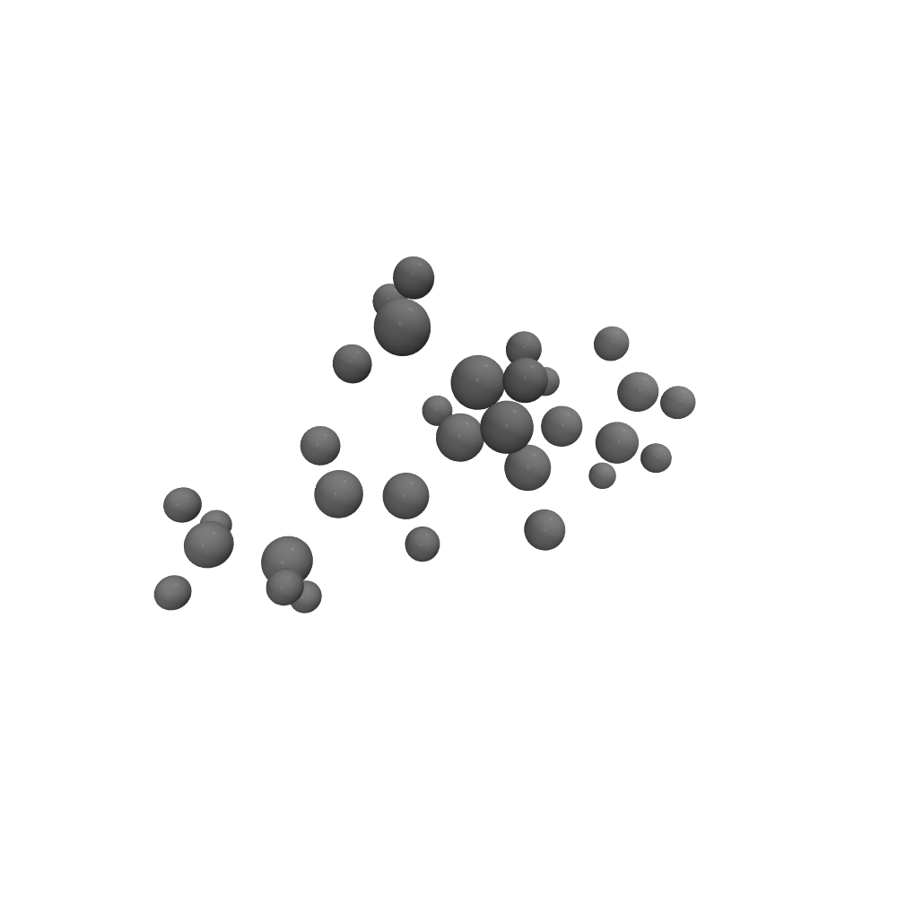
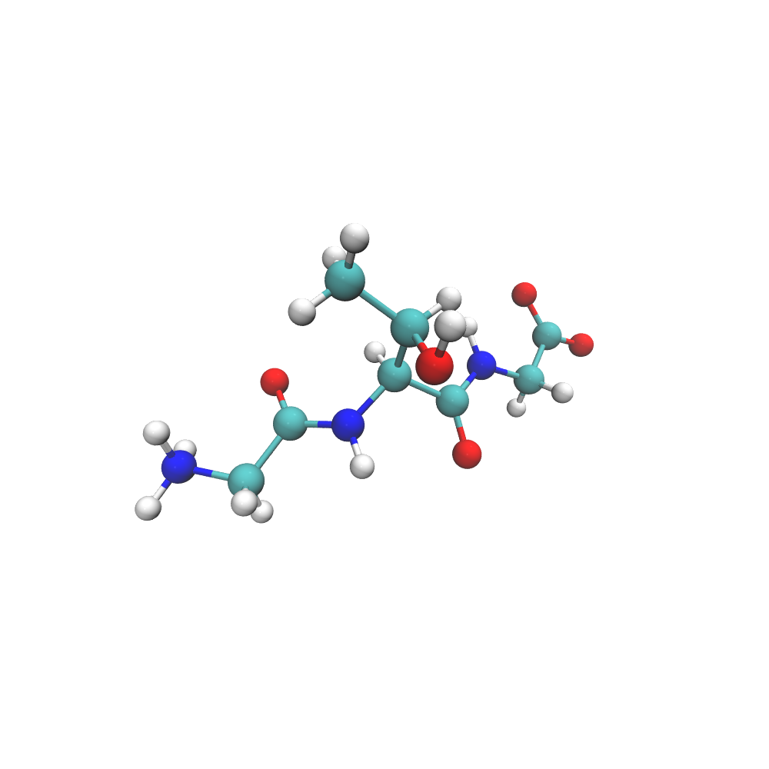
Denatured State

Slide 22
Single point mutant ΔΔG

Slide 23
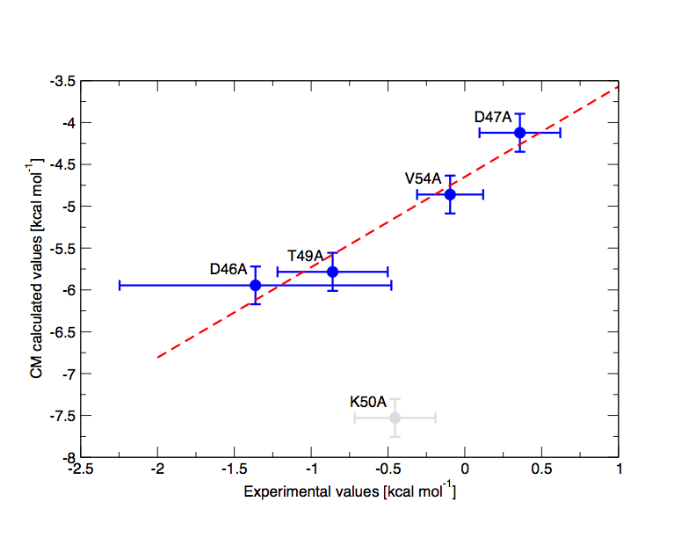
Results
-12
-12.5
-13
Kobayashi et al., Biochem. 2000

Slide 24
Future perspectives
Extension of the technique to multiple mutations

Slide 25
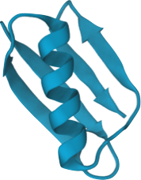
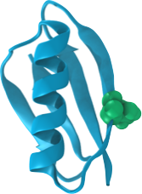
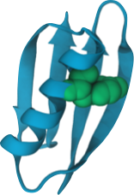
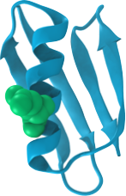
Future perspectives
Extension of the technique to multiple mutations
Application of the method on a large set of mutants of bigger systems

Slide 26
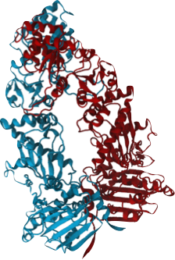
Future perspectives
Extension of the technique to multiple mutations
Application of the method on a large set of mutants of bigger systems
Use of the method to study new possible sites of interest in disease-related proteins

Slide 27
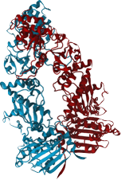
Thanks for your attention

