Slide 1
Time Resolved dynamics of La_{0.65}Sr_{0.35}MnO₃ thin films

Slide 2
Outline
My project
Experiments on La_{0.65}Sr_{0.35}MnO₃
What is La_{0.65}Sr_{0.35}MnO₃?
Time resolved optical measurements
Reflectivity
Kerr effect

Slide 3
Ultraspin endstation
A new laser beamline for time resolved photoelectron spectroscopy

Slide 4
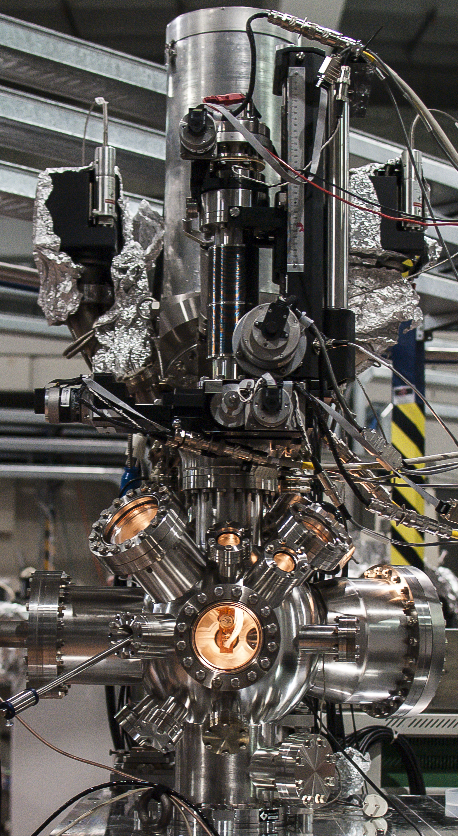
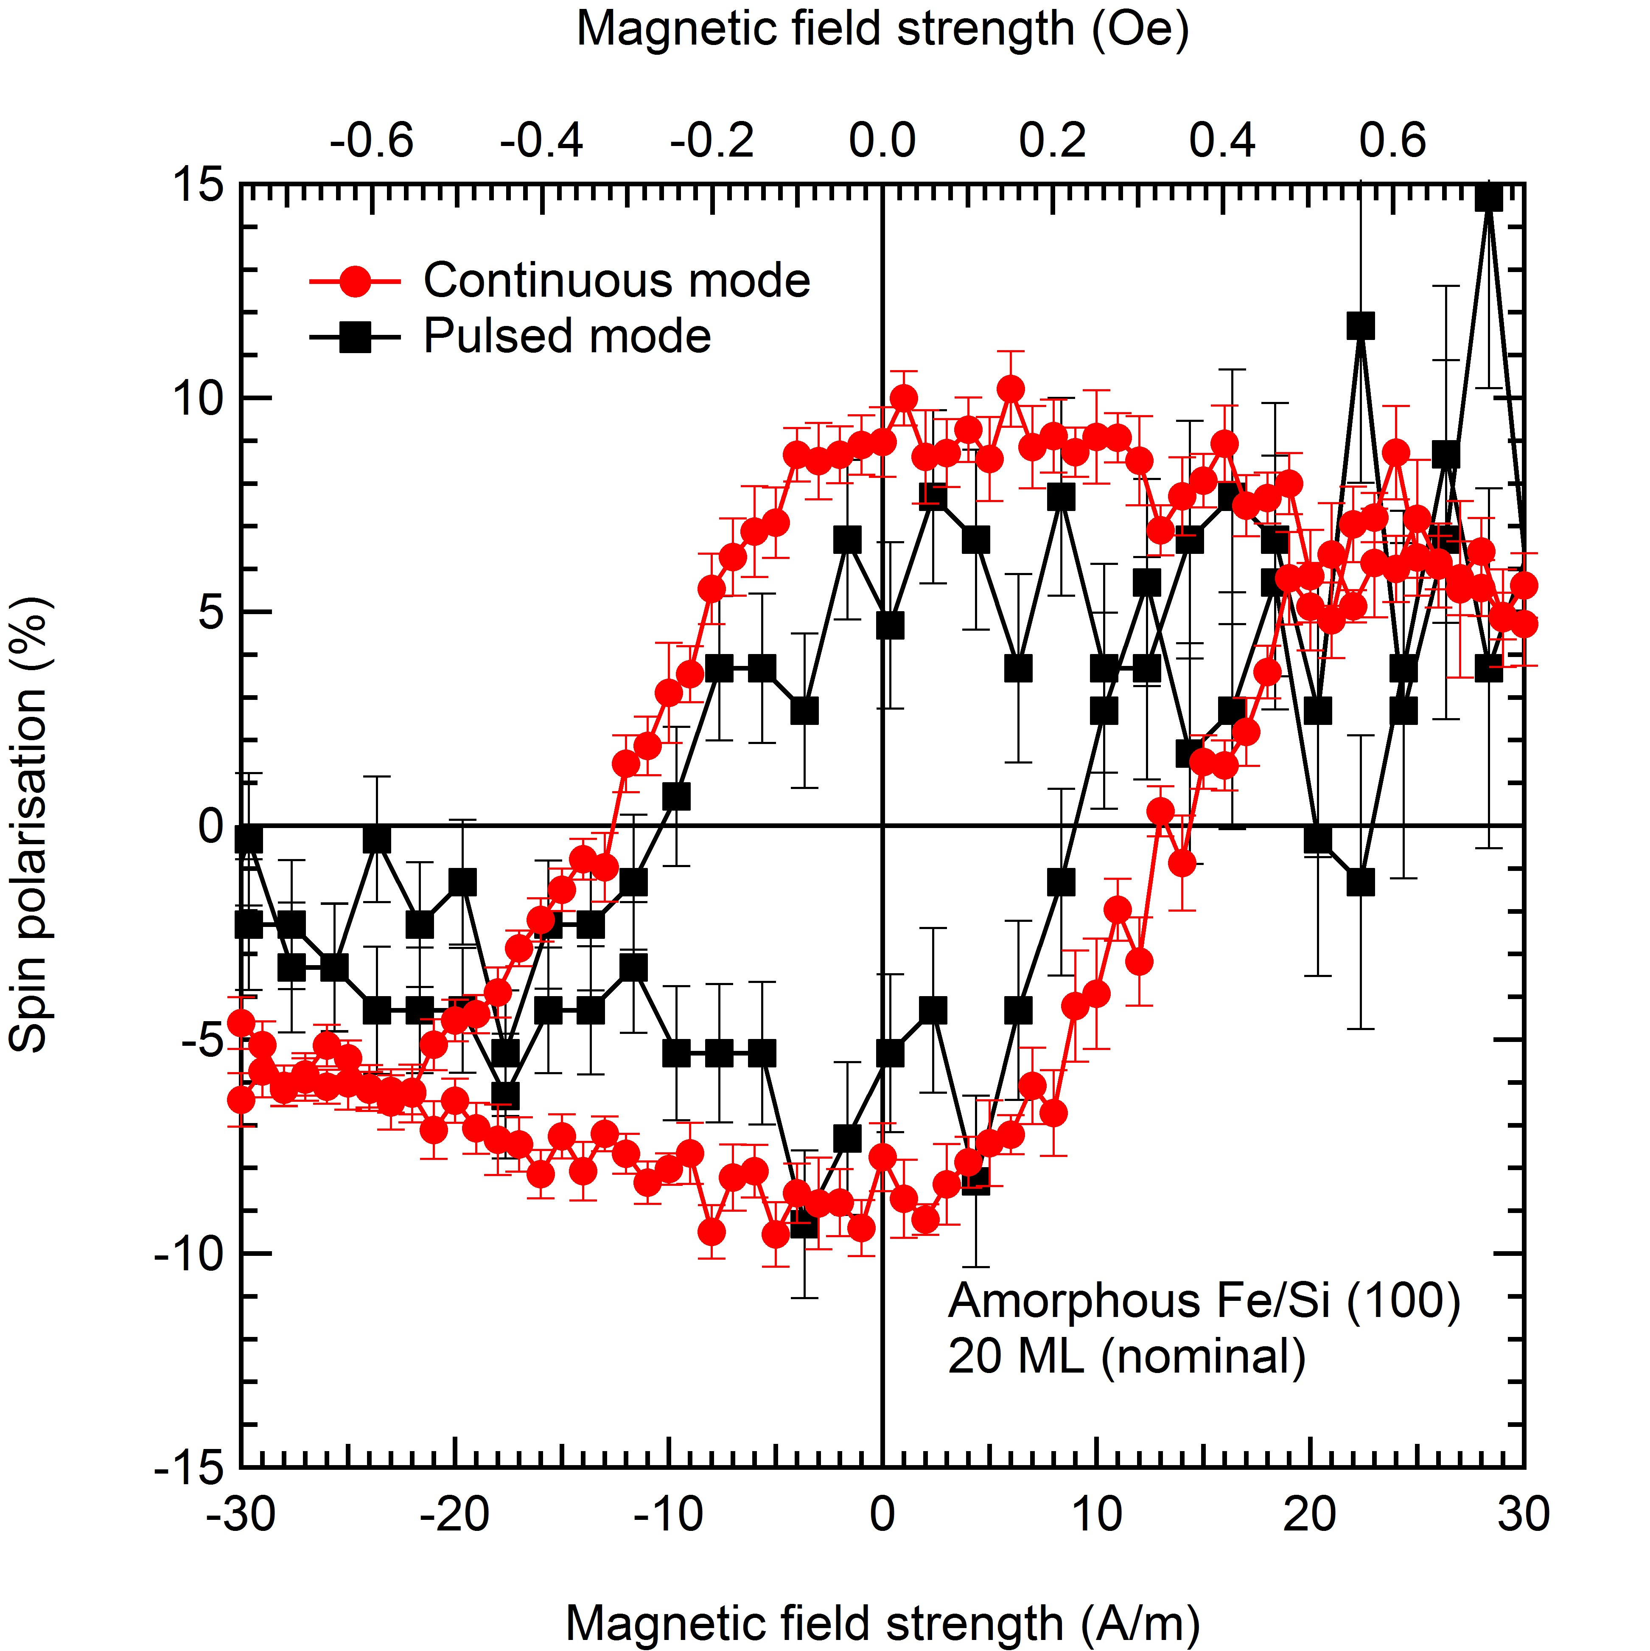
ULTRASPIN ENDSTATION
Vectorial
Spin-polarimeter
Sample Preparation chamber
High spin polarization of the emitted electrons
Number of electrons
Kinetic energy
E_{F}
Analysis
chamber

Slide 5
Experiments on La_{0.65}Sr_{0.35}MnO₃

Slide 6
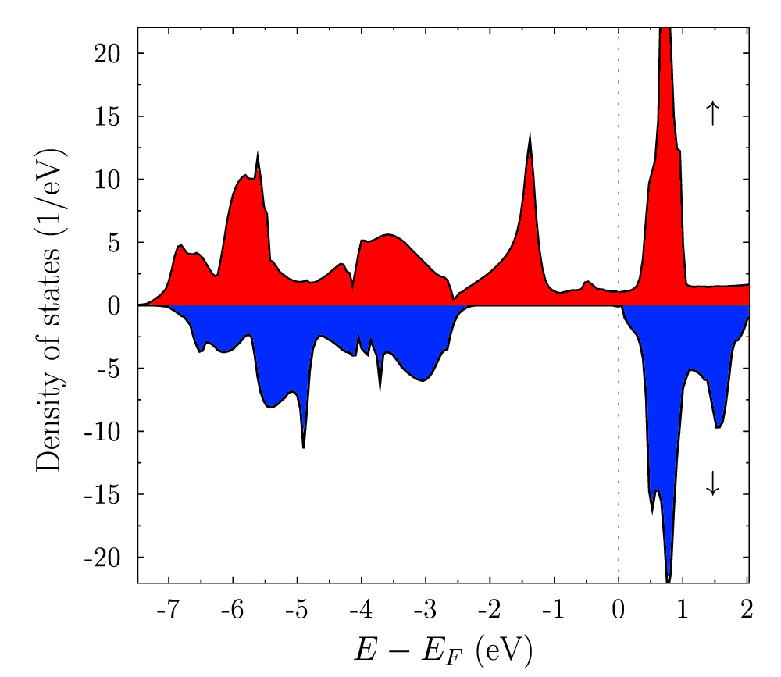
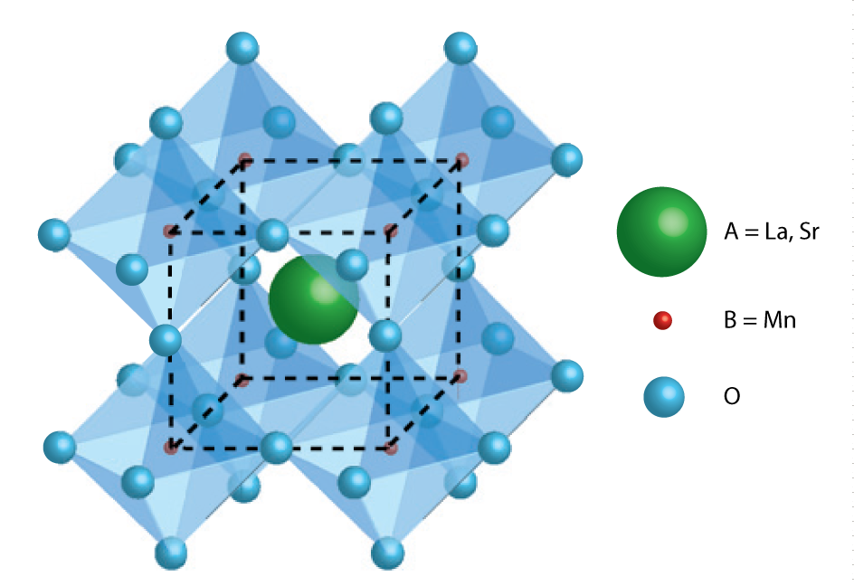
What is La_{0.65}Sr_{0.35}MnO₃?
Perovskite structure.
Itinerant ferromagnetism (double exchange).
J. Phys.: Condens. Matter. 25 136005 (2013)
Half metallic bandstructure, very high spin-polarization at the Fermi energy
Strong correlation between lattice structure, electronic structure and magnetic behaviour.
J. Phys. D: Appl. Phys. 47 (2014) 034010.

Slide 7
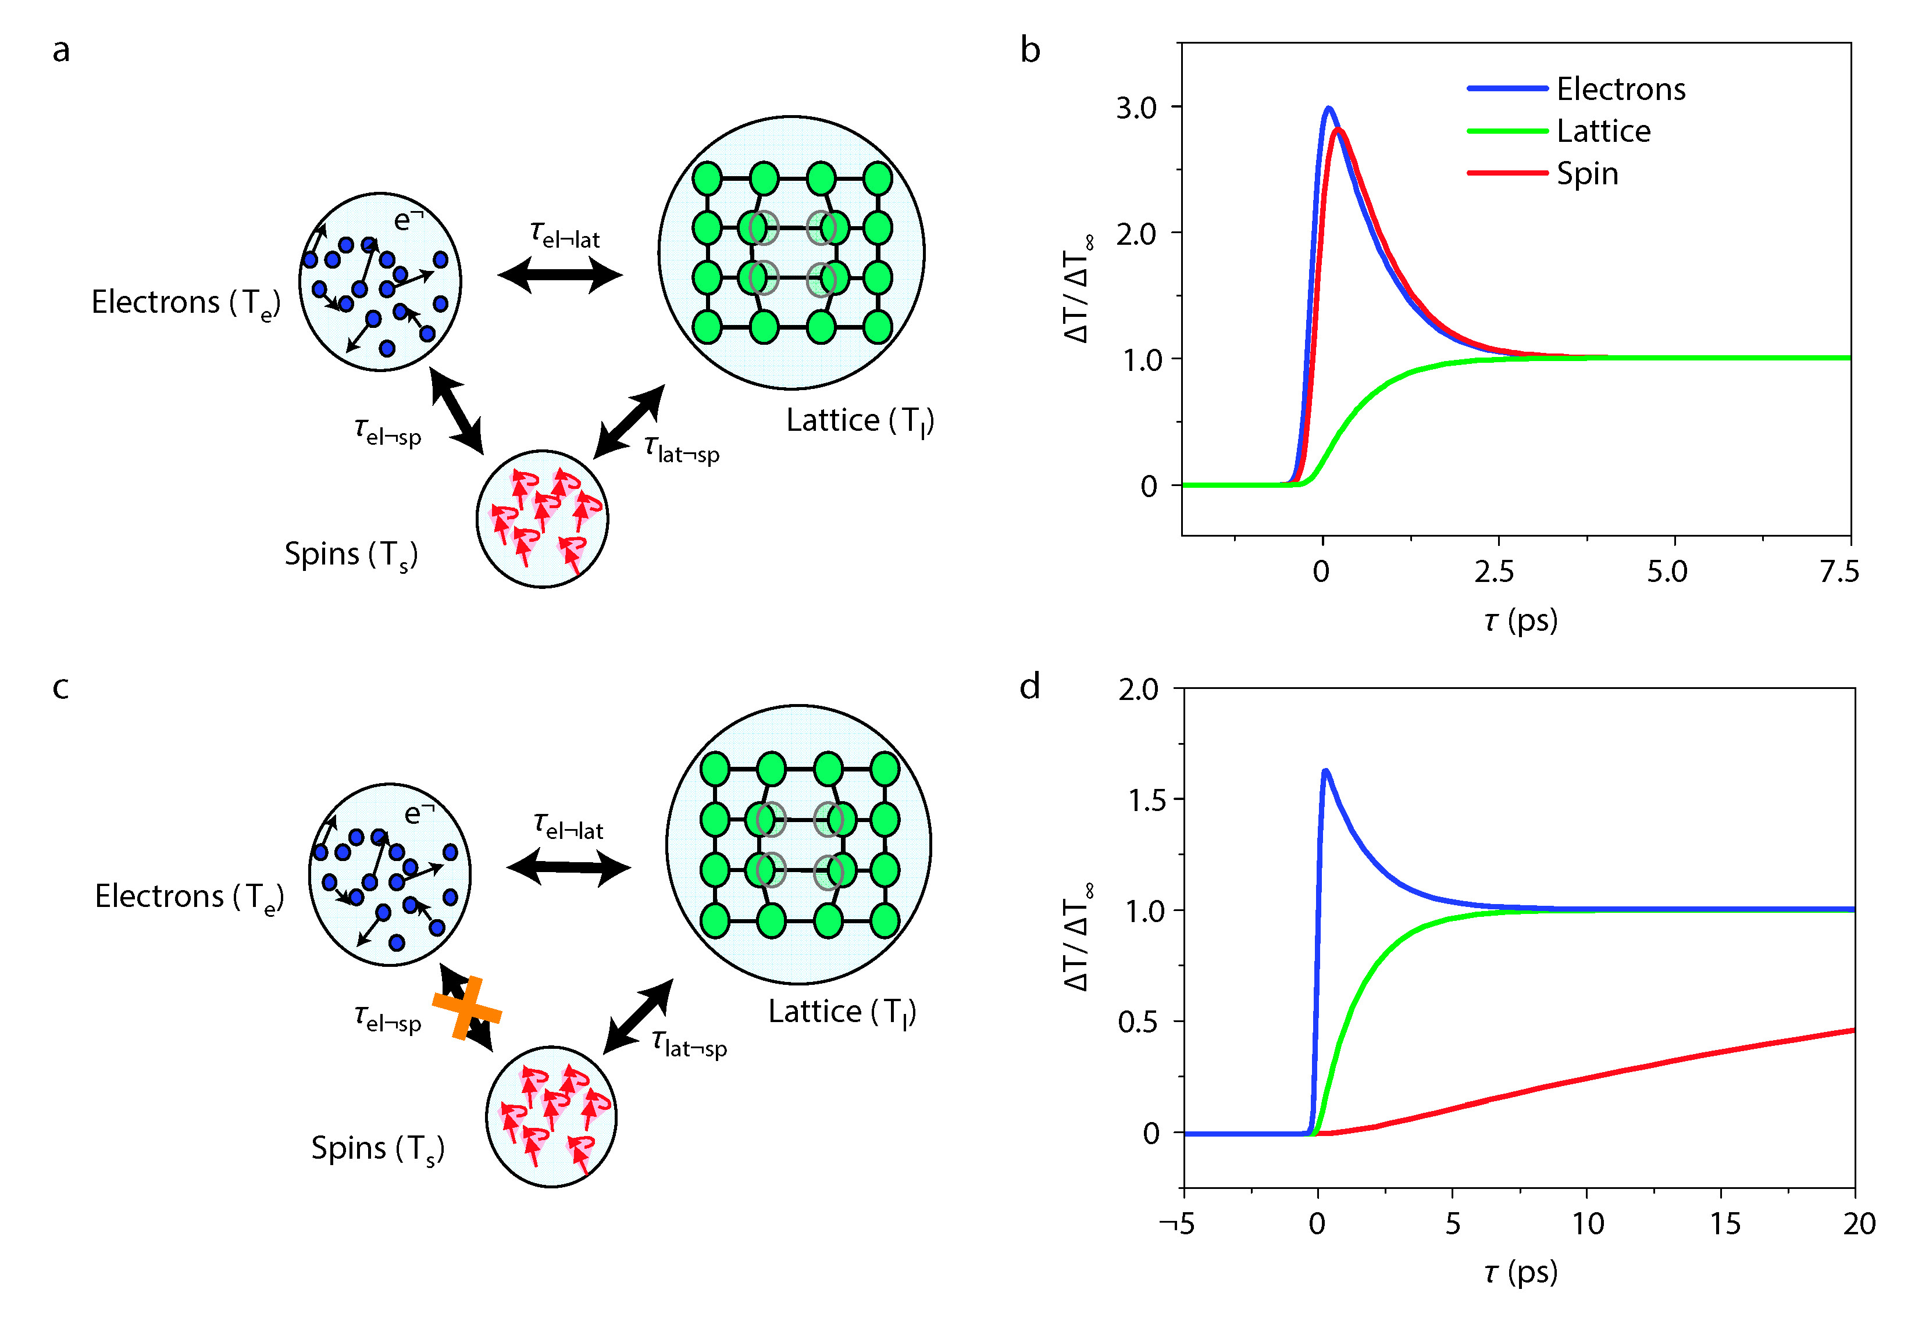
Ferromagnetic Metal
Number of electrons
E_{f}
Absence of final states for spin-flip scattering
Half-metal
Magnetic quenching is very slow with respect to metals
Nat. Mat. 8, 56 (2008)

Slide 8
Time resolved optical measurements
Reflectivity and magneto-optical Kerr effect measurements in pump-probe mode

Slide 9
Optical measurements
Laser characteristics:
High repetition rate (80 kHZ).
Two colour (pump 1.55 eV, probe 3.1 eV).
Pulse duration 70 fs FWHM.
Sample characteristics:
LSMO (001) on SrTiO₃ substrate, (1%) tensile strain.
MBE grown (high purity, high crystalline quality).
Transition from ferromagnetic metal to paramagnetic (higher-resistivity) metal at T_{c}=330 K.

Slide 10
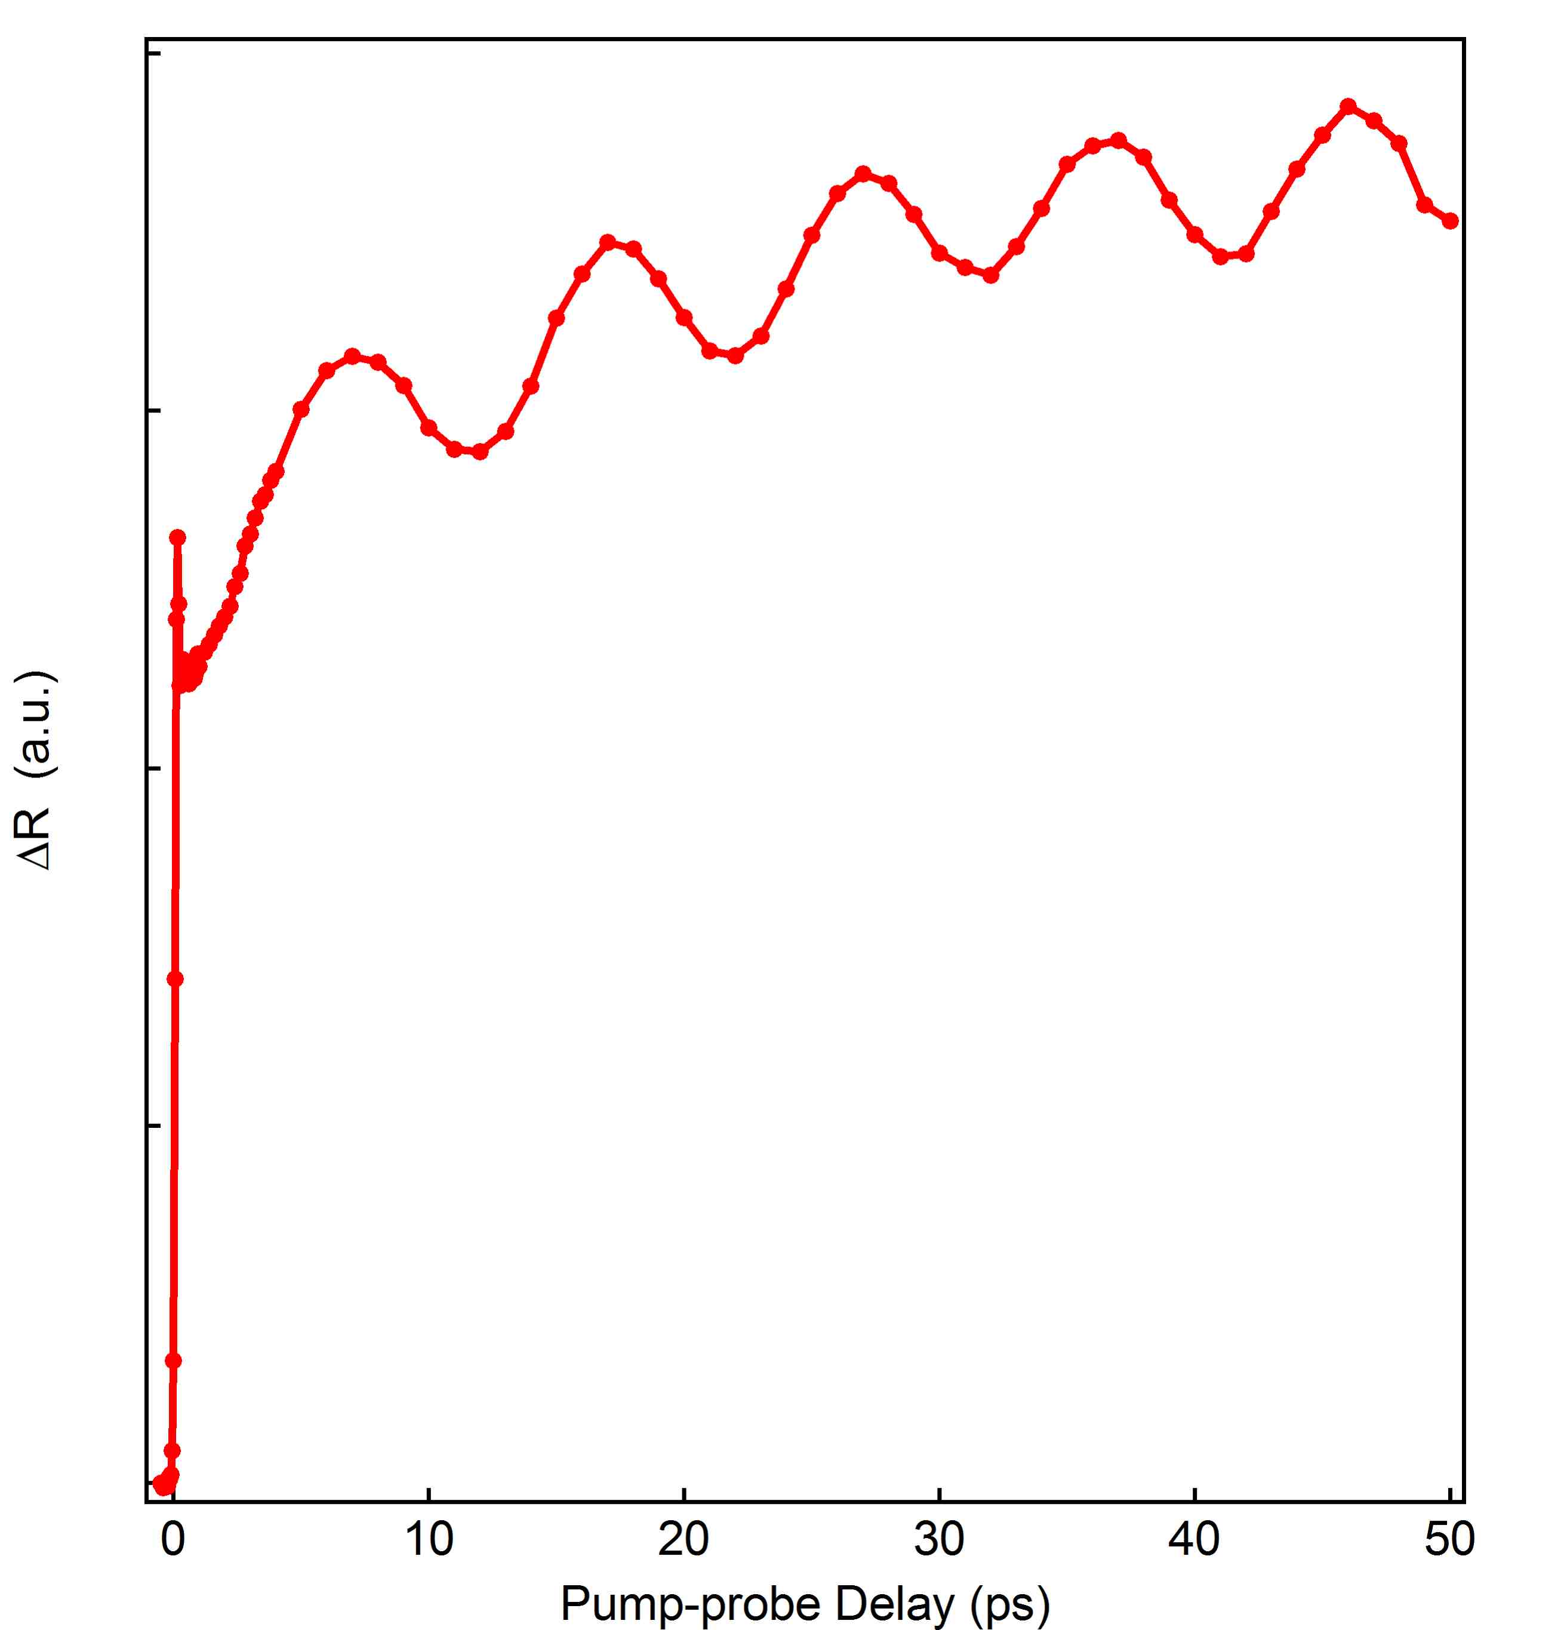
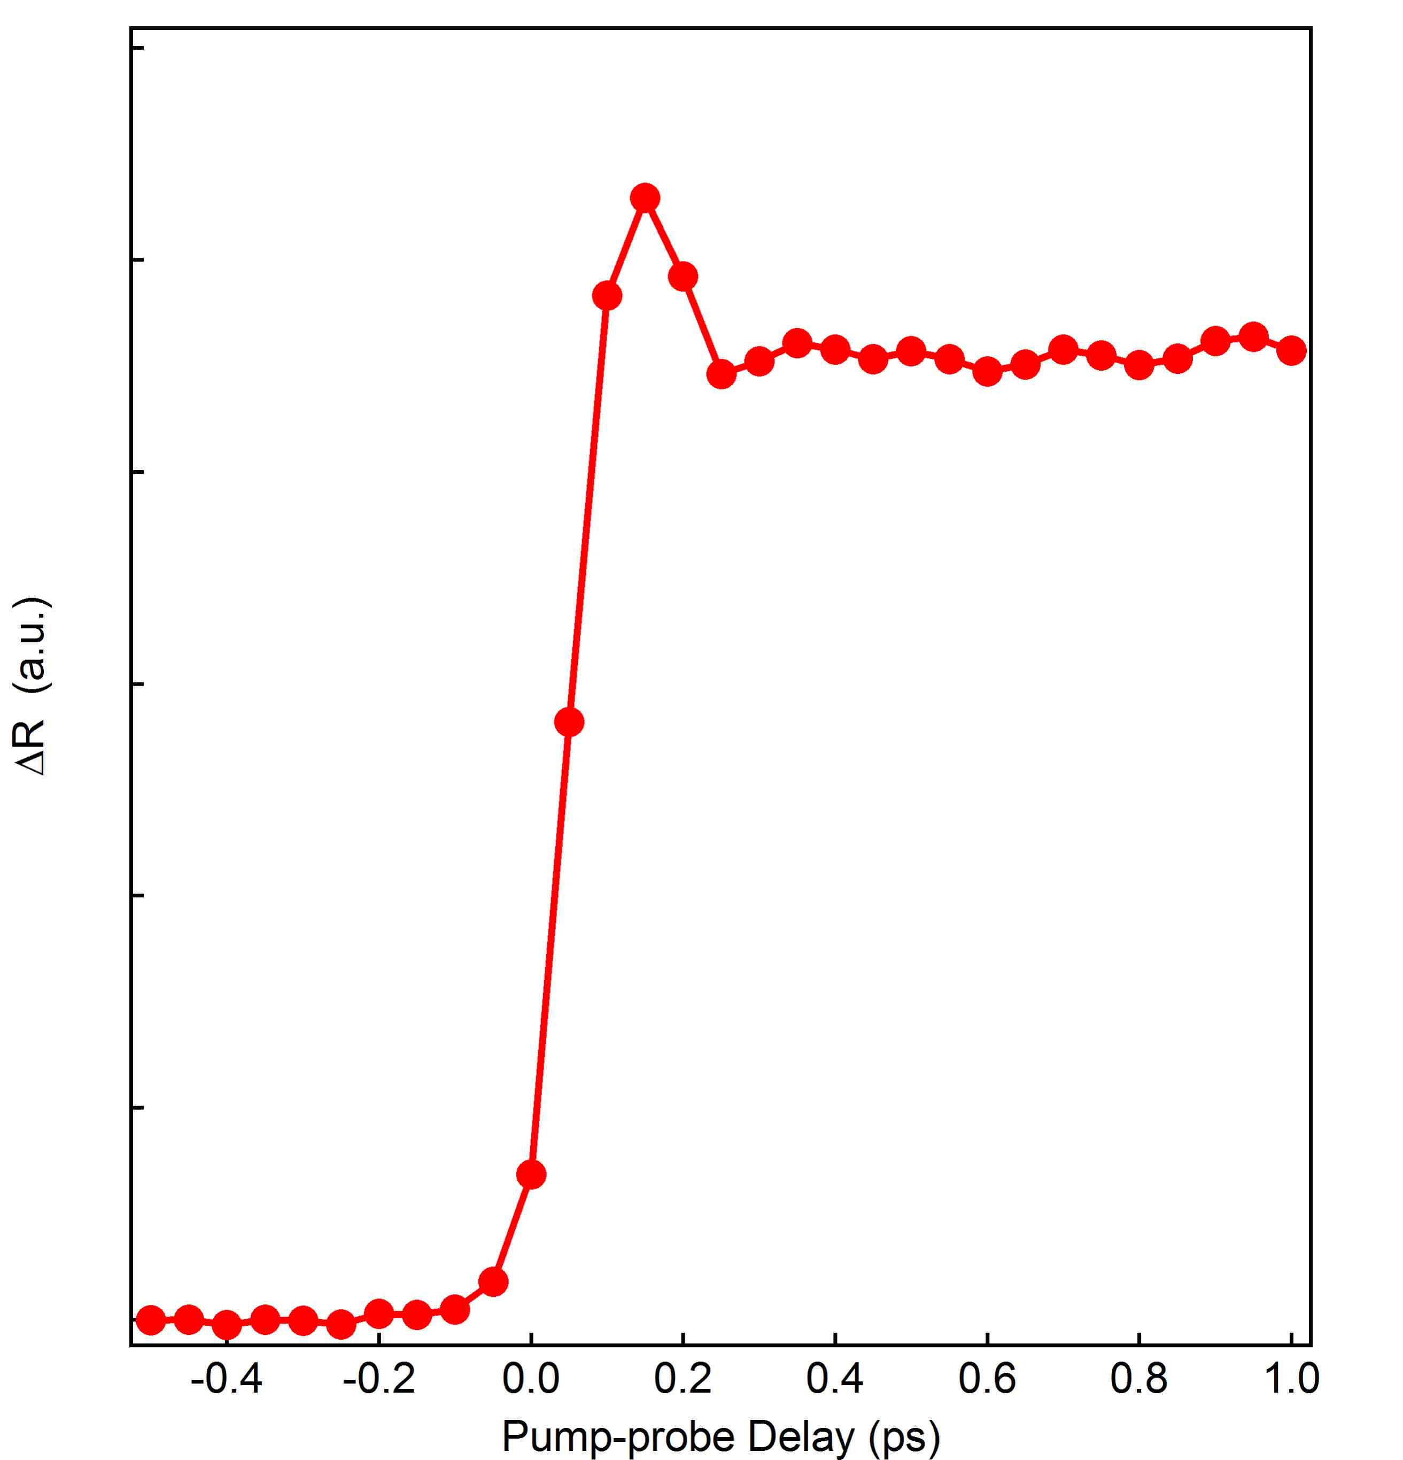
Reflectivity
Ultrafast conductivity change due to large excitation density (10⁻¹ ph/Mn site)
Electrons equilibrate with lattice within 1ps
Shock Wave (coherent optical phonon) interfering with probe.

Slide 11
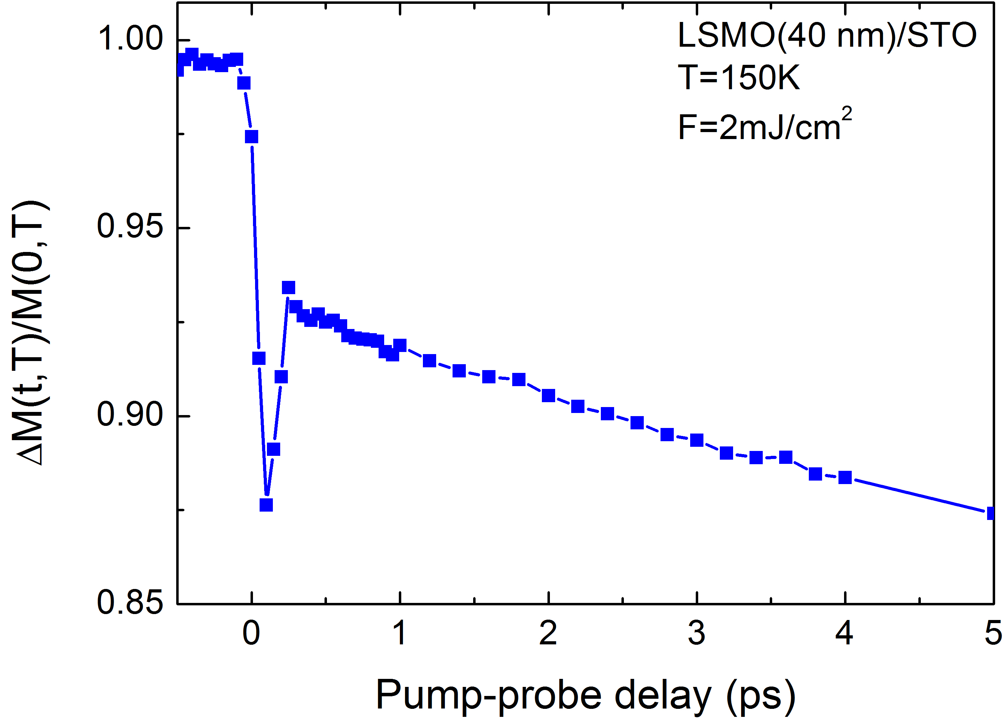
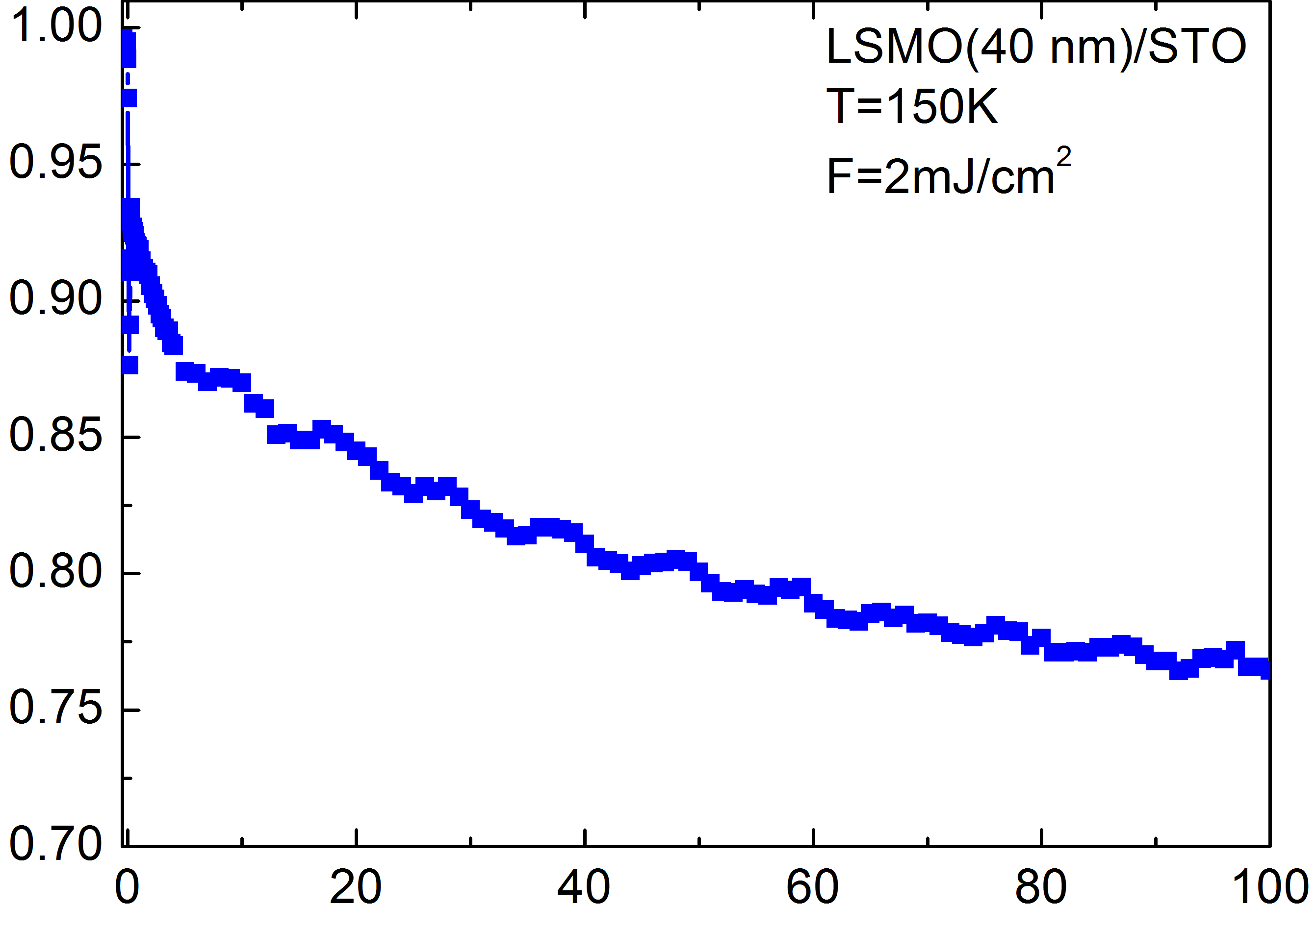
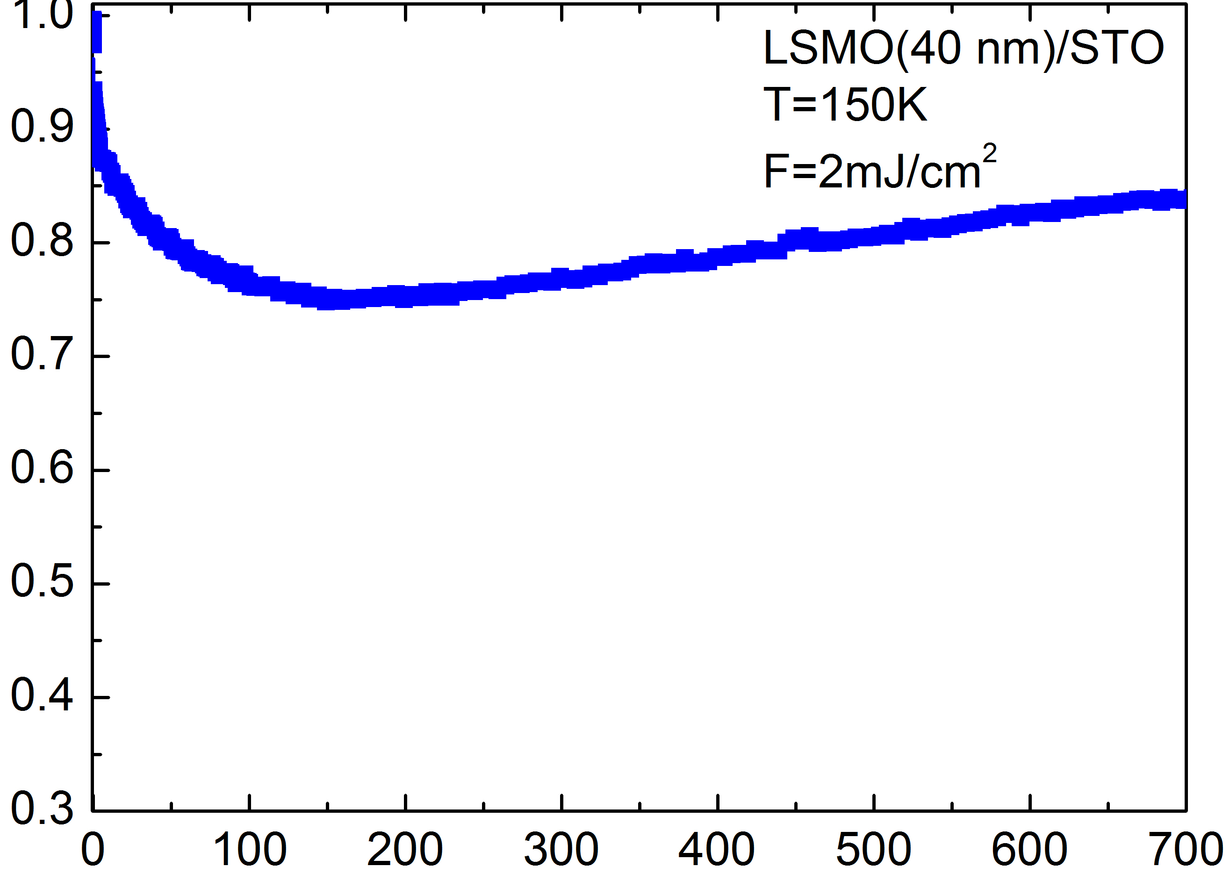
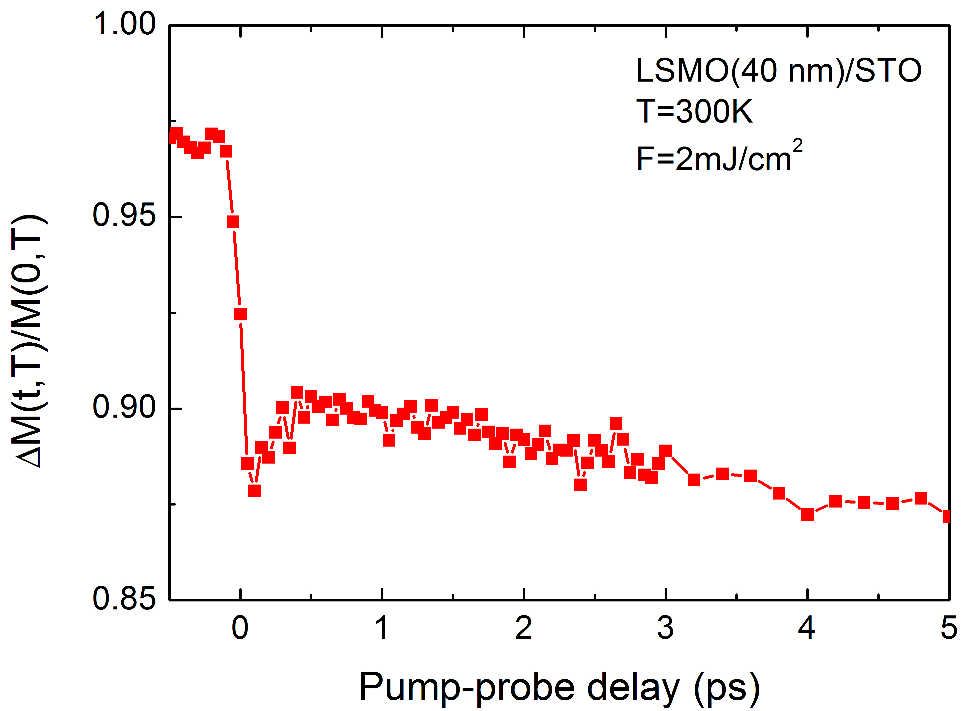
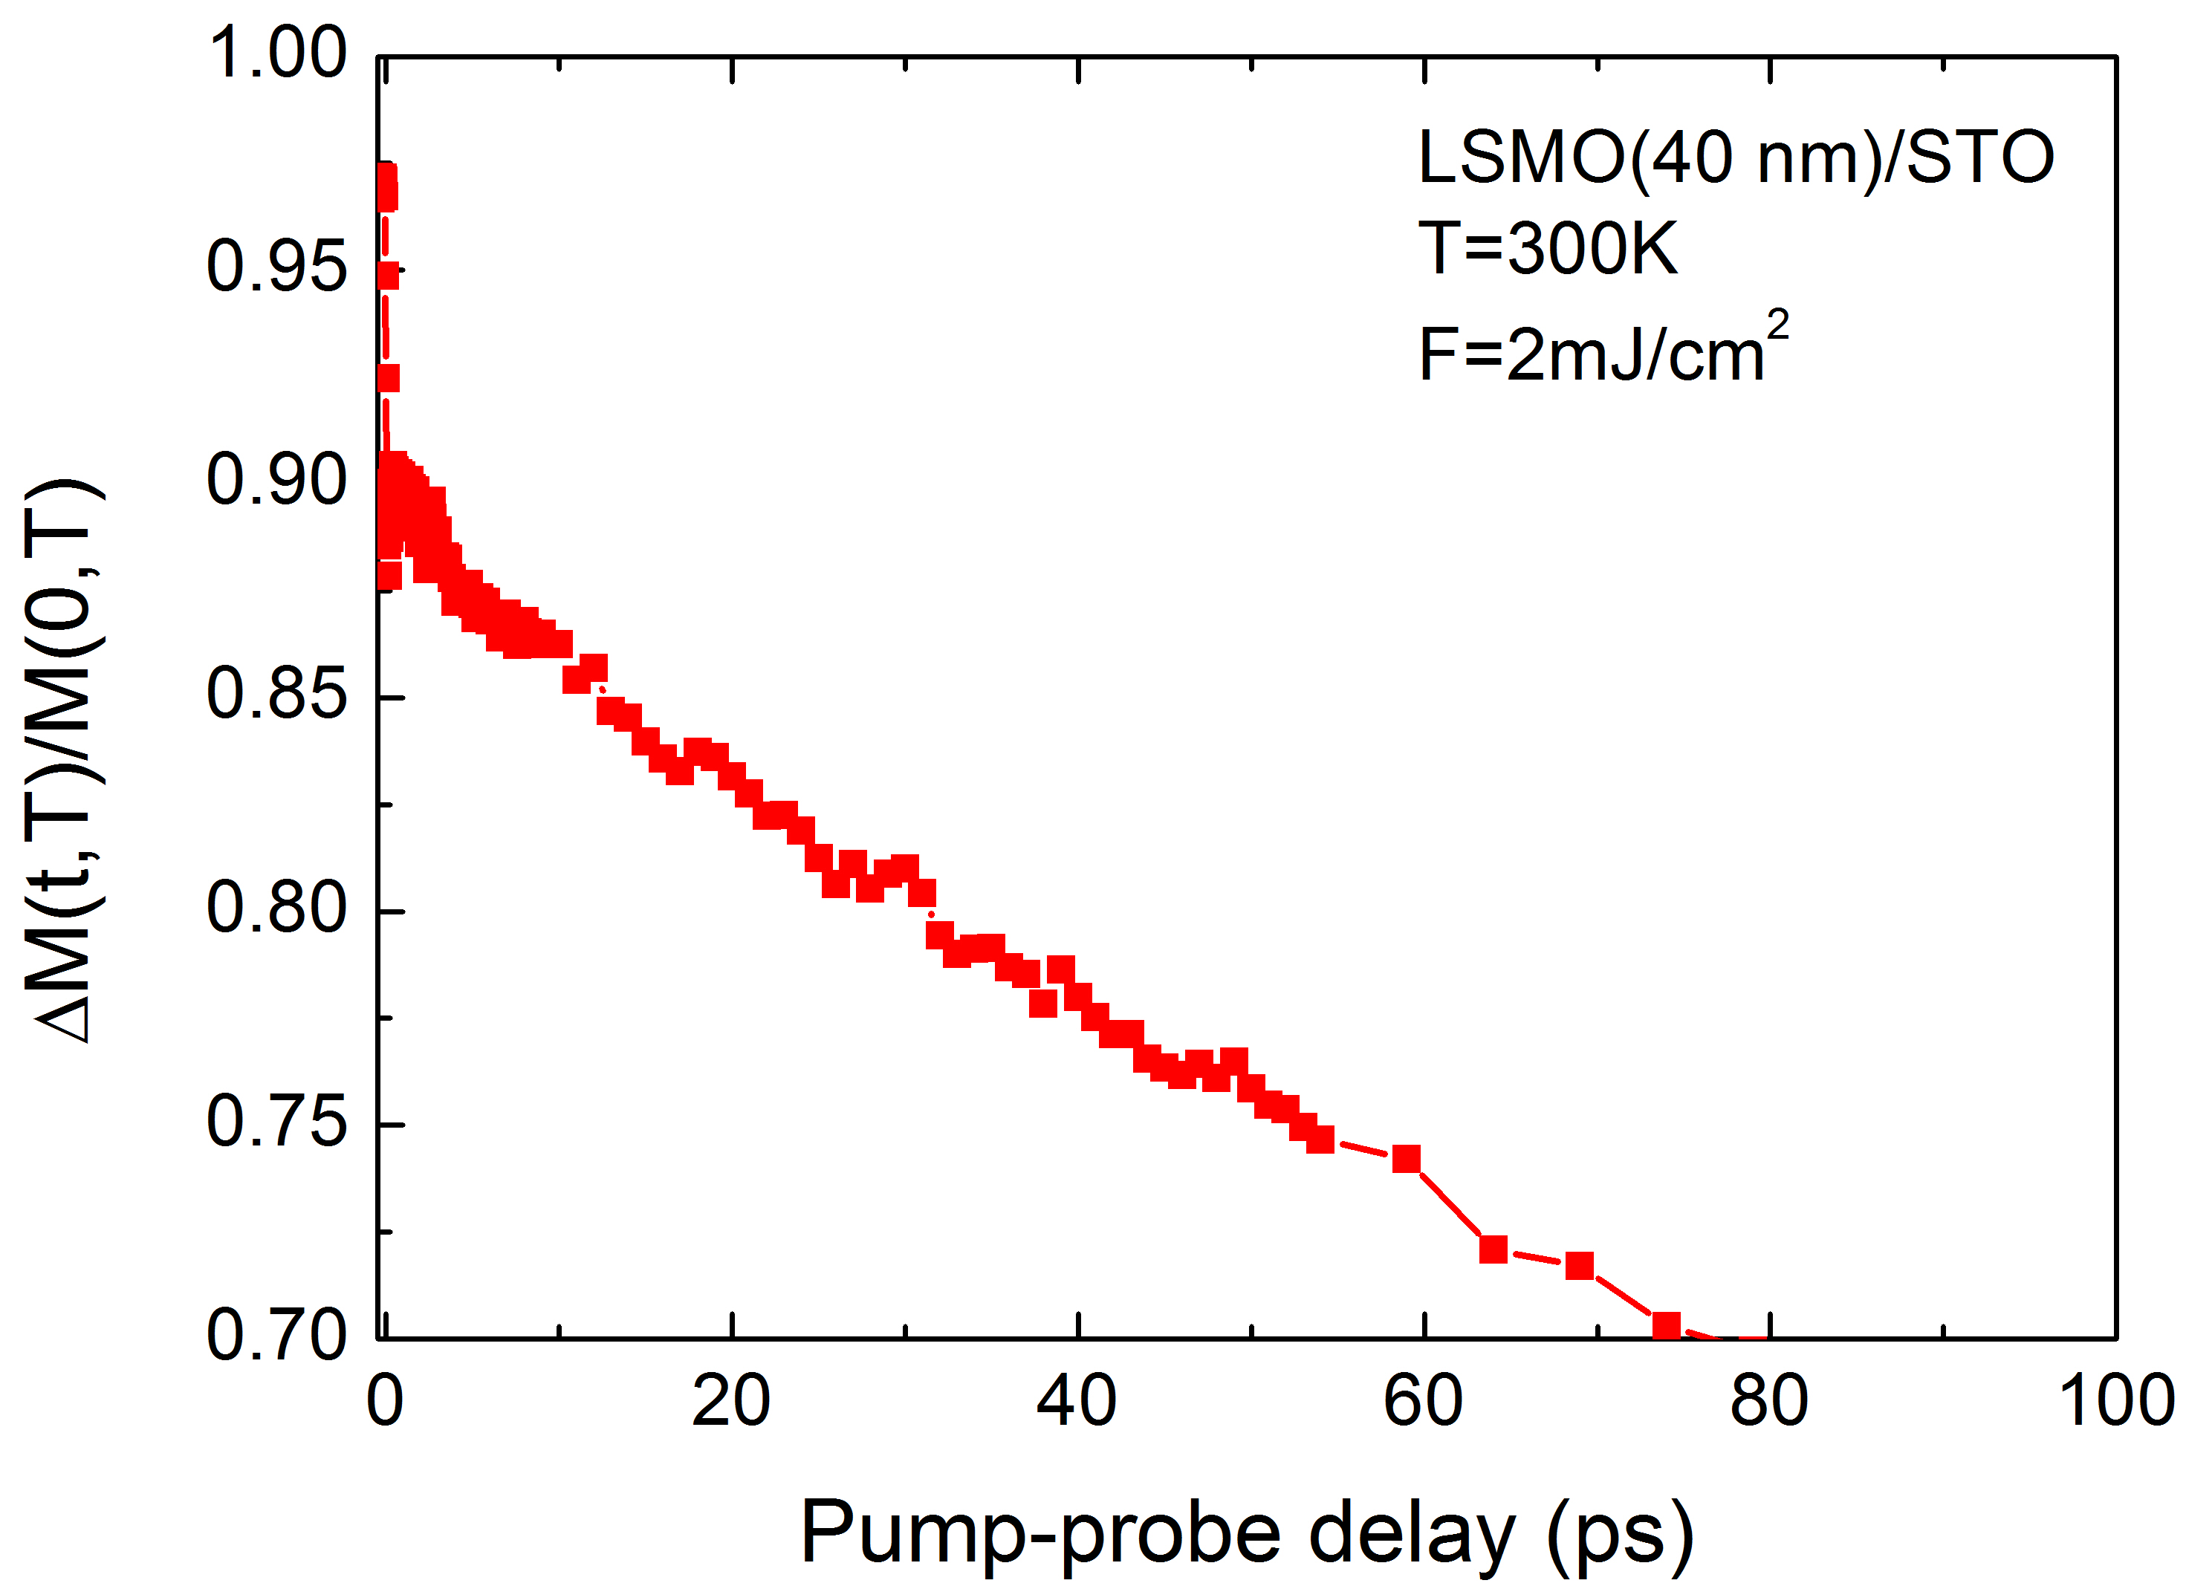
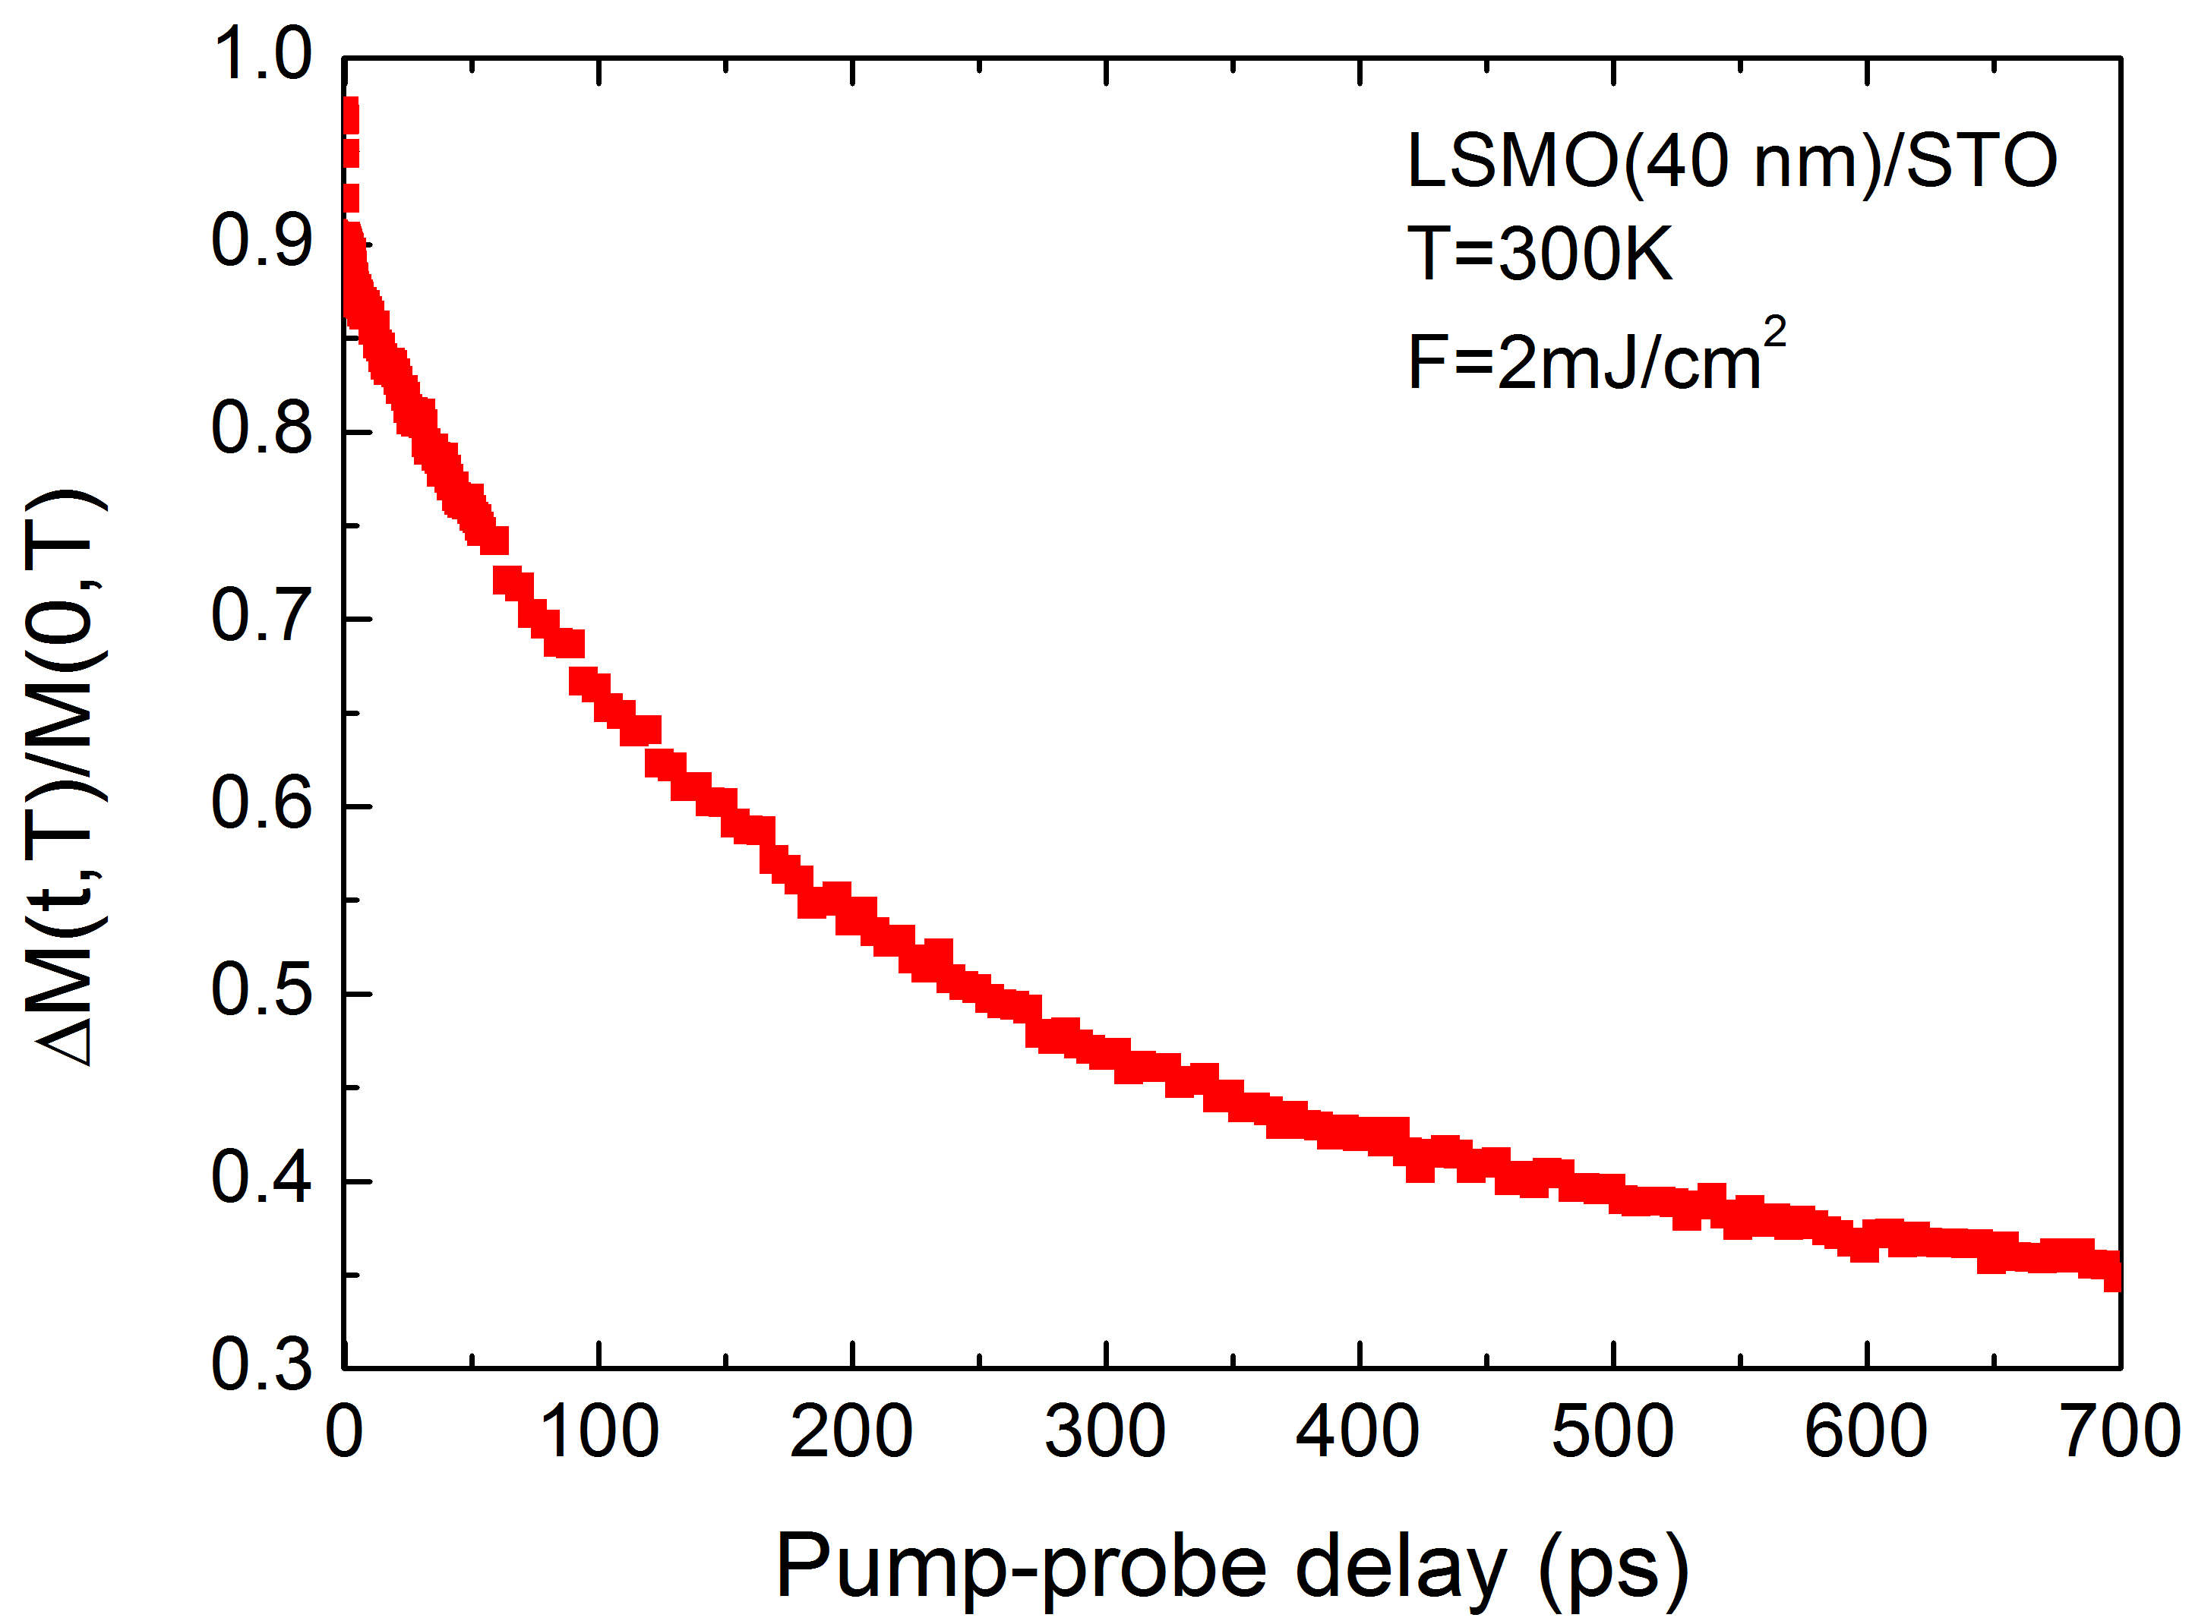
MOKE measurements
Same timescales
Different amplitude
Coupling with phonon
Different timescales and amplitudes

Slide 12
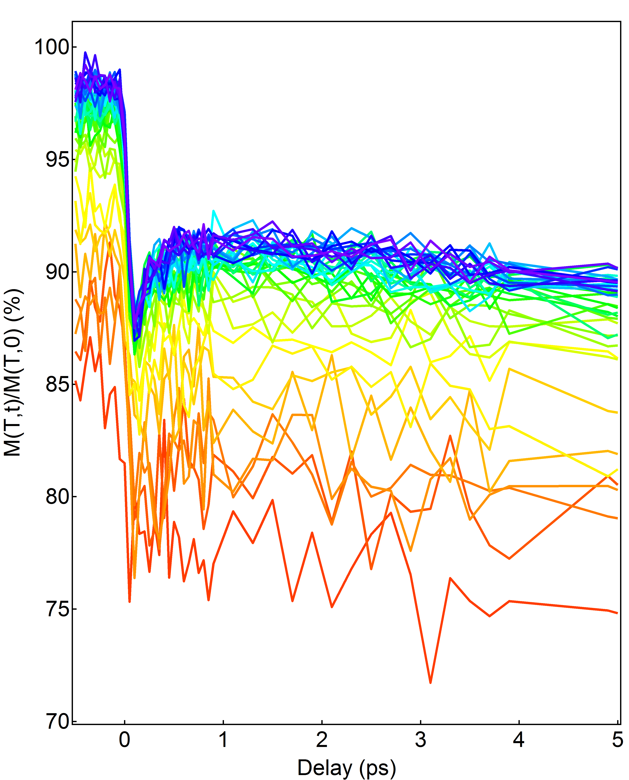
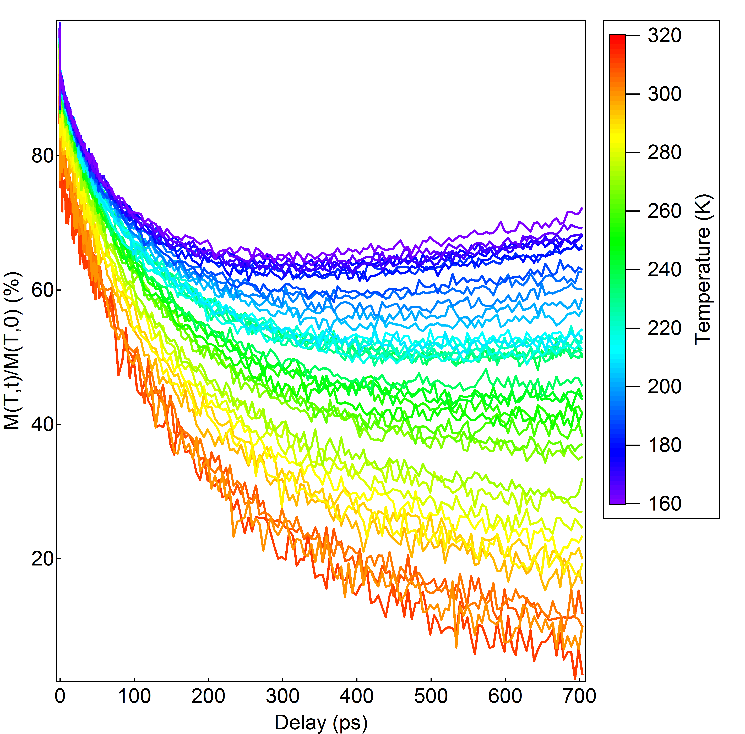
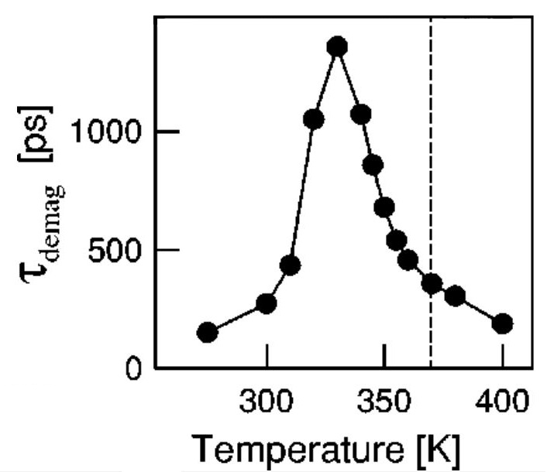
MOKE - Temperature
Electronic excitation
of magnetic system
Lattice heating
Of magnetic system
Critical slow-down occurs close to T_{c} as observed in T. Ogasawara et al. PRB 68, 180407 (R) (2003). Magnetization decay time increases.

Slide 13
Results
0-5 ps timescale: We identified an ultrafast quenching in an half-metal, that must have purely electronic origin.
5-100 ps timescale: We identified a coupling between the coherent optical phonon and the magnetic response.
100-700 ps timescale: The behaviour agrees well with considerations based on the bandstructure.

Slide 14
Open questions
0-5 ps timescale: How can we explain the ultrafast quenching? We need measurements that directly probe the electronic structure: Time-Resolved Photoelectron Spectroscopy.
5-100 ps timescale: What generates the coupling between the phonon and the magnetization? Is it possible to control it, p.e. with strain?

Slide 15
Thank you for your attention!

Slide 16
Acknowledgements
S. Günther, M. Kronseder, M. Büchner, H. Körner, Prof. C.H. Back
– My kind hosts in Regensburg Universität
A. Y. Petrov, B. Davidson
- Sample growth and characterization (transport, XRD)
G. Panaccione, G. Rossi

Slide 17
Appendix
Useful tools

Slide 18
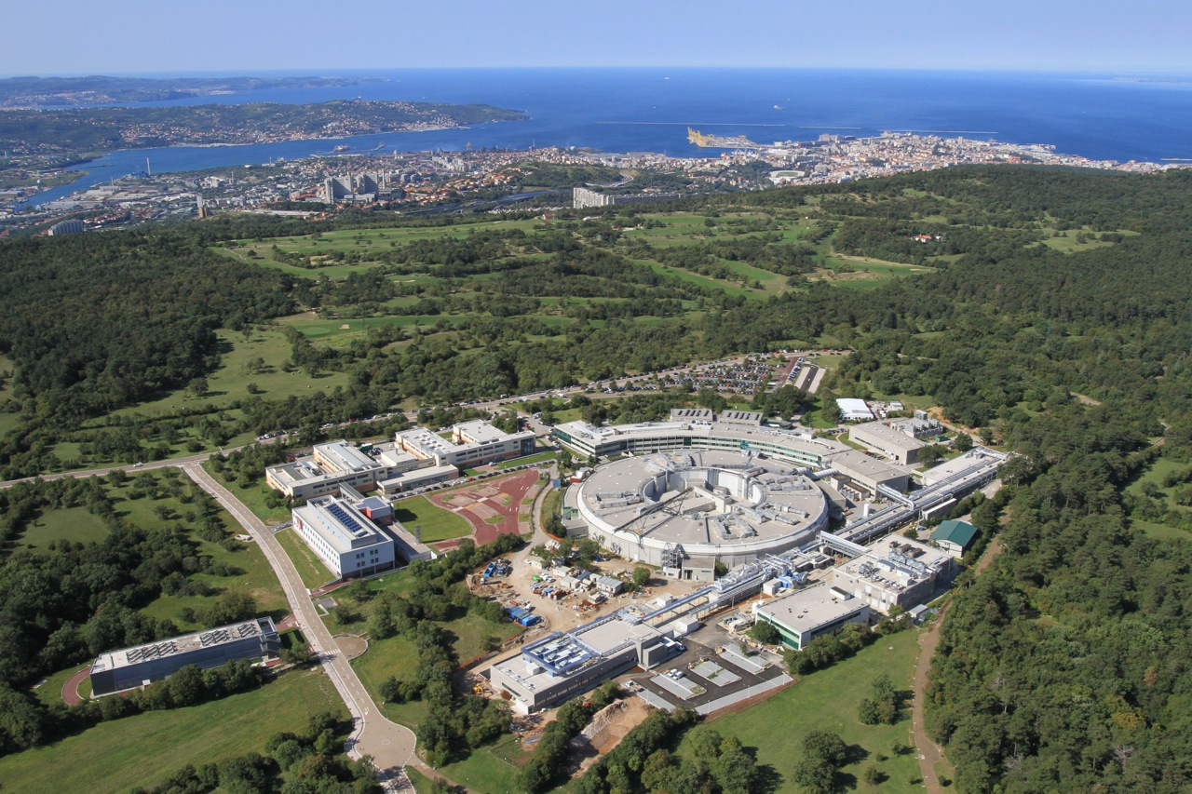
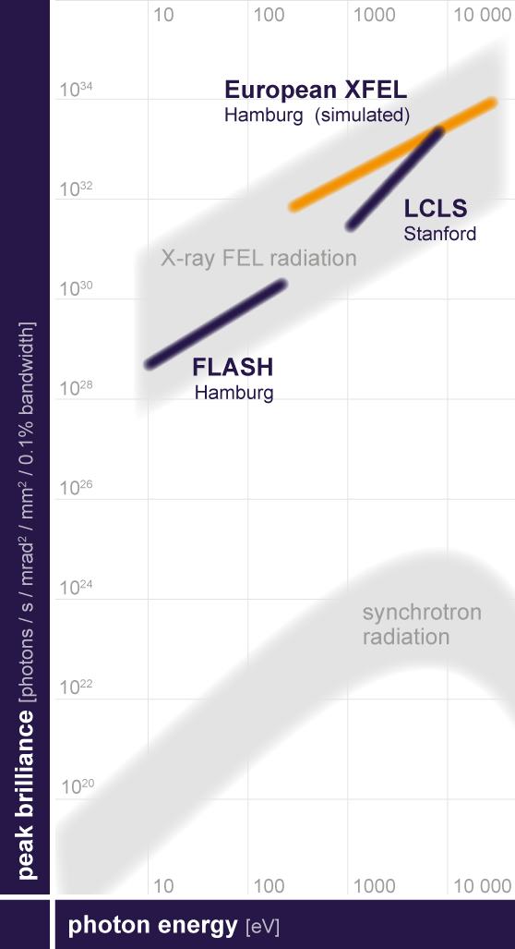
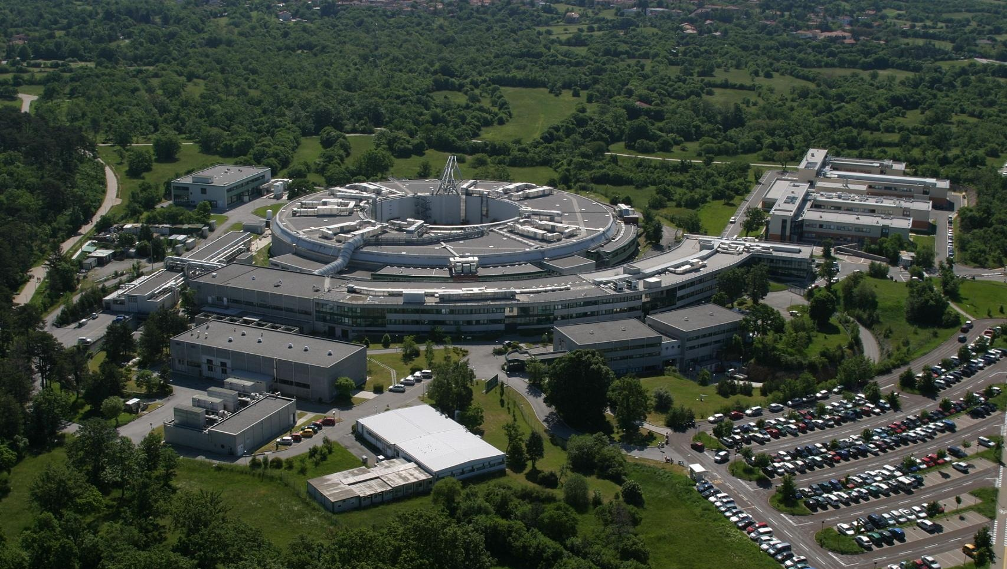
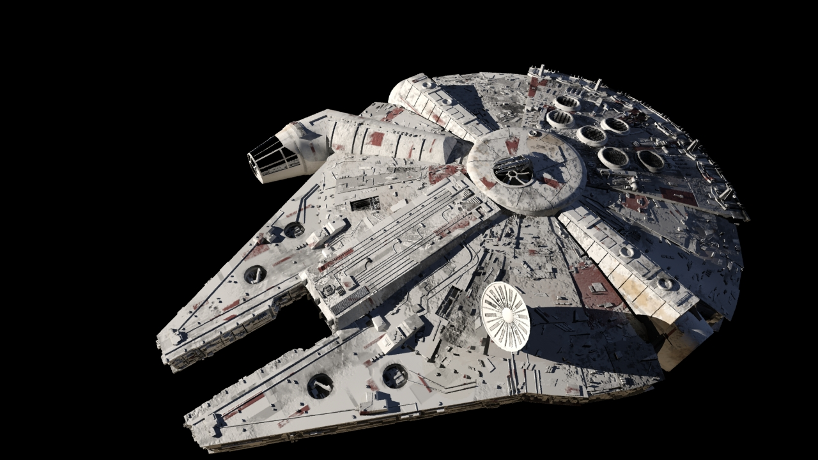
Elettra Storage Ring
Linac Building Extension
New world of non-equilibrium phenomena
Extremely strong user selection
Experimental Hall
Undulator Hall
L. Pastrovicchio et al. Topolino 3070, 2

Slide 19
High Harmonics Generation
Harmonics generation from a gas (Ar, Ne)
Gives ultra-short, coherent, soft-X ray photon pulses from a solid state laser
Low intensity
Can provide an intermediate step between the laboratory and the Free Electron Laser

Slide 20
T-REX
Interaction Chamber
Monochromator and switch
Slits and Refocussing
Pump Laser
Pharos 20W 400 µJ
ULTRASPIN

Slide 21
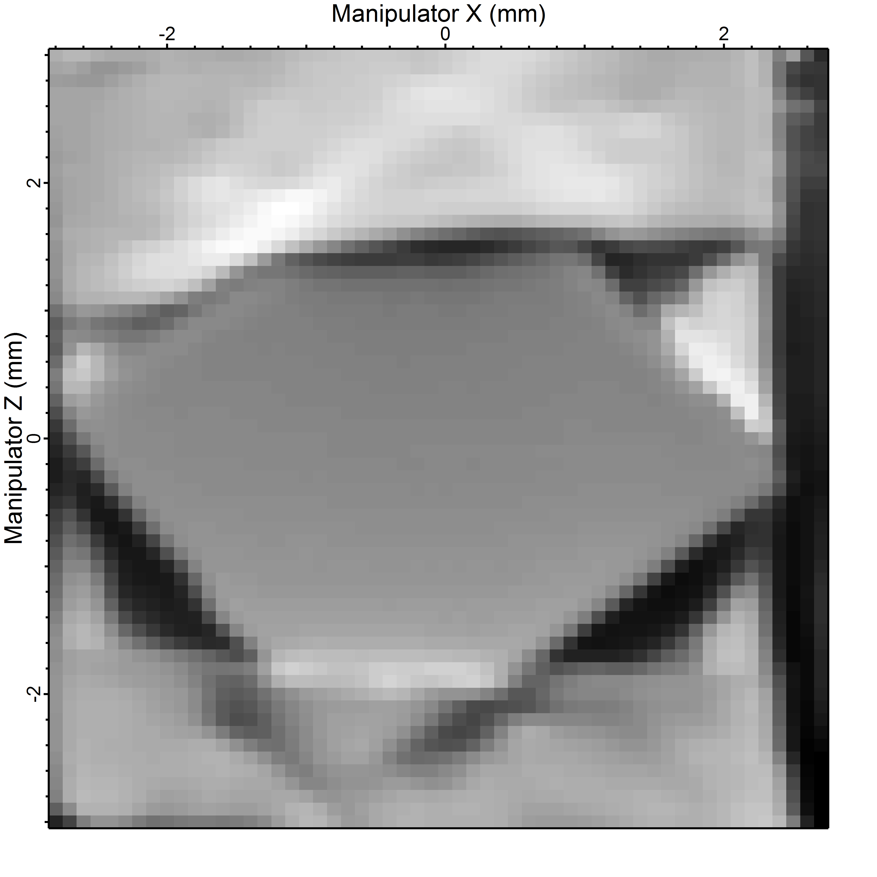
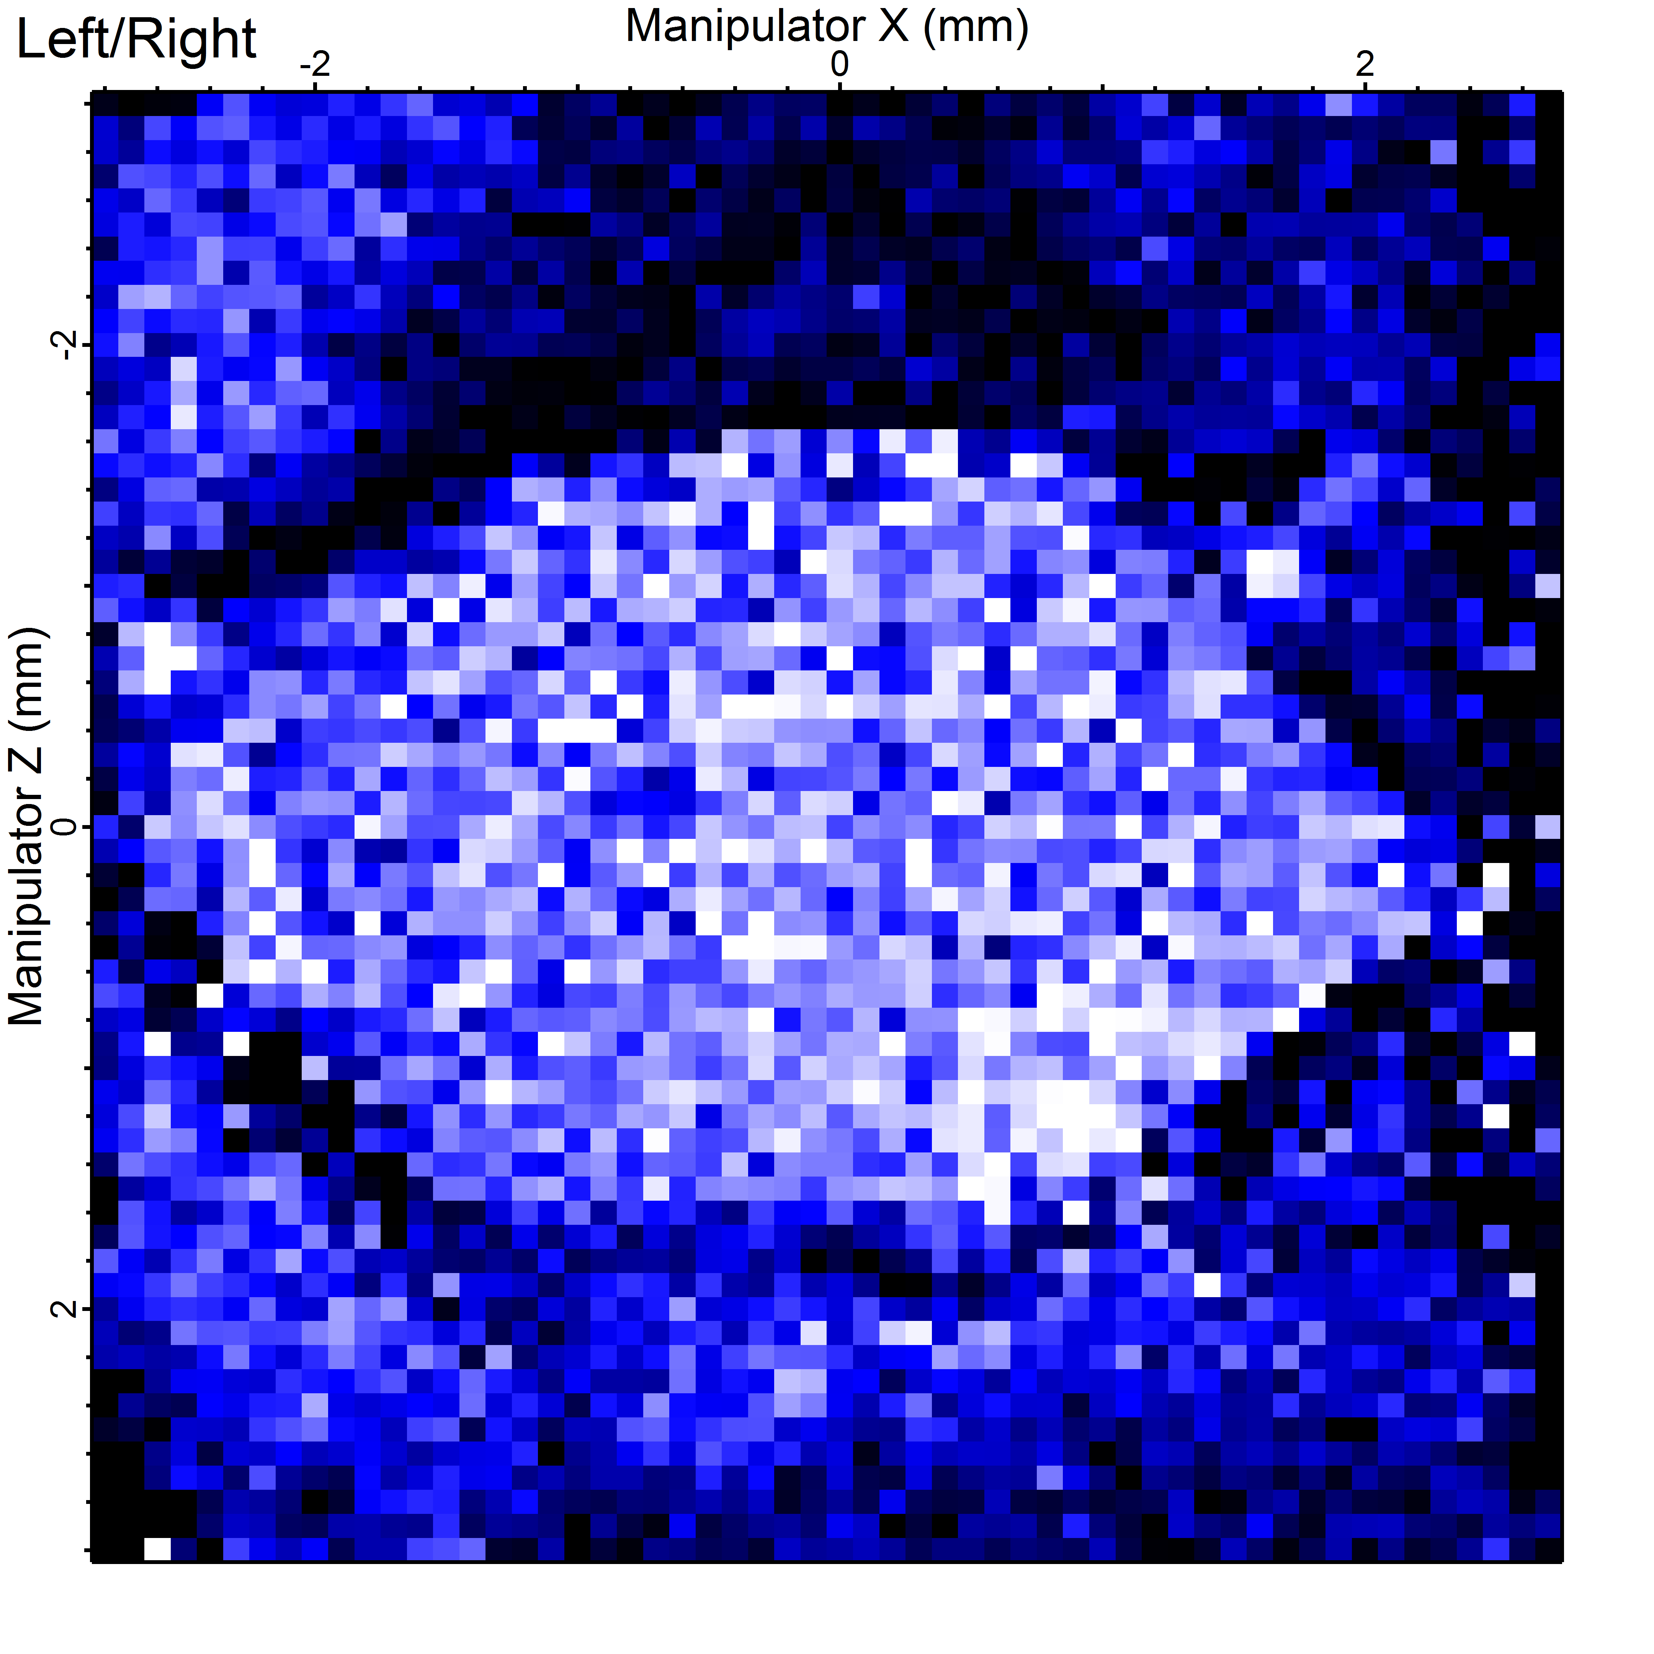
ULTRASPIN ENDSTATION
Vectorial
Spin-polarimeter
Sample Preparation chamber
Analysis
chamber

Slide 22
Mott scattering
Spin dependence in scattering processes
Scattering Mott (1932):
$\frac{dσ}{dΩ}=I\left(θ\right)[1+S\left(θ\right)(\vec{P}∙\hat{n})]$
Elastic electrons (40-200 keV)
Spin-orbit effect

Slide 23
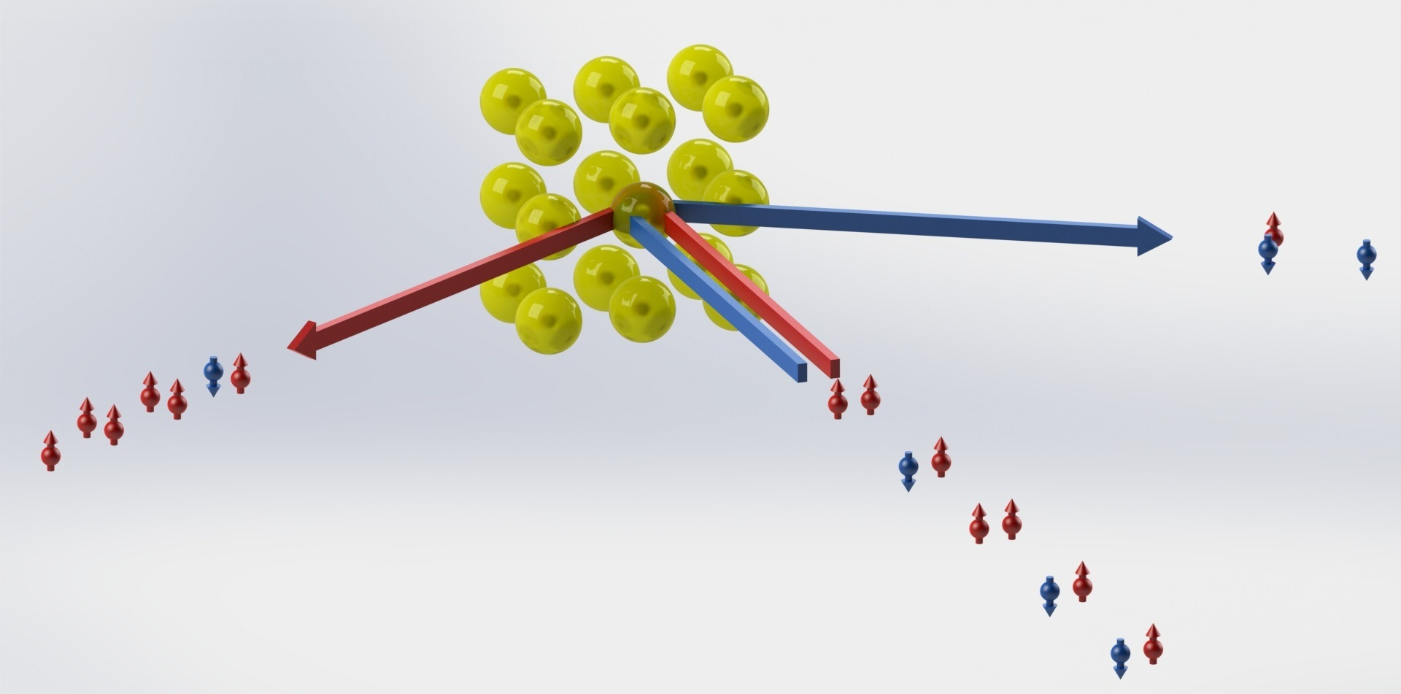
Mott Polarimeter
Stable
Two components of $\vec{P}$ at a time
$$A=\frac{N_{↑}−N_{↓}}{N_{↑}+N_{↓}}=S_{eff}P_{⊥}$$
Sherman function

Slide 24
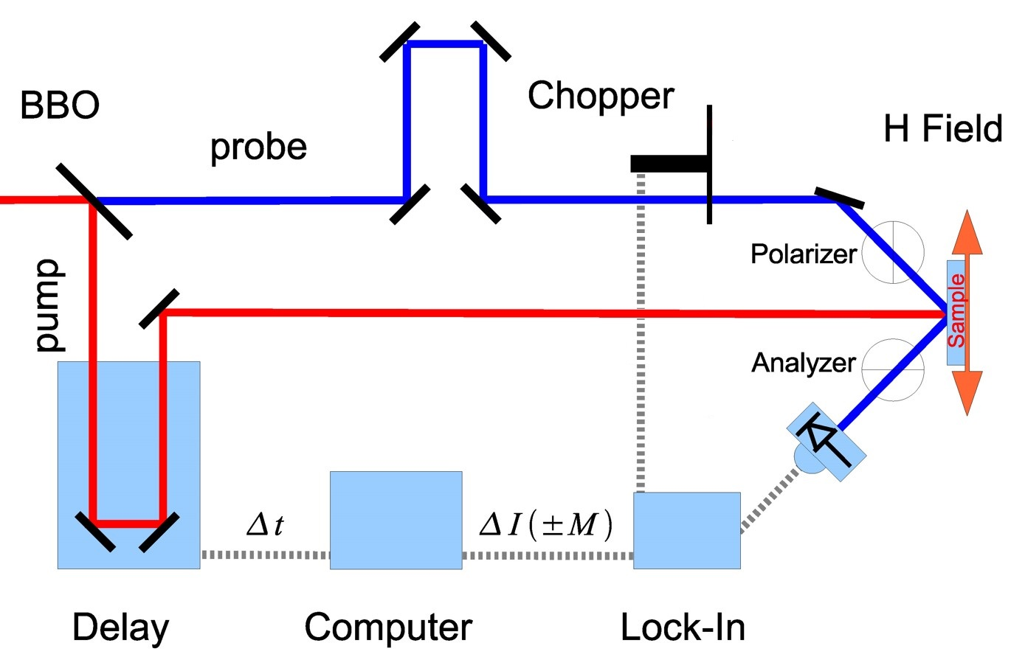
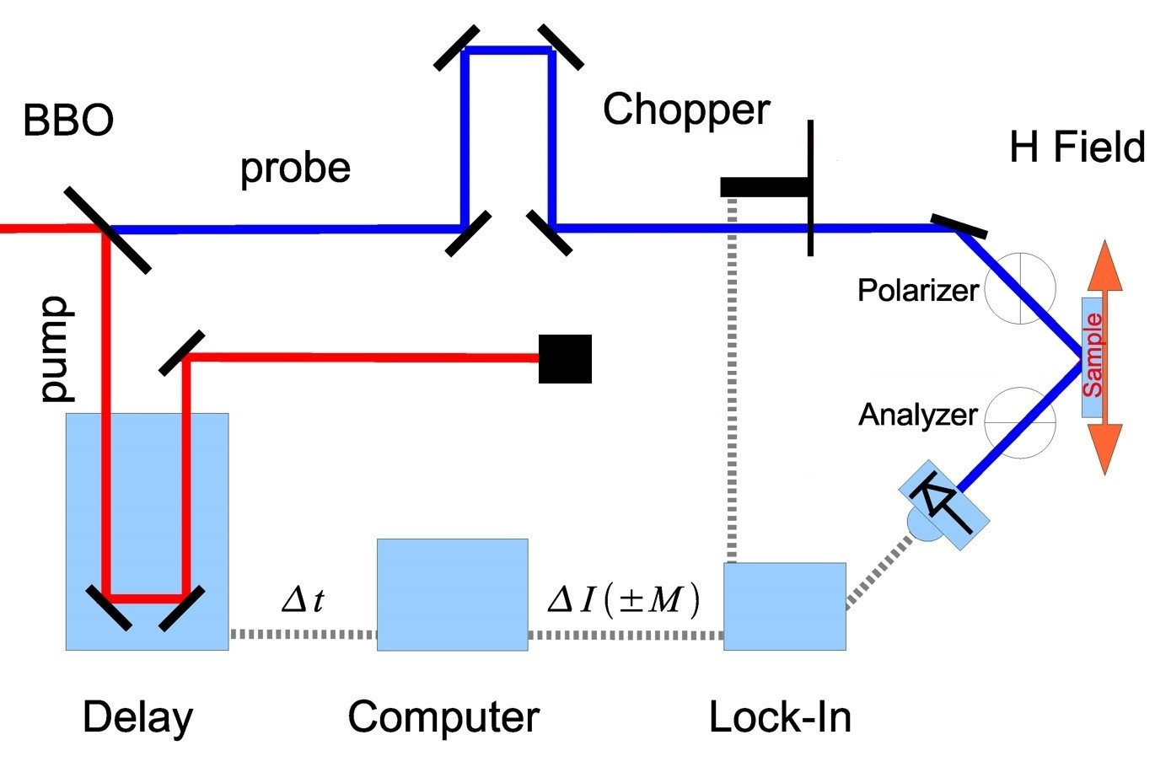
TR-MOKE measurement set-up
BBO crystal generates the second harmonic (3eV) of the pump laser (1.5eV)
Sample is magnetized and measured with applied field (saturation) in opposite directions
A delay line allows to remotely control the pump-probe delay
$$1ns≈30cm$$
When dynamical hysteresis are measured, the blue beam is chopped.
A chopper, connected to a lock-in allows to MODULATE the PUMP BEAM
When normalizationhysteresis are measured, the blue is chopped AND red is blocked.

Slide 25
Magnetism characteristic lengths

