Slide 1
Experimental generation of squeezed states of light
Carmen Porto
Supervisor: Prof. Simone Cialdi
Co-Supervisor: Prof. Matteo Paris
PhD school of Physics

Slide 2
Outline
Introduction:
Electric-field vacuum fluctuations
Squeezed states of light and their applications
Generation and detection squeezed states:
Experimental setup
Full quantum state reconstruction

Slide 3
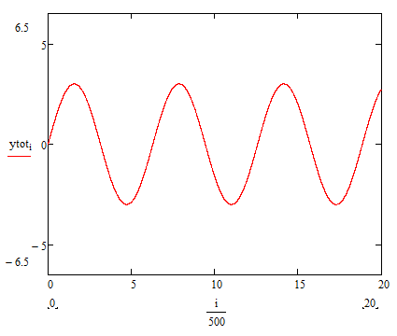
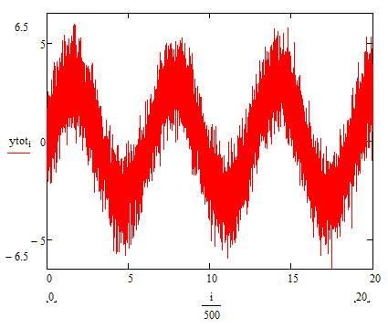
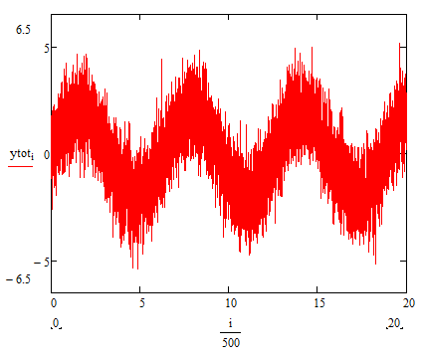
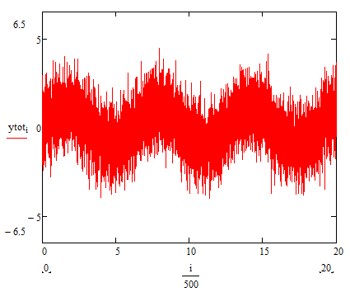
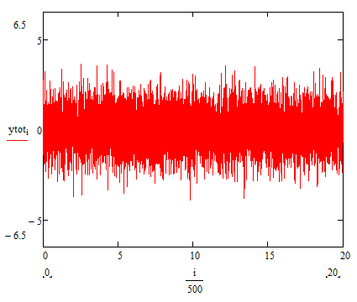
Electromagnetic field
Quantum point of view
Classical point of view
From Maxwell equations
Vacuum state
The variance of Electric Field
Amplitude
Time
Heisenberg uncertainty principle
Electric-field vacuum fluctuations or vacuum noise

Slide 4
ˆ
Brief theoretical introduction
Electric Field Operator E
We can introduce the quadrature operators
amplitude quadrature
phase quadrature

Slide 5
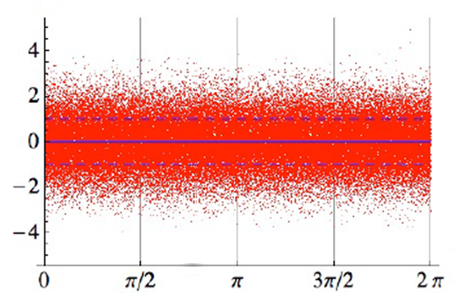
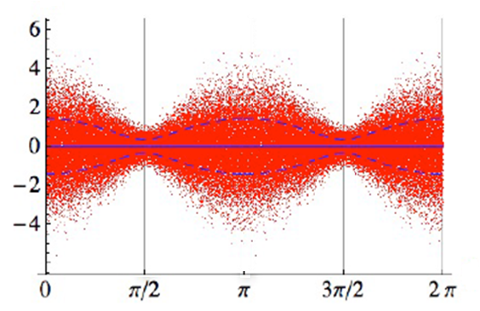
Vacuum state
We can generate states in which the noise of the electric field at certain phases falls below that of the vacuum states
Squeezed state

Slide 6
Applications of squeezed states
Gravitational wave detectors — GEO 600 (http://www.geo600.org)

Slide 7
Applications of squeezed states
Quantum Teleportation
In the first teleportation experiment
involving continuous variables, the
entangled channel was generated by
the interference of two squeezed,
and thus Gaussian, states with
orthogonal squeezing phases:
“Unconditional Quantum Teleportation”,
A. Furusawa et al., Science 282, 706 (1998)

Slide 8
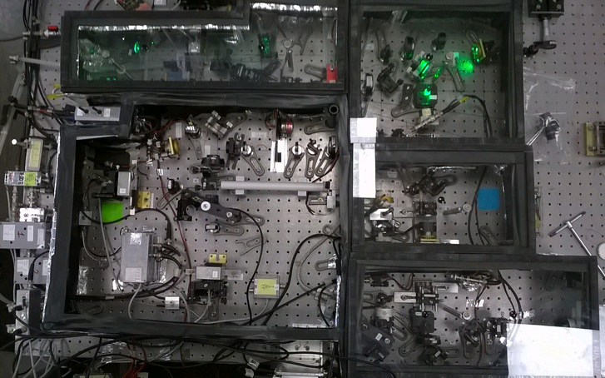
Generation of squeezed states of light
Laser (1064nm , 532nm)
LO
Signal
OPO
Homodyne detector
OPO active stabilization

Slide 9
Nd:YAG Laser
Nd:YAG
1064nm
532nm
PPLN
Home-made
Single-mode operation
Second harmonic generation

Slide 10
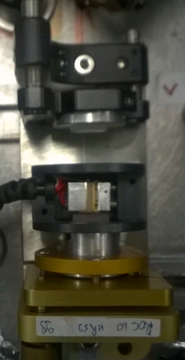
R @ 1062nm = 92%
R @ 1064nm = 99%
Optical Parametric Oscillator (OPO)
Pump
@ 532nm
Seed
@ 1064nm
OUT
Niobato di Litio 10mm
Generation of squeezed states

Slide 11
How to generate squeezed state?
Parametric Down-conversion (PDC)
Nonlinear crystal
If we start from the vacuum
The crystal transfers the noise from X2 to X1

Slide 12
The amount of squeezing obtained by a single pass of a continuous-wave pump laser through a nonlinear crystal of a reasonable size is very small.
OPO
Vacuum noise
Squeezed vacuum
Nonlinear
crystal
pump
The OPO cavity is actively stabilized
The cavity is resonant to the laser,
effectively allowing multiple passing (~ 100)
of the signal through the crystal

Slide 13
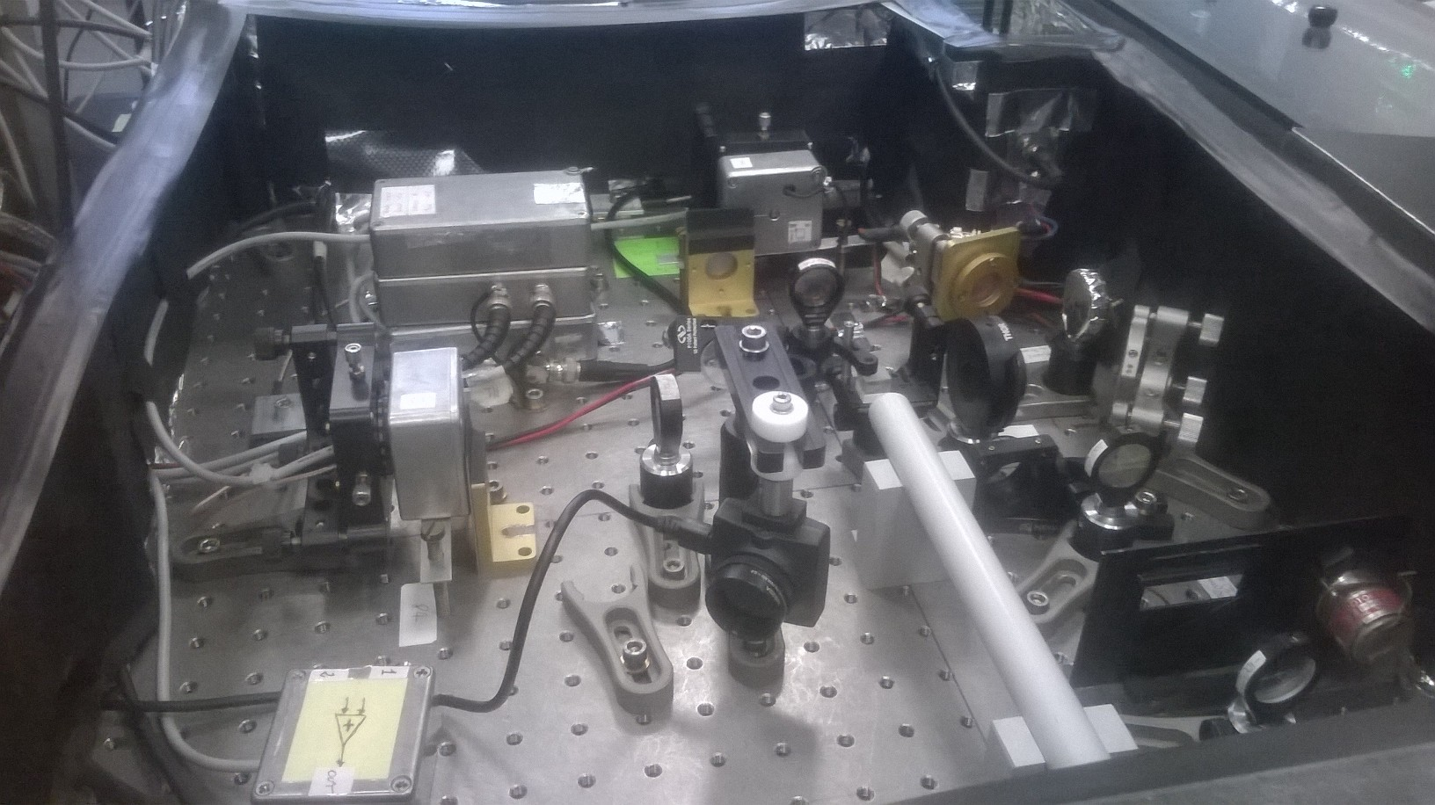
Homodyne detector
Local Oscillator (LO)
Signal

Slide 14
Homodyne detector
Differenzial Amplifier
Photodetectors
BS (T=R)

Slide 15
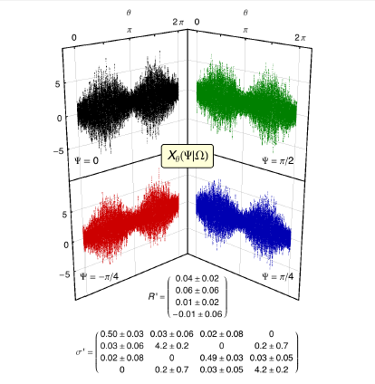
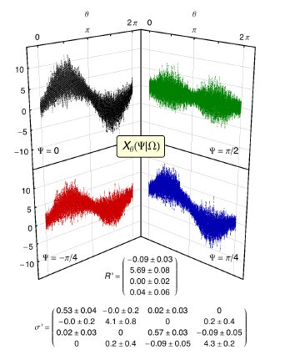
S. Cialdi, C. Porto, D. Cipriani, S. Olivares and M. G. A. Paris Full quantum state reconstruction of spectral field modes via homodyne detection Preprint arXiv:1505.03903 [quant-ph] (2015)
Squeezed vacuum state
Squeezed coherent state
Lavori

Slide 16
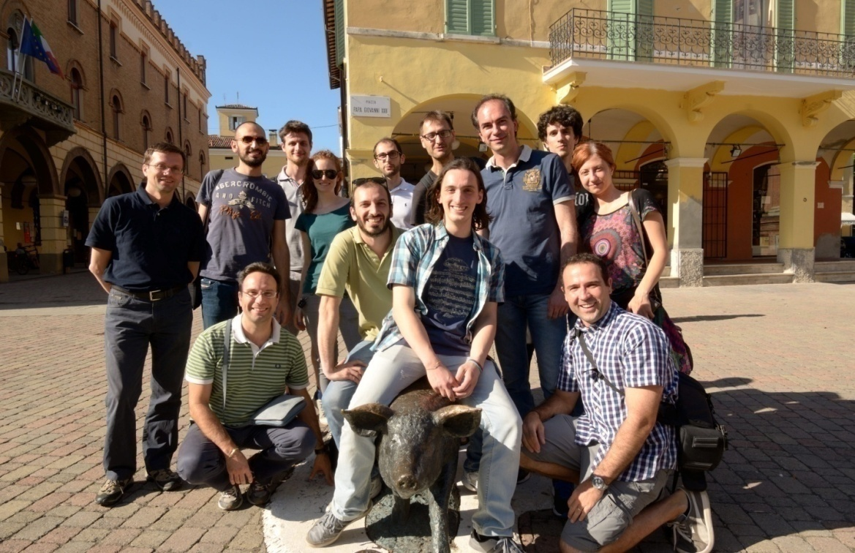
Support from:
MIUR, Firb “LiCHIS” (RBFR10YQ3H)
EU, “QuProCS” (641277)
UniMi, H2020 Transition Grant (15-6-3008000-625)
UniMi, “UNIMI14” (15-6-3008000-609)

Slide 17
Thank you for your attention

