Slide 1
Testing antimatter gravity: the Aegis experiment at Cern
Phd Student: Michele Sacerdoti
Phd Workshop: 12-13/10/2015
Supervisors: Fabrizio Castelli, Marco Giammarchi

Slide 2
Index
Theoretical aspects
Aegis experiment
Critical aspects
Montecarlo simulations on various alternatives

Slide 3
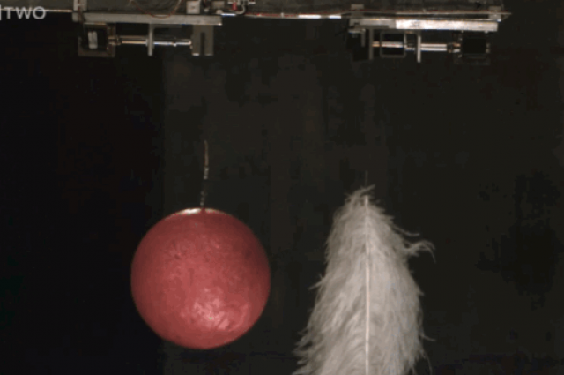
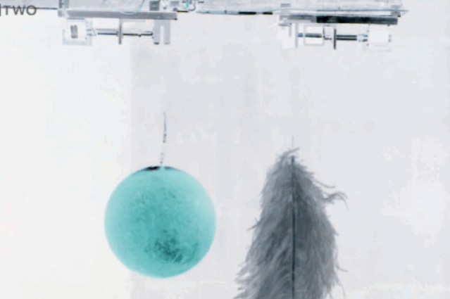
The weak equivalence principle (WEP)
CPT symmetric situation
All matter bodies at the same space-time point in a given matter gravitational field will undergo the same acceleration
All antimatter bodies at the same space-time point in a given antimatter gravitational field will undergo the same acceleration
Notes:
4. Il principio di equivalenza debole afferma che, in un dato campo gravitazionale di materia, tutti i corpi costituiti da materia nello stesso punto dello spazio tempo subiranno la medesima accelerazione. Il teorema di simmetria CPT prevede che dovremmo osservare il medesimo comportamento anche nel caso di corpi di antimateria in un campo gravitazionale di antimateria.

Slide 4
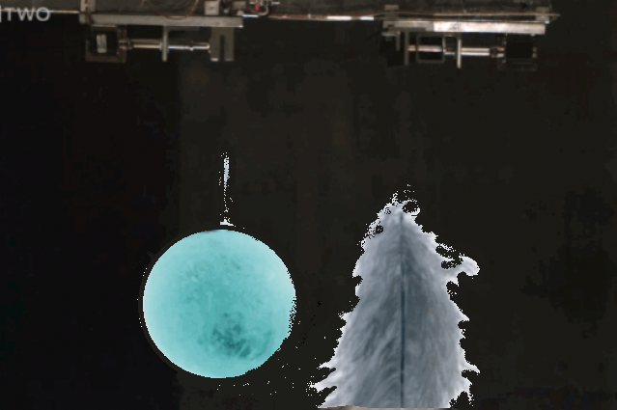
The weak equivalence principle (WEP)
All matter bodies at the same space-time point in a given matter gravitational field will undergo the same acceleration
Will antimatter bodies at the same space-time point in a given matter gravitational field undergo the same acceleration?
All antimatter bodies at the same space-time point in a given antimatter gravitational field will undergo the same acceleration
Notes:
5. Ma, cosa accade quando abbiamo dell’antimateria in un dato campo gravitazionale di materia?

Slide 5
Supergravity theories
As pointed out by Scherk in 1979 besides the graviton with spin 2 and zero mass the gravitational interaction could be mediated by a Kaluza-Klein vector particle with spin 1 and a scalar particle with spin 0 with non zero mass
The graviscalar is attractive while the gravivector is repulsive.
It could happen that antimatter experiences a greater acceleration towards earth than matter or a smaller one.
The effect of the two particles could be cancelled in matter experiments and appear in matter-antimatter experiments.

Slide 6
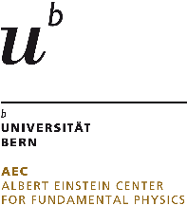
AEgIS collaboration
CERN
Czech Technical
University
ETH Zurich
Stefan Meyer Institute
University of
Genova
University of
Milano
University of
Padova
University of
Pavia
Institute of Nuclear
Research of the
Russian Academy
of Science
Max-Planck Institute
Heidelbert
Politecnico di
Milano
University College
London
University of
Bergen
University of
Bern
University of
Brescia
Heidelberg
University
University of
Oslo
University of
Paris Sud
University of
Trento
University of Lyon 1
INFN sections of:
Genova, Milano,
Padova, Pavia,
Trento
Notes:
6. Dare una risposta sperimentale a questo quesito è il principale obiettivo dell’esperimento AEgIS, che è una collaborazione tra 21 diversi istituti in tutta Europa, di cui molti italiani. Ora, quello che in AEgIS ci si propone di fare è

Slide 7
The goal of Aegis
Measure gravitational acceleration of Antihydrogen with a 1% precision with free fall and a classical Moiré deflectometer
Antihydrogen is neutral, so electric fields should not hide the gravitational acceleration
We need to create one antihydrogen atom per second to be able to have the result in a reasonable amount of time, around 1 month
The atom must be very cold so that its thermal vibration doesn’t hide the gravitational acceleration (100 mK)

Slide 8
Classical Moirè deflectometer
photon
70 μm
30 μm
1 μm
precision
L = 25 cm
The beam is created through Stark acceleration with a non uniform electric field
as antihydrogen is created in a Rydberg level with an electric dipole (100m/s)

Slide 9
Aegis strategy to create antihydrogen
Control of the antihydrogen quantum state
Cold antihydrogen atoms (v_{antihydrogen} ~ v_{antiproton})
Cross section goes with n⁴ of Ps and is maximum when the orbital velocity of Ps is equal to its velocity
Charge exchange with Positronium excited at Rydberg (high n) levels
For n=25
velocity of Ps orbital velocity
Antiprotons from
AD at Cern
Notes:
8. In AEgIS si è pianificato di produrre Antidrogeno attraverso la reazione di scambio di carica tra antiprotoni e atomi di Positronio. Grazie a questa reazione, possiamo controllare lo stato quantico dell’Antidrogeno e la sua temperatura. Ma il più importante vantaggio di questa reazione è la sezione d’urto, che risulta essere molto alta. Infatti, se diamo un’occhiata al tipico modo di produrre antidrogeno, che vuol dire ricombinare antiprotoni e positroni, una grossa problematica è che gli atomi di antidrogeno così generati sono troppo caldi e anche la sezione d’urto è di molto inferiore rispetto alla nostra strategia. Pertanto, come si evince immediatamente, il Positronio diventa per noi un mezzo fondamentale per produrre atomi di Antidrogeno freddi. Vediamo un attimo cos’è

Slide 10
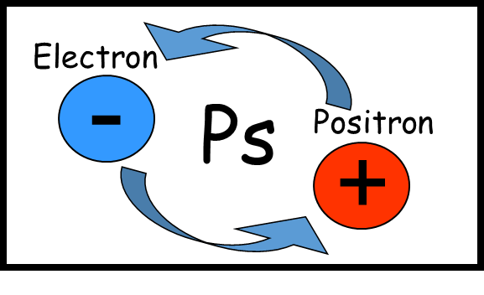
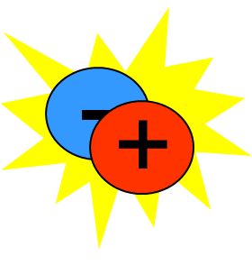
Positronium atom
Purely leptonic atom
Ps n-level energy
$$E_{Ps_{n}}=\frac{E_{H_{n}}}{2}$$
γ
para-Ps
Singlet state
Mean lifetime 0,125ns
2γ annihilation
γ
orto-Ps
Triplet state
Mean lifetime 142ns
3γ annihilation
γ
γ
γ
γ Energies = 511keV
γ Energies < 511keV
Notes:
9. Il Positronio è un atomo puramente leptonico, essendo uno stato confinato tra un elettrone e un positrone. Esso esiste in due stati differenti: lo stato di singoletto, chiamato para-Ps e lo stato di tripletto chiamato orto-Ps. Il para-Ps ha una vita media molto breve e, quando muore annichila in due raggi gamma; l’orto positronio vive un po’ più a lungo e quando muore annichila in tre raggi gamma di energia più bassa.

Slide 11
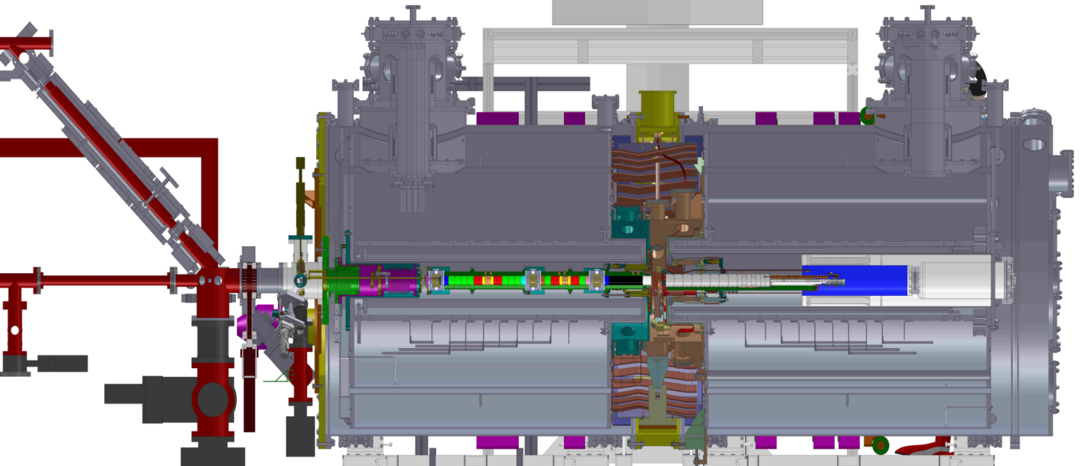
The experimental apparatus
Transfer line
4.46 T magnet
1 T magnet
²²Na
Accumulator
Trap
Ps chamber
Positron system
AD beam line
Degraders
4.46 T catching traps
1 T manipulation traps

Slide 12
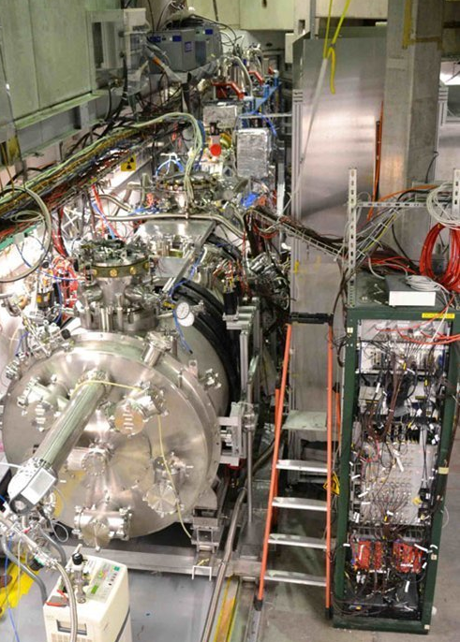
Detail of the apparatus
Classical Moiré deflectometer
Antiprotons accumulated from CERN AD
(Antiproton Decelerator)
e+
p⁻
p⁻
2 laser
beams
for Ps
excitation
e+ beam
accumulated from Na²² source

Slide 13
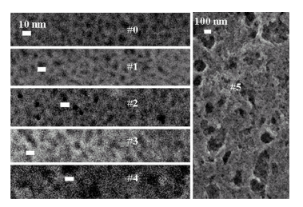
The Positronium production
e+/Ps converter
Positronium is created in the material bulk
Nanochanneled Si
Frontal view
Porous Silicon target
e+
Positron pulse:
4,2kV
A bunched positron beam is sent toward a porous «target» able to convert positrons into Positronium.
Pores diameter
~10nm
4.2 kV
A fraction of the Ps exiting the target is thermalized into the target pores
cooled Positronium cloud
Notes:
17. A buncher, providing a parabolic potential, has the task to further accelerate and compress in time the positron dump coming from the accumulator. The bunched positron beam is then implanted inside a porous silicon target. In this way, some positrons capture an electron from the material and generate Positronium at around 20000K. Atoms exit the target through the pores
and, bouncing on their walls, cool down. As a result, we have outside the target a Ps cloud with a thermalized percentage.
This percentage depends on how deep was the implantation of positrons, and therefore on their implantation energy.

Slide 14
Strategy for Rydberg laser excitation
Continuum
0,75eV
~1680nm
High n
n=3
6,05eV
205nm
n=1
30% efficiency
The laser apparatus has been studied and prepared in Milan
Milan Aegis Group: “Efficient two-step Positronium laser excitation to Rydberg levels" in Nuclear Instruments and Methods in Physics Research Section B: Beam Interactions with Materials and Atoms 269, 1527 (2011).

Slide 15
Critical aspects
Density and temperature of antiprotons (10⁵ per bunch)
Number, velocity and direction of Ps due to the limited solid angle (10⁸ per bunch)
Excitation efficiency of Ps by the lasers (30%)
Effect of the 1T magnetic field on the trajectory of Ps towards the antiprotons
As a result very limited number of generated antihydrogen atoms

Slide 16
Montecarlo Simulations
I am working on montecarlo simulations to increase the experiment efficiency
Until now the number of antihydrogen atoms is too small and needs to be increased (3 atoms per 200 s)
Reflectors and electric focusing of Ps through Stark effect have been simulated (12 and 4 atoms per 200 s)
The best result is obtained using a transmission target aligned to the antiprotons trajectory with Ps normal emission instead of a reflection one (1105 atoms per 200 s)
The preparation of such a target is under investigation

Slide 17
Results of Montecarlo Simulations
Layout | Number of antih atoms in 200 s
Proposal | 3
Ellipsoidal reflector | 12
Focusing through Stark effect | 4
Transmission target off-axis with normal emission | 112
Transmission target on-axis with normal emission | 1105

Slide 18
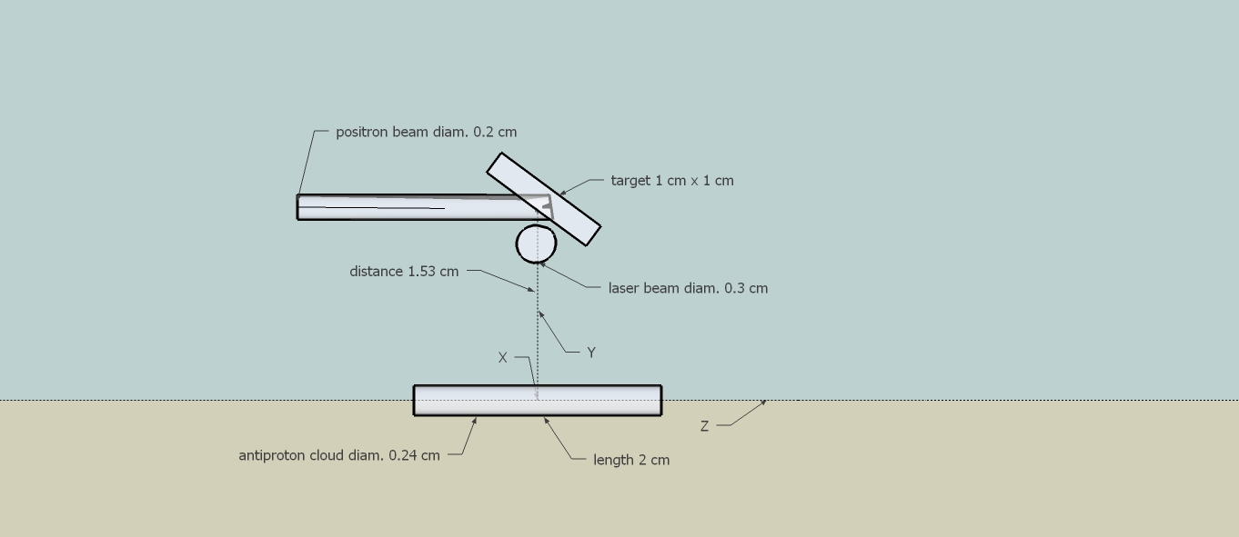
Ps and anti-hydrogen generation

Slide 19
Ellipsoidal reflector
ellipsoidal reflector
focus in target center and
antiproton cloud center
trap electrodes radius 0.85 cm

Slide 20
Focusing through Stark effect

Slide 21
Transmission target off-axis

Slide 22
Transmission target on-axis

