Slide 1
Search for sterile neutrinos with SOX: Monte Carlo studies of the experiment sensitivity
Davide Basilico
1st year Workshop – 11/10/17 Tutors: Dott. Barbara Caccianiga, Prof. Emanuela Meroni

Slide 2
Outline
Sterile neutrinos
SOX project
SOX analysis and sensitivity studies

Slide 3
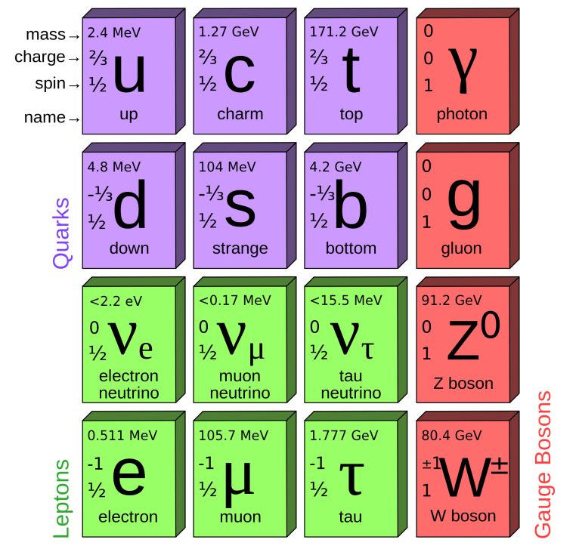
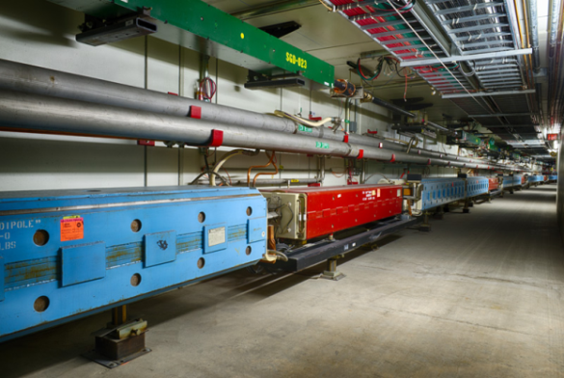
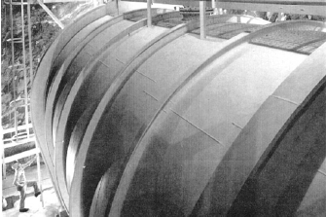
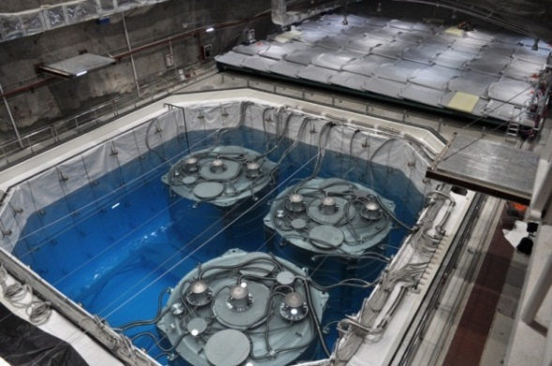
Sterile neutrinos: experimental anomalies
Neutrino flavor eigeinstates ≠ mass eigenstates → neutrino flavor oscillations
Confirmed by several experiments
(${∆m}_{21}^{2}=7.6⋅{10}^{−5}{\text{eV}}^{2}$, ${∆m}_{31}^{2}=2.4⋅{10}^{−3}{\text{eV}}^{2}$ );
Anyway some experiments reveal «anomalies» :
Accelerators : ${\overline{ν}}_{e}$ appearance from ${\overline{ν}}_{μ}$ beam;
Radiochemical: $ν_{e}$ events deficit (disappearance) from artificial sources
Reactors: ${\overline{ν}}_{e}$ events deficit (disappearance) short-baseline (L ∼ (10 − 100) m)
Anomalies can not be included in the three-flavor model, since they hint towards a new mass squared difference ${∆m}_{new}^{2}\sim {\text{eV}}^{2}$

Slide 4
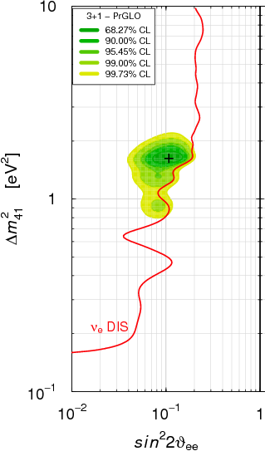
Sterile neutrinos
Anomalies can be explained with a new neutrino state:
It has to be sterile: interacts only through gravitational force (LEP constraints total number of active ν ) $→$ impossible direct detection
Indirect detection: active ν can oscillate in sterile states:
New oscillation length justifies anomalies (oscillation parameters $\sin^{2}\left(2θ_{41}\right)≈0.11$, $Δm_{41}≈1.6 {\text{eV}}^{2}$)
Confirm/reject the sterile hypotesis with a new experiment:
Search for sterile neutrinos with Borexino detector: SOX project

Slide 5
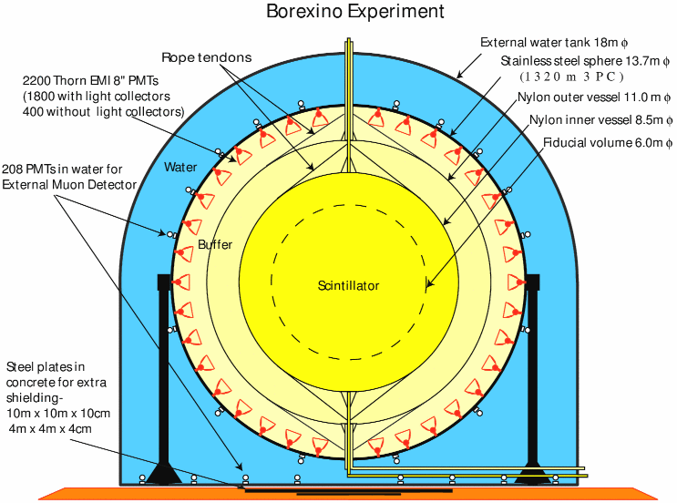
Borexino detector
Scintillator sphere (300 ton) at LNGS, data-taking started in 2007 (mainly solar neutrinos)
Extremely high shielding and radiopurity;
2200 PMTs collect scintillation photons:
Energy $→$ number of photons (σ _{E} ∼ 3.5% @2 MeV);
Position $→$ photons time arrival (σ _{L} ∼ 12 cm).

Slide 6
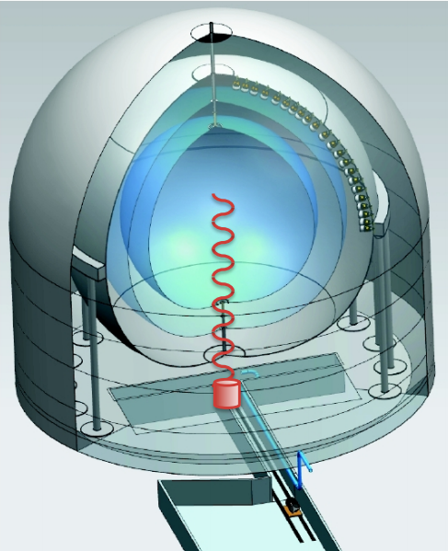
SOX project
SOX goal: give a definitive answer to the sterile hypotesis.
Measurements of ${\overline{ν}}_{e}$ events coming from a flux of a powerful artificial source
${\overline{ν}}_{e}$ source: ¹⁴⁴Ce –¹⁴⁴Pr , activity∼1.5 PBq, placed below Borexino
Distance L ∼ m, energy E ∼ MeV
Sensitive to ∆m² ≈ E/L ∼ (0.1 − 10) eV²
Data taking in 2018 for 1.5 ys
Detected through Inverse Beta Decay ${\overline{ν}}_{e}+p→n+e^{+}$ («golden channel»)
8.5 m
${\overline{ν}}_{e}$ source
Expected events
∼ 10000 ${\overline{ν}}_{e}$ signal (source)
∼ 20-40 ${\overline{ν}}_{e}$ background (geo-neutrinos / reactors) → background-free experiment

Slide 7
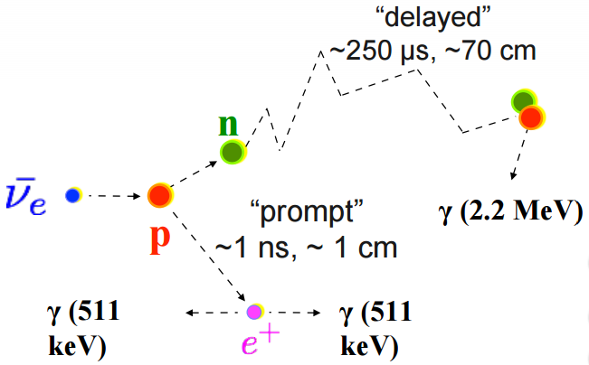
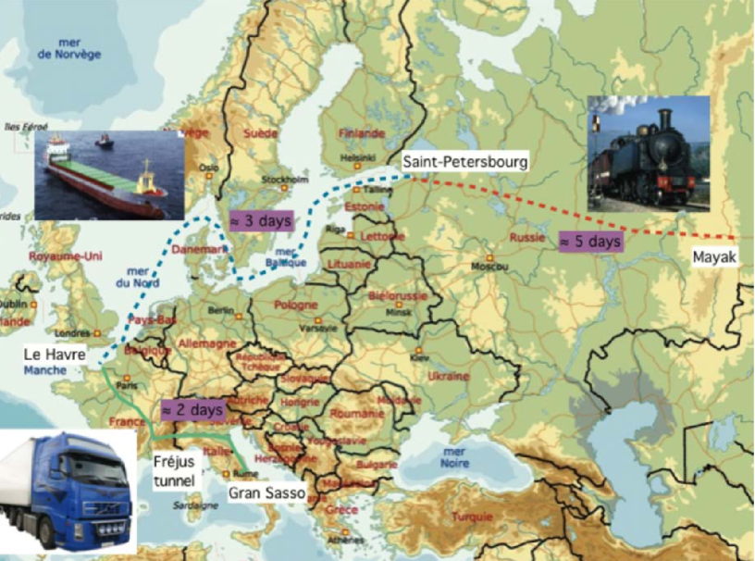
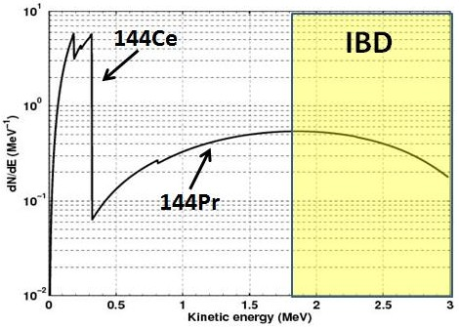
SOX project
Prompt (1.8-3 MeV): e⁺ annichilation $→$ event L and E
Delayed (2.2 MeV): γ emission after n capture
e⁺ -n space/time/energy coincidence
Energy threshold: $E_{e}=1.8 \text{MeV}$
¹⁴⁴Ce-¹⁴⁴Pr spectrum
Source transportation (Russia-Italy)

Slide 8
SOX – Analysis concept
WITH oscillation (example) ($\sin^{2}\left(2θ_{41}\right)=0.3$, $Δm_{41}=2 {\text{eV}}^{2}$)
NO oscillation
Number of events as a function of distance from source (L) and energy (E)
“Rate-only” analysis: total rate counting (search for ${\overline{ν}}_{e}$ "disappearance" )
“Shape-only” analysis / oscillometry: events distribution as a function of L and E -> search for profile deformation due to the ${\overline{ν}}_{e }→{\overline{ν}}_{s}$ oscillation

Slide 9
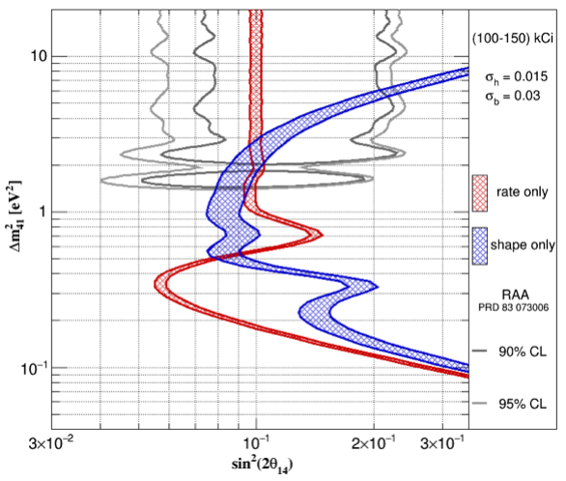
SOX Sensitivity
Working on the SOX official sensitivity framework.
Plot axis: $\sin^{2}\left(2θ_{41}\right)$, $Δm_{41}^{2}$
Δm²< 0.2 eV²: osc.length longer than detector;
0.2 eV² < Δ m² < 1 eV²: entire oscilation length scanned: maximum sensitivity;
Δ m² > 1 eV²: osc.length smaller than resolution:
“Rate-only analysis”
Source activity
Detection efficiency
Active volume knowledge
“Shape-only” analysis (blue)
L ed E reconstruction
Unmistakable sign for sterile oscillation existence

Slide 10
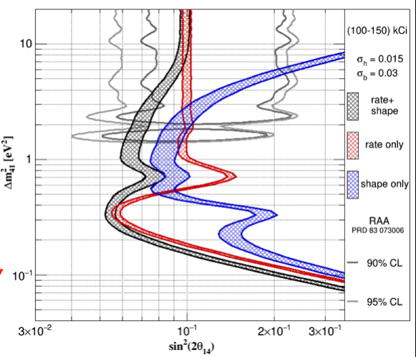
SOX Sensitivity
Working on the SOX official sensitivity framework.
Plot axis: $\sin^{2}\left(2θ_{41}\right)$, $Δm_{41}^{2}$
Δm²< 0.2 eV²: osc.length longer than detector;
0.2 eV² < Δ m² < 1 eV²: entire oscilation length scanned: maximum sensitivity;
Δ m² > 1 eV²: osc.length smaller than resolution:
Rate+Shape analysis (black): combined information from «rate only» and «shape only analysis»

Slide 11
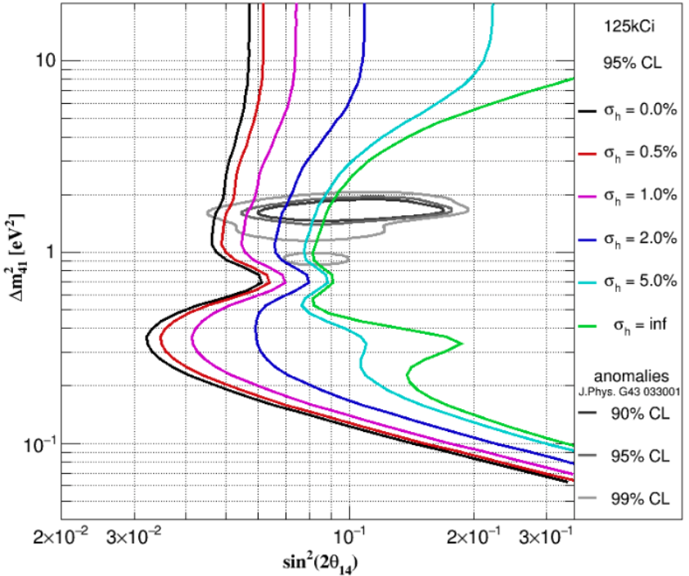
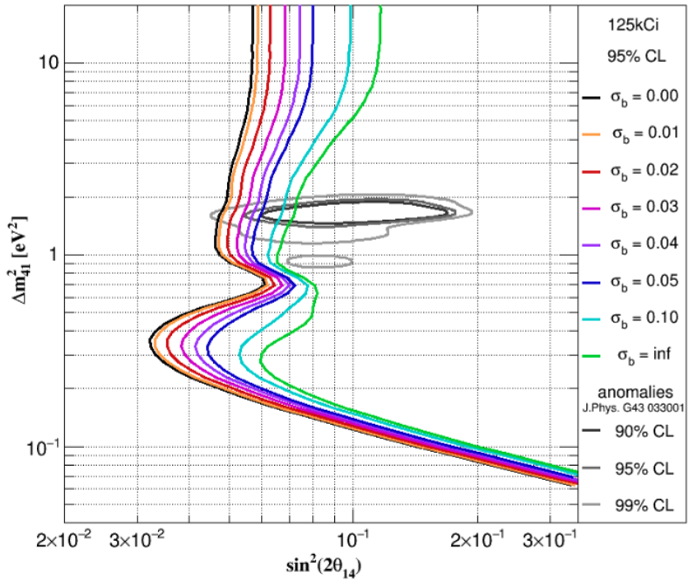
SOX Sensitivity - Systematics
Systematics related to the source
Source activity uncertainty
144Ce-144Pr shape uncertainty
Weakens knowledge on total expected events → rate analysis weakened
Goal: σh=0.5% (red contour)
Affects both rate and shape analysis
Goal: σb=0.02 (red cont.)

Slide 12
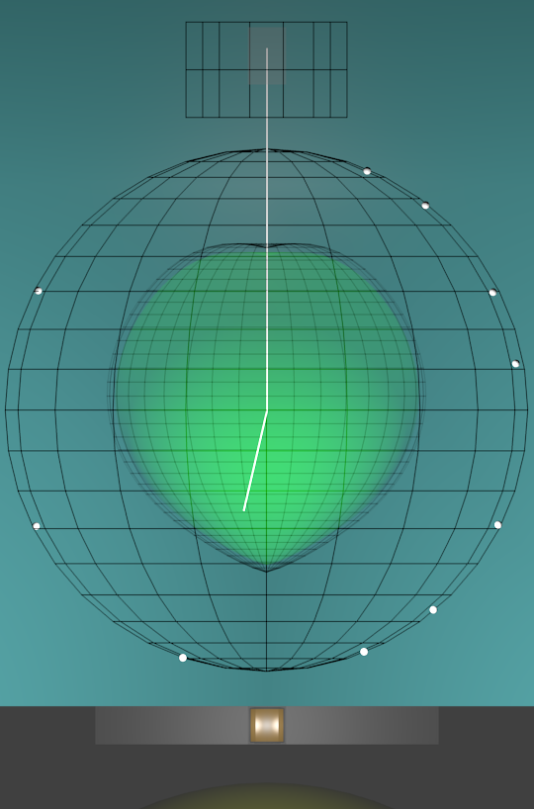
New Borexino calibrations
New detector calibrations (latest ones in 2009):
Neutron detection efficiency
Energy and position reconstruction
Tuning Data-MC
Radioactive sources (α, β, γ, n) in the scintillator through a rod system:
Can be inclined and rotated
System purification, ultrapure materials
2-3 months, beginning of 2018, 200 positions to be scanned

Slide 13
Summary
SOX goal: conclusive answer to the sterile hypotesis;
${\overline{ν}}_{e}$ MeV-energy intense source, events detected through IBD reaction;
Sensitivity analysis rely on the total number events (“rate”) and on the events distribution (“shape”);
Systematics:
Source-related (uncertainty on the activity / ${\overline{ν}}_{e}$ emitted spectrum);
Detector-related (bias on position reconstruction -> to be studied carefully).

Slide 14
Thank you!

Slide 15
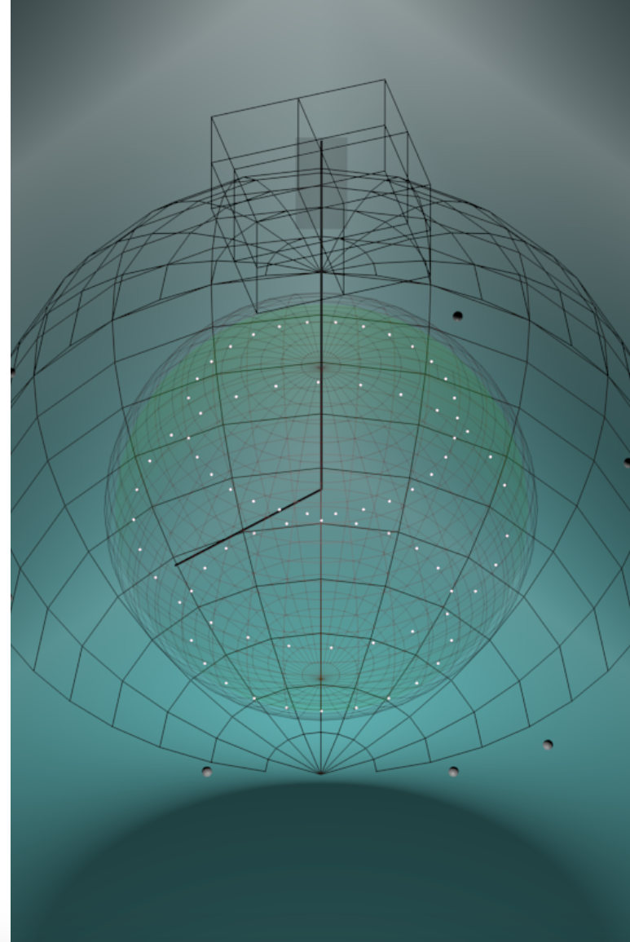
Borexino calibrations - Sources
Neutrons (E<9 MeV): detector mapping for neutron detection efficiency
α e β+: position reconstruction studies
γ mono-energetic (E<3.2 MeV): energy response
2-3 months (2018) of intensive calibrations in 200 positions

