Slide 1

Electronic Properties of Low Dimensional Quantum Materials
C. Bigi

Slide 2
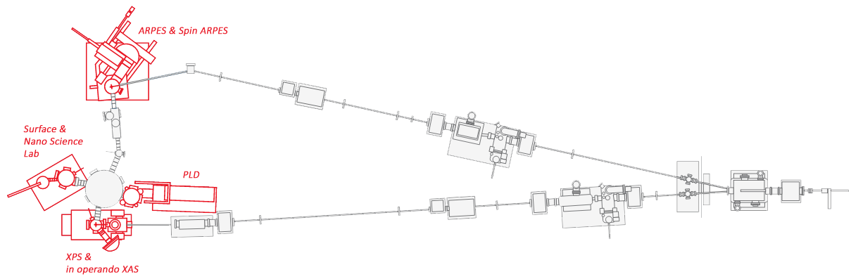


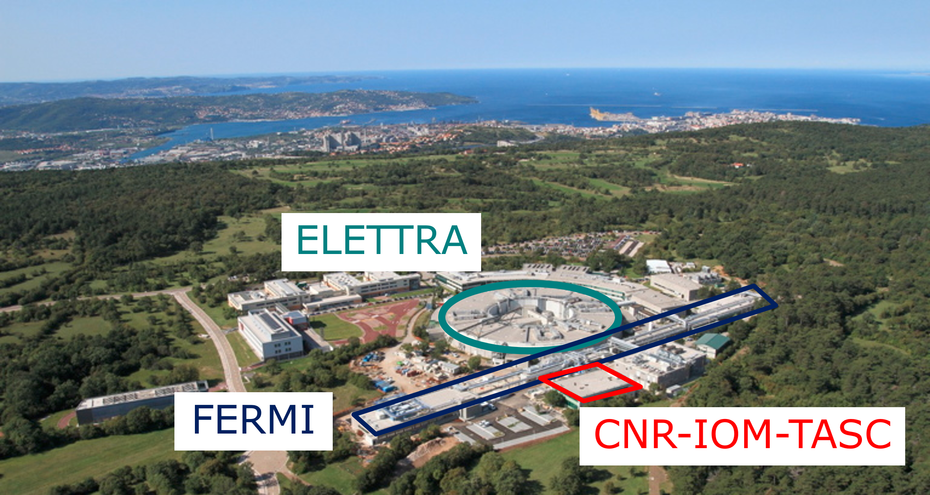

OUTLINE
APE BEAMLINE
Motivations
Experimental techniques
Case study: Bi₂Se₃ thin films
Perspectives

Slide 3

WHAT ARE WE LOOKING AT?
E
Many properties of solids are determined by electrons within a narrow energy slice around E_{F}
E_{F}
Metal
Semimetal
Semiconductor
Insulator

Slide 4
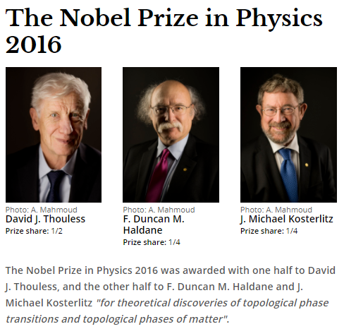

NEW PHASES OF MATTER
2016

Slide 5
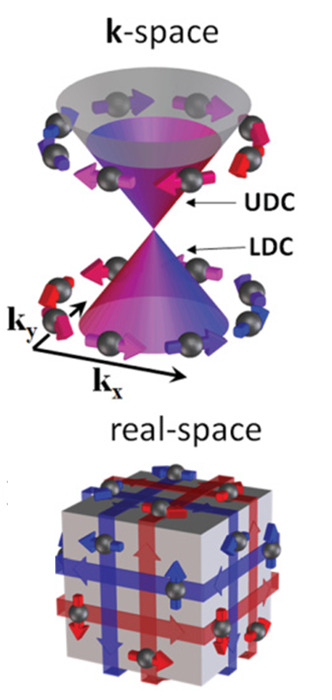
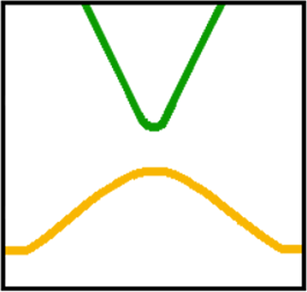
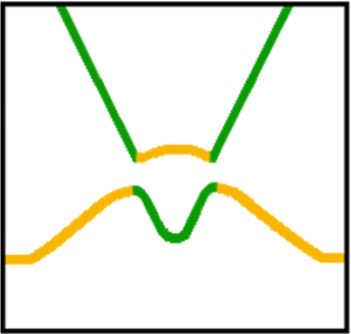

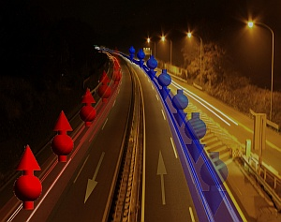
WHY TOPOLOGICAL INSULATORS?
Trivial insulator
Topological insulator
SOC
E_{F}
TRS
BZ
BZ
NPG Asia Materials research highlight, 29 November 2010
Phys. Rev. B 84, 165113
(2011)
Topological insulators possess robust metallic surface states with characteristic spin texture

Slide 6

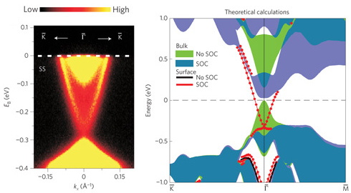
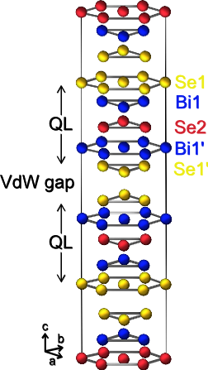
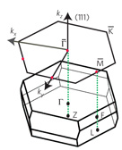
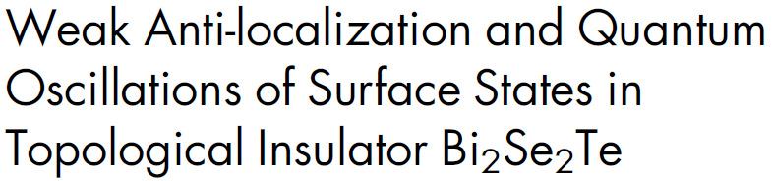
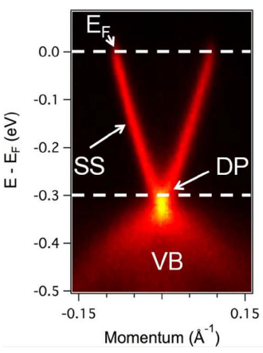
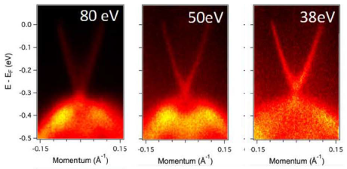
WHY TOPOLOGICAL INSULATORS?
SCIENTIFIC REPORTS | 2 : 726 | 2012

Slide 7
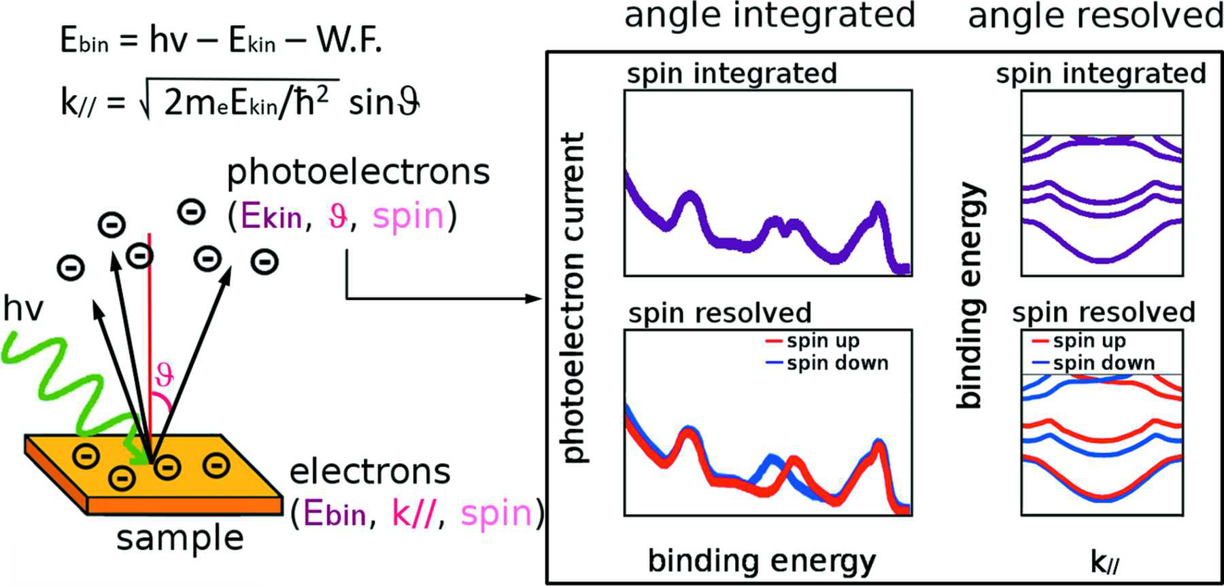

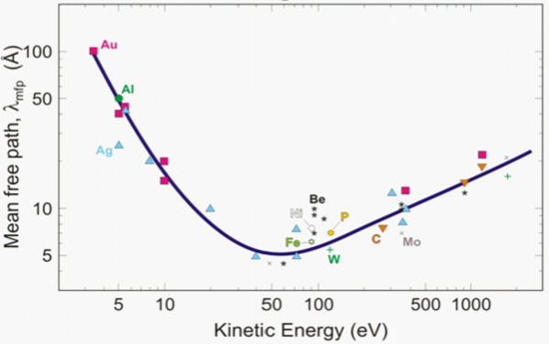
PHOTOEMISSION SPECTROSCOPY
SARPES
Conventional ARPES very few layers
Soft X-Ray ARPES “bulk” contribution

Slide 8


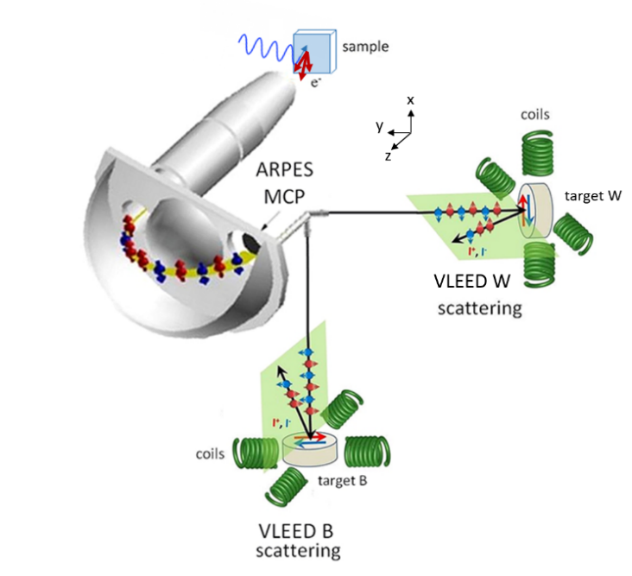
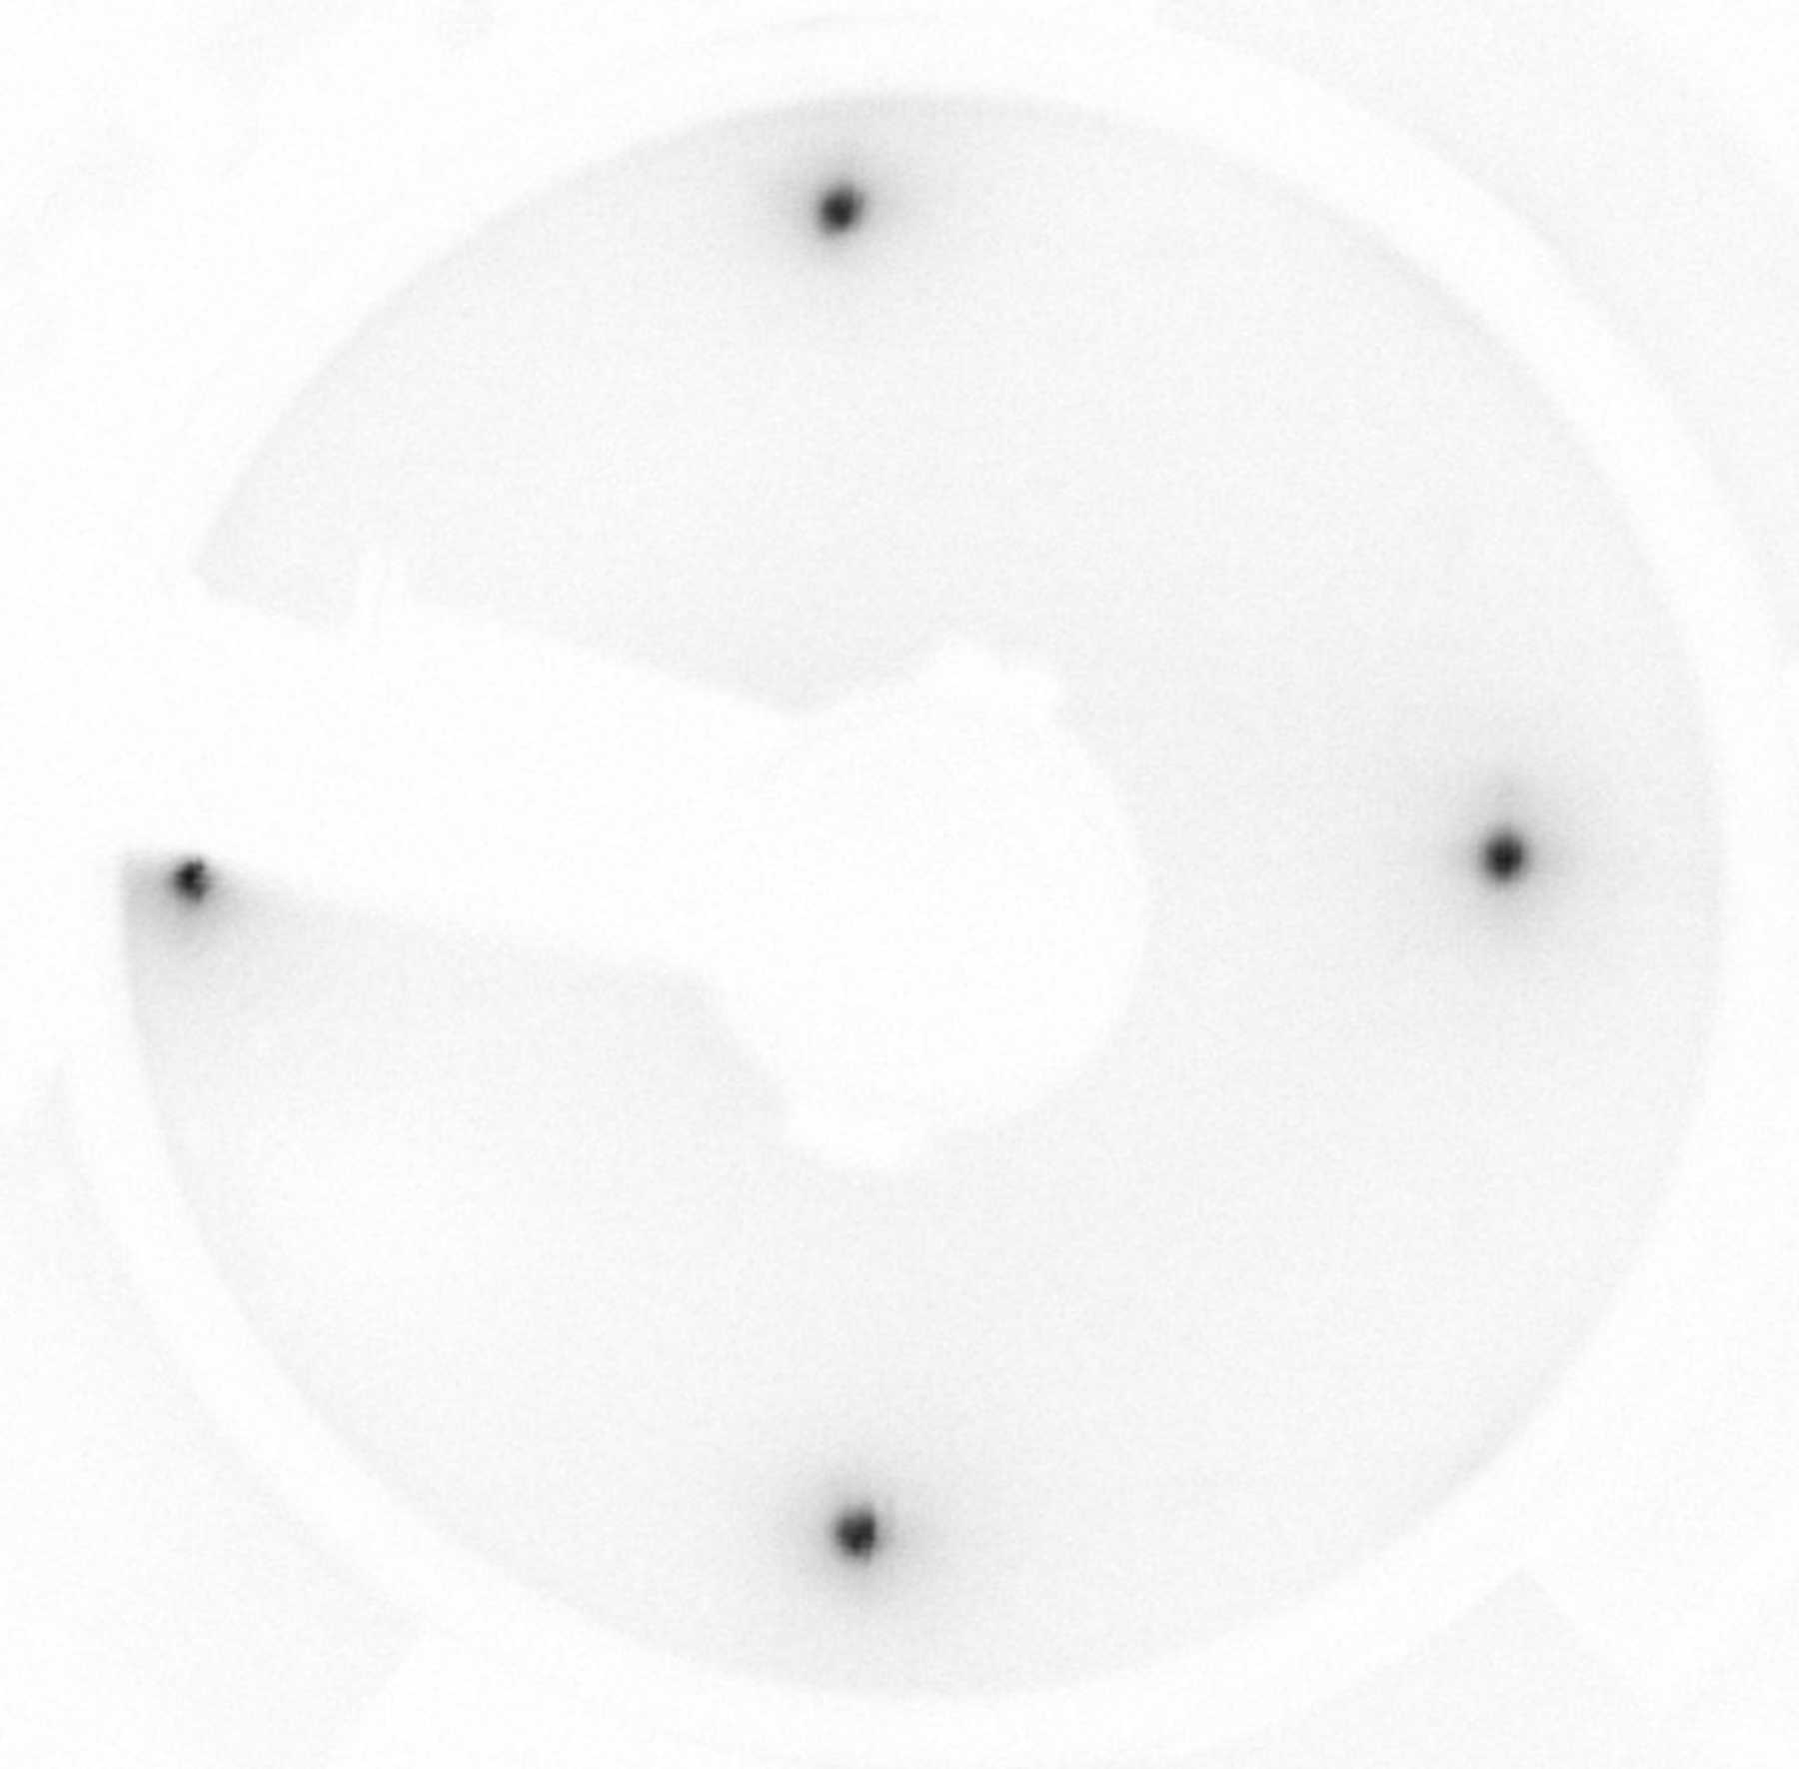
SPIN-RESOLVED ARPES: EXCHANGE SCATTERING
Very Low Energy Electrons Diffraction (VLEED)
Exchange scattering
6
ferromagnetic O₂ passivated Fe(001) target grown on MgO substrate

Slide 9

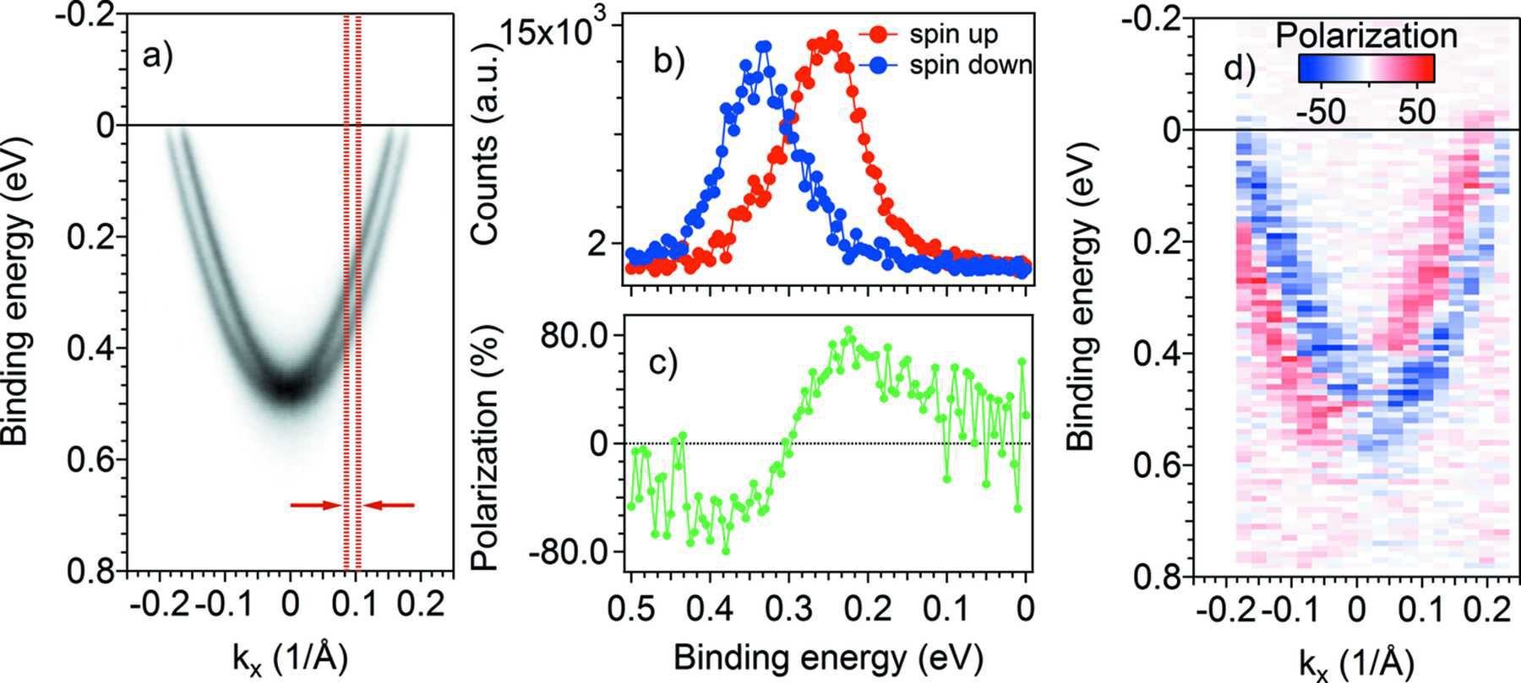
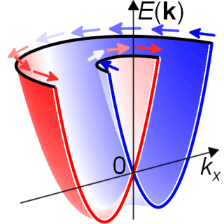
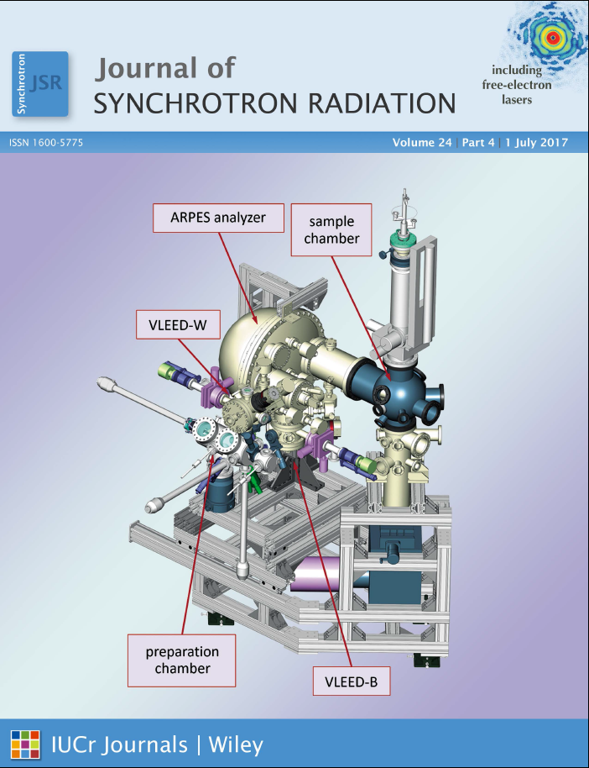
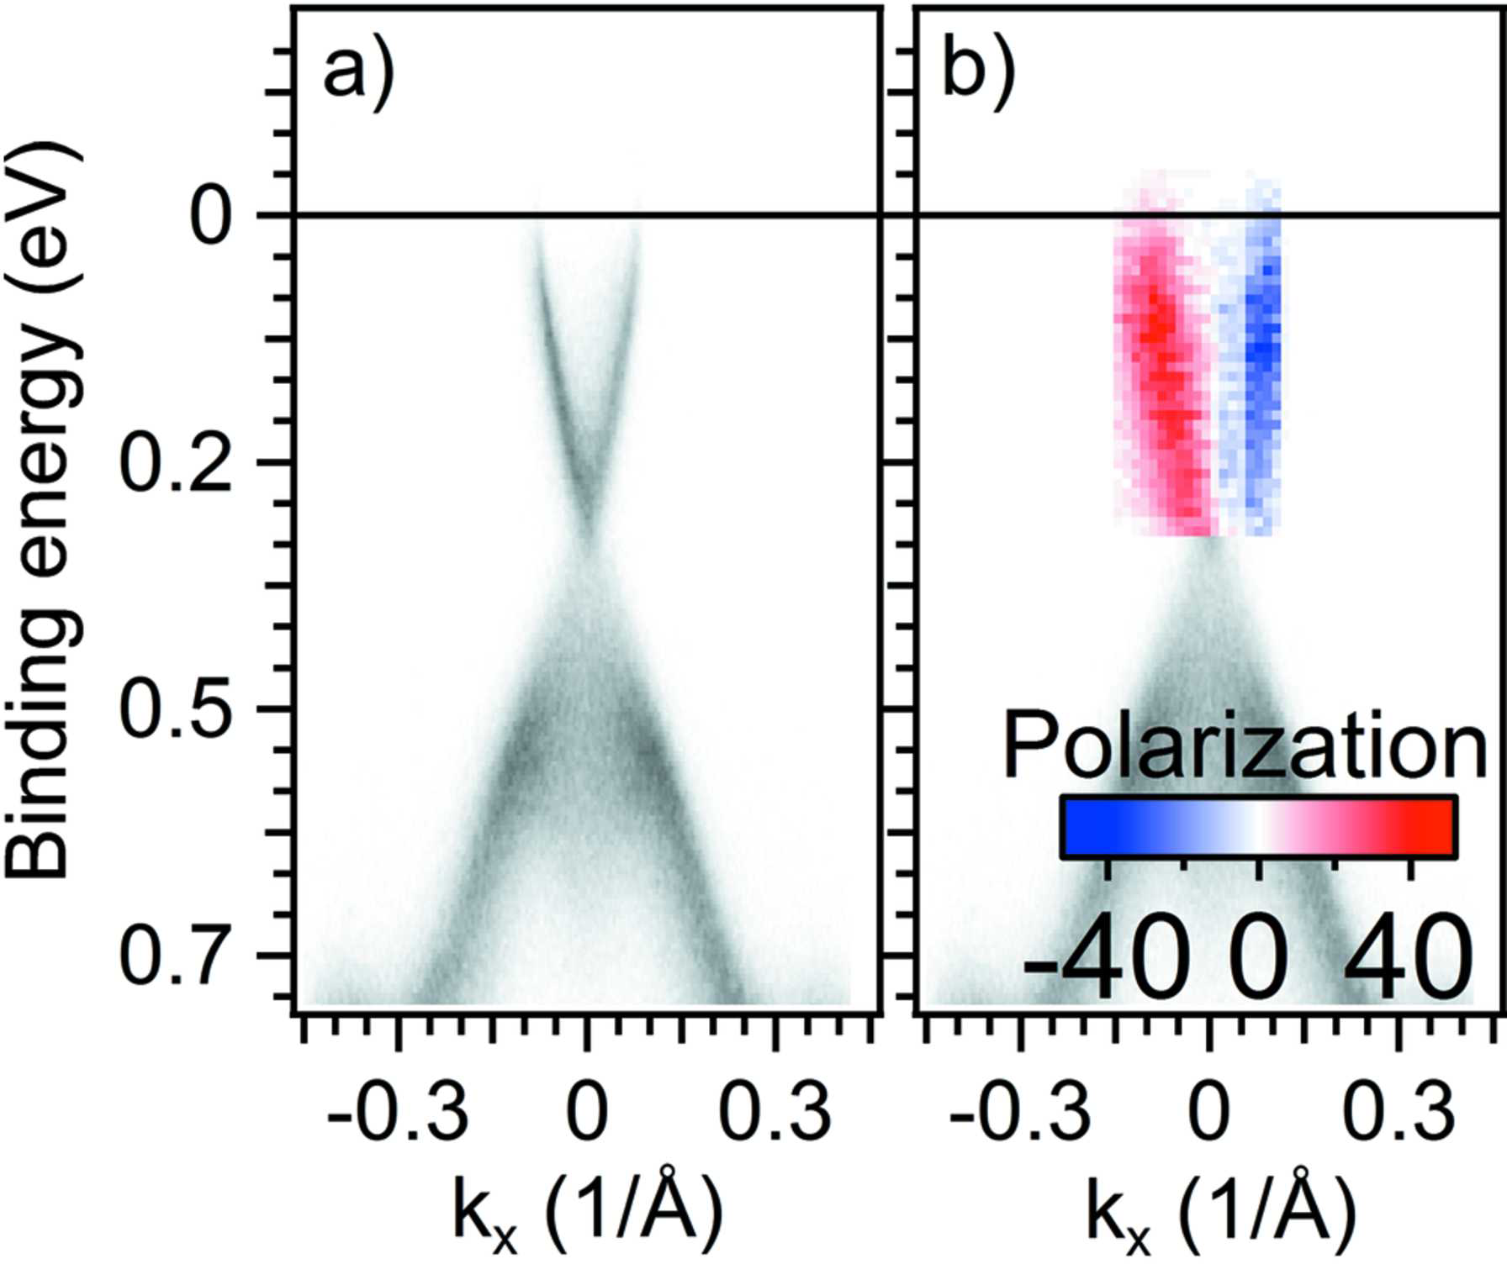
SPIN-RESOLVED ARPES: VESPA DETECTOR
hv= 30 eV
ΔE~ 70 meV
ΔE~ 100 meV
Au(111)
VESPA: Very Efficient Spin
Polarization Analysis
hv= 50 eV
S = 0.3 – 0.5
FOM = 3.3 · 10⁻²
Bigi C. et al, JSR, 24,4 (2017)

Slide 10
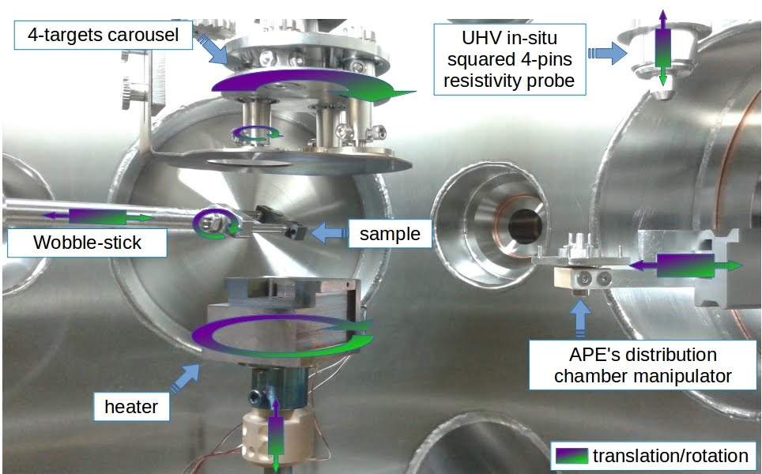
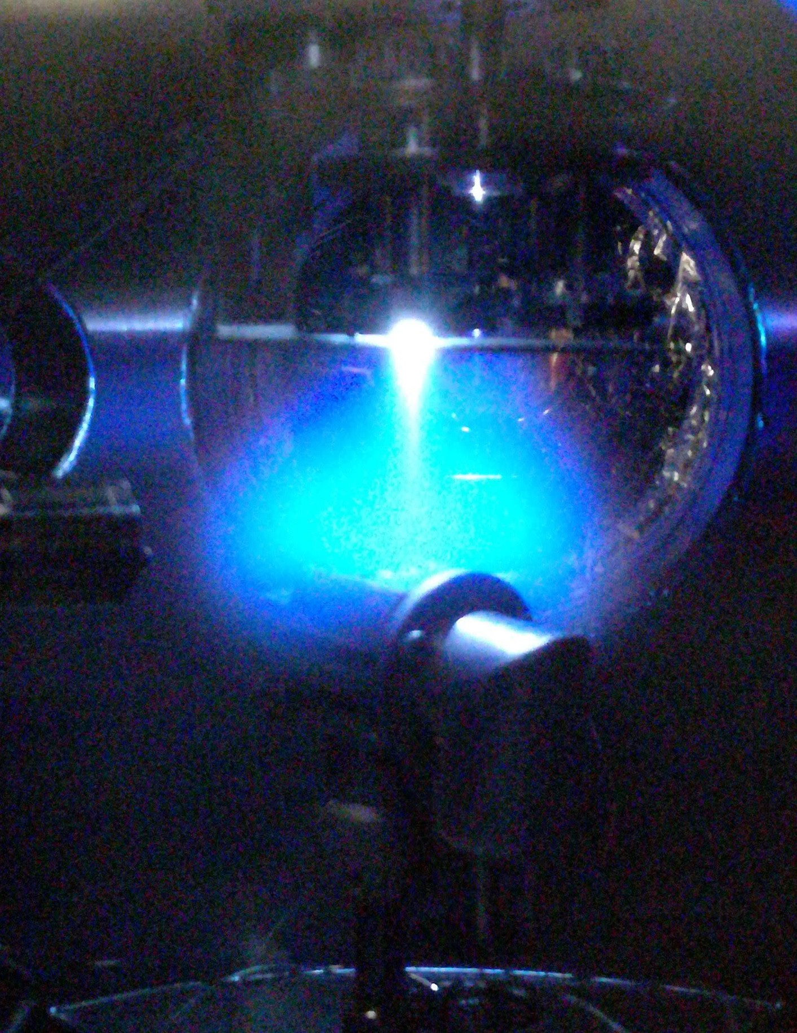


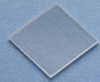
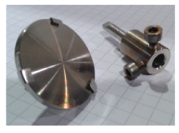
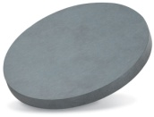
PULSED LASER DEPOSITION TECHNIQUE
Manganites | Cuprates
La-Ba-Mn-O | Y-Ba-Cu-O
La-Ca-Mn-O | Other materials
La-Sr-Mn-O | La-Al-O
La-Ce-Mn-O | Sr-Ti-O
Sr-Mn-O | TiO₂
Bi-Mn-O | Bi₂Se₃

Slide 11
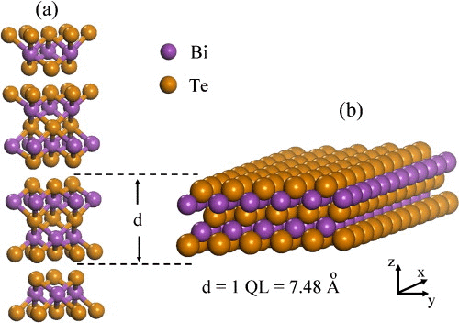
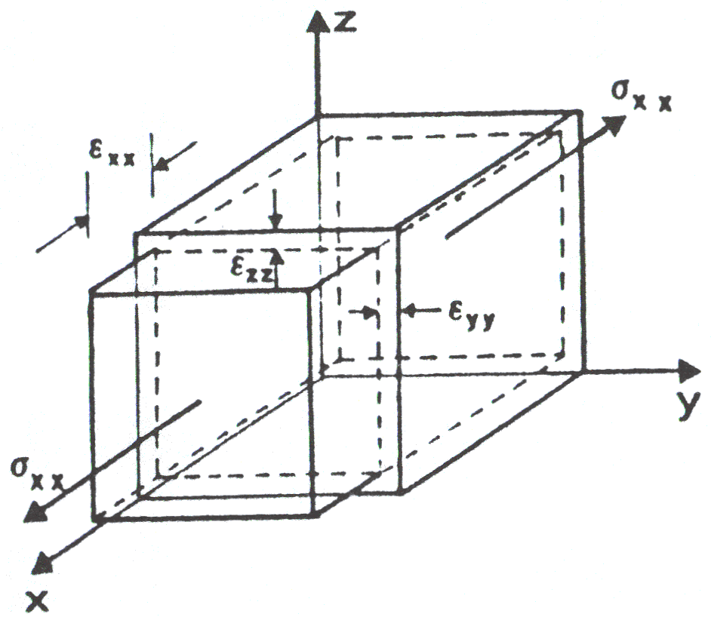
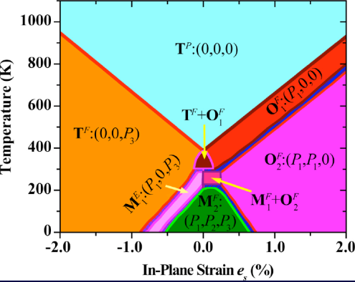
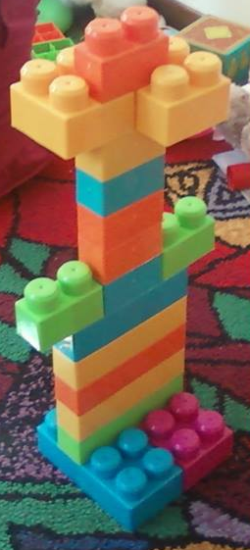
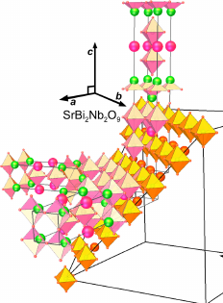
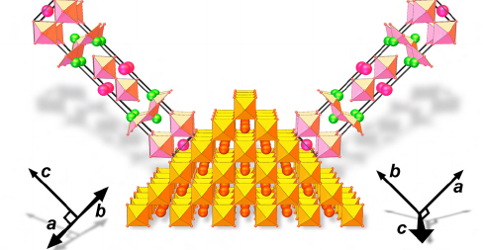

WHY THIN FILMS?
ULTRA-thin layers
(e.g. single-unit or
sub-unit cell)
Substrate induced strain
(e.g. deformation and/or forbidden phases)
Zahid and Lake, APL 2010
D.G.Schlom’s group
Orientation control
Tailored hetero-structures
(courtesy of Sara Orgiani)
D.G.Schlom’s group

Slide 12
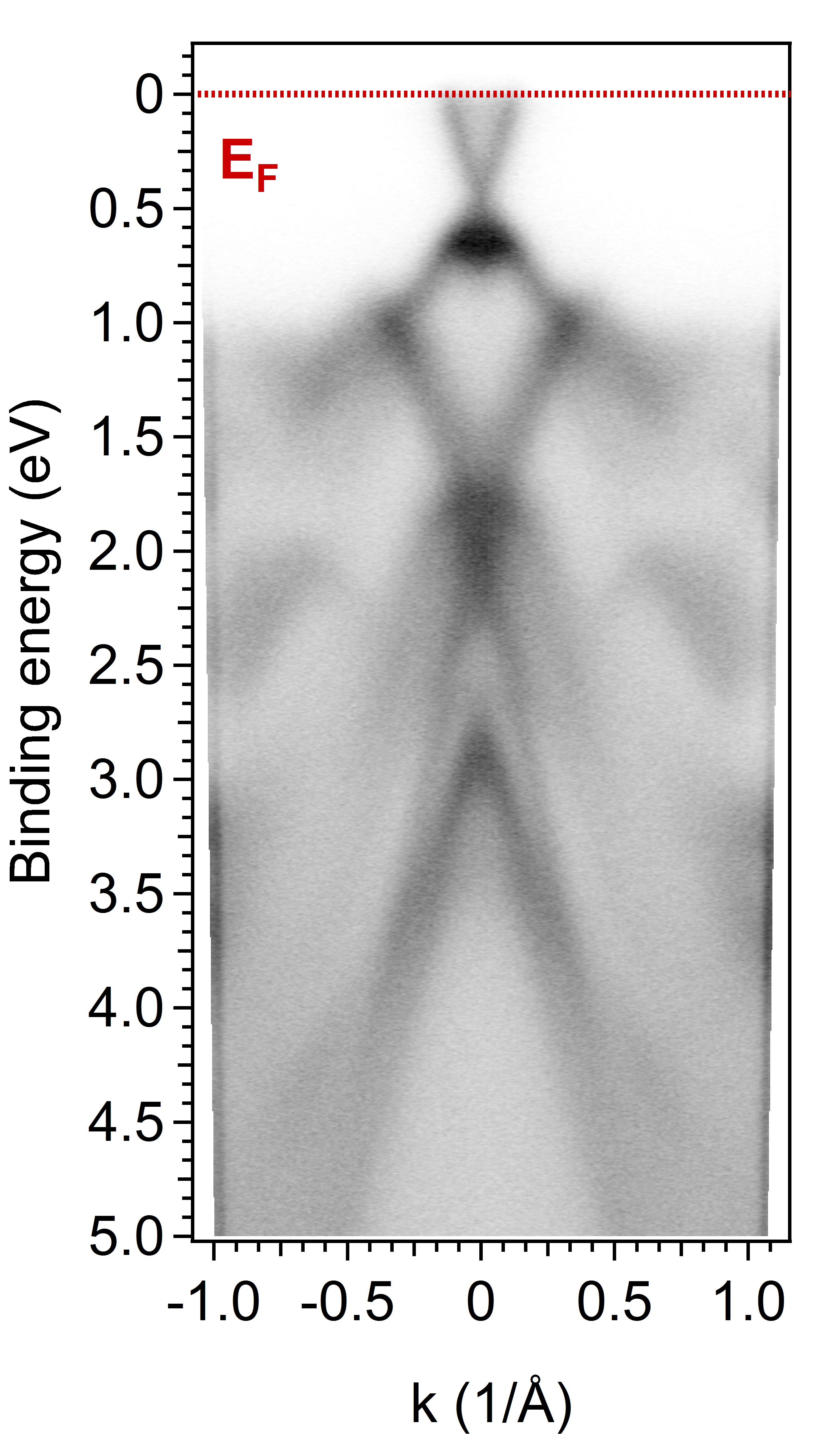
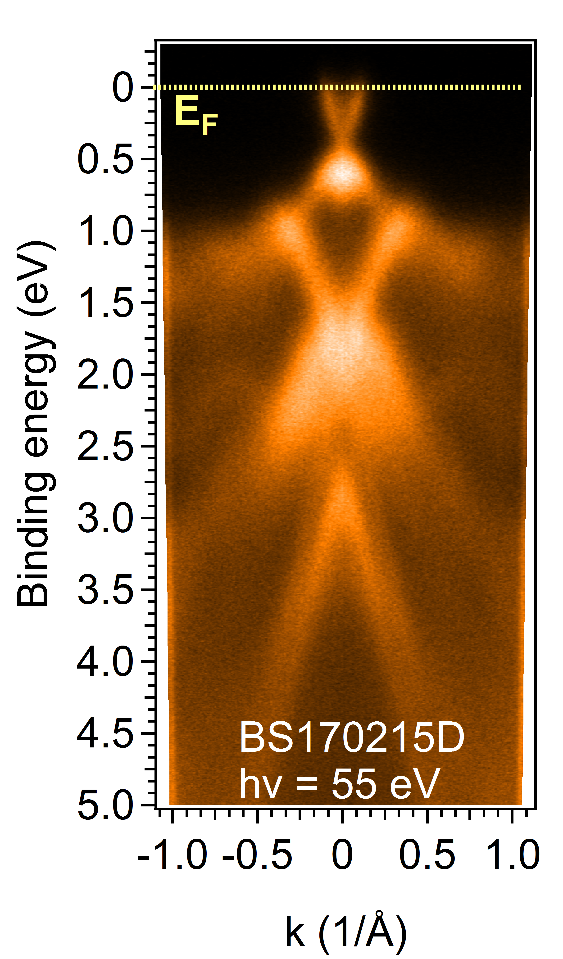
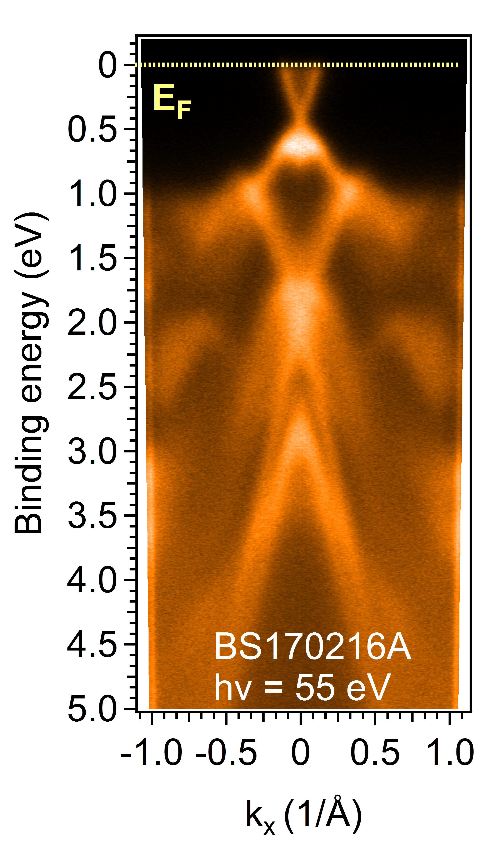
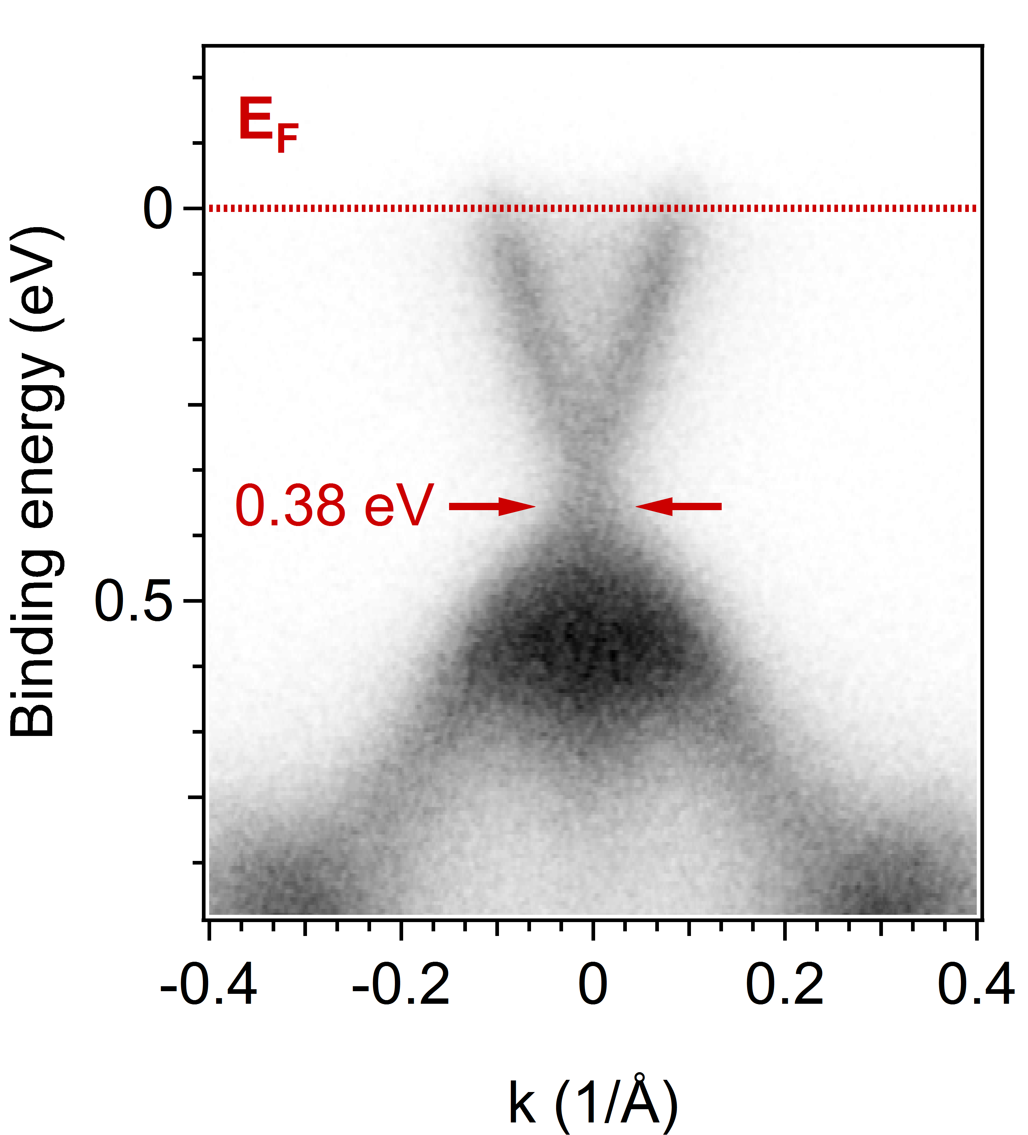
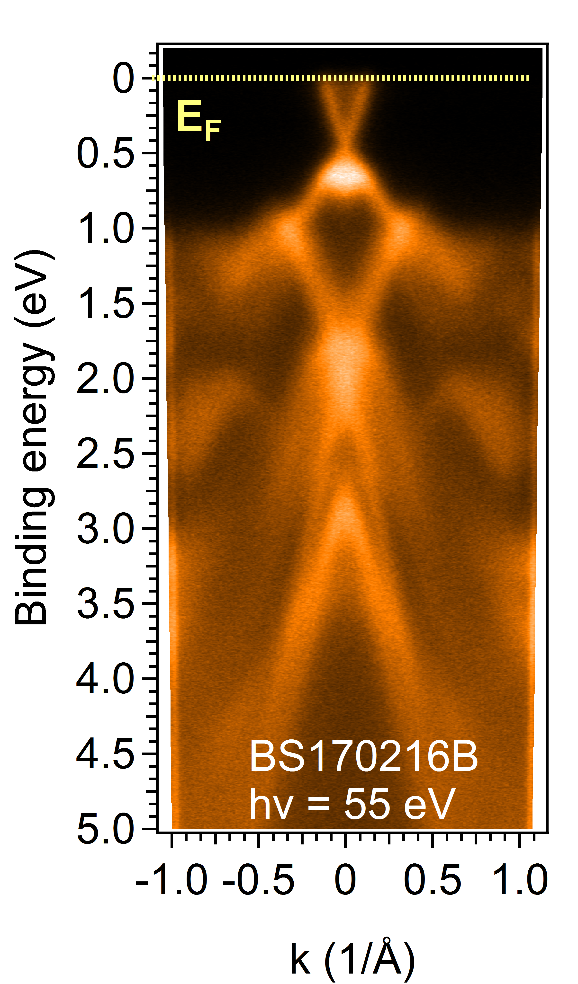
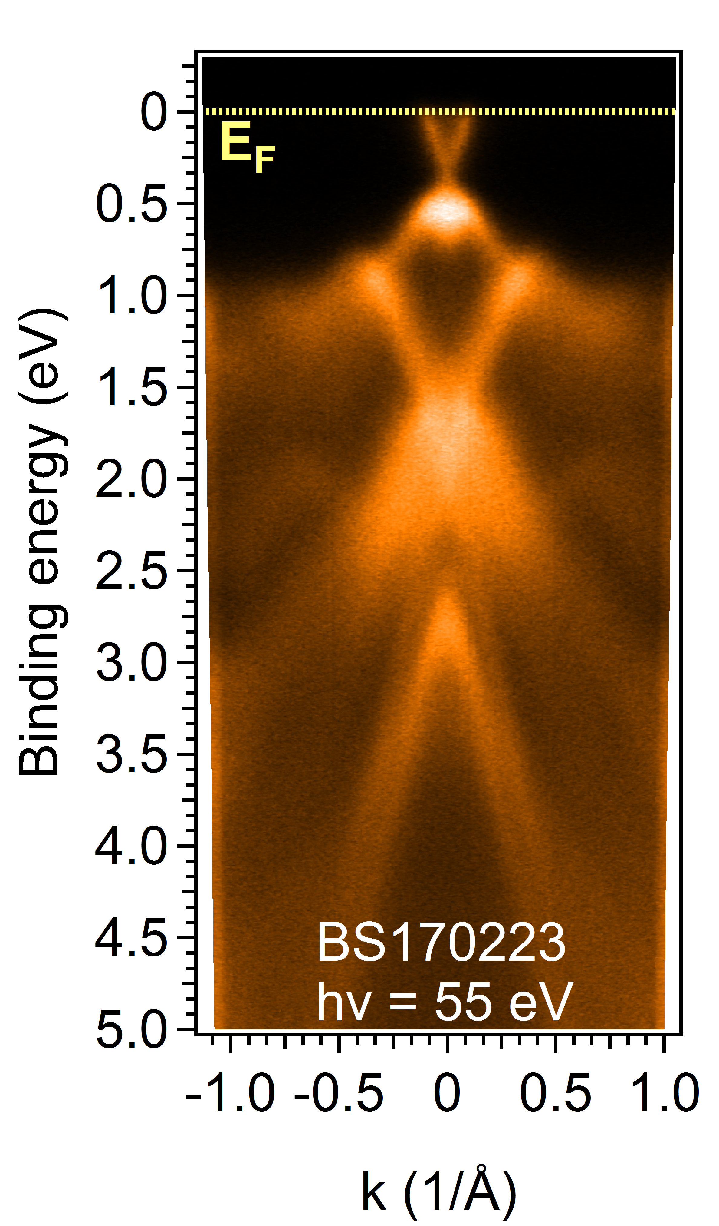
ARPES ON PLD Bi₂Se₃ THIN FILMS
hv = 55 eV

Slide 13
SPIN-RESOLVED ARPES ON PLD Bi₂Se₃
THIN FILMS
TRS
Phys. Rev. B 84,
165113 (2011)
hv = 55 eV
Orgiani P., Bigi C. et al, APL, 110, 171601 (2017)

Slide 14
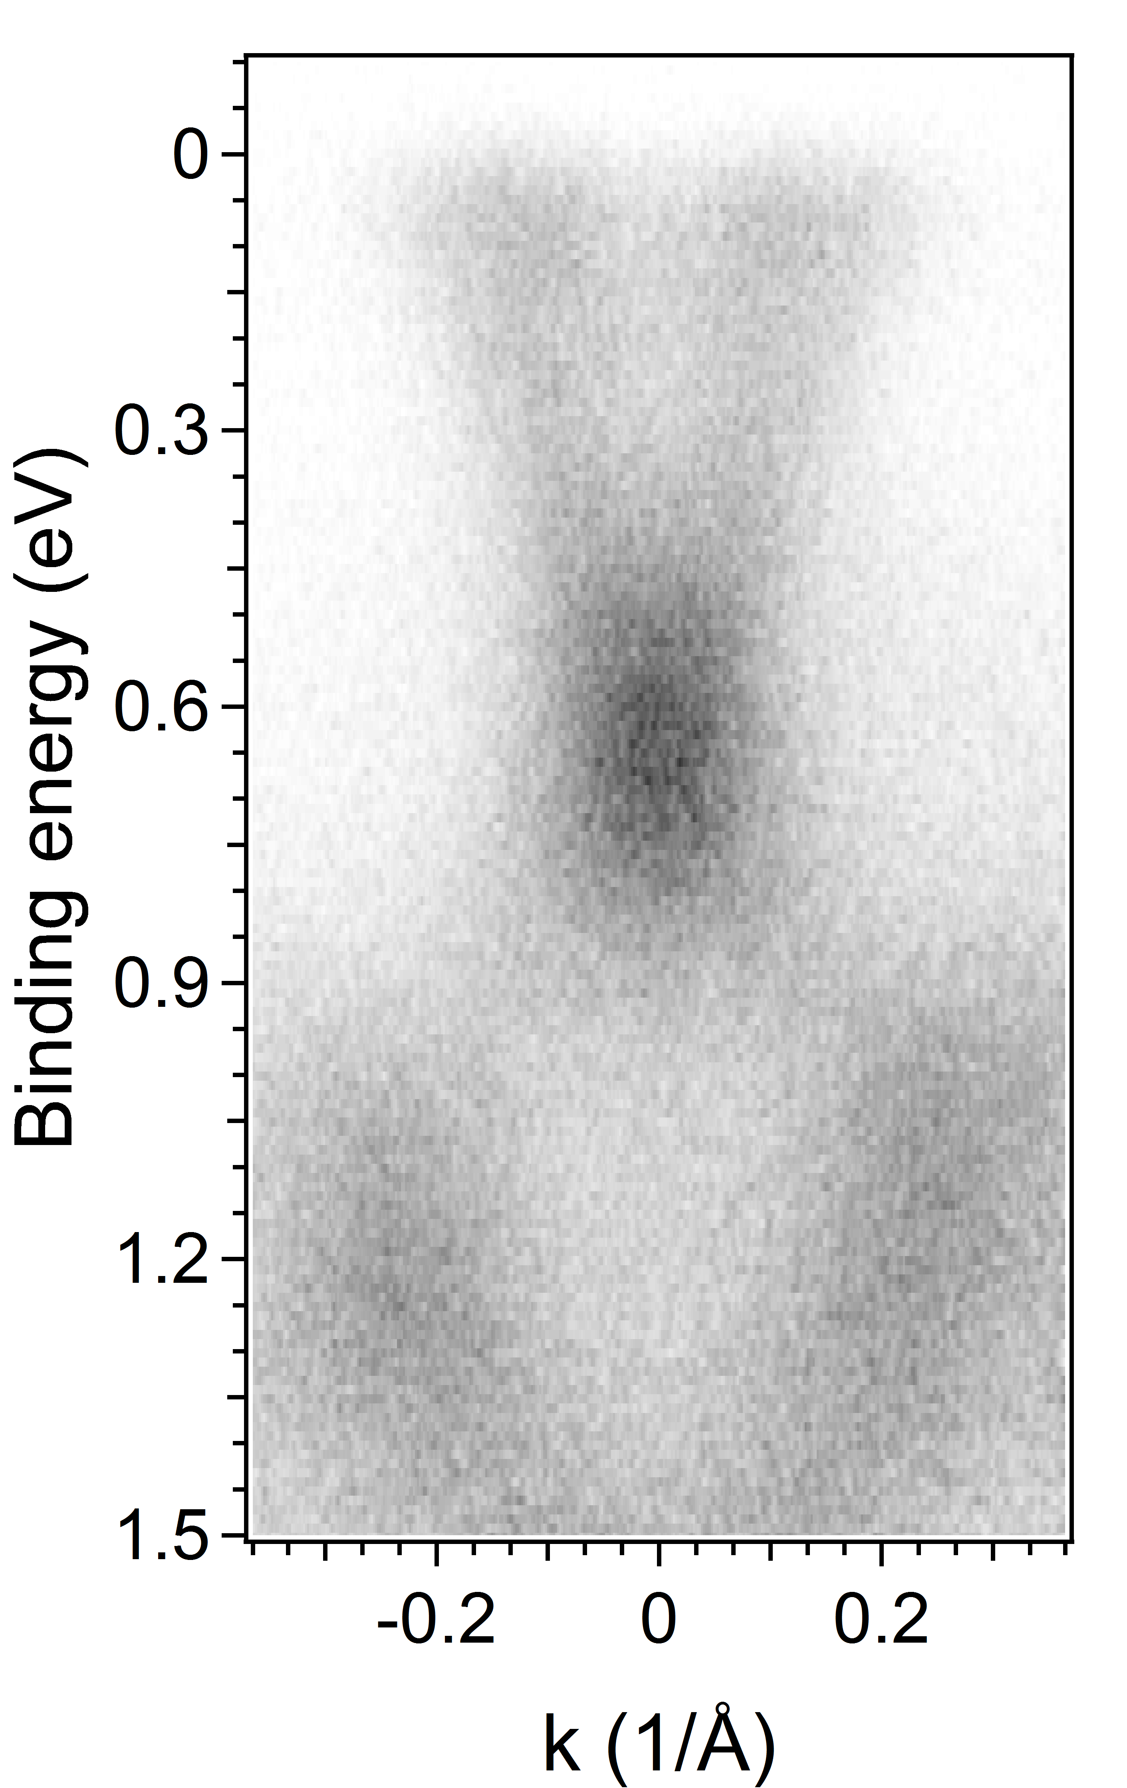
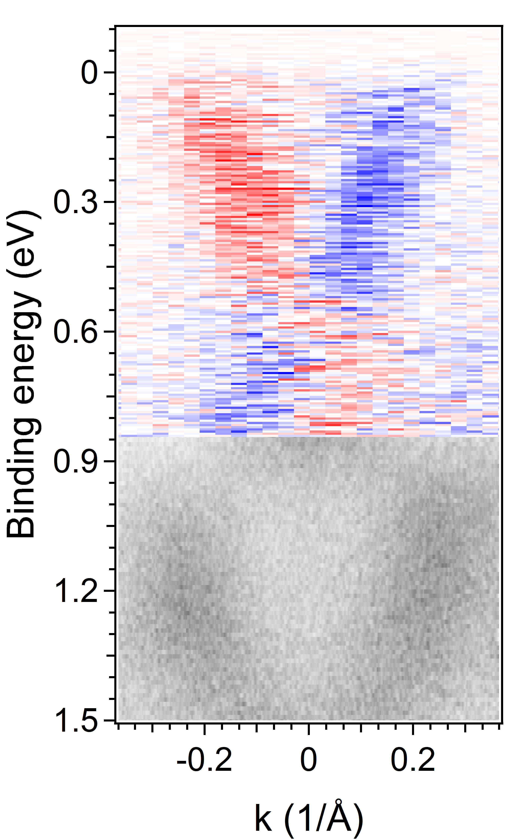
SPIN-RESOLVED ARPES ON PLD Bi₂Se₃
THIN FILMS
hv = 55 eV
E_{F}
E_{F}
TRS
-40 0 40
Phys. Rev. B 84,
165113 (2011)
Even in presence of slight Se off-stoichiometry, SARPES investigation shows the TSS are protected and not destroyed by any small source of chemical or structural disorder

Slide 15
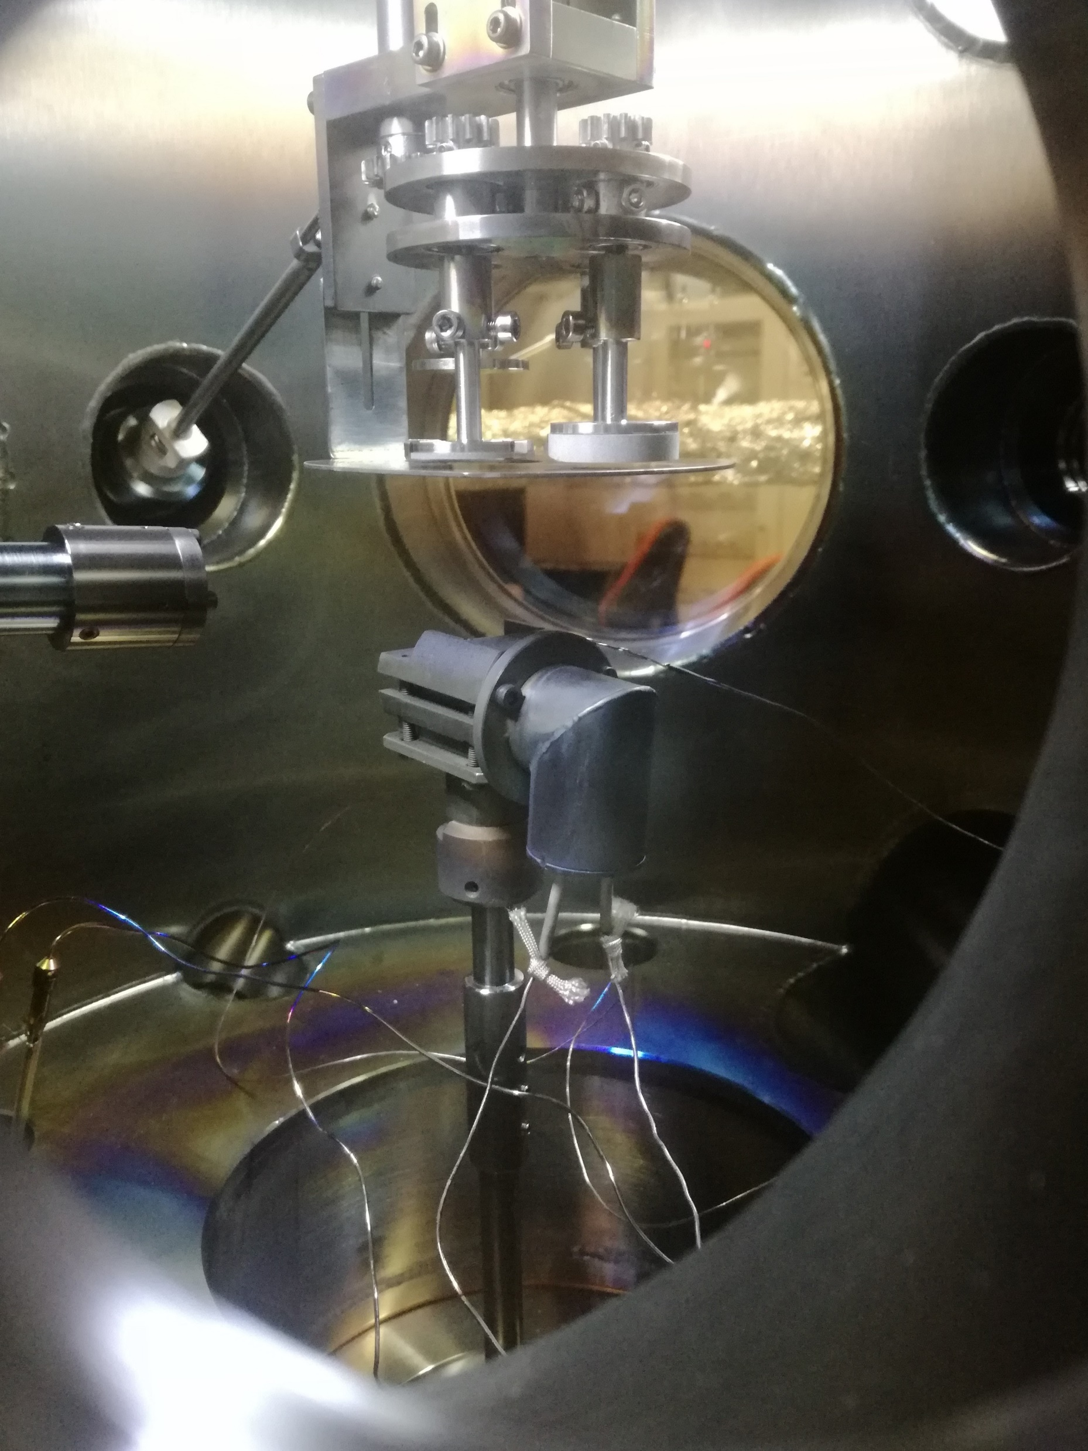
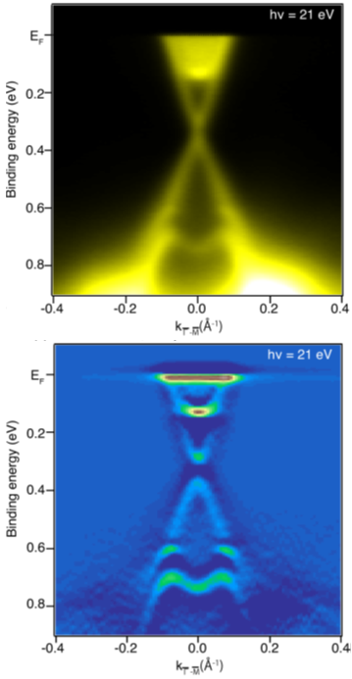
PERSPECTIVES
Low deposition rate will allow the doping (e.g. Mn, Fe, Co) of the films in a large range of values
Heterostructures with HTC superconductors may pave the way to experimentally detect new physics
High-pressure RHEED is currently under commissioning better control of film thickness and surface properties
Nature 511, 449 (2014)
NanoLett 17, 3493 (2017)

Slide 16
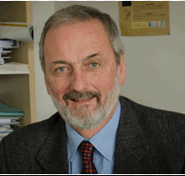


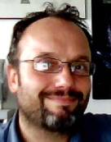




THANKS FOR YOUR ATTENTION
Acknowledgments
Growth + XRD + LEED
P.Orgiani, C.Bigi
ARPES + SpinARPES
C.Bigi, P.Kumar Das,
J.Fujii, I.Vobornik
XPS
P.Orgiani, C.Bigi,
B.Gobaut, P.Torelli G.Panaccione
PhD Supervisor
G.Rossi
Financial support
NOXSS-PRIN MIUR NFFA-MIUR

Slide 18
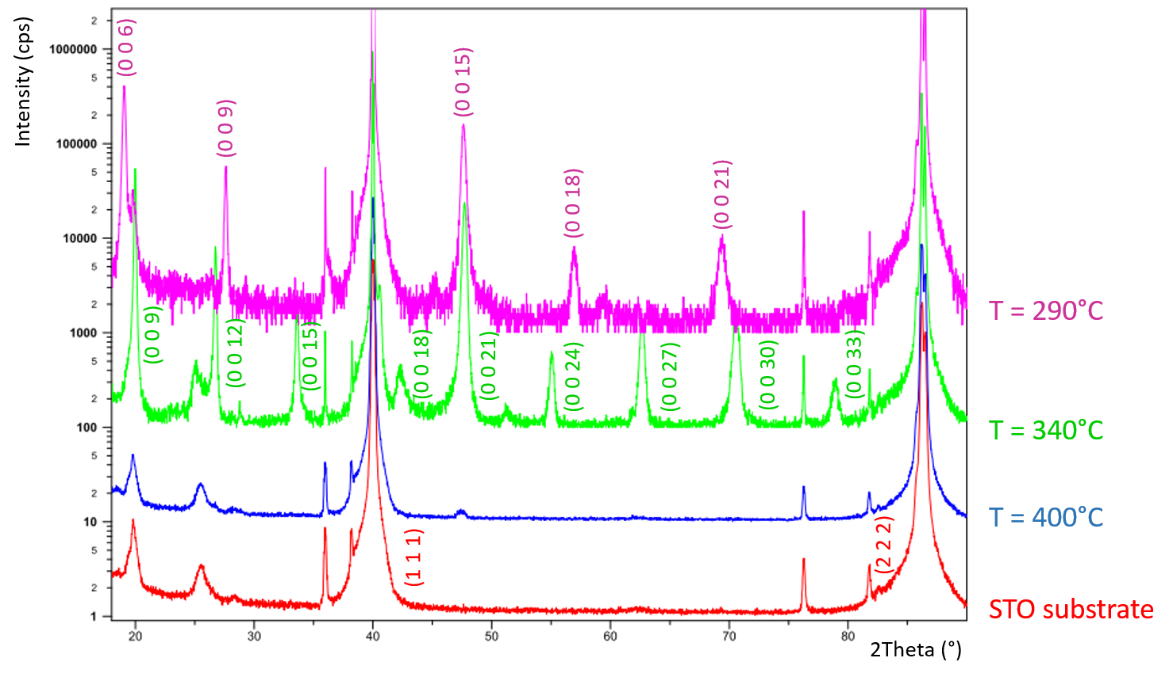
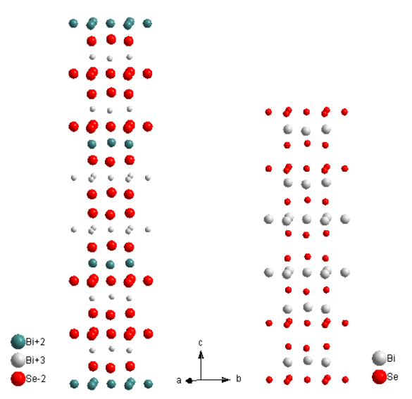
GROWTH OPTIMIZATION: TEMPERATURE
VdW
gap
SL
VdW
gap
v
QL
T~290°C Bi₂Se₃
T~340°C Bi₃Se₄
STO substrate
T~400°C amorphous

Slide 19
GROWTH OPTIMIZATION: PRESSURE
hv =500 eV
T_{s} = 290°C
Se3d
Bi5d
P = 10^-3 mbar
Bi0
Bi0
Se3d
Bi5d
P = 10^-1 mbar

Slide 20
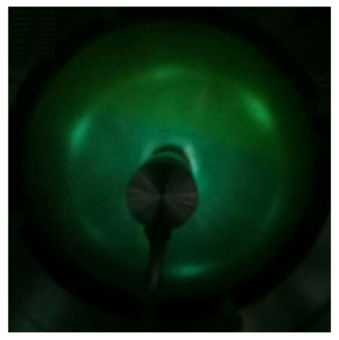
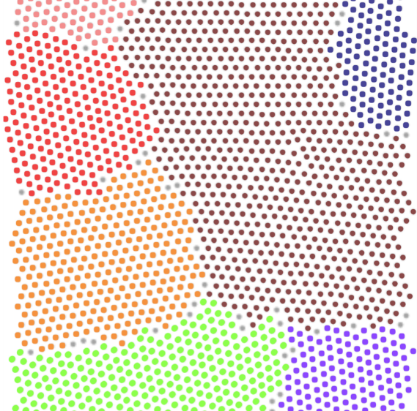
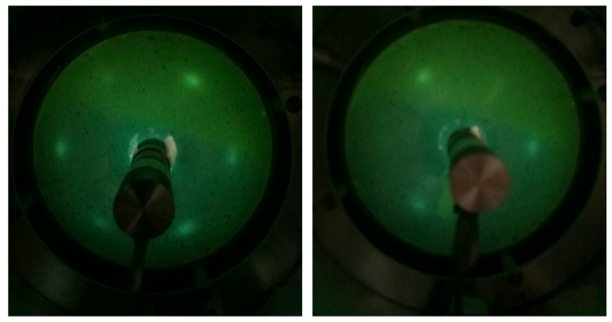
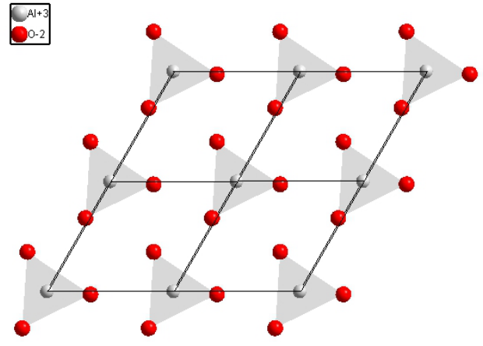
GROWTH – SrTiO₃ (111) vs Al₂O₃ SUBSTRATES
The out-of-plane c-axis and the in-plane a-axis were found to be 2.858 nm and 0.422 nm, which indicates a slight tensile in-plane strain which elastically induce a reduction of the
out-of-plane cell elongation. (c=2.864 nm a=0.414 nm)

Slide 21


GROWTH ON Al₂O₃ (0001) SUBSTRATE
laser fluence | 5 J/cm²
laser frequency | 1 Hz
substrate temperature | 290 ° C
Ar pressure | 10⁻¹ mbar
growth rate | 0.07 nm/shot
Orgiani P., Bigi C. et al, APL, 110, 171601 (2017)

Slide 22

PLD-GROWN BI₂Se₃ (001) THIN FILMS
XPS @ 920 eV
laser fluence | 5 J/cm²
laser frequency | 1 Hz
substrate temperature | 290 ° C
Ar pressure | 10⁻¹ mbar
growth rate | 0.07 nm/shot
Good surface quality on Al₂O₃(001) substrates
Absence of C and O contaminants
Absence of Bi or Se cluster aggregation
Orgiani P., Bigi C. et al, APL, 110, 171601 (2017)

Slide 23


SPIN-RESOLVED ARPES: VESPA DETECTOR
Very Low Energy Electrons Diffraction (VLEED)
Okuda et al. Rev. Sci. Instrum. 79, 123117 (2008); Bertacco et al. APL (1998)
E_{k} = 90 eV
ferromagnetic O₂ passivated Fe(001) target grown on MgO substrate
Operates @ E_{k} = 6 eV
Bigi C. et al, JSR, 24,4 (2017)

Slide 24



EXCHANGE SCATTERING: Fe(001)-p(1x1)-O
TARGET
Okuda et al. Rev. Sci. Instrum. 79, 123117 (2008); Bertacco et al. APL (1998); Rev.Sci.Instrum.(1999); Pincelli Master thesis

Slide 25


Slide 26
TOPOLOGY IN BAND THEORY

Slide 27
TOPOLOGY IN BAND THEORY

Slide 28
TIME REVERSAL SYMMETRY

