Slide 1
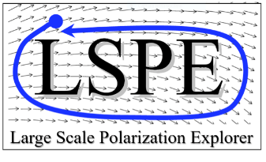
Hunting primordial B-modes in CMB polarization maps: data analysis for the LSPE/STRIP experiment
Silvia Caprioli
Supervisors: Barbara Caccianiga, Maurizio Tomasi
1° year PhD students workshop, 11 October 2017
Department of Physics, University of Milan

Slide 2
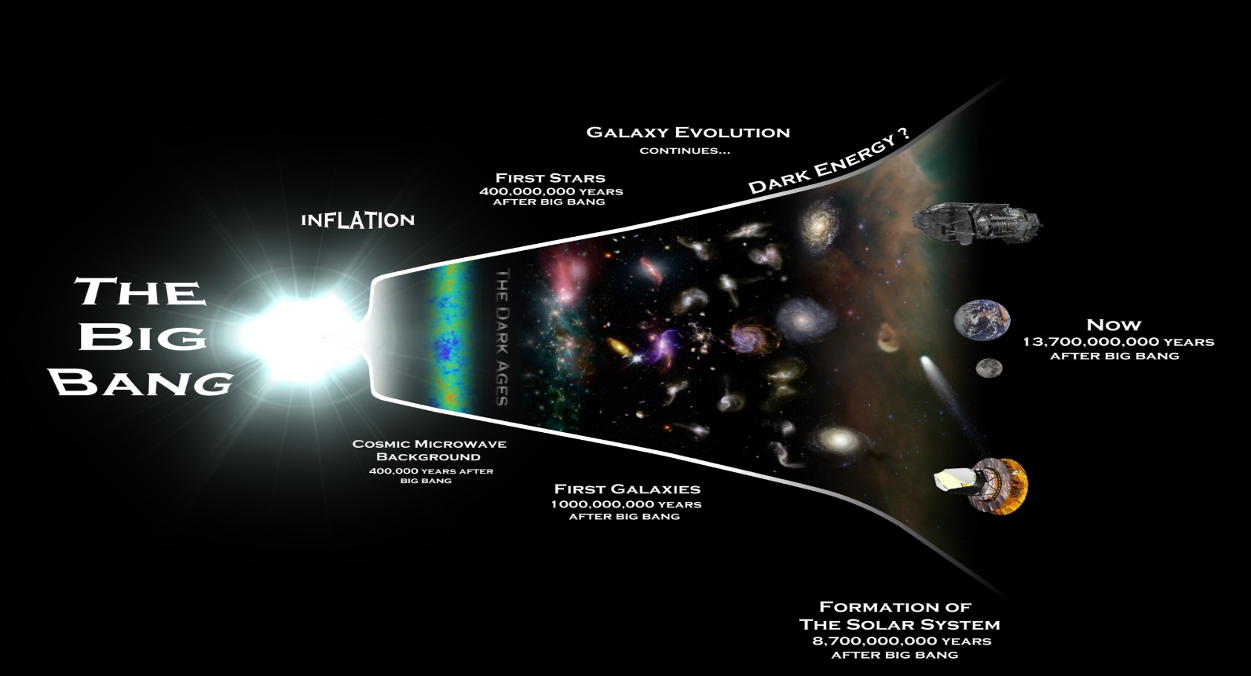
A (very) brief history of the Universe : the Cosmic Microwave Background
In early Universe matter and radiation were in thermal equilibrium.
Thomson scattering: γ + e⁻ γ + e⁻
The Universe was opaque
≈ 380 000 yr after the Big Bang temperature was low enough (T ≈ 3000 K) to allow the formation of neutral atoms
Decoupling of matter and radiation
photons free to propagate through space
We now see those primordial photons as Cosmic Microwave Background (CMB)

Slide 3
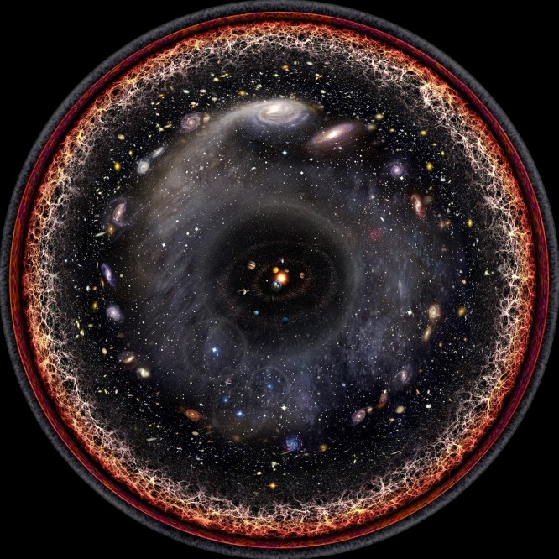
The Cosmic Microwave Background
The Cosmic Microwave Background is the relic electromagnetic radiation of the primordial Universe.
It is the earliest direct image of the Universe we can ever obtain (at least from photons…).
Big Bang
CMB γ
Here and Now
13.8 billion years
Last Scattering Surface
The decoupling happend everywere.
The CMB photons we observe on Earth are emitted from a spherical shell around us:
the Surface of Last Scattering, z=1100.

Slide 4
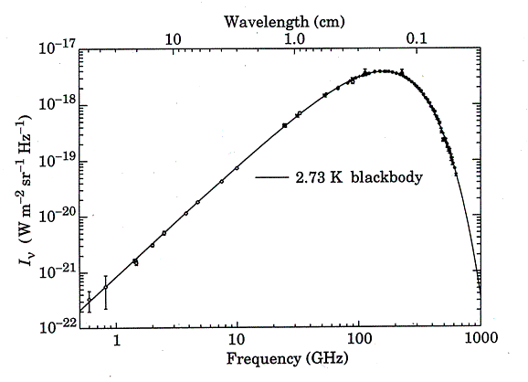
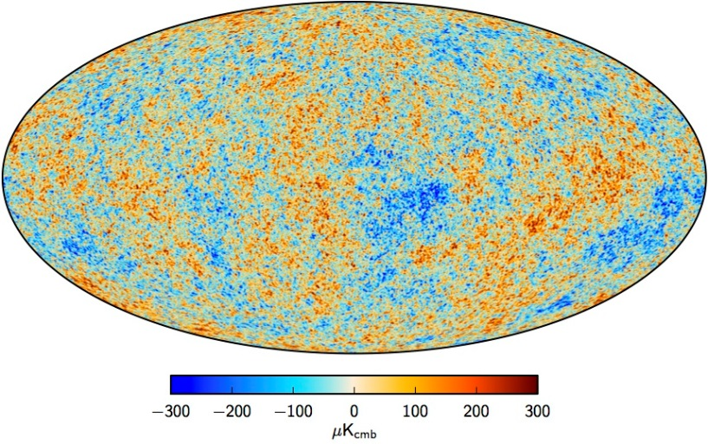
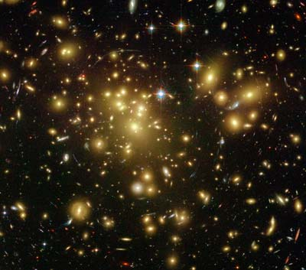
What do we know about the CMB?
SPECTRUM
The CMB is an almost perfect black-body spectrum at T ≈ 2.73 K
It peaks at ≈ 160 GHz, in the microwave range of frequencies
Very low photon density: n _{γ} ≈ 400 cm⁻³
FIRAS (COBE), 1994
TEMPERATURE ANISOTROPIES
The CMB is extremely (but not perfectly!) isotropic
They can be seen as seeds for the large scale structures we observe today (galaxies, cluster of galaxies…)
Tiny temperature anisotropies ΔT/T ≈ 10⁻⁵
They reflect density fluctuations in primordial plasma
galactic plane
Measured by Planck (2009-2013) with unprecedent high sensitivity and angular resolution

Slide 5
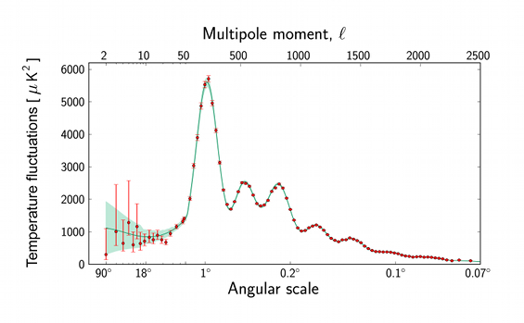
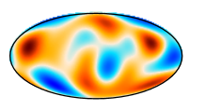
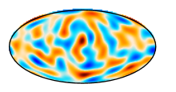
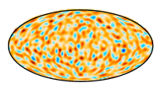
The Power Spectrum
To measure the properties of the CMB on the sphere it is useful to expand its temperature field using spherical harmonics:
δT(θ, φ) = $\sum_{l=0}^{∞}{\sum_{m=−l}^{l}{a_{l,m }Y_{l,m}(\text{q}\text{, }\text{f})}}$
$C_{l}= \left\langle a_{l,m }a_{l,m}^{∗}\right\rangle$ = $\frac{1}{2l+1}$ $\sum_{m=−l}^{m=l}{{{|a}_{l,m }|}^{2}}$
Power spectrum
It gives the amplitude of the fluctuations at different angular scales

Slide 6
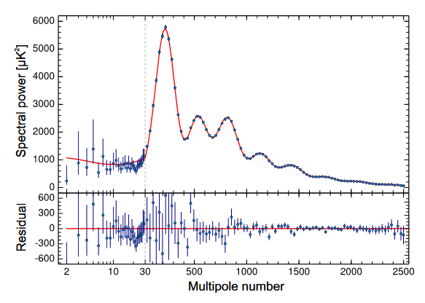
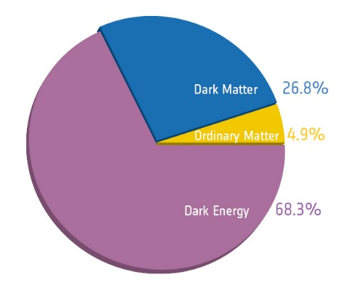
The Cosmological Parameters
Planck (2015)
Best ΛCDM model fit
This plot is full of cosmological information!
Extremely good match!
We can do precision cosmology
From the fit of the CMB power spectrum we can extract the cosmological parameters:
Barionic matter density: ${\text{W}}_{b}h^{2}=0.02222 ±0.00023$
Dark matter density: ${\text{W}}_{c}h^{2}=0.1197 ±0.0022$
Dark energy density: ${\text{W}}_{\text{L}}=0.683±0.017$
Hubble constant: $H_{0}= 67.8 ±0.9 {km s}^{−1 }{Mpc}^{−1}$
Acoustic Scale: ${\text{q}}_{∗}=0.59636°±0.00027°$
Scalar spectral index: ${\text{n}}_{s}=0.9655±0.0062$
Optical depth: $τ=0.078±0.019$
Etc....

Slide 7
Standard Big Bang Model problems
CMB measurements highlight some problems in the traditional Big Bang scenario:
Horizon problem
CMB measurements show a very homogeneous Universe at large scales
2.73 K
Nearly isotropic
But this includes regions too distant to ever been in casual contact
Best current explanation? INFLATION
Density fluctuations problem
CMB measurements show tiny anisotropies in the CMB
But what generates primordial density fluctuations?
Flatness problem
CMB measuremets show a flat Universe
(${\text{W}}_{tot}=1.0002±0.0026$)
But k=0 solution of Friedmann equations is unstable. Fine tuning?

Slide 8
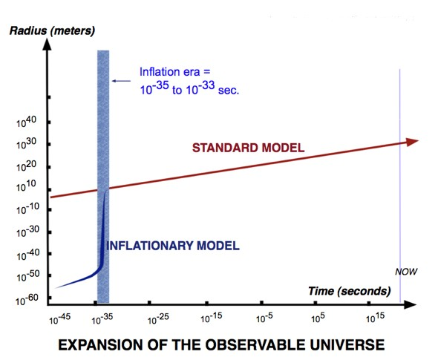
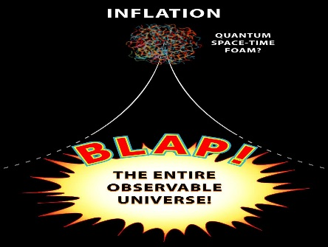
The Inflationary paradigm
Inflationary paradigm
from 10 ⁻³⁵ to 10 ⁻³³ s after the Big Bang the Universe expanded exponentially $a(t)\sim e^{Ht}$
(increasing its size by a factor ≈ 10 ²⁷ (at least)!!)

Slide 9
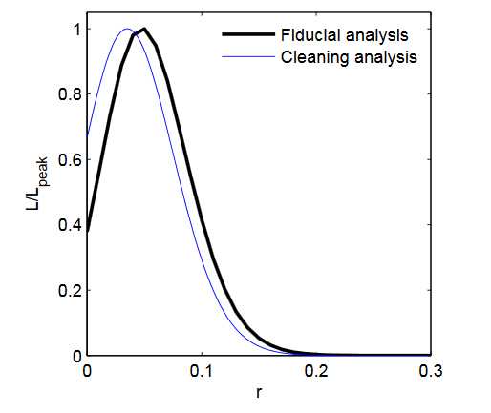
The Inflationary paradigm
Inflationary paradigm
from 10 ⁻³⁵ to 10 ⁻³³ s after the Big Bang the Universe expanded exponentially $a(t)\sim e^{Ht}$
(increasing its size by a factor ≈ 10 ²⁷ (at least)!!)
Inflation is generated by a quantum scalar field (Inflaton)
$$φ\left(x,t\right)= φ_{0}(t)+ δφ(x,t)$$
Key signature of inflation!
Scalar perturbations
Tensor perturbations
Tensor to scalar ratio: $r≡ \frac{∆_{t}}{∆_{s}}$
density fluctuations
gravitational waves
Gives the amplitude of the tensor perturbations
No experimental proof so far (just upper limits: r < 0.11 at 95% C.L.)
A measurement of r would probe the theory of inflation!
Seeds of large scale structures we observe today
Keck Array-BICEP2-Planck (2015)
CMB Polarization

Slide 10
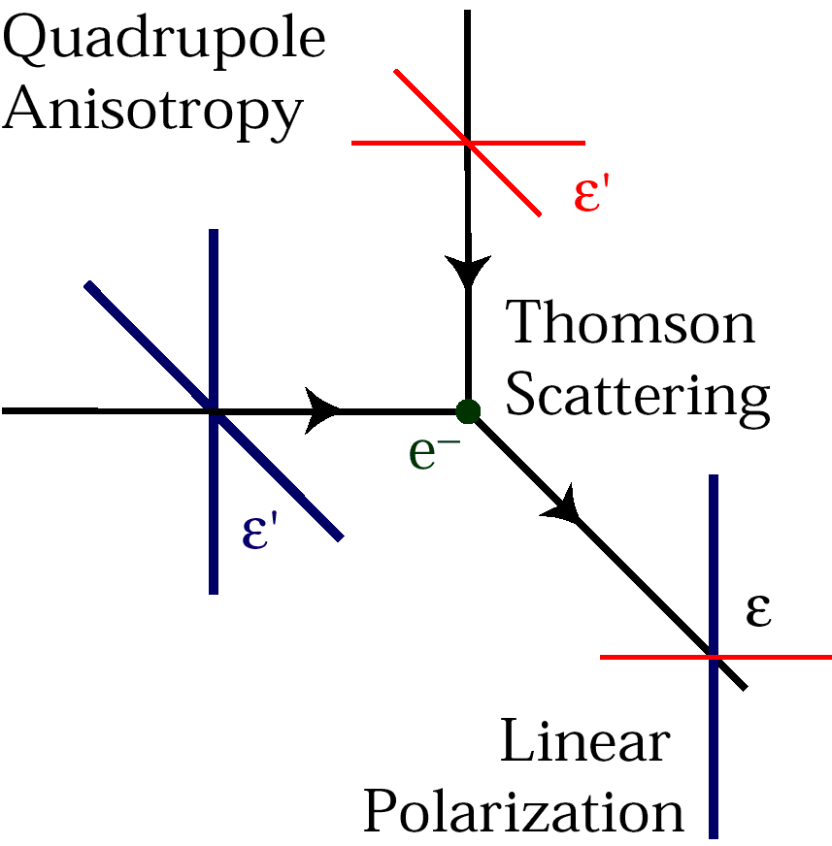
The CMB polarization
Cold
The CMB is linearly polarized at the ≈ 10% level
Polarization results from Thomson Scattering at decoupling, only in case of Quadrupole Anisotropy
Hot
Polarization is usually quatified using Stokes parameters I, Q, U, V.
But we can also decompone the polarization pattern in the sky into 2 components:
E-modes
Produced by:
Density fluctuations in primordial plasma (scalar)
Primordial gravitational waves (tensor)
Already detected
(Planck, WMAP, QUIET, POLARBEAR etc.)
Predicted by inflation!!
B-modes
Produced by:
Primordial gravitational waves (tensor)
Never been detected so far
Primordial B-modes detection would be the smoking gun of inflation!
The problem is that.. It is a very difficult measurement!

Slide 11
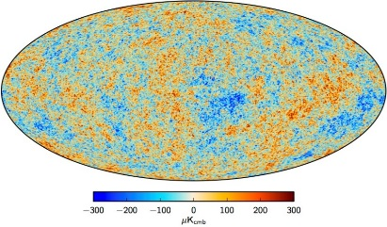
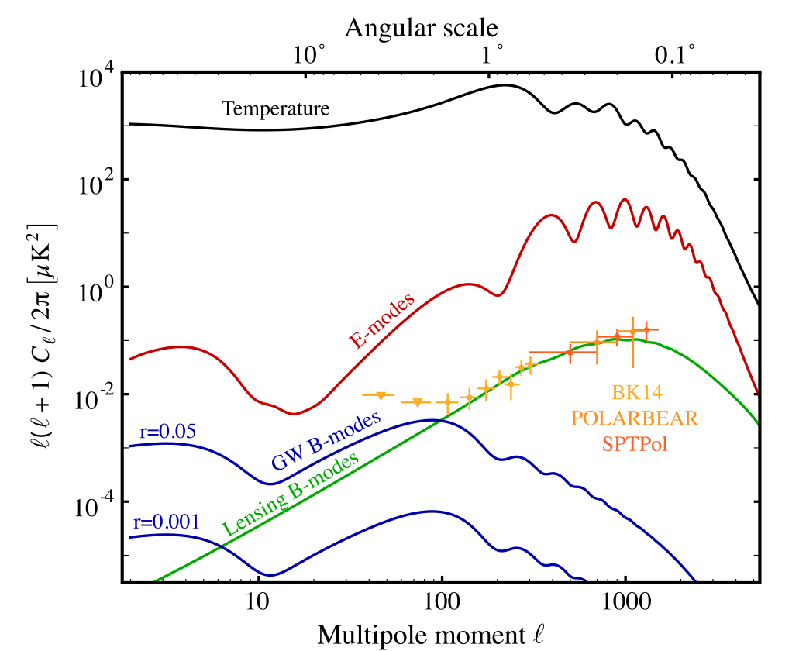
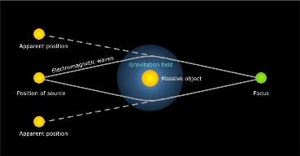
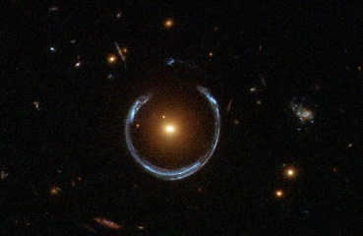
Hunting primordial B-modes: why is it difficult?
Tensor to scalar ratio: $r≡ \frac{∆_{t}}{∆_{s}}$
E-modes
B-modes
B-modes signal is very weak: $≲1μK$
Not only primordial GW produce B-modes… also gravitational lensing!
It deforms the CMB power spectrum, commuting E-modes in B-modes
It dominates the B-modes power spectrum at small angular scales
…we should look at large angular scales

Slide 12
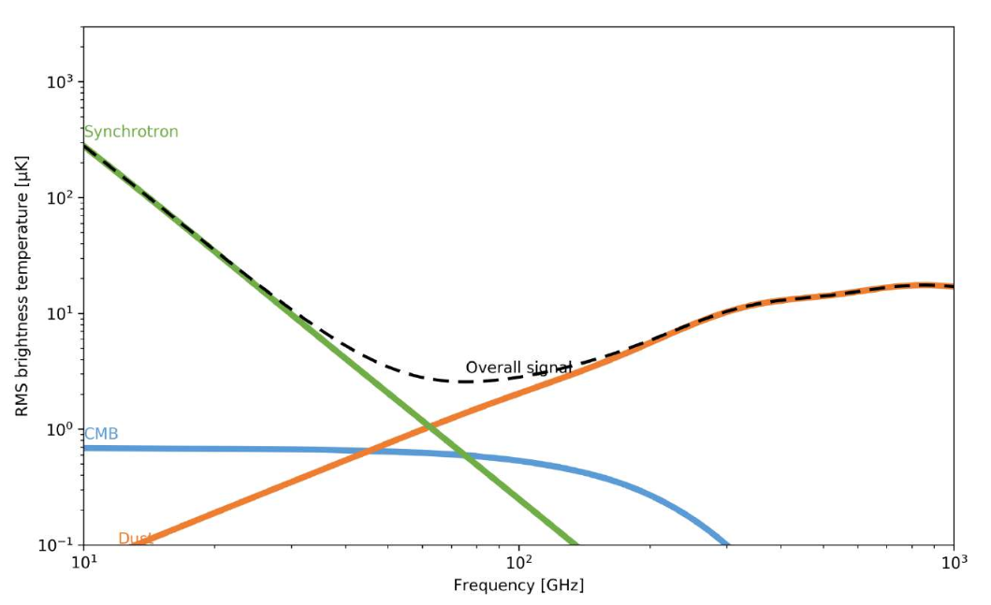
Hunting primordial B-modes: why is it difficult?
Mainly polarized emissions from our Galaxy
There’s not only CMB in our data… but also FOREGROUNDS
Synchrotron emission: due to cosmic rays trapped in the galactic magnetic field lines (intrinsecally polarized) dominates at low frequences $≲70 GHz$
Thermal dust emission: due to interstellar dust grains (polarized for aspherical grains)
dominates at high frequences $≳100 GHz$
Multi-frequency measurements are necessaries to disentangle CMB from foregrounds
There is no frequency where CMB polarization signal is dominant!

Slide 13
Hunting primordial B-Modes: a lot of competition!
Name | Years | Location | Frequency Range (GHz) | Technology
B-Machine COFE | 2002- | California, USA and Balloon | 10, 40 | HEMT
KECK | 2010- | South Pole, Antarctica | 35, 270 | TES bolometers
ABS | 2011- | Atacama Desert, Chile | 145 | Bolometers
SPTpol | 2012- | South Pole, Antarctica | 95, 150 | TES bolometers
POLARBEAR | 2012- | Atacama Desert, Chile | 150 | TES bolometers
QUIJOTE | 2012- | Tenerife, Canary Islands | 11, 13, 17, 19, 30 | HEMT
BICEP2 | 2014- | South Pole, Antarctica | 95 | TES bolometers
CBASS | 2015- | California, USA and South Africa | 5 | HEMT
LSPE | Future (2018) | Tenerife, Canary Islands and balloon | 40, 90, 150, 220, 240 | HEMT, TES bolometers
GroundBIRD | Future (2018) | Tenerife, Canary Islands | 145, 220 | MKIDs
QUBIC | Future (2019) | Alto Chorillo, Argentina | 97, 150, 230 | Bolometric Interferometer
Simons Array | Future | Atacama Desert, Chile | 90, 150, 220, 280 | TES bolometers
LiteBIRD | Future | Space | 6 bands between 50 and 320 | TES bolometers or MKIDs

Slide 14
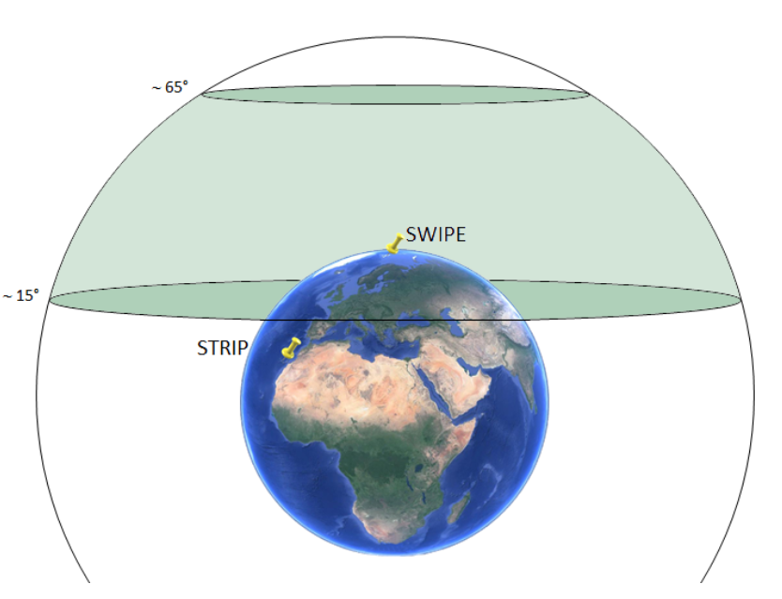
LSPE: Large Scale Polarization Explorer
International collaboration under italian leadership
(funded by ASI and INFN)
Scientific goals:
precision measurement of the CMB polarization at large angular scales.
Measurement of the polarized emissions of our galaxy
constraint on the B-modes down to r = 0.03
Sky coverage (25%)
LSPE

Slide 15
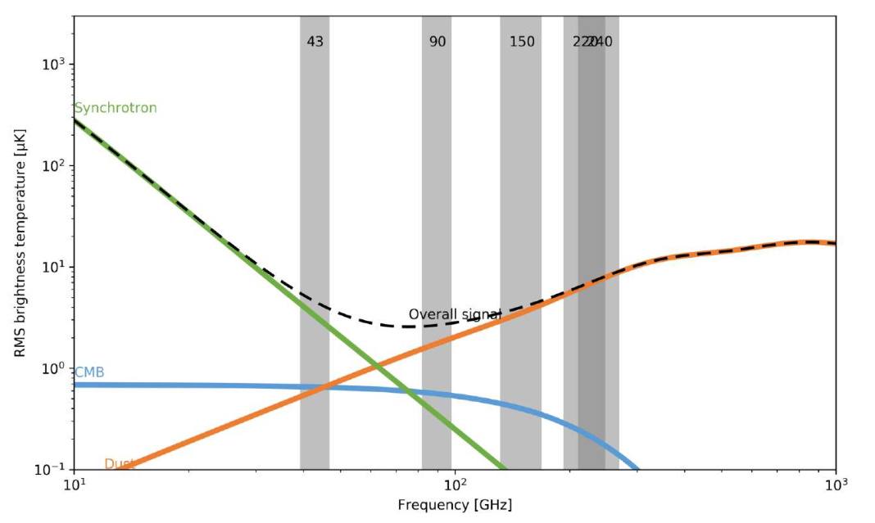
LSPE: Large Scale Polarization Explorer
International collaboration under italian leadership
(funded by ASI and INFN)
Scientific goals:
precision measurement of the CMB polarization at large angular scales.
Measurement of the polarized emissions of our galaxy
constraint on the B-modes down to r = 0.03
constraint on the B-modes down to r = 0.03
LSPE Frequency coverage

Slide 16
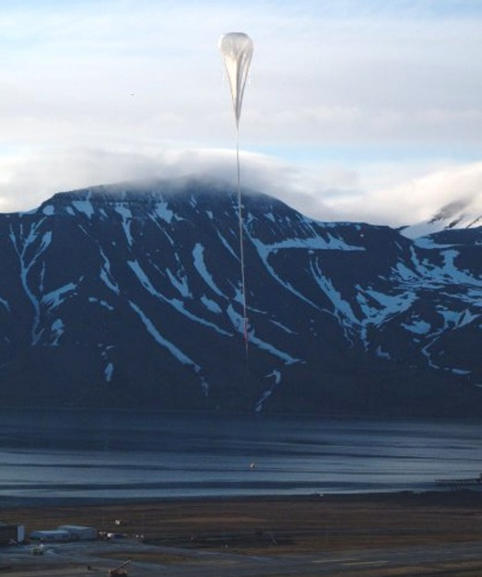
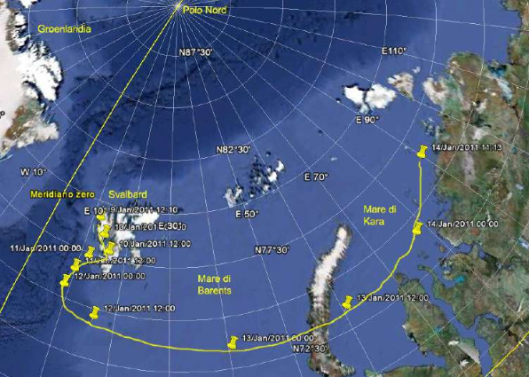
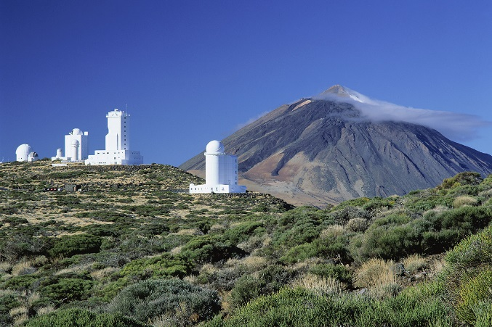
LSPE: Large Scale Polarization Explorer
Sinergy of two different instruments
SWIPE
Spinning stratospheric balloon
Bolometers
High frequency: 140, 220, 240 GHz
15 days of circumpolar flight during the Artic night.
Estimated launch date: December 2018 from Svalbard Islands
STRIP
Ground-based instrument
Coherent polarimeters
Low frequency: 43, 90 GHz
2 years of data taking at Teide Observatory
in Tenerife (Canary Islands).
Estimated shipping date: Summer 2018

Slide 17
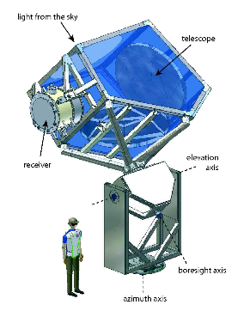
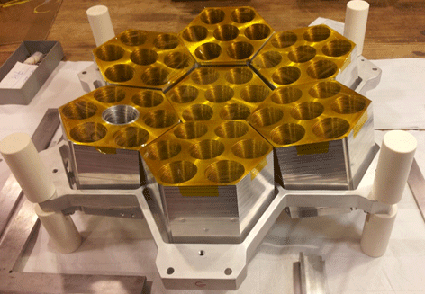
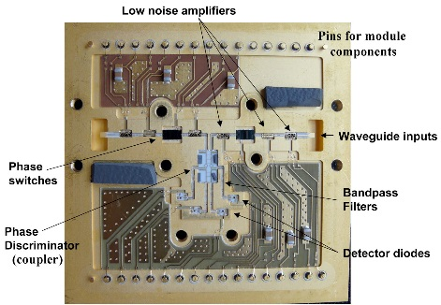
LSPE: The STRIP instrument
Dual reflector telescope with an alt-azimuth 3-axis mount
it can fully rotate in azimuth to scan the sky
49 coherent polarimeters at 43 GHz (Q-band)
precision measurement of the galaxy synchrotron emission
6 coherent polarimeters at 90 GHz (W-band)
Atmosphere monitoring
UniMi leads the development of STRIP
Program management
Fabrication and testing of the feed horn arrays and instrument mechanical structure
Polarimeters testing at Milano Bicocca Cryogenic Millimetre Lab

Slide 18
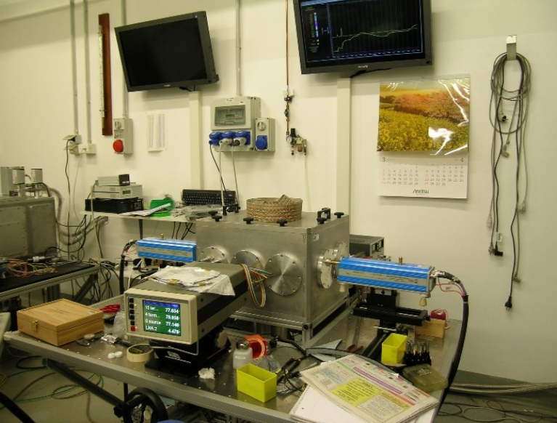
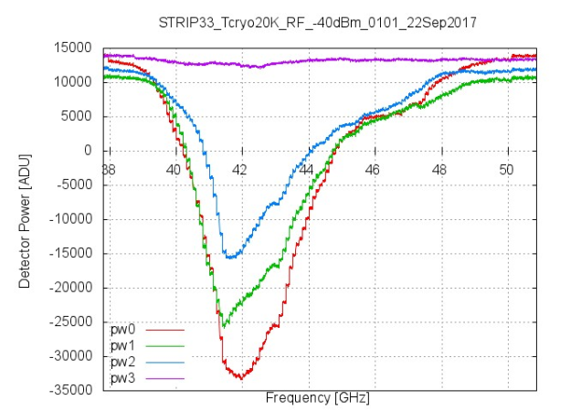
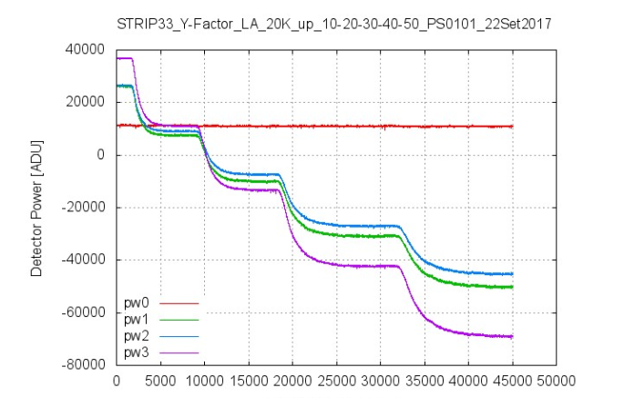
LSPE/STRIP polarimeters testing
Bandwidth test
T_{sys} test

Slide 19
LSPE: The STRIP instrument
Dual reflector telescope with an alt-azimuth 3-axis mount
it can fully rotate in azimuth to scan the sky
49 coherent polarimeters at 43 GHz (Q-band)
precision measurement of the galaxy synchrotron emission
6 coherent polarimeters at 90 GHz (W-band)
Atmosphere monitoring
UniMi leads the development of STRIP
Program management
Fabrication and testing of the feed horn arrays and instrument mechanical structure
Polarimeters testing at Milano Bicocca Cryogenic Millimetre Lab
Definition of instrument scanning strategy
Preparation of the scientific data anaysis pipeline
see Federico Incardona’s talk

Slide 20
Data Analysis in a CMB experiment
Raw data
Cleaning, calibration
Time ordered information (TOI)
Map-making
Sky maps (one for each frequency)
Component separation
Clean CMB map
Power spectrum estimation
Power spectrum
Parameter estimation
Voltage (V)
Cosmological parameters
Time
The output of the telescope is a time series of voltage values for each detector
The telescope scans the sky

Slide 21
Data Analysis in a CMB experiment
Raw data
Cleaning, calibration
Time ordered information (TOI)
Map-making
Sky maps (one for each frequency)
Component separation
Clean CMB map
Power spectrum estimation
Power spectrum
Parameter estimation
Temperature (K)
Cosmological parameters
Time
Cleaning:
remove dirty data
(bad weather, Sun, instrumental mulfunction etc.)
Calibration:
Voltage Temperature or Flux
Using a source with known signal
(e.g. Crab Nebula)

Slide 22
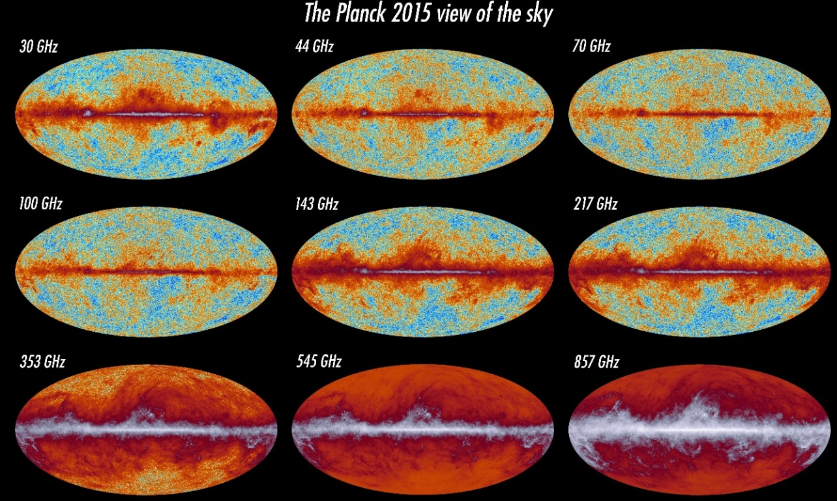
Data Analysis in a CMB experiment
Raw data
Cleaning, calibration
Time ordered information (TOI)
Map-making
Sky maps (one for each frequency)
Component separation
Clean CMB map
Planck data
Power spectrum estimation
Power spectrum
Parameter estimation
Map- making:
reconstruct a map of the sky from TOI (known the pointing sequence)
N.B. this is the Planck case! LSPE will produce 5 maps
Cosmological parameters

Slide 23
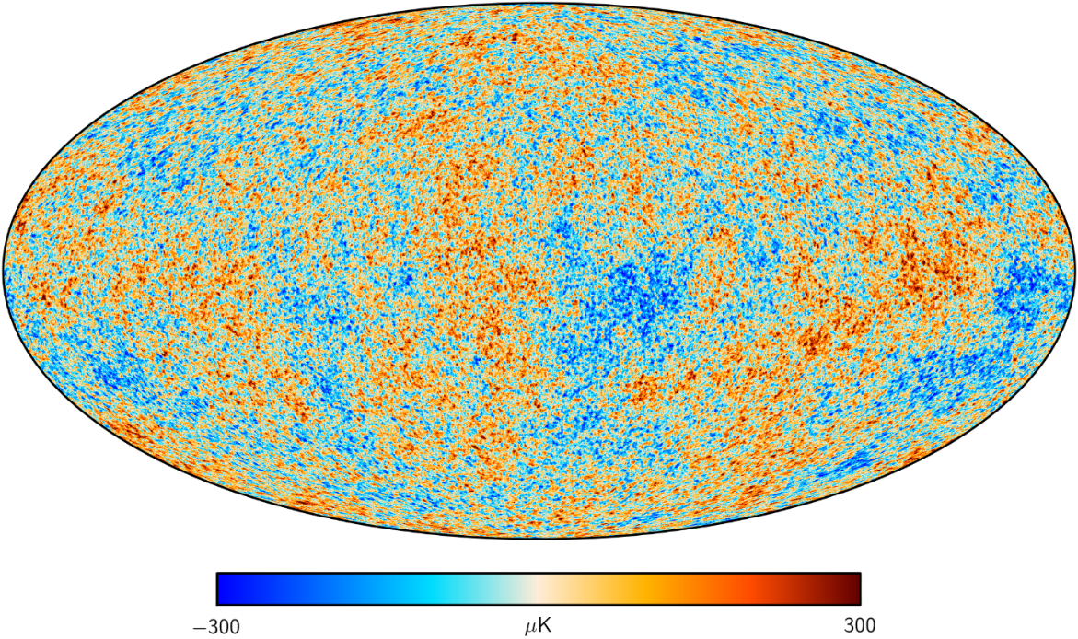
Data Analysis in a CMB experiment
Raw data
Cleaning, calibration
Time ordered information (TOI)
Map-making
Sky maps (one for each frequency)
Component separation
Clean CMB map
Power spectrum
Component separation:
separate the contribution of CMB and foregrounds
Planck data
Parameter estimation
We use the fact that CMB and foregrounds:
have different frequency dependencies
Are not correlated
Cosmological parameters

Slide 24
Data Analysis in a CMB experiment
Raw data
Cleaning, calibration
Time ordered information (TOI)
Map-making
Sky maps (one for each frequency)
Component separation
Clean CMB map
Power spectrum estimation
Power spectrum
Parameter estimation
Cosmological parameters
Planck data
δT(θ, φ) = $\sum_{l=0}^{∞}{\sum_{m=−l}^{l}{a_{l,m }Y_{l,m}(\text{q}\text{, }\text{f})}}$
$C_{l}= \left\langle a_{l,m }a_{l,m}^{∗}\right\rangle$ = $\frac{1}{2l+1}$ $\sum_{m=−l}^{m=l}{{{|a}_{l,m }|}^{2}}$

Slide 25
Data Analysis in a CMB experiment
Raw data
Cleaning, calibration
Time ordered information (TOI)
Map-making
Sky maps (one for each frequency)
Component separation
Clean CMB map
Power spectrum estimation
Power spectrum
Performing a fit of the power spectrum with ΛCDM model
Parameter estimation
Cosmological parameters
${\text{W}}_{b}, { \text{W}}_{c}, {\text{W}}_{\text{L}},$ $H_{0}{\text{, }\text{q}}_{∗},$ ${\text{n}}_{s}$, $τ$, r etc.

Slide 26
Data Analysis for the LSPE/STRIP experiment
Raw data
My focus is on this part
of the pipeline
Cleaning, calibration
Time ordered information (TOI)
simulations and data analysis to go:
Map-making
Sky maps (one for each frequency)
STRIP raw data
Component separation
Cleen CMB map
42 GHz and 90 GHz I,Q, U sky maps
Power spectrum estimation
For that we need also SWIPE sky maps
Power spectrum
Parameter estimation
Cosmological parameters
Main challenges:
Map-making implementation
Studying of systematic effects: noise properties (white, 1/f), pointing uncertainties (star tracker?) etc.
Studying of atmosphere properties

Slide 27
Conclusions
Observation of B-modes in the CMB polarization would probe the theory of Inflation
A lot of experimental efforts are ongoing throughout the World
The LSPE experiment will start taking data in middle/late 2018 hunting for B-modes signal at large angular scales.
UniMi group leads the development of the STRIP detector.
It is an extremely challenging measurement (very low signal, foregrounds etc.)
My focus is on the simulations and preparation of the data analysis pipeline for the STRIP experiment, which will produce the sky map of the synchrotron foreground

Slide 28
Thank you
for your
attention!

Slide 29
Backup Slides

Slide 30
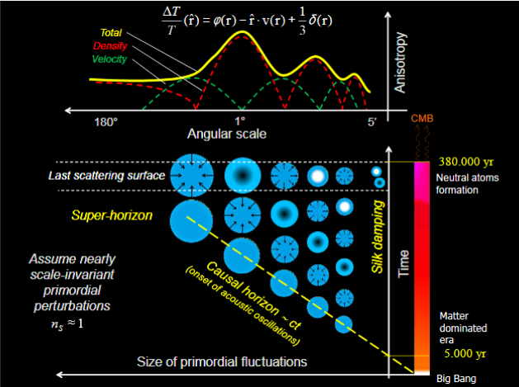
Peaks in the CMB power spectrum: Acoustic Oscillations

Slide 31
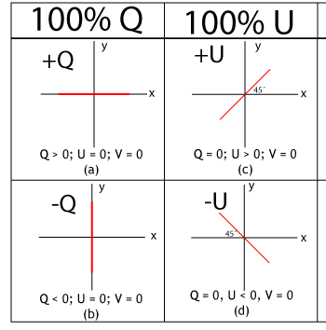
Polarization
Electromagnetic plane wave propagating along the z direction
Stokes parameters
$$I= {{<E}_{x}>}^{2}+{{ <E}_{y}>}^{2}$$
Q $= {{<E}_{x}>}^{2 }−{{ <E}_{y}>}^{2}$
U $= {{<E}_{a}>}^{2 }−{{ <E}_{b}>}^{2}$
To describe the CMB polarization anisotropies using spherical harmonics, as done for the temperature case, we can introduce the quantities $Q±iU$ and expand them in terms of tensor spherical harmonics
($Q±iU$)(θ, φ) = $\sum_{l=0}^{∞}{\sum_{m=−l}^{l}{{a_{l,m }}^{±2} {Y_{l,m}\left(\text{q}\text{, }\text{f}\right)}^{±2}}}$
Instead of ${a_{l,m }}^{±2}$ it is convenient to introduce their linear combinations:
${a_{l,m }}^{E}$ = - (- ${a_{l,m }}^{+2}+{a_{l,m }}^{−2})/2$
E-Modes
${a_{l,m }}^{B}$ = i (- ${a_{l,m }}^{+2}−{a_{l,m }}^{−2})/2$
B-Modes

Slide 32
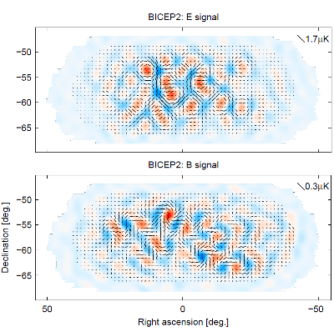
E-modes and B-modes: The BICEP case
Announcement on 17 March 2014 : detection of B-modes, $r= {0.20}_{−0.05}^{+0.07}$
In 2015 joint analysis of BICEP2 and Planck data:
Signal can be entirely attributed to dust in the Milky Way

Slide 33
LSPE/STRIP polarimeters scheme

