Slide 1


Optical characterization
of mineral dust in ice cores
Workshop 2017
Llorenç Cremonesi

Slide 2
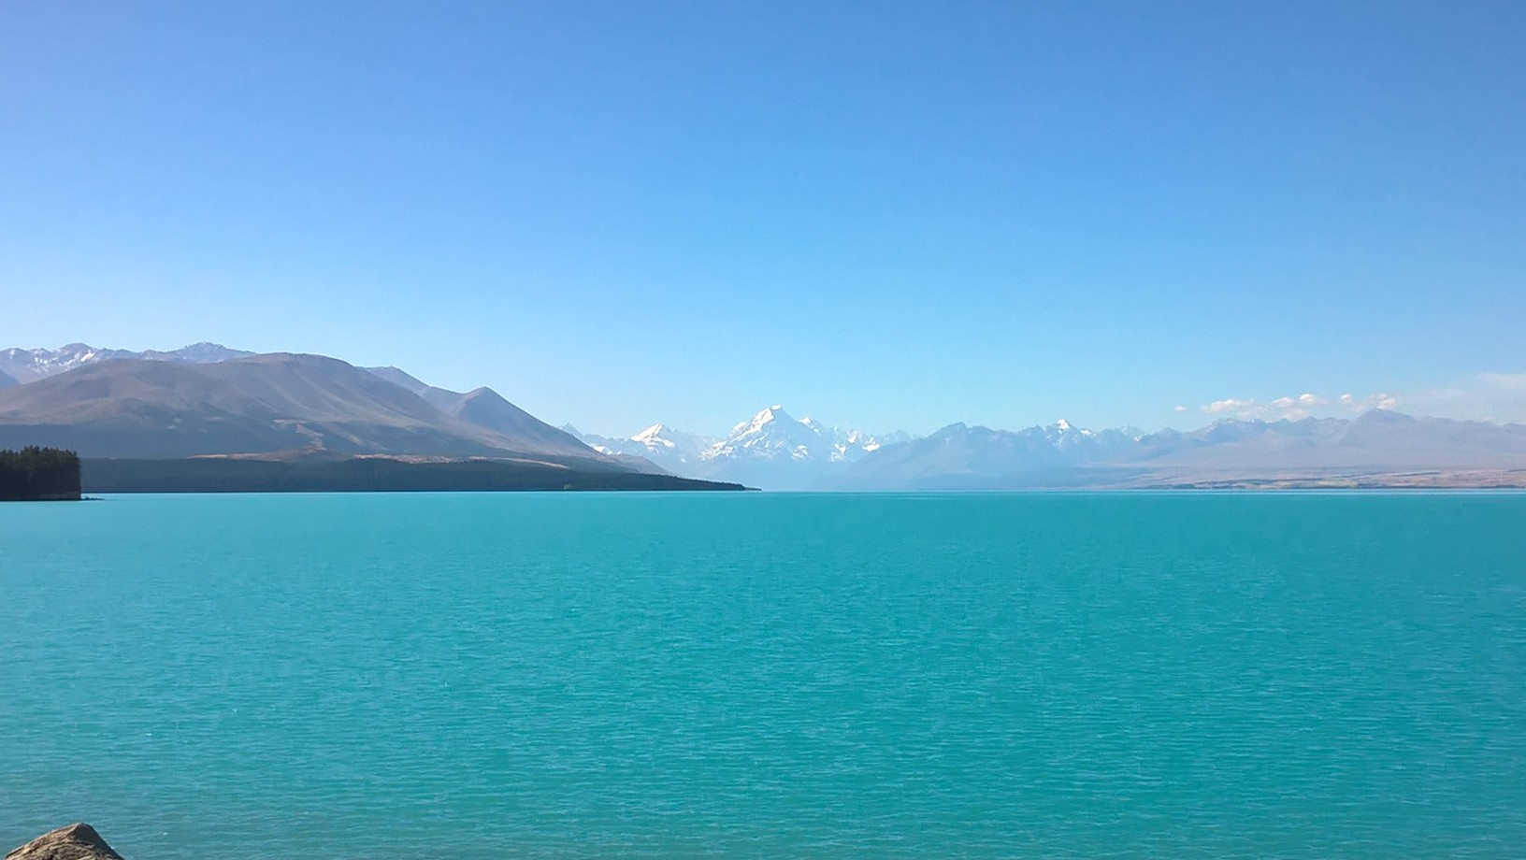

Mineral dust ubiquity and relevance
Interacts with solar and terrestrial radiation
Impacts on cloud formation
Suspended in the atmosphere
(Undergoes transport and deposition)
affects global climate
Deposited and stored in ice
Suspended in water (rivers and river deltas, lakes, seas, …)
Lake Pukaki, New Zealand, 2017
llorenc.cremonesi@unimi.it
Optical characterization of mineral dust in ice cores
10.10.2017

Slide 3


Why optical methods?
✔ fast (statistically significant)
✔ non invasive
✔ continuous flow analysis
✔ field measurements
Direct access to optical
properties of particles
→ size (commonly investigated)
→ composition
→ shape, hence orientation
→ internal structure, surface properties
Indirect access to
particle morphology
Scattering cross section depends primarily on size (at given λ)
common model: spheres of a given material
and yet… many parameters affect scattering
A more detailed model can give much deeper insight
llorenc.cremonesi@unimi.it
Optical characterization of mineral dust in ice cores
10.10.2017

Slide 4


Light scattering by small particles
What can we measure in the lab?
Laser beam
The power of the beam is partially scattered
scattering cross section
The transmitted power is reduced accordingly
extinction cross section
Extinction and scattering act simultaneously
llorenc.cremonesi@unimi.it
Optical characterization of mineral dust in ice cores
10.10.2017

Slide 5
Single Particle Extinction and Scattering (SPES)
Scattering in the forward direction
Sensor
Laser beam
Self Reference
Interference Scheme
forward scattered + transmitted
interference
Complete information on the forward scattered field: modulus and phase
Simultaneous measurement of two independent parameters
Single particle approach:
a flow of particles across a focused laser beam
llorenc.cremonesi@unimi.it
Optical characterization of mineral dust in ice cores
10.10.2017

Slide 6
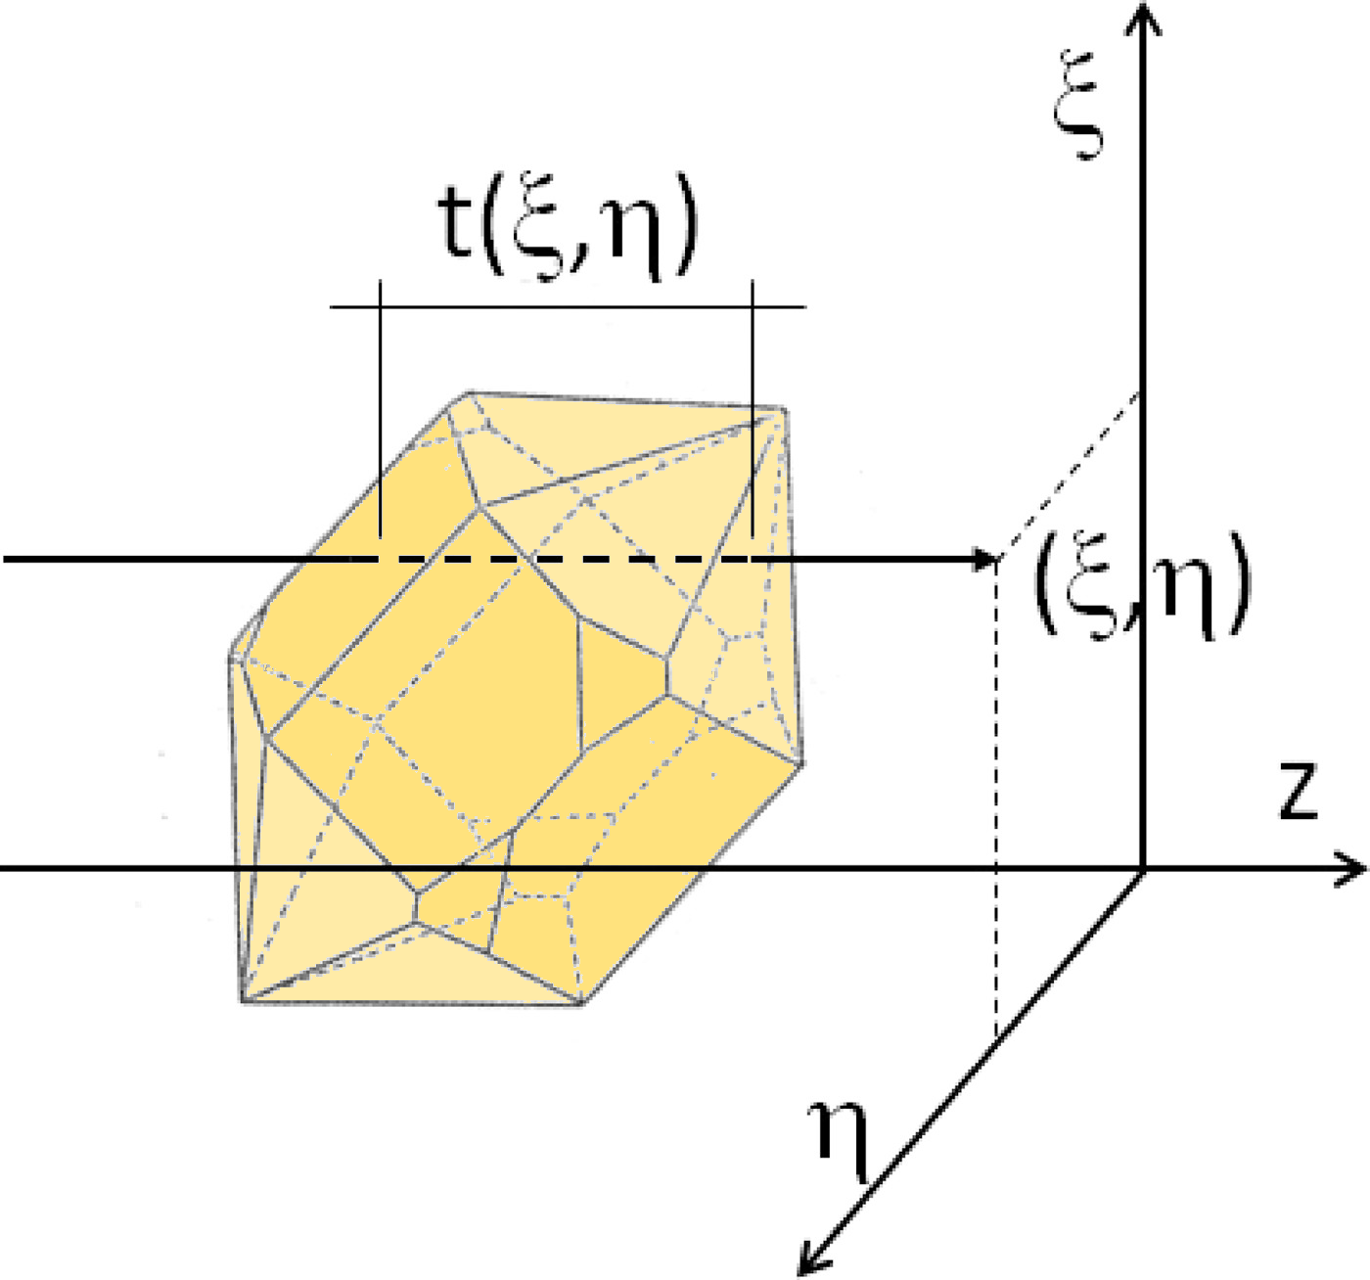
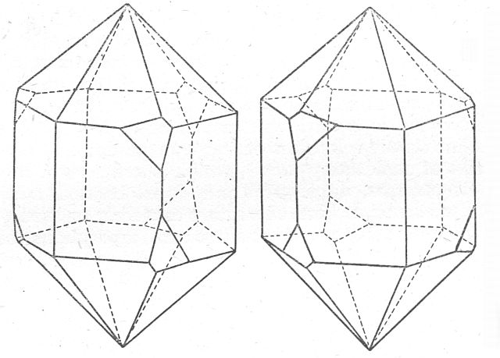

A simple model for complex shapes
SPES simultaneously recovers two scattering parameters
which can be related to:
Extinction cross section C_{ext}
accurately determined
monotonically increasing with size
2) Optical thickness ρ
related to the refractive index
affected by shape and orientation
$ρ \sim$ $\left\langle t\right\rangle ⋅(n/n_{0} −1)$
‹ t ›
H. C. Van de Hulst. Light Scattering by Small Particles. Dover, 1981
llorenc.cremonesi@unimi.it
Optical characterization of mineral dust in ice cores
10.10.2017

Slide 7
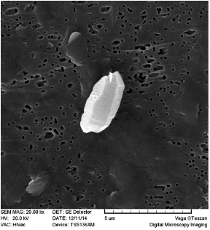
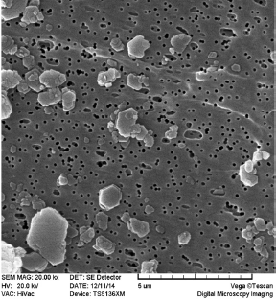
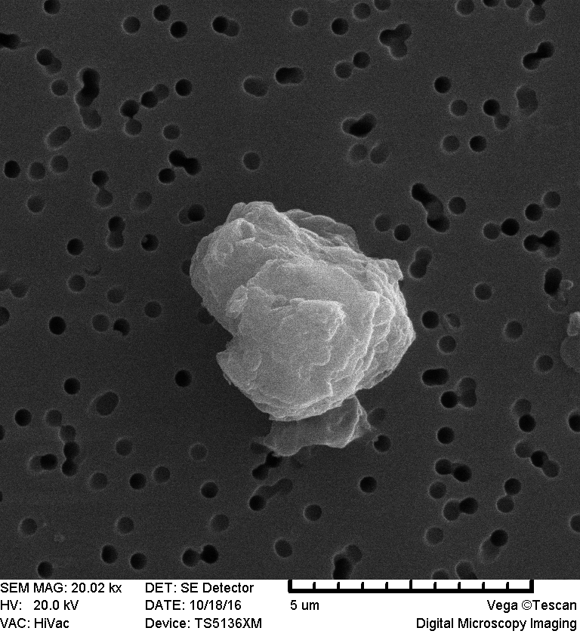
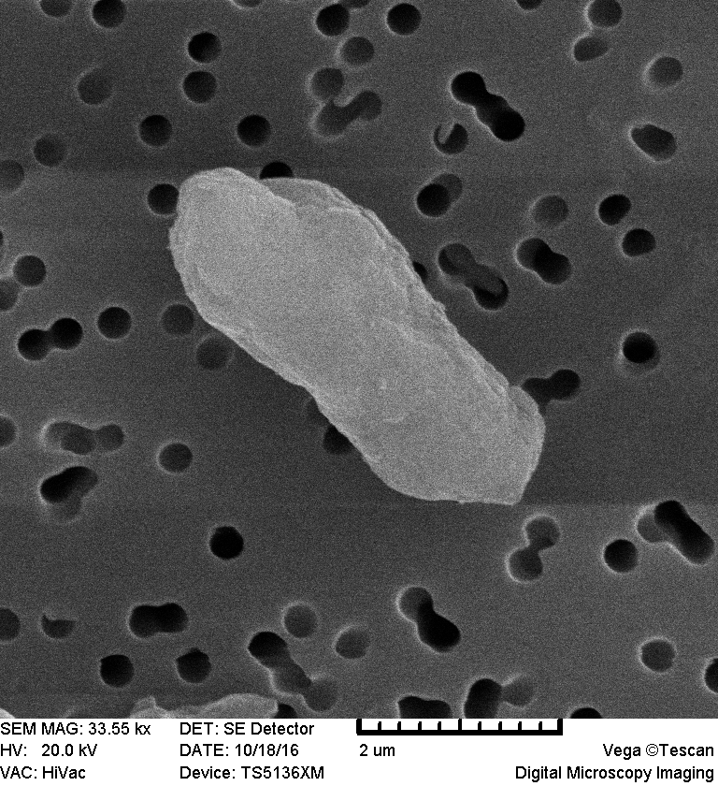
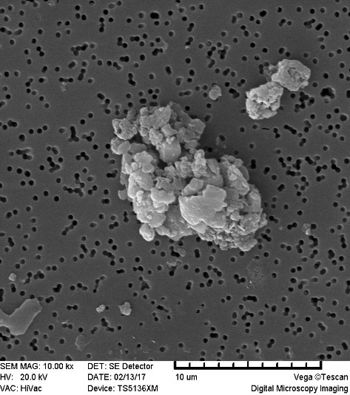
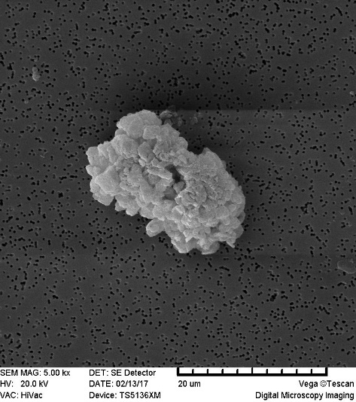
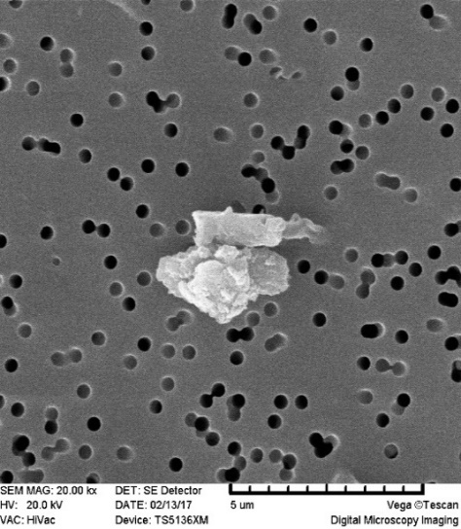
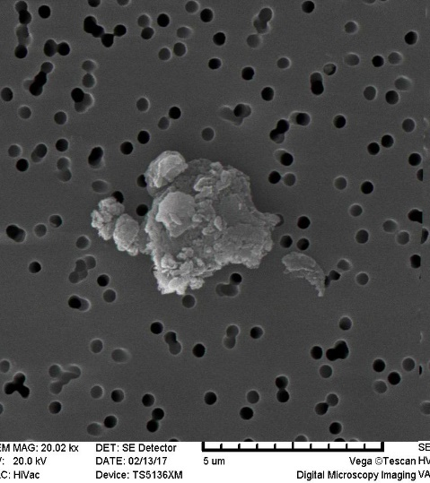
Measuring mineral dust: definitely not spheres
quartz
kaolinite
EDC 5316
EDC 5316
EDC 5534
EDC 5534
EDC 5768
EDC 5768
MAC Potenza et al, (2017) ACS Earth and Space Chemistry ; Villa et al., (2016) Journal of Applied Physics, 119, 24901.
llorenc.cremonesi@unimi.it
Optical characterization of mineral dust in ice cores
10.10.2017

Slide 8
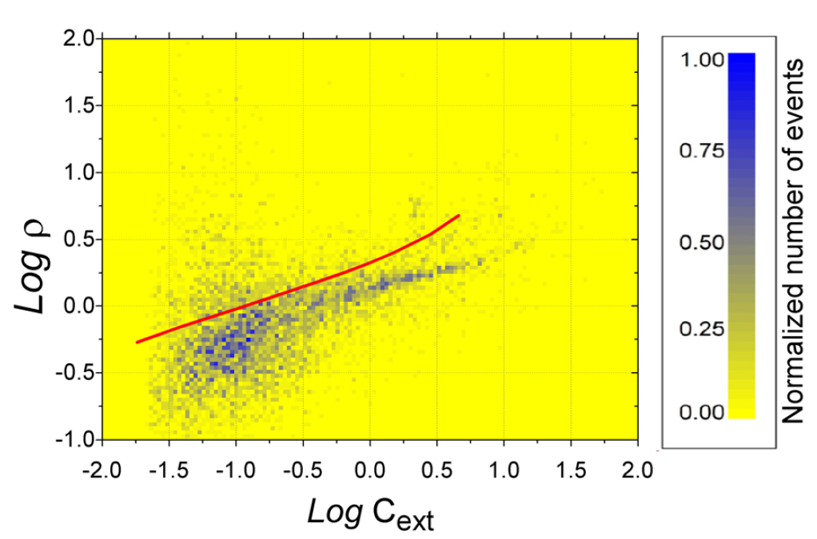
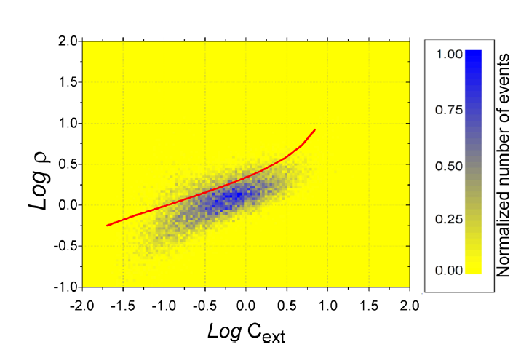
Shape impact on scattering
shape introduces orientation variability
oblate and prolate particles exhibit ρ anomalies
No mineral matches
such a low refractive index
spheres
quartz (prolate) n = 1.54
equivalent spheres n = 1.40
spheres
kaolinite (oblate) n = 1.42
equivalent spheres n = 1.37
Villa et al., (2016) Journal of Applied Physics, 119, 24901.
llorenc.cremonesi@unimi.it
Optical characterization of mineral dust in ice cores
10.10.2017

Slide 9
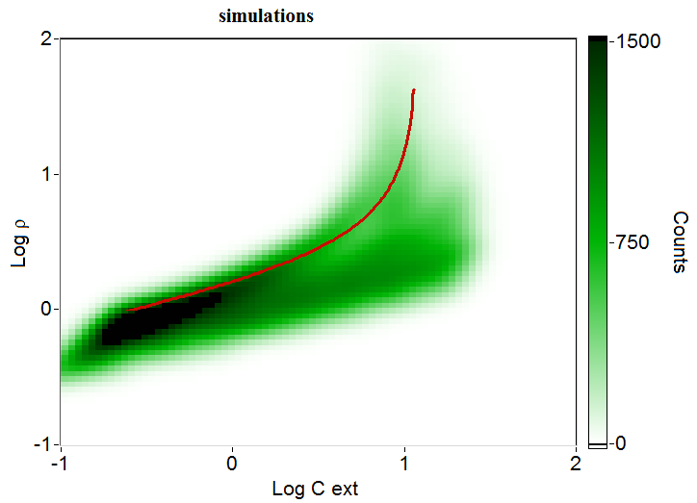
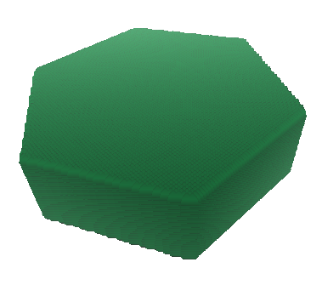
Shape impact on scattering
Polidisperse population of
randomly oriented prisms
spheres
n = 1.55
Aspect Ratio = 0.3
increasing size
height
oblate particles
width
500 nm < size < 2500 nm
we can quantify the average Aspect Ratio from the spread
llorenc.cremonesi@unimi.it
Optical characterization of mineral dust in ice cores
10.10.2017

Slide 10
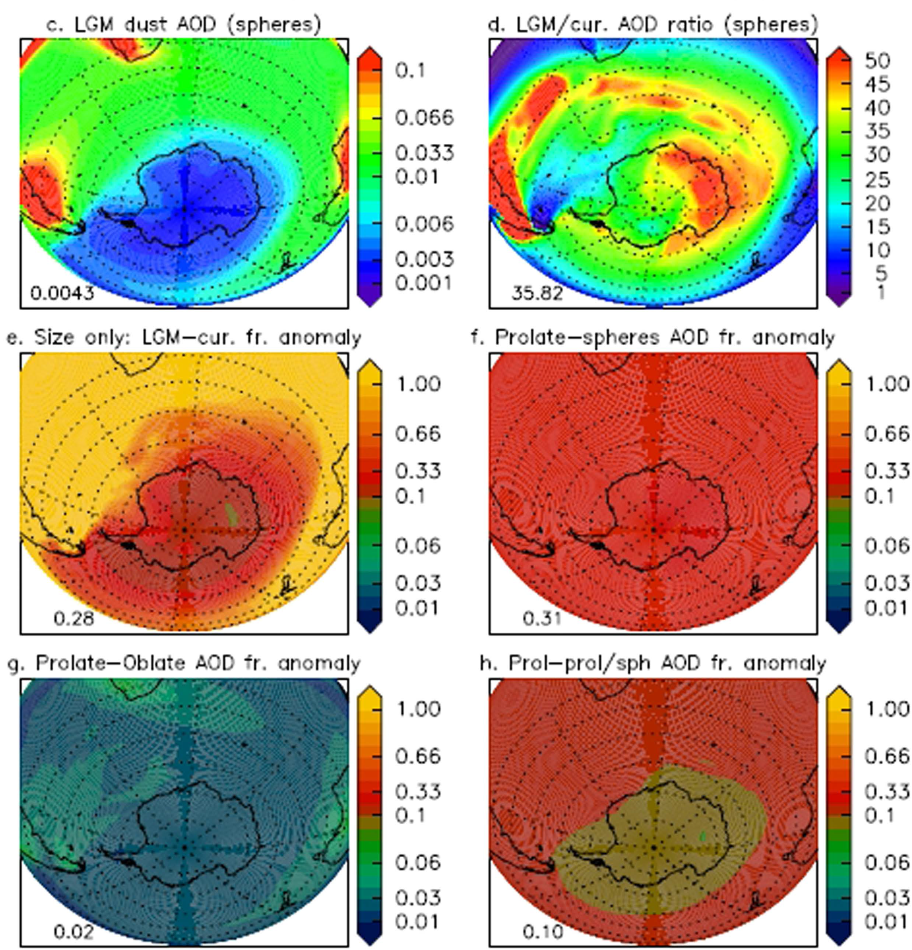
Shape relevance for Radiative Transfer
Anomalies in Aerosol Optical Depth (AOD)
Considering non-sphericity: 31%
Oblate or prolate particles: 2%
Focus on the Aspect Ratio
MAC Potenza, S Albani, B Delmonte, S Villa, T Sanvito, B Paroli, N. Mahowald & V Maggi, (2016). Sci. Rep, 6, 28162.
llorenc.cremonesi@unimi.it
Optical characterization of mineral dust in ice cores
10.10.2017

Slide 11
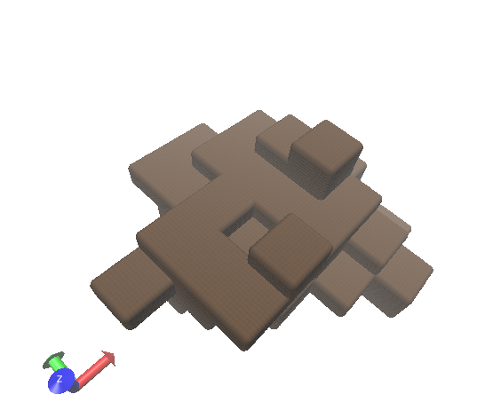

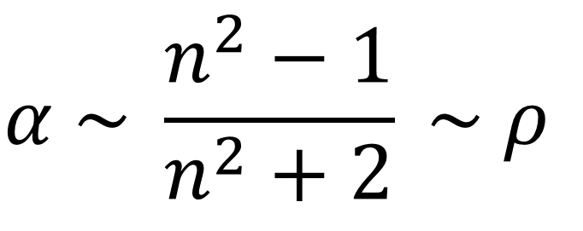
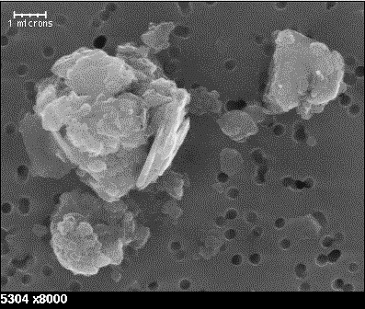
Back to isometric particles: detecting aggregates in EDC
optical thickness
average polarizability
Aspect Ratio ~ 1
Depth (m)
~ 3000 m deep ice cores
(more than 500’000 years ago)
mineral dust undergoes in situ aggregation
A challenge for sizing
Dust Concentration (ppb)
llorenc.cremonesi@unimi.it
Optical characterization of mineral dust in ice cores
10.10.2017

Slide 12
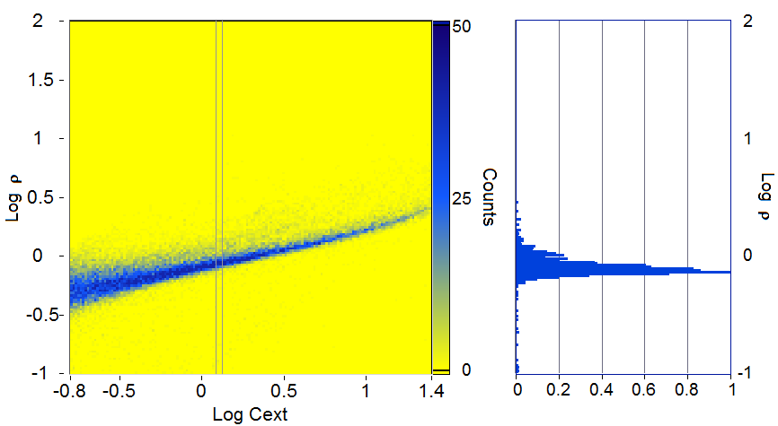
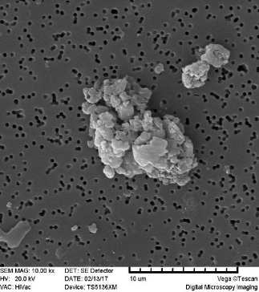
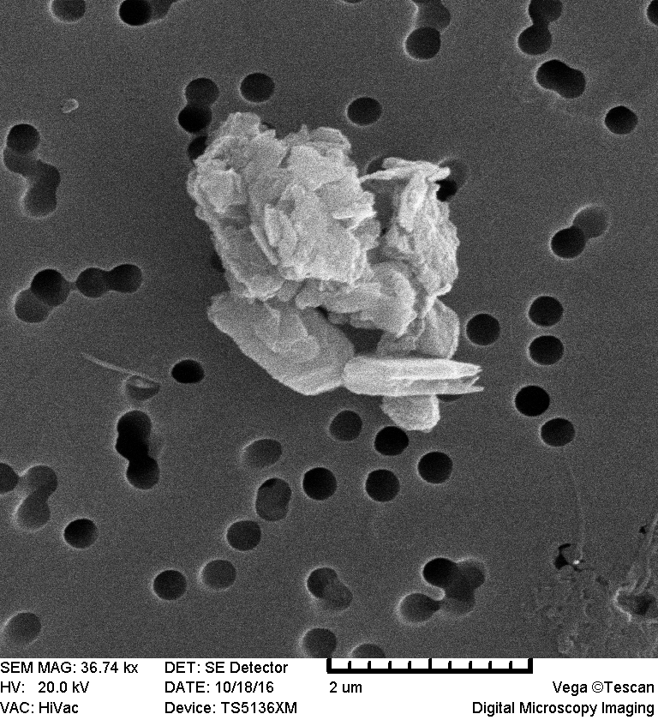
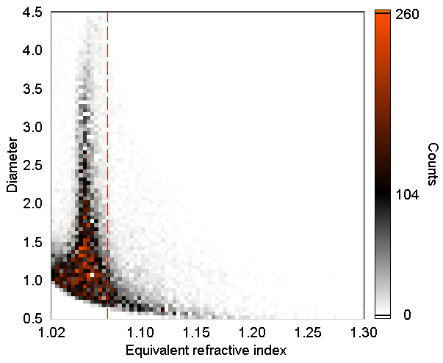
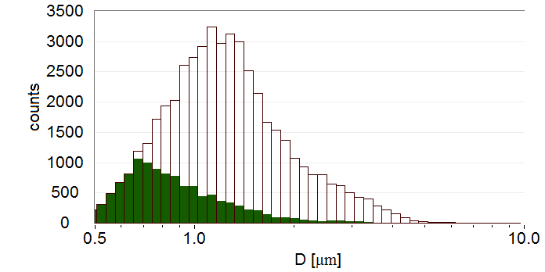
Isometric particles: detecting aggregates in EDC
EDC 5534
Look up table Inversion:
diameter and
refractive index
n = 1.4
Aggregates n<1.42
n = 1.42
Solid particles n>1.42
MAC Potenza et al, (2017) ACS Earth and Space Chemistry
llorenc.cremonesi@unimi.it
Optical characterization of mineral dust in ice cores
10.10.2017

Slide 13
Work in progress
Characterization of RECAP Holocene and Glacial samples
Calibration of extinction cross section diameter measurements (Abakus)
Characterization of Dome B Last Gacial Maximum ice core samples
Measurements of powders in alpine snow (Testa del Rutor)
llorenc.cremonesi@unimi.it
Optical characterization of mineral dust in ice cores
10.10.2017

Slide 14
Orienting particles: a courtesy of shear
Slow flow ~ 0.1 m/s
1.5 mm wide cell
moderate velocities: particles orient randomly in the cell
the system is dominated by velocity gradients within the cell
Comparing results obtained with two different systems
can give information about the particles aspect ratio
Fast flow ~ 1 m/s
200 μm wide cell
oblate
prolate
llorenc.cremonesi@unimi.it
Optical characterization of mineral dust in ice cores
10.10.2017

Slide 15
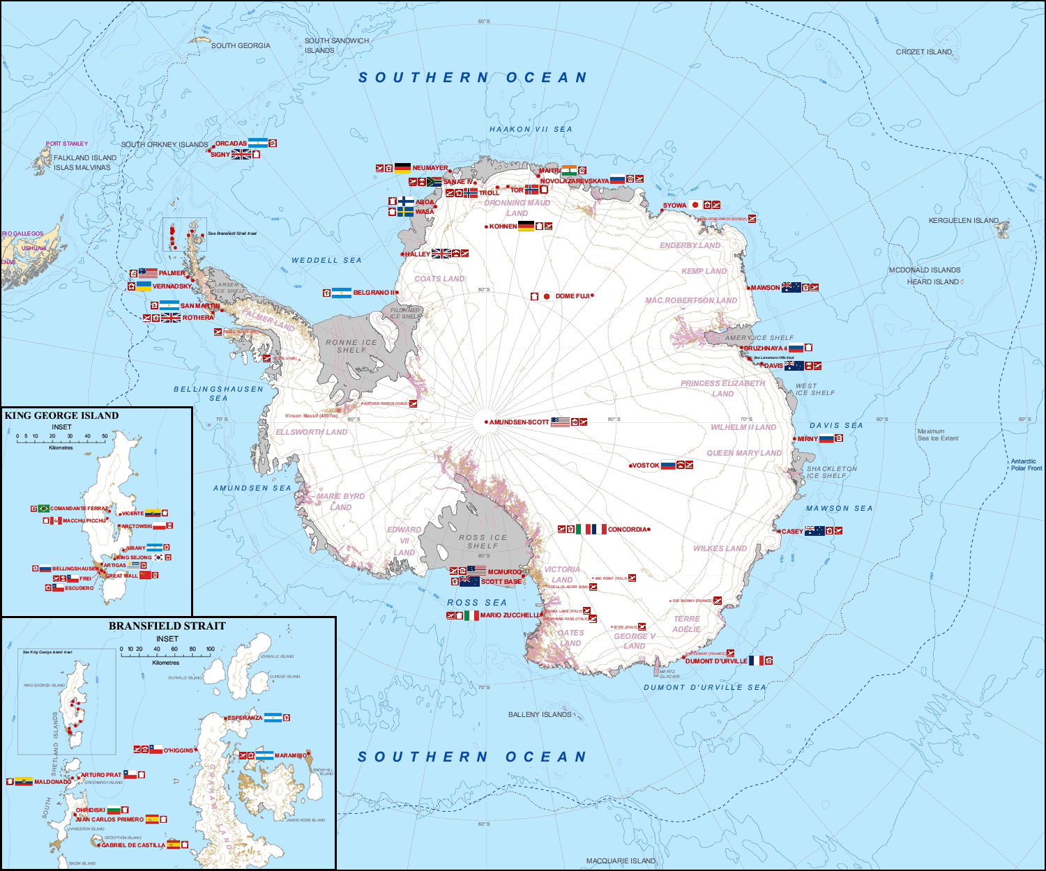
Dome C

Slide 16
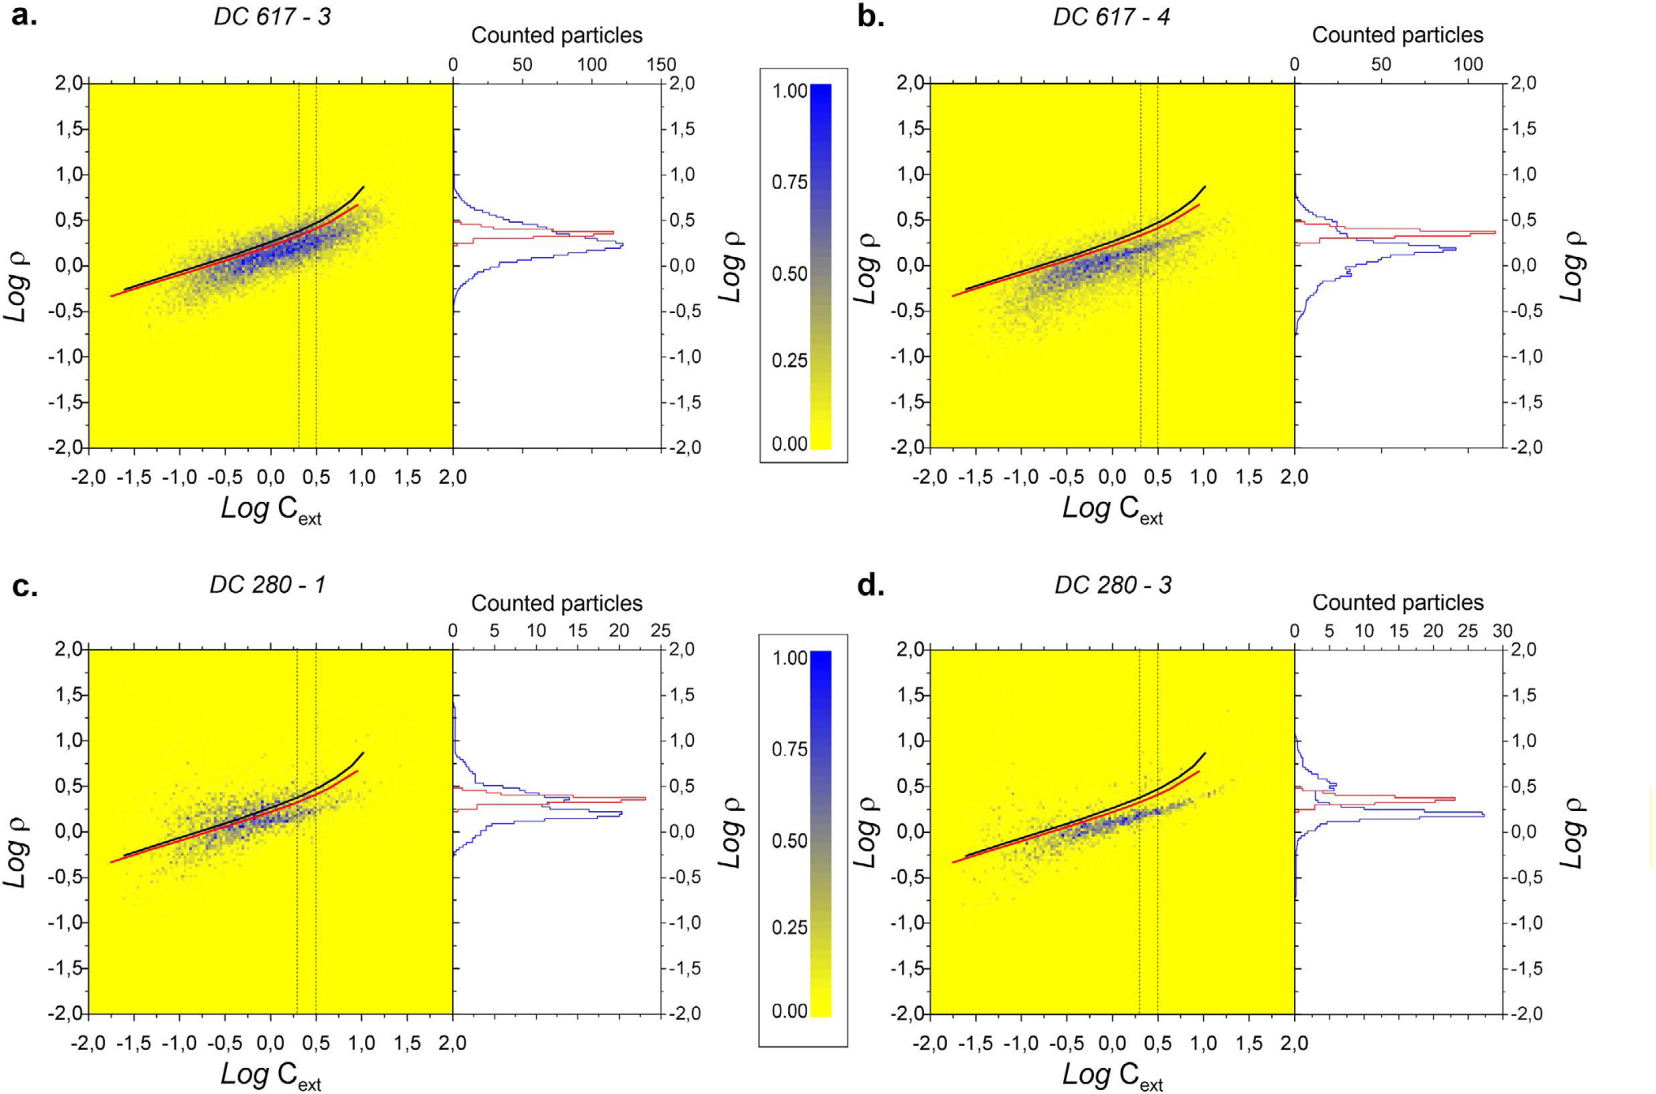
Ice core dust: Old Dome C - Antarctica
n = 1.55
n = 1.50
n = 1.55
n = 1.50
LGM 22.3 ka BP
LGM 22.3 ka BP
n = 1.55
n = 1.50
n = 1.55
n = 1.50
Hol. 7.4 ka BP
Hol. 7.4 ka BP
MAC Potenza, S Albani, B Delmonte, S Villa, T Sanvito, B Paroli, N. Mahowald & V Maggi, (2016). Sci. Rep, 6, 28162.
llorenc.cremonesi@unimi.it
Optical characterization of mineral dust in ice cores
10.10.2017

Slide 17
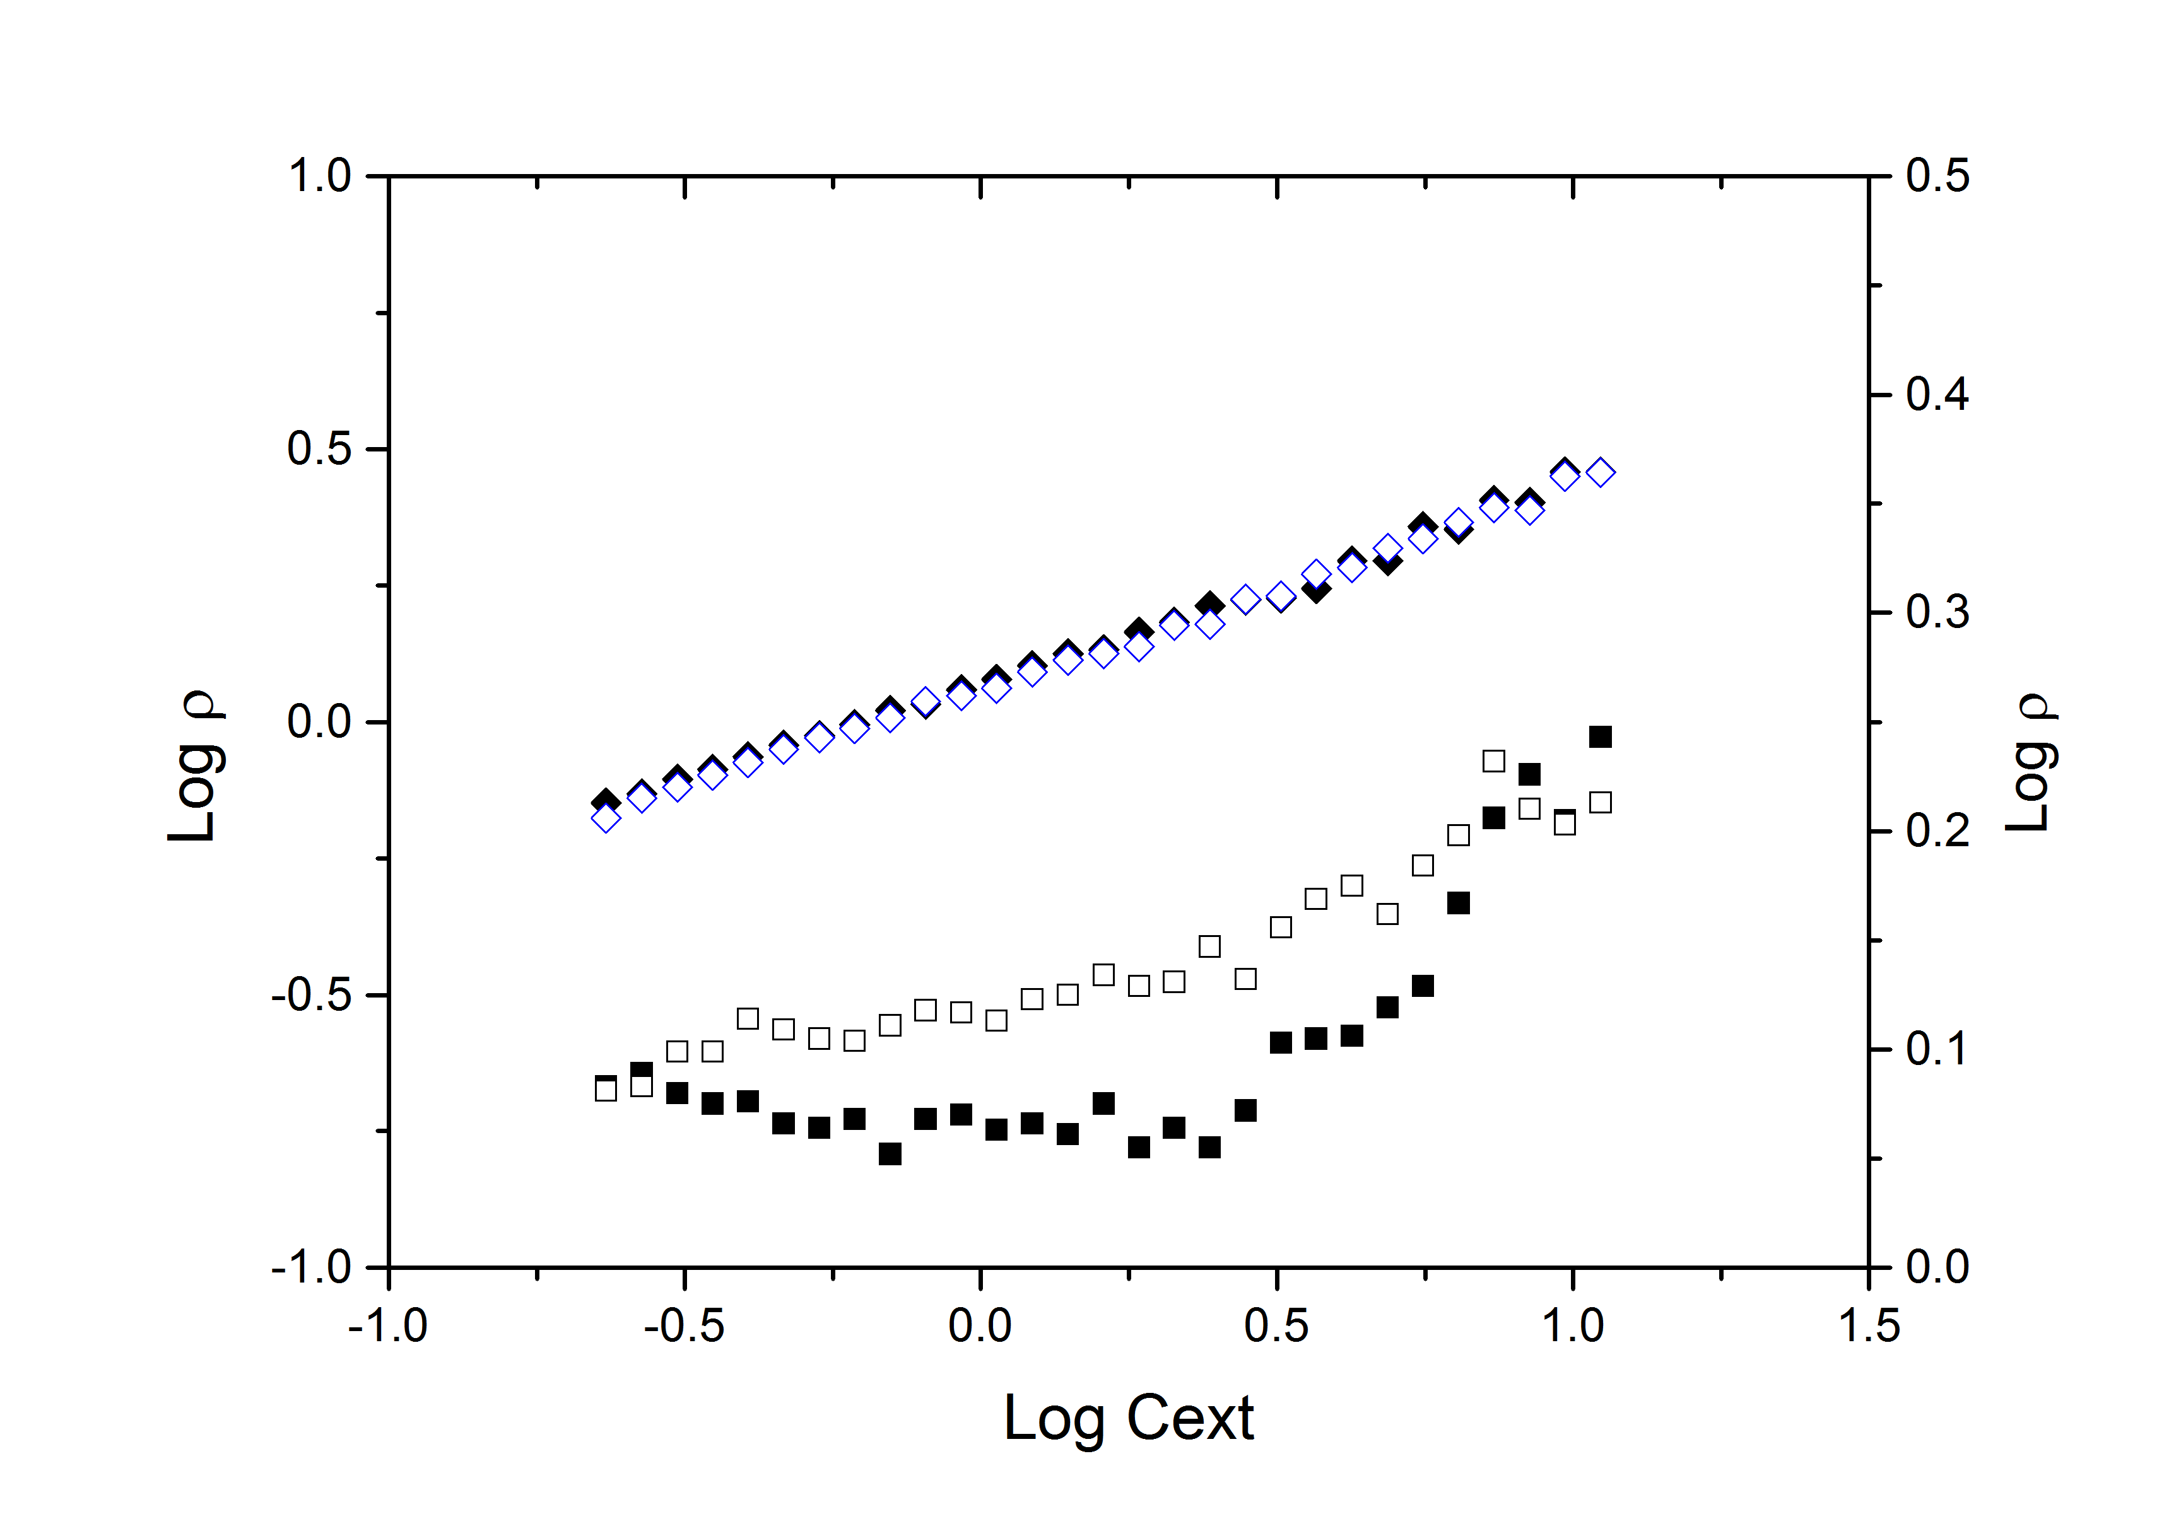
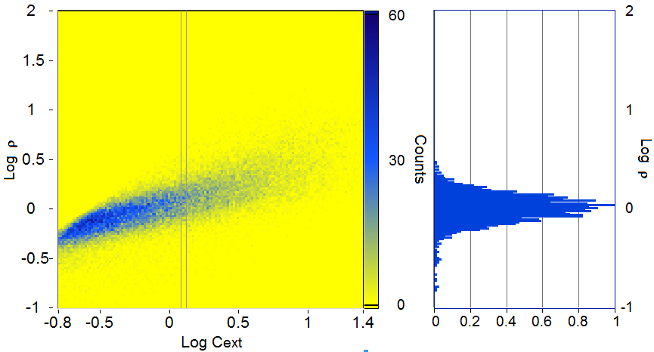
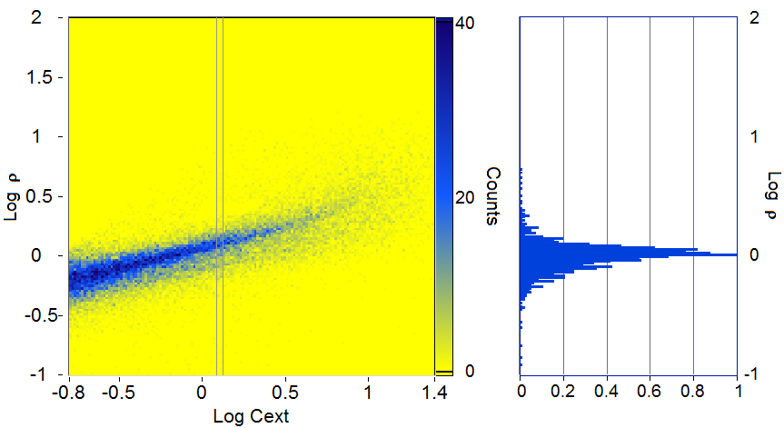
Ice core dust: aggregates in EDC
Thick cell
mode
std dev
Thin cell
Data cannot be inverted with
spherical model
oblate particles and not aggregates
Platelets with aspect Ratio ≃ 3
MAC Potenza et al, (2017) ACS Earth and Space Chemistry
llorenc.cremonesi@unimi.it
Optical characterization of mineral dust in ice cores
10.10.2017

Slide 18
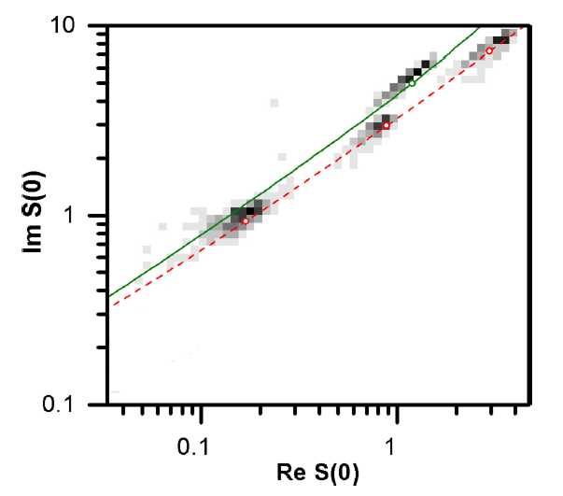
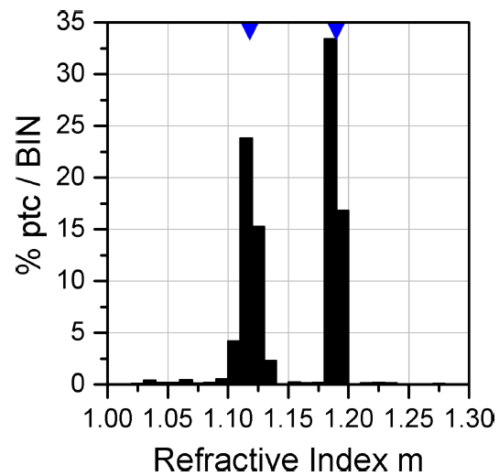
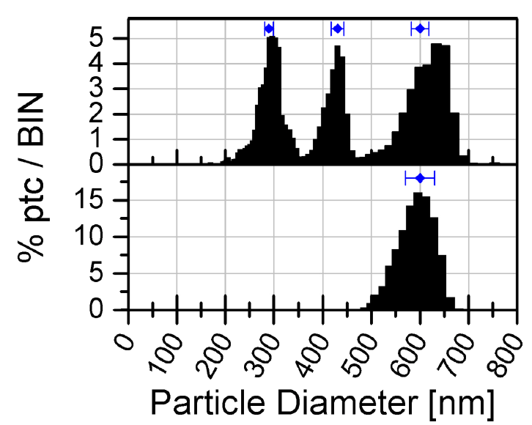
Applying SPES to PS and PMMA calibrated samples
expected
600 nm
Scattering [a.u.]
600 nm
PMMA spheres
400 nm
300 nm
PS spheres
Extinction [a.u.]
The refractive index is commonly assumed a priori
This would bias the particle sizing
MAC Potenza, T Sanvito, A Pullia, (2015). AIP advances, 5, 117222.

