Slide 1
Delayed creep of weak gels. A microrheological investigation.
Paolo Edera
Complex Fluids and Molecular Biophysics Lab
UNIMI PhD School

Slide 2
Delayed creep of weak gels. A microrheological investigation.
$load: σ$
$$time$$
$$γ\left(t\right)=\int_{−∞}^{t}{J(t−t^{′})}\dot{σ} \left(t^{′}\right)dt′$$
$$deformation: γ(t)$$
$J$ creep compliance
WHAT IS GOING ON DURING DELAY TIME?
WHAT HAPPENS TO THE MATERIAL JUST BEFORE IT BREAKS?
HOW DOES THE MATERIAL KNOWS IT HAS TO BREAK?
ARE THERE ANY PRECURSORS TO THE MATERIAL FAILURE?
$$τ_{delay}$$
$$∼hours÷months$$
$$time$$
Notes:
Material’s mechanical characteristics are encoded in this function $J$called creep compliance.
Several question arise concernig this phenomenon:
Is J caracteristic of the unperturbed system?
Or J depends on the stress \sigma?
changes because of the application of a stress
In other words, can the creep time be predected by some unperturbed state characteristic?

Slide 3
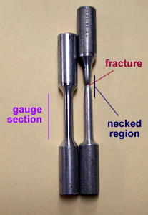
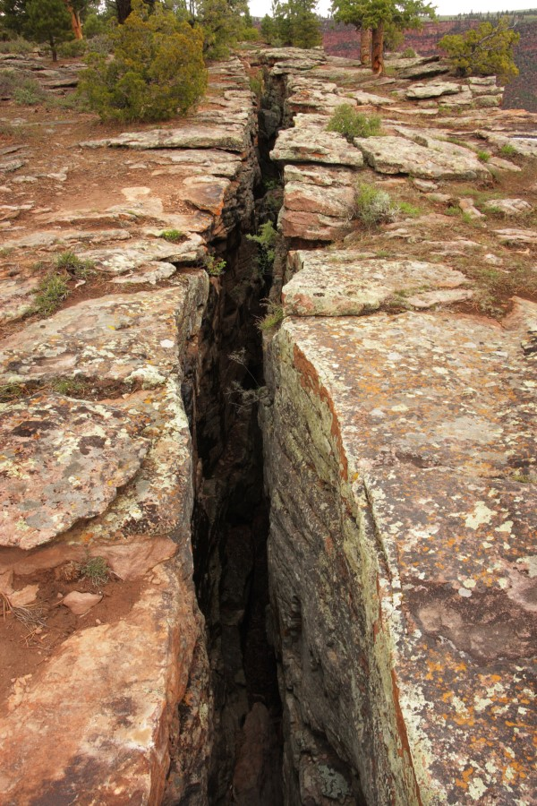
Delayed creep of weak gels. A microrheological investigation.
This phenomenon is common to a wide class of materials
paintings
metals
Earth’s crust

Slide 4
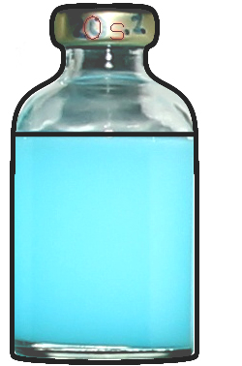
Delayed creep of weak gels. A microrheological investigation.
What’s a Gel?
Gel is a two phases material
Liquid phase
Liquid phase
Solid phase
Solid space-spanning network
Gels can be divided in
STRONG if network energy per bond $≫k_{B}T$
and
WEAK if network energy per bond$∼k_{B}T$

Slide 5
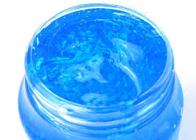
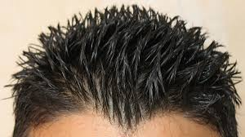
Delayed creep of weak gels. A microrheological investigation.
Notes:
Gels often combines advantageous features of liquids, in applicability, and solids in ‘stability’

Slide 6
Delayed creep of weak gels. A microrheological investigation.
$$ρ_{D}>ρ_{s}$$
$$σ_{g}=Δρ⋅φ⋅g⋅h$$
$$Δρ=0.5 g /cm^{3}$$
$$φ=10\%$$
$$h=10 cm$$
$$σ_{g}=5 Pa$$
Notes:
Si forma un sistema eterogeneo con una fase solida (vetrosa) e una fase liquida

Slide 7
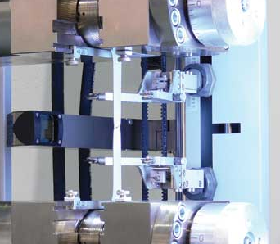
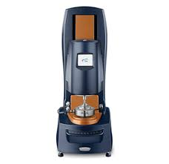
Delayed creep of weak gels. A microrheological investigation.
We are dealing with very fragile materials
Weak gels
Traditional mechanical methods are not sensitive enough
estensometer
rheometer

Slide 8
Delayed creep of weak gels. A microrheological investigation.
Brownian motion can help us!
Relation between position-fluctuation and creep compliance
$<Δ{\tilde{x}}^{2}\left(s\right)>=\frac{k_{B}T}{π a}\tilde{J}\left(s\right)$
In the simple case of newtonian fluids it reduces to
$<Δx^{2}\left(t\right)>=\frac{{2⋅N k}_{B}T}{6 πa η }t$
$N$ number of dimensions
$η$ fluid viscosity
$a$ particle’s radius

Slide 9
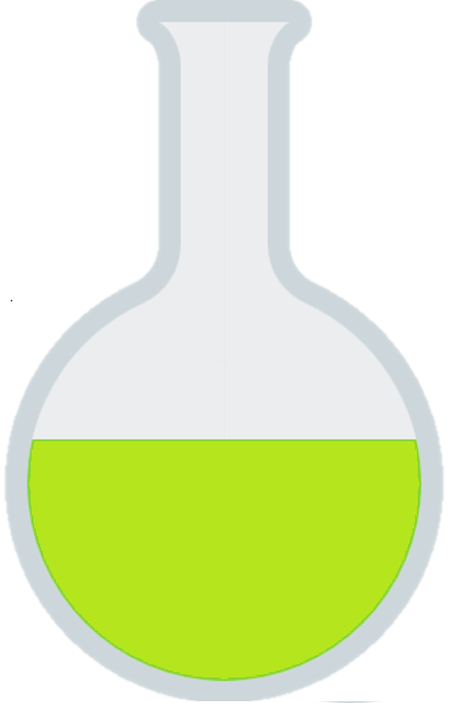
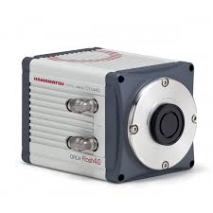
Delayed creep of weak gels. A microrheological investigation.
microscope
$$h\sim 100 μm$$
capillary
sample
tracers
$$a\sim 0.05÷5 μm$$
videocamera
Frame rate $1e3÷1e−2 Hz$
Notes:
Please note that tracers can be smaller than optical resolution limit, and there is no need to resolve them individually

Slide 10
Delayed creep of weak gels. A microrheological investigation.
The correlation between images at a given temporal delay contains the information about tracers’ mean square displacement.
Time evolution of correlation is conveniently studied in the Fourier domain
$$C\left(q,Δt\right)=∫dΔx<c\left(0,t\right)c\left(Δx,Δt\right)>{ e}^{−iqΔx}$$
$∝∫dΔx p\left(Δx,Δt\right){ e}^{−iq Δx}$
$$=^{∗}{ e}^{−q^{2} Δx^{2}(t)/4}$$
$∗$Gaussian displacement distribution
Notes:
Since the particle concentration corralation in the fourier domain is by definition the fourier transorm of the displacement probability distribution

Slide 11
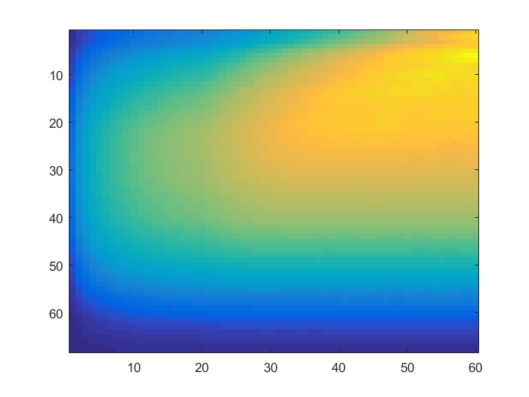
Delayed creep of weak gels. A microrheological investigation.
Differential Dynamic Microscopy
$${D\left(q,t\right)= <\left\|FFT\{I\left(t\right)−I(t+Δt)\text{\}}\right\|}^{2}> = A\left(q\right)\left(1−e^{−q^{2}Δx^{2}(t) /4}\right)+B(q)$$
$$q={10}^{5}÷{10}^{7}\left[\frac{1}{m}\right]$$
$$t={10}^{−3}÷{10}^{2}\left[s\right]$$
From a single experiment (a single stack of images) are obtained several independent correlation functions
$$t$$
$$D\left(q,τ\right)$$
$$q$$

Slide 12
Delayed creep of weak gels. A microrheological investigation.
Inversion problem:
$$D\left(q,t\right)=A\left(q\right)\left(1−e^{−q^{2}Δx^{2}(t) /4}\right)+B(q)$$
$$Δx^{2}\left(q,t\right)=−\frac{4}{q^{2}} log\left(1−\frac{D\left(q,t\right)−B\left(q,t\right)}{A\left(q\right)}\right)$$
$$σ^{2}$$
$$msd Δx^{2}$$
$$msd Δx^{2}$$
$$msd Δx^{2}$$
$$t$$
$$t$$
$$t$$
This self consistent procedure aloud to measure msd
with no a priori assumption on it’s functional form

Slide 13
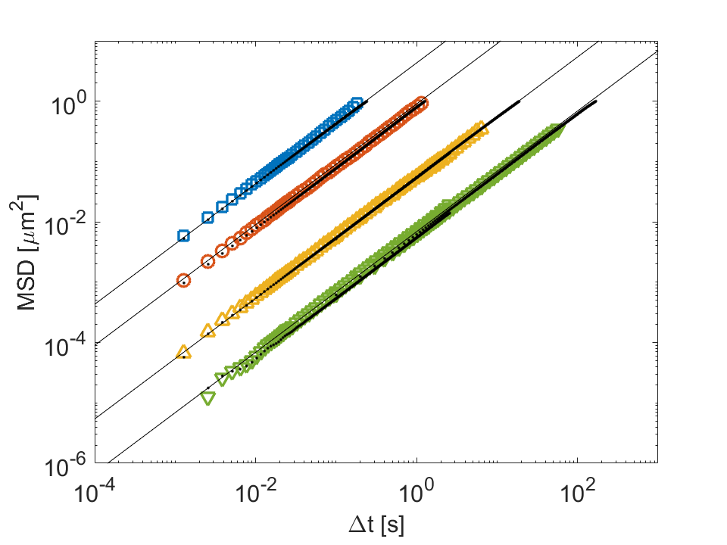
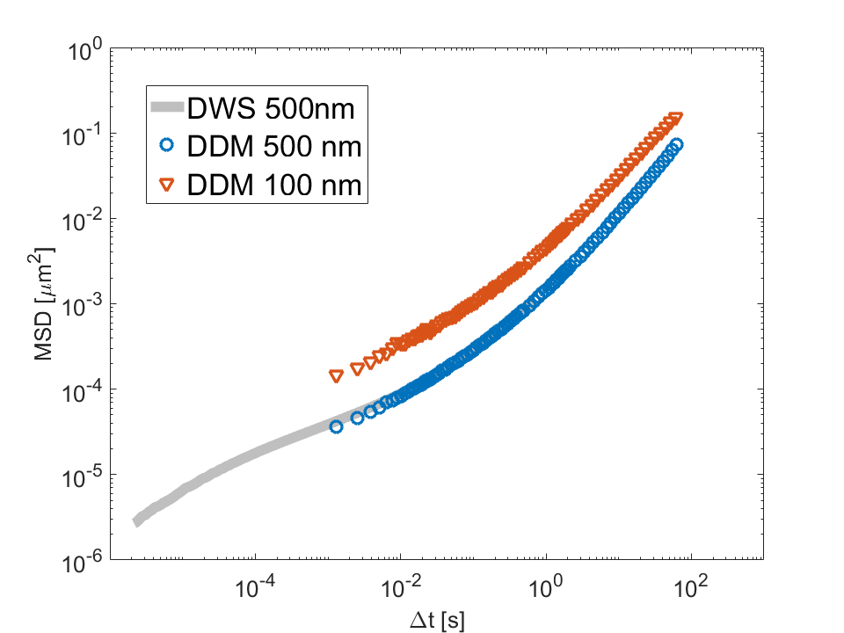
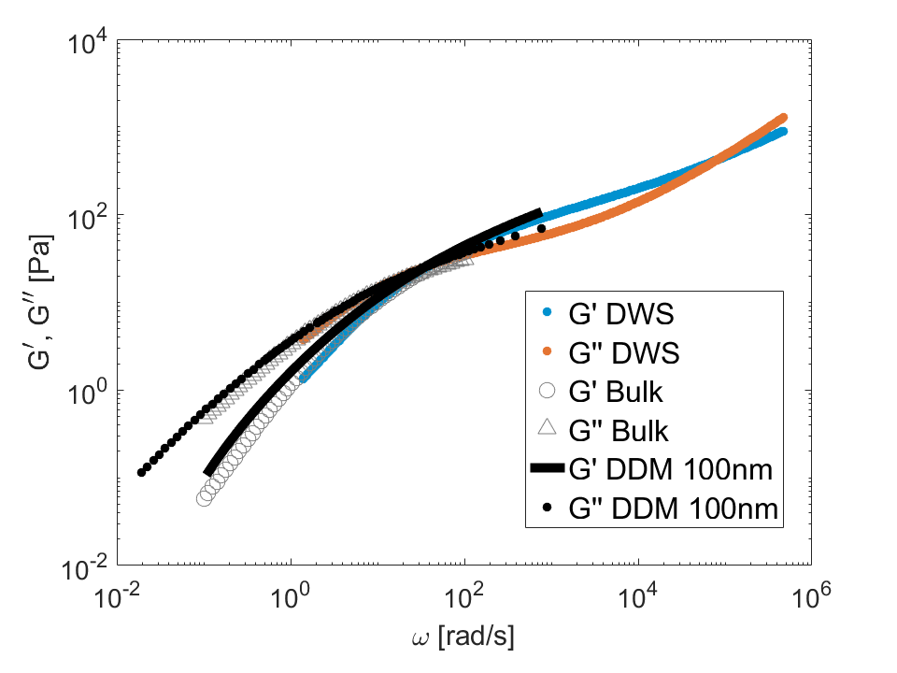
Delayed creep of weak gels. A microrheological investigation.
Water and glycerol mixtures
Polymeric Solution in semi-diluted regime (PEO 2MDa 2% wt)

Slide 14
Delayed creep of weak gels. A microrheological investigation.
Completed tasks:
Extended DDM to micro rheology
Not Discussed
Identified and removed artefacts due to:
Finite exposure time
Finite size images
Next steps:
Apply DDM microrheology to gels with and without external load
Possible heterogeneity
Possible violation of gaussian displacement distribution hypothesis

Slide 15
Delayed creep of weak gels. A microrheological investigation.
Grazie per l’attenzione

Slide 16
Delayed creep of weak gels. A microrheological investigation.
$$U_{T}=k_{B}T≃4.1e−21$$
$$σ=U_{bond}⋅ρ_{bond}=\frac{U}{V_{bond}}=\frac{k_{B}T}{{\left(100 nm\right)}^{3}}≃4.1 Pa$$

Slide 17
Delayed creep of weak gels. A microrheological investigation.
Microrheology
$\tilde{G}\left(s\right)=\frac{k_{B}T}{π a <Δ{\tilde{r}}^{2}\left(s\right)>}$
$<Δ{\tilde{r}}^{2}\left(s\right)>=\frac{k_{B}T}{π a\tilde{G}\left(s\right)}$
$<Δ{\tilde{r}}^{2}\left(s\right)>=\frac{k_{B}T}{π a}\tilde{J}\left(s\right)$
J(t) is the creep compilance: the time dependent strain following a suddenly applied weak shear stress.
$$<Δ{\tilde{r}}^{2}\left(s\right)> =\frac{N k_{B}T}{3 πa s \tilde{G}(s)}$$

Slide 18
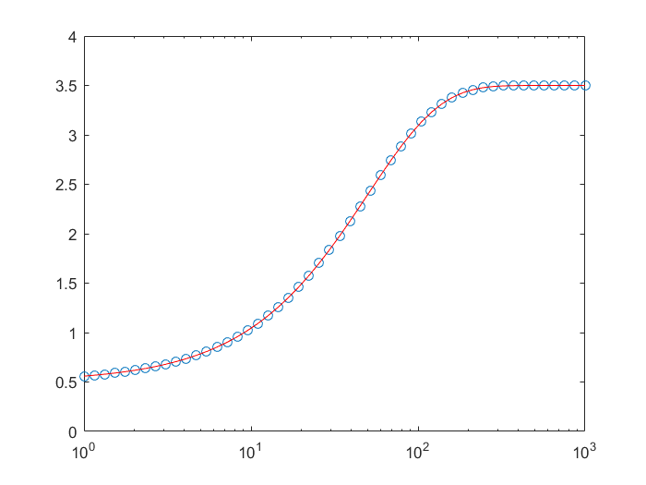
$$A (q)$$
$$B(q)$$

Slide 19
Delayed creep of weak gels. A microrheological investigation.
$${<\left\|FFT\{I\left(t1\right)−I(t1+Δt)\text{\}}\right\|}^{2}>_{t1}$$
$$I\left(t1\right)−I(t1+Δt)$$
$FFT\{I\left(t1\right)−I(t1+Δt)$}
${<\left\|FFT\{I\left(t\right)−I(t+Δt)\text{\}}\right\|}^{2}> = 2⋅\{C\left(q,0\right)−Re[C\left(q,Δt 0)]\right\}$= $A\left(q\right)\left(1−e^{−Δx^{2}(t)/q^{2}}\right)+B(q)$
$$C\left(q,Δt\right)=∫dΔx<c\left(0,t\right)c\left(Δx,Δt\right)>{ e}^{−iqΔx}$$
$$∝∫dΔx p\left(Δx,Δt\right){ e}^{−iq Δx}$$
$$={ e}^{−q^{2} Δx^{2}(t)}$$

