Slide 1
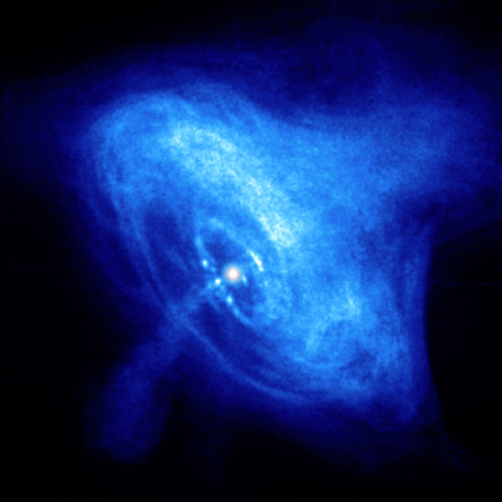
STRAINS AND STRESSES IN THE CRUST OF SPINNING-DOWN PULSARS
Elia Giliberti
Supervisor: Prof. P. M. Pizzochero PhD
School in Physics of Università degli Studi di Milano
First-Year students Workshop, 11 Oct. 2017

Slide 2
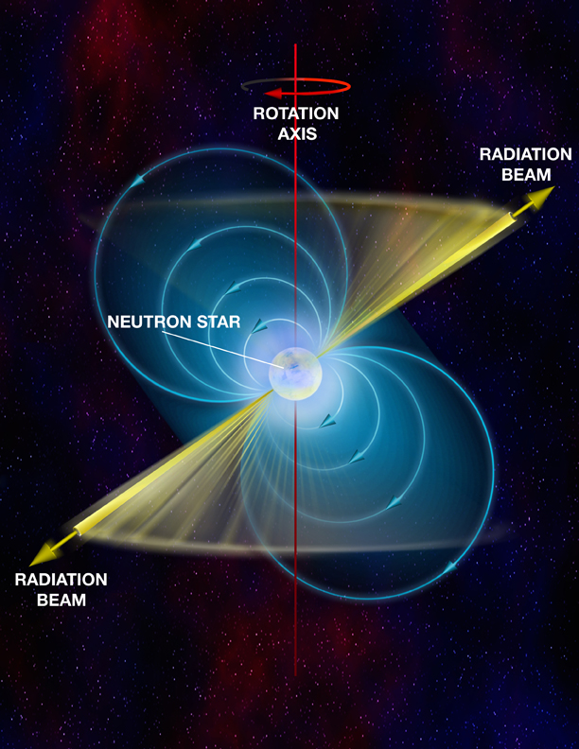
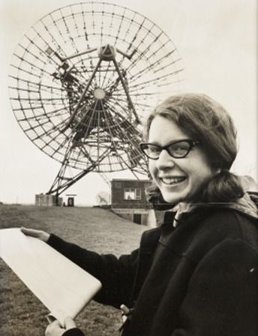
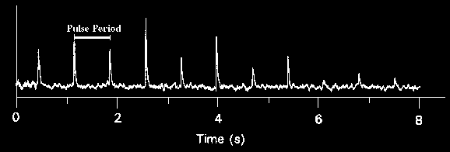
Pulsar (Hewish & Bell 1967)
Rotating neutron star
$M≈1÷2 M_{}$
$R≈10$km
$P≈ {10}^{−3}÷10$ s
$ρ_{c}≈3−10ρ_{0}$
$B≈{10}^{12}÷{10}^{16}$G
Jocelyn Bell

Slide 3
Neutron star structure
OUTER CORE
Neutrons Superfluid
Protons and electrons
ATMOSPHERE$\sim 0.1−10 cm$
Hot ionized plasma
$$ρ_{Neutron Drip}$$
$$ρ≈0.5ρ_{0}$$
OUTER CRUST
$\sim 0.1−0.5$km
Crystal lattice of nuclei + electrons
$$ρ≈2ρ_{0}$$
INNER CORE
Hyperons?
Kaons? Quarks?
$$R^{′}$$
$$ρ≈3−10ρ_{0}$$
INNER CRUST
$\sim 1 km$
Crystal lattice of nuclei + electrons
Free neutrons
CORE
$$R^{′}≅0.9R$$
R
CRUST

Slide 4
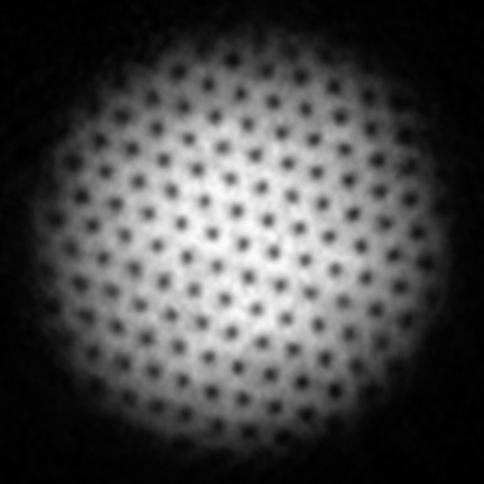
Superfluidity
$$\vec{Ω}$$
Vortex array in superfluid rotating helium
Vortex
The superfluid doesn’t rotate as a normal fluid: it creates an array of vortex lines parallel with the rotation axis.
You can have macroscopic rotation thanks to these quantized vortex lines.
Vortex cannot end into the bulk (Helmholtz theorem)! They are pinned to the crust.

Slide 5
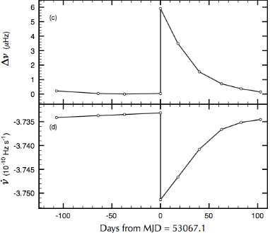
Glitches
$$\frac{∆P}{P}={10}^{−11}÷{10}^{−5}$$
The neutron star is slowing down, thus the pulsar period increases
After the glitch the neutron star resumes its slowdown and the pulsar period increases again
Period (s)
Glitch! The neutron star rotation suddenly increases and the period decreases abruptly
Spin up in less than a minute (best resolution)
Time (Month)

Slide 6
Two components model
«Normal» component: crust + charged core particles
Superfluid component: neutrons superfluid
$$\vec{Ω}$$
$${\vec{B}}_{axis}$$
The normal component slows down due to the electromagnetic torque;

Slide 7
Two components model
«Normal» component: crust + charged core particles
Superfluid component: neutrons superfluid
$$\vec{Ω}−\vec{δΩ}$$
The normal component slows down due to the electromagnetic torque;
The superfluid can slow down only by expelling the vorteces;
Vorteces are pinned to the crust, thus the lag ($_{super}−_{normal}$) arises;
$$\vec{Ω}$$

Slide 8
Two components model
«Normal» component: crust + charged core particles
Superfluid component: neutrons superfluid
$$\vec{Ω}−\vec{δΩ}$$
The normal component slows down due to the electromagnetic torque;
The superfluid can slow down only by expelling the vorteces;
Vorteces are pinned to the crust, thus the lag ($_{super}−_{normal}$) arises;
$$\vec{Ω}$$
When the lag reach a critical threshold, vorteces are expelled. The angular momentum of the vortex array goes to the crust, that accelerates;
TRIGGER MECHANISM
CLOCKWORK MODEL

Slide 9
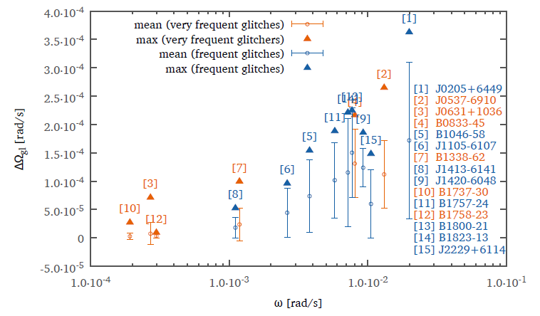
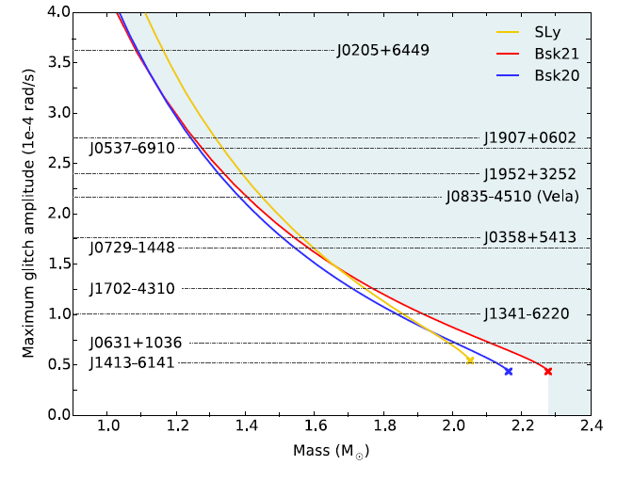
Trigger?
MODEL
DATA
$$ω=<|\dot{Ω}|×T_{interglitches}>$$
Heavier stars have thinner crusts and smaller radii
Study of the strain dependence on the stellar physical characteristics
CRUSTQUAKE?

Slide 10
Work Scheme
OUTER CRUST
OUTER CRUST
CORE
OUTER CORE
INNER
CORE
INNER CRUST
INNER CRUST

Slide 11
Model’s hypothesis summary
Newtonian Gravity;
$$\vec{Ω}$$
Slow rotation;
$$\frac{Ω^{2}R^{2}}{v_{K}^{2}}≅{10}^{−4}≪1$$
Elastic crust;
$$σ_{ij}=2μu_{ij}$$
Perfect fluid core+vorteces;

Slide 12
Model’s hypothesis summary
HYPOTHESIS
Newtonian Gravity;
$$\vec{Ω}$$
Slow rotation;
$$\frac{Ω^{2}R^{2}}{v_{K}^{2}}≅{10}^{−4}≪1$$
Elastic crust;
$$σ_{ij}=2μu_{ij}$$
Perfect fluid core+vorteces;
Magnetic field neglected;
Realistic equations of state (EOSs)
$P(ρ)$;
INGREDIENTS

Slide 13
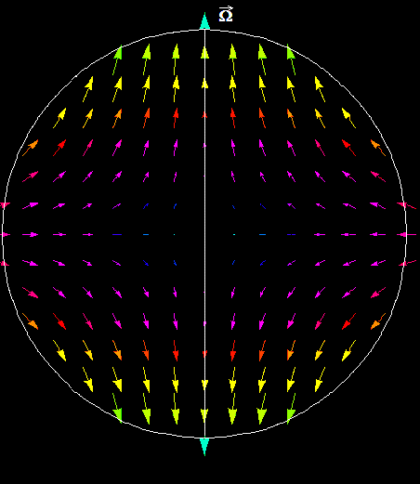
$$\vec{Ω}$$
Strain and stress
$$\vec{Ω}−\vec{δΩ}$$
SLOWDOWN
CORE
CORE
CORE
CORE
$$u_{ij}=\frac{1}{2}\left(\frac{∂u_{i}}{∂x_{j}}+\frac{∂u_{j}}{∂x_{i}}\right)$$
$$\vec{u}=\left(u_{r},u_{θ},0\right)$$
STRAIN
Study of the strain/stress for different masses and EOSs.
Are there strong differences among stars with different masses, but the same rotational parameters?

Slide 14
$$\vec{Ω}$$
Strain and stress
$$\vec{Ω}−\vec{δΩ}$$
CORE
CORE
CORE
CORE
Crustquakes?
Failure Criterion
$ε_{Max}\text{−}ε_{Min}$=Shear Strain max
$\frac{1}{2}$ $Strain max$=Breaking Strain
First «realistic» study of a crustquake due to slowdown and pinning, and of its effect.

Slide 15
Results and next steps
First Answers
If we slowdown the star without the pinning of the vortices the stresses are not strongly dipendent on star’s parameters;
The crustquake can not be caused only by slowdown.
Next steps
Collaboration with the Geophysics Department for the study of the glitch’s jump induced by a starquake;
Inclusion of the pinning force in the model.

Slide 16
Thank you for your attention

Slide 17
TOV equations
$$\frac{dm}{dr}=4πr^{2}ρ$$
$$\frac{dP}{dr}=−\frac{ρm}{r^{2}}\left(1+\frac{P}{ρ}\right)\left(1+\frac{4πPr^{3}}{m}\right){\left(1−\frac{2m}{r}\right)}^{−1}$$
$$\frac{dφ}{dr}=−\frac{1}{ρ}\frac{dP}{dr}{\left(1+\frac{P}{ρ}\right)}^{−1}$$

Slide 18
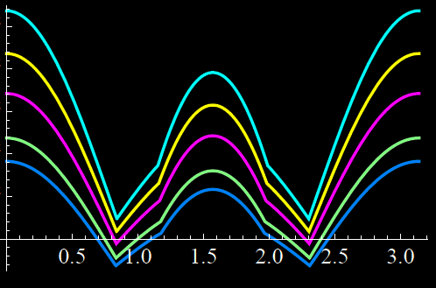
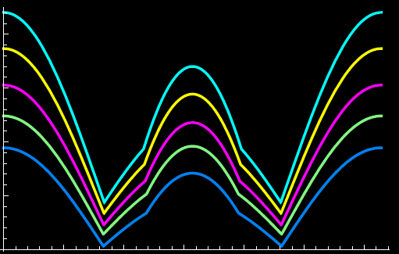
Two-density model: Analysis
$$Breakin Strain ≅ {10}^{−2}$$
$$Strain$$
$$Strain$$
$$3.5×{10}^{−8}$$
$$5.×{10}^{−8}$$
$$3.×{10}^{−8}$$
$$4.×{10}^{−8}$$
$$2.5×{10}^{−8}$$
$$3.×{10}^{−8}$$
$$2.×{10}^{−8}$$
$$1.5×{10}^{−8}$$
$$2.×{10}^{−8}$$
$$θ$$
$$θ$$
$$0.5$$
$$1.0$$
$$1.5$$
$$2.0$$
$2.$5
3.0
$$0.5$$
$$1.0$$
$$1.5$$
$$2.0$$
$2.$5
3.0
SLY EOS
$$L=0.88$$
GM1 EOS
$L=0.$90
$$L=0.92$$
$L=0.9$4
$L=0.9$5

Slide 19
Typical timescale
$$t_{cross}=\frac{2R}{c_{s}}≈{10}^{−2}s$$
$$t_{Emission}=\frac{Ω}{\dot{Ω}}≈{10}^{11}s$$
$$=70 rad/s$$
$${∆t}_{interglitch}≈2.5 years$$

Slide 20
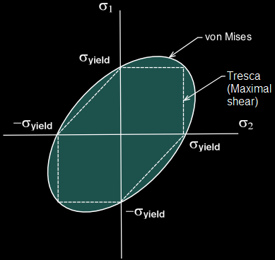
Failure Criterion
Tresca Criterion
$\frac{1}{2}$ $Strain max$=Breaking Strain
Von Mises Criterion
$${{\overline{σ}}^{2}=\frac{1}{2}σ}_{ab}σ^{ab}$$
${\overline{σ}}^{2}$>${{\overline{σ}}^{2}}_{max}$

Slide 21
LFE models
Perturbation
Rotating configuration
New deformed configuration
$$Ω$$
$$Ω−δΩ$$
$$\vec{Ω}$$
$$δϕ$$
Not self-consistent
By Hand
$$R^{′}$$
$$∆p$$
$$R$$
$$\left|\vec{u}\right|∝ΩδΩ$$
$$L→0$$
$$\vec{Ω}$$
$$L=\frac{R^{′}}{R}$$
$$0≤$$
$$≤1$$
$$L=0 all crust L=1 all fluid$$

Slide 22
$$\vec{Ω}$$
$$\vec{Ω}$$
INNER CRUST
INNER CRUST
BODY FORCE:
PINNING FORCE
VORTECES

Slide 23
Pinning force
$${f_{Pinning}=4 x Ω {ω\left(x\right)}_{critical}\frac{\int_{0}^{l(x)/2}{ρ_{n}\left(\sqrt{x^{2}+z^{2}}\right)dz}}{z_{crosta}}}_{}$$
$$−δ$$
$${\vec{F}}_{Pinning}$$
$$x$$

Slide 24
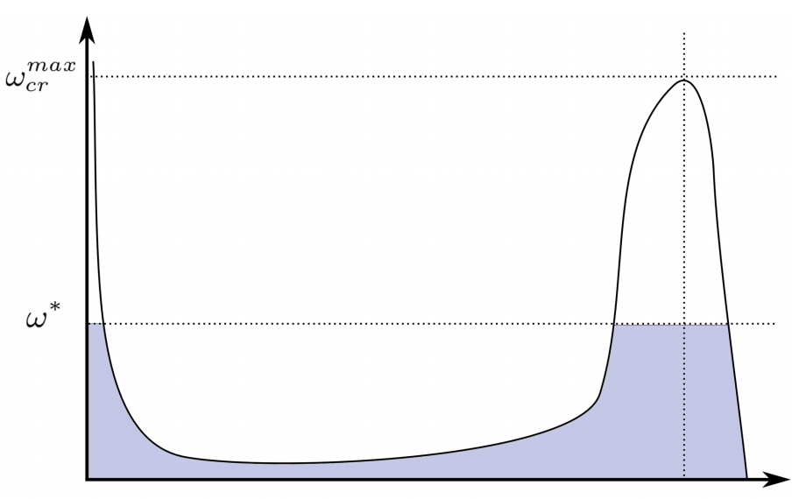
Pinning force
$${f_{Pinning}=4 x Ω {ω\left(x\right)}_{critical}\frac{\int_{0}^{l(x)/2}{ρ_{n}\left(\sqrt{x^{2}+z^{2}}\right)dz}}{z_{crosta}}}_{}$$
$x$ cylindrical
radius

Slide 25
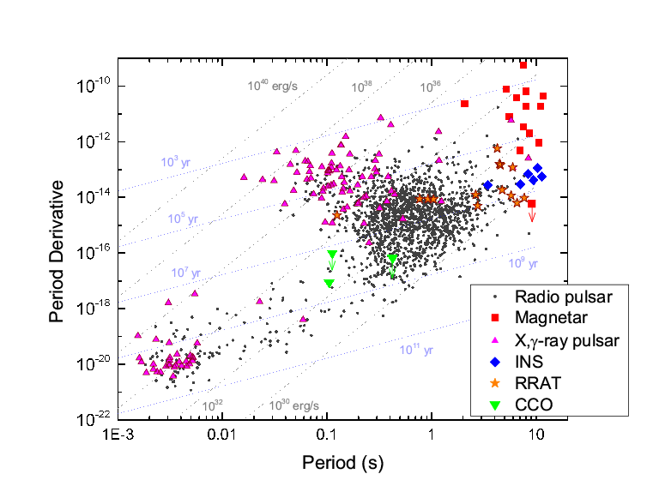
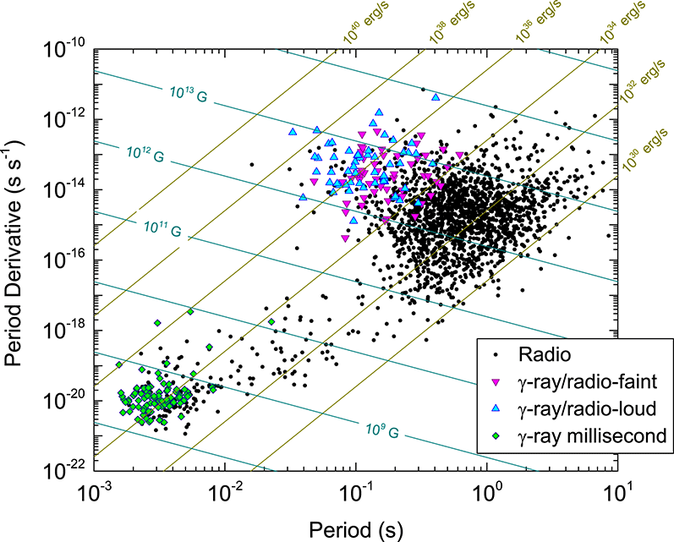
Neutron Stars Zoo

