Slide 1
How Statistical Physics can help Computational Complexity
What can we say about the new computational challenges

Slide 2
Complex Computational Problems
We live in an era where information is gathered more than any other resource, at increasingly high rates.
Ninety percent of the data in the world today has been created in the last two years alone. Our current output of data is roughly 2.5 quintillion bytes a day. By 2020 it’s estimated that for every person 1.7MB will be created every second. 1 floppy disk per second!

Slide 3
Complex Computational Problems

Slide 4
Complex Computational Problems
With all this data, we can infer new incredible information about our society, optimize complex networks and design a better future.
Alas all comes with a cost. The cost of great computational barriers. To process this data is all but as simple task, especially in an era without quantum computers.

Slide 5
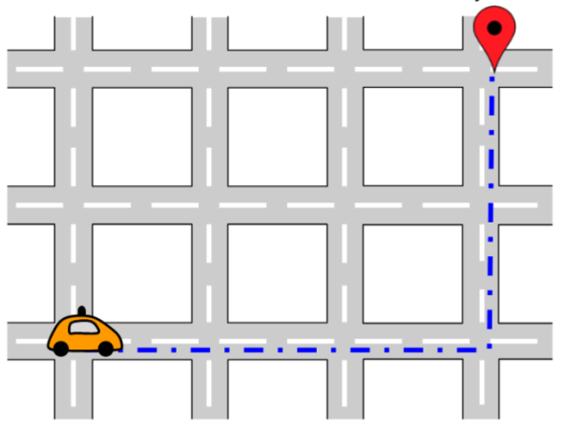
You want some examples? I give you some examples.
Millions of people commute by car every day; for example, to school or to their workplace. Self-driving vehicles are an exciting development for transportation. They aim to make traveling by car safer and more available while also saving commuters time.
Given a list of pre-booked rides in a city and a fleet of self-driving vehicles, assign the rides to vehicles, so that riders get to their destinations on time.

Slide 6
You want some examples? I give you some examples.
Or:
Given a fleet of drones, a list of customer orders and availability of the individual products in warehouses, schedule the drone operations so that the orders are completed as soon as possible.
Or:
Given a schema of a data center and a list of available servers, assign servers to slots within the rows​and to logical pools ​so that the lowest guaranteed capacity​of all pools is maximized.
Else{ Return 0 }

Slide 7
A brief excursion through definitions
But what does it mean for a problem to be complex?
The running time of the program is the measure for the complexity of the problem.
Example: Multiplying two $n×n$ matrices requires $n^{3}$ multiplications. This means the problem has a complexity of $O(n^{3})$
Other Example: Finding all the possible combinations of $n$ elements requires $2^{n}$ operations, this means $O(2^{n})$
Since we feel uncomfortable with anything worse than polynomial, we define the $O(n^{α})$ as tractable problems, while the others are deemed intractable.

Slide 8
We love classics
All this problems are just complex versions of some classical computational conundrums

Slide 9
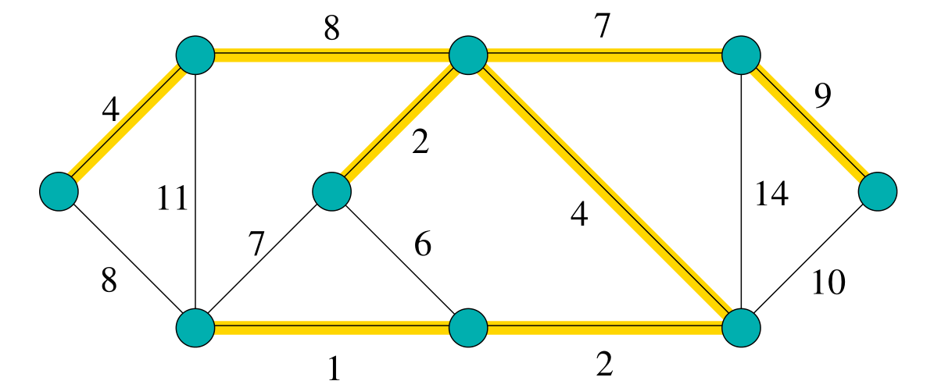
We love classics
As an example consider the following problem from network design. You have a business with several offices and you want to lease phone lines to connect them up with each other. The phone company charges different amounts of money to connect different pairs of cities, and your task is to select a set of lines that connects all your offices with a minimum total cost.

Slide 10
We love classics
The Minimum Spanning Tree (MST): Given a weighted graph $G= \left(V,E\right)$ with non-negative weights. Find a spanning Tree $T ⊆ G$with minimum total weight.
This is a tractable problem. Equipped with a polynomial algorithm you can find minimum spanning trees with thousands of nodes within seconds on a personal computer. Compare this to exhaustive search!

Slide 11
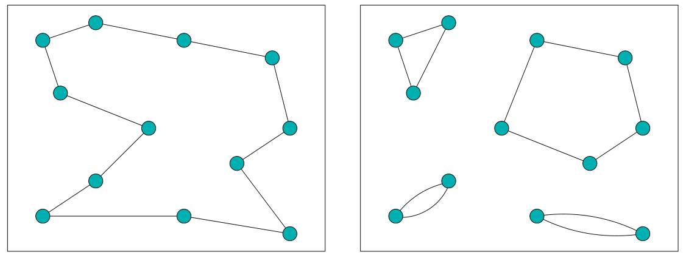
We love classics
The Travel Salesman Problem (TSP): Given a $n×n$ distance matrix with elements $d_{ij}≥0$. Find a cyclic permutation $π\left[1…n\right]\left[1…n\right]$ that minimizes $c_{n}(π)$
$$c_{n}(π)=\sum_{i=1}^{n}{d_{iπ(i)}}$$
Assignment: Given a $n×n$ distance matrix with elements $d_{ij}≥0$. Find a permutation $π\left[1…n\right]\left[1…n\right]$ that minimizes $c_{n}(π)$

Slide 12
Hard decisions
Any optimization problem can be turned into a decision problem by adding a bound B to the instance.
Examples:
MST (DECISION): Given a weighted graph $G = (V,E)$with non-negative weights and a number $B ≥ 0$. Does G contain a spanning tree $T$ with total weight $≤ B$?
TSP (DECISION ): Given a $n × n$distance matrix with elements $d_{ij}≥ 0$ and a number $B ≥ 0$. Is there a tour π with length $≤ B$?

Slide 13
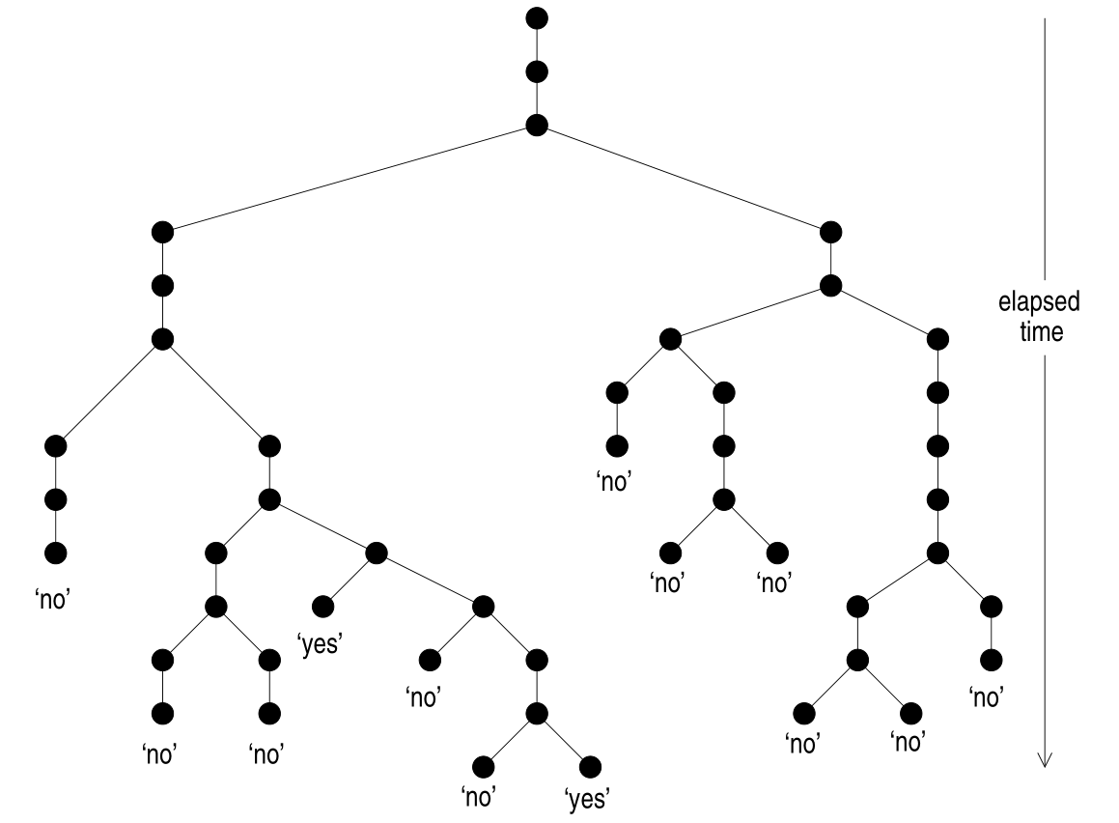
Hard decisions
Imagine such an algorithm, in which you could check multiple solutions in parallel. If you could solve your problem in polynomial time like this, then it belongs to the class of Nondeterministic Polynomial Time (NP)

Slide 14
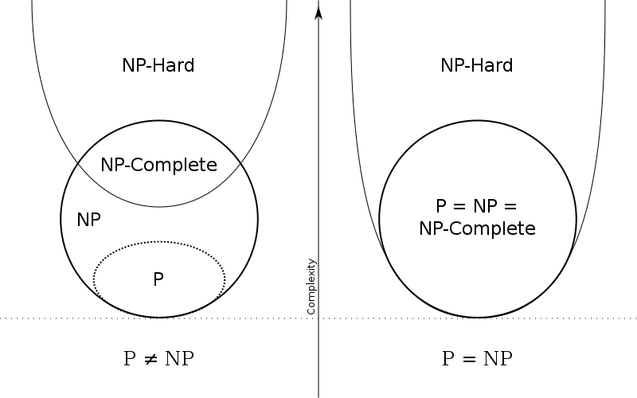
Hard decisions
If furthermore it’s solvable by a “realistic” algorithm in polynomial time, it’s a Polynomial Time (P) class problem
Warning: this picture may be difficult to grasp

Slide 15
How can we help
That’s nice and all, but physicists couldn’t help but notice some details.
All the computational theory is based on the worst case scenario, meaning the maximal possible computations.
But that’s not even remotely the most common case…

Slide 16
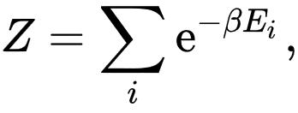
How can we help
How can we play with such problems?
First of all we must express analytically the cost function of the system.
After this, we can interpret it as a Hamiltonian and study the partition function, analyze the phase space and find mean values, phase transitions and stuff
$$c_{n}(π)=\sum_{i=1}^{n}{d_{iπ(i)}}$$

Slide 17
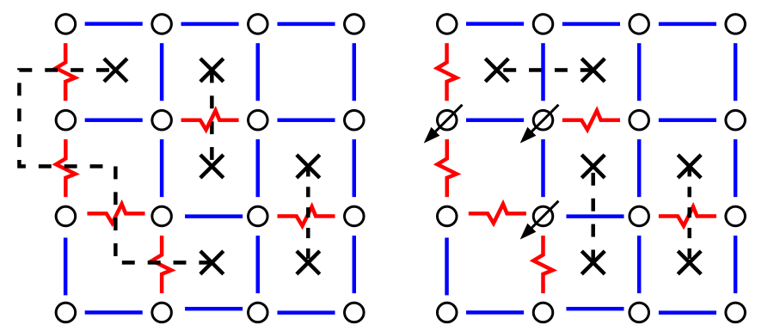
How can we help
An example is the Matching Problem, which we can treat as a 2d-Ising model

Slide 18
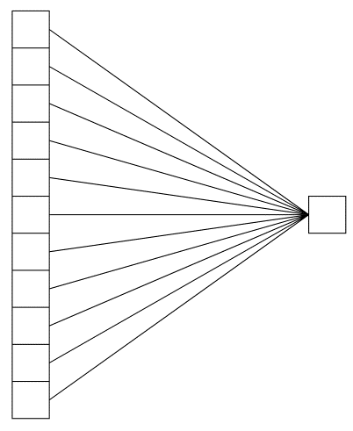
Can we help even more?
Our help is especially appreciated in fields where nobody said anything relevant so far, such as in the study of Neural Networks.
$$E=\sum_{i=1}^{p}{θ(−σ^{i}Wξ)}$$
$$W$$
$ξ_{1},ξ_{2}$, $ξ_{3}$,…, $ξ_{p}$
$N$ Inputs
Output
$$p=αN$$

Slide 19
Can we help even more?
Our help is especially appreciated in fields where nobody said anything relevant so far, such as in the study of Neural Networks.

Slide 20
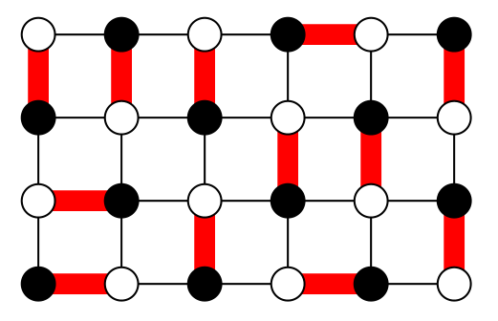
A brilliant problem
The dimer covering of a lattice.
Simple to formulate, yet hard to resolve. How does the matching between neighbors look on a lattice?
What’s the number of such possible configurations?
How does it scale? How much is the problem frustrated?
What about the exited levels?

Slide 21
A brilliant problem
The dimer covering of a lattice.
Simple to formulate, yet hard to resolve. How does the matching between neighbors look on a lattice?
What’s the number of such possible configurations?
How does it scale? How much is the problem frustrated?
What about the exited levels?
$K=\left(\begin{matrix}1 & ⋯ & −1 \\ ⋮ & ⋱ & ⋮ \\ −1 & ⋯ & 1\end{matrix}\right)$
$Z=\left|detK\right|$

Slide 22
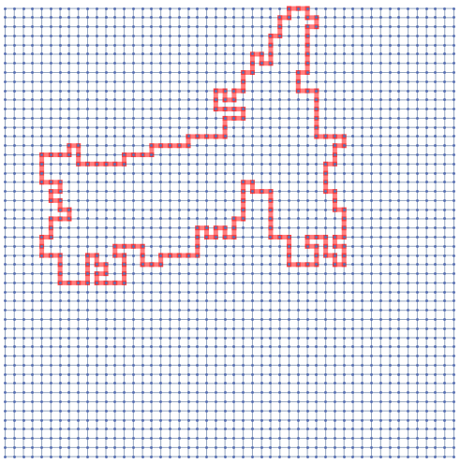
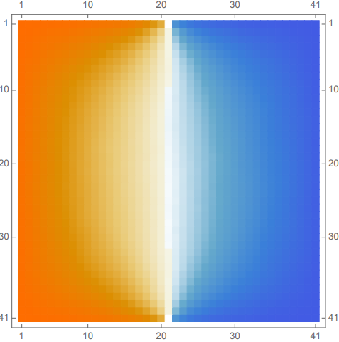
A brilliant problem
A lot of interesting properties arise when studying excited states. In general, the energy landscape is highly non trivial
Possible Conformal limit?
SLE?

Slide 23
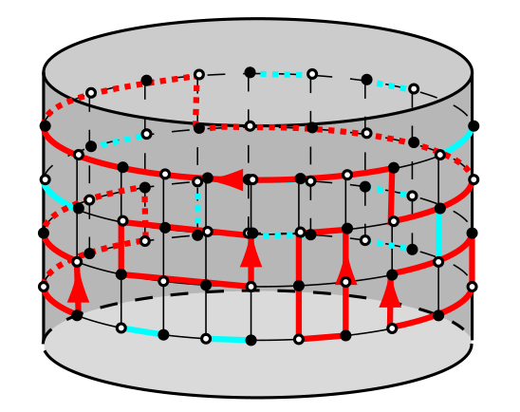
Why not
Fun fact #915: Did you know dimers could be used to describe fermions?

Slide 24
Concluding
That’ll be all

