Slide 1
Development and optimisation of experimental and modelling approaches to characterise high-time resolution atmospheric aerosol and its sources
PhD Student: Alice Forello
Tutor: Prof. Roberta Vecchi
End First-Year Workshop
9th October 2018

Slide 2
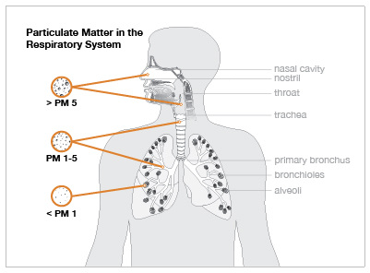
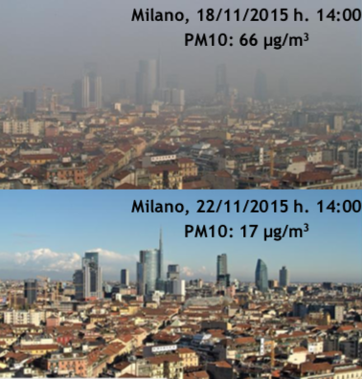

Why do we care about atmospheric aerosol?
Impact on local and global scale:
Adverse human health effects
Decrease visibility
Influence the climate
Direct effect
(scattering and absorption of light)
Indirect effect
(Cloud Condensation Nuclei)
(IPCC, 2013)
Aerosol → main cause of uncertainty in total anthropogenic radiative forcing!
Notes:
During breathing, these particles can enter deep in the respiratory tract and can cause…

Slide 3
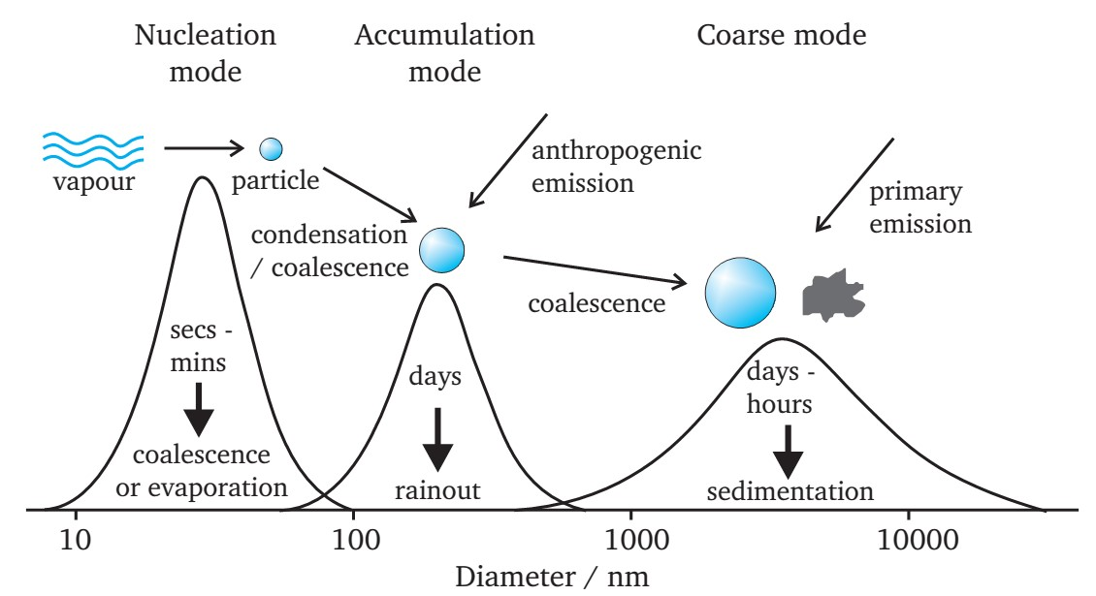
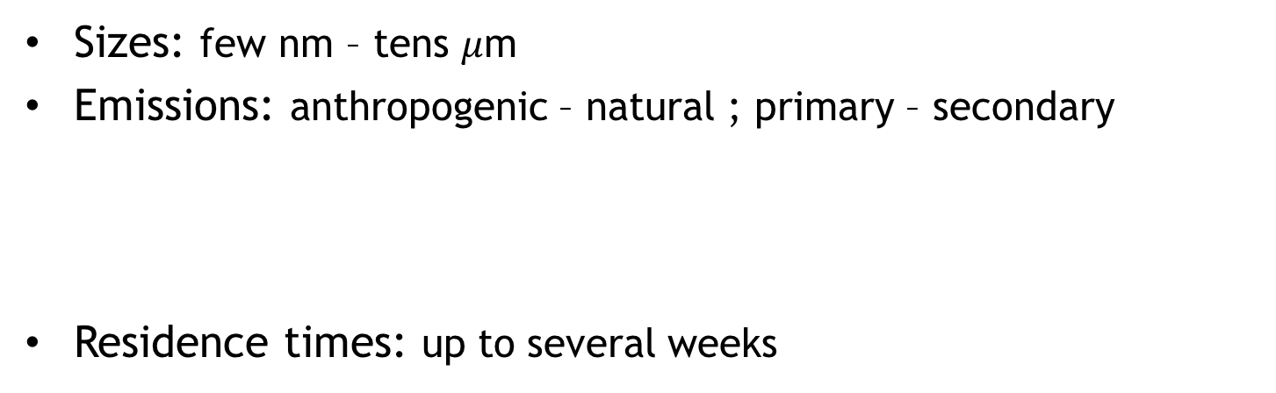
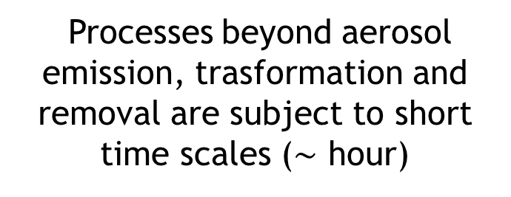
Why do we care about atmospheric aerosol?
Sizes: few nm – tens $μ$m
Emissions: anthropogenic – natural ; primary – secondary
Residence times: up to several weeks
Directly emitted
in atmosphere
After gas-to-particle
conversion
Processes beyond aerosol emission, trasformation and removal are subject to short time scales ($\sim$ hour)
High-time resolution

Slide 4

Main goal of my PhD research
High-time resolution and
size-segregated experimental data
Advanced and tailored multivariate modelling
Synergy
Ultimate goal → Face an open issue:
Assessment of
non-exhaust traffic emissions
Notes:
The main goal of my PhD research is to exploit a synergistic approach to make the most of…

Slide 5
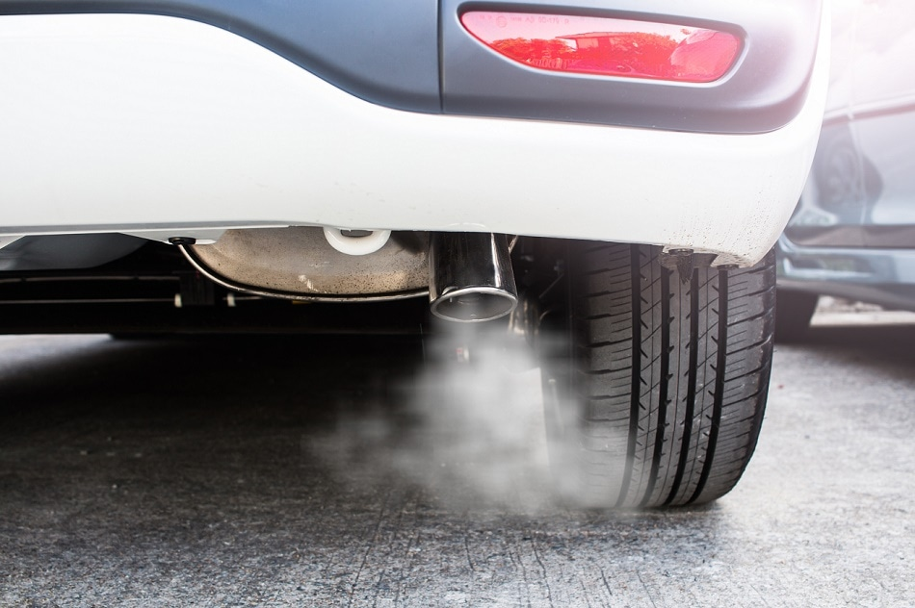
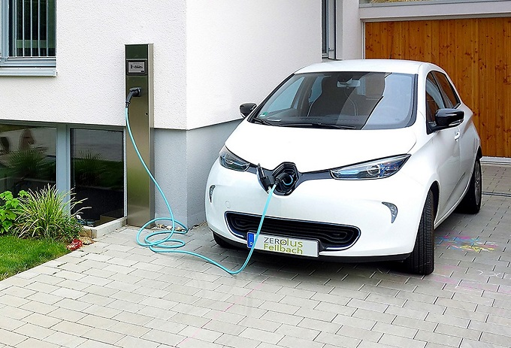
Urban areas → Traffic is an important contributor to aerosol concentration in the atmosphere
Exhaust
≅ Non-exhaust!
(Amato et al., 2014)
Non-Exhaust emissions:
Tyre and brake wear
Asphalt abrasion
Road dust re-suspension
Exhaust emissions
Electric cars
? Zero aerosol emissions ?
To face the problem:
First year → Optimisation of the modelling approach
Next years → Experimental work and modelling application
Notes:
Leggere Horvat su auto elettriche

Slide 6
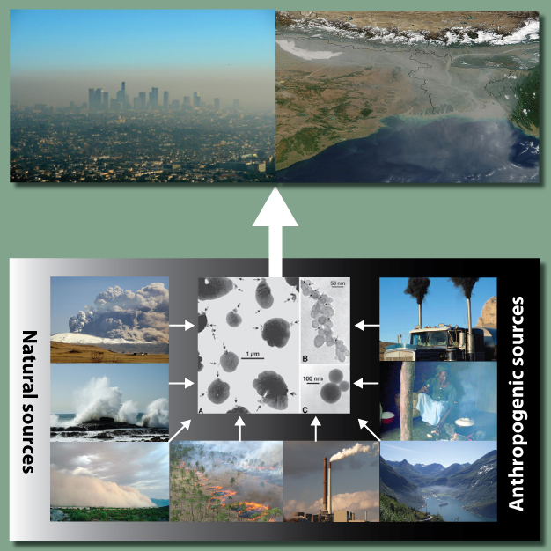
Modelling approach
Source apportionment:
Dispersion models (deterministic)
Receptor models (statistical)
Conservation of mass between emission source and receptor site
Input:
Output:
Chemical composition of environmental aerosol samples
Source temporal patterns
Source apportionment
Source chemical profiles
Notes:
Sapere metodo di minimizzazione

Slide 7
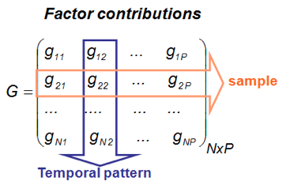
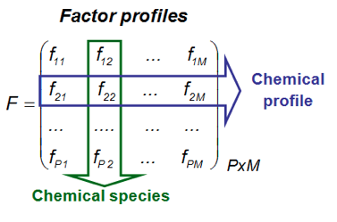
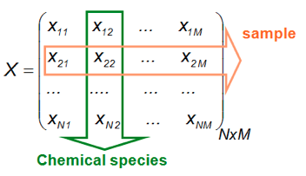
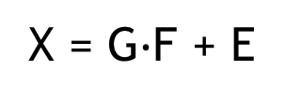
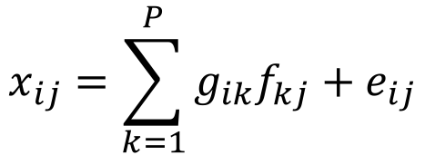
Principles of receptor modelling
$$x_{ij}=\sum_{k=1}^{P}{g_{ik}f_{kj}+e_{ij}}$$
X = G$∙$F + E
Factors
Sources
Physical
interpretation
GOAL: Estimate source contributions at the receptor site

Slide 8
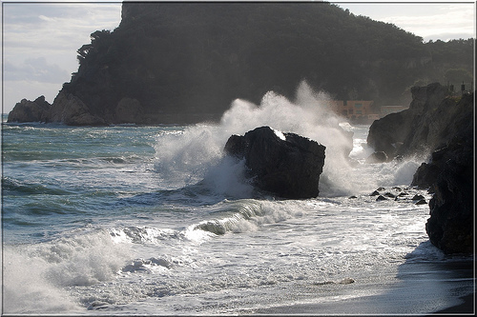
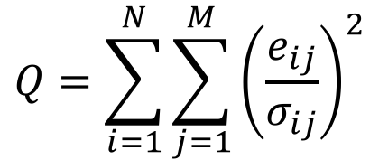
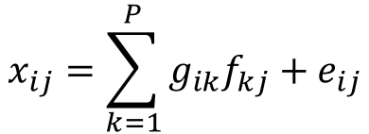
How is the problem solved?
$$x_{ij}=\sum_{k=1}^{P}{g_{ik}f_{kj}+e_{ij}}$$
→ Minimization of the object function Q:
$$Q=\sum_{i=1}^{N}{\sum_{j=1}^{M}{{\left(\frac{e_{ij}}{σ_{ij}}\right)}^{2}}}$$
Weighed on data uncertainties
Ill-posed problem
Not a unique solution!
Addition of physical constraints
(Non-negativity; but also other a priori information)
Simple example:
Source of fresh sea-salt aerosol
Mg/Na = 0.12
Cl/Na = 1.8
(Bulk sea water composition from
Seinfeld & Pandis, 1998)

Slide 9
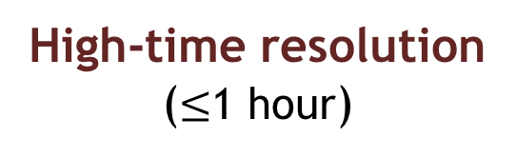
Receptor modelling: state of the art
During measurement campaigns usually instrumentation with different time resolution is available
Low-time resolution
(e.g. 24 hours)
High-time resolution
($≤$1 hour)
Advantages:
Detailed chemical speciation
Disadvantages:
Little detail of sources temporal patterns
Episodic sources not detected
Advantages:
Temporal patterns of source markers
Episodic sources
Disadvantages:
Little detail on chemical speciation
Intensive campaigns
Advanced receptor modelling
→ Couple the advantages !

Slide 10
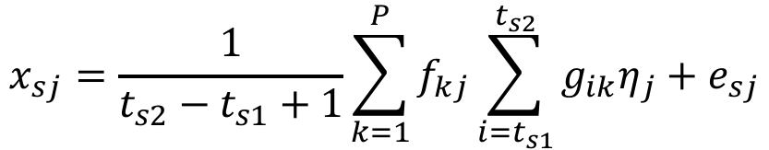
Advanced receptor modelling: Multi-time
First implementation of Multi-time model (Zhou et al., 2004)
through Multilinear Engine 2 (ME-2) script (Paatero, 1999)
Main equation is modified to take into account experimental data with different time resolution
$$x_{sj}=\frac{1}{t_{s2}−t_{s1}+1}\sum_{k=1}^{P}{f_{kj}\sum_{i=t_{s1}}^{t_{s2}}{g_{ik}η_{j}}+e_{sj}}$$
Adjustment factors
(species replicated with different time resolution)
Sample time interval
Research group of Milan (Crespi et al., 2016)
Implementation of:
BOOTSTRAP analysis
Constraints

Slide 11
My contribution
→ Validation of the modelling chain with a test dataset collected during my master’s degree thesis (Milan 2016)
→ Entry of new metrics (optical absorption properties) for a better identification of the sources
Dataset:
Total 386 samples
22 low-time resolution variables (PM10 mass, Na, Mg, Al, Si, S, K, Ca, Cr, Mn, Fe, Cu, Zn, Pb, EC, OC, NO₃⁻, levoglucosan, b_{abs} 405 nm, b_{abs} 532 nm, b_{abs} 635 nm, b_{abs} 780 nm)
17 hourly variables (Na, Mg, Al, Si, S, K, Ca, Cr, Mn, Fe, Cu, Zn, Pb, b_{abs} 405 nm, b_{abs} 532 nm, b_{abs} 635 nm, b_{abs} 780 nm)

Slide 12
Results
7 factors solution
Mm⁻¹
Physical interpretation:
Presence of chemical tracers
(e.g. Ca, Si, Al for resuspended dust)
Temporal patterns
Day and night variation; Seasonal variation
Ratio between chemical species
(2-9%)
(2-5%)
(6-12%)
(25-42%)
(9-19%)
…etc…
Forello et al., in preparation
(12-18%)
(16-24%)
Notes:
Error Bars su torta

Slide 13
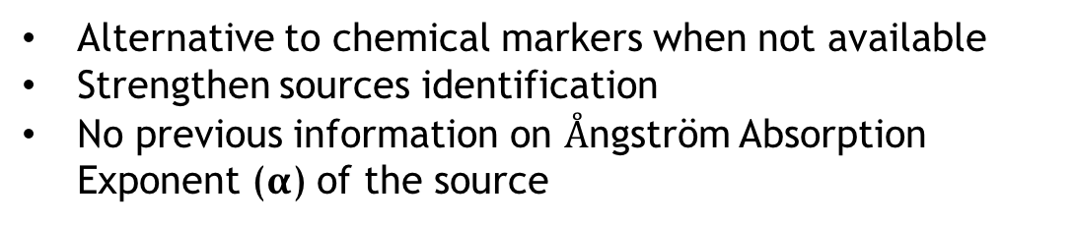
New metrics: 𝛃_{abs} at 4 wavelength (405, 532, 635, 780 nm)
Optical markers
Chemical markers →
Levoglucosan
Fe, Cu, EC
Mm⁻¹
Mm⁻¹
Main Advantages:
Alternative to chemical markers when not available
Strengthen sources identification
No previous information on $Å$ngström Absorption Exponent (𝛂) of the source
𝛃_{abs}∝𝛌^{-𝛂}
Forello et al., in preparation
Notes:
Dire che non sempre disponibili chemical markers (nel primo punto dei vantaggi)
Angstrom abs exponent o abs exponent?
AGGIUNGERE INFO SU ALFA?
Mettere anche info sull’errore??Bootstrap
Error bars

Slide 14

On-going work and outlook
MODELLING:
Dataset from CARE (Carbonaceous Aerosol in Rome and Environs) → New variables (optical variables, Non-Refractory components…)
Dataset in collaboration with research group EGAR (Environmental Geochemistry and Atmospheric Research) of the Spanish research council (CSIC) of Barcelona
Implementation and optimization of models in ME-2 script:
Real-world profiles (e.g. road dust)
Expansion of the Bootstrap analysis
Coupling different advanced approaches (e.g. different temporal resolution + different sizes)
Notes:
ALTRO COMING SOON
LEGGERE TESI ALICE SU COME AMPLIARE BOOTSTRAP
I did not focus on this point because I had no time

Slide 15
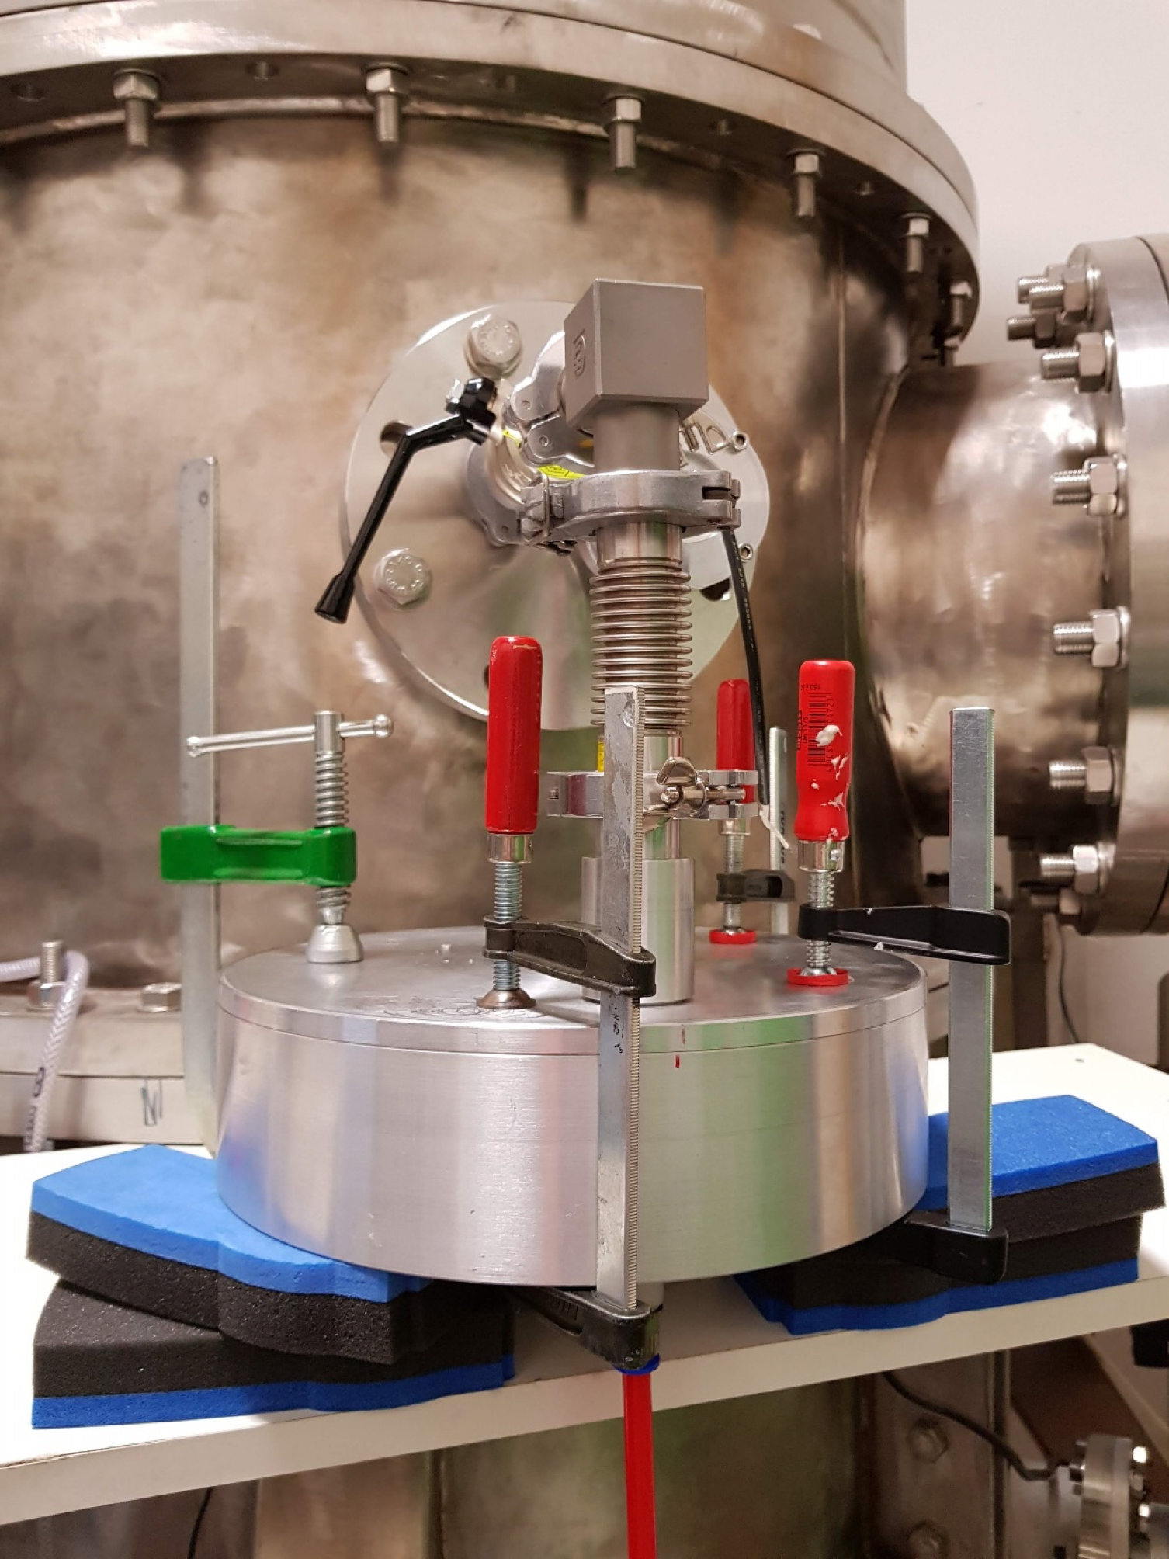

On-going work and outlook
EXPERIMENTAL:
Contribution to INFN experiment TRACCIA (Time Resolved Aerosol Characterization Challenging Improvements and Ambitions) devoted to the realization of a new high-time resolution sampler
Measurement and analysis of components of non-exhaust emissions (e.g. brake wear) in laboratory
Collaboration with EGAR group of Barcelona
(6 months abroad)
Notes:
LEGGERE TESI ALICE SU COME AMPLIARE BOOTSTRAP
I did not focus on this point because I had no time

Slide 16


Slide 17
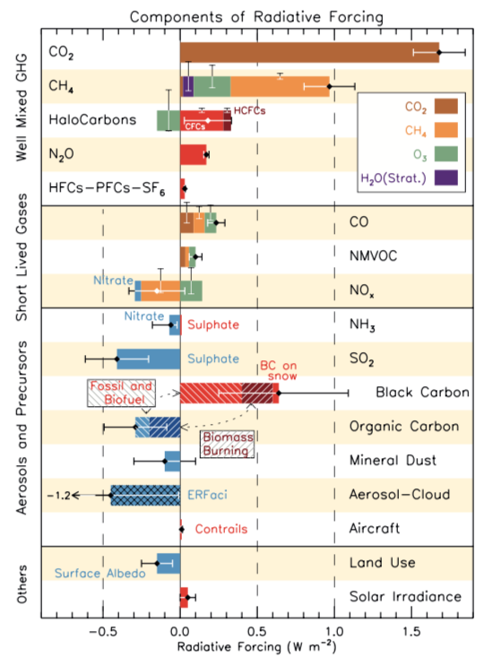
(IPCC, 2013)

Slide 18
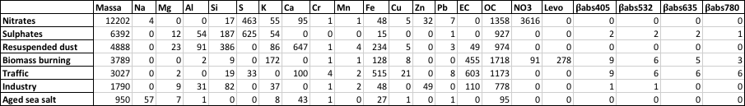
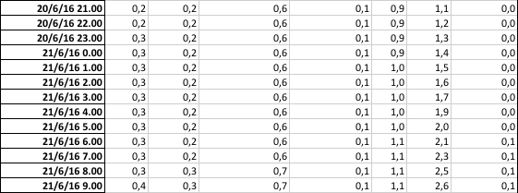
Results
Forello et al., in preparation
F:
P=7
ng/m³
Mm⁻¹
G:
…
…
…
…
…
…
…
…
average=1
…
…
…
…
…
…
…
…
Notes:
Vincoli? F e EVF facile?
In realtà i babs sono in Mm-1/ng
MOSTRO DIRETTAMENTE LA SOLUZIONE CONS3

Slide 19
First year: Experimental
INFN experiment TRACCIA
(Time Resolved Aerosol Characterization Challenging Improvements and Ambitions)
Collaboration with other Italian research groups
(Florence-LABEC, Genoa, Lecce)
Design and construction of STRAS
(Size and Time Resolved Aerosol Sampler)
PM sampler with hourly resolution that resolves atmospheric aerosol in two different sizes
→optimization for IBA and optical techniques
Piè di pagina: spazio libero per eventuale nome struttura o altro
Notes:
Critical issues of available similar instrumentation highlighted also during my master’s degree thesis

Slide 20
My contribution
Study of the theoretical efficiency curves for membrane filters to be used in STRAS
→ Good agreement with experimental data (within 3%)
Collection Efficiency =
Impaction + (2) Diffusion + (3) Direct interception
(Spurny & Lodge, 1972)
On going: STRAS prototype validation with tests at the atmospheric simulation chamber (ChAMBRe-Ge), field tests by the end of the year
Notes:
The very first work…I won’t focus on that today…
- Mettere conti???
CHIEDERE A GIULIA E SILVIA CONFRONTO SPERIMENTALE

Slide 21
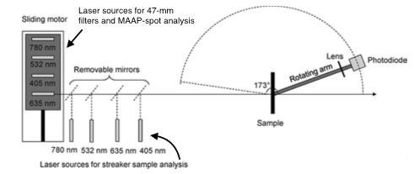

Slide 22
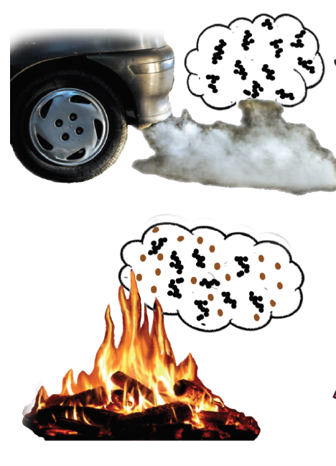
(1) Aethalometer model (Sandradewi et al., 2008)
(2) Multi-Wavelength Absorption Analyzer model (MWAA)
(Massabò et al., 2015)
(1)
b_{abs}(λ)=b_{abs}(λ)+ b_{abs}(λ)
^{FF}
^{WB}
0.8 – 1.1
b_{abs}(λ)~λ^{-αFF}
b_{abs}(λ) = A’ λ^{-αFF} + B’ λ^{-αWB}
^{FF}
b_{abs}(λ)~λ^{-αWB}
^{WB}
0.9 – 2.2
(2)
Need of a priori information on 𝛂 of sources
EC and OC apportionment is obtained with regressions/multiple regressions
b_{abs}(λ) = A’ λ^{-αFF} + B’ λ^{-αWB}
b_{abs}(λ) = A λ^{-αBC} + B λ^{-αBrC}

Slide 23
BOOTSTRAP:
1) Resampling and reweighting
(dataset perturbation)
2) Random rotational pulling (G solution)
Particularly stable for chemical and optical tracers (Fe, Cu, EC, 𝛃_{abs} multi-wavelength)
TRAFFIC
 | F1 | F2 | F3 | F4 | F5 | F6 | F7
F1 | 99 | 0 | 0 | 0 | 0 | 0 | 0 | 0
F2 | 2 | 93 | 2 | 0 | 0 | 0 | 0 | 2
F3 | 0 | 0 | 99 | 0 | 0 | 0 | 0 | 0
F4 | 0 | 0 | 0 | 99 | 0 | 0 | 0 | 0
F5 | 0 | 0 | 0 | 0 | 99 | 0 | 0 | 0
F6 | 2 | 0 | 2 | 0 | 0 | 95 | 0 | 0
F7 | 0 | 0 | 0 | 0 | 0 | 0 | 99 | 0

