Slide 1
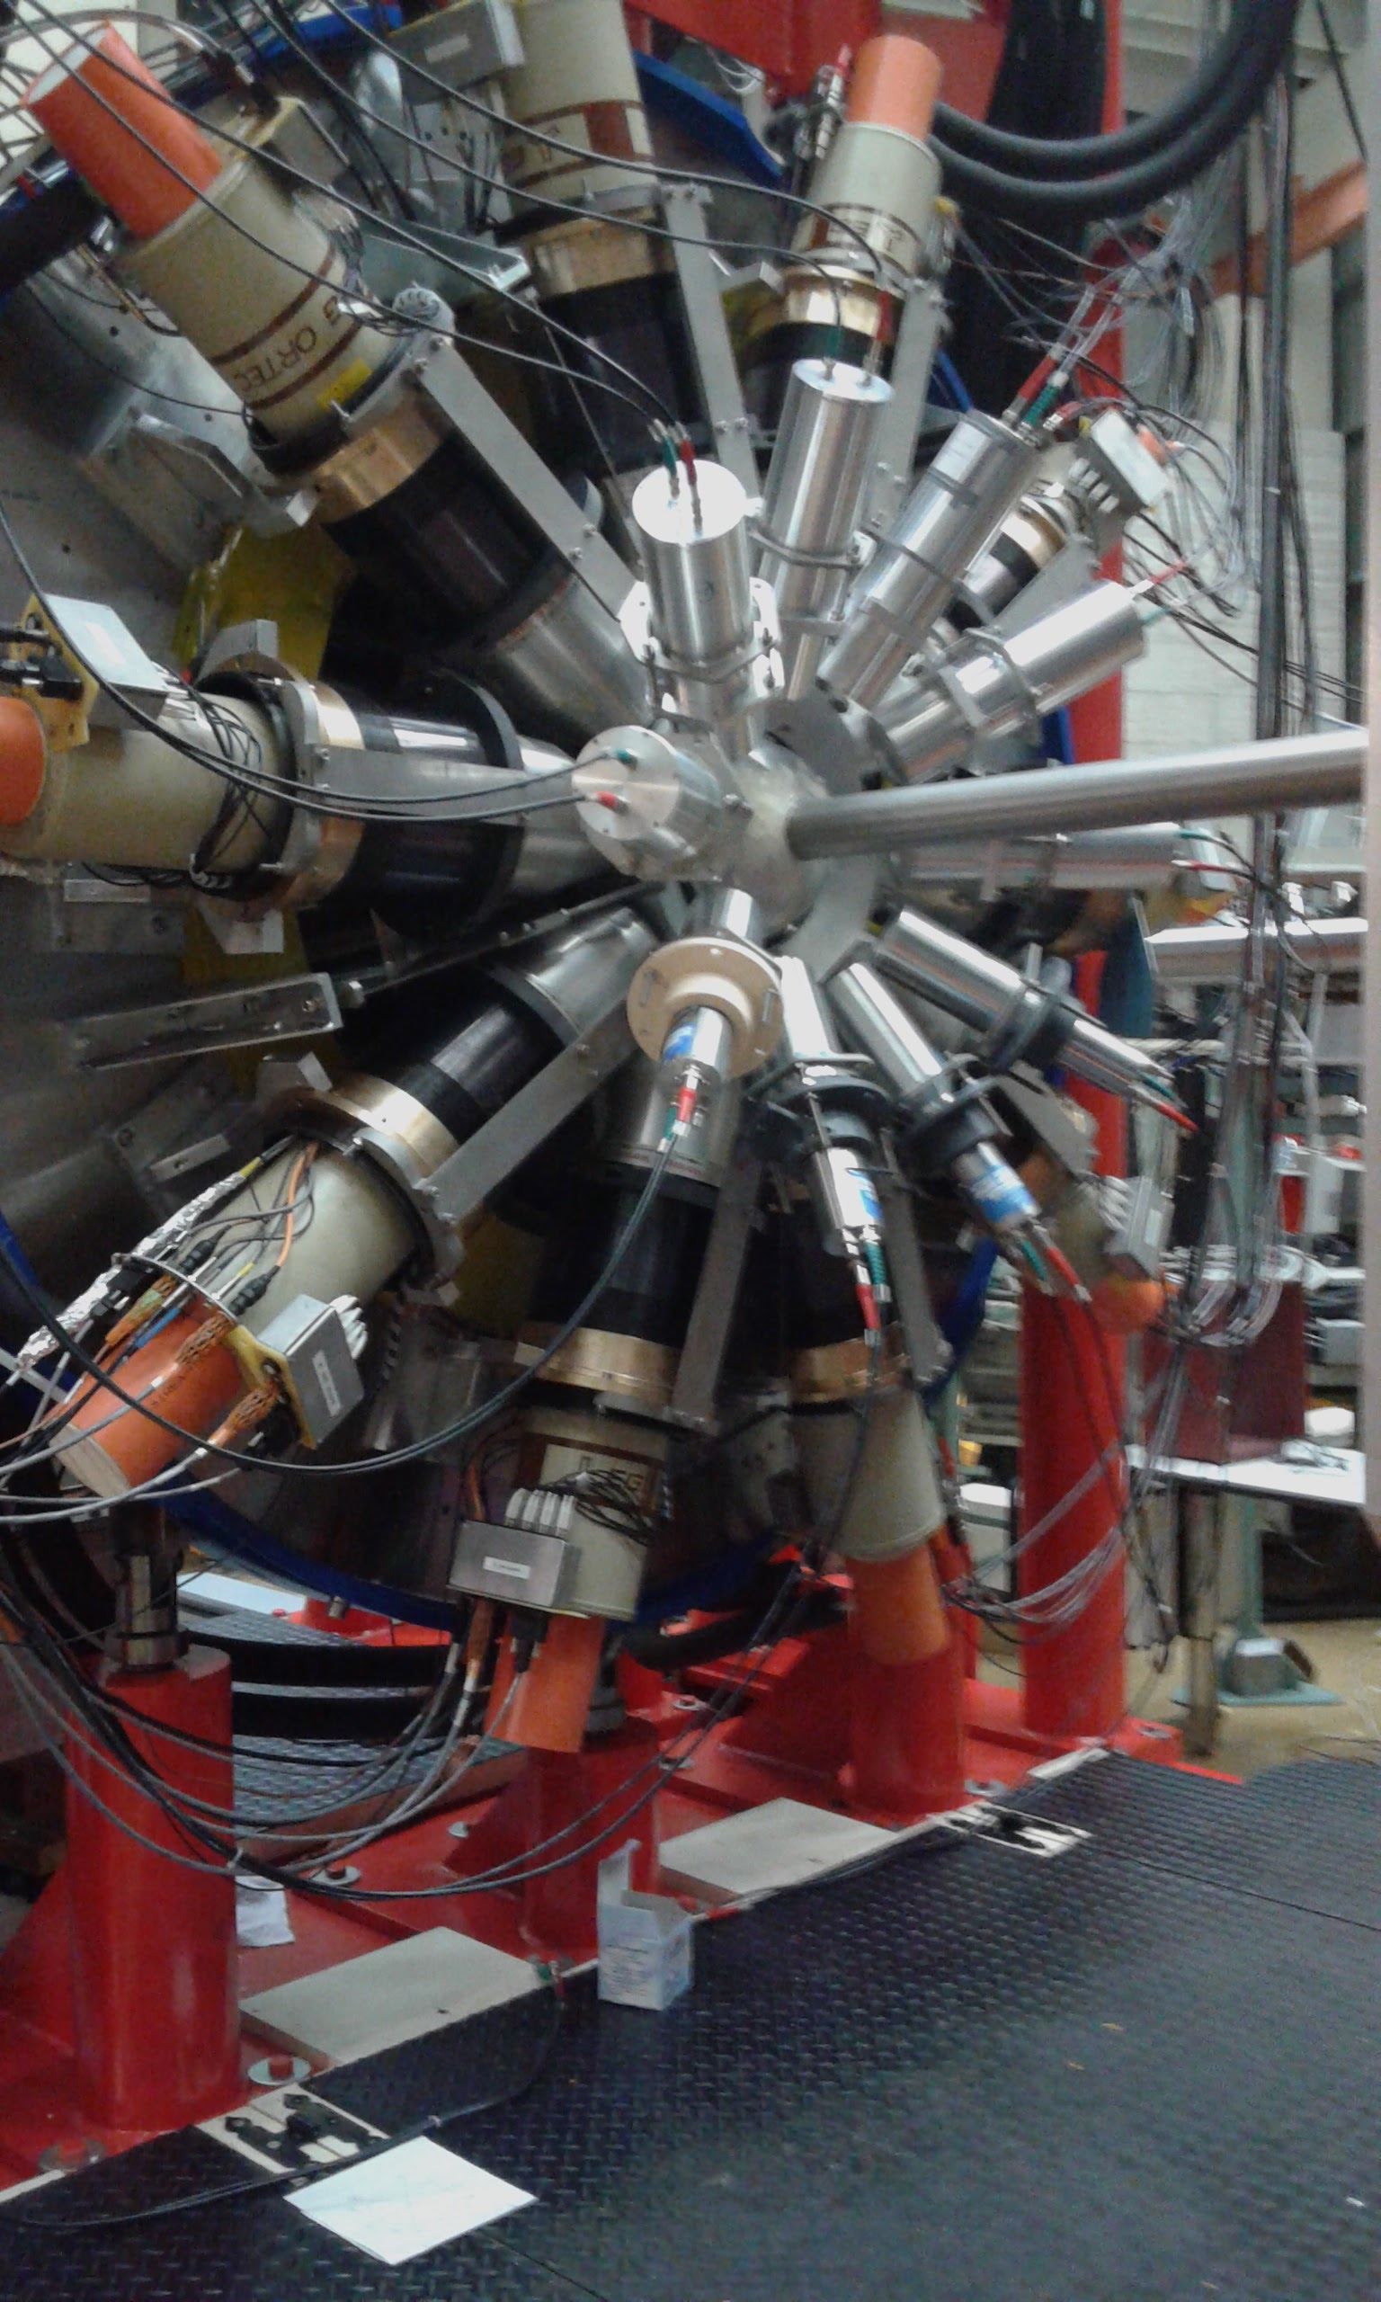
Study of the Isospin Symmetry in ⁶⁰Zn
Dedicated to PF
Giulia Gosta
University of Milan and INFN
Supervisor: Franco Camera
Assistant Supervisor: Angela Bracco

Slide 2
Outline
The isospin symmetry and its breaking
The experiment
Preliminary analysis and first results
Isospin breaking beyond nuclear structure
Conclusion

Slide 3
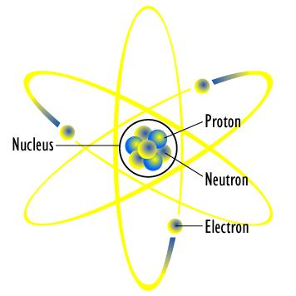
The isospin symmetry
Based on two assumption related to the nuclear interaction:
Charge symmetry :
n-n interaction is the same as p-p interaction
I = ½
I_{z} = ½
n
I_{z} = (N-Z)/2
I_{z} < I < (N+Z)/2
N
g.s. I=I_{z}
p
Charge independence : n-p interaction is also the same
I_{z} = - ½
In N=Z nuclei I = I_{z}=0

Slide 4
Isospin Symmetry Breaking
The Coulomb interaction (that is much weaker than the nuclear interaction) breaks the Isospin symmetry inducing a mixing between state with different Isospin

Slide 5
Isospin Symmetry Breaking
The Coulomb interaction (that is much weaker than the nuclear interaction) breaks the Isospin symmetry inducing a mixing between state with different Isospin
Ground State

Slide 6
Isospin Symmetry Breaking
The Coulomb interaction (that is much weaker than the nuclear interaction) breaks the Isospin symmetry inducing a mixing between state with different Isospin Perturbative approach
Mixing probability in the g.s.
Isovector part of the Coulomb potential
Ground State
Becomes important between states closed in energy

Slide 7
Isospin Symmetry Breaking
How much is it? α² vs E* ?
The Coulomb interaction (that is much weaker than the nuclear interaction) breaks the Isospin symmetry inducing a mixing between state with different Isospin Perturbative approach
Mixing probability in the g.s.
Isovector part of the Coulomb potential
Ground State
Becomes important between states closed in energy

Slide 8
Compound nuclei
Compound nuclear reactions take place when a projectile is captured, creating a compound nucleus in an excited energy state which subsequently decays.

Slide 9
... In compound nuclei
Coulomb Spreading width : weak E* dependence
Compound nucleus decay width: strong E* dependence

Slide 10
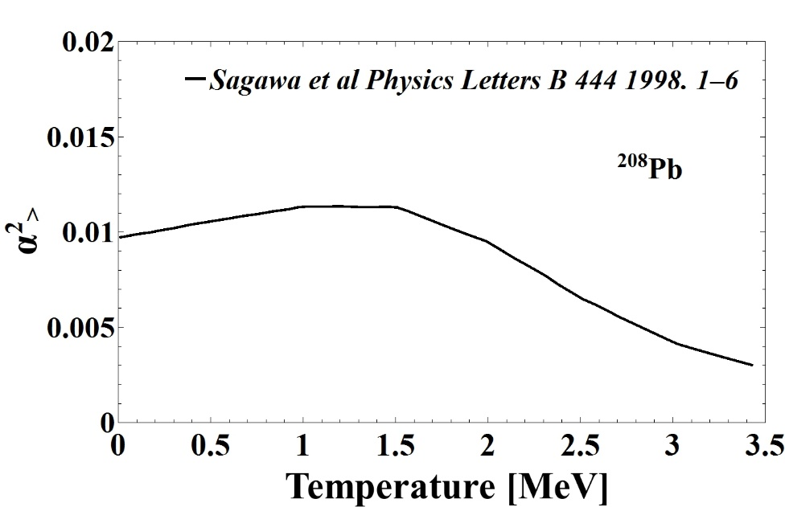
... In compound nuclei
Coulomb Spreading width : weak E* dependence
Compound nucleus decay width: strong E* dependence
Morinaga’s hypothesis (1955): Isospin becomes a better symmetry as excitation energy increases.

Slide 11
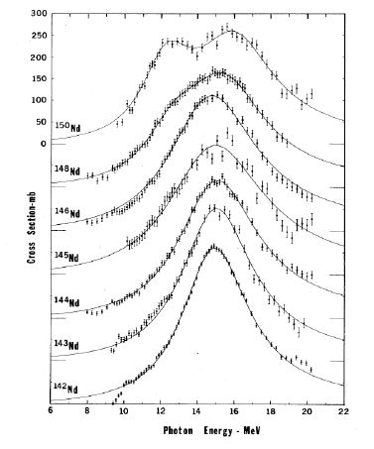
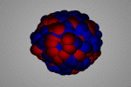
How can we measure it ?
Electric dipole transition (E1)
Electric (ΔS=0) and isovector (ΔI=1),
the strenght is concentrated in the Giant Dipole Resonance

Slide 12
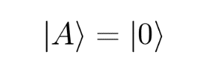
How can we measure it ?
Electric dipole transition (E1)
Electric (ΔS=0) and isovector (ΔI=1),
the strenght is concentrated in the Giant Dipole Resonance
NO MIXING
I=0
I=0
I=1

Slide 13
How can we measure it ?
Electric dipole transition (E1)
Electric (ΔS=0) and isovector (ΔI=1),
the strenght is concentrated in the Giant Dipole Resonance
NO MIXING
I=0
I=0
I=1

Slide 14
How can we measure it ?
Electric dipole transition (E1)
Electric (ΔS=0) and isovector (ΔI=1),
the strenght is concentrated in the Giant Dipole Resonance
NO MIXING
I=0
I=0
I=1

Slide 15
How can we measure it ?
Electric dipole transition (E1)
Electric (ΔS=0) and isovector (ΔI=1),
the strenght is concentrated in the Giant Dipole Resonance
NO MIXING
I=0
I=0
I=1
Inhibition of γ-decay
(few I=1 states)

Slide 16
How can we measure it ?
Electric dipole transition (E1)
Electric (ΔS=0) and isovector (ΔI=1),
the strenght is concentrated in the Giant Dipole Resonance
NO MIXING
MIXING
I=0
I=0
+
I=1
I=0
I=1
I=0
I=1
Inhibition of γ-decay
(few I=1 states)

Slide 17
How can we measure it ?
Electric dipole transition (E1)
Electric (ΔS=0) and isovector (ΔI=1),
the strenght is concentrated in the Giant Dipole Resonance
NO MIXING
MIXING
I=0
I=0
+
I=1
I=0
I=1
I=0
I=1
Inhibition of γ-decay
(few I=1 states)

Slide 18
How can we measure it ?
Electric dipole transition (E1)
Electric (ΔS=0) and isovector (ΔI=1),
the strenght is concentrated in the Giant Dipole Resonance
NO MIXING
MIXING
I=0
I=0
+
I=1
I=0
I=1
I=0
I=1
Inhibition of γ-decay
(few I=1 states)

Slide 19
How can we measure it ?
Electric dipole transition (E1)
Electric (ΔS=0) and isovector (ΔI=1),
the strenght is concentrated in the Giant Dipole Resonance
NO MIXING
MIXING
I=0
I=0
+
I=1
I=0
I=1
I=0
I=1
Inhibition of γ-decay
(few I=1 states)

Slide 20
How can we measure it ?
Electric dipole transition (E1)
Electric (ΔS=0) and isovector (ΔI=1),
the strenght is concentrated in the Giant Dipole Resonance
NO MIXING
MIXING
I=0
I=0
+
I=1
I=0
I=1
I=0
I=1
Inhibition of γ-decay
(few I=1 states)
The observed E1 strenght is a signature of the mixing

Slide 21
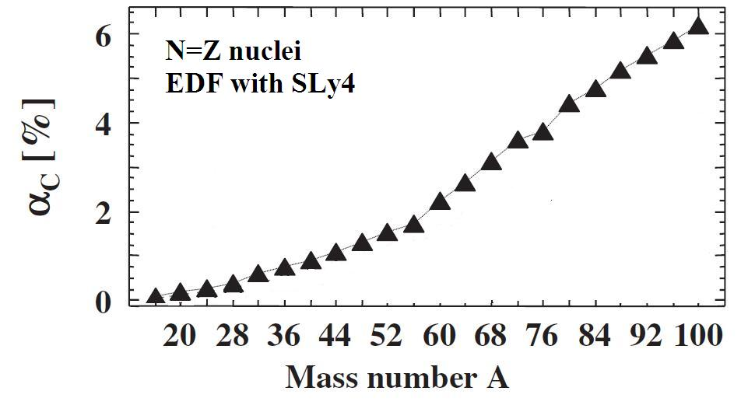
The experiment
June 2016 @Laboratori Nazionali di Legnaro-INFN
D. Mondal et al.
Ceruti et al. & Corsi at al.
We form a I=0 Compound Nucleus by fusion-evaporation reaction:
³²S + ²⁸Si ⁶⁰Zn*
This work
(N=Z N=Z N=Z)
Satula et al., PRL 103 (2009)

Slide 22
The experiment
June 2016 @Laboratori Nazionali di Legnaro-INFN
D. Mondal et al.
Ceruti et al. & Corsi at al.
We form a I=0 Compound Nucleus by fusion-evaporation reaction:
³²S + ²⁸Si ⁶⁰Zn*
This work
(N=Z N=Z N=Z)
Satula et al., PRL 103 (2009)
We form a I≠0 Compound Nucleus by fusion-evaporation reaction:
³²S + ³⁰Si ⁶²Zn*
(N=Z N≠Z N ≠ Z)

Slide 23
The experiment
June 2016 @Laboratori Nazionali di Legnaro-INFN
D. Mondal et al.
Ceruti et al. & Corsi at al.
We form a I=0 Compound Nucleus by fusion-evaporation reaction:
³²S + ²⁸Si ⁶⁰Zn*
This work
(N=Z N=Z N=Z)
Satula et al., PRL 103 (2009)
We form a I≠0 Compound Nucleus by fusion-evaporation reaction:
the mixing effect in ⁶²Zn should not be practically evident
³²S + ³⁰Si ⁶²Zn*
(N=Z N≠Z N ≠ Z)

Slide 24
The experiment
June 2016 @Laboratori Nazionali di Legnaro-INFN
D. Mondal et al.
Ceruti et al. & Corsi at al.
The γ-rays yield from the E1 decay of the GDR built on the CN was measured.
From the data fit α² can be extracted.
We form a I=0 Compound Nucleus by fusion-evaporation reaction:
³²S + ²⁸Si ⁶⁰Zn*
This work
(N=Z N=Z N=Z)
Satula et al., PRL 103 (2009)
We form a I≠0 Compound Nucleus by fusion-evaporation reaction:
the mixing effect in ⁶²Zn should not be practically evident
³²S + ³⁰Si ⁶²Zn*
T₁ = 2.0 MeV (E*= 47 MeV)
T₂ = 2.4 MeV (E*= 58 MeV)
(N=Z N≠Z N ≠ Z)

Slide 25
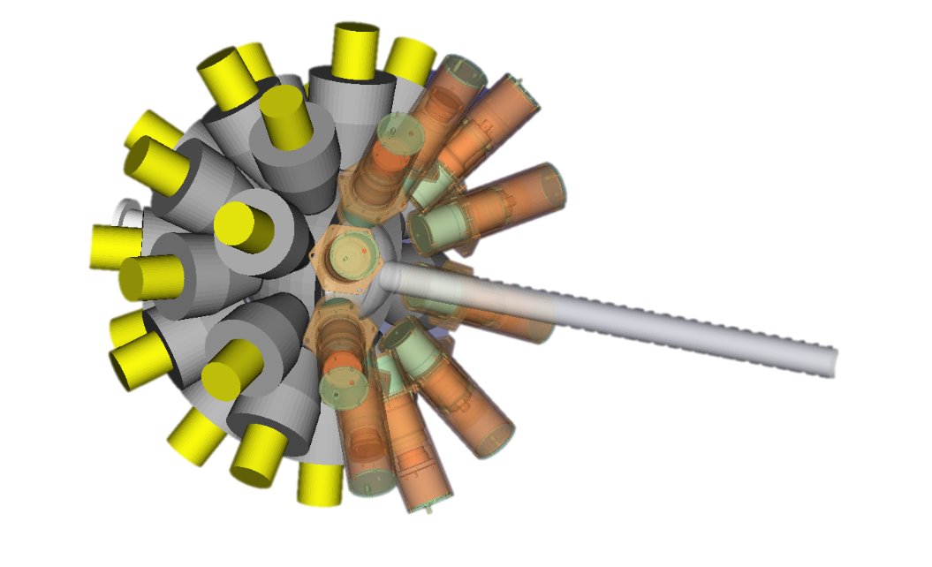
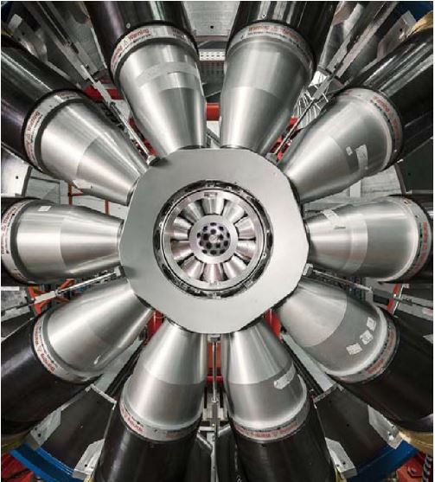
The experimental setup
Array of 10 LaBr₃:Ce crystals
(at 70° at 20 cm from the target)
for the measurement of high-energy γ rays.
GALILEO array of
25 HPGe detectors
for the measurement of low-energy γ rays

Slide 26
The experimental setup
Array of 10 LaBr₃:Ce crystals
(at 70° at 20 cm from the target)
for the measurement of high-energy γ rays.
GALILEO array of
25 HPGe detectors
for the measurement of low-energy γ rays
Ancillary detectors:
EUCLIDES (array of 40 ∆E-E Si telescopes)
Neutron Wall (array of 15 liquid scintillators BC-501A)
Used to tuning in a more accurate way the statistical model trough the analysis of the compound nuclei residues population

Slide 27
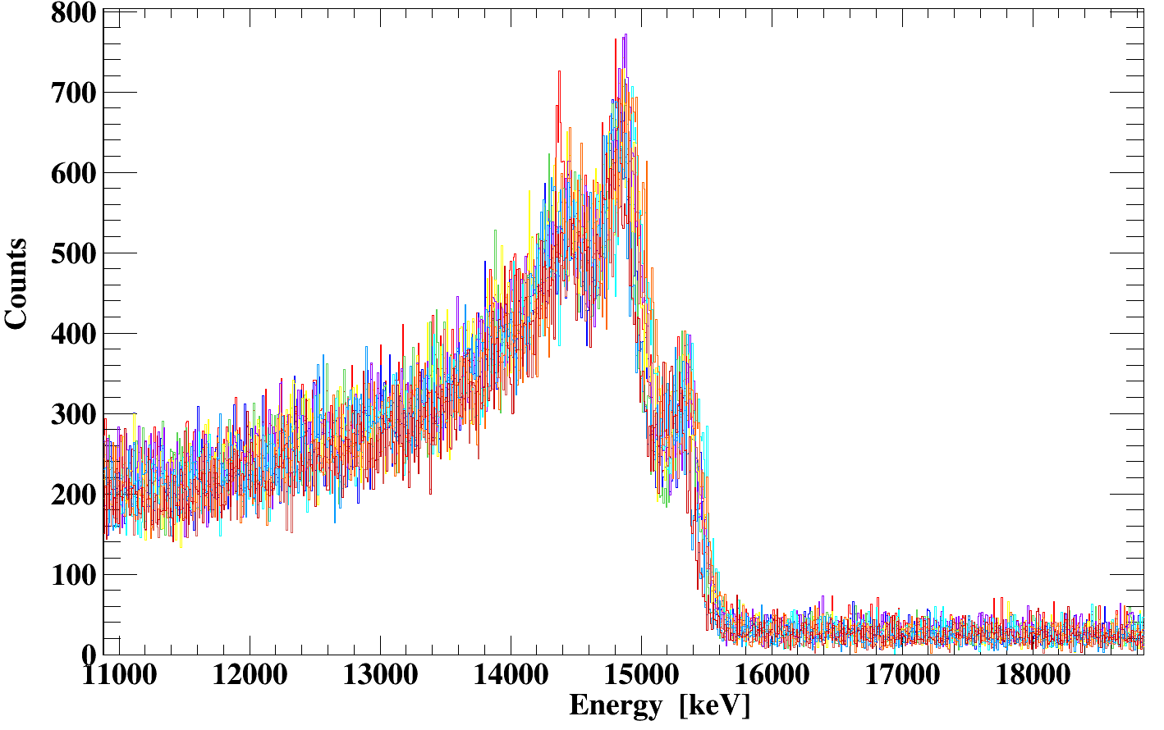
Pre-analysis
¹¹B + D -> ¹³C*
(up to 15.1 MeV)
Energy Calibration
LaBr₃:Ce
Linear calibration at low energy (using standard sources)
Quadratic calibration at high energy (in beam calibration)
HPGe
Up to 5 order polynomial curves (using standard sources)
Time calibration LaBr₃:Ce
Time alignment
Time walk correction
Time drift correction

Slide 28
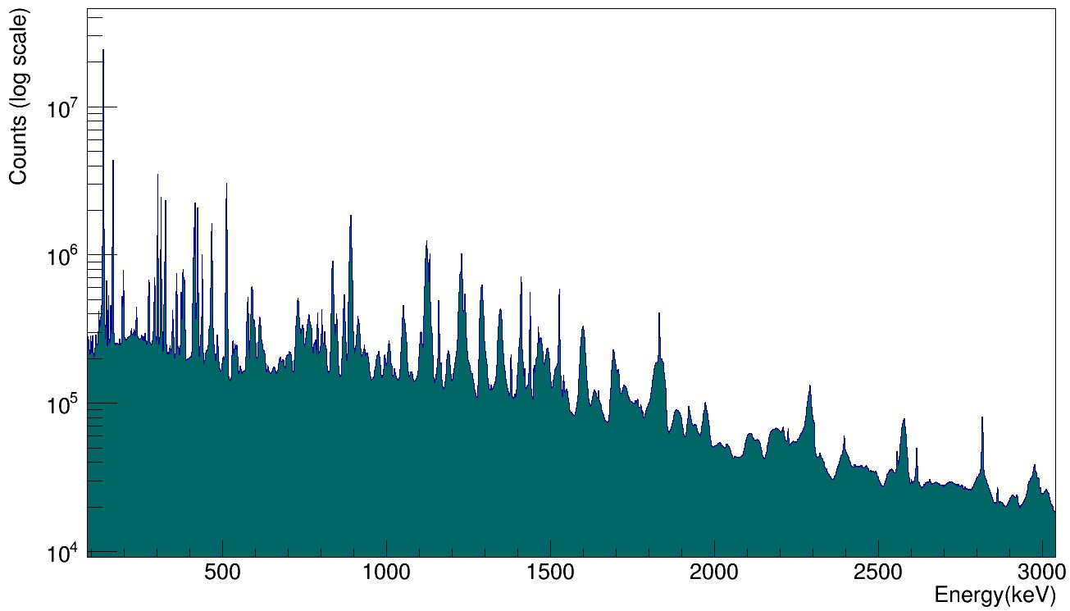
Pre-analysis
¹¹B + D -> ¹³C*
(up to 15.1 MeV)
Energy Calibration
LaBr₃:Ce
Linear calibration at low energy (using standard sources)
Quadratic calibration at high energy (in beam calibration)
HPGe
Up to 5 order polynomial curves (using standard sources)
Time calibration LaBr₃:Ce
Time alignment
Time walk correction
Time drift correction

Slide 29
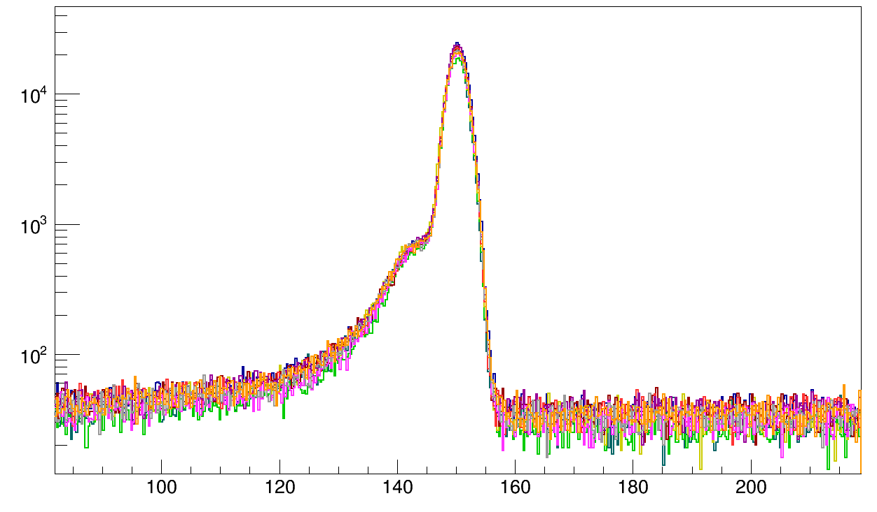
Pre-analysis
¹¹B + D -> ¹³C*
(up to 15.1 MeV)
Energy Calibration
LaBr₃:Ce
Linear calibration at low energy (using standard sources)
Quadratic calibration at high energy (in beam calibration)
HPGe
Up to 5 order polynomial curves (using standard sources)
Time calibration LaBr₃:Ce
Time alignment
Time walk correction
Time drift correction

Slide 30
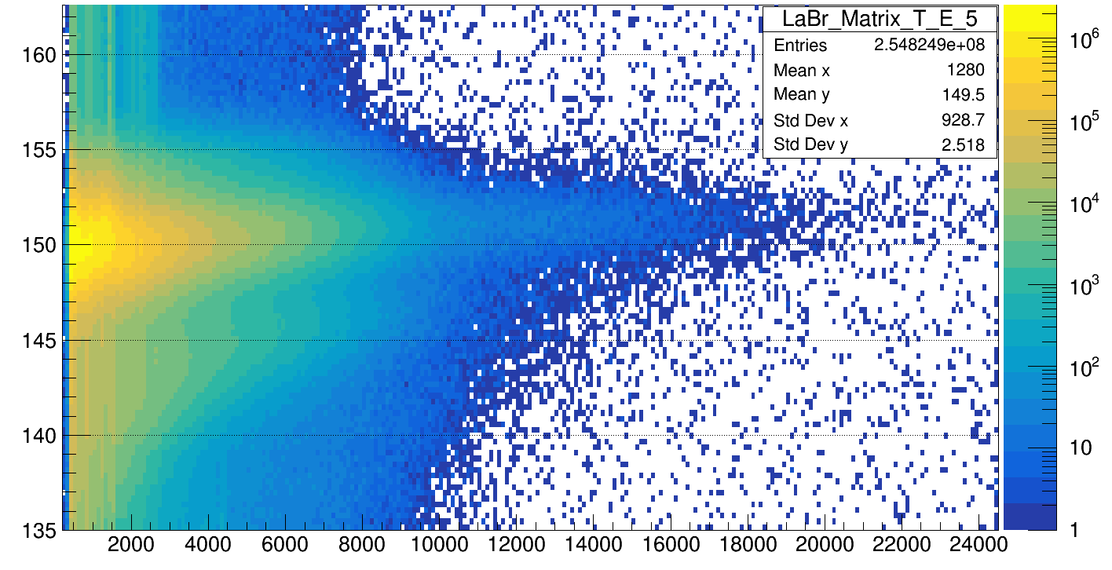
Pre-analysis
¹¹B + D -> ¹³C*
(up to 15.1 MeV)
Energy Calibration
LaBr₃:Ce
Linear calibration at low energy (using standard sources)
Quadratic calibration at high energy (in beam calibration)
HPGe
Up to 5 order polynomial curves (using standard sources)
Time calibration LaBr₃:Ce
Time alignment
Time walk correction
Time drift correction

Slide 31
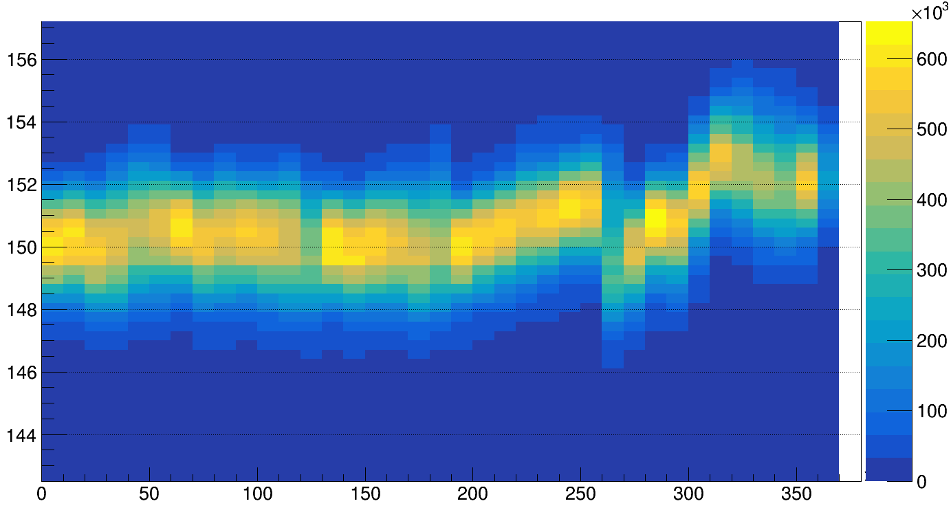
Pre-analysis
¹¹B + D -> ¹³C*
(up to 15.1 MeV)
Energy Calibration
LaBr₃:Ce
Linear calibration at low energy (using standard sources)
Quadratic calibration at high energy (in beam calibration)
HPGe
Up to 5 order polynomial curves (using standard sources)
Time calibration LaBr₃:Ce
Time alignment
Time walk correction
Time drift correction

Slide 32
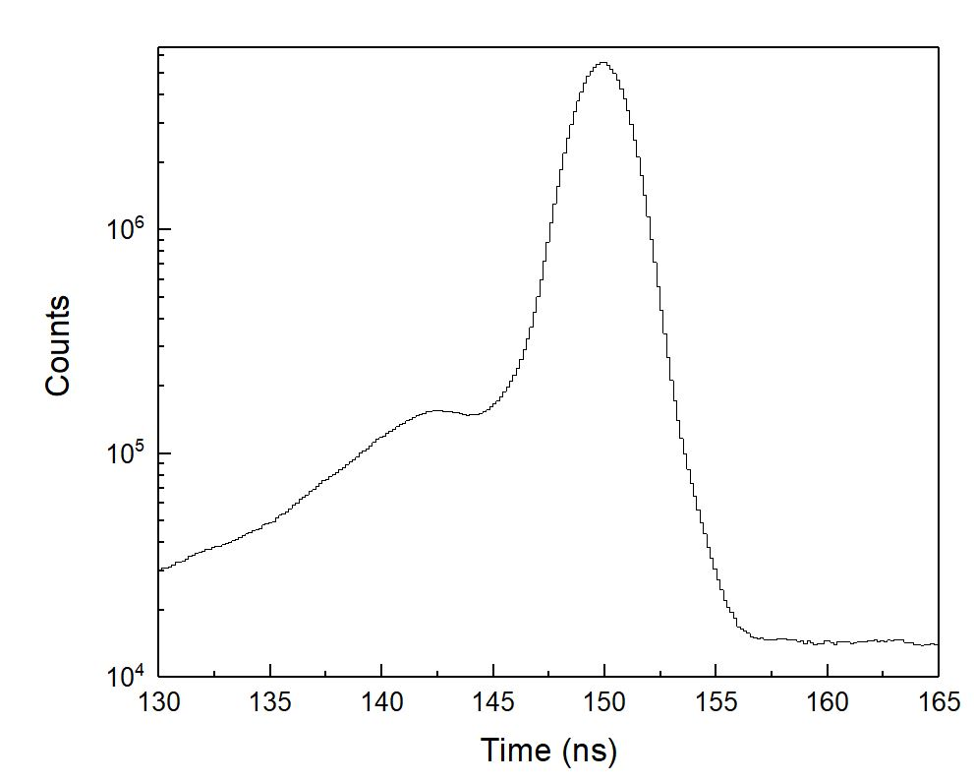
Gate on time peak
³²S+ ³⁰Si ⁶²Zn^{* (T=2,4 MeV)}

Slide 33
Gate on time peak
³²S+ ³⁰Si ⁶²Zn^{* (T=2,4 MeV)}

Slide 34
Gate on time peak
³²S+ ³⁰Si ⁶²Zn^{* (T=2,4 MeV)}

Slide 35
Gate on time peak
³²S+ ³⁰Si ⁶²Zn^{* (T=2,4 MeV)}

Slide 36
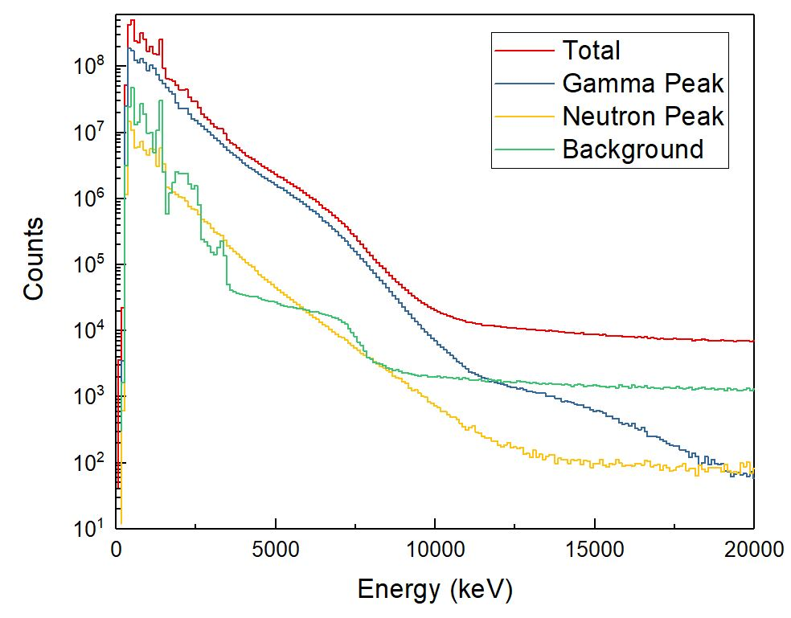
Gate on time peak
³²S+ ³⁰Si ⁶²Zn^{* (T=2,4 MeV)}

Slide 37
Gate on time peak
GDR
³²S+ ³⁰Si ⁶²Zn^{* (T=2,4 MeV)}

Slide 38
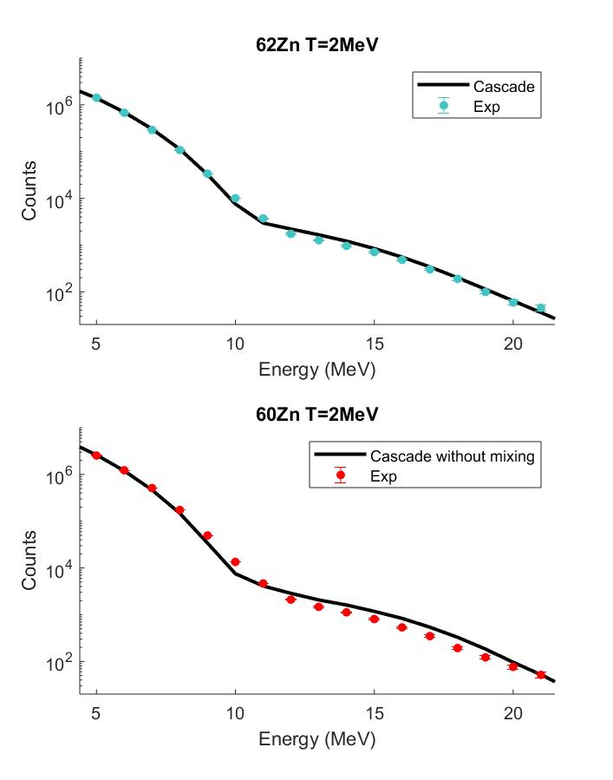
Compare with statistical model
Preliminary

Slide 39
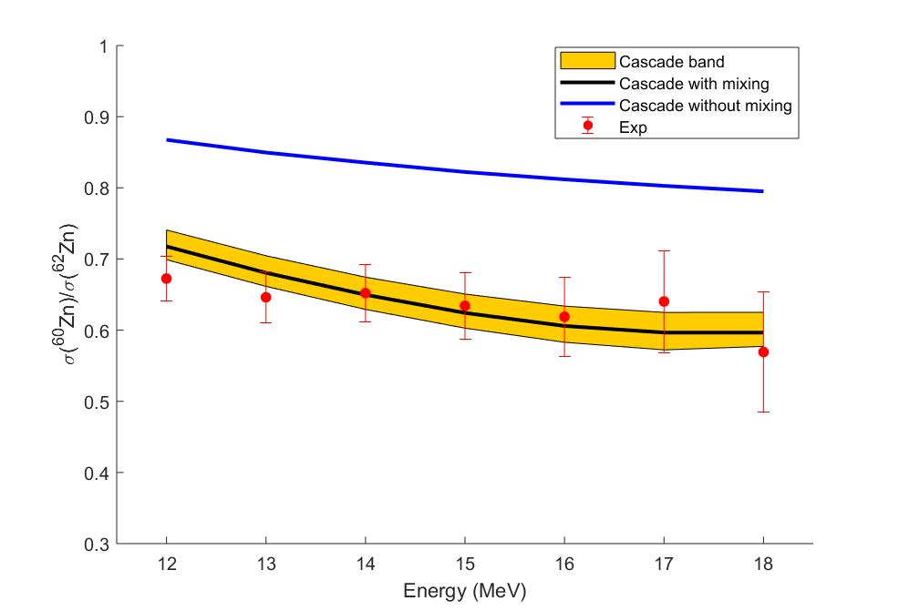
Compare with statistical model
Γ = 10keV
Preliminary

Slide 40
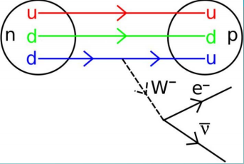
Isospin Mixing beyond nuclear structure
The Cabibbo–Kobayashi–Maskawa matrix, CKM matrix contains information on the strength of the flavor-changing weak interaction.
β decay is an example of a weak decay, governed by the fisrt term of the CKM matrix V_{ud}. A quark u change in a quark d (or viceversa)

Slide 41
Super-allowed Fermi transitions are excellent probes for testing properties of weak interaction.
A «corrected» value Ft is defined as:
Radiative correction
I.S. Towner and J.C. Hardy PRC 82, 065501 (2010)
Isospin symmetry breaking correction

Slide 42
Conclusion
Isospin symmetry was introduced in order to simplify the description of the nucleus
Coulomb interaction breaks the symmetry
In certain conditions the approximation is valid, in other the effect is not negligible
This study is relevant also beyond the nuclear structure

Slide 43
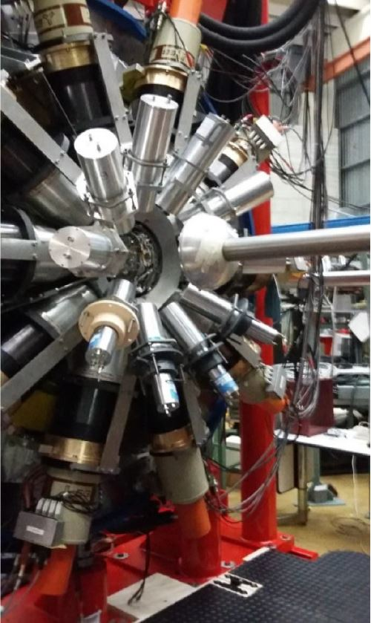
Thank you for your attention…

Slide 44
... In compound nuclei
Coulomb spreding width of the Isobaric Analog State (Form Data)
Width of the nonopole resonance at the energy of IAS (Parameter)
Colo’ et al .PRC 54(1996)
M.N. Harakeh et al. Phys. Lett. B 176(1986)297
A.Behr et al. Phys. Rev. Lett. 70(1993)3201
Sagawa et al Physics Letters B 444 1998. 1–6
Satula et al PRL 103, 012502 (2009)
Decay width of the nucleus (From CN decay)
Γ (T) = Γ (T=0)*(1+cT)
Should be determined trough a microscopic calculation

Slide 45
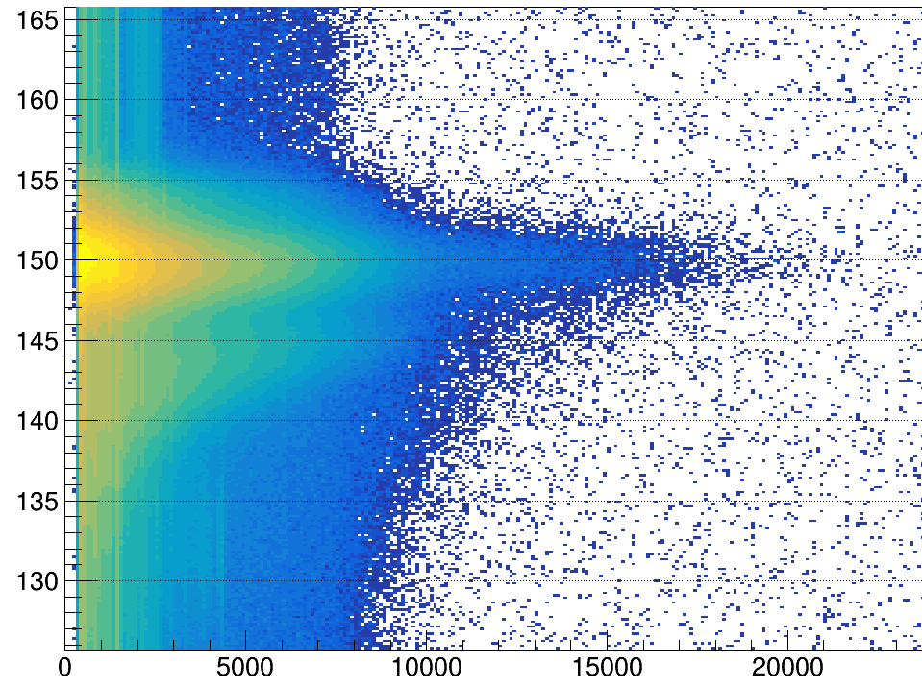
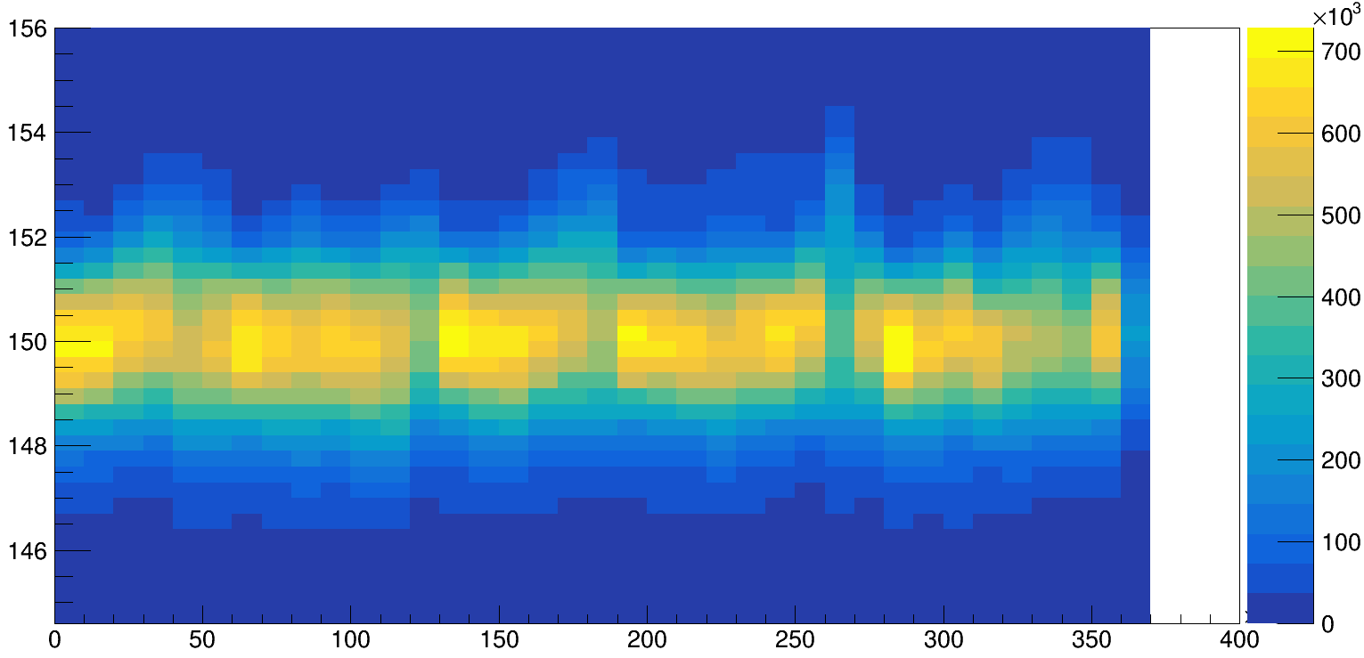
Time-walk and drift correction
³²S+ ³⁰Si ⁶²Zn^{* (T=2,4 MeV)}

Slide 46
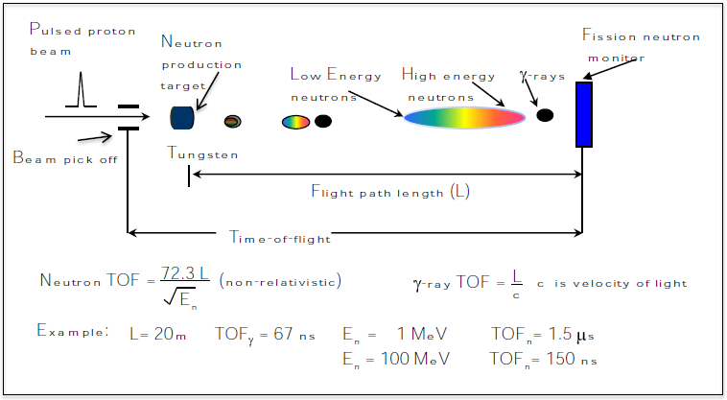
Time of flight teqnique
γ-peak
Target
Slow Neutron
Gamma rays
LaBr₃:Ce
Fast Neutrons
Counts (log scale)
n-peak
Time (ns)

Slide 47
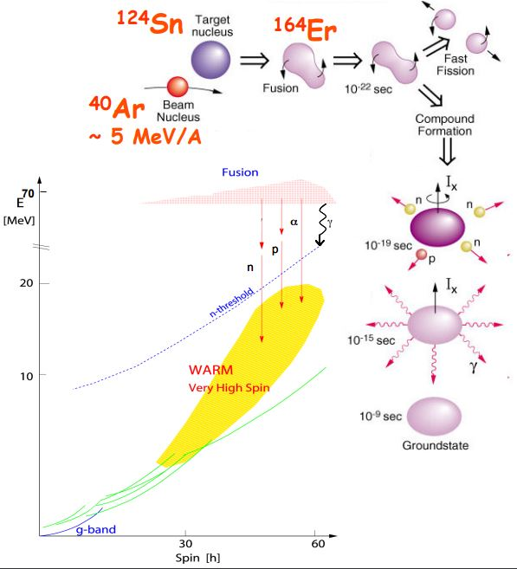
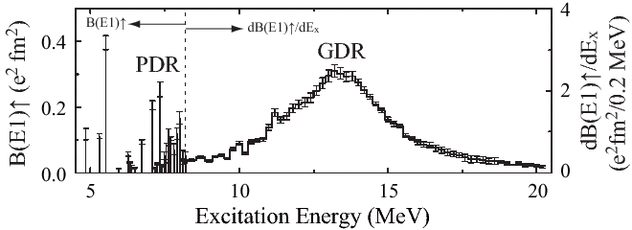
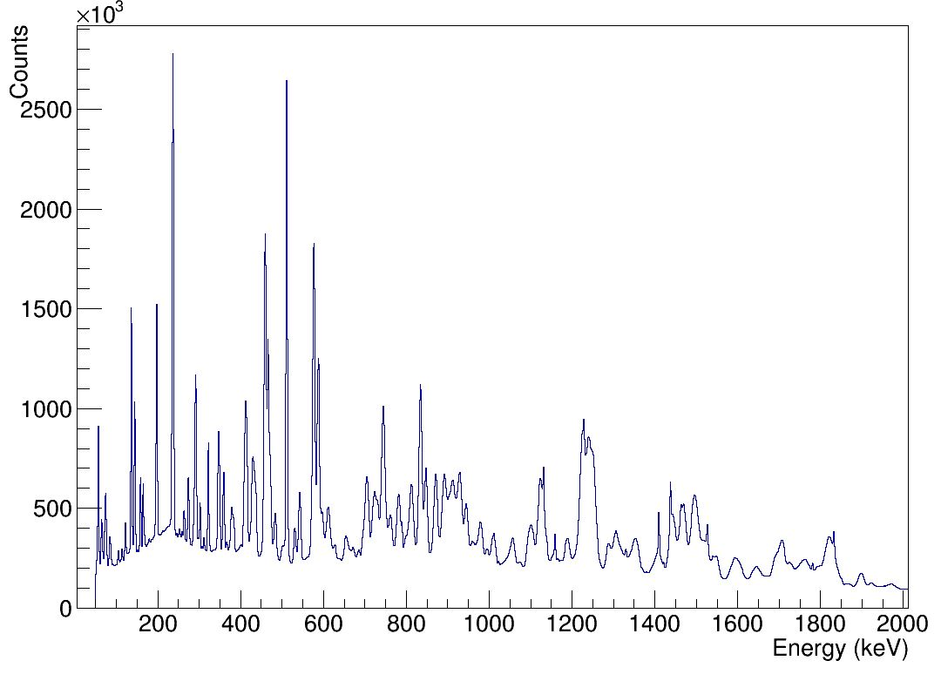
Compound nucleus decay
E= 31.2 A^{-1/3} +20.6A^{-1/6}
Giant Dipole Resonance
Eγ ~ 15 MeV
FWHM ~ 5-7 MeV
Pγ/Ppart≈ 10⁻³
γ-decay below n-threshold Eγ < 8 MeV
FWHM ~ 2-10 keV
Mγ ~ 20-30 (within few ps)

Slide 48
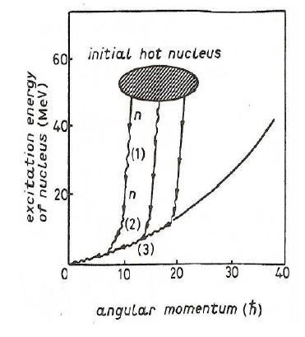
Statistical Model Tuning:
2. Residual nuclei
⁵¹Mn
⁴³Sc
⁵⁷Co
⁴⁶Ti
⁵⁶Co
⁴⁵Ti
⁵⁴Fe
⁶⁰Zn T=2,4 MeV

Slide 49
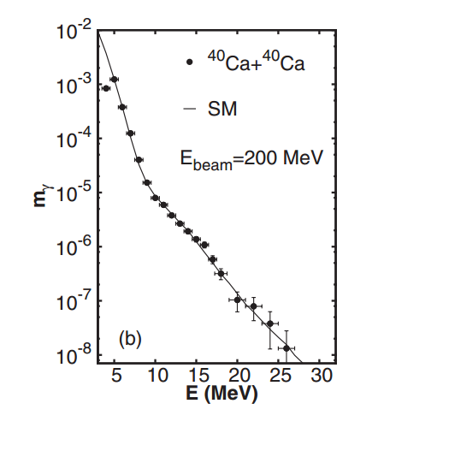
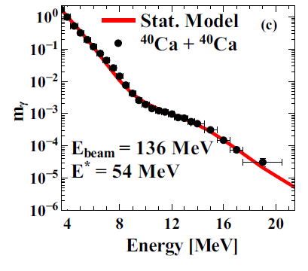
Previous results: Isospin mixing in ⁸⁰Zr
⁴⁰Ca + ⁴⁰Ca ⁸⁰Zr*
α² (T=0)=(4.6±0.9)%
S.Ceruti et al. PRL 115, 222502 (2015)
A.Corsi et al. PRC 84, 041304(R) (2011)
Γ↓ does not change with T
α² is larger at T = 2 MeV
Γ↓=10±3 keV, α²=0.013±0.004
Γ↓=12±3 keV, α²=0.046±0.007
T ≈ 3 MeV
T ≈ 2 MeV

Slide 50
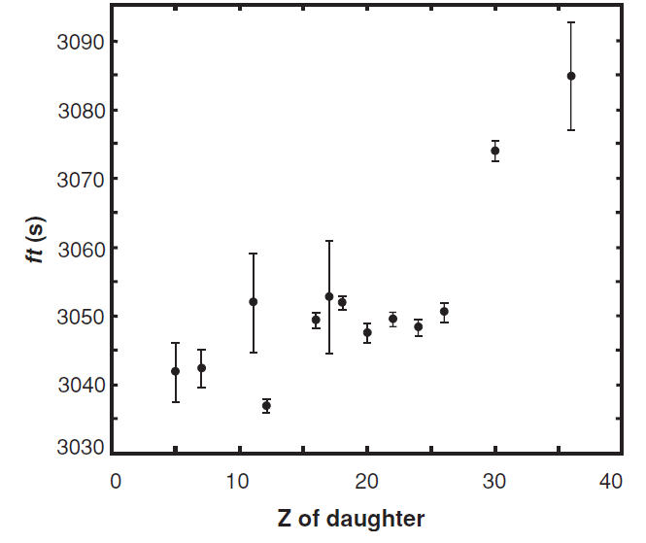
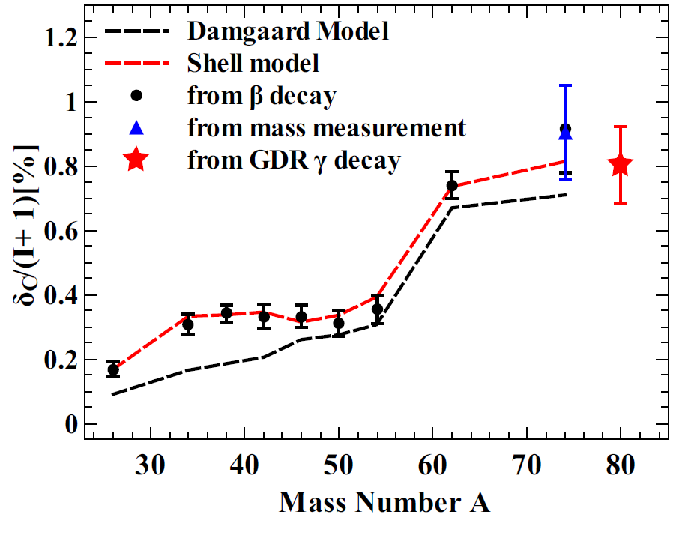
Super-allowed Fermi
Measurement of ß-particle anisotropy emission
Difficult for very unstable nuclei
ƒt depends only on universal quantities, should be mass independent !
Partial half-life of transition
Vector coupling constant (from semi-leptonic weak interction)
I.S. Towner and J.C. Hardy PRC 82, 065501 (2010)
Weak interaction coupling constant
Fermi Matrix element
ƒt G_{v} V_{ud}
δ_{C} is not directly measurable
Auerbach proposed the following parametrization:
I.S. Towner and J.C. Hardy PRC 82, 065501 (2010)
Isospin mixing
N.Auerbach, PRC 79, 035502 (2009)

