Slide 1
Development and implementation of direct injection mass spectrometry (DIMS) based analytical method to study volatile organic compounds (VOCs): Beer as a challenging case study
PhD student:
Manjeet Kumar
Supervisors name:
Prof. Paolo Piseri (Unimi)
Prof. Franco Biasioli (FEM)

Slide 2
Outline
Volatile Organic Compounds (VOCs)
Importance of VOCs
VOCs in foods
VOC Measurement Methods
Gas Chromatography (GC)
Direct Injection Mass Spectrometry (DIMS)
Case Study: Beer
Challenges
Prospective

Slide 3
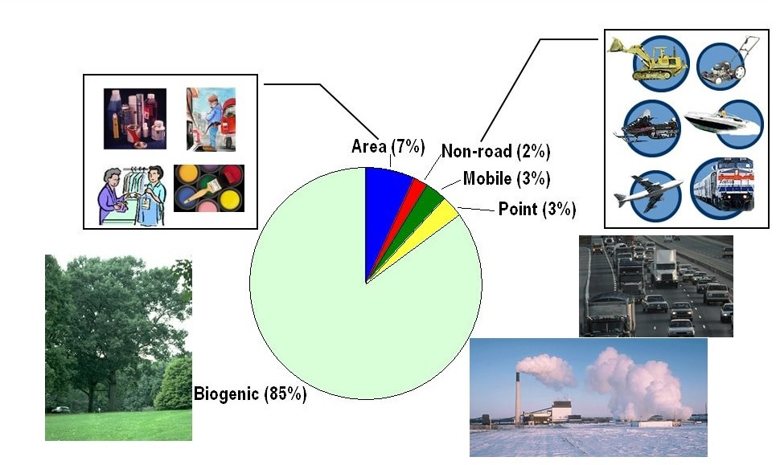
Volatile Organic Compounds (VOCs)
VOCs are organic chemicals that easily vaporize at room temperature.
VOCs are present in our daily lives and can be toxic.
VOC's are naturally emitted by a number of plants and trees.
VOCs are also emitted from burning of fuels, wood, biomass, etc.
Some VOCs can be hazardous to health and the environment.

Slide 4
VOCs play important role in different fields
Environment
Biogenic, abiotic and artificial VOCs are involved in many processes of relevance for atmospheric chemistry:
Greenhouse effect
Aerosol formation
Ozone
Health
Air quality (indoor and outdoor)
Breath analysis
Groundwater analysis
VOCs give rise to aroma and are fundamental in making food enjoyable to eat.
VOCs can be used as non invasive markers for food control or process monitoring.
Foods

Slide 5
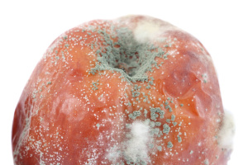
VOCs in foods and drinks
VOCs give rise to Flavour and Aroma.
Migrants from packaging.
VOCs are also emitted from microbial action, fermentation, spoilage, food processing etc.
VOCs released during food decay (shelf life etc.).

Slide 6
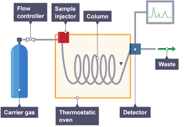
Reference methods to study VOCs
Gas Chromatography (GC) has been widely used within food quality and safety for:
Analysis of target compounds
Target and non-target metabolomics
Profiling of volatile compounds
Pros:
GC provides higher separation efficiency and can be
combined with mass spectrometry for accurate identification.
Cons:
Typically slow, needs sample pretreatment to achive enough sensitivity
Limited to thermally stable analytes.
GC

Slide 7
Direct Injection Mass Spectrometry (DIMS) methods
Recently proposed DIMS based method (SIFT-MS, PTR-MS and APCI etc.) are more rapid and provide higher sensitivity. These methods find applications in different fields:
Environmental monotoring/atmospheric chemistry/air quality
Health applications
Food science and technology
Bioprocess monitoring
Pros:
Provide high-throughput… , non-invasive, non-destructive and highly-sensitive analysis of VOCs.
Cons:
Typically only tentative compound identification.

Slide 8
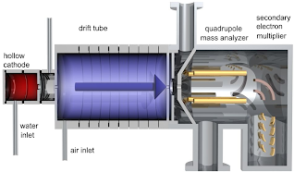
PTR-MS Proton transfer reaction-mass spectrometry (PTR-MS) is a new and emerging DIMS technique for the measurement and monitoring of volatile organic compounds (VOCs).
PTR-MS is an analytic technique uses gas phase $H_{3}O^{+}$ion as a principle ion source.
$H_{3}O^{+}$+ M → M$H^{+}$ + $H_{2}O$
Pros &Cons
Low fragmentation compared to electron ionization (EI).
Low limits of detections (~10 pptv)
VOCs can be monitored on-line, real-time quantification.
Ability to analyse complex VOC mixtures.
Poor selectivity and identification capabilities.
PTR-MS

Slide 9
Case study: Beer
Beer: Complex composition containing CO2, ethyl alcohol, several inorganic salts and a blend of more than 800 organic compounds. Beer also contains minerals, vitamins and fibres.
Beer ingredients:
Barley malt
Yeast
Water
Hops
To ensure the quality of the beer:
Elements in the beer are tested for characteristics,
quality (Flavour, aroma and colour) and contamination.
Heavy metals and inorganic contaminants in water
Yeast classifications
Inorganic and organic contaminates (pesticides etc.) in hops.
Concentration of carbon dioxide.
Monitoring and control some chemical elements.

Slide 10
Main challenges in the proposed Project
Individual VOC components require high sensitivity for their identification and quantification which is quite challenging.
In this study main challenges come from:
Complexity of the mixture, difficult for any separative method and from the high ethanol content, that deplete the primary ion signal.
Chemical transformation, interaction among various compounds and disparity in flavour sensation.
Complexity of different food matrices and its influence in the flavour perception.
Difficult to model and visualize the complex relationship between chemical composition and flavour perception.

Slide 11
Aim of the PhD project
To Improve the efficiency of ptr-ms by:
Improving sensitivity, throughput and analytical efficiency without losing analytical performances.
Improving sampling techniques which lessen the risk of loosing most volatile components.
Improve data analysis software/data base for PTR-MS.
Refine analytical capability to track concentrations that rapidly change in time.
Improving specificity by the implementation of a fast GC and ion funnel tools.
Dependence of sensitivity and fragmentation on ethanol concentration.
Define a reference data base for interesting compounds (fermentation, reaction constants estimation, dependence of fragmentation on experimental parameters as drift tube voltage etc).
Enhance ion focusing methods (e.g. Ion simulations SIMION)
Verify the method
On Beer as a challenging case study

Slide 12
Prospective
Rapidly increasing role of MS in physical, chemical and biological sciences has lead to the improvement in the design to enhance the sensitivity of MS. To achieve the higher sensitivity, ions created at higher pressures must be transmitted with high efficiency in MS.
Issues to be addressed:
Most of the ions lost before ions reach the detector in different vacuum stages.
High rate of collisions prevent effecting focusing.
My focus will be:
To reduce ion losses, improve ion focusing and hence the sensitivity of MS.
Improvement in the ionization techniques (manage fragmentation).
Improvement in the software for fast-GC and ion funnel.

Slide 13
Thank you for your attention

