Slide 1


Analysis of the
LSPE-STRIP optical system
1st year Ph.D. students workshop
Università degli Studi di Milano, Physics Department
October 10th, 2018
Sabrina Realini
Supervisors: Prof. A. Mennella, Dott. C. Franceschet

Slide 2
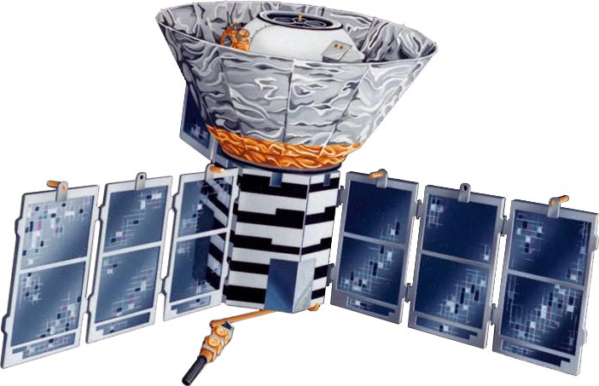
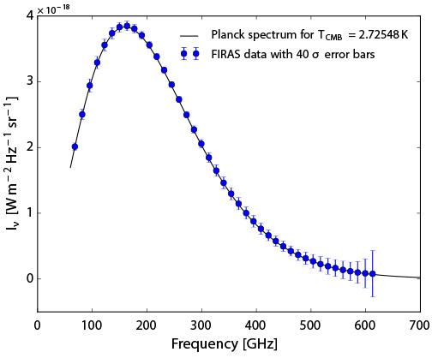
The Cosmic Microwave Background
SPECTRUM
Blackbody spectrum at T = 2,725 ± 0,002 K

Slide 3
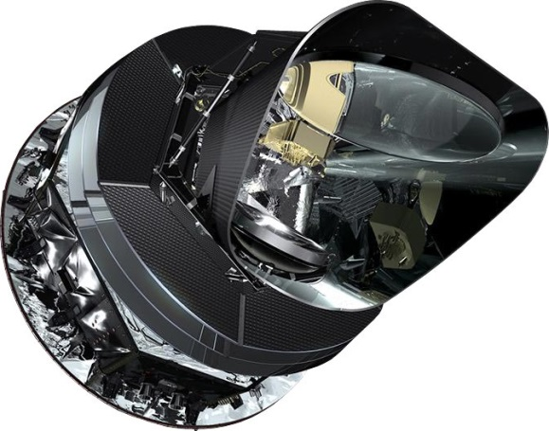
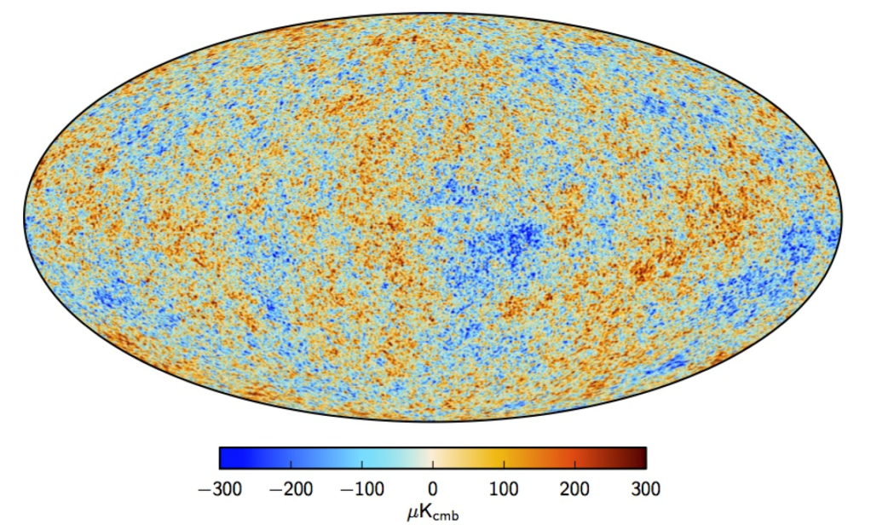

The Cosmic Microwave Background
ANISOTROPIES
Temperature anisotropies at ΔT $\sim {10}^{−5}$ K
Polarization anisotropies at ΔP $\sim {10}^{−6}$ K
Planck Collaboration, 2013

Slide 4
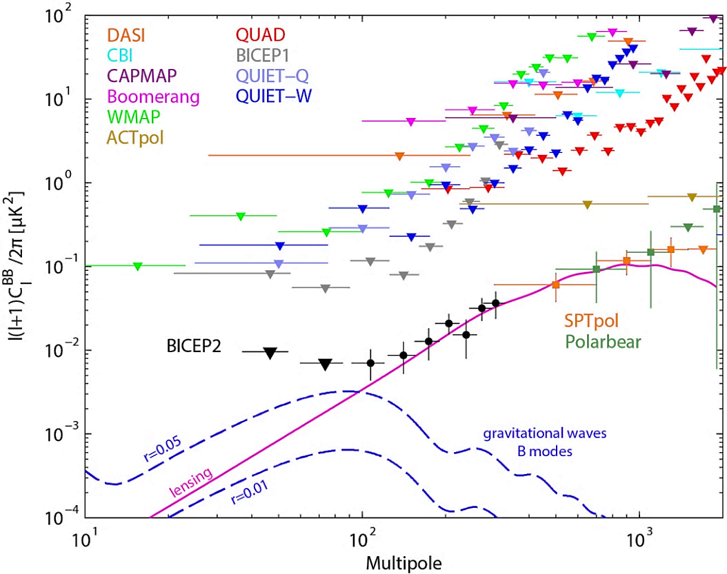
The Cosmic Microwave Background
POLARIZATION
CMB is linearly polarized at the 10% level
Theory of inflation predicts the presence of gravitational waves
signature on CMB polarization (B-modes)
Notes:
A key motivation for polarization measurements is the theory of inflation, which posits that the size of the universe expanded by an unimaginably large factor during a tiny fraction of a second at the time of the Big Bang.
prediction of inflation is that it would produce a background of gravitational waves. These gravitational waves are too faint to directly detect today, but they can be observed through their signature on the CMB polarization.
Models of inflation predict that gravitational waves will source B modes at angular scales of a degree or larger, but they don’t predict the amplitude, which we parametrize with the tensor-to-scalar ratio, r.

Slide 5
The Large Scale Polarization Explorer
OBJECTIVES
Search for polarization B-modes of the Cosmic Microwave Background
Produce wide maps of foreground polarization generated by synchrotron and interstellar dust emissions
INSTRUMENTS
SWIPE: balloon-borne instrument (140 – 220 – 240 GHz)
STRIP: ground-based telescope (43 – 90 GHz)

Slide 6

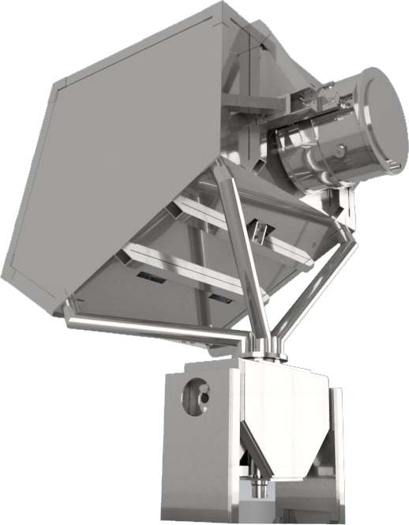
The STRIP instrument
Ground-based experiment in Tenerife
  2 years observation
  Sky coverage ∼25%
Two arrays of coherent receivers

Slide 7
The STRIP instrument
49 polarimeters in the Q-band (43 GHz)
  CMB polarization
  Polarized synchrotron emission
6 polarimeters in the W-band (95 GHz)
  Track amount of water vapour
  Characterize atmosphere in Tenerife

Slide 8

The Optical System

Slide 9
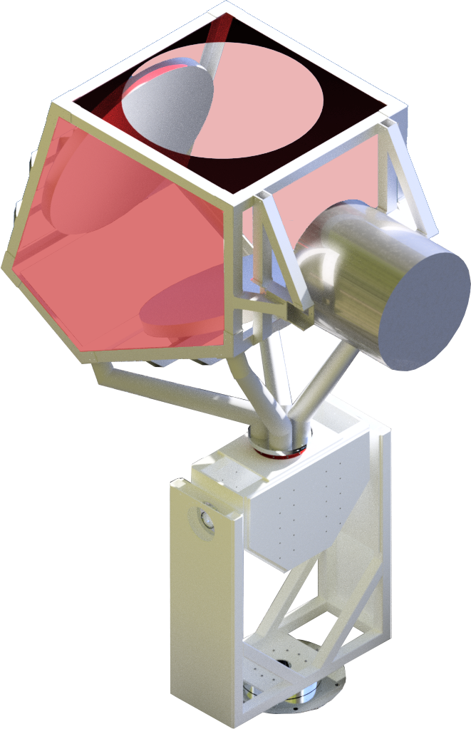
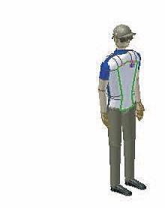
The Optical System: the Telescope
3-AXES TELESCOPE MOUNT
Fully rotating azimuth axis at 1 r.p.m.
Elevation axis fixed at 20°
Boresight axis (fixed)
OPTICS
Crossed-Dragone configuration with 1.5 m aperture
F/# = 1.8
Comoving baffle

Slide 10
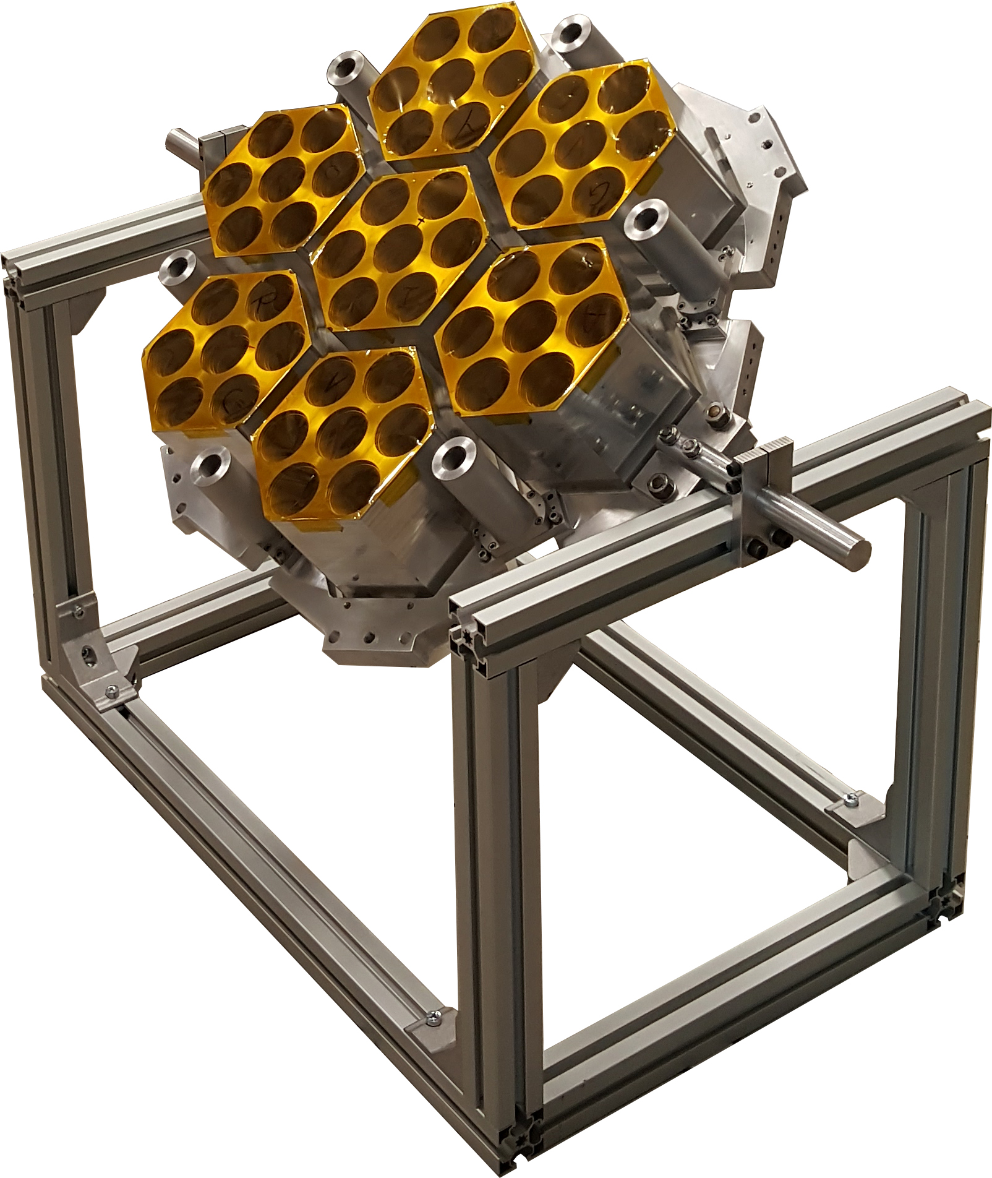
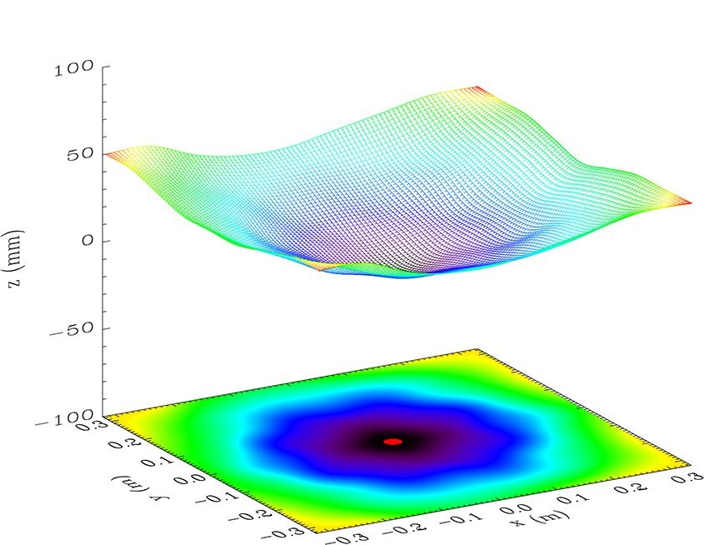
The Optical System: the Focal Plane
FOCAL PLANE UNIT
Focal surface evaluation
Corrugated feedhorns

Slide 11
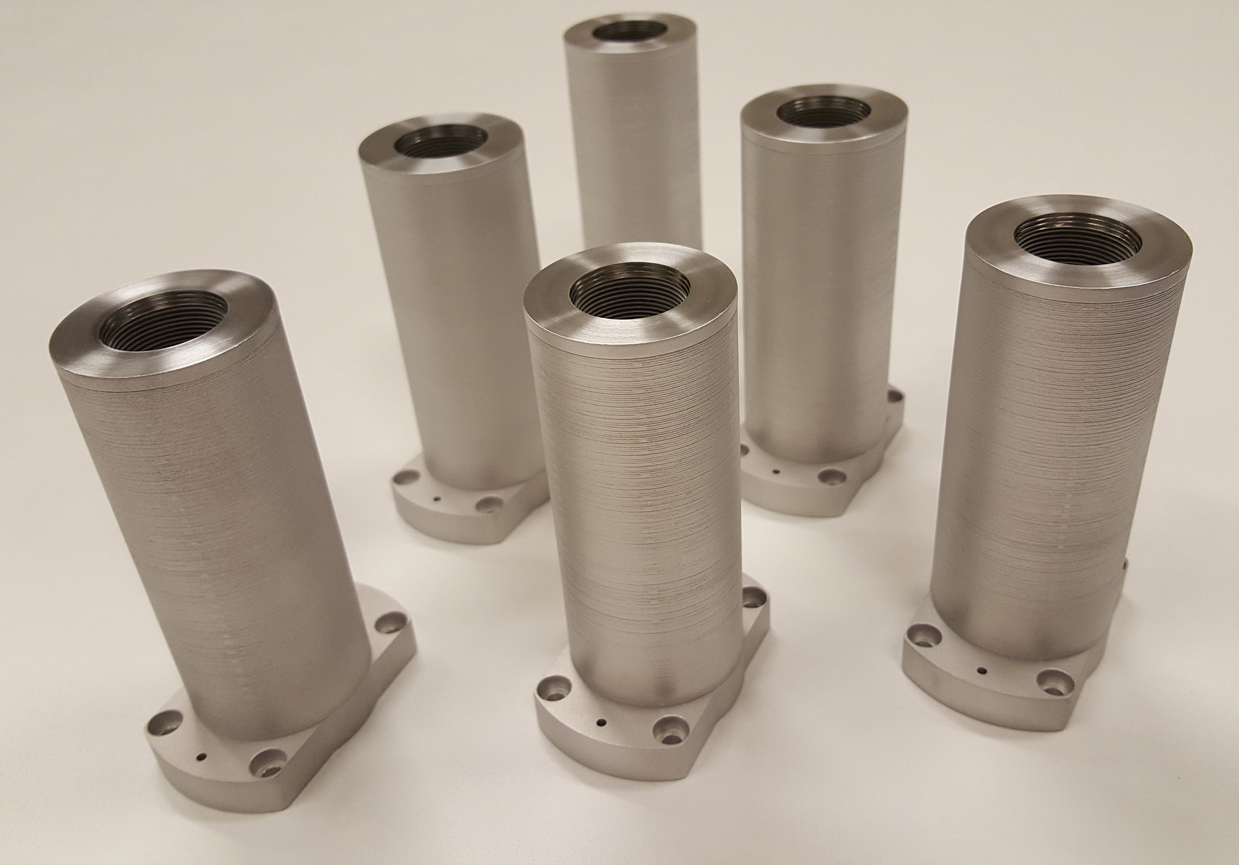
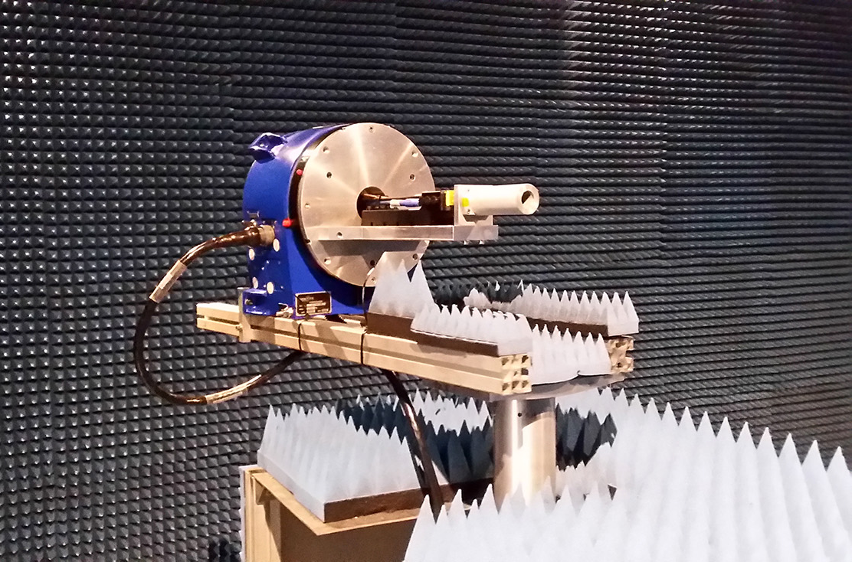
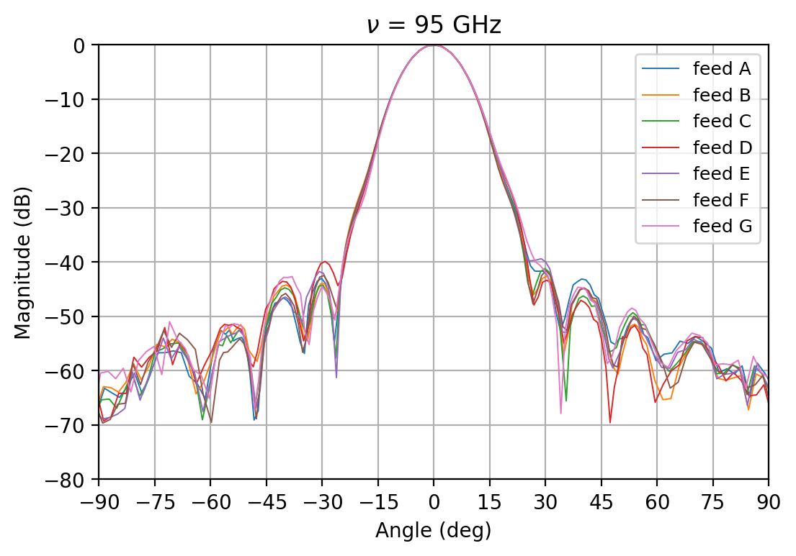
The Optical System: the Focal Plane
W-BAND FEEDHORNS MEASUREMENT
Six dual-profiled corrugated horns
Platelet technique engineering
Performance requirements
  Center frequency f₀ = 95 GHz
  Return loss < -30 dB
  Cross-polarization < -35 dB
  Sidelobes level < -25 dB
  Main beam ellipticity < 1%
…setup in anechoic chamber…
E-plane of W-band feedhorns at 95 GHz

Slide 12
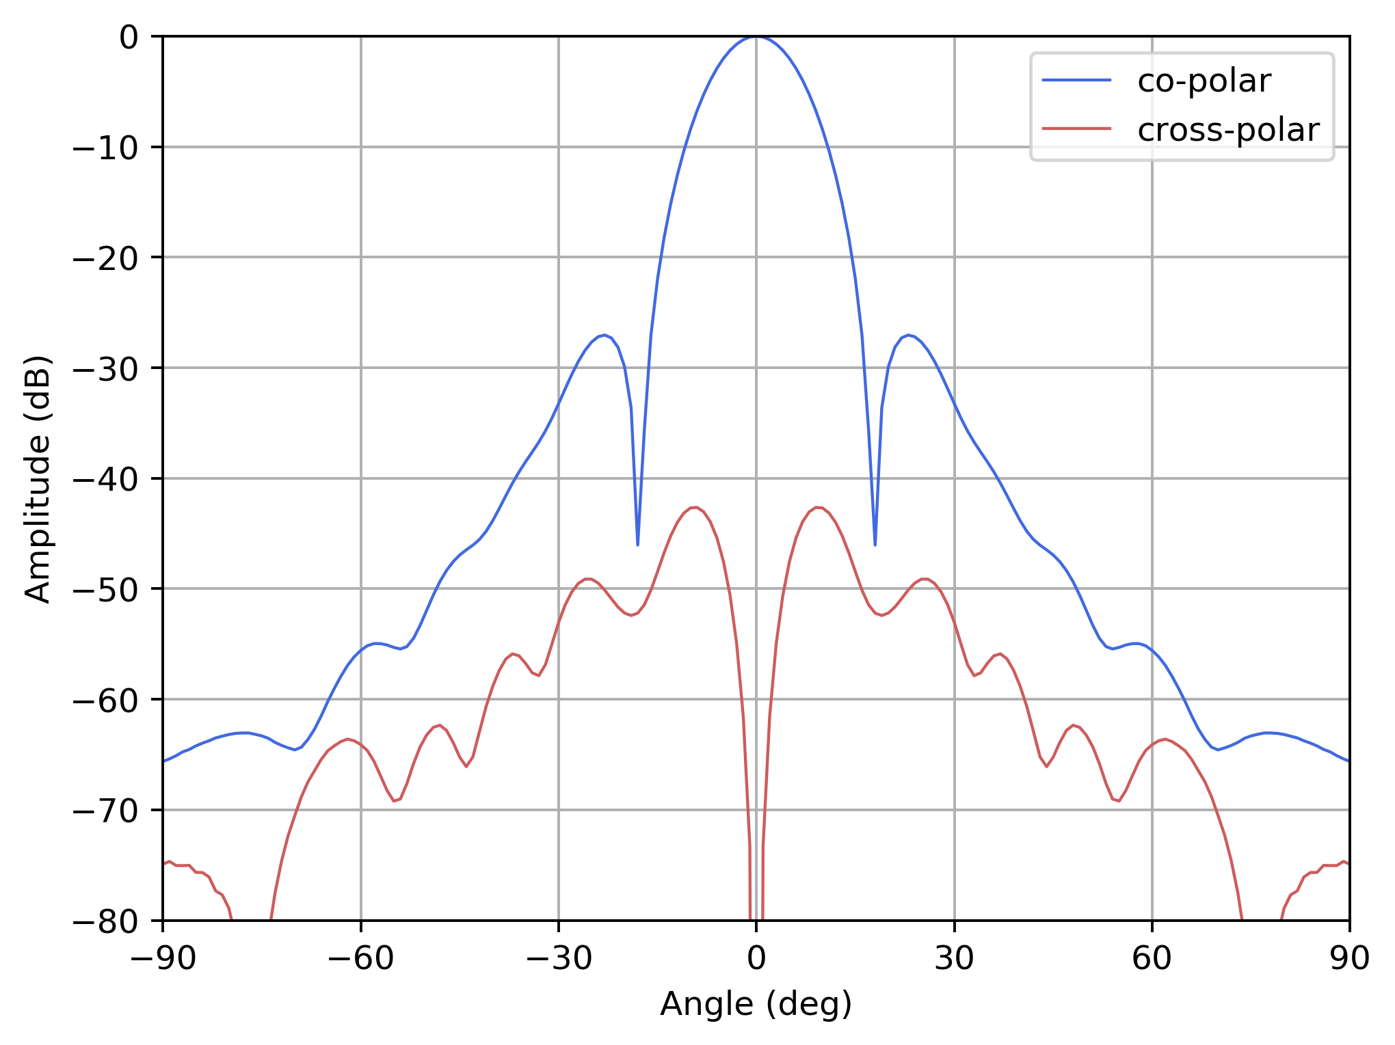
The Optical System: the Radiation Pattern
RADIATION PATTERN
Main beam
Sidelobes (near & far)
Cross-polarization
z
ϑ
r
y
x
ϕ

Slide 13
Performance Analysis

Slide 14
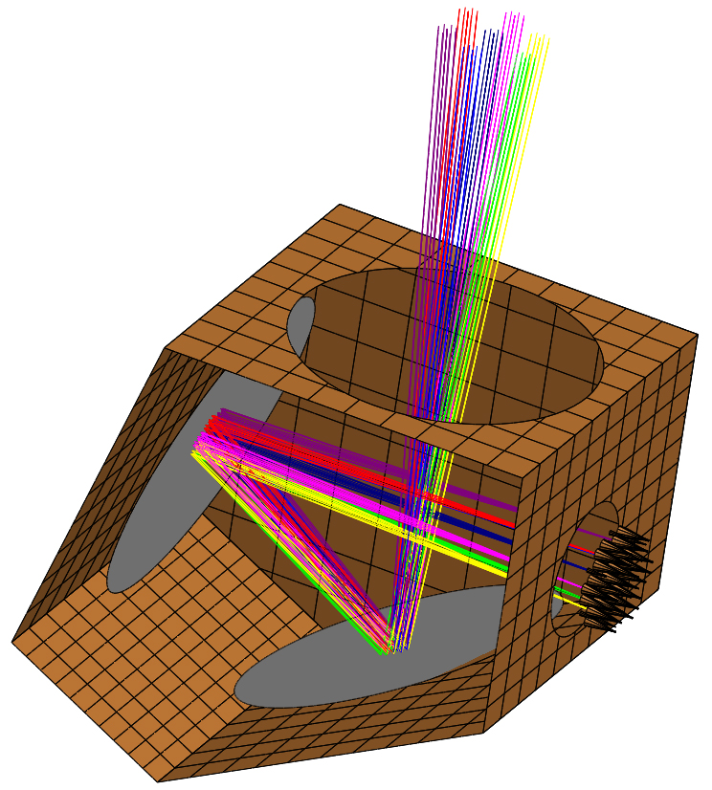
Performance Analysis: Optics Model
OPTICS MODEL with TICRA® GRASP
Focal plane unit
  49 Q-band corrugated feedhorns
  6 W-band corrugated feedhorns
Main and sub reflector
Comoving baffle

Slide 15
Performance Analysis: Optics Model
ELECTROMAGNETIC SIMULATIONS
Main beam (PO/PTD)
Sidelobes (MrGTD)

Slide 16
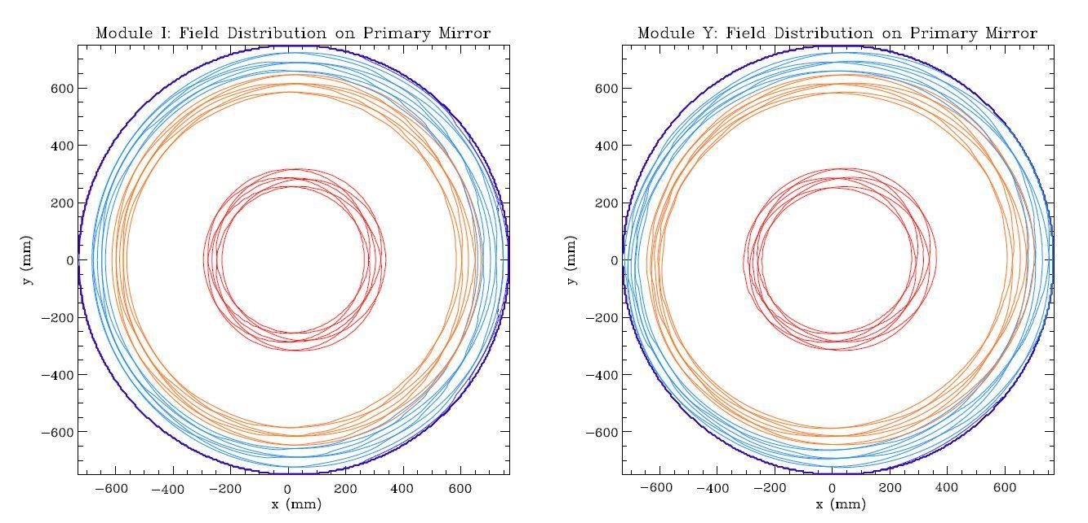
Performance Analysis: Field Distribution
FIELD DISTRIBUTION
Edge taper curves
Notes:
The contour plots of the total amplitude field incident on the main reflector in a surface grid with 301X301 points. The mirror illumination is roughly elliptical, then the field amplitude on the primary mirror rim is not constant. The edge tapers curves are reported in figure.

Slide 17
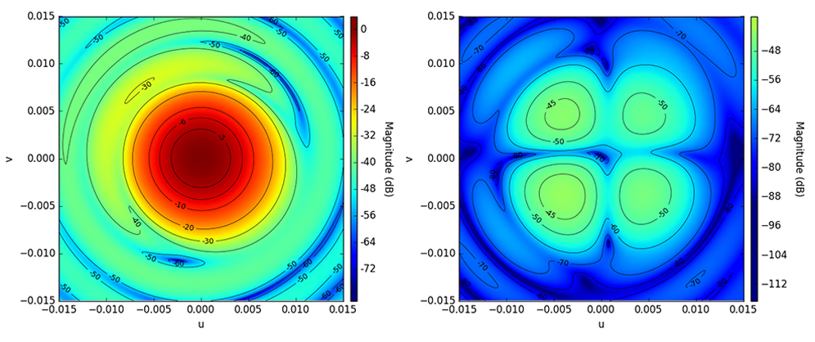
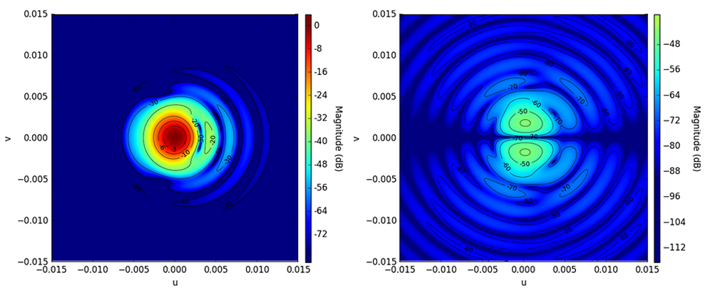
Performance Analysis: Main Beams
MAIN BEAMS
49 beams at 43.5 GHz
6 beams at 95 GHz
PARAMETERS
Angular resolution (FWHM)
Ellipticity
Directivity
Cross-polarization
copolar (Q-band)
cross-polar (Q-band)
copolar (W-band)
cross-polar (W-band)
Notes:
The contour plots of the total amplitude field incident on the main reflector in a surface grid with 301X301 points. The mirror illumination is roughly elliptical, then the field amplitude on the primary mirror rim is not constant. The edge tapers curves are reported in figure.

Slide 18
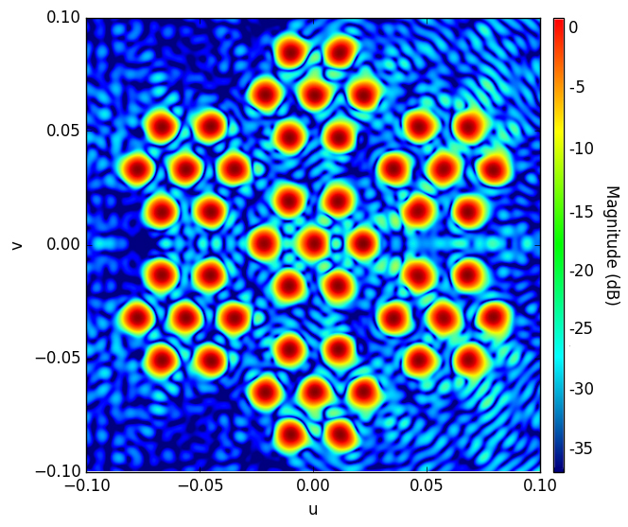
Performance Analysis: Main Beams
Q-BAND
FWHM ≈ 21 arcmin
Ellipticity 1.003 – 1.033
Directivity ≈ 54.7 dBi
Cross-polarization < -40 dB
Notes:
Very uniform

Slide 19
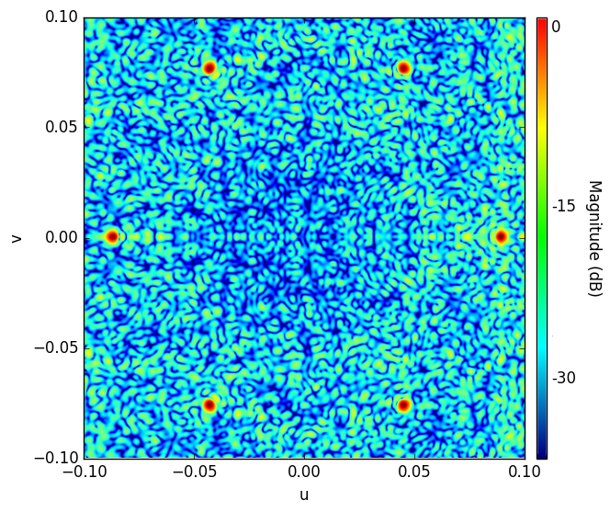
Performance Analysis: Main Beams
W-BAND
FWHM ≈ 9.5 arcmin
Ellipticity 1.006 – 1.041
Directivity ≈ 61.4 dBi
Cross-polarization < -40 dB
Notes:
The contour plots of the total amplitude field incident on the main reflector in a surface grid with 301X301 points. The mirror illumination is roughly elliptical, then the field amplitude on the primary mirror rim is not constant. The edge tapers curves are reported in figure.

Slide 20
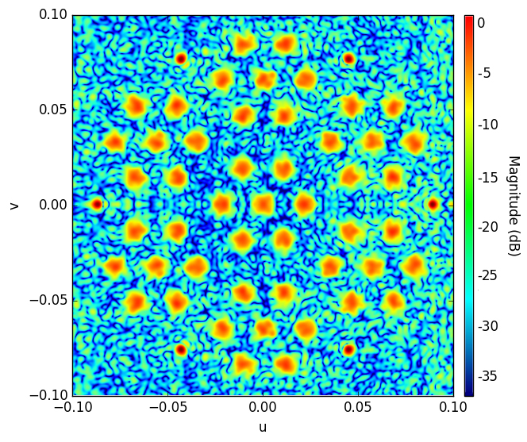
Performance Analysis: Main Beams
Notes:
The contour plots of the total amplitude field incident on the main reflector in a surface grid with 301X301 points. The mirror illumination is roughly elliptical, then the field amplitude on the primary mirror rim is not constant. The edge tapers curves are reported in figure.

Slide 21
Performance Analysis: Main Beams
10°
Notes:
The contour plots of the total amplitude field incident on the main reflector in a surface grid with 301X301 points. The mirror illumination is roughly elliptical, then the field amplitude on the primary mirror rim is not constant. The edge tapers curves are reported in figure.

Slide 22
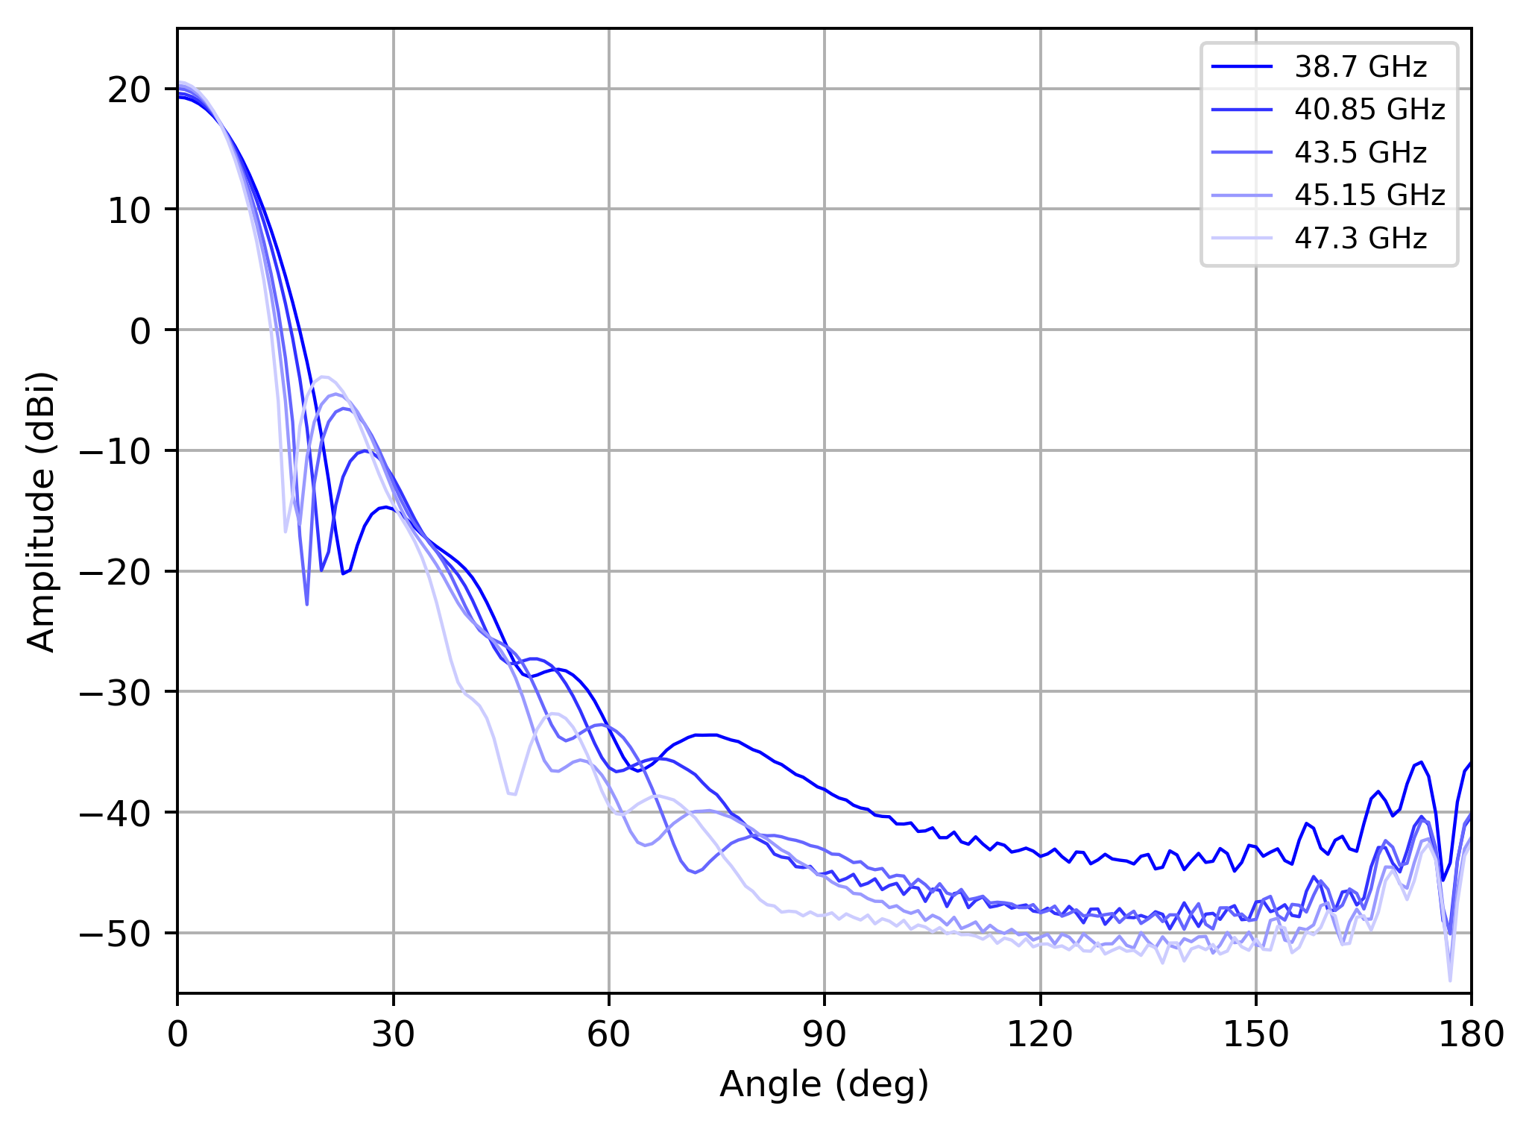
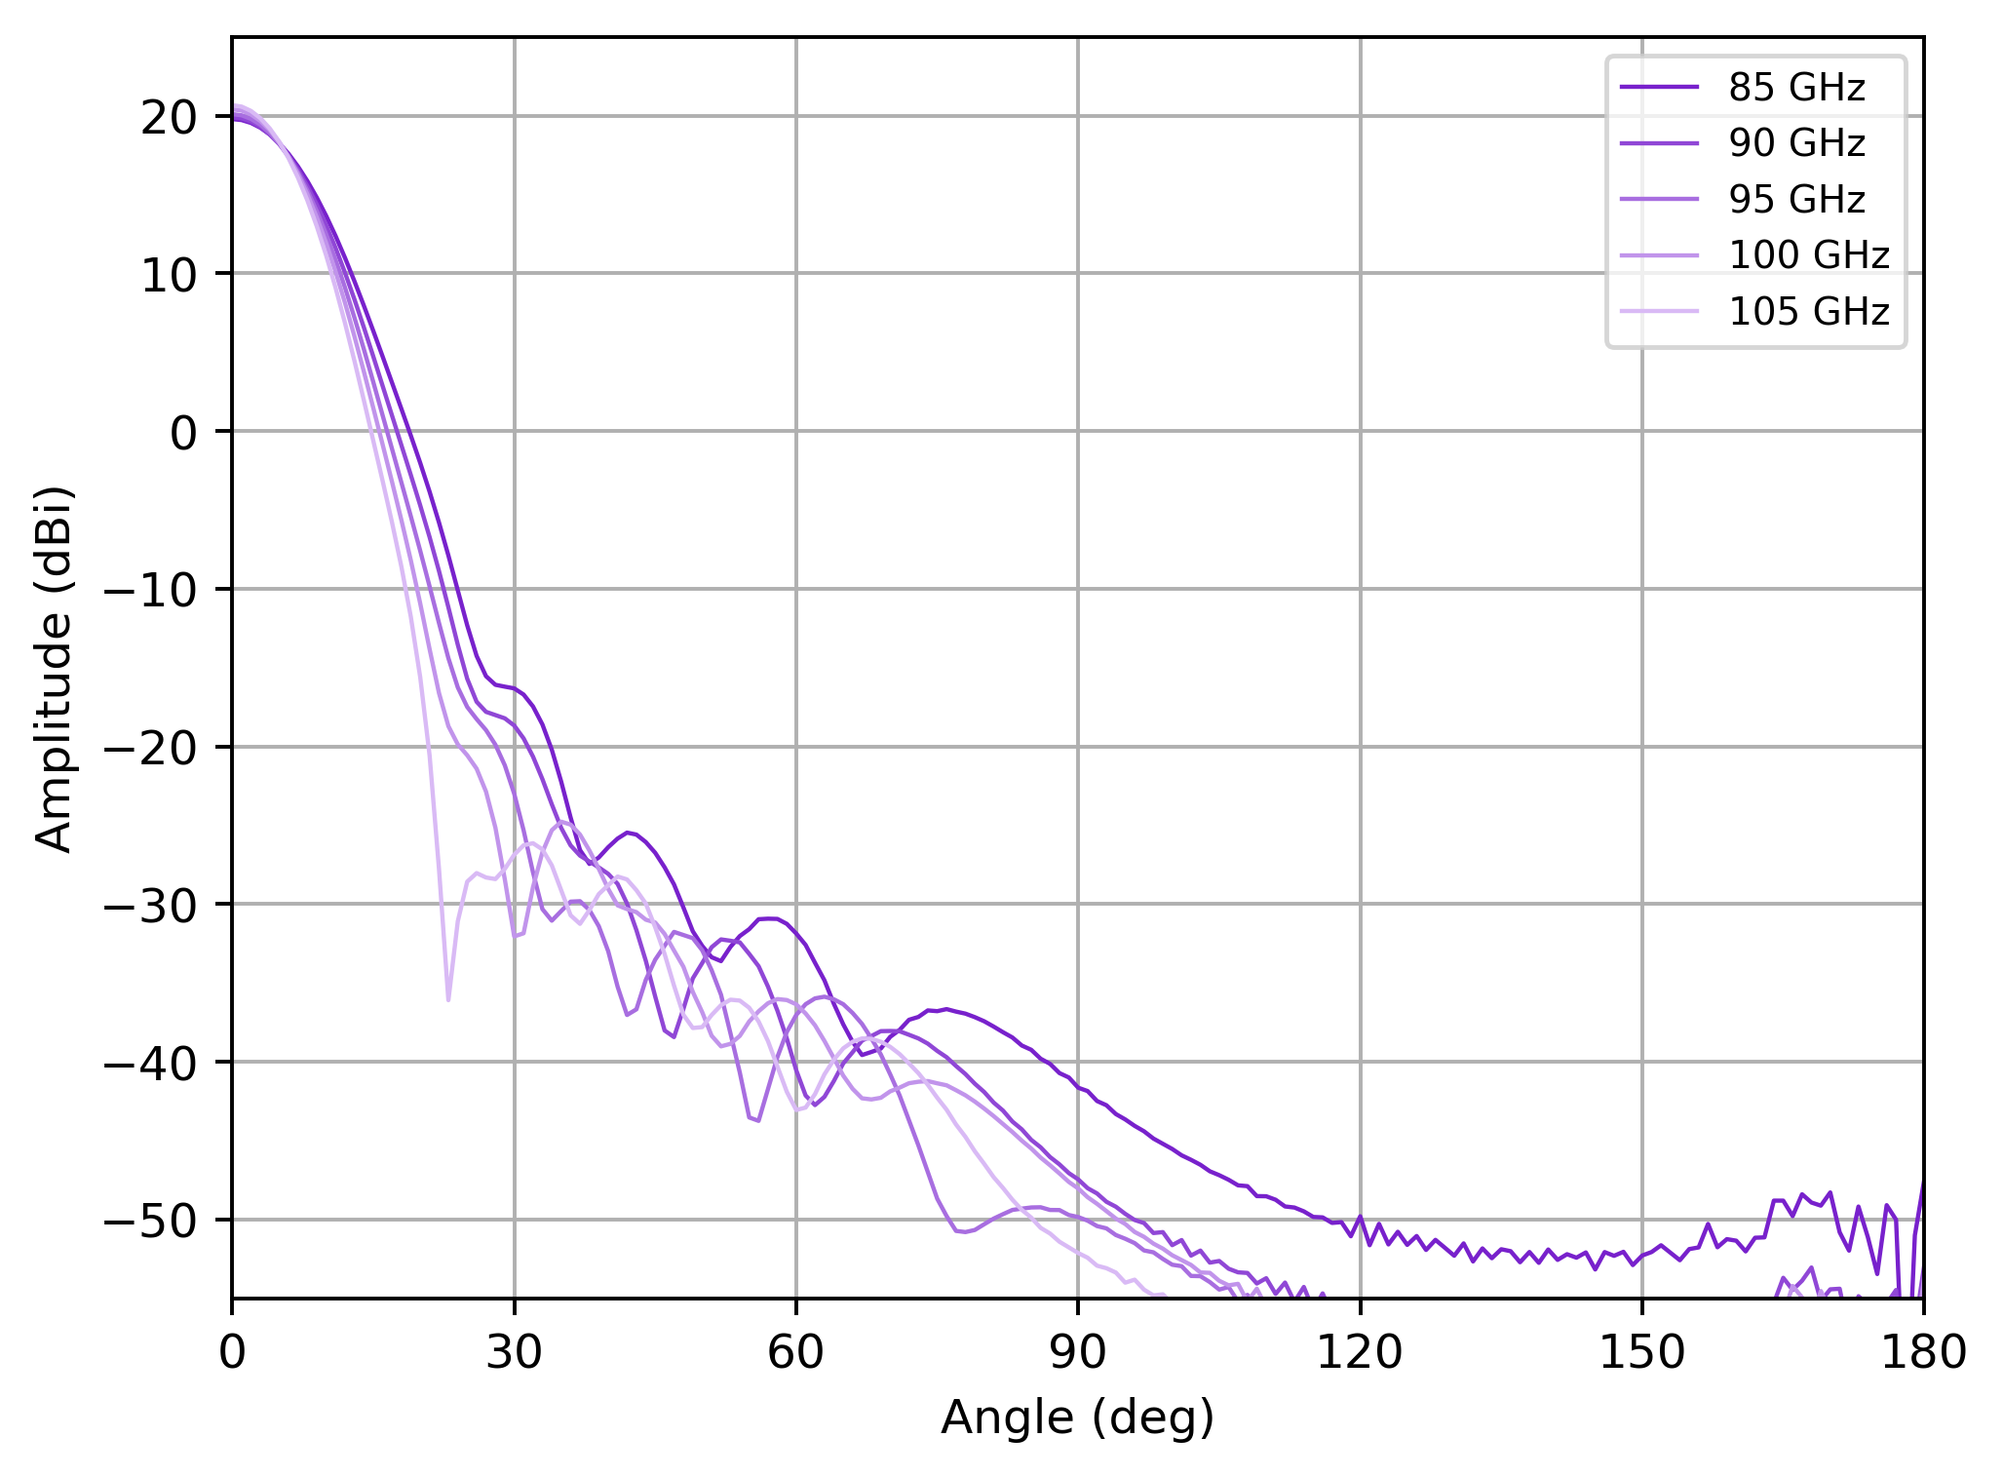
Performance Analysis: Main Beams
MAIN BEAMS IN THE BANDWIDTH
Radiation pattern changes with frequency
Notes:
The contour plots of the total amplitude field incident on the main reflector in a surface grid with 301X301 points. The mirror illumination is roughly elliptical, then the field amplitude on the primary mirror rim is not constant. The edge tapers curves are reported in figure.

Slide 23
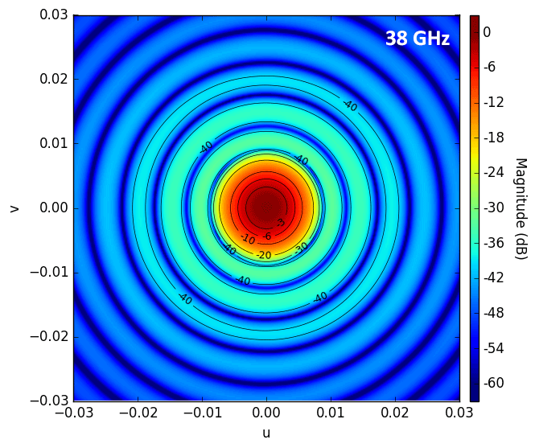
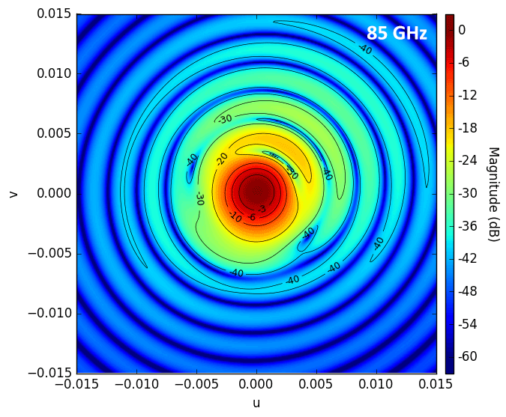
Performance Analysis: Main Beams
MAIN BEAMS IN THE BANDWIDTH
Q-band: 38 - 41 - 43 - 45 -47 GHz
W-band: 85 - 90 - 95 -100 - 105 GHz
copolar (Q-band)
copolar (W-band)
Notes:
The contour plots of the total amplitude field incident on the main reflector in a surface grid with 301X301 points. The mirror illumination is roughly elliptical, then the field amplitude on the primary mirror rim is not constant. The edge tapers curves are reported in figure.

Slide 24
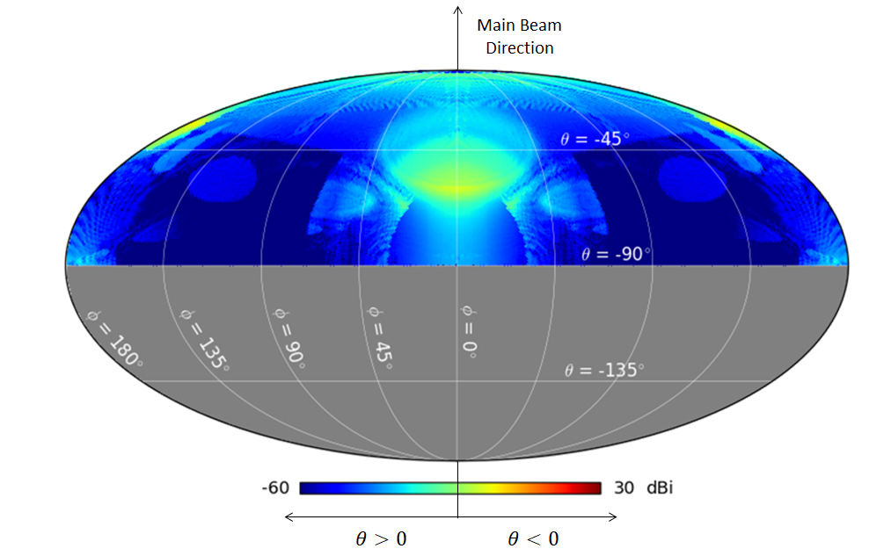
Performance Analysis: Sidelobes
SIDELOBES
4π beam pattern at 43.5 GHz for 4 representative feedhorns up to the 3° order of interaction (reflection or diffraction)
REQUIREMENTS
Near lobes < -55 dB
Far lobes < -65 dB
Not satisfyed in two areas
Notes:
The contour plots of the total amplitude field incident on the main reflector in a surface grid with 301X301 points. The mirror illumination is roughly elliptical, then the field amplitude on the primary mirror rim is not constant. The edge tapers curves are reported in figure.

Slide 25
Performance Analysis: Sidelobes
SIDELOBES
4π beam pattern at 43.5 GHz for 4 representative feedhorns up to the 3° order of interaction (reflection or diffraction)
REQUIREMENTS
Near lobes < -55 dB
Far lobes < -65 dB
Not satisfyed in two areas
direct
spillover
Notes:
The contour plots of the total amplitude field incident on the main reflector in a surface grid with 301X301 points. The mirror illumination is roughly elliptical, then the field amplitude on the primary mirror rim is not constant. The edge tapers curves are reported in figure.

Slide 26
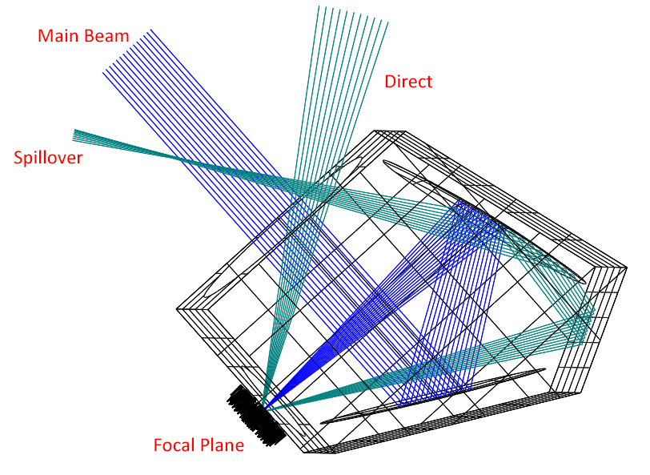
Performance Analysis: Sidelobes
MAIN CONTRIBUTIONS
Direct contribution: rays entering the feedhorns without any interaction with the reflectors
Spillover: rays reflected by one of the shields and then reflected by the sub-reflector

Slide 27
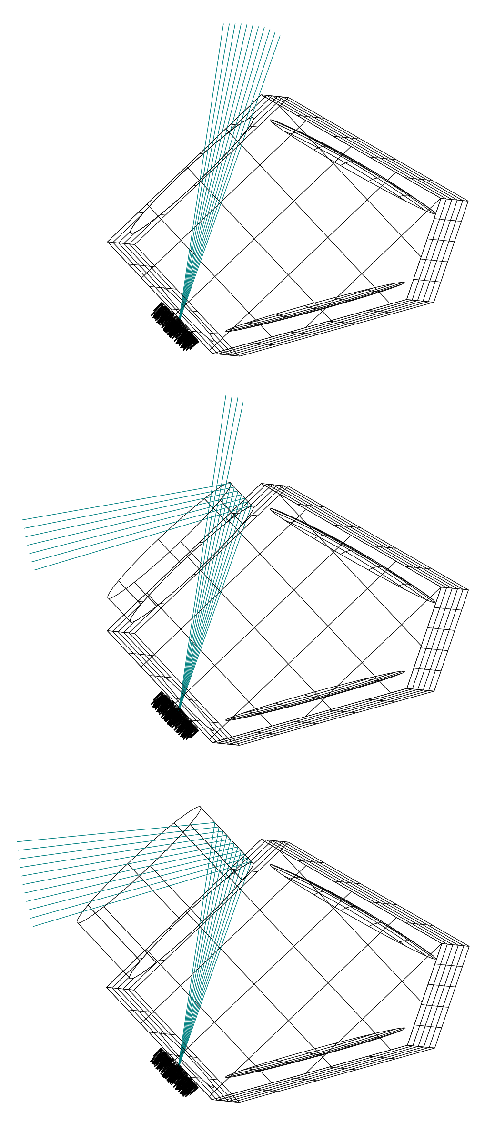
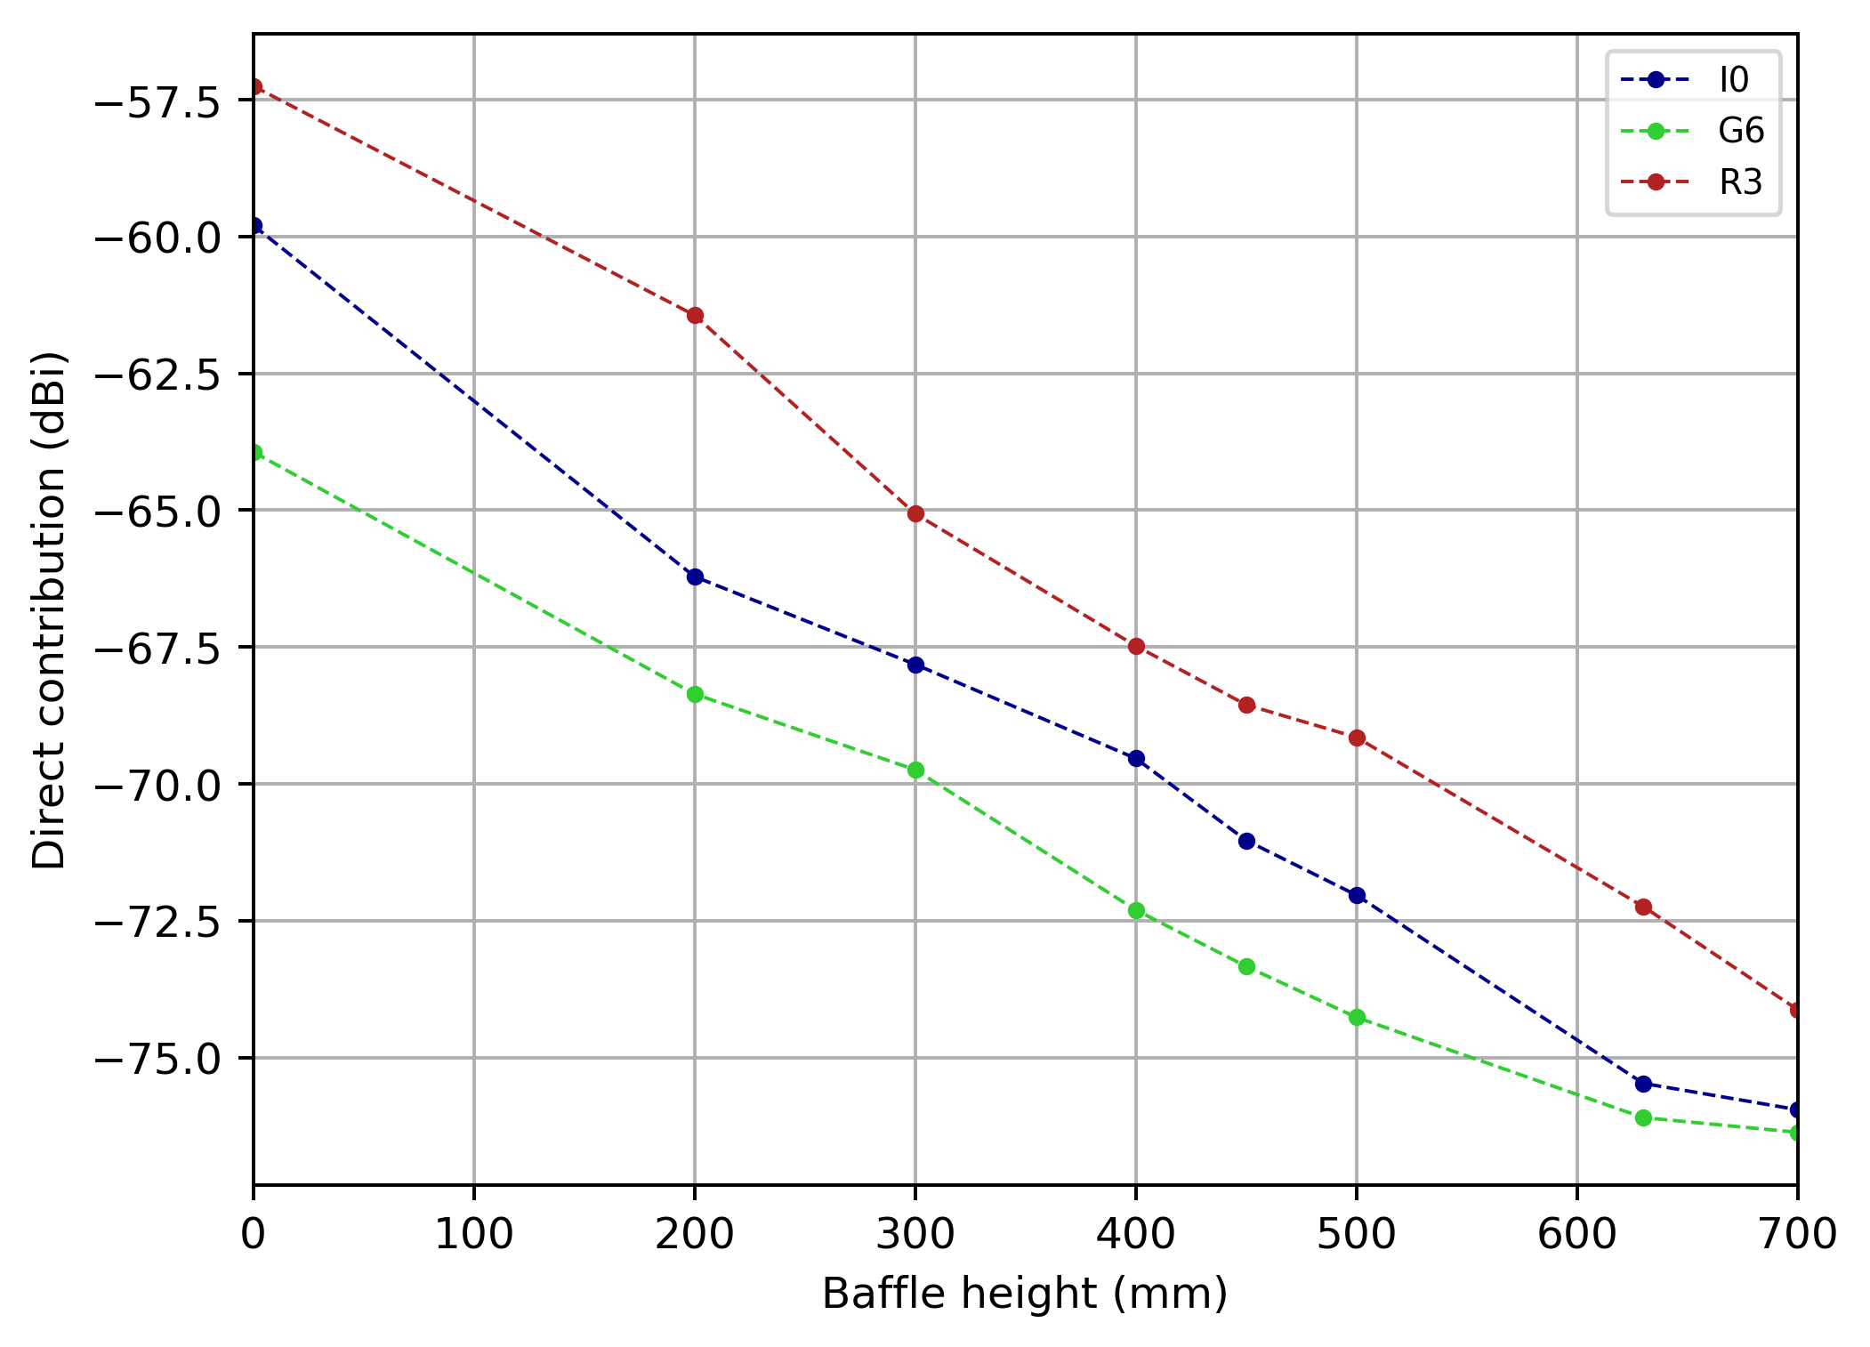
Performance Analysis: Sidelobes
FOREBAFFLE ANALYSIS
Cylindrical surface to change direct contribution level

Slide 28
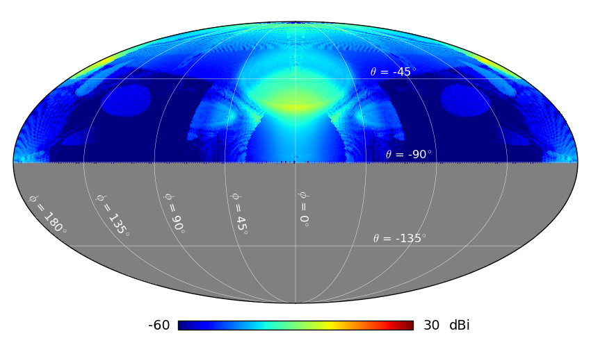
Performance Analysis: Sidelobes
FOREBAFFLE ANALYSIS
Increasing complexity of angular response

Slide 29

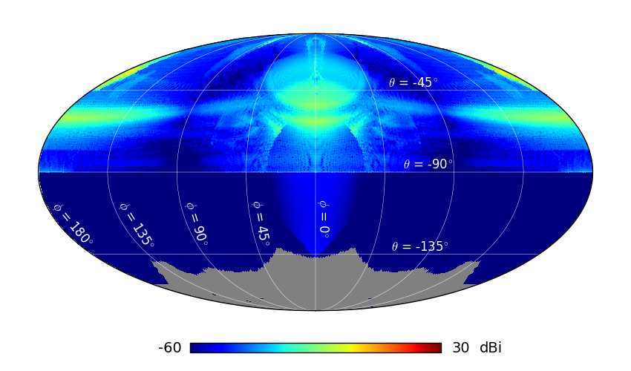
Performance Analysis: Sidelobes
FOREBAFFLE ANALYSIS
Increasing complexity of angular response

Slide 30
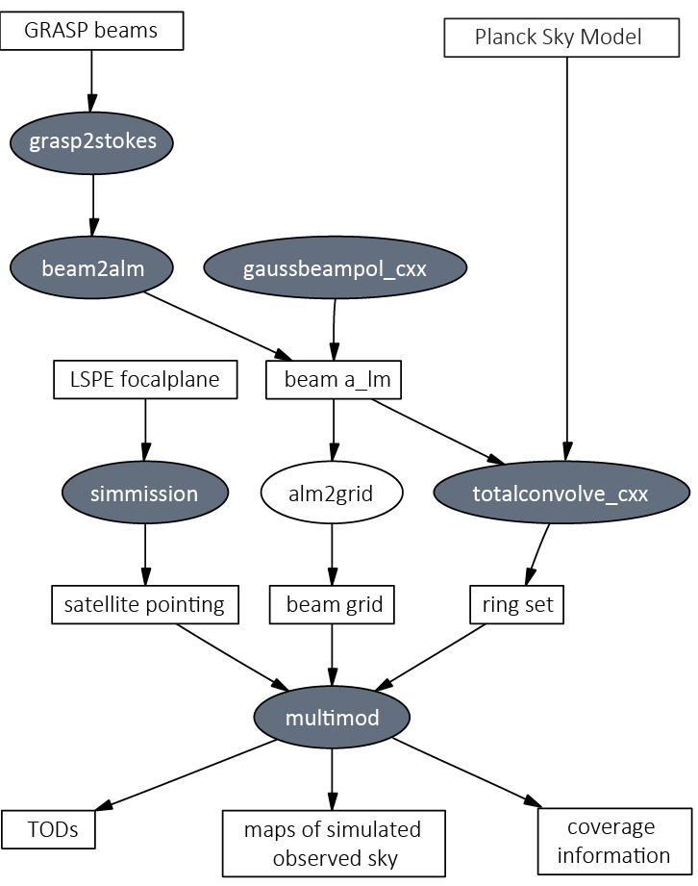
Future Work
IMPACT ON CMB OBSERVATIONS
STRIP LevelS simulator
  Focal plane geometry
  Scanning strategy
  Instrument pointing
  Beam response
Notes:
Valutazione effetto disallineamento

Slide 31



Future Work
IMPACT ON CMB OBSERVATIONS
STRIP LevelS simulator
  Focal plane geometry
  Scanning strategy
  Instrument pointing
  Beam response
Notes:
Valutazione effetto disallineamento

Slide 32

Future Work
IMPACT ON CMB OBSERVATIONS
STRIP LevelS simulator
  Focal plane geometry
  Scanning strategy
  Instrument pointing
  Beam response
Notes:
Valutazione effetto disallineamento

Slide 33
Analysis of the
LSPE-STRIP optical system

Slide 34
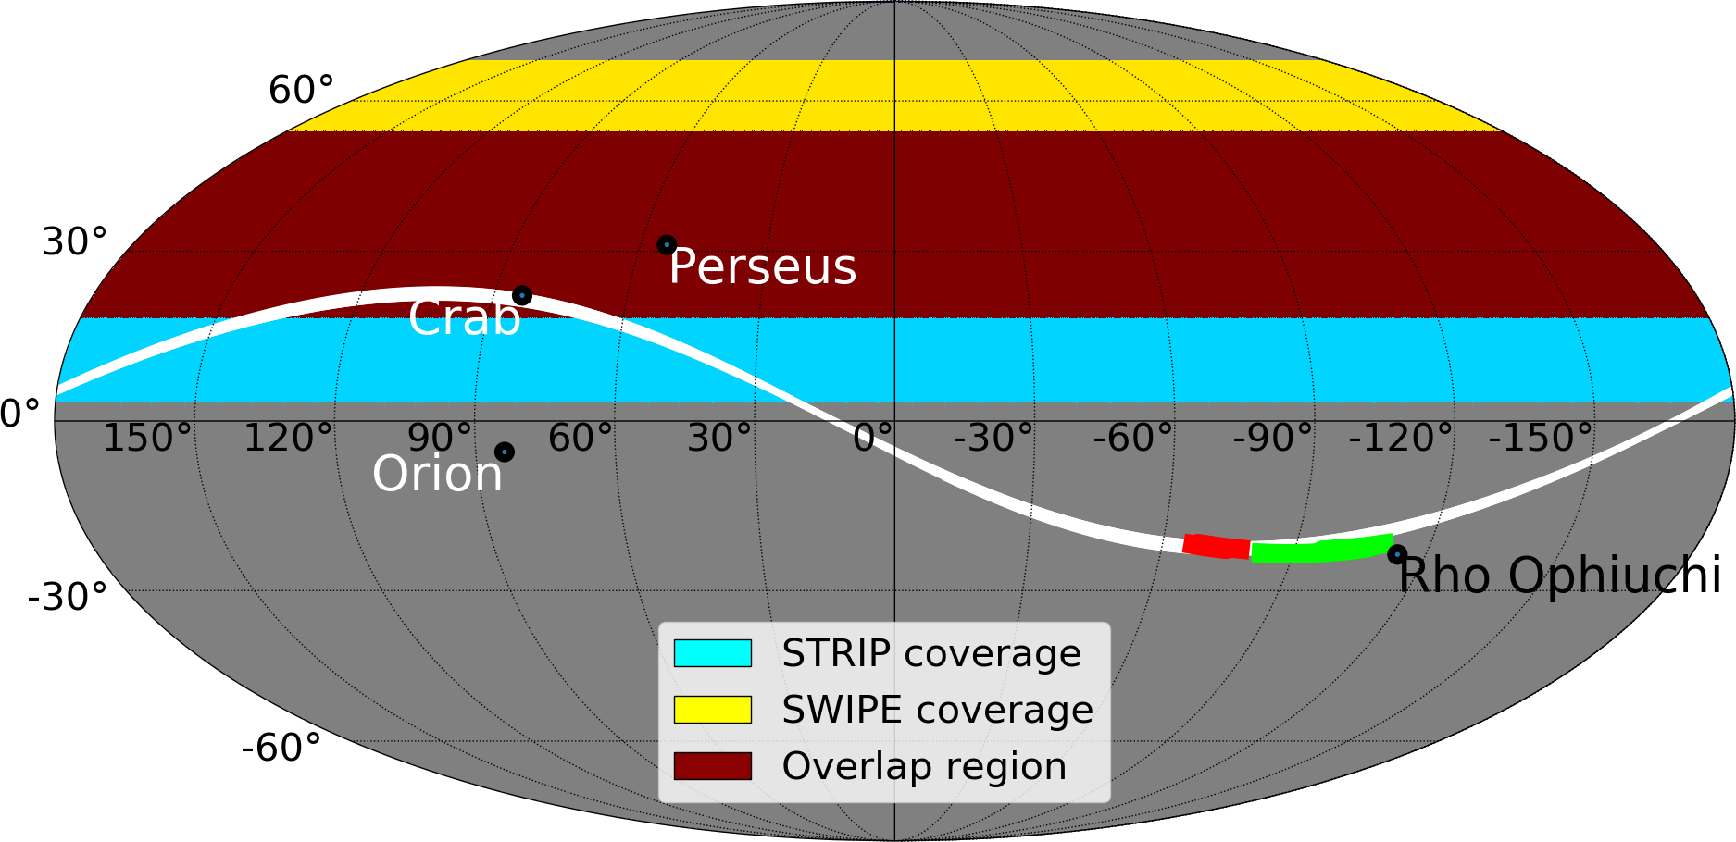
The STRIP Scanning Strategy
PRELIMINARY SCANNING STRATEGY
STRIP sky coverage with 20° elevation
STRIP/SWIPE overlap ∼ 80%
Ref.: F. Incardona, 2018

Slide 35
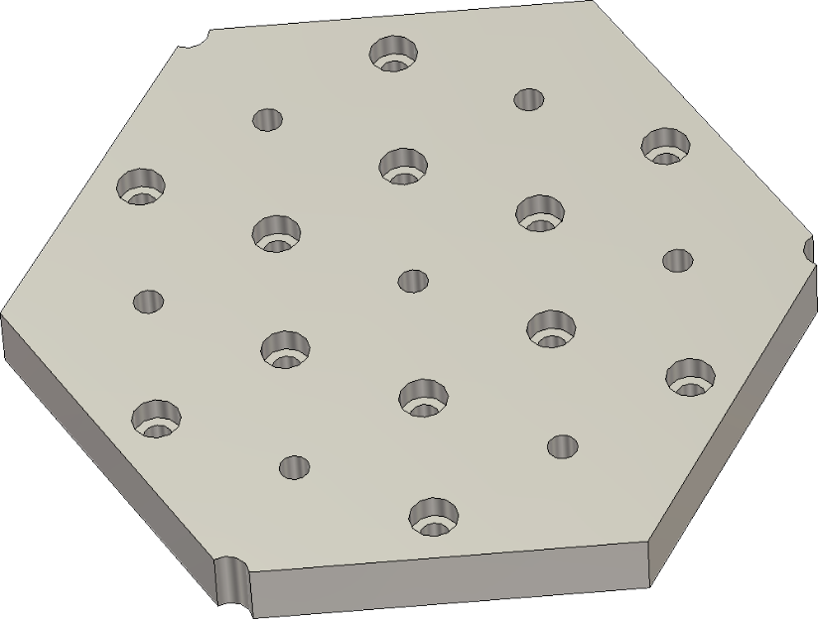
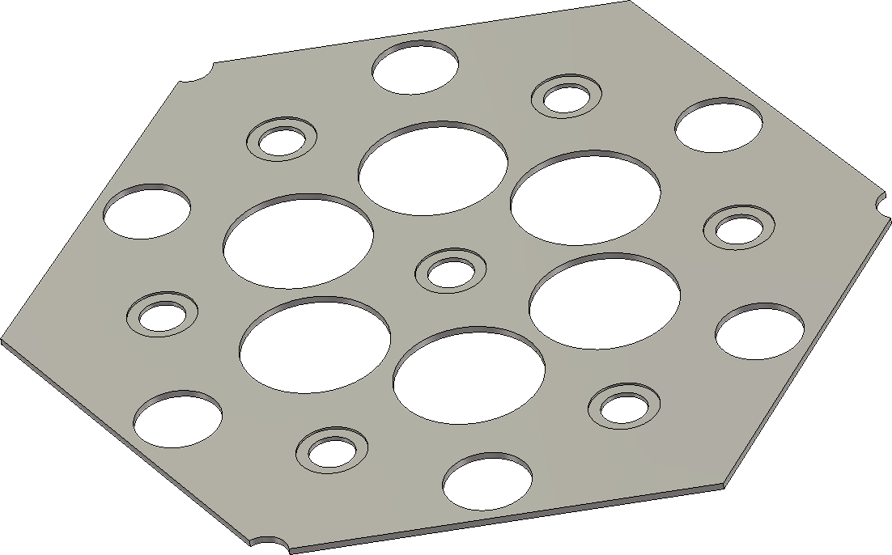
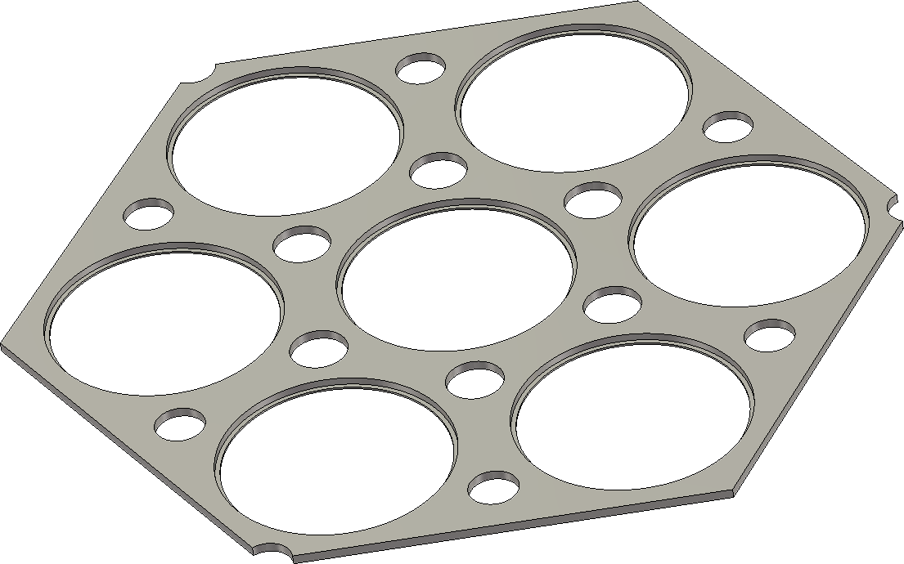
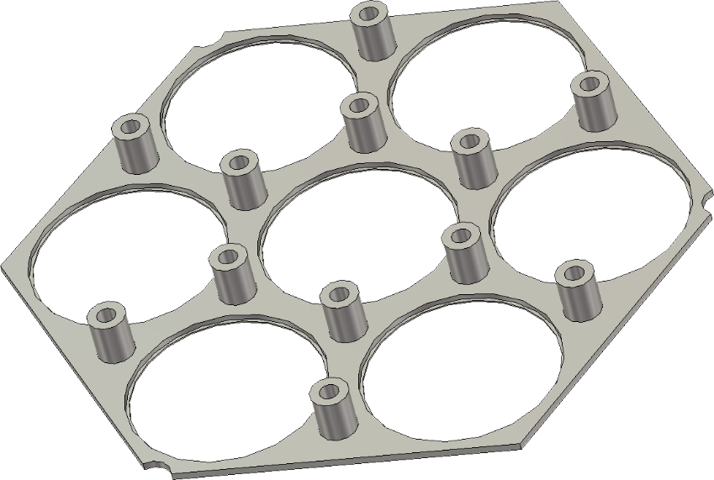
The Q-Band Passive Feed-System
Q-BAND FEEDHORN MODULES
Seven dual-profiled corrugated horn per module
Platelet technique engineering
  72 body plates
  Head plate with bolts
  12 x M6 Ergal screws (Al7075)
Performance requirements on 20% bandwidth
  Center frequency f₀ = 43 GHz
  Return loss < -30 dB
  Cross-polarization < -30 dB
  Sidelobes level < -25 dB
  Main beam ellipticity < 1%

Slide 36
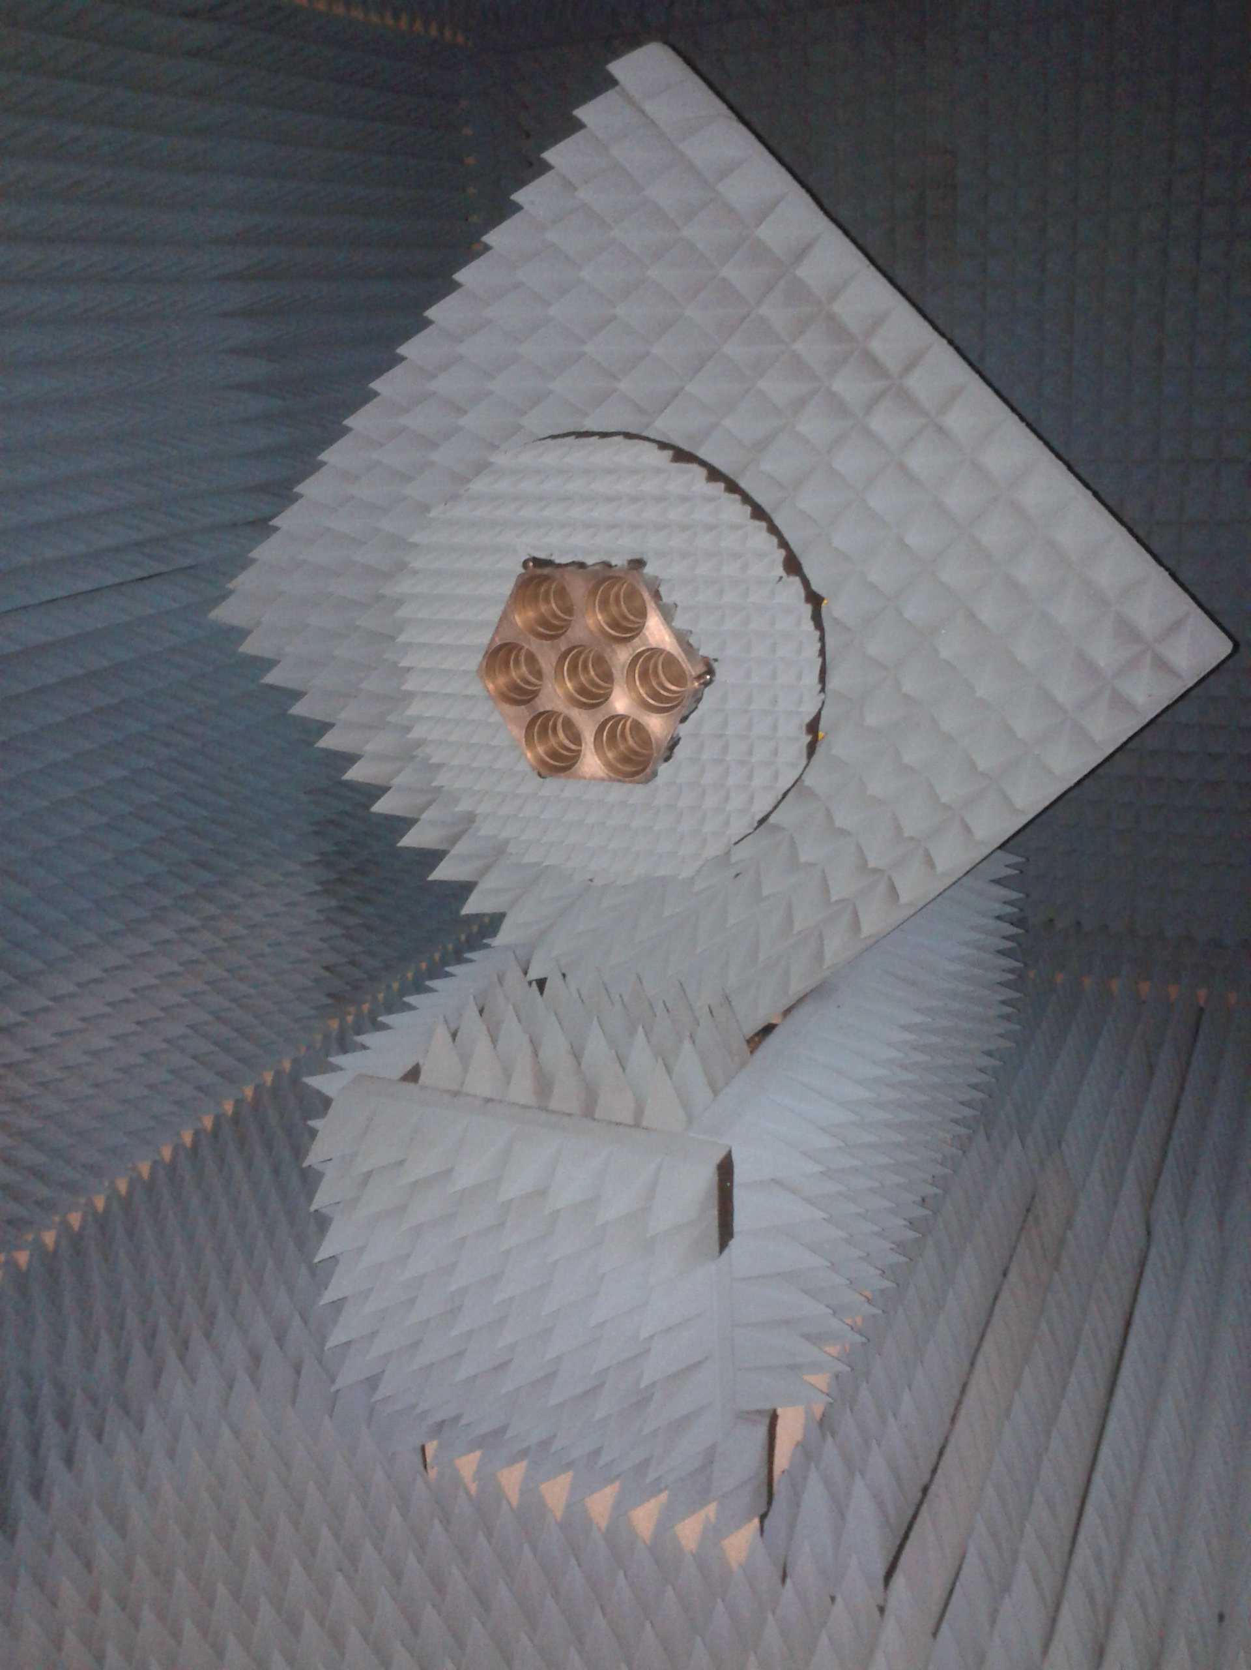
The Q-Band Passive Feed-System
Q-BAND FEEDHORN MODULES
Measurement of all 49 feedhorns at 43 GHz
Co-polar 45°plane
Cross-polar 45° plane
Radiation pattern
measurements

Slide 37
STRIP & SWIPE Frequency Coverage
Ref.: adapted from Planck Collaboration, 2015

Slide 38
Scientific Objectives & Requirements
 | Q-band | W-band
Angular resolution | at least 0.5°
Observed sky fraction | ≥ 18%
Sensitivity per 1° pixel in µK | ≤ 1.2 | ≤ 4.5

Slide 39
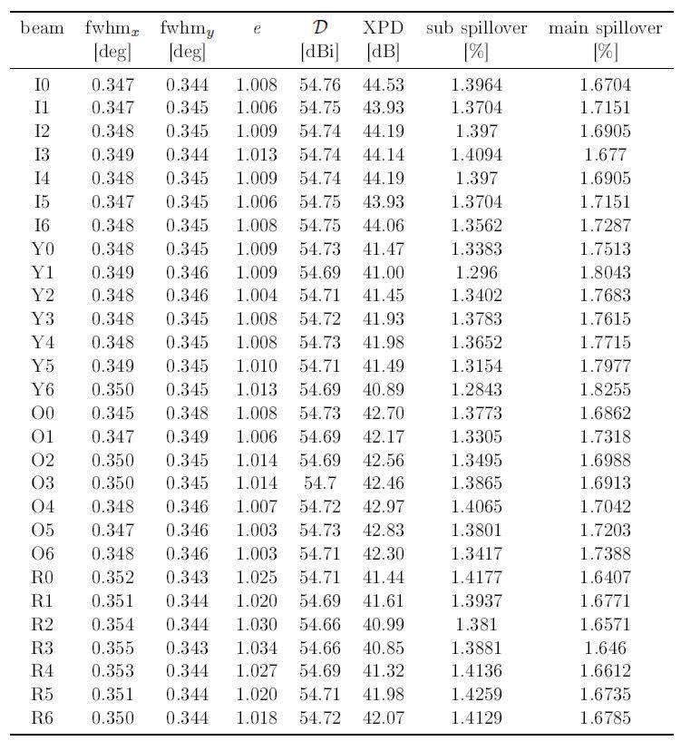
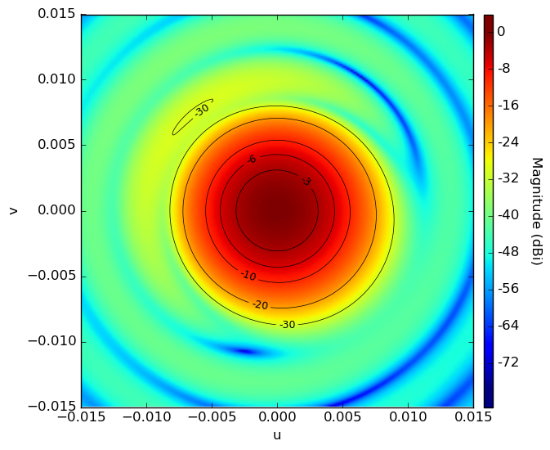
The STRIP Instrument: Optical Performance
Crossed-Dragone optics leads to very uniform and excellent beam performance
Ref.: S. Realini, 2017

Slide 40
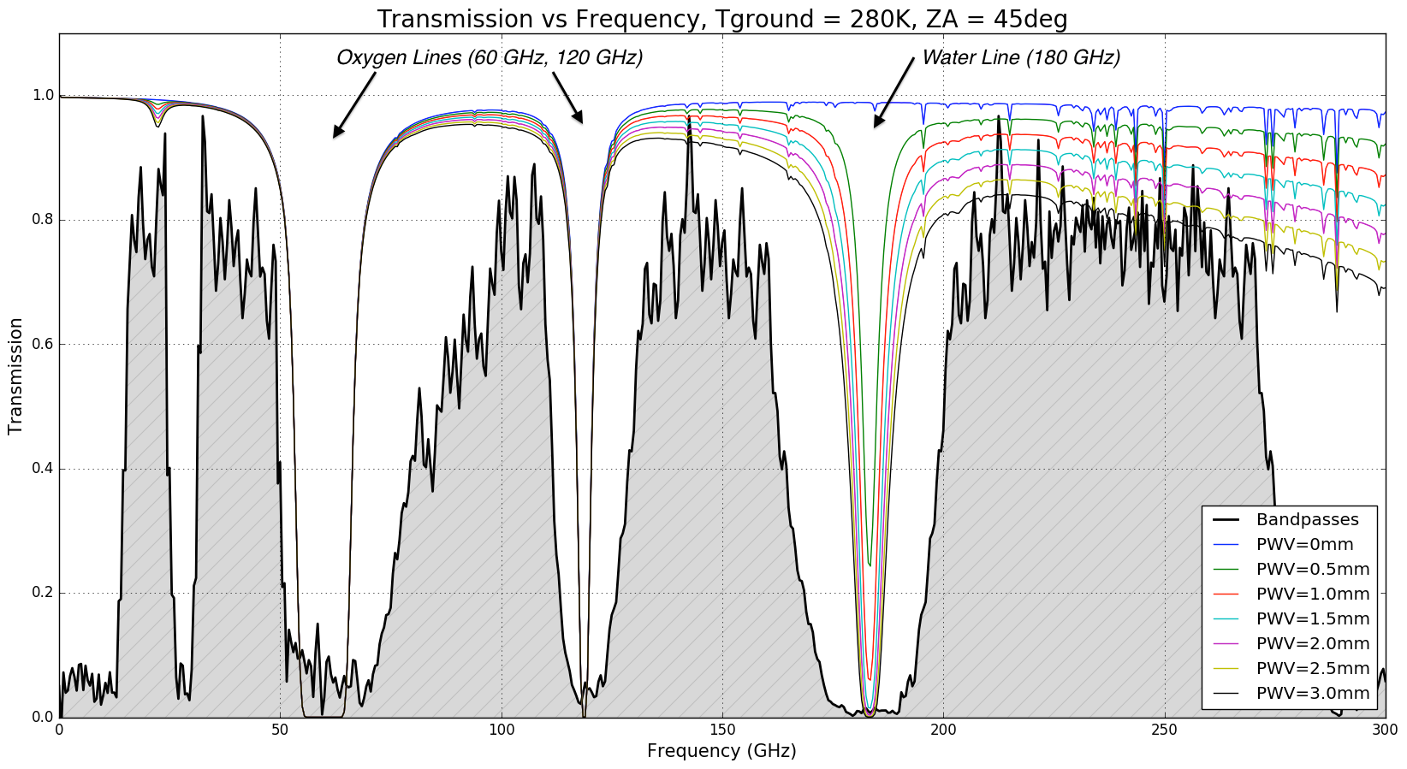
Transmission of the Atmosphere in the Millimeter Band

