Slide 1
Search for exotic particles in LHCb
1° year workshop
9th October 2018
Elisabetta Spadaro Norella
Supervisor: N. Neri
Università di Milano
and INFN Milano

Slide 2
Outline
Search for pentaquarks and glueball in B⁰_{(s)}➞J/ψpp̄ decays
My current project
Observation of the decays → Branching Ratio measurement
2. Future perspectives
Amplititude analysis
Introduction

Slide 3
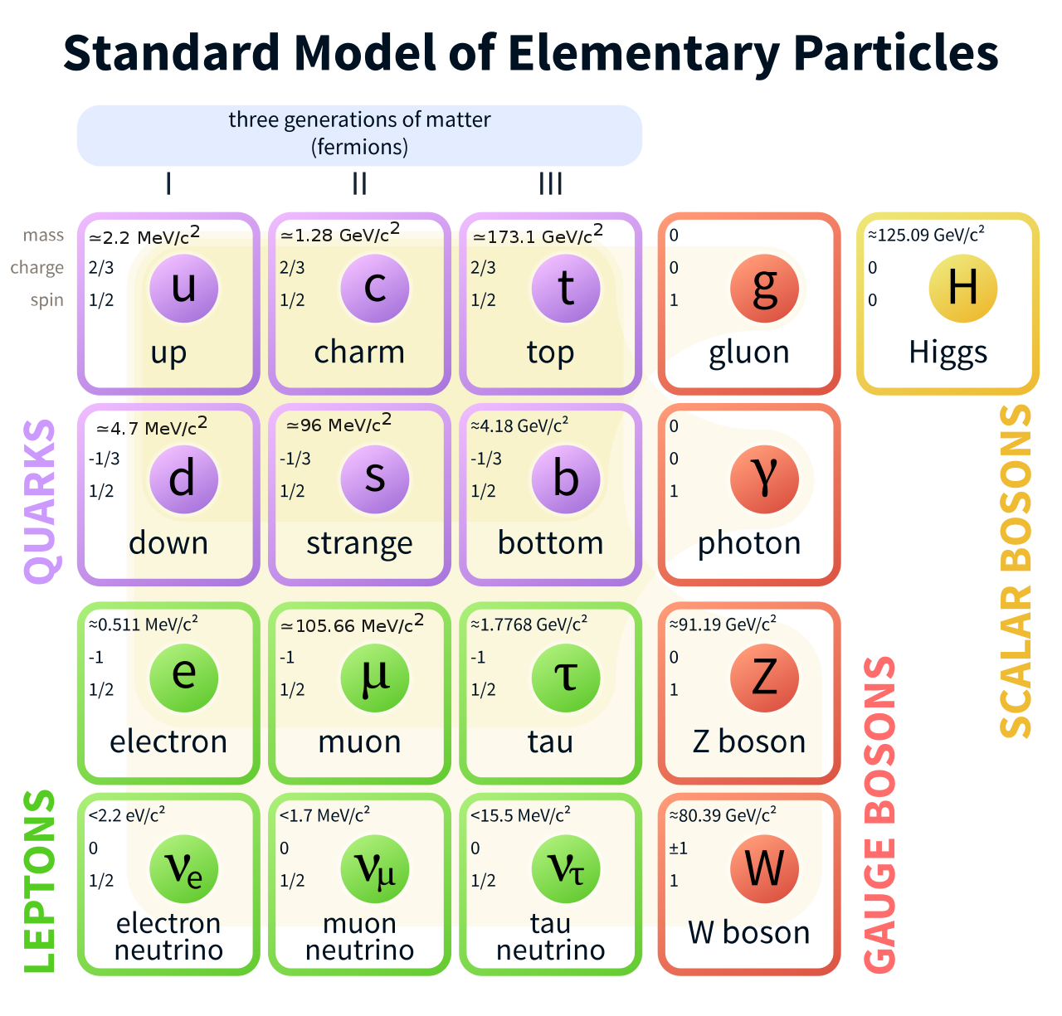
B⁰_{(s)}➞J/ψpp̄ decays
Search for rare decays sensitive to exotic structures
OZI suppression
B_{s} branching ratio could be enhanced by resonances: pentaquark and glueball
Introduction
Notes:
Amplititude: ∝ α³_{strong}

Slide 4
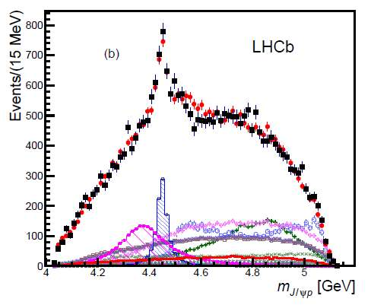
PENTAQUARK: AN UNEXPECTED DISCOVERY
Introduction
What is a Pentaquark?
Composite state of five quarks
predicted by Standard Model
2015: first observation made by LHCb:
decaying to [J/ψ p]
Amplititude fit: variation from expected phase space
But a confirmation is needed!
Phys. Rev. Lett. 115, 072001 (2015)
Introduction
MeV/c
Notes:
Discovered by LHCb in 2015 in decay of Λ_{b}➞J/ψpK [*]:
reveals the existence of 2 states: P_{c}⁺(4380) and P_{c}⁺(4450)
with J^{P} = 3/2⁺ and 5/2⁻ [*] Phys. Rev. Lett. 115, 072001 (2015)

Slide 5
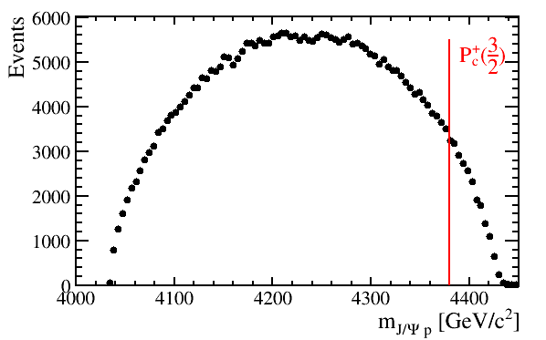
A PROMISING CANDIDATE FOR PENTAQUARK
Introduction
P_{c}⁺
Candidate for independent observation the [J/ψ p]
and [J/ψ p̄] systems
Help discriminate among different models for pentaquark
Ground state of P_{c}⁺(1/2)?
MC B⁰_{s}
P_{c}⁺(3/2)
P_{c}⁺(1/2) ?
Introduction
MeV/c

Slide 6
GLUEBALL: THEORETICAL PREDICTION
Introduction
Glueball: composite state of gluons
predicted by SM but never observed
resonant state f_{j}(2220) → pp̄ for the B_{s} [*]
[*] Eur. Phys. J. C75 (2015), no. 3 101
Peak at 2,2 GeV
Seen as an enhancement in Branching Ratio
Limit on BR to:
Introduction
MeV/c

Slide 7
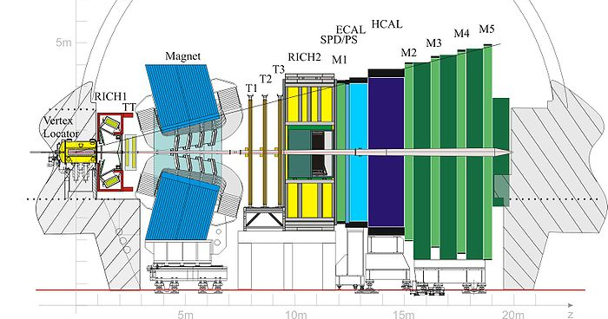
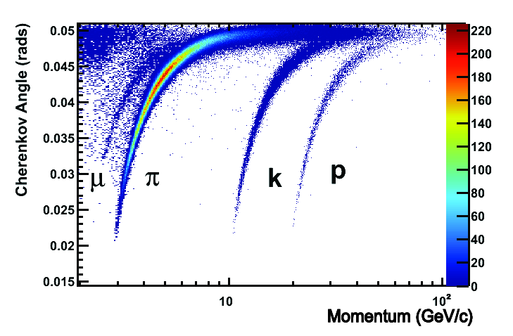
THE EXPERIMENTAL SETUP: LHCb
BR measurement
μ⁺
-Tracking: σ_{p} / p ~ 0,5 - 1%
∼7 mm
μ⁻
J/ψ
p
B⁰ decay vertex
B⁰ production vertex
p̄
- IP resolution: ~25 μm
-Protons: particle ID from cherenkov detectors, eff~85% for p
-Muon chambers, hardware trigger
Analysis

Slide 8
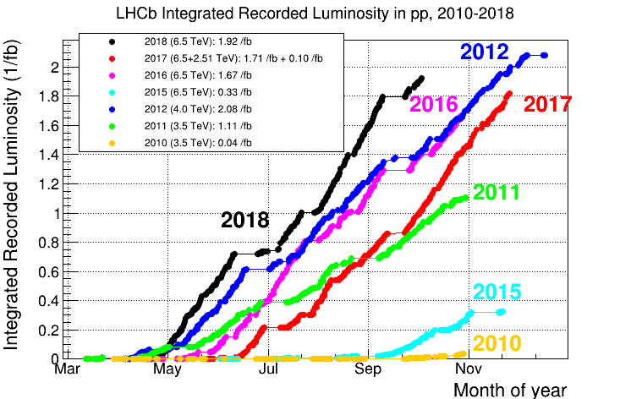
HISTORY OF THE DECAY: FROM 2011 TO DATE
Introduction
2011
RUN1
FIRST analysis of B⁰_{(s)}➞J/ψpp̄ with 2011 dataset
JHEP09 (2013) 006
7 TeV
No observation, limits set to:
L_{int}=1 fb⁻¹
8 TeV
2012
2015
RUN2
THIS analysis: full Run1 + Run2 (2015-2016)
L_{int} = 3.2 fb⁻¹ + 2 fb⁻¹
N° events = σ_{process}x L_{int}
13 TeV
2016
Future: include data till 2018
from 5.2 fb⁻¹ → 9 fb⁻¹
NOW
Introduction
Analysis

Slide 9
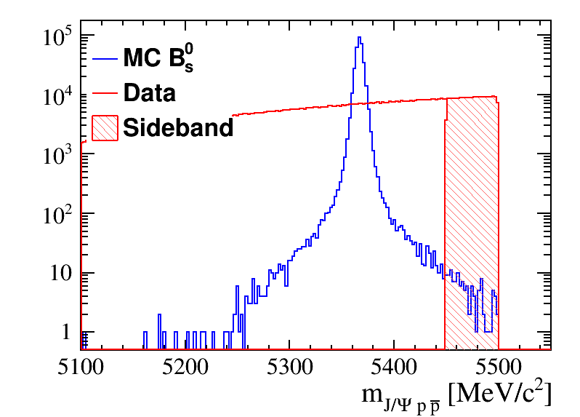
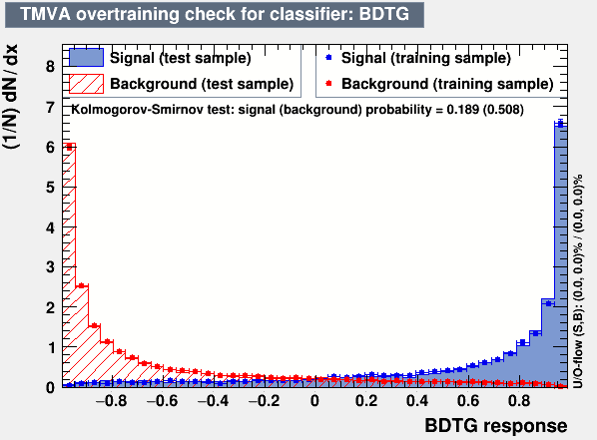
SIGNAL SELECTION
Due to the rare decays, a big amount of background has to be removed
Combinatorial tracks: K and pi misidentified as protons
In order to discriminate between signal and background:
Multivariate analysis:
-- Discriminating variables:
χ² fit to the vertex
B and proton kinematic variables
proton PID variables
Selection: cut on the response of the algorithm
→ High purity signal
Analysis

Slide 10
AMPLITITUDE ANALYSIS
BR measurement
Next year work: phenomenological for the decay amplititude → spectroscopy studies to test the existence of pentaquark and glueball
MODEL
Decay model describing the decay kinematic by a set of (unknown) parameters
-Invariant mass dependence
-Angular dependence: helicity formalism (projection of spin in momentum direction)
DATA
Measured distribution of variables describing decay kinematic
FIT
extract the parameters of resonances, like quantum numbers and mass
Future work
Notes:
Theoretical expectation with naive contribution

Slide 11
CONCLUSIONS
Conclusions
First observation of B⁰_{d}➞J/ψpp̄ and B⁰_{s}➞J/ψpp̄
Branching ratio
Mass measurements
Analysis under review within LHCb
Amplititude analysis might shed light on new exotic resonant structures
Funding from: Fond. Fratelli Confalonieri
Conclusions

